Slide 1
Agent-based Modeling
Pedro R. Andrade
Munster, 2013

Slide 2
Many many names...
Agent-based modelling (ABM)
Agent-based modelling and simulation (ABMS)
Agent-based systems (ABS)
Multi-agent systems (MAS)
Multi-agent simulation (MAS)
Individual-based modelling (IBM)
...

Slide 3
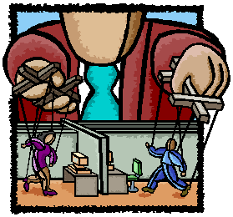
It has been used in different areas of science
economy
sociology
archaeology
ecology
linguistics
political sciences
...

Slide 4
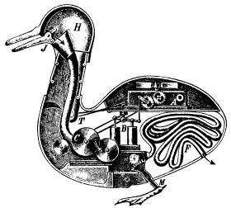
Agent-based modelling (ABM)
Bottom-up approach for building complex systems, through the dynamical interaction of agents.
flexibility
natural approach
emergence
An agent is any actor within an environment, any entity that can affect itself, the environment and other agents.

Slide 5
Agent-Based Modelling
Representations
Goal
Communication
Communication
Action
Perception
Environment
source: Nigel Gilbert

Slide 6
Why is it interesting?
Structure
  structure is emergent from agent interaction
  this can be directly modeled
Agency
  agents have goals, beliefs and act
  this can be directly modeled
Dynamics
  things change, develop, evolve
  agents move (in space and social location) and learn
  these can be directly modeled
Source: (Gilbert, 2006)

Slide 7
Is it qualitative or quantitative?
Agent-based models can handle all types of data
quantitative attributes
  age
  size of organization
qualitative
  ordinal or categorical (e.g. ethnicity),
  relational (e.g. I am linked to him and her)
vague
  A sends B a message about one time in three
Source: (Gilbert, 2006)

Slide 8
First agent-based model
Develop a model where one single agent walks randomly in a 30x30 cellular space

Slide 9
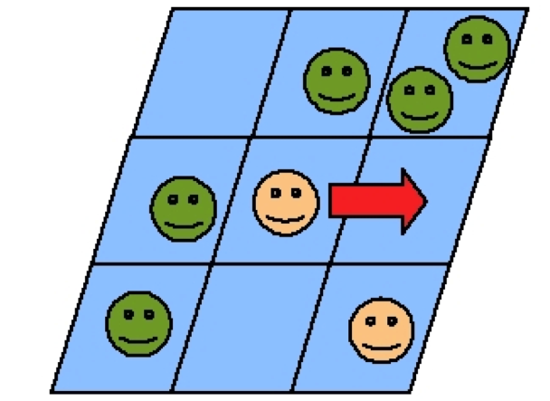
Agent
singleFooAgent = Agent {
-- attributes
size = 10,
name = "foo",
-- execution
execute = function(self)
self.size = self.size + 1
cell = self:getCell():getNeighborhood():sample()
self:move(cell)
end
}

Slide 10
Basic placement
cs = CellularSpace {
xdim = 10,
ydim = 10
}
cs:createNeighborhood()
e = Environment {
cs,
singleFooAgent
}
e:createPlacement{strategy = "random"}
t = Timer {
Event{action = singleFooAgent}
}
t:execute(10)

Slide 11
Society of moving agents
Develop a model where 20 agents walk randomly in a 30x30 cellular space
It is not possible to have more than one agent per cell

Slide 12
Society
CBB
CAC
CBA
CCB
ACA
CCC
AAC
BBC
ABC
BBA
AAA
上海宋
BAB

Slide 13
Society
fooSociety = Society {
instance = singleFooAgent,
quantity = 50
}
env = Environment {fooSociety, cs}
env:createPlacement{strategy = "random", max = 1}
t = Timer {
Event {action = fooSociety}
}
t:execute(10)

Slide 14
Traversing the Society
capital = 100
capital = 50
capital = 25
forEachAgent(mag, function(agent)
agent.capital = agent.capital + 100
end)
capital = 200
capital = 150
capital = 125

Slide 15
Reproducing Agents
Agents fixed in space, reproducing asexually at each time step, putting a descendant into one random neighbor cell as long as it is empty
  ﻿child = self:reproduce()
  Plot the size of the society along the simulation
Agents can die: self:die()
  by randomness (10%)
  by overpopulation (more than three populated neighbors)
  by age (10 time steps)

Slide 16
Agent-based Modeling
Pedro R. Andrade
Munster, 2013

