Slide 1

Sugarscape
Pedro R. Andrade
Munster, 2013

Slide 2
Agent-Based Modelling
Representations
Goal
Communication
Communication
Action
Perception
Environment
source: Nigel Gilbert

Slide 3
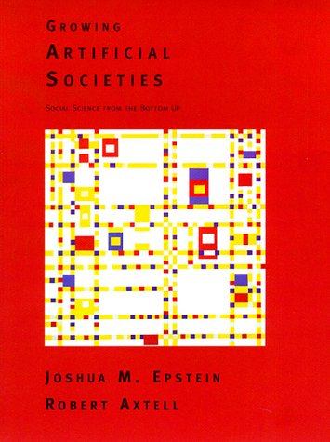
Sugarscape model
Agents that need sugar to survive
look for sugar to eat
quantitative attributes
  age
  wealth

Slide 4
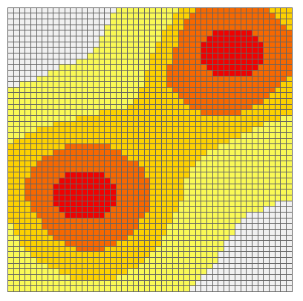
Sugarscape
Maximum sugar between 0 and 4
Each cell produces one unit of sugar by time step

Slide 5
Simple Agent
Look for a random neighbor and moves whenever it has more sugar than the current cell to eat.

Slide 6
More complex Agent
Look for a random neighbor and moves whenever it has more sugar than the current cell.
Initial wealth (sugar) between 5 and 25
Metabolism between 1 and 4 sugar per each step
Age starting with zero and increasing by one per time step
Die by age (maximum age between 60 and 100)
Die by absence of wealth
Whenever it dies, creates another agent and put it in a random cell

Slide 7
Changes
How to improve the movement to find more sugar?
What happens with the average wealth and average age when the number of agents grow?

Slide 8
Sugarscape
Pedro R. Andrade
Munster, 2013

