Slide 1
Deforestation Part 1: Database
Pedro R. Andrade
Münster, 2013

Slide 2
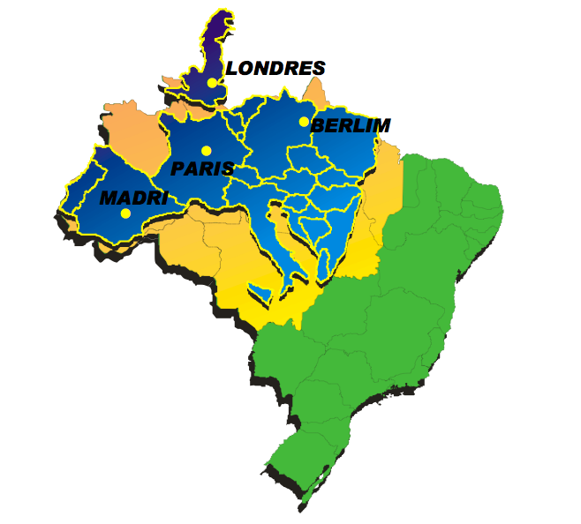
Brazilian Amazonia
Source: PRODES (INPE)

Slide 3
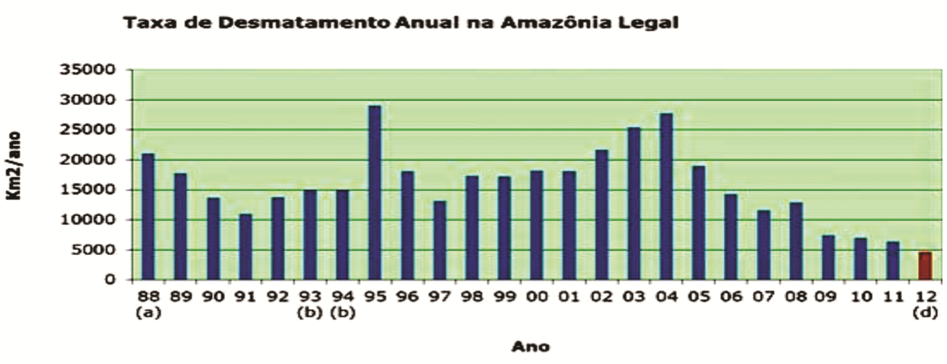
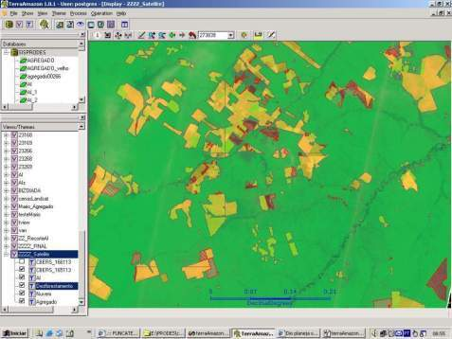
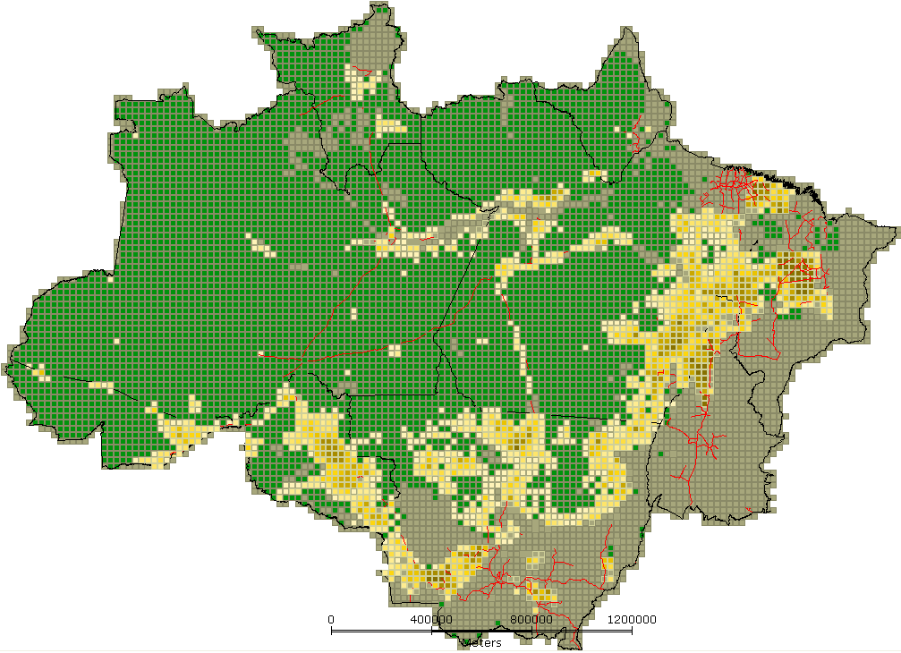
PRODES - Deforestation in Amazonia

Slide 4
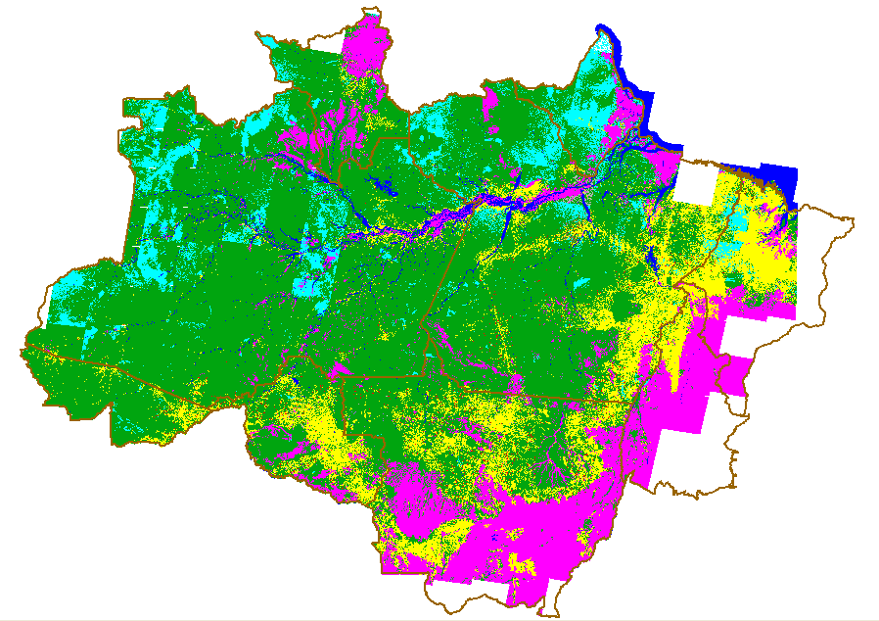
What drives deforestation?

Slide 5
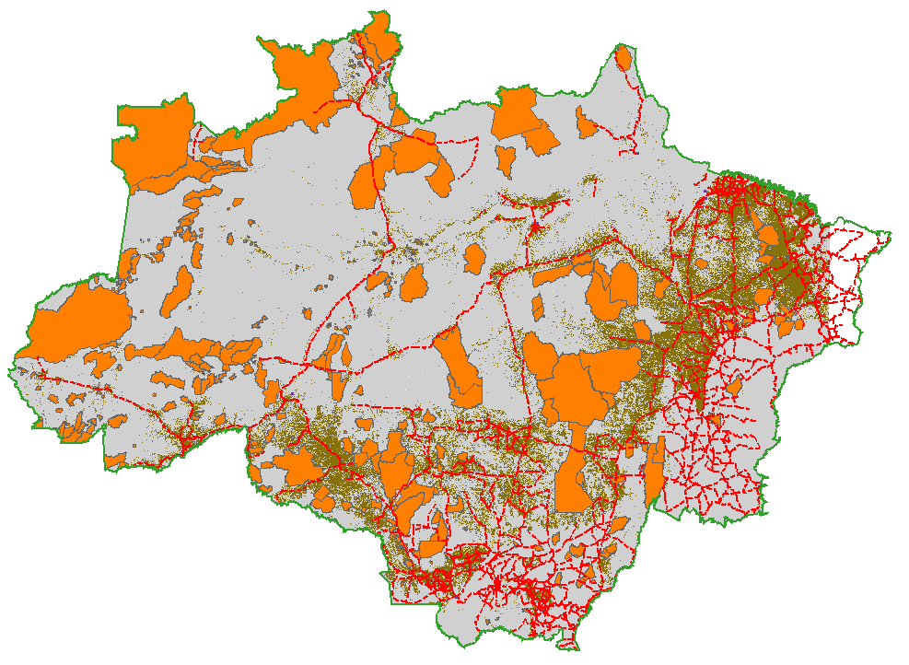
What drives deforestation?

Slide 6
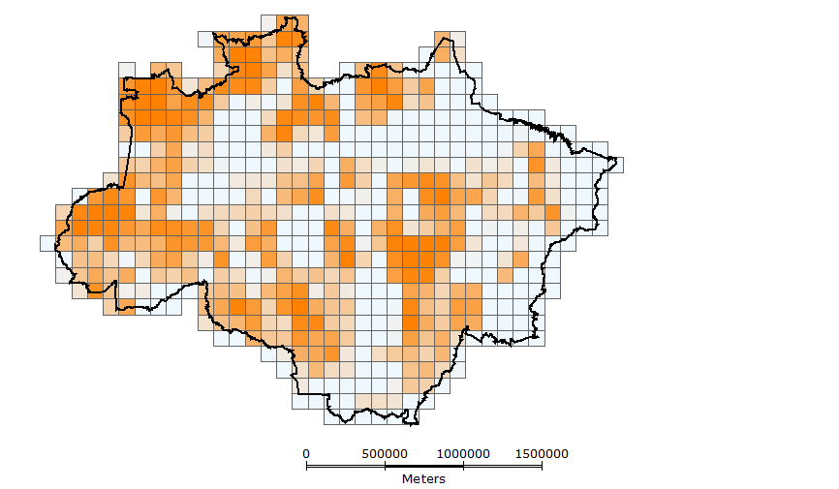
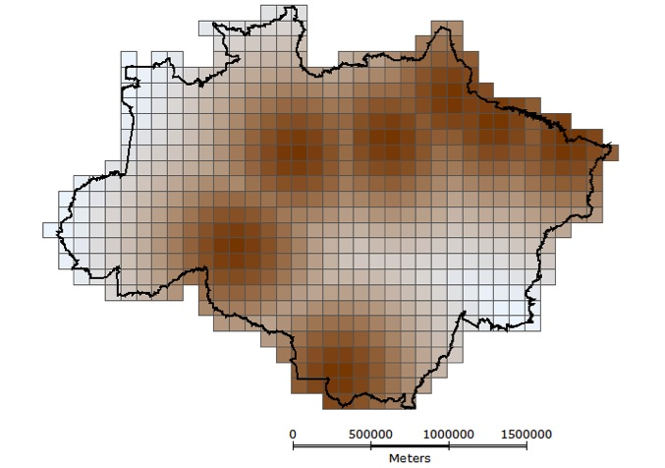
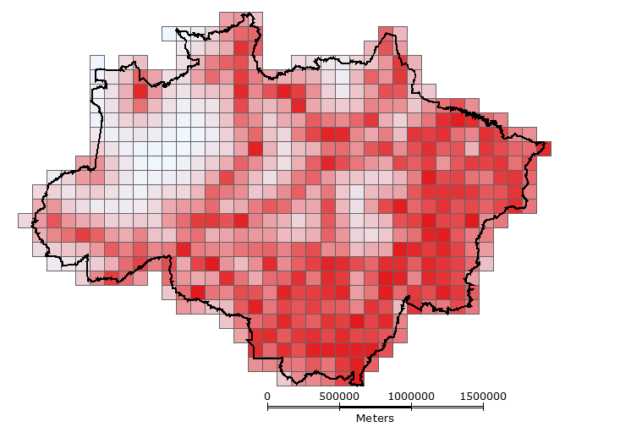
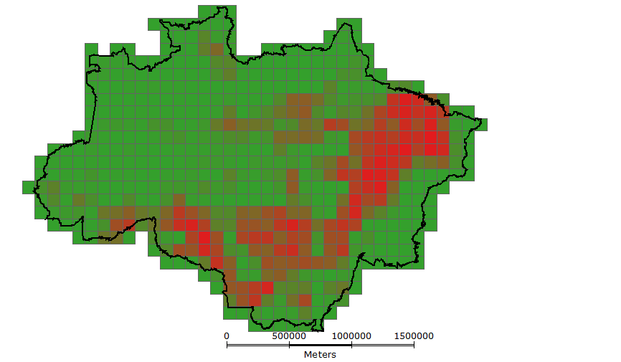
Cellular Spaces
Protected Areas
Ports
Deforestation
Roads

Slide 7
Amazonia Database
TerraView version 4.2.0
Database AMZ.mdb
Create a Layer of Cells
Fill cells plugin to create attributes
Visualize the attributes

Slide 8
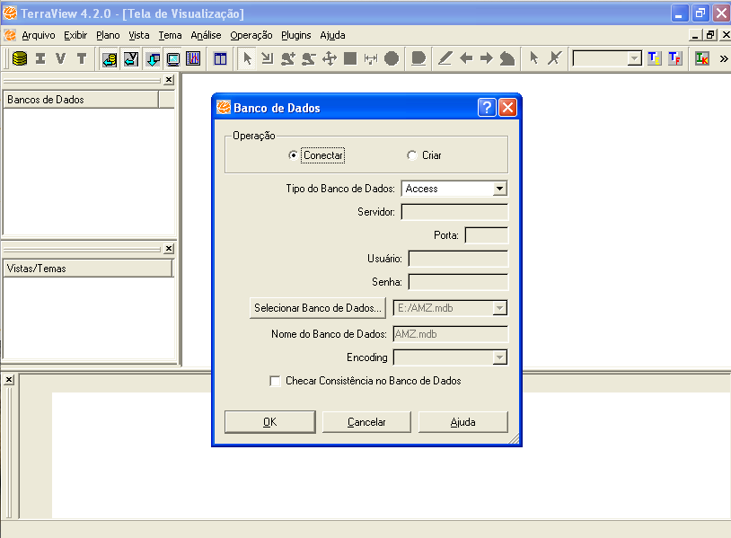

Slide 9
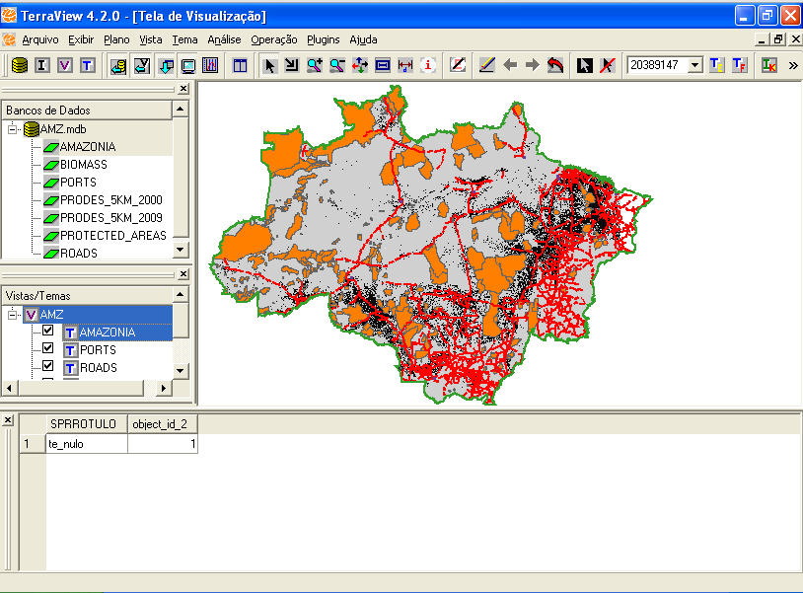

Slide 10
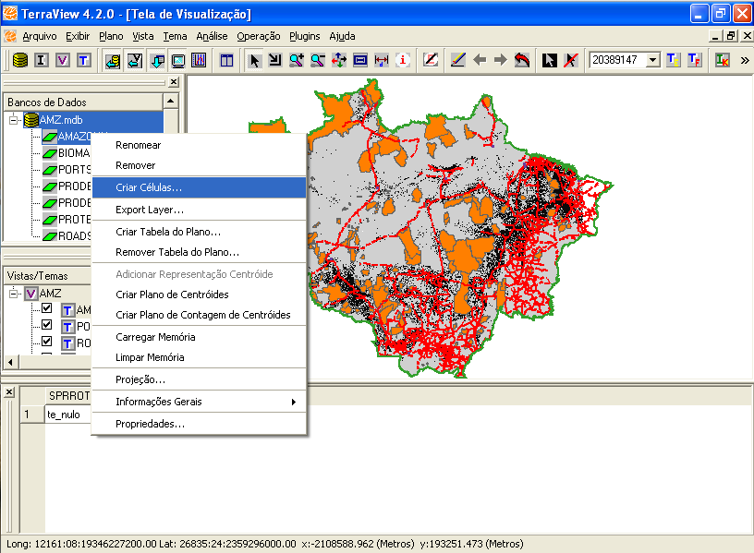
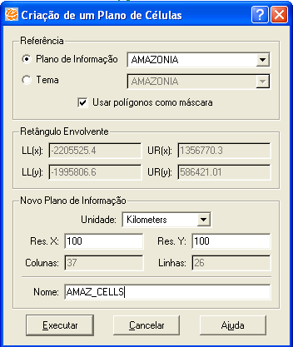

Slide 11
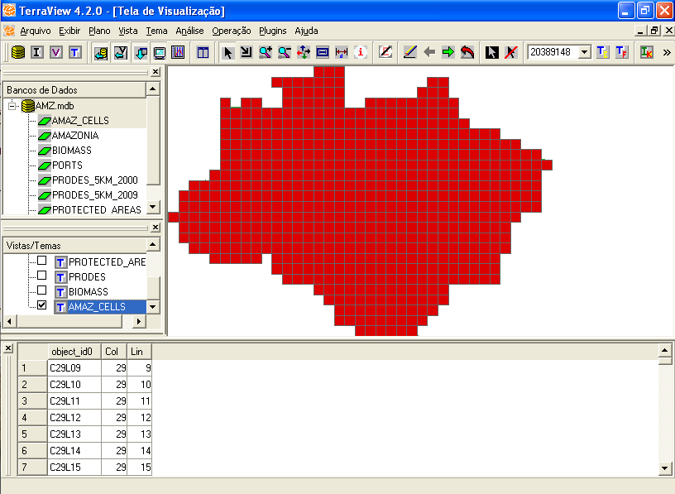
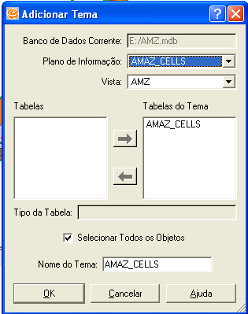

Slide 12
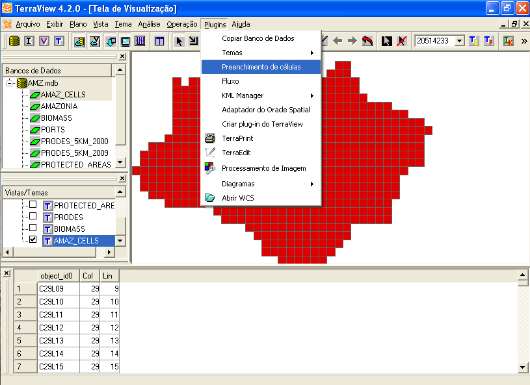

Slide 13
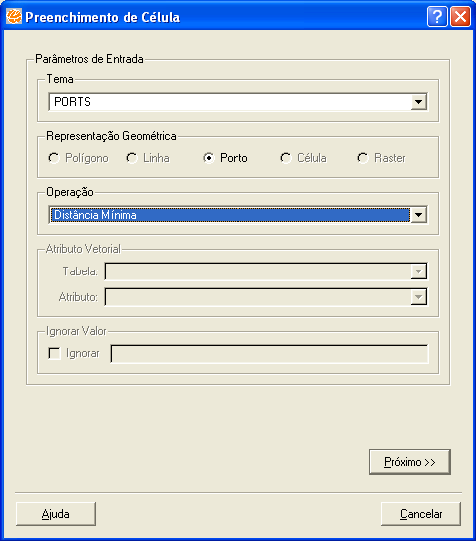
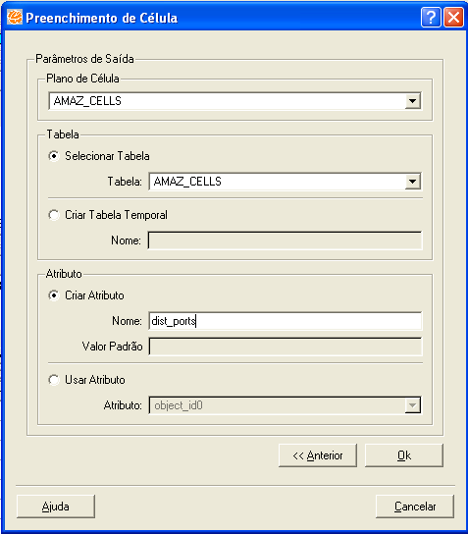

Slide 14
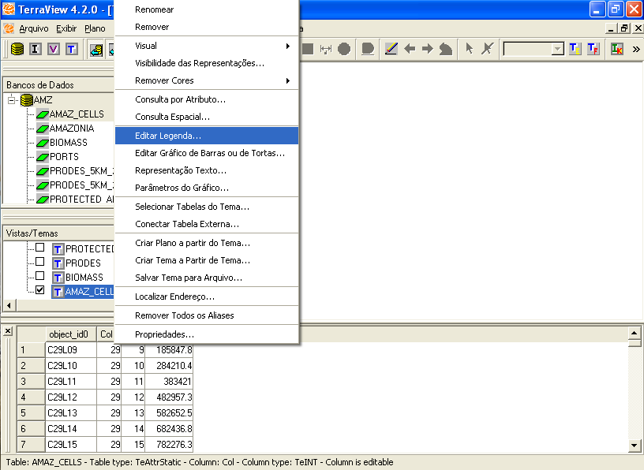
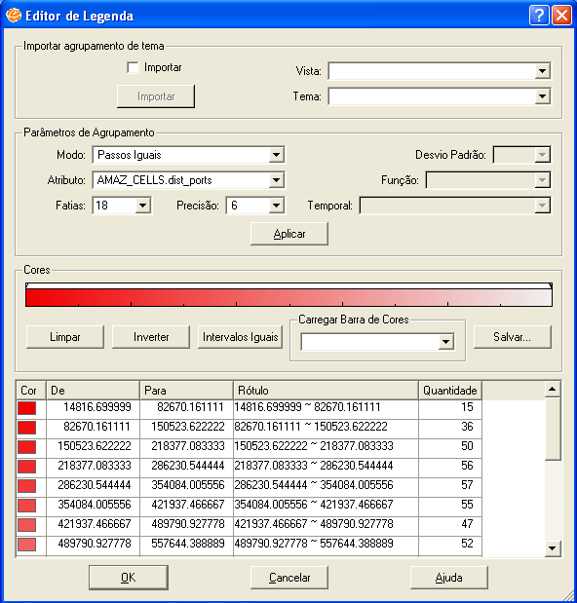

Slide 15
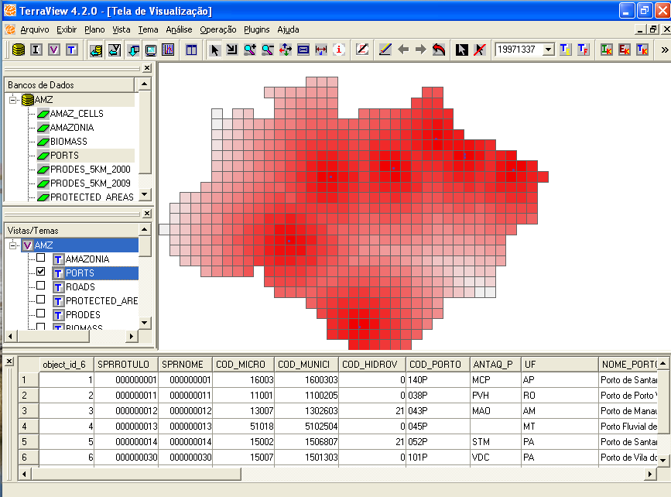

Slide 16
Filling the CellularSpace
Theme | Operation | Attribute
PROTECTED_AREAS | Intersection Area | protected
PORTS | Minimum distance | dist_ports
ROADS | Minimum distance | dist_roads
BIOMASS | Percentage of Each Class | biomass_
PRODES | Percentage of Each Class | defor_
www.obt.inpe.br/prodes to get data for the years 2005 and 2011
Create another Layer of cells with 50x50km and compute the same attributes again

Slide 17
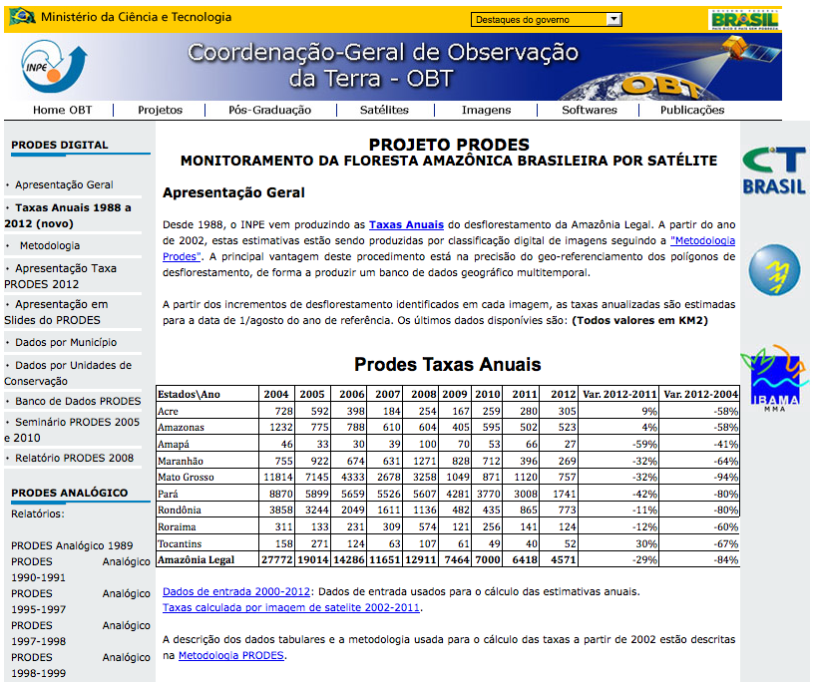
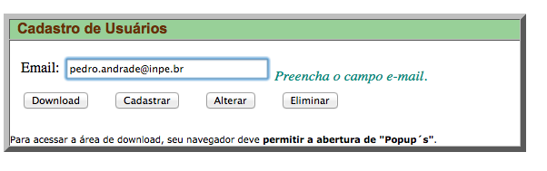
www.obt.inpe.br/prodes

Slide 18
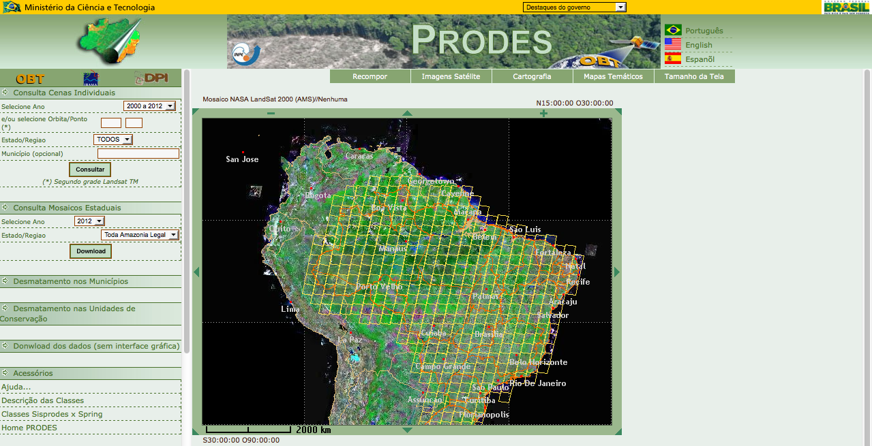
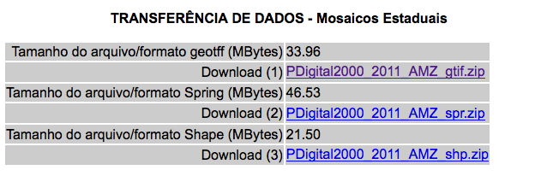
2005 and 2011 images

Slide 19
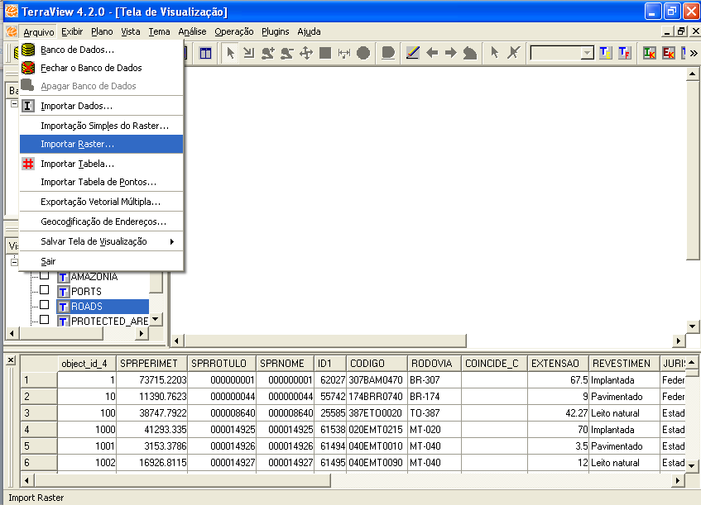
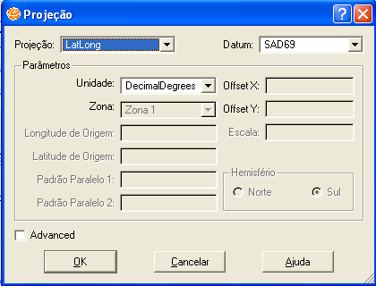
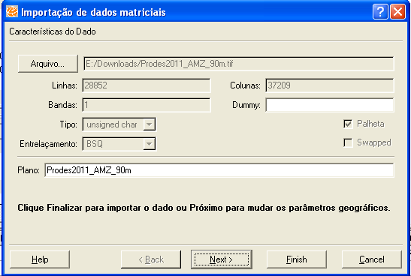
Importing data

