Slide 1
Deforestation Part 2: Top-down Modelling
Pedro R. Andrade
Münster, 2013

Slide 2
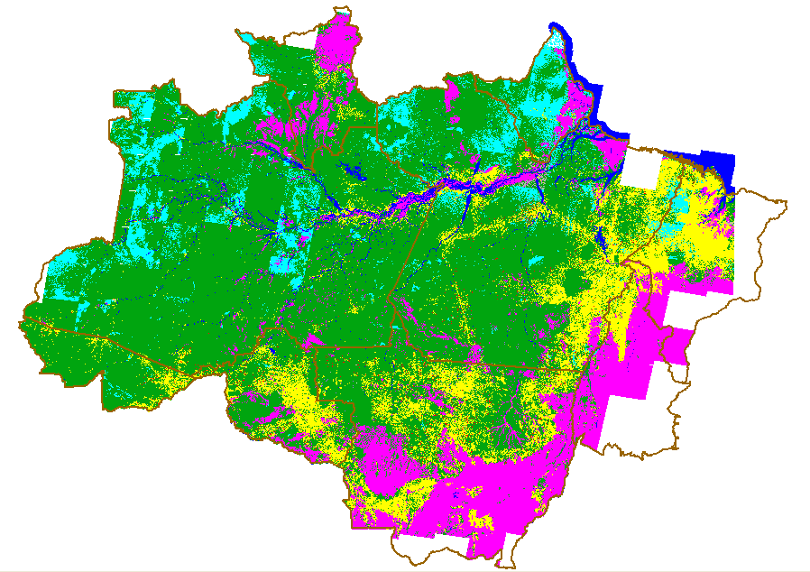
Representing the process
How to develop a deforestation model?

Slide 3
Modelling and Public Policy
External
Influences
System
Ecology
Economy
Politics
Desired
System
State
Scenarios
Decision
Maker
Policy
Options

Slide 4
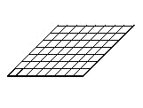
Top-down Land Change Models
Input data
Demand submodel
How much?
Transition potential
submodel
Where?
Change allocation
submodel
Land use at t
Time loop
Land use at t+1

Slide 5
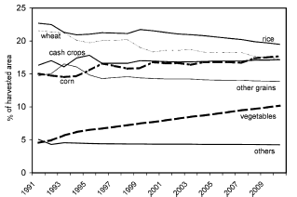
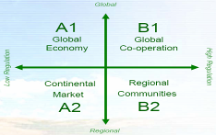
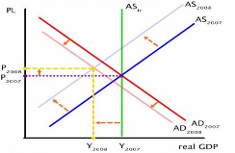
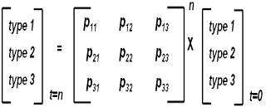
Demand
Trend analysis
Building Scenarios
Global economic model
Transition Matrix (Markov chain)

Slide 6
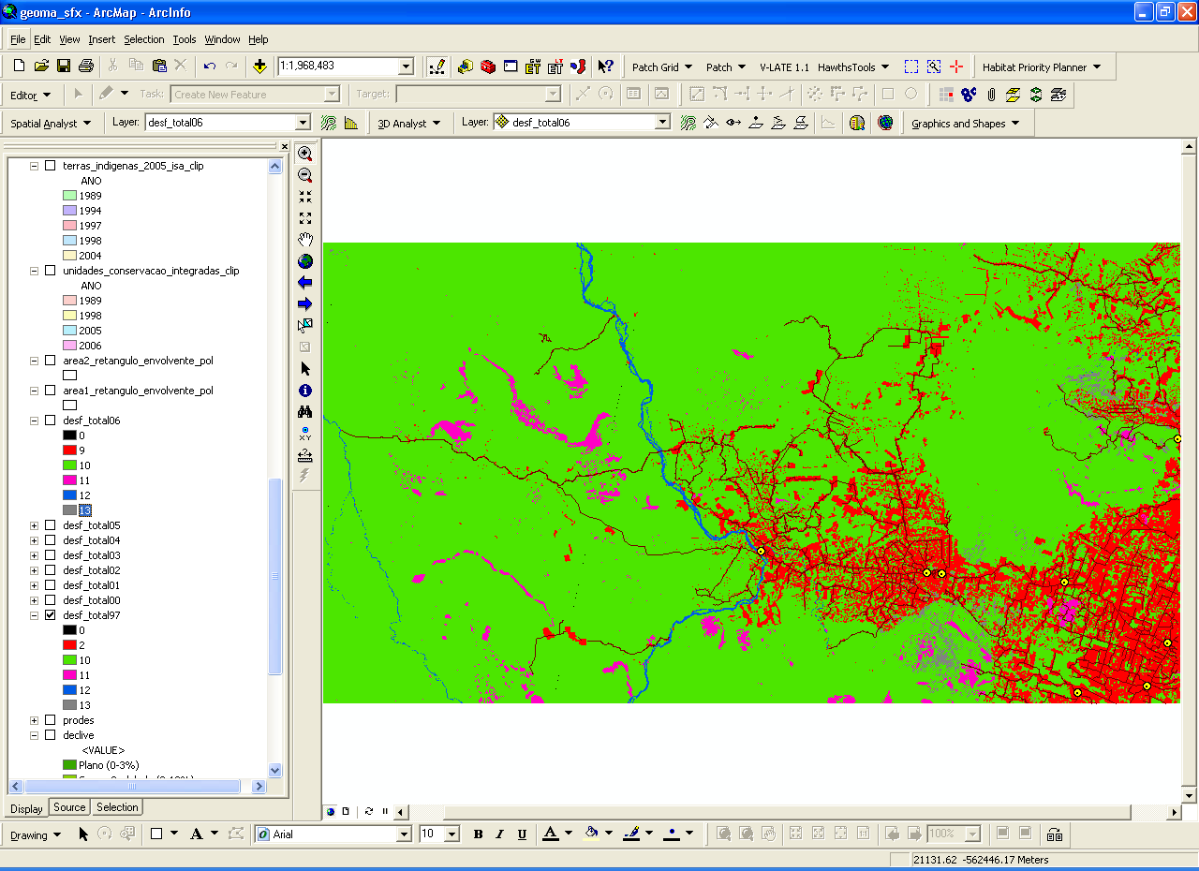
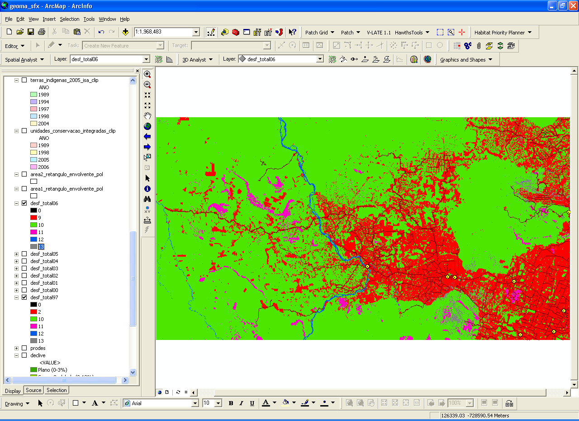
Simple Demand
Difference between years
Demand submodel

Slide 7
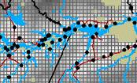
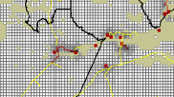
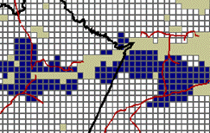
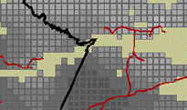
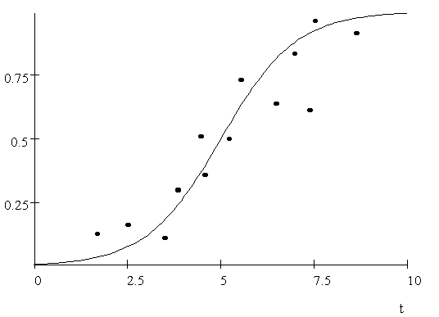
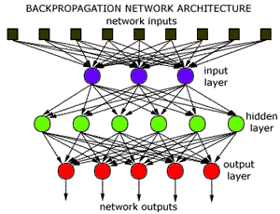
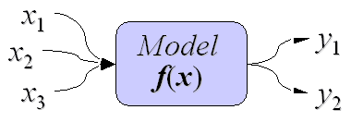
Potential
_{Driving factors}
_{Potential map}
Transition potential
submodel
Multivariate Statistics
Neural Network
Mathematics

Slide 8
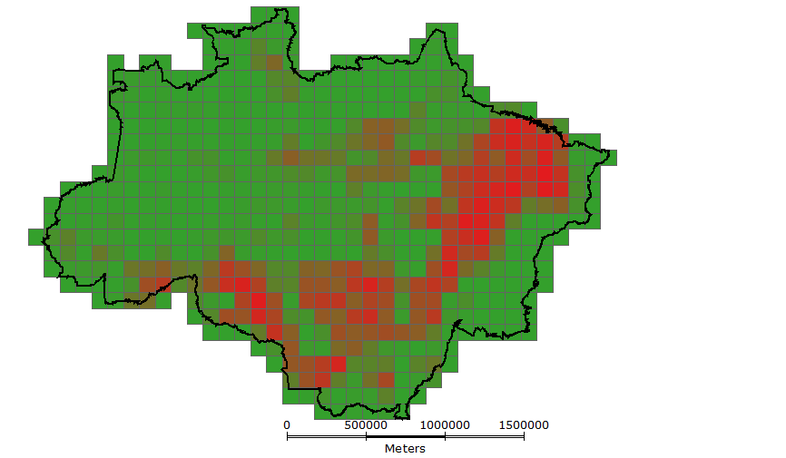
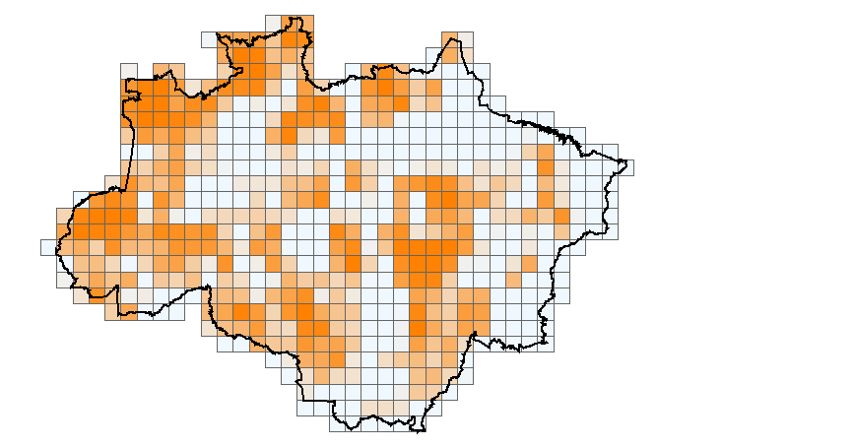
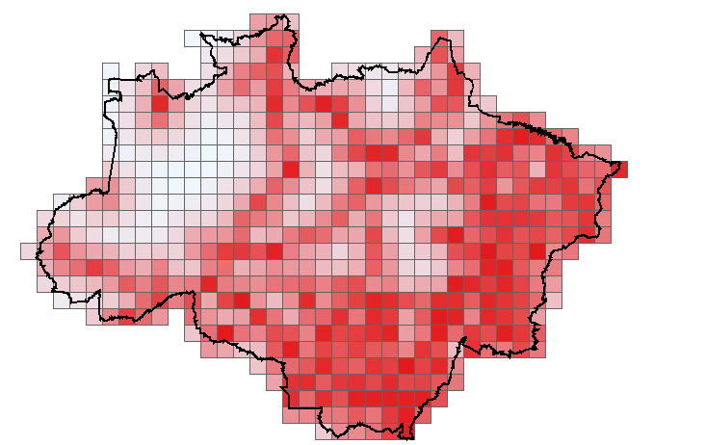
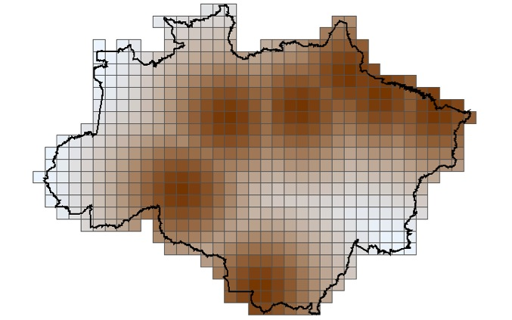
Potential – CLUE like
Deforestation
Protected Areas
Subtract
from
Ports
_{Potential map}
Transition potential
submodel
Roads
Deforestation

Slide 9

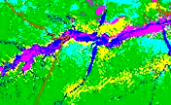
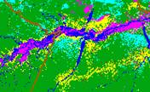
Allocation
Demand
t+1
Allocation
submodel
Landscape map at t
Rank-order
Stochastic
Iterative
Landscape map at t+1
Potential map at t

Slide 10
deforestation.lua
Three strategies for computing potential:
Neighborhood: Based on the average deforestation of the neighbors
Regression: Based on distance to roads, ports, and protected area
Mixed: Based on these four attributes
Fixed yearly demand

Slide 11
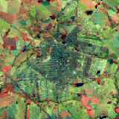
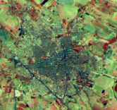
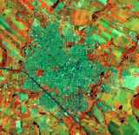
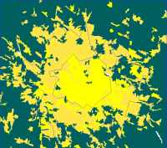
Models need to be Calibrated and “Validated”
Scenario
t_{p} - 20
t_{p} - 10
t_{p}
Calibration
t_{p} + 10
Validation
Source: Cláudia Almeida

Slide 12
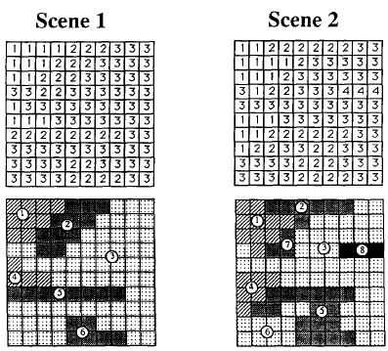
Goodness-of-fit
Source: Costanza, 1989

Slide 13
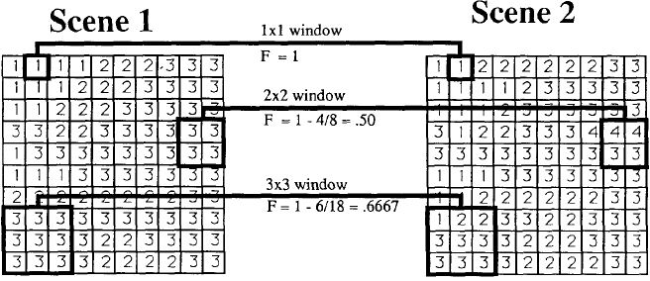
Goodness-of-fit: Multilevel
Source: Costanza, 1989

Slide 14
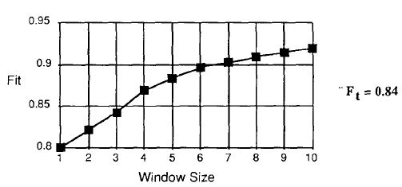
Fit According to Window Size

Slide 15
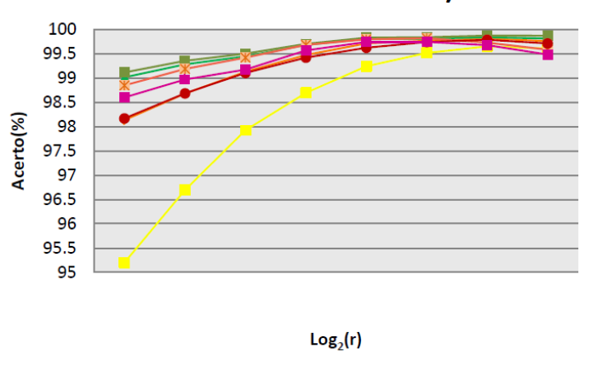
Goodness-of-fit of Land Change Models

Slide 16
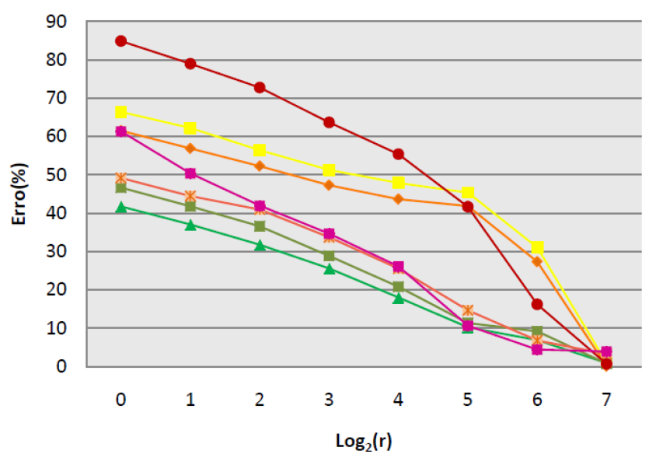
Goodness-of-fit of Land Change Models
Normalize the error according to the demand
Compute error instead of fit

Slide 17
Exercise
Use the PRODES data as yearly demand (from “total-prodes.lua”)
Compute the final real deforestation summing up the deforestation data in 2001 with the yearly PRODES until 2011
Use the multi-resolution metric to calibrate the different potential strategies by changing the weights manually (see an example of computing the goodness-of-fit in “check-fit.lua”)
Is it possible to be better than the allocation from the potential based only on the neighborhood?

Slide 18
Land Change Models x Cellular Automata
Grid of cells
Neighbourhood
Finite set of discrete states
Finite set of transition rules
Initial state
Discrete time
Behavior parallel in space
Read from the neighbors and write in the cell
Can a land change model be considered a Cellular Automata?

