Slide 1
Sorting Algorithms
Comparison In Graphs

Slide 2
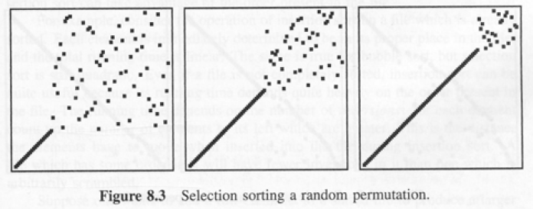
Selection Sort

Slide 3
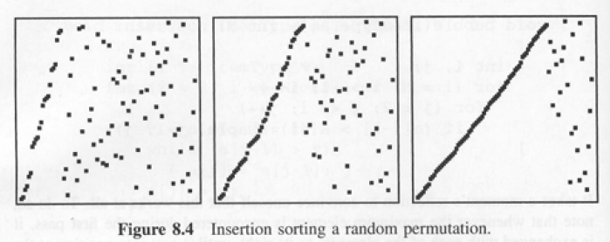
Insertion Sort

Slide 4
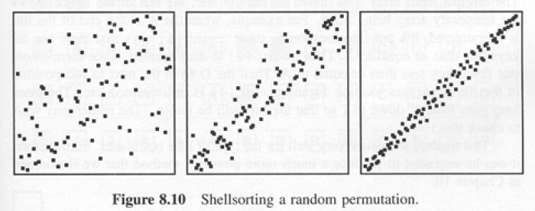
Shell Sort

Slide 5
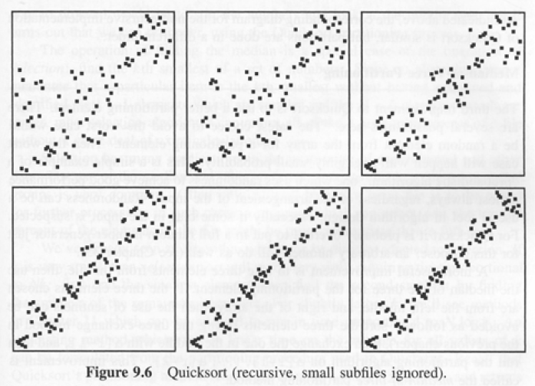
Quick Sort

Slide 6
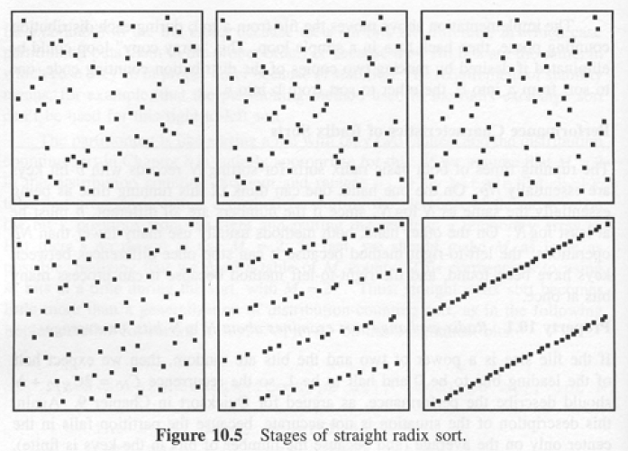
Straight Radix Sort

Slide 7
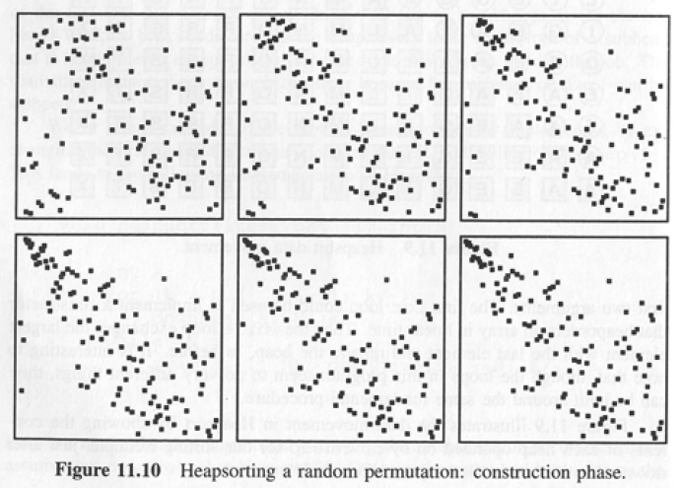
Heap Sort (1/2)

Slide 8
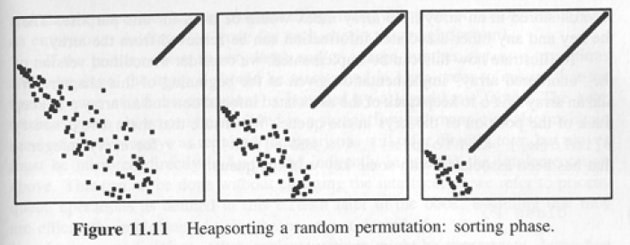
Heap Sort (2/2)

Slide 9
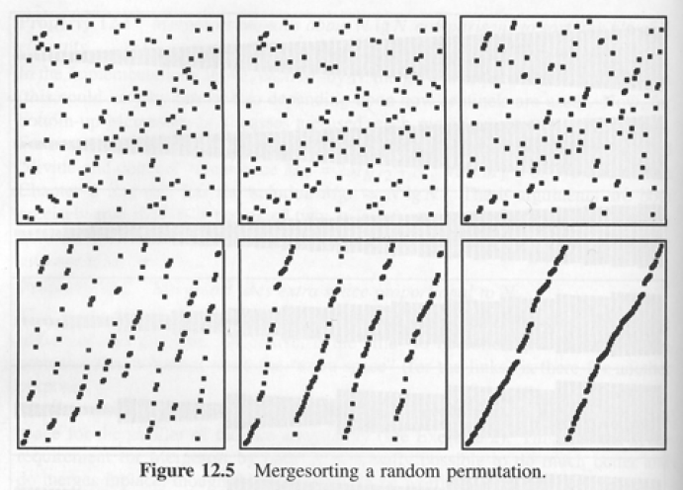
Merge Sort

