Slide 1
Overflow Handling
An overflow occurs when the home bucket for a new pair (key, element) is full.
We may handle overflows by:
  Search the hash table in some systematic fashion for a bucket that is not full.
    Linear probing (linear open addressing).
    Quadratic probing.
    Random probing.
  Eliminate overflows by permitting each bucket to keep a list of all pairs for which it is the home bucket.
    Array linear list.
    Chain.

Slide 2
Linear Probing – Get And Insert
divisor = b (number of buckets) = 17.
Home bucket = key % 17.
0
4
8
12
16
34
0
45
6
23
7
28
12
29
11
30
33
Insert pairs whose keys are 6, 12, 34, 29, 28, 11, 23, 7, 0, 33, 30, 45

Slide 3
Linear Probing – Delete
0
4
8
12
16
34
0
45
6
23
7
28
12
29
11
30
33
Delete(0)
0
4
8
12
16
34
45
6
23
7
28
12
29
11
30
33
Search cluster for pair (if any) to fill vacated bucket.
0
4
8
12
16
34
45
6
23
7
28
12
29
11
30
33

Slide 4
Linear Probing – Delete(34)
0
4
8
12
16
34
0
45
6
23
7
28
12
29
11
30
33
0
4
8
12
16
0
45
6
23
7
28
12
29
11
30
33
Search cluster for pair (if any) to fill vacated bucket.
0
4
8
12
16
0
45
6
23
7
28
12
29
11
30
33
0
4
8
12
16
0
45
6
23
7
28
12
29
11
30
33

Slide 5
Linear Probing – Delete(29)
0
4
8
12
16
34
0
45
6
23
7
28
12
29
11
30
33
0
4
8
12
16
34
0
45
6
23
7
28
12
11
30
33
Search cluster for pair (if any) to fill vacated bucket.
0
4
8
12
16
34
0
45
6
23
7
28
12
11
30
33
0
4
8
12
16
34
0
45
6
23
7
28
12
11
30
33
0
4
8
12
16
34
0
6
23
7
28
12
11
30
45
33

Slide 6

Performance Of Linear Probing
0
4
8
12
16
34
0
45
6
23
7
28
12
29
11
30
33
Worst-case find/insert/erase time is Θ(n), where n is the number of pairs in the table.
This happens when all pairs are in the same cluster.

Slide 7

Expected Performance
0
4
8
12
16
34
0
45
6
23
7
28
12
29
11
30
33
α = loading density = (number of pairs)/b.
  α = 12/17.
S_{n} = expected number of buckets examined in a successful search when n is large
U_{n} = expected number of buckets examined in a unsuccessful search when n is large
Time to put and remove governed by U_{n}.
Notes:
A put that increases the number of pairs in the table involves an unsuccessful search followed by the addition of an element. An unsuccessful remove is essentially an unsuccessful search. A successful remove must also go to the end of the cluster and so is like an unsuccessful search.

Slide 8
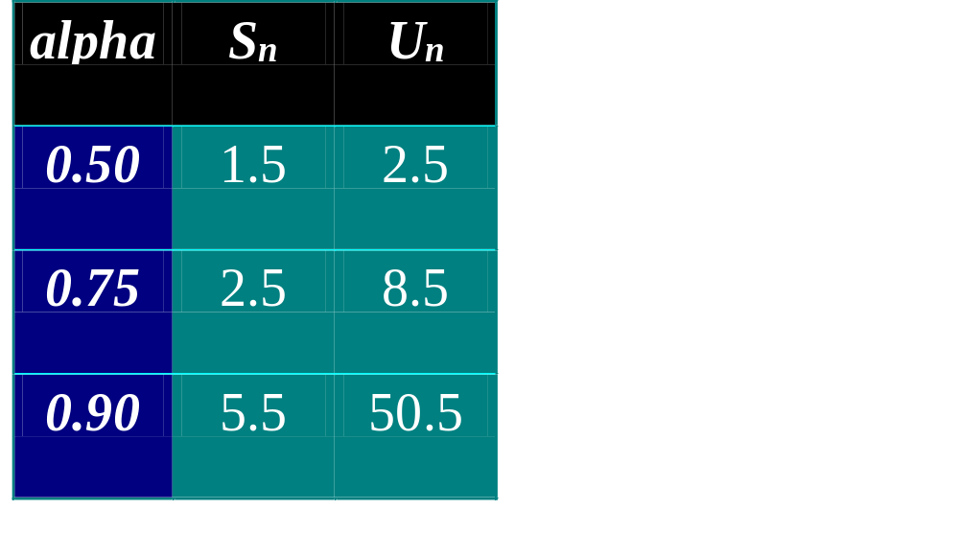
Expected Performance
S_{n} ~ ½(1 + 1/(1 – α))
U_{n} ~ ½(1 + 1/(1 – α)²)
Note that 0 <= α <= 1.
α <= 0.75 is recommended.

Slide 9
Hash Table Design
Performance requirements are given, determine maximum permissible loading density.
We want a successful search to make no more than 10 compares (expected).
  S_{n} ~ ½(1 + 1/(1 – α))
  α <= 18/19
We want an unsuccessful search to make no more than 13 compares (expected).
  U_{n} ~ ½(1 + 1/(1 – α)²)
  α <= 4/5
So α <= min{18/19, 4/5} = 4/5.

Slide 10
Hash Table Design
Dynamic resizing of table.
  Whenever loading density exceeds threshold (4/5 in our example), rehash into a table of approximately twice the current size.
Fixed table size.
  Know maximum number of pairs.
  No more than 1000 pairs.
  Loading density <= 4/5 => b >= 5/4*1000 = 1250.
  Pick b (equal to divisor) to be a prime number or an odd number with no prime divisors smaller than 20.

Slide 11
Linear List Of Synonyms
Each bucket keeps a linear list of all pairs for which it is the home bucket.
The linear list may or may not be sorted by key.
The linear list may be an array linear list or a chain.

Slide 12
[0]
0
34
Sorted Chains
Put in pairs whose keys are 6, 12, 34, 29, 28, 11, 23, 7, 0, 33, 30, 45
Home bucket = key % 17.
[4]
6
23
7
[8]
11
28
45
[12]
12
29
30
[16]
33
Notes:
The chains may be sorted or unsorted (the text uses sorted chains).

Slide 13
Expected Performance
Note that α >= 0.
Expected chain length is α.
S_{n} ~ 1 + α/2.
U_{n} ~ α

