Slide 1
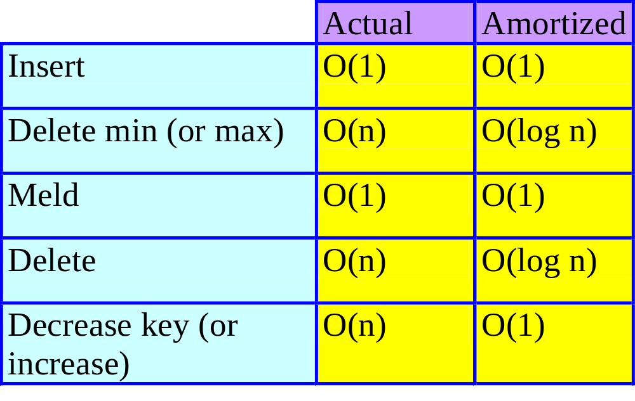
Analysis Of Fibonacci Heaps
Notes:
n may be any of the following: number of operations, number of inserts, number of elements in the Fibonacci heap in which the operation is performed.
All operations (other than cascading cut) will pay for the future pairwise combining of the trees they leave behind. For cascading cut, this cost is borne by the operation that changed the childcut field to True.

Slide 2
MaxDegree
Let N_{i} = min # of nodes in any min (sub)tree whose root has i children.
N₀ = 1.
6
5
N₁ = 2.
9

Slide 3
N_{i} , i > 1
b
c₁
c₂
…
…
c_{i}
Children of b are labeled in the order in which they became children of b.
  c₁ became a child before c₂ did, and so on.
So, when c_{k} became a child of b, degree(b) >= k –1.
degree(c_{k}) at the time when c_{k} became a child of b
= degree(b) at the time when c_{k} became a child of b
>= k – 1.

Slide 4
N_{i} , i > 1
b
c₁
c₂
…
…
c_{i}
So, current degree(c_{k}) >= max{0, k – 2}.
So, N_{i} = N₀ + (Σ_{0<=q<=i-2} N_{q} ) + 1
= (Σ_{0<=q<=i-2} N_{q} ) + 2.

Slide 5
Fibonacci Numbers
F₀ = 0.
F₁ = 1.
F_{i} = F_{i-1} + F_{i-2}, i > 1
= (Σ_{0<=q<=i-2} F_{q} ) + 1, i > 1.
N₀ = 1.
N₁ = 2.
N_{i} = (Σ_{0<=q<=i-2} N_{q} ) + 2, i > 1.
N_{i} = F_{i+2}~ ((1 + sqrt(5))/2)^{i} , i >= 0.
Notes:
So, the degree is logarithmic in the number of nodes.

Slide 6
MaxDegree
MaxDegree <= log_{φ}n, where φ = (1 + sqrt(5))/2.

Slide 7
Accounting Method
Insert.
  Guessed amortized cost = 2.
  Use 1 unit to pay for the actual cost of the insert and keep the remaining 1 unit as a credit for a future remove min operation.
  Keep this credit with the min tree that is created by the insert operation.
Meld.
  Guessed amortized cost = 1.
  Use 1 unit to pay for the actual cost of the meld.
Notes:
Every top-level tree will have a credit of 1; every node with childcut = true will have a credit of 2.

Slide 8
Delete Nonmin Element
1
6
5
theNode
4
7
3
9
2
4
9
10
5
8
5
6
7
9
6
8

Slide 9
Delete Nonmin Element
10
5
1
6
5
9
7
3
9
2
4
9
8
5
6
7
Guessed amortized cost = 2log_{φ}n + 3.
Use log_{φ}n units to pay for setting parent fields to null for subtrees of deleted node.
Use 1 unit to pay for remaining work not related to cascading cut.
6
8
Notes:
Remaining work not related to cascading cut => combine the circular list of top-level trees and that of children of deleted node; pull deleted node out of its sibling list; and so on.

Slide 10
Delete Nonmin Element
10
5
1
6
5
9
7
3
9
2
4
9
8
5
6
7
6
Keep log_{φ}n units to pay for possible future pairwise combining of the new top-level trees created.
Kept as 1 credit per new top-level tree.
Discard excess credits (if any).
8
Notes:
Credit of 1 on each new tree.

Slide 11
Delete Nonmin Element
10
5
1
6
5
9
7
3
9
2
4
9
8
5
Keep 1 unit to pay for the time when node whose ChildCut field is set to true is cut from its parent, and another 1 unit for the pairwise combining of the cut subtree.
6
7
6
8
Notes:
Credit of 2 placed on node whose childcut becomes true.

Slide 12
Delete Nonmin Element
10
5
1
6
5
9
7
3
9
2
4
9
8
5
Keep the 2 credits on the node (if any) whose ChildCut field is set to true by the ensuing cascading cut operation.
  If there is no such node, discard the credits.
6
7
6
8
Notes:
Credit of 2 placed on node whose childcut becomes true.

Slide 13
Delete Nonmin Element
Guessed amortized cost = 2log_{φ}n + 3.
Use log_{φ}n units to pay for setting parent fields to null.
Use 1 unit to pay for remaining work not related to cascading cut.
Keep 1 unit to pay for the time when node whose ChildCut field is set to true is cut from its parent, and another 1 unit for the pairwise combining of the cut subtree.
Keep log_{φ}n units to pay for possible future pairwise combining of the new top-level trees created.
Notes:
Each childcut value of T has 2 credits.

Slide 14
Delete Nonmin Element
Placement of credits.
  Keep 1 unit on each of the newly created top-level trees.
  Keep 2 units on the node (if any) whose ChildCut field is set to true by the ensuing cascading cut operation.
  Discard the remaining credits (if any).

Slide 15
DecreaseKey(theNode, theAmount)
1
6
5
theNode
4
7
3
9
2
4
9
10
5
8
5
6
7
9
6
8

Slide 16
DecreaseKey(theNode, theAmount)
0
1
6
5
10
5
7
3
9
2
9
8
4
5
9
6
7
6
Guessed amortized cost = 4.
8

Slide 17
DecreaseKey(theNode, theAmount)
0
1
6
5
10
5
7
3
9
2
9
8
4
5
9
6
7
6
Use 1 unit to pay for work not related to cascading cut.
8

Slide 18
DecreaseKey(theNode, theAmount)
0
1
6
5
10
5
7
3
9
2
9
8
4
5
9
Keep 1 unit to pay for possible future pairwise combining of the new top-level tree created whose root is theNode.
Kept as credit on theNode.
6
7
6
8

Slide 19
DecreaseKey(theNode, theAmount)
0
1
6
5
10
5
7
3
9
2
9
8
4
5
9
Keep 1 unit to pay for the time when node whose ChildCut field is set to true is cut from its parent, and use another 1 unit for the pairwise combining of the cut subtree.
6
7
6
8

Slide 20
DecreaseKey(theNode, theAmount)
0
1
6
5
10
5
7
3
9
2
9
8
4
5
9
Keep the 2 credits on the node (if any) whose ChildCut field is set to true by the ensuing cascading cut operation.
  If there is no such node, discard the credits.
6
7
6
8

Slide 21
Decrease Key
Guessed amortized cost = 4.
Use 1 unit to pay for work not related to cascading cut.
Keep 1 unit to pay for the time when node whose ChildCut field is set to true is cut from its parent, and use another 1 unit for the pairwise combining of the cut subtree.
Keep 1 unit to pay for possible future pairwise combining of the new top-level tree created whose root is theNode.

Slide 22
Decrease Key
Keep the 2 credits on the node (if any) whose ChildCut field is set to true by the ensuing cascading cut operation.
  If there is no such node, discard the credits.

Slide 23
Delete Min
Guessed amortized cost = 3log_{φ}n.
Actual cost <= 2log_{φ}n – 1 + #MinTrees.
Allocation of amortized cost.
  Use 2log_{φ}n – 1 to pay part of actual cost.
  Keep remaining log_{φ}n + 1 as a credit to pay part of the actual cost of a future delete min operation.
  Put 1 unit of credit on each of the at most log_{φ}n + 1 min trees left behind by the delete min operation.
  Discard the remaining credits (if any).
Notes:
#MinTrees = number of min trees in heap just before remove min operation.

Slide 24
Paying Actual Cost Of A Delete Min
Actual cost <= 2log_{φ}n – 1 + #MinTrees
How is it paid for?
  2log_{φ}n – 1 is paid for from the amortized cost of the delete min.
  #MinTrees is paid by the 1 unit credit on each of the min trees in the Fibonacci heap just prior to the delete min operation.

Slide 25
Who Pays For Cascading Cut?
Only nodes with ChildCut = true are cut during a cascading cut.
The actual cost to cut a node is 1.
This cost is paid from the 2 units of credit on the node whose ChildCut field is true. The remaining unit of credit is kept with the min tree that has been cut and now becomes a top-level tree.

Slide 26
Potential Method
P(i) = Σ[#MinTrees(j) + 2*#NodesWithTrueChildCut(j)]
  #MinTrees(j) is #MinTrees for Fibonacci heap j.
  When Fibonacci heaps A and B are melded, A and B are no longer included in the sum.
P(0) = 0
P(i) >= 0 for all i.

