Slide 1
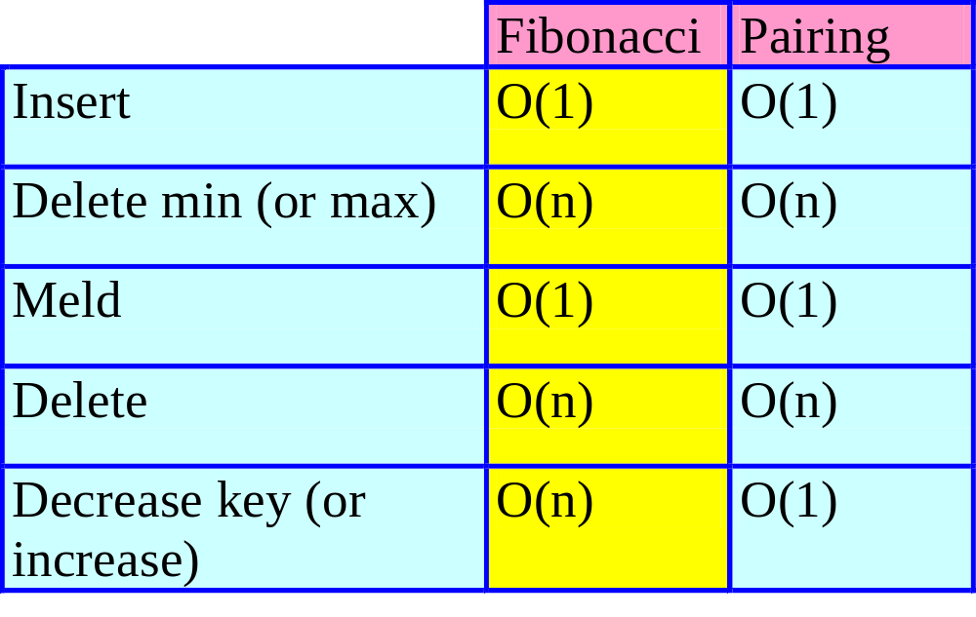
Pairing Heaps
Actual Complexity
Notes:
Amortized complexity of increase/decrease key is Omega(log log n).

Slide 2
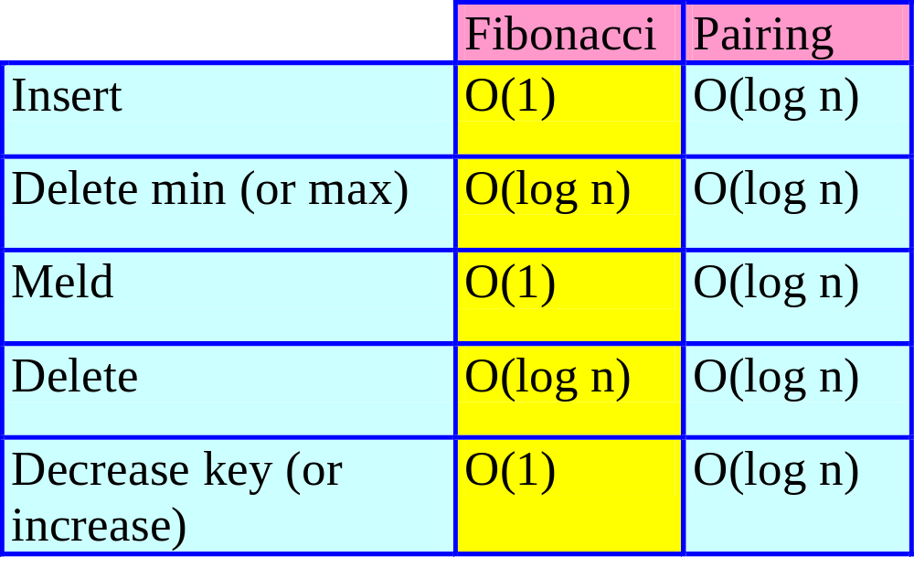
Pairing Heaps
Amortized Complexity
Notes:
If n = I + RM + D, Fibonacci heap takes O(I + RM log I + D) whereas pairing heap takes O(n log I) time (or I + D + RM*I).

Slide 3
Pairing Heaps
Experimental results suggest that pairing heaps are actually faster than Fibonacci heaps.
  Simpler to implement.
  Smaller runtime overheads.
  Less space per node.

Slide 4
Definition
A min (max) pairing heap is a min (max) tree in which operations are done in a specified manner.
8
Max Tree
3
6
4
5
2
1
3
4
5
3
1
2
1

Slide 5
Node Structure
Child
  Pointer to first node of children list.
Left and Right Sibling
  Used for doubly linked linked list (not circular) of siblings.
  Left pointer of first node is to parent.
  x is first node in list iff x.left.child = x.
Data
Note: No Parent, Degree, or ChildCut fields.

Slide 6
Meld – Max Pairing Heap
Compare-Link Operation
  Compare roots.
  Tree with smaller root becomes leftmost subtree.
9
7
9
+
=
7
6
7
6
6
7
6
3
3
Actual cost = O(1).
Notes:
Compare-link is similar to the pairwise combining operation used in binomial and Fibonacci heaps. The difference is that in the compare-link operation the two trees may not have the same degree.
Leftmost or next to leftmost is easiest place to add new tree.

Slide 7
Insert
Create 1-element max tree with new item and meld with existing max pairing heap.
9
9
+
=
insert(2)
2
7
6
7
7
6
7
6
3
6
3

Slide 8
Insert
Create 1-element max tree with new item and meld with existing max pairing heap.
14
9
9
+
=
insert(14)
7
6
7
7
7
6
Actual cost = O(1).
6
3
3
6

Slide 9
Worst-Case Degree
Insert 9, 8, 7, …, 1, in this order.
9
1
…
7
8
Worst-case degree = n –1.

Slide 10
Worst-Case Height
Insert 1, 2, 3, …, n, in this order.
5
4
Worst-case height = n.
3
2
1

Slide 11
IncreaseKey(theNode, theAmount)
Since nodes do not have parent fields, we cannot easily check whether the key in theNode becomes larger than that in its parent.
So, detach theNode from sibling doubly-linked list and meld.

Slide 12
IncreaseKey(theNode, theAmount)
9
theNode
4
2
6
6
4
1
2
3
1
5
3
2
3
4
If theNode is not the root, remove subtree rooted at theNode from its sibling list.
1
Notes:
IncreaseKey(theNode,14).

Slide 13
IncreaseKey(theNode, theAmount)
18
9
2
6
2
3
6
3
4
1
1
5
3
2
4
1
Meld subtree with remaining tree.

Slide 14
IncreaseKey(theNode, theAmount)
18
9
2
3
2
6
3
6
4
1
1
5
Actual cost = O(1).
3
2
4
1
Notes:
Doubly linked list is required to detach theNode from its circular list in O(1) time. Can’t use copy from next node trick used in Binomial heaps, because of the pointers from the external world to nodes in the data structure. These pointers enable the remove(theNode) and decreaseKey(theNode, theAmount) operations.

Slide 15
Delete Max
If empty => fail.
Otherwise, remove tree root and meld subtrees into a single max tree.
How to meld subtrees?
  Good way => O(log n) amortized complexity for remove max.
  Bad way => O(n) amortized complexity.

Slide 16
Bad Way To Meld Subtrees
currentTree = first subtree.
for (each of the remaining trees)
currentTree = compareLink(currentTree,
  nextTree);

Slide 17
Example
9
8
6
4
2
1
3
5
7
Delete max.
8
6
4
2
1
3
5
7
8
Meld into one tree.
7
5
3
1
2
4
6
Notes:
After 2 removemaxs we look like the original tree.

Slide 18
Example
Actual cost of insert is 1.
Actual cost of delete max is degree of root.
n/2 inserts (9, 7, 5, 3, 1, 2, 4, 6, 8) followed by n/2 delete maxs.
  Cost of inserts is n/2.
  Cost of delete maxs is 1 + 2 + … + n/2 – 1 = Θ(n²).
  If amortized cost of an insert is O(1), amortized cost of a delete max must be Θ(n).
Notes:
Actually, if amortized cost of insert is less than Omega(n), that of remove max must be Omega(n). Otherwise we cannot get a sequence cost that is Theta(n²).

Slide 19
Good Ways To Meld Subtrees
Two-pass scheme.
Multipass scheme.
Both have same asymptotic complexity.
Two-pass scheme gives better observed performance.

Slide 20
Two-Pass Scheme
Pass 1.
  Examine subtrees from left to right.
  Meld pairs of subtrees, reducing the number of subtrees to half the original number.
  If # subtrees was odd, meld remaining original subtree with last newly generated subtree.
Pass 2.
  Start with rightmost subtree of Pass 1. Call this the working tree.
  Meld remaining subtrees, one at a time, from right to left, into the working tree.

Slide 21
Two-Pass Scheme – Example
Pass 1
T1
T2
T3
T4
T5
T6
T7
T8
S1
S2
S3
S4
Notes:
If there is a T9, meld with S4 before proceeding to Pass 2.

Slide 22
Two-Pass Scheme – Example
Pass 2
S1
S2
S3
S4
R1
R2
R3

Slide 23
Multipass Scheme
Place the subtrees into a FIFO queue.
Repeat until 1 tree remains.
  Remove 2 subtrees from the queue.
  Meld them.
  Put the resulting tree onto the queue.

Slide 24
Multipass Scheme – Example
T1
T2
T3
T4
T5
T6
T7
T8
S1
T3
T4
T5
T6
T7
T8
S1
S2
T5
T6
T7
T8
S1
S2
S3
T7
T8

Slide 25
Multipass Scheme--Example
S1
S2
S3
T7
T8
S1
S2
S3
S4
S3
S4
R1
R1
R2

Slide 26
Multipass Scheme--Example
R1
R2
Q1
Actual cost = O(n).

Slide 27
Delete Nonroot Element
Remove theNode from its sibling list.
Meld children of theNode using either 2-pass or multipass scheme.
Meld resulting tree with what’s left of original tree.

Slide 28
Delete(theNode)
9
theNode
4
2
6
6
4
1
2
3
1
5
3
2
3
4
1
Remove theNode from its doubly-linked sibling list.
Notes:
When the leftmost child is removed, we change the child pointer in the parent node. Note that the left sibling pointer in the leftmost child gets us to the parent.

Slide 29
Delete(theNode)
9
2
6
6
4
4
1
1
5
2
3
3
2
4
3
1
Meld children of theNode.

Slide 30
Delete(theNode)
9
2
6
6
4
1
1
5
3
3
2
4
2
3
1
Meld with what’s left of original tree.

Slide 31
Delete(theNode)
9
3
2
6
6
2
3
1
1
4
5
3
2
4
Actual cost = O(n).
1

