Slide 1
Dynamic Dictionaries
Primary Operations:
  Get(key) => search
  Insert(key, element) => insert
  Delete(key) => delete
Additional operations:
  Ascend()
  Get(index)
  Delete(index)

Slide 2
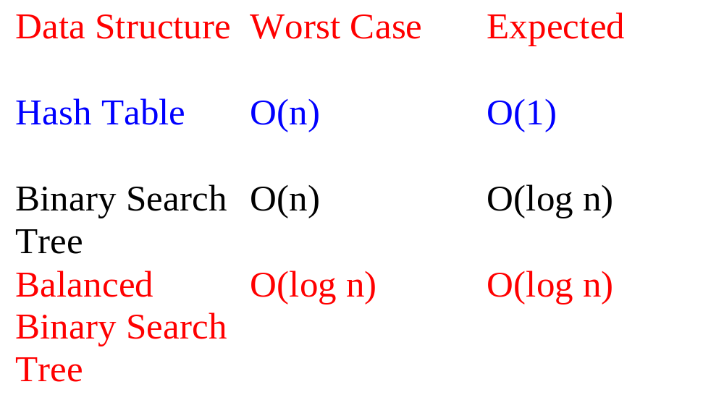
Complexity Of Dictionary Operations
Get(), Insert() and Delete()
n is number of elements in dictionary

Slide 3
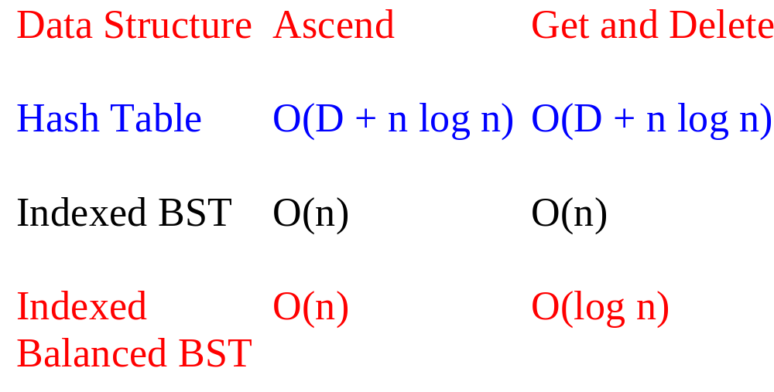
Complexity Of Other Operations
Ascend(), Get(index), Delete(index)
D is number of buckets
Notes:
Hash table get and remove using O(n) select would take O(D + n) time.

Slide 4
AVL Tree
binary tree
for every node x, define its balance factor
  balance factor of x = height of left subtree of x
  – height of right subtree of x
balance factor of every node x is – 1, 0, or 1

Slide 5
Balance Factors
-1
1
1
0
1
-1
0
0
0
0
-1
0
0
This is an AVL tree.

Slide 6
Height Of An AVL Tree
The height of an AVL tree that has n nodes is at most 1.44 log₂ (n+2).
The height of every n node binary tree is at least log₂ (n+1).
log₂ (n+1) <= height <= 1.44 log₂ (n+2)

Slide 7
Proof Of Upper Bound On Height
Let N_{h} = min # of nodes in an AVL tree whose height is h.
N₀ = 0.
N₁ = 1.

Slide 8
N_{h}, h > 1
L
R
Both L and R are AVL trees.
The height of one is h-1.
The height of the other is h-2.
The subtree whose height is h-1 has N_{h-1} nodes.
The subtree whose height is h-2 has N_{h-2} nodes.
So, N_{h} = N_{h-1} + N_{h-2} + 1.

Slide 9
Fibonacci Numbers
F₀ = 0, F₁ = 1.
F_{i} = F_{i-1} + F_{i-2} , i > 1.
N₀ = 0, N₁ = 1.
N_{h} = N_{h-1} + N_{h-2} + 1, i > 1.
N_{h} = F_{h+2} – 1.
F_{i} ~ φ^{i}/sqrt(5).
φ = (1 + sqrt(5))/2.
Notes:
Note that for Fibonacci heaps N_{i} = F_{i+2}. Also, for Fibonacci heaps, i is the degree
(not height).

Slide 10
AVL Search Tree
-1
10
1
1
7
40
0
1
-1
0
45
3
8
30
0
0
0
-1
0
60
35
1
5
20
0
25
Notes:
AVL search tree is often simply referred to as an AVL tree.

Slide 11
Insert(9)
-1
10
0
1
1
7
40
0
-1
1
-1
0
45
3
8
30
0
0
0
0
-1
0
60
35
1
5
9
20
0
25
Notes:
Some balance factors on insert path change.
When a bf changes from 0 to +1 or –1 the subtree height increases and we need to go further up the tree adjusting balance factors.

Slide 12
Insert(29)
-1
10
1
1
7
40
0
1
-1
0
45
3
8
30
0
0
0
-2
-1
0
60
35
1
5
20
RR imbalance => new node is in right subtree of right subtree of white node (node with bf = –2)
0
-1
25
0
29
Notes:
White node is the A node, nearest ancestor of newly inserted node whose bf becomes +2 or –2.

Slide 13
Insert(29)
-1
10
1
1
7
40
0
1
-1
0
45
3
8
30
0
0
0
0
0
60
35
1
5
25
0
0
20
29
RR rotation.

Slide 14
Insert
Following insert, retrace path towards root and adjust balance factors as needed.
Stop when you reach a node whose balance factor becomes 0, 2, or –2, or when you reach the root.
The new tree is not an AVL tree only if you reach a node whose balance factor is either 2 or –2.
In this case, we say the tree has become unbalanced.

Slide 15
A-Node
Let A be the nearest ancestor of the newly inserted node whose balance factor becomes +2 or –2 following the insert.
Balance factor of nodes between new node and A is 0 before insertion.

Slide 16
Imbalance Types
RR … newly inserted node is in the right subtree of the right subtree of A.
LL … left subtree of left subtree of A.
RL… left subtree of right subtree of A.
LR… right subtree of left subtree of A.

Slide 17
LL Rotation
A
1
A
2
B
0
B
0
A_{R}
B
1
A_{R}
B’_{L}
A
0
h
h
h+1
B_{L}
B_{R}
B’_{L}
B_{R}
B_{R}
A_{R}
h
h
h+1
h
h
h
Before insertion.
After insertion.
After rotation.
Subtree height is unchanged.
No further adjustments to be done.

Slide 18
LR Rotation (case 1)
A
1
A
2
C
0
B
0
B
-1
B
0
0
A
C
0
Before insertion.
After insertion.
After rotation.
Subtree height is unchanged.
No further adjustments to be done.
Notes:
B is a leaf prior to the insert.

Slide 19
LR Rotation (case 2)
A
1
A
2
C
0
B
0
A_{R}
B
-1
A_{R}
0
B
-1
A
h
h
B_{L}
0
B_{L}
1
C
B_{L}
C’_{L}
C_{R}
A_{R}
C
h
h
h
h
h-1
h
C_{L}
C_{R}
C’_{L}
C_{R}
h-1
h-1
h
h-1
Subtree height is unchanged.
No further adjustments to be done.
Notes:
B is not a leaf prior to the insert, the insert takes place in the left subtree of C.

Slide 20
LR Rotation (case 3)
A
1
A
2
C
0
B
0
A_{R}
B
-1
A_{R}
1
B
0
A
h
h
B_{L}
0
B_{L}
-1
C
B_{L}
C_{L}
C’_{R}
A_{R}
C
h
h
h
h-1
h
h
C_{L}
C_{R}
C_{L}
C’_{R}
h-1
h-1
h-1
h
Subtree height is unchanged.
No further adjustments to be done.

Slide 21
Single & Double Rotations
Single
  LL and RR
Double
  LR and RL
  LR is RR followed by LL
  RL is LL followed by RR

Slide 22
LR Is RR + LL
A
2
A
2
C
0
B
-1
A_{R}
C
A_{R}
B
A
h
1
0
h
B_{L}
-1
C
B
C’_{R}
B_{L}
C_{L}
C’_{R}
A_{R}
h
h
h
h-1
h
h
C_{L}
C’_{R}
B_{L}
C_{L}
h-1
h
h
h-1
After insertion.
After RR rotation.
After LL rotation.

Slide 23
Delete An Element
-1
10
1
1
7
40
0
1
-1
0
45
3
8
30
0
0
0
-1
0
60
35
1
5
20
0
25
Delete 8.
Notes:
Remove 5; no traceback needed.

Slide 24
Delete An Element
-1
10
q
2
1
7
40
0
1
-1
45
3
30
0
0
0
-1
0
60
35
1
5
20
0
Let q be parent of deleted node.
Retrace path from q towards root.
25
Notes:
No q => tree is empty following deletion.

Slide 25
New Balance Factor Of q
q
Deletion from left subtree of q => bf--.
Deletion from right subtree of q => bf++.
New balance factor = 1 or –1 => no change in height of subtree rooted at q.
New balance factor = 0 => height of subtree rooted at q has decreased by 1.
New balance factor = 2 or –2 => tree is unbalanced at q.
Notes:
Initially q is the parent of the deleted node. At this time, one subtree of q is empty and the other has just one node. As q moves up towards the root, neither subtree of q is empty.

Slide 26
Imbalance Classification
Let A be the nearest ancestor of the deleted node whose balance factor has become 2 or –2 following a deletion.
Deletion from left subtree of A => type L.
Deletion from right subtree of A => type R.
Type R => new bf(A) = 2.
So, old bf(A) = 1.
So, A has a left child B.
  bf(B) = 0 => R0.
  bf(B) = 1 => R1.
  bf(B) = –1 => R-1.

Slide 27
R0 Rotation
A
1
A
2
B
-1
B
0
A_{R}
B
0
A’_{R}
B_{L}
A
1
h
h-1
h
B_{L}
B_{R}
B_{L}
B_{R}
B_{R}
A’_{R}
h
h
h
h
h
h-1
Before deletion.
After deletion.
After rotation.
Subtree height is unchanged.
No further adjustments to be done.
Similar to LL rotation.

Slide 28
R1 Rotation
A
1
A
2
B
0
B
1
A_{R}
B
1
A’_{R}
B_{L}
A
0
h
h-1
h
B_{L}
B_{R}
B_{L}
B_{R}
B_{R}
A’_{R}
h
h-1
h
h-1
h-1
h-1
Before deletion.
After deletion.
After rotation.
Subtree height is reduced by 1.
Must continue on path to root.
Similar to LL and R0 rotations.

Slide 29
R-1 Rotation
A
1
A
2
C
0
B
-1
A_{R}
B
-1
A’_{R}
B
A
h
h-1
B_{L}
b
B_{L}
b
C
B_{L}
C_{L}
C_{R}
A’_{R}
C
h-1
h-1
h-1
h-1
C_{L}
C_{R}
C_{L}
C_{R}
New balance factor of A and B depends on b.
Subtree height is reduced by 1.
Must continue on path to root.
Similar to LR.

Slide 30
Number Of Rebalancing Rotations
At most 1 for an insert.
O(log n) for a delete.

Slide 31
Rotation Frequency
Insert random numbers.
  No rotation … 53.4% (approx).
  LL/RR … 23.3% (approx).
  LR/RL … 23.2% (approx).
Notes:
Frequencies do not sum to 100% because of rounding errors in reporting frequencies to one decimal place.

