Slide 1
Router/Classifier/Firewall Tables
Set of rules—(F,A)
  F is a filter
    Source and destination addresses.
    Port number and protocol.
    Time of day.
  A is an action
    Drop packet
    Forward to machine x (next hop).
    Reserve 10GB/sec bandwidth.
Notes:
No time to do any of the dynamic programming stuff.

Slide 2
Example Filters
QoS-router filter
  (source, destination, source port, destination port, protocol)
Firewall filter
  >= 1 field
Destination-based packet-forwarding filter
  Destination address
1-D filter
  Exactly 1 field – destination address

Slide 3
Destination-Address Filters
Range
  [35, 2096]
Address/mask pair
  101100/011101
  Matches 101100, 101110, 001100, 001110.
Prefix filter.
  Mask has 1s at left and 0s at right.
  101100/110000 = 10* = [32, 47].
  Special case of a range filter.

Slide 4
Example Router Table
P1 = 10*
P2 = 111*
P3 = 11001*
P4 = 1*
P5 = 0*
P6 = 1000*
P7 = 100000*
P8 = 1000000*
P1 matches all addresses that begin with 10.

Slide 5
Tie Breakers
First matching rule.
Highest-priority rule.
Most-specific rule.
  [2,4] is more specific than [1,6].
  [4,14] and [6,16] are not comparable.
Longest-prefix rule.
  Longest matching-prefix.

Slide 6
Longest-Prefix Matching
P1 = 10*
P2 = 111*
P3 = 11001*
P4 = 1*
P5 = 0*
P6 = 1000*
P7 = 100000*
P8 = 1000000*
Destination = 100000000
P1, P4, P6, P7, P8 match this destination
P8 is longest matching prefix

Slide 7
Static & Dynamic Router Tables
Static
  Lookup time.
  Preprocessing time.
  Storage requirement.
Dynamic
  Lookup time.
  Insert a rule.
  Delete a rule.

Slide 8
IPv4 Router Tables
Database | #Prefixes | #Nodes
Paix | 85862 | 173012
Pb | 35151 | 91718
MaeWest | 30599 | 81104
Aads | 26970 | 74290
MaeEast | 22630 | 65862
Notes:
#Nodes in 1-bit trie. Height is 32 for IPv4. Need to search in less than (say) 6 memory accesses.
Current tables go up to about 200K rules.

Slide 9
Ternary CAMs
0010?
1100?
11???
01???
00???
1????
d = 11001

Slide 10
Ternary CAMs
0010?
1100?
11???
01???
00???
1????
d = 11001
Longest prefix matching
Highest priority matching
Insert/Delete

Slide 11
Ternary CAMs
Capacity
Cost
Power
Board space
Scalability to IPv6?
Ranges?
Multidimensional filters?

Slide 12
1-Bit Trie
P1 = 10*
P2 = 111*
P3 = 11001*
P4 = 1*
P5 = 0*
P6 = 1000*
P7 = 100000*
P8 = 1000000*
P5
P4
P1
P2
P6
P3
P7
P8
Notes:
For LMP and HPP (highest-priority prefix).
Leaf-pushed trie.

Slide 13
Complexity
P5
P4
P1
P2
O(W)/operation
P6
P3
P7
P8
Notes:
Lookup, insert, delete.

Slide 14
Static Trie-Based Router Tables
Reduce number of memory accesses for a lookup.
  Multibit trie.

Slide 15
Multibit Tries
Branching at a node is done using >= 1 bit (rather than exactly 1 bit)
  Fixed stride
    Nodes on same level use same number of bits
  Variable stride

Slide 16
Fixed-Stride Tries
Number of levels = number of distinct prefix lengths.
Use prefix expansion to reduce number of distinct lengths.
Notes:
Must have a level for each prefix length so that prefix may be inserted into proper node.

Slide 17
Prefix Expansion
P1 = 10*
P2 = 111*
P3 = 11001*
P4 = 1*
P5 = 0*
P6 = 1000*
P7 = 100000*
P8 = 1000000*
P1 = 10*
P2a = 11100*
P2b = 11101*
P2c = 11110*
P2d = 11111*
P3 = 11001*
P4a = 11*
P5a = 00*
P5b= 01*
P6a = 10000*
P6b = 10001*
P7a = 1000001*
P8 = 1000000*
#lengths = 7
#lengths = 3
Notes:
Example is for longest prefix matching.

Slide 18
Fixed-Stride Trie
2
P5
P5
P1
P4
3
P6
P6
3
P3
P2
P2
P2
P2
2
P8
P7
Notes:
Red number is node stride

Slide 19
Optimization Problem
Find least memory fixed-stride trie whose height is at most k.
P5
P5
P1
P4
P6
P6
P3
P2
P2
P2
P2
P8
P7

Slide 20
Covering and Expansion Levels
P5
P4
P1
P2
P6
P3
P7
P8
P5
P5
P1
P4
P6
P6
P3
P2
P2
P2
P2
P8
P7
Notes:
Root of FST covers levels 0 & 1 of one-bit trie.
Next level covers levels 2 through 4 of 1-bit trie.
Last level covers levels 5 & 6 of 1-bit trie.
[s,e] pair for each level—[0,1], [2,4], [5,6]
Expansion levels are 0, 2, and 5.

Slide 21
Dynamic Programming
C(j,r) = cost of best FST whose height is at most r and which covers levels 0 through j of the 1-bit trie
Want C(root,k)
C(-1,r) = 0
C(j,1) = 2^{j+1}, j >= 0
P5
P4
P1
P2
P6
P3
P7
P8

Slide 22
Dynamic Programming
nodes(i) = #nodes at level i of 1-bit trie
nodes(0) = 1
nodes(3) = 2
P5
P4
P1
P2
P6
P3
P7
P8

Slide 23
Dynamic Programming
C(j,r) = min_{-1<=m<j}{C(m,r-1) + nodes(m+1)*2^{j-m}}, j >= 0, r > 1
P5
P4
P1
Compute C(W,k)
Complexity = O(kW²)
P2
P6
P3
P7
P8
Notes:
Complexity excludes cost of computing nodes().

Slide 24
Alternative Formulation
C(j,r) = min{C(j,r-1), U(j,r)}
U(j,r) = min_{r-2<=m<j}{C(m,r-1) + nodes(m+1)*2^{j-m}}, j >= 0, r > 1
Let M(j,r), be smallest m that minimizes right side of equation for U(j,r).
M(j,r) >= max{M(j-1,r), M(j,r-1)}, r > 2.
Faster by factor of between 2 and 4.

Slide 25
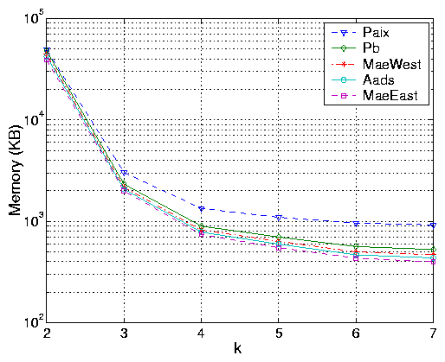
Size of FST

Slide 26
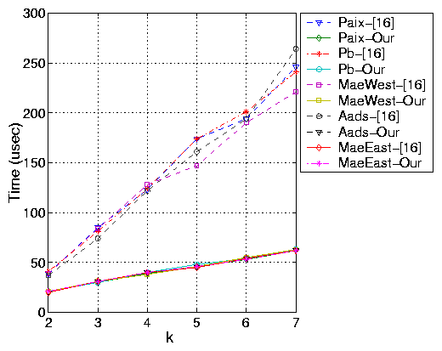
Run Time
Notes:
Our → alternative formulation

Slide 27
Variable-Stride Tries
P5
P4
P1
P2
P6
P3
P7
P8
2
P5
P5
P1
P4
3
P3
P2
P2
P2
P2
5
P8
P7
P6
P6
P6
P6
P6
P6
. . .

Slide 28
Dynamic Programming
r-VST = VST with <= r levels
Opt(N,r) = cost of best r-VST for 1-bit trie rooted at node N
Want to compute Opt(root,k)
D_{s}(N) = all level s descendents of N
D₁(N) = children of N

Slide 29
Dynamic Programming
Opt(N,s,r) = Σ_{M in Ds(N)} Opt(M,r)
= Opt(LeftChild(N),s-1,r)
+ Opt(RightChild(N),s-1,r), s > 0
Opt(null,*,*) = 0
Opt(N,0,r) = Opt(N,r)
Opt(N,0,1) = 2^{1+height(N)}
Optimal k-VST in O(mWk) ~ O(nWk)
Notes:
m is #nodes in 1-bit trie; n is #prefixes, m = O(n) for practical tables
For Opt(N,0,r) we can write a recurrence in terms of Opt(N,s,r), s > 0.

Slide 30
Faster k = 2 Algorithm
Opt(root,2) = min_{s}{2^{s} + C(s)}
C(s) = Σ_{M in Ds(root)} 2^{1+height(M)}
1 <= s <= 1+height(root)
Complexity is O(m) = O(n) on practical router data
P5
P4
P1
P2
P6
P3
P7
P8
Notes:
Use a postorder traversal to compute C(*) incrementally. When a node M is visited, it adds 2^{1+height(M)} to C(level(M)).

Slide 31
Faster k = 3 Algorithm
Opt(root,3) = min_{s}{2^{s} + T(s)}
T(s) = Σ_{M in Ds(root)} Opt(M,2)
1 <= s <= 1+height(root)
Complexity is O(m) = O(n) on practical router data that have non-skewed tries.
Otherwise, complexity is O(mW), where W is trie height.
P5
P4
P1
P2
P6
P3
P7
P8

Slide 32
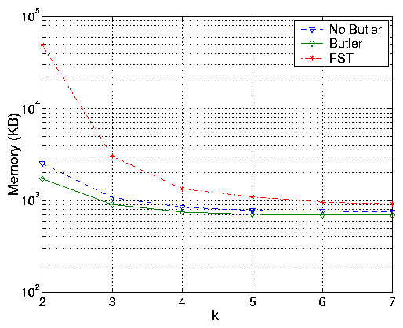
Memory—Paix

Slide 33
Two-Dimensional Filters
Destination-Source pairs.
d > 2 may be mapped to d = 2 using buckets; number of filters in each bucket is small.
d > 2 may not be practical for security reasons.
Notes:
Can map d > 2 to d = 1 but then bucket size is large.

Slide 34
Destination-Source Pairs
Address Prefix.
  10* = [32, 47].
(0*, 1100*)
  Dest address begins with 0 and source with 1100
Least-cost tie breaker
  (0*, 11*, 4) and (00*, 1*, 2)
  Packet (00…, 11…)
  Use second rule.
Notes:
First matching rule is modeled by having cost equal to index in list.

Slide 35
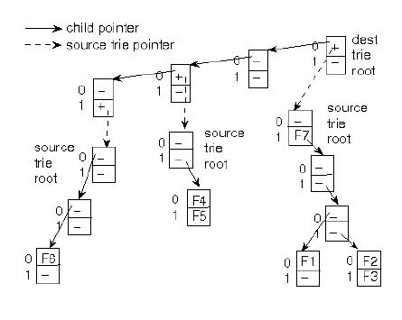
2D Tries
F1 = (0*, 1100*, 1)
F2 = (0*, 1110*, 2)
F3 = (0*, 1111*, 3)
F4 = (000*, 10*, 4)
F5 = (000*, 11*, 5)
F6 = (0001*, 000), 6)
F7 = (0*, 1*, 7)

Slide 36
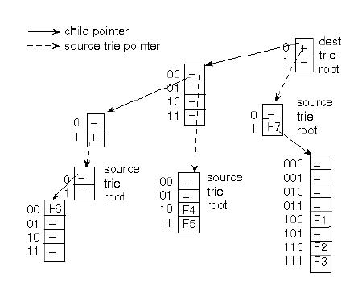
2D Tries
F1 = (0*, 1100*, 1)
F2 = (0*, 1110*, 2)
F3 = (0*, 1111*, 3)
F4 = (000*, 10*, 4)
F5 = (000*, 11*, 5)
F6 = (0001*, 000), 6)
F7 = (0*, 1*, 7)

Slide 37
Space-Optimal 2D Tries
Given k.
Find 2DMT that can be searched with <= k memory accesses and has minimum memory requirement.

Slide 38
Performance
2DMTs may be searched with ¼ to ½ memory accesses as required by 2D1BTs with same memory budget
With 50% memory penalty, memory accesses fall to between 1/8 and 1/4

