Slide 1
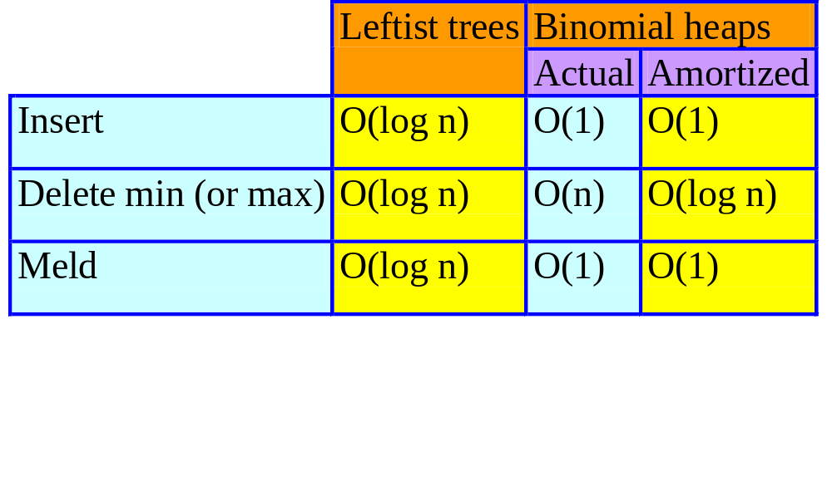
Binomial Heaps
Notes:
On the surface it looks like Binomial Heaps are great if you have no remove mins. But, in this case you need only keep track of the current min item using O(1) space per PQ. Insert, meld, and find min each take O(1) actual time. Binomial heap is a step to Fibonacci heaps. Could be useful if you have infrequent remove mins and frequent insert/meld.

Slide 2
Min Binomial Heap
Collection of min trees.
2
1
4
4
5
9
7
3
6
7
6
8
5
5
8
6
9
9
Notes:
Way in which operations are performed constrains the tree structure.

Slide 3
Node Structure
Degree
  Number of children.
Child
  Pointer to one of the node’s children.
  Null iff node has no child.
Sibling
  Used for circular linked list of siblings.
Data
Notes:
Space requirements are similar to those of a leftist tree. Now we have a degree field instead of an s-value field. As we shall see, degree and s-values are both O(log n).

Slide 4
Binomial Heap Representation
Circular linked list of min trees.
A
2
1
4
4
5
9
7
3
6
7
6
8
5
5
8
Degree fields not shown.
6
9
9

Slide 5
Insert 10
Add a new single-node min tree to the collection.
Update min-element pointer if necessary.
A
2
1
4
4
5
9
7
3
10
6
7
6
8
5
5
8
6
9
9
Notes:
New tree is added next to tree with min element. This takes O(1) time.

Slide 6
Meld
1
4
5
7
B
3
7
9
A
8
Combine the 2 top-level circular lists.
Set min-element pointer.
Notes:
O(1) time.

Slide 7
Meld
1
4
5
7
C
7
3
9
8

Slide 8
Delete Min
Empty binomial heap => fail.

Slide 9
Nonempty Binomial Heap
Remove a min tree.
Reinsert subtrees of removed min tree.
Update binomial heap pointer.
A
2
1
4
4
5
9
7
3
10
6
7
6
8
5
5
8
6
9
9

Slide 10
Remove Min Tree
Same as remove a node from a circular list.
a
b
c
d
d
e
A
No next node => empty after remove.
Otherwise, copy next-node data and remove next node.
Notes:
Don’t really need this trick either as later pairwise combine will need to go through all top-level trees in any case. So, can get same asymptotic complexity by doing the remove in conjunction with the pairwise combine.

Slide 11
Reinsert Subtrees
1
4
5
7
7
3
9
B
A
8
subtrees
Combine the 2 top-level circular lists.
  Same as in meld operation.

Slide 12
Update Binomial Heap Pointer
Must examine roots of all min trees to determine the min value.

Slide 13
Complexity Of Delete Min
Remove a min tree.
  O(1).
Reinsert subtrees.
  O(1).
Update binomial heap pointer.
  O(s), where s is the number of min trees in final top-level circular list.
  s = O(n).
Overall complexity of remove min is O(n).
Notes:
Since our delete min operation has to walk through original top-level circular list, we may as well do the removal of the min tree during this walk (instead of using the copy from forward node trick) .

Slide 14
Enhanced Delete Min
During reinsert of subtrees, pairwise combine min trees whose roots have equal degree.

Slide 15
Pairwise Combine
2
1
4
4
5
9
7
3
10
6
7
6
8
5
5
8
6
9
9
Examine the s = 7 trees in some order.
Determined by the 2 top-level circular lists.
Notes:
One of the top-level circular lists is the original top-level list (minus the removed min tree); the other is the list of the removed min tree’s subtrees.

Slide 16
Pairwise Combine
2
4
10
5
6
1
5
4
5
9
9
7
3
9
6
7
6
8
8
4
3
tree table
2
1
0
Use a table to keep track of trees by degree.

Slide 17
Pairwise Combine
2
4
10
5
6
1
5
4
5
9
9
7
3
9
6
7
6
8
8
4
3
tree table
2
1
0

Slide 18
Pairwise Combine
2
4
10
5
6
1
5
4
5
9
9
7
3
9
6
7
6
8
8
4
3
tree table
2
1
Combine 2 min trees of degree 0.
0
Make the one with larger root a subtree of other.

Slide 19
Pairwise Combine
2
4
5
6
1
5
4
5
9
10
9
7
3
9
6
7
6
8
8
4
3
tree table
2
1
Update tree table.
0

Slide 20
Pairwise Combine
2
4
5
6
1
5
4
5
9
10
9
7
3
9
6
7
6
8
8
4
3
tree table
2
1
Combine 2 min trees of degree 1.
0
Make the one with larger root a subtree of other.

Slide 21
Pairwise Combine
2
4
6
1
5
4
5
9
10
5
7
3
9
6
7
6
9
8
8
4
3
tree table
2
1
Update tree table.
0

Slide 22
Pairwise Combine
2
4
6
1
5
4
5
9
10
5
7
3
9
6
7
6
9
8
8
4
3
tree table
2
1
0

Slide 23
Pairwise Combine
2
4
6
1
5
4
5
9
10
5
7
3
9
6
7
6
9
8
8
4
3
tree table
2
1
Combine 2 min trees of degree 2.
0
Make the one with larger root a subtree of other.

Slide 24
Pairwise Combine
2
6
1
5
4
5
9
7
3
9
4
6
7
6
10
8
5
8
9
4
3
tree table
2
1
Combine 2 min trees of degree 3.
0
Make the one with larger root a subtree of other.

Slide 25
Pairwise Combine
1
6
5
4
7
3
2
9
4
9
10
5
8
5
6
7
9
6
4
3
tree table
2
8
1
0
Update tree table.

Slide 26
Pairwise Combine
1
6
5
4
7
3
2
9
4
9
10
5
8
5
6
7
9
6
4
3
tree table
2
8
1
0

Slide 27
Pairwise Combine
1
6
5
4
7
3
2
9
4
9
10
5
8
5
6
7
9
6
4
3
tree table
2
8
1
0
Create circular list of remaining trees.

Slide 28
Complexity Of Delete Min
Create and initialize tree table.
  O(MaxDegree).
  Done once only.
Examine s min trees and pairwise combine.
  O(s).
Collect remaining trees from tree table, reset table entries to null, and set binomial heap pointer.
  O(MaxDegree).
Overall complexity of remove min.
  O(MaxDegree + s).
Notes:
Total #combines is at most s-1 as each combine reduces #trees by 1.

Slide 29
Binomial Trees
B_{k} is degree k binomial tree.
B₀
B_{k} , k > 0, is:
…
B_{k-1}
B₁
B₂
B₀
Notes:
Order of subtrees is not important.

Slide 30
Examples
B₂
B₃
B₀
B₁

Slide 31
Number Of Nodes In B_{k}
N_{k} = number of nodes in B_{k}.
B₀
N₀ = 1
B_{k} , k > 0, is:
…
B_{k-1}
B₁
B₂
B₀
N_{k} = N₀ + N₁ + N₂ + …+ N_{k-1} + 1
= 2^{k}.

Slide 32
Equivalent Definition
B_{k} , k > 0, is two B_{k-1}s.
One of these is a subtree of the other.
B₁
B₂
B₃

Slide 33
N_{k} And MaxDegree
N₀ = 1
N_{k} = 2N_{k-1}
= 2^{k}.
If we start with zero elements and perform operations as described, then all trees in all binomial heaps are binomial trees.
So, MaxDegree = O(log n).

