Slide 1
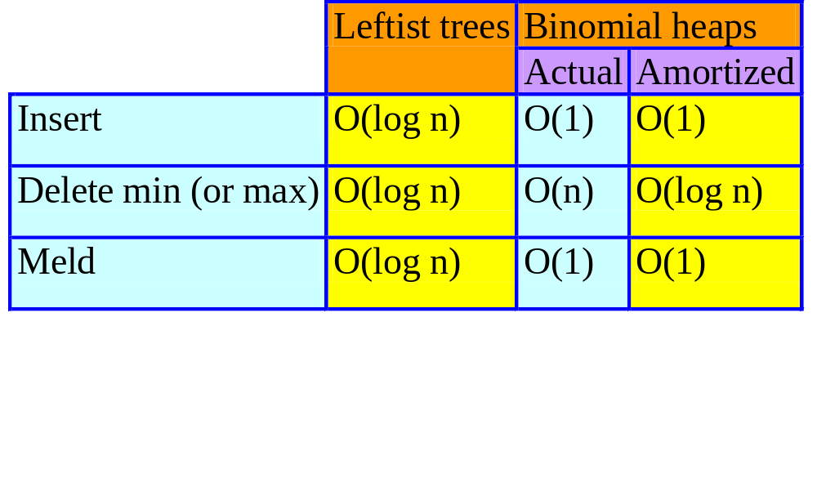
Analysis Of Binomial Heaps

Slide 2
Operations
Insert
  Add a new min tree to top-level circular list.
Meld
  Combine two circular lists.
Delete min
  Pairwise combine min trees whose roots have equal degree.
  O(MaxDegree + s), where s is number of min trees following removal of min element but before pairwise combining.

Slide 3
Binomial Trees
B_{k} , k > 0, is two B_{k-1}s.
One of these is a subtree of the other.
B₀
B₁
B₂
B₃
Notes:
K is degree of B_{k}

Slide 4
All Trees In Binomial Heap Are Binomial Trees
Insert creates a B₀.
Meld does not create new trees.
Pairwise combine takes two trees of equal degree and makes one a subtree of the other.
Let n be the number of operations performed.
  Number of inserts is at most n.
  No binomial tree has more than n elements.
  MaxDegree <= log₂n.
  Complexity of remove min is O(log n + s) = O(n).

Slide 5
Aggregate Method
Get a good bound on the cost of every sequence of operations and divide by the number of operations.
Results in same amortized cost for each operation, regardless of operation type.
Can’t use this method, because we want to show a different amortized cost for remove mins than for inserts and melds.

Slide 6
Aggregate Method – Alternative
Get a good bound on the cost of every sequence of delete mins and divide by the number of delete mins.
Consider the sequence insert, insert, …, insert, delete min.
  The cost of the delete min is O(n), where n is the number of operations in the sequence.
  So, amortized cost of a delete min is O(n/1) = O(n).

Slide 7
Accounting Method
Guess the amortized cost.
  Insert => 2.
  Meld => 1.
  Delete min => 3log₂n.
Show that P(i) – P(0) >= 0 for all i.

Slide 8
Potential Function
P(i) = amortizedCost(i) – actualCost(i) + P(i – 1)
P(i) – P(0) is the amount by which the first i operations have been over charged.
We shall use a credit scheme to show P(i) – P(0) >= 0 for all i.
P(i) = number of credits after operation i.
Initially number of credits is 0.
P(0) = 0.
Notes:
Potential equals number of credits. Initially number of credits is zero.

Slide 9
Insert
  Guessed amortized cost = 2.
  Use 1 unit to pay for the actual cost of the insert.
  Keep the remaining 1 unit as a credit for a future delete min operation.
  Keep this credit with the min tree that is created by the insert operation.
  Potential increases by 1, because there is an overcharge of 1.
Notes:
Each min-tree root has a credit of 1 to pay for its future pairwise combine. Potential equals number of credits.

Slide 10
Meld
  Guessed amortized cost = 1.
  Use 1 unit to pay for the actual cost of the meld.
  Potential is unchanged, because actual and amortized costs are the same.
Notes:
Each min-tree root has a credit of 1 to pay for its future pairwise combine.

Slide 11
Delete Min
Let MinTrees be the set of min trees in the binomial heap just before delete min.
Let u be the degree of min tree whose root is removed.
Let s be the number of min trees in binomial heap just before pairwise combining.
  s = #MinTrees + u – 1
Actual cost of delete min is <= MaxDegree + s
<= 2log₂n –1+ #MinTrees.

Slide 12
Delete Min
Guessed amortized cost = 3log₂n.
Actual cost <= 2log₂n – 1 + #MinTrees.
Allocation of amortized cost.
  Use 2log₂n – 1 to pay part of actual cost.
  Keep remaining log₂n + 1 as a credit to pay part of the actual cost of a future delete min operation.
  Put 1 unit of credit on each of the at most log₂n + 1 min trees left behind by the delete min operation.
  Discard the remaining credits (if any).

Slide 13
Paying Actual Cost Of A Delete Min
Actual cost <= 2log₂n – 1 + #MinTrees
How is it paid for?
  2log₂n –1 comes from amortized cost of this delete min operation.
  #MinTrees comes from the min trees themselves, at the rate of 1 unit per min tree.
  Potential remains nonnegative, because there are enough credits to pay the balance of the actual cost.

Slide 14
Potential Method
Guess a suitable potential function for which P(i) – P(0) >= 0 for all i.
Derive amortized cost of ith operation using ΔP = P(i) – P(i – 1)
  = amortized cost – actual cost
amortized cost = actual cost + ΔP

Slide 15
Potential Function
P(i) = Σ#MinTrees(j)
  #MinTrees(j) is #MinTrees for binomial heap j.
  When binomial heaps A and B are melded, A and B are no longer included in the sum.
P(0) = 0
P(i) >= 0 for all i.
ith operation is an insert.
  Actual cost of insert = 1
  ΔP = P(i) – P(i – 1) = 1
  Amortized cost of insert = actual cost + ΔP
  = 2

Slide 16
ith Operation Is A Meld
Actual cost of meld = 1
P(i) = Σ#MinTrees(j)
ΔP = P(i) – P(i – 1) = 0
Amortized cost of meld = actual cost + ΔP
= 1

Slide 17
ith Operation Is A Delete Min
old => value just before the delete min
new => value just after the delete min.
#MinTrees^{old}(j) => value of #MinTrees in jth binomial heap just before this delete min.
Assume delete min is done in kth binomial heap.

Slide 18
ith Operation Is A Delete Min
Actual cost of delete min from binomial heap k
<= 2log₂n – 1 + #MinTrees^{old}(k)
ΔP = P(i) – P(i – 1)
= Σ[#MinTrees^{new}(j) – #MinTrees^{old}(j)]
= #MinTrees^{new}(k) – #MinTrees^{old}(k).
Amortized cost of delete min = actual cost + ΔP
<= 2log₂n – 1 + #MinTrees^{new} (k)
<= 3log₂n.

