Slide 1
Chapter 7 Sorting: Outline
Introduction
  Searching and List Verification
  Definitions
Insertion Sort
Quick Sort
Merge Sort
Heap Sort
Counting Sort
Radix Sort
Shell Sort
Summary of Internal Sorting

Slide 2
Introduction (1/9)
Why efficient sorting methods are so important ?
The efficiency of a searching strategy depends on the assumptions we make about the arrangement of records in the list
No single sorting technique is the “best” for all initial orderings and sizes of the list being sorted.
We examine several techniques, indicating when one is superior to the others.

Slide 3
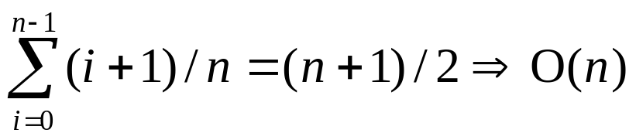
Introduction (2/9)
Sequential search
  We search the list by examining the key values list[0].key, … , list[n-1].key.
    Example: List has n records.
    4, 15, 17, 26, 30, 46, 48, 56, 58, 82, 90, 95
  In that order, until the correct record is located, or we have examined all the records in the list
  Unsuccessful search: n+1 ⇒ O(n)
  Average successful search

Slide 4
Introduction (3/9)
Binary search
  Binary search assumes that the list is ordered on the key field such that list[0].key ≤ list[1]. key ≤ … ≤ list[n-1]. key.
  This search begins by comparing searchnum (search key) and list[middle].key where
  middle=(n-1)/2
[5]
46
[2]
[8]
4, 15, 17, 26, 30, 46, 48, 56, 58, 82, 90, 95
17
58
[0]
[3]
[6]
[10]
4
26
48
90
Figure 7.1:
Decision tree for
binary search (p.323)
[1]
[4]
[7]
[9]
[11]
15
30
56
82
95

Slide 5
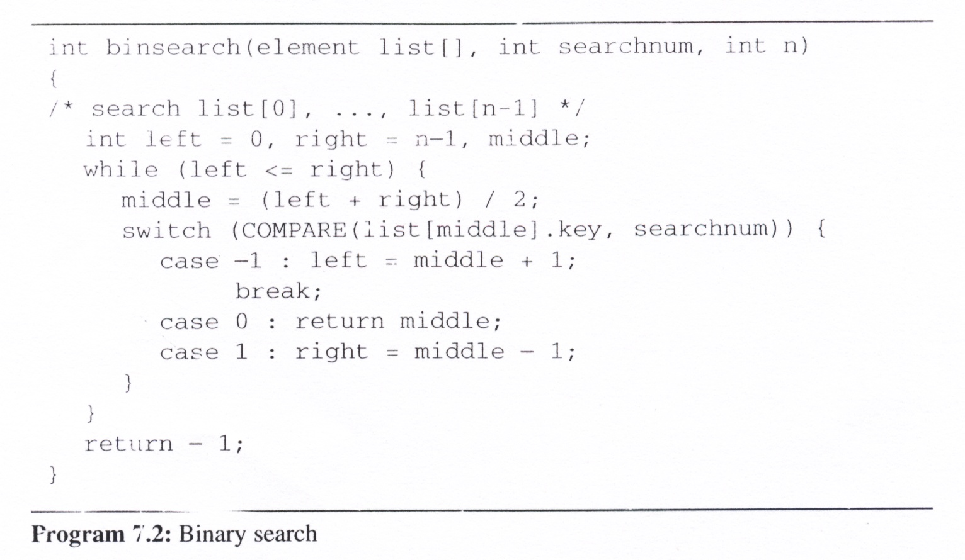
Introduction (4/9)
Binary search (cont’d)
  Analysis of binsearch: makes no more than O(log n) comparisons

Slide 6
Introduction (5/9)
List Verification
  Compare lists to verify that they are identical or identify the discrepancies.
Example
  International Revenue Service (IRS)
  (e.g., employee vs. employer)
Reports three types of errors:
  all records found in list1 but not in list2
  all records found in list2 but not in list1
  all records that are in list1 and list2 with the same key but have different values for different fields

Slide 7
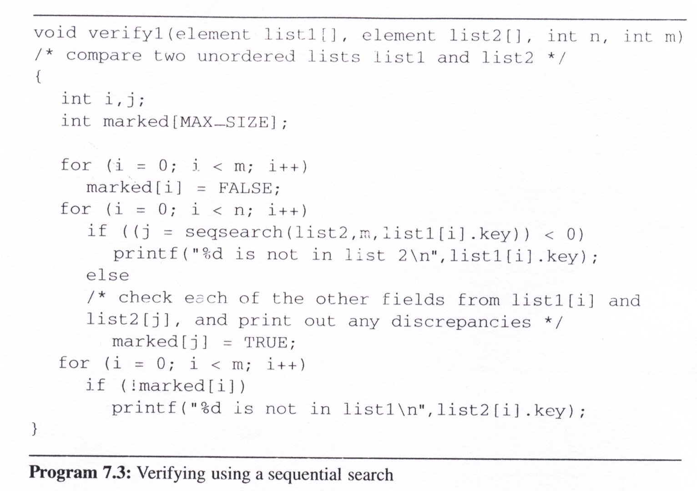
Introduction (6/9)
Verifying using a sequential search
Check whether the elements in list1 are also in list2
And the elements in list2 but not in list1 would be show up

Slide 8
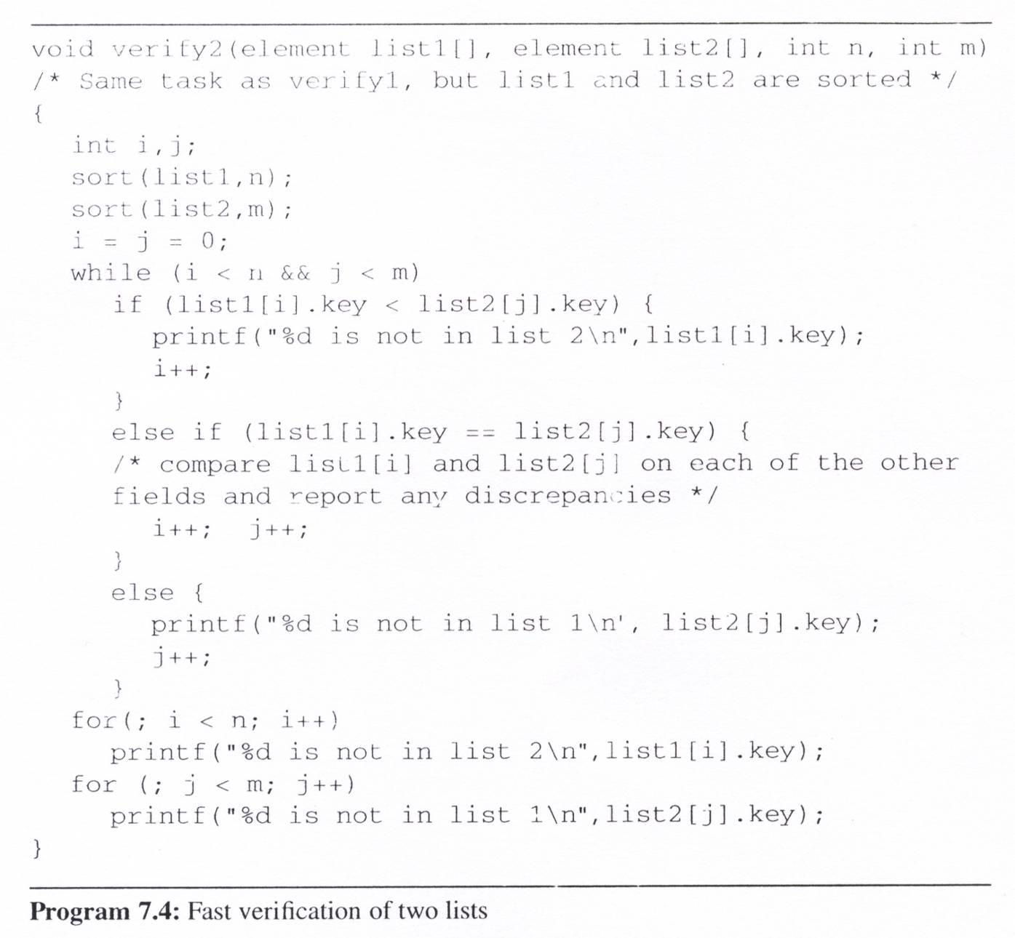
Introduction (7/9)
Fast
verification
of two lists
The element of list1 is not in list2
The element of two lists are matched
The element of list2 is not in list1
The remainder elements of a list is not a member of another list

Slide 9
Introduction (8/9)
Complexities
  Assume the two lists are randomly arranged
  Verify1: O(mn)
  Verify2: sorts them before verification
  O(tsort(n) + tsort(m) + m + n) ⇒ O(max[nlogn, mlogm])
    tsort(n): the time needed to sort the n records in list1
    tsort(m): the time needed to sort the m records in list2
    we will show it is possible to sort n records in O(nlogn) time
Definition
  Given (R₀, R₁, …, R_{n-1}), each R_{i} has a key value K_{i}
  find a permutation σ, such that K_{σ(i-1)} ≤ K_{σ(i)}, 0<i ≤ n-1
  σ denotes an unique permutation
  Sorted: K_{σ(i-1)} ≤ K_{σ(i)}, 0<i<n-1
  Stable: if i < j and K_{i} = K_{j} then R_{i} precedes R_{j} in the sorted list

Slide 10
Introduction (9/9)
Two important applications of sorting:
  An aid to search
  Matching entries in lists
Internal sort
  The list is small enough to sort entirely in main memory
External sort
  There is too much information to fit into main memory

Slide 11
Insertion Sort (1/3)
Concept:
  The basic step in this method is to insert a record R into a sequence of ordered records, R₁, R₂, …, R_{i} (K₁ ≤ K₂ ≤, …, ≤ K_{i}) in such a way that the resulting sequence of size i is also ordered
Variation
  Binary insertion sort
    reduce search time
  List insertion sort
    reduce insert time

Slide 12
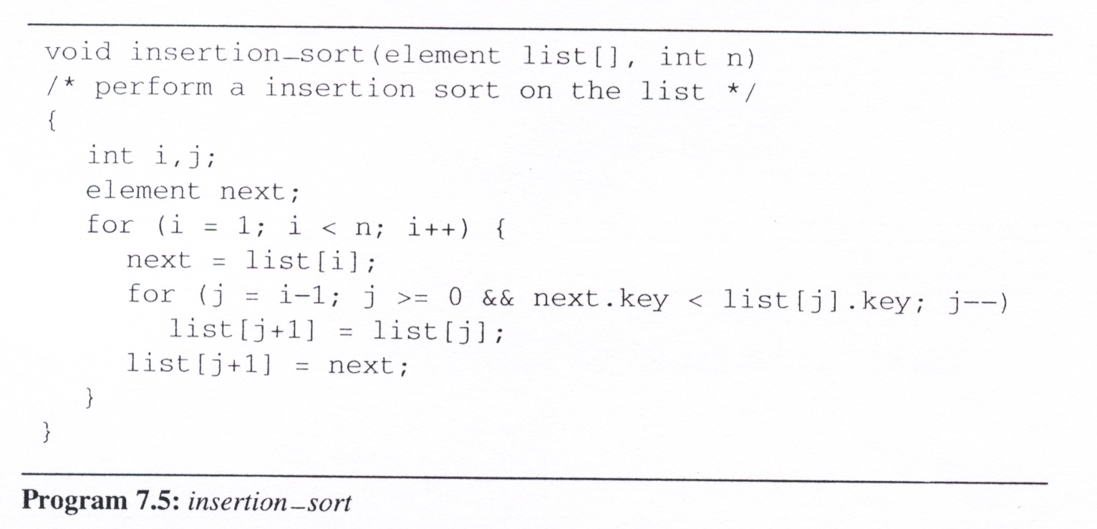
Insertion Sort (2/3)
list
[0]
[1]
[2]
[3]
[4]
Insertion sort program
5
2
1
2
5
3
2
3
5
3
1
5
4
4
5
i =
1
3
4
2
next =
3
1
4
2

Slide 13
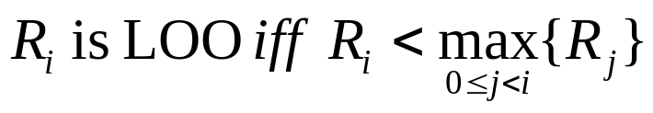
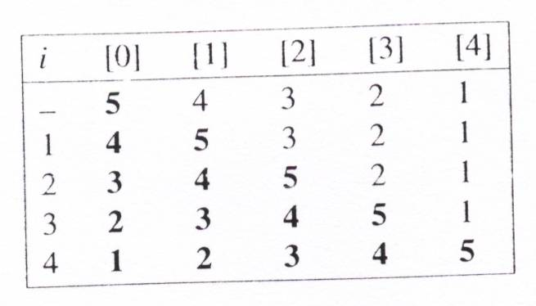
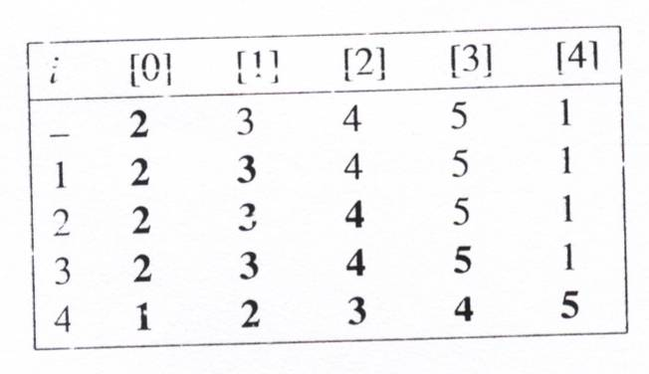
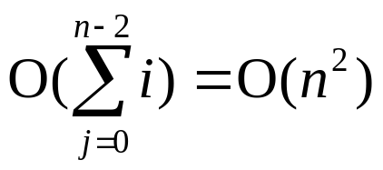
Insertion Sort (3/3)
Analysis of InsertionSort:
  If k is the number of records LOO, then the computing time is O((k+1)n)
  The worst-case time is O(n²).
  The average time is O(n²).
  The best time is O(n).
left out of order (LOO)
O(n)

Slide 14
Quick Sort (1/6)
The quick sort scheme developed by C. A. R. Hoare has the best average behavior among all the sorting methods we shall be studying
Given (R₀, R₁, …, R_{n-1}) and K_{i} denote a pivot key
If K_{i} is placed in position s(i),
then K_{j} ≤ K_{s(i)} for j < s(i), K_{j} ≥ K_{s(i)} for j > s(i).
After a positioning has been made, the original file is partitioned into two subfiles, {R₀, …, R_{s(i)-1}}, R_{s(i)}, {R_{s(i)+1}, …, R_{s(n-1)}}, and they will be sorted independently

Slide 15
Quick Sort (2/6)
Quick Sort Concept
  select a pivot key
  interchange the elements to their correct positions according to the pivot
  the original file is partitioned into two subfiles and they will be sorted
  independently
R₀
R₁
R₂
R₃
R₄
R₅
R₆
R₇
R₈
R₉
26
5
37
1
61
11
59
15
48
19
11
5
19
1
15
26
59
61
48
37
1
5
11
19
15
26
59
61
48
37
1
5
11
19
15
26
59
61
48
37
1
5
11
15
19
26
59
61
48
37
1
5
11
15
19
26
48
37
59
61
1
5
11
15
19
26
37
48
59
61
1
5
11
15
19
26
37
48
59
61

Slide 16
In-Place Partitioning Example
a
6
6
2
8
8
5
11
10
4
1
9
7
3
3
a
6
6
2
3
5
11
11
10
4
1
1
9
7
8
a
6
6
2
3
5
1
10
10
4
4
11
9
7
8
a
6
6
2
3
5
1
4
4
10
10
11
9
7
8
bigElement is not to left of smallElement, terminate process. Swap pivot and smallElement.
a
4
2
3
5
1
4
6
6
10
11
9
7
8

Slide 17
Quick Sort (4/6)
Analysis for Quick Sort
  Assume that each time a record is positioned, the list is divided into the rough same size of two parts.
  Position a list with n element needs O(n)
  T(n) is the time taken to sort n elements
  T(n)<=cn+2T(n/2) for some c
  <=cn+2(cn/2+2T(n/4))
  ...
  <=cnlog₂n+nT(1)=O(nlogn)
Time complexity
  Average case and best case: O(nlogn)
  Worst case: O(n²)
  Best internal sorting method considering the average case
Unstable

Slide 18
Quick Sort (5/6)
Lemma 7.1:
  Let T_{avg}(n) be the expected time for quicksort to sort a file with n records. Then there exists a constant k such that T_{avg}(n) ≤ knlog_{e}n for n ≥ 2
Space for Quick Sort
  If the smaller of the two subarrays is always sorted first, the maximum stack space is O(logn)
Stack space complexity:
  Average case and best case: O(logn)
  Worst case: O(n)

Slide 19
Quick Sort (6/6)
Quick Sort Variations
  Quick sort using a median of three: Pick the median of the first, middle, and last keys in the current sublist as the pivot. Thus, pivot = median{K_{l}, K_{(l+r)/2}, K_{r}}.

Slide 20
Median of Three Partitioning Example
a
6
6
2
8
5
11
10
10
4
1
9
7
3
3
a
3
3
2
8
5
11
10
10
4
1
9
7
6
6
a
3
3
2
8
5
11
6
4
1
9
7
10
6
10
a
3
3
2
5
11
7
4
6
10
8
1
9
6
10
a
3
3
2
1
5
7
8
9
6
10
11
4
6
10
a
3
3
2
1
5
11
8
9
6
10
4
7
6
10
a
3
3
2
1
5
4
6
11
8
9
7
10
6
10

Slide 21
Merge Sort (1/7)
Before looking at the merge sort algorithm to sort n records, let us see how one may merge two sorted lists to get a single sorted list.
Merging
  Uses O(n) additional space.
  It merges the sorted lists
  (list[i], … , list[m]) and (list[m+1], …, list[n]),
  into a single sorted list, (sorted[i], … , sorted[n]).
  Copy sorted[1..n] to list[1..n]

Slide 22
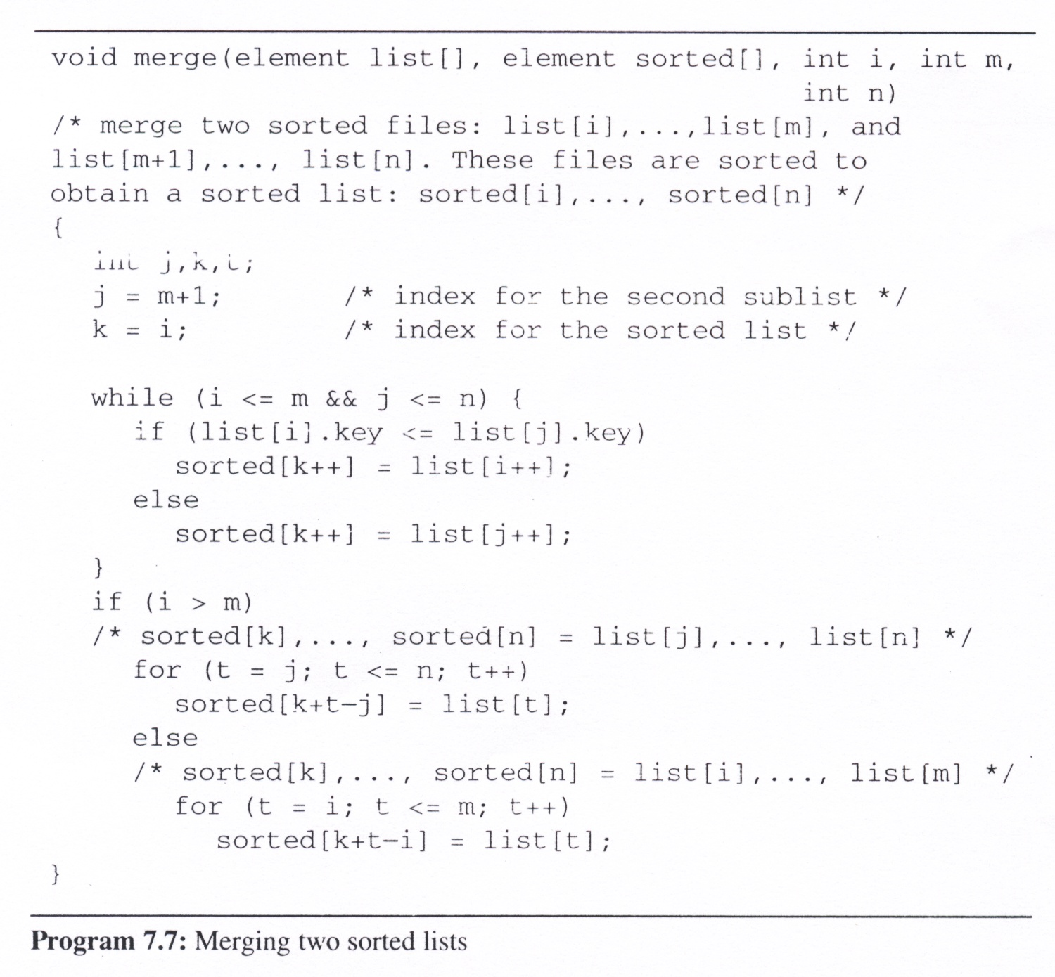
Merge (using O(n) space)

Slide 23
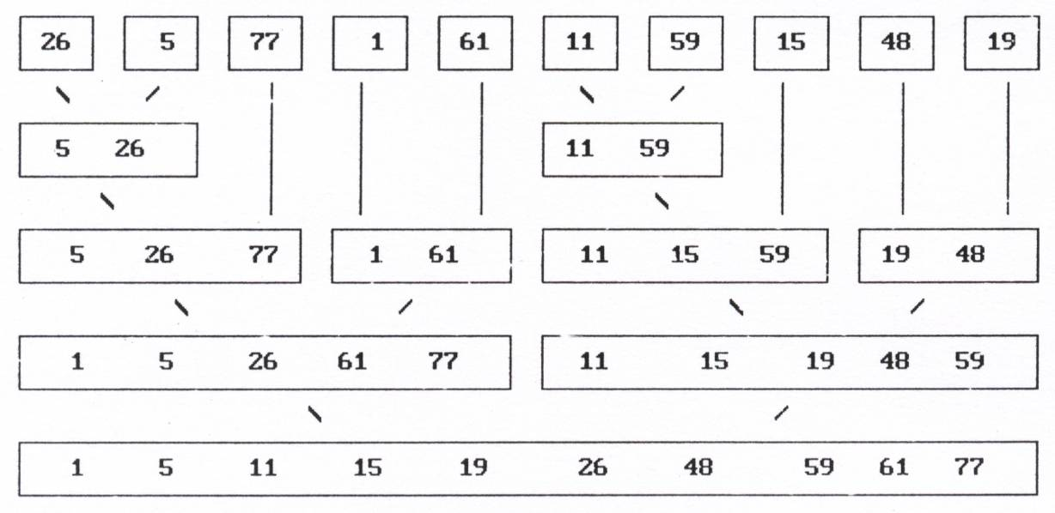
Merge Sort (3/7)
Recursive merge sort concept

Slide 24
Merge Sort (4/7)
Recursive merge sort concept

Slide 25
Merge Sort (5/7)
Recursive merge sort concept

Slide 26
Merge Sort (6/7)
Recursive merge sort concept

Slide 27
Merge Sort (7/7)
Recursive merge sort concept

Slide 28
Heap Sort (1/3)
The challenges of merge sort
  The merge sort requires additional storage proportional to the number of records in the file being sorted.
Heap sort
  Require only a fixed amount of additional storage
  Slightly slower than merge sort using O(n) additional space
  The worst case and average computing time is O(n log n), same as merge sort
  Unstable

Slide 29
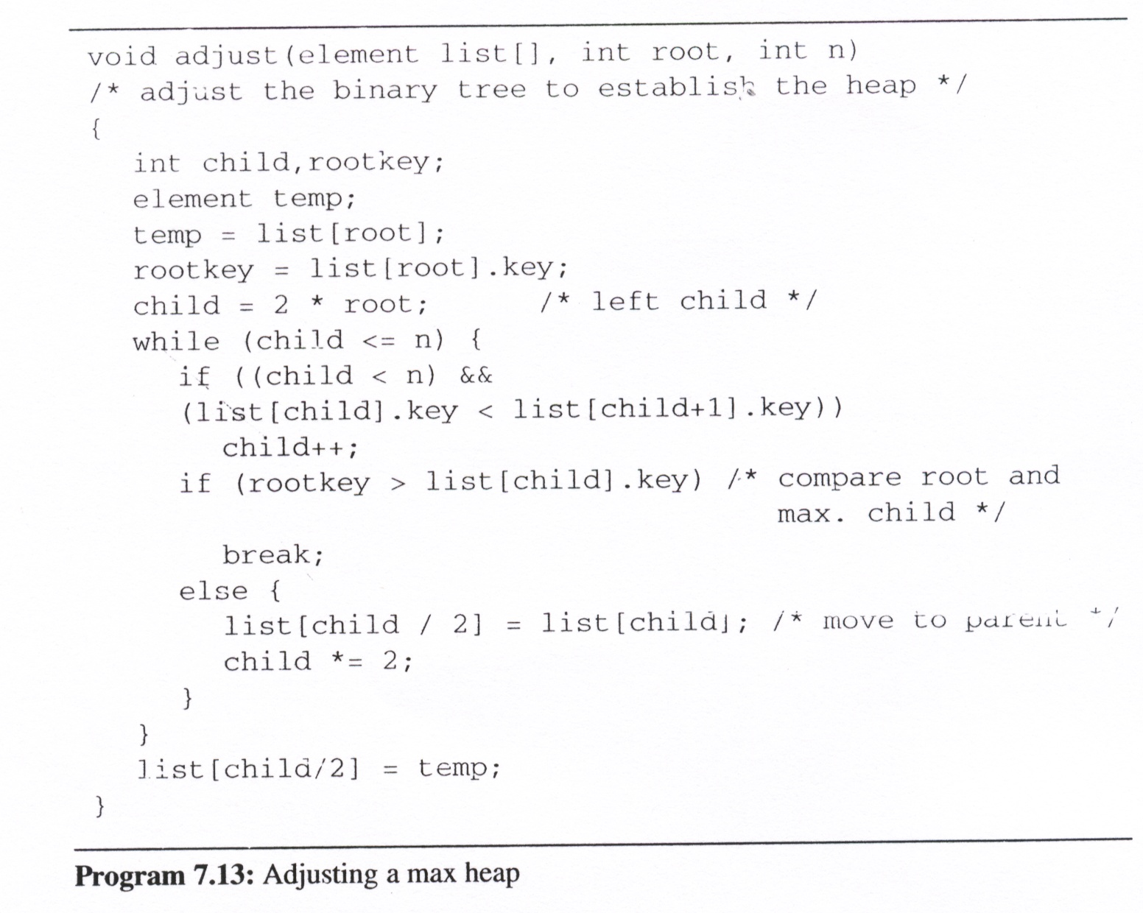
adjust
  adjust the binary tree to establish the heap
root = 1
n = 10
rootkey =
26
child =
2
3
6
7
14
/* compare root and max. root */
[1]
77
/* move to parent */
26
5
77
[2]
[3]
59
1
61
11
26
[4]
[5]
[6]
[7]
59
[8]
15
[9]
48
19
[10]

Slide 30
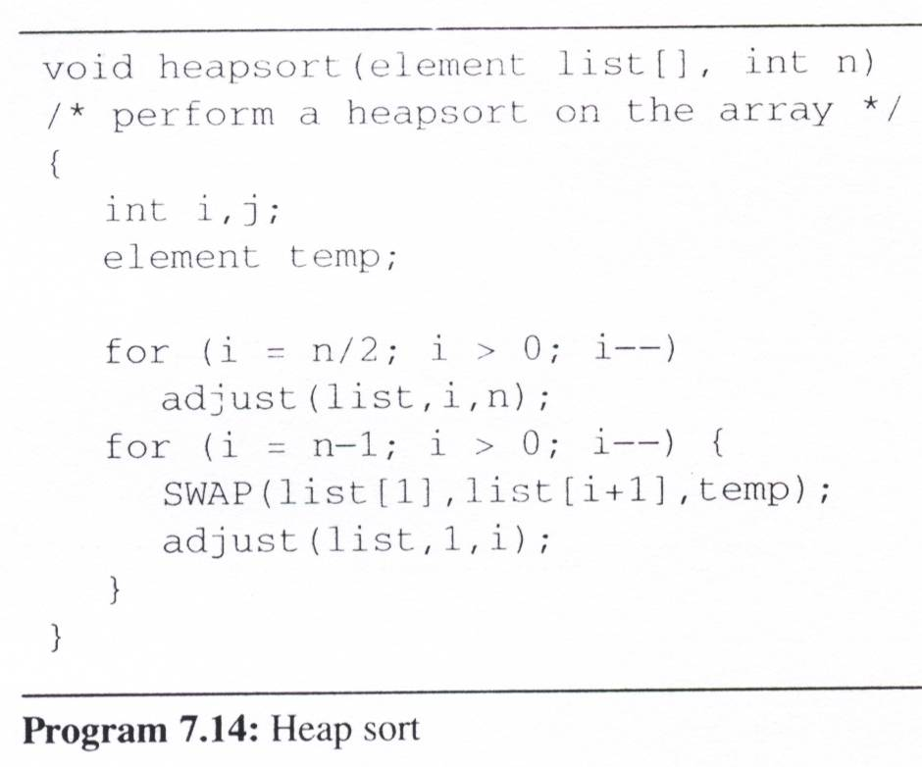
Heap Sort (3/3)
heapsort
n = 10
i =
5
4
3
2
1
9
8
7
6
5
4
3
2
1
bottom-up
ascending order
(max heap)
[1]
26
61
48
19
1
77
59
26
15
11
5
1
5
1
5
1
1
5
top-down
1
[2]
5
77
15
61
5
1
5
[3]
11
59
26
11
48
1
19
1
61
11
59
48
15
15
1
[4]
[5]
19
19
5
26
1
[6]
[7]
26
48
1
[8]
15
48
19
59
5
[9]
1
61
5
77
[10]

Slide 31
Counting Sort
For key values within small range
1. scan list[1..n] to count the frequency of every value
2. sum to find proper index to put value x
3. scan list[1..n] and put to sorted[]
4. copy sorted to list
O(n) for time and space

Slide 32
Radix Sort (1/5)
We considers the problem of sorting records that have several keys
  These keys are labeled K⁰ (most significant key), K¹, … , K^{r-1} (least significant key).
  Let K_{i} ^{j} denote key K^{j} of record R_{i}.
  A list of records R₀, … , R_{n-1}, is lexically sorted with respect to the keys K⁰, K¹, … , K^{r-1} iff
  (K_{i}⁰, K_{i}¹, …, K_{i}^{r-1}) ≤ (K⁰_{i+1}, K¹_{i+1}, …, K^{r-1}_{i+1}), 0≤ i < n-1

Slide 33
Radix Sort (2/5)
Example
  sorting a deck of cards on two keys, suit and face value, in which the keys have the ordering relation:
  K⁰ [Suit]: ♣ < ♦ < ♥ < ♠
  K¹ [Face value]: 2 < 3 < 4 < … < 10 < J < Q < K < A
  Thus, a sorted deck of cards has the ordering:
  2♣, …, A♣, … , 2♠, … , A♠
  Two approaches to sort:
    MSD (Most Significant Digit) first: sort on K₀, then K₁, ...
    LSD (Least Significant Digit) first: sort on K_{r-1}, then K_{r-2}, ...

Slide 34
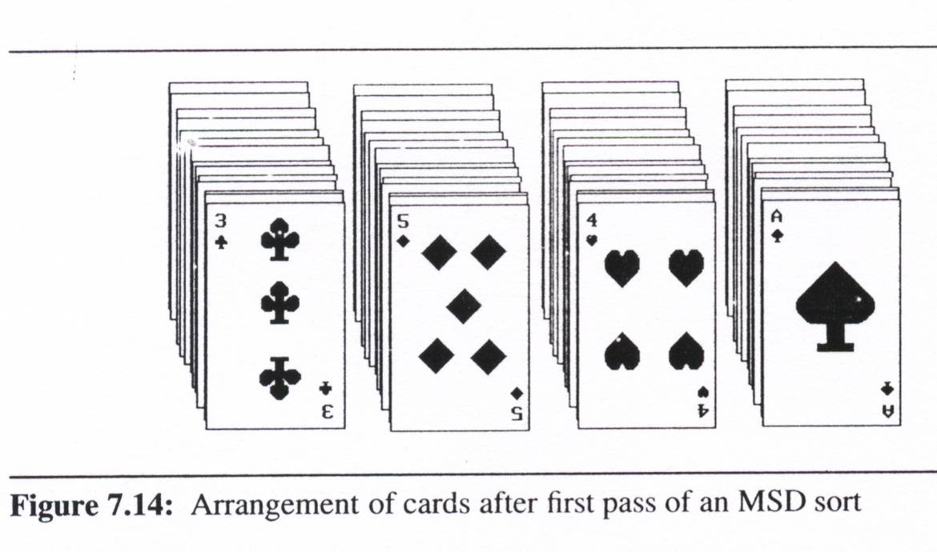
Radix Sort (3/5)
MSD first
  MSD sort first, e.g., bin sort, four bins ♣ ♦ ♥ ♠
  LSD sort second
  Result: 2♣, …, A♣, … , 2♠, … , A♠

Slide 35
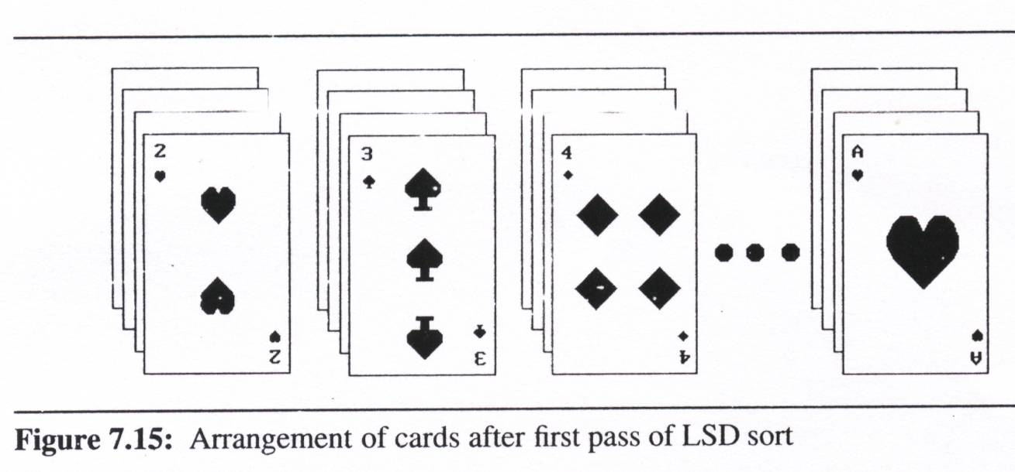
Radix Sort (4/5)
LSD first
  LSD sort first, e.g., face sort,
  13 bins 2, 3, 4, …, 10, J, Q, K, A
  MSD sort second (may not needed, we can just classify these 13 piles into 4 separated piles by considering them from face 2 to face A)
  Simpler than the MSD one because we do not have to sort the subpiles independently
Result:
2♣, …, A♣, … ,
2♠, …, A♠

Slide 36
Radix Sort (5/5)
We also can use an LSD or MSD sort when we have only one logical key, if we interpret this key as a composite of several keys.
Example:
  integer: the digit in the far right position is the least significant and the most significant for the far left position
  range: 0 ≤ K ≤ 999
  using LSD or MSD sort for three keys (K⁰, K¹, K²)
  since an LSD sort does not require the maintainence of independent subpiles, it is easier to implement
MSD
LSD
0-9
0-9
0-9

Slide 37
Shell Sort
For (h = magic1; h > 0; h /= magic2)
  Insertion sort elements with distance h
Idea: let data has chance to “long jump”
Insertion sort is very fast for partially sorted array
The problem is how to find good magic?
Several sets have been discussed
Remember 3n+1

Slide 38
Summary of Internal Sorting (1/2)
Insertion Sort
  Works well when the list is already partially ordered
  The best sorting method for small n
Merge Sort
  The best/worst case (O(nlogn))
  Require more storage than a heap sort
  Slightly more overhead than quick sort
Quick Sort
  The best average behavior
  The worst complexity in worst case (O(n²))
Radix Sort
  Depend on the size of the keys and the choice of the radix

Slide 39
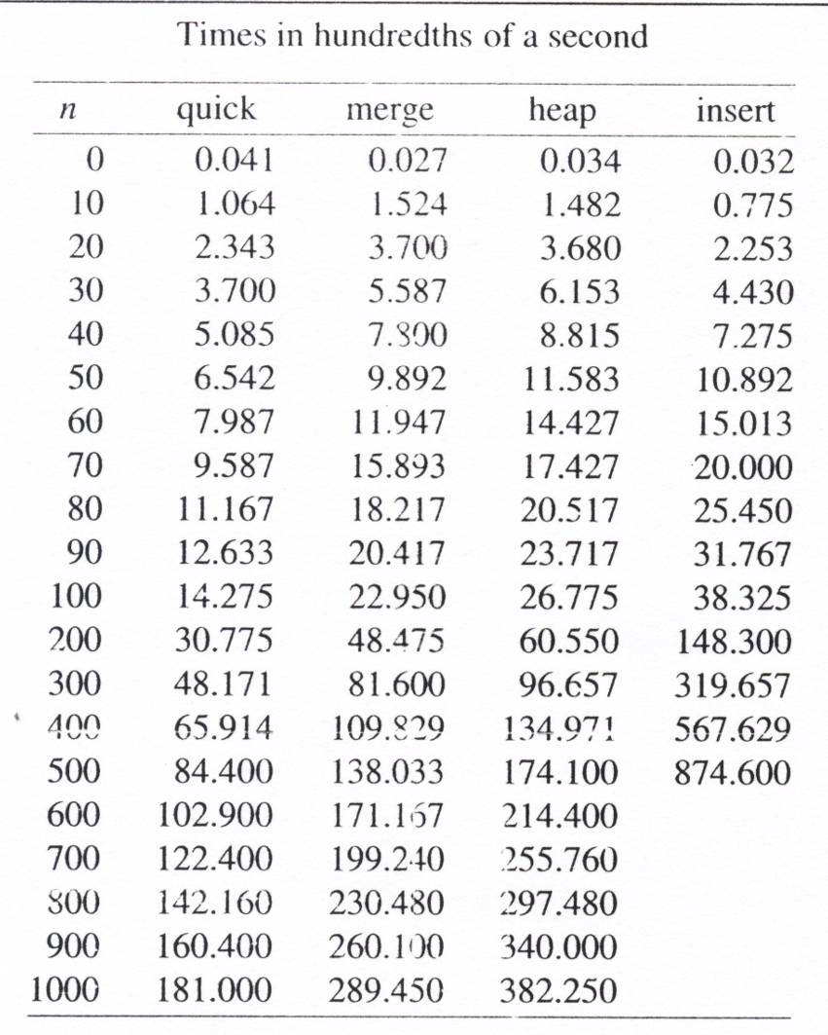
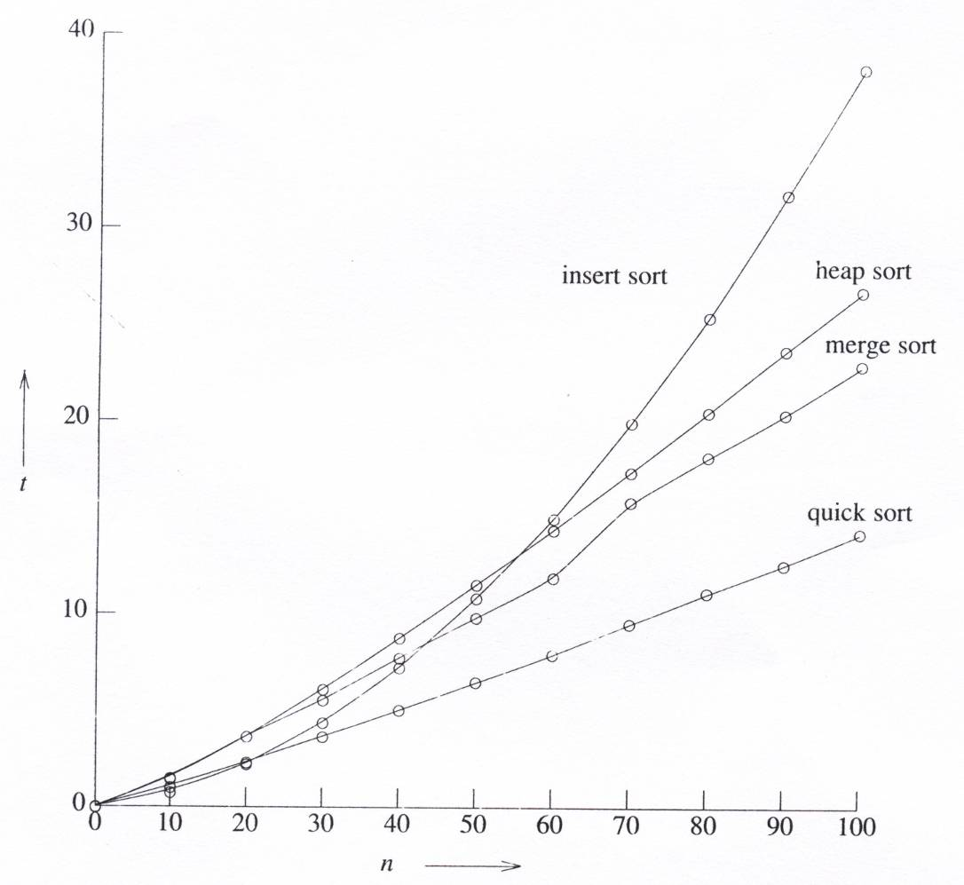
Summary of Internal Sorting (2/2)
Analysis of the average running times

