Slide 1
Graphs
To Make You Know More Clearly

Slide 2
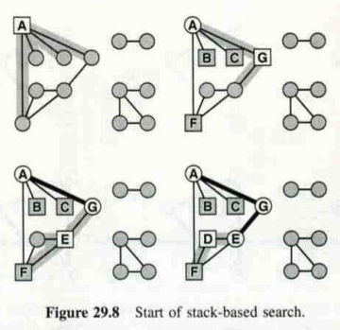
Stack-based search

Slide 3
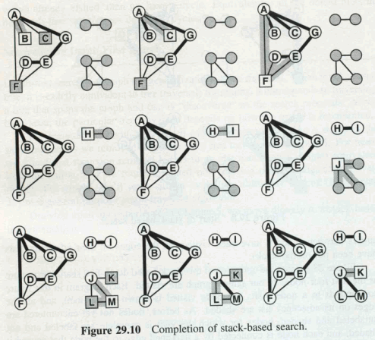
Stack-based search

Slide 4
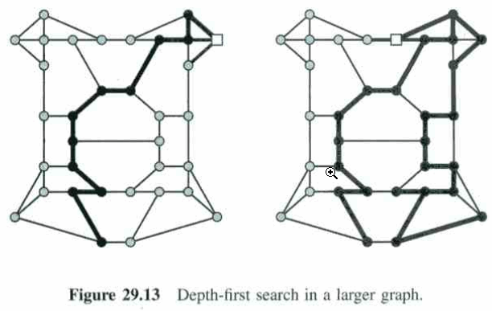
DFS

Slide 5
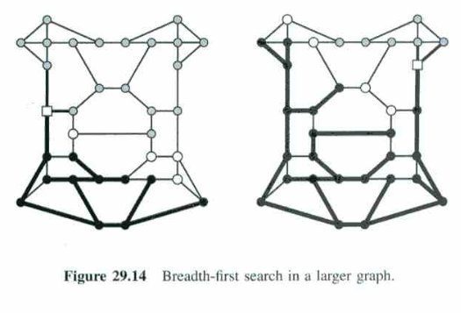
BFS

Slide 6
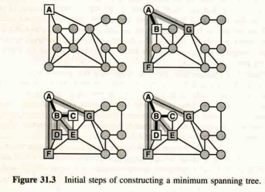
Minimum Spanning Tree

Slide 7
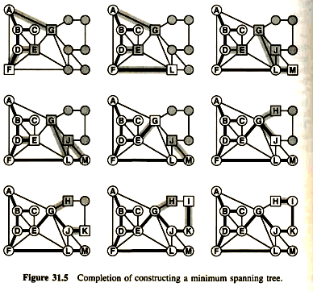
Minimum Spanning Tree

Slide 8
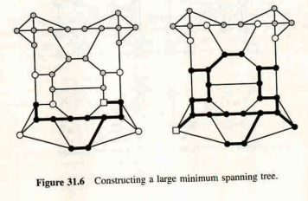
Minimum Spanning Tree

Slide 9
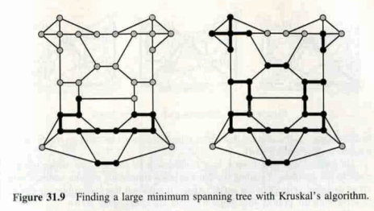
Minimum Spanning Tree

Slide 10
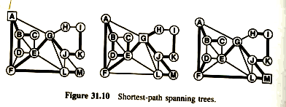
Shortest Path

Slide 11
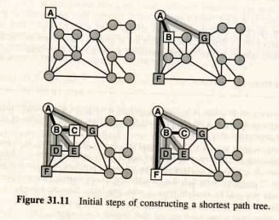
Shortest Path

Slide 12
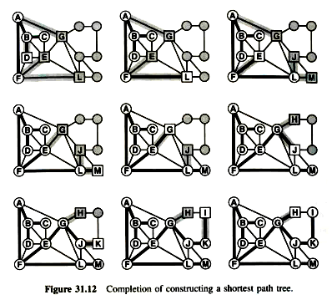
Shortest Path

Slide 13
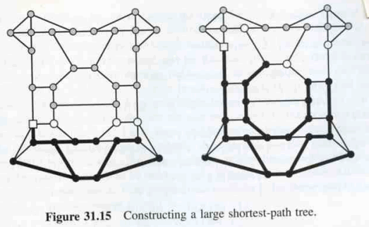
Shortest Path

