Slide 1

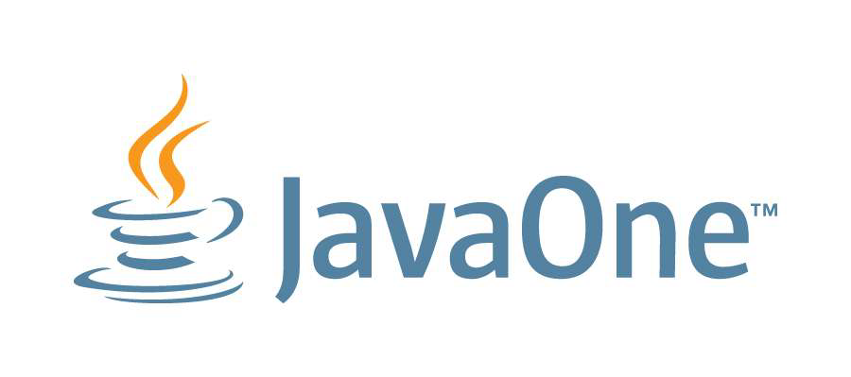

Market Risk Engineering JavaOne 2012
Luke Hutteman
October 24, 2012

Slide 2
JavaOne 2012 – presentation overview
Java 7
Java 8
Tools

Slide 3
Java 7

Slide 4
Java 7
Java7 is a major release
Many new language features
We’re not using any of them yet
But we should!
For now: Mars only
Mars is running on Java7
RVF is still on Java5, but testing Java7 this week
WebService is on Java6, hopefully moving to Java7 soon

Slide 5
Java 7
Project Coin
“small change”
No JVM changes! (language/libraries only)
NIO.2
Fork/Join
Core library additions

Slide 6
Project Coin
“A suite of language and library changes to make things programmers do every day easier”
Motivation:
Remove extra text to make programs more readable
Encourage writing programs that are more reliable
Integrate well with past and future changes

Slide 7
Project Coin
6 main features:
Consistency & Clarity:
Improved numeric literals
Strings in switch
Easier to use Generics:
SafeVarargs (fixes varargs compiler warnings)
Diamond Operator
More Concise Error handling
Multi-catch and precise rethrow
Try-with-resources

Slide 8
Improved Literals
Binary integral literals
New 0b prefix
0b00101101
0b1111
Underscores in numeric literals
5_000_000
Not necessarily just for thousands-separators:
long social = 123_45_6789;
long hexValue = 0xCAFE_BABE;
Long maxLong = 0x7fff_ffff_ffff_ffffL;
byte b = 0b0001_1101;

Slide 9
Improved Literals
Multiple underscores allowed // Courtesy Josh Bloch int bond = 0000_____________0000________0000000000000000__000000000000000000+ 00000000_________00000000______000000000000000__0000000000000000000+ 000____000_______000____000_____000_______0000__00______0+ 000______000_____000______000_____________0000___00______0+ 0000______0000___0000______0000___________0000_____0_____0+ 0000______0000___0000______0000__________0000___________0+ 0000______0000___0000______0000_________000+__0000000000+ 0000______0000___0000______0000________0000+ 000______000_____000______000________0000+ 000____000_______000____000_______00000+ 00000000_________00000000_______0000000+ 0000_____________0000________000000007;

Slide 10
Strings in switch
switch (nodeType) {
case "INVENTORY":
handleInventory();
break;
case "DESK":
handleDesk();
break();
case "TRADER":
handleTrader();
break;
default:
throw new IllegalArgumentException(
"Unknown node type: " + nodeType);
}

Slide 11
Strings in Switch
Details:
Can null be a case label?
No
What does switching on a null do?
NullPointerException
Case insensitive comparisons?
No
Implementation:
Relies on String.hashCode
On average faster than if-else chain with >3 cases

Slide 12
Diamond Operator
No more repetition of generic arguments:
Map<String, List<Double>> map = new HashMap<String, List<Double>>();
Map<String, List<Double>> map = new HashMap<>();

Slide 13
Diamond Operator
No more repetition of generic arguments:
Map<String, Map<String, Map<String, Map<String, float[]>>>> deskGroupPnlMap = new HashMap<String, Map<String, Map<String, Map<String, float[]>>>>();
Map<String, Map<String, Map<String, Map<String, float[]>>>> deskGroupPnlMap = new HashMap<>();

Slide 14
Diamond Operator
Not just for initialization:
List<Map<String, Integer> listOfMaps;
...
...
...
listOfMaps = new ArrayList<>();
public List<Map<String, Integer> compute() {
...
...
...
return new ArrayList<>();
}

Slide 15
Multi-catch and precise rethrow
Multi-catch:
Ability to catch multiple exceptions in a single catch clause:
try {
...
} catch (FirstException | SecondException ex) {
...
}
Precise rethrow:
Change can-throw analysis of a catch clause
Rethrow based on exceptions that can be thrown by the try-block, instead of the caught exception type

Slide 16
Multi-catch and precise rethrow
Example:
void exampleMethod(Future future) throws
InterruptedException, ExecutionException, TimeoutException {
Object result = future.get(5, SECONDS);
}
How do we catch, cleanup, rethrow?

Slide 17
Multi-catch and precise rethrow
Java6: multiple catch clauses
void exampleMethod(Future future) throws
InterruptedException, ExecutionException, TimeoutException {
try {
Object result = future.get(5, SECONDS);
} catch (InterruptedException ex) {
cleanup();
throw ex;
} catch (ExecutionException ex) {
cleanup();
throw ex;
} catch (TimeoutException ex) {
cleanup();
throw ex;
}
}

Slide 18
Multi-catch and precise rethrow
Java6 with single catch (poor style)
void exampleMethod(Future future) throws
Exception {
try {
Object result = future.get(5, SECONDS);
} catch (Exception ex) {
cleanup();
throw ex;
}
}

Slide 19
Multi-catch and precise rethrow
Java7: multi-catch
void exampleMethod(Future future) throws
InterruptedException, ExecutionException, TimeoutException {
try {
Object result = future.get(5, SECONDS);
} catch (InterruptedException | ExecutionException |
TimeoutException ex) {
cleanup();
throw ex;
}
}

Slide 20
Multi-catch and precise rethrow
Java7: precise rethrow
void exampleMethod(Future future) throws
InterruptedException, ExecutionException, TimeoutException {
try {
Object result = future.get(5, SECONDS);
} catch (Throwable th) {
cleanup();
throw th;
}
}
(is this good style now?)

Slide 21
Try-with-resources
A variation of the try-catch-finally statement
Allows initialization of a resource variable
Must be of type AutoCloseable
close() method will be called from generated finally block
Exceptions thrown by close() will be added to a suppressed exception list
Useful for avoiding leaks of external objects
Files, SQL statements, resultsets, …
Many JDK classes retrofitted to be AutoCloseable

Slide 22
Try-with-resources
You type this:
try (Resource r = createResource()) {
doSomething(r);
} catch (Exception e) {
handleException(e);
} finally {
cleanup();
}

Slide 23
Try-with-resources
Compiler generates this:
try {
Resource r = null;
try {
r = createResource()) {
doSomething(r);
} finally {
if (r != null)
r.close(); // actually a bit more complicated
}
} catch (Exception e) {
handleException(e);
} finally {
cleanup();
}

Slide 24
NIO.2
Improved File I/O
Package java.nio.file
Path – used to locate a file in a file system
Similar to java.io.File now
Paths – defines static methods that return a Path
Files – defines static methods to operate on files and directories

Slide 25
Path
Represents an absolute or relative path
Create from path String or URI or File.toPath()
Consists of one or more name elements, or a root component and zero or more name elements
Immutable
Defines methods to access elements of the path
Defines methods to combine paths, returning a new path
Path path = Paths.get("/foo");

Slide 26
Files
Consists exclusively of static methods that operate on files
Most methods take a Path as a parameter to locate the file
Files.createFile(path)
Oftentimes also returns a Path
Path foo = Files.createDirectory(dir.resolve("foo"));

Slide 27
Files
Simple file operations
byte[] bytes = Files.readAllBytes(path);
List<String> lines = Files.readAllLines(path, UTF_8);
BufferedReader r = Files.newBufferedReader(path, UTF_8);
OutputStream out =
Files.newOutputStream(path, CREATE, APPEND);
Files.copy(sourcePath, destinationPath);

Slide 28
Files
Additional logic for
Directories
Including recursively walking a directory tree
File Attributes
Symbolic links
File change notifications
Watch files and directories for changes
No need to poll the file system

Slide 29
Core library additions
Utility classes with static methods
Objects.equals(obj1, obj2); // checks for null
Objects.deepEquals(obj1, obj2); // handles arrays
Objects.requireNonNull(obj);
Objects.toString(obj);
Objects.toString(obj, nullDefault);
StandardCharsets.UTF_8;
// no need to worry about UnsupportedCharsetException
Collections.emptyIterator();
Collections.emptyEnumeration();

Slide 30
Java 8

Slide 31
Java8
Java SE 8 is a big step forward in modernizing the Java Language
Lambda expressions (closures)
Interface evolution (default methods)
Java SE 8 is a big step forward in modernizing the Java Libraries
Bulk data operations on Collections
More library support for parallelism
Together, perhaps the biggest upgrade ever to the Java programming model

Slide 32
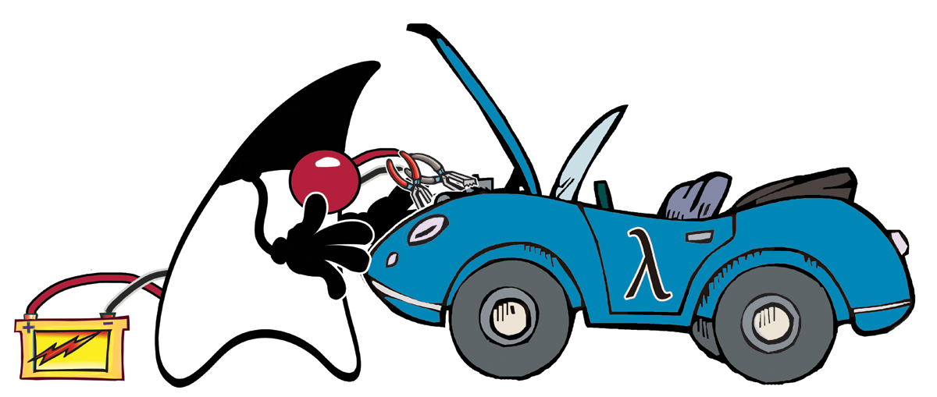
What is a Lambda Expression?
A Lambda expression (closure) is an anonymous method
Has an argument list, a return type, and a body
(Object o) -> o.toString()
Can refer to values from the enclosing lexical scope
(Person p) -> p.getName().equals(name)
A method reference is a reference to an existing method
Object::toString
Allows you to treat code as data
Behavior can be stored in variables and passed to methods.
Similar to single-method anonymous classes

Slide 33
Times Change
In 1995, most popular languages did not support closures
Today, Java is just about the last holdout that does not
C++ added them recently
C# added them in 3.0
New languages being designed today almost all do

Slide 34
External Iteration
Snippet takes the red shapes and colors them blue
Uses foreach loop
Loop is inherently sequential
Client has to manage iteration
This is called external iteration
Foreach loop hides complex interaction between library and client
for (Shape s : shapes) {
if (s.getColor() == RED)
s.setColor(BLUE);
}

Slide 35
Lambda Expressions
Re-written to use lambda and Collection.forEach
Not just a syntactic change!
Now the library is in control
This is internal iteration
More what, less how
Library free to use parallelism, out-of-order execution, laziness
Client passes behavior into the API as data
shapes.forEach(s -> {
if (s.getColor() == RED)
s.setColor(BLUE);
})

Slide 36
Functional Interfaces
What is the type of a lambda expression or method reference?
Historically, Java has uses single-method interfaces to represent functions
Runnable, Comparator, ActionListener
Let’s give these a name: functional interfaces
and add some new ones like Predicate<T>, Block<T>
A lambda expression evaluates to an instance of a functional interface
Predicate<String> isEmpty = s -> s.isEmpty();
Predicate<String> isEmpty = String::isEmpty;
Runnable r = () -> { doSomething(); };
So existing libraries are forward compatible to lambdas

Slide 37
Interface Evolution
The example used a new Collection method – forEach()
Where did that come from?
Adding methods to interfaces breaks existing implementations
New feature: default methods
Virtual method with default implementation
Allows libraries to compatibly evolve over time
interface Collection<T> {
default void forEach(Block<T> action) {
for (T t : this)
action.apply(t);
}
}

Slide 38
Default Methods
Is this multiple inheritance in Java?
Java always had multiple inheritance of types
This adds multiple inheritance of behavior
But not inheritance of state, where most of the trouble comes from
Some similarities (and differences) with C# extension methods
Java default methods are virtual and declaration-site
C# extension methods are static and use-site
Primary goal is API evolution
But useful as an inheritance mechanism on its own

Slide 39
Default methods – inheritance rules
How are conflicts between multiple supertypes resolved?
Rule 1 – prefer superclass methods to interface methods (“Class wins”)
Defaults only considered if no method declared in superclass chain
Rule 2 – prefer more specific interfaces to less (“Subtype wins”)
An implementation in List would take precedence over one in Collection
Rule 3 – otherwise, act as if the method is abstract
If conflicting defaults, concrete class must provide an implementation
Looking for a unique, most specific default-providing interface

Slide 40
Diamonds – no problem
Without state, diamonds are easy
interface A { default void m() { ... } }
interface B extends A { }
interface C extends A { }
class D implements B, C
Still easy if B also provides a default for m()
B is more specific than A, so D inherits m() from B
interface B extends A { default void m() { ... } }

Slide 41
Explicit disambiguation
If default cannot be resolved via the rules, subclass must implement it
interface A { default void m() { ... } }
interface B { default void m() { ... } }
class C implements A, B {
// must implement/re-abstract m()
public void m() { A.super.m(); }
}
In this example, C must implement m()
Can delegate to inherited implementation with new syntax A.super.m()

Slide 42
Default Methods – Evolving Interfaces
New Collection methods
forEach(Block)
removeIf(Predicate)
filter(Predicate)
...
Subclasses may provide better implementations
Defaults implemented in terms of other interface methods

Slide 43
Bulk operations on Collections
The lambda version of the “shapes” code can be further decomposed
New bulk operations added, like filter, map, into, …
shapes.forEach(s -> {
if (s.getColor() == RED)
s.setColor(BLUE);
})
shapes.filter(s -> s.getColor() == RED)
.forEach(s -> { s.setColor(BLUE); });

Slide 44
Bulk operations on Collections
Compute the sum of notionals of irc-eligible positions
List<Position> positions = ...
double notionalSumOfIrcPositions =
positions.filter(p -> p.isIrcEligible())
.map(p -> p.getNotional())
.sum();
Or with method references:
double notionalSumOfIrcPositions =
positions.filter(Position::isIrcEligible)
.map(Position::getNotional)
.sum();
Uses lazy evaluation and streams

Slide 45
Bulk operations on Collections
List<Position> positions = ...
double notionalSumOfIrcPositions =
positions.parallel() // parallel view of the collection!
.filter(p -> p.isIrcEligible())
.map(p -> p.getNotional())
.sum();
Explicit but unobtrusive parallelism
All three operations fused into a single parallel pass

Slide 46
Example: Sorting
Currently:
Collections.sort(positions, new Comparator<Position>() {
public int compare(Position p1, Position p2) {
return p1.getNotional().compareTo(p2.getNotional());
}
});
Could use lambda to implement a Comparator
Collections.sort(positions,
(p1, p2) -> p1.getNotional().compareTo(p2.getNotional());
Conflates extraction of sort key with ordering of that key

Slide 47
Example: Sorting
Comparator<Position> byNotional =
Comparators.comparing(p -> p.getNotional());
Collections.sort(positions, byNotional);
How does this work?
class Comparators {
public static<T, U extends Comparable<? super U>>
Comparator<T> comparing(Mapper<T, U> m) {
return (x, y) -> m.map(x).compareTo(m.map(y));
}
}
Higher order function (function-in, function-out)

Slide 48
Example: Sorting
Collections.sort(positions, comparing(p -> p.getNotional());
positions.sort(comparing(p -> p.getNotional());
positions.sort(comparing(Position::getNotional));

Slide 49
Example: Sorting
positions.sort(comparing(Position::getNotional).reverse());
positions.sort(comparing(Position::getNotional)
.compose(comparing(Position::getMarketValue)));
Uses new default methods on Comparator:
Comparator.reverse() – reverses order of a Comparator
Comparator.compose(Comparator) – computes “dictionary order” between one comparator and another

Slide 50
So how does this all work?
Anonymous inner classes are compiled to actual .class files
MyClass$1
MyClass$2
etc.
Could do the same for lambdas:
p -> p.getNotional() > minNotional would become:
class MyClass$1 implements Predicate<Position> {
private final double v;
public MyClass$1(double v) { this.v = v; }
public boolean test(Position p) {
return p.getNotional() > v;
}
}

Slide 51
Why not inner classes?
Would mean one class per lambda expression
Lambda usage would mean invoking a constructor
Positions.filter(p -> p.getNotional() > minNotional)
Positions.filter(new MyClass$1(minNotional))
This choice would become the binary representation of lambdas
We’d be stuck with it forever

Slide 52
invokedynamic
New JVM bytecode added in Java7
Meant for dynamic languages like Jruby, Jython, Groovy, etc.
def add(x, y) { x + y }
Types of x and y are not known at compile time
And could change from call to call … but probably don’t so often
Good chance that if called with 2 ints, next call will be with 2 ints
We win by not having to re-link the call site for every invocation
JVM generates code at runtime depending on types of parameters

Slide 53
Not just for dynamic language anymore
Lambdas are compiled to bytecode using invokedynamic
Some overhead on first usage
…but inner classes would have overhead as well!
Subsequent calls have no overhead
Lambdas are compiled to methods:
Predicate<Position> p = p -> p.getNotional() > minNotional;
private static boolean lambda$1(double capturedNotional,
Position p) {
return p.getNotional() > capturedNotional;
}

Slide 54
Translation strategies
Generate the same class the compiler would, just at runtime
Alternatively, create one wrapper class per interface
Different approaches might be better for different circumstances
Different JVM implementations could choose different translations
JVM could decide at runtime between different translations

Slide 55
Performance
Sample application
4 socket x 10 core x 2 thread Nehalem EX server
numbers in ops/µSec
Single- Saturated Scalability
threaded
Inner class 160 1,407 8.8x
Non-capturing lambda 636 23,201 36.4x
Capturing lambda 160 1,400 8.8x
Worst-case lambda numbers equal to inner classes

Slide 56
Tools

Slide 57
JOverflow
Advanced heap analysis, based on heap dumps
Heap dumps can view the entire object graph
Existing tools:
View object’s data fields, object graph navigation
Object Query Language (OQL) queries:
Ex: SELECT s from java.lang.String where s.count > 100
Powerful when you know what you’re looking for
…but not as much when you don’t :-(
Doesn’t tell you whether the data structures are good or bad

Slide 58
What is a “bad” data structure?
One definition: its memory can be reduced without loss of useful information
Data structures that are allocated but not used
Data structures that reserve (a lot) more space than they need
Suboptimal data format
Objects instead of primitive types
Complex collection classes instead of arrays
Many small collections
Data duplication
…

Slide 59
Examples:
HashMaps with only a few values
Repetitive data like countryCodes, assetTypes, …
Pretty typical in MyBatis SQL resultsets
Consider using StringCache.intern()

Slide 60
Examples:
List<List<Integer> twoDimPoints = new ArrayList<>(10_000);
for (int i = 0; i < 10_000; i++) {
List<Integer> point = new ArrayList<>(2);
point.add(readX());
point.add(readY());
twoDimPoints.add(point);
}
10,001 ArrayLists + 20,000 Integer objects!

Slide 61
Examples:
int[][] twoDimPoints = new int[10_000][];
for (int i = 0; i < 10_000; i++) {
int[] point = new int[2];
point[0] = readX();
point[1] = readY();
twoDimPoints[i] = point;
}
10,001 arrays objects

Slide 62
Examples:
int[][] twoDimPoints = new int[2][];
twoDimPoints[0] = new int[10_000];
twoDimPoints[1] = new int[10_000];
for (int i = 0; i < 10_000; i++) {
twoDimPoints[0][i] = readX();
twoDimPoints[1][i] = readY();
}
3 arrays objects

Slide 63
Main idea of JOverflow:
Automatically identify data structures matching known bad patterns
Calculate their overhead: how much memory could ideally be saved
Aggregate objects with same problems
Show reference chains, etc.
For some bad patterns, can automatically analyze the code and recommend fixes (experimental)

Slide 64
Some recognized patterns:
Empty unused collections (modification count == 0)
Empty used collections
Sparse collections: less than half the slots are occupied
Collections containing boxed primitives
Small collections (1-4 elements)
“Vertical bar”, like List(10,000) of List(10)
Many small sub-lists or sub-arrays collectively incur a high overhead
Duplicate String and primitive arrays
2 strings are duplicate if s1.equals(s2), but s1 != s2
Unused data field (Foo.bar is null or 0 in all instances of Foo
Underused data field (is null or 0 in > 90% of all instances )

Slide 65
Calculation of overhead
Empty collection – whole implementation size
Sparse collections – (empty slots) x (pointer size)
Collections containing boxed primitives – roughly, how much we would save by switching from ArrayList<Integer> to int[]
“Vertical bar” – savings by flipping dimensions
Duplicate String and primitive arrays – how much we would save if we only had unique strings/arrays
Unused data field – savings by deleting field

Slide 66
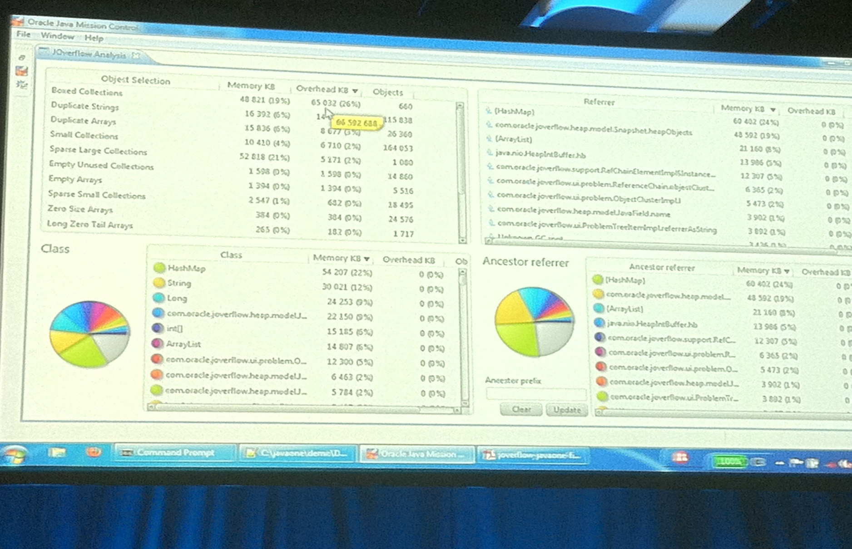
Screenshot

Slide 67
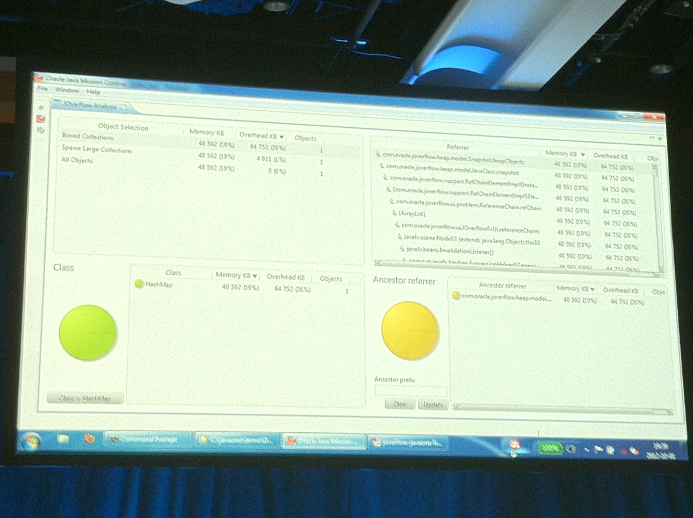
Screenshot

Slide 68
In-Memory Data Grid
What is an In-Memory Data Grid?
Several JVMs sharing in-memory partitioned data
Allowing you to:
Query and manipulate data
Observe changes
Execute on the data
from any node.

Slide 69
Why IMDG?
Share data (session, application state)
Performance (caching, in-memory processing)
Scalability

Slide 70
Products
Hazelcast
Oracle Coherence
IBM eXtreme Scale
Gigaspaces
vmWare GemFire
Redhat Infinispan
Gridgain
Terracotta

Slide 71
Common features
Distributed Maps
Caching, evictions
Code execution
Listeners
Queries
Transactions
…

Slide 72
Hazelcast
Free and open source
Lightweight without any dependency
Just one 1.7MB jar-file to add to your classpath
Map, queue, set, list, lock, semaphore, topic and executor service
Native Java, C#, REST and Memcache interfaces
Dynamic clustering, backup, fail-over

Slide 73
Hazelcast – code samples
import java.util.Map;
import com.hazelcast.core.Hazelcast;
...
Map<String, String> map = Hazelcast.getMap("mymap");
map.put("1", "value");
...
map.get("1");
// User must be Serializable
List<User> = Hazelcast.getList("users");
// better: com.hazelcast.nio.DataSerializable

Slide 74
Project Sumatra
HSA (Heterogeneous System Architecture)
Java on GPU
By AMD & Oracle
Converts bytecode to OpenCL at runtime
Performance improvements as much as 60x

Slide 75

Q&A

