Slide 1

Charts
Deals
Dashboard
Drupal MySQL

Slide 2
Charts
Google Chart API
Fusioncharts

Slide 3
Google Chart API
1、动态创建图表
2、每天请求图片的次数没有限制
3、每个请求返回一个PNG格式图片
4、URL：
http://chart.apis.google.com/chart? Chart API 调用地址。
&参数分隔符。
chs=200x125图表尺寸。
chd=s:helloWorld图表数据值。
cht=lc图表类型。
chxt=x,y显示 x、y 轴坐标。
chxl=0:|Mar|Apr|May|June|July|1:||50+Kbx、y 轴坐标值。
5、网页中使用img元素插入图表：
<img src="http://chart.apis.google.com/chart?chs=200x125&amp;chd=s:helloWorld&amp;cht=lc&amp;chxt=x,y&amp;chxl=0:|Mar|Apr|May|June|July|1:||50+Kb" alt="Sample chart" />
6、图表数据要转换为0～100之间的浮点数

Slide 4
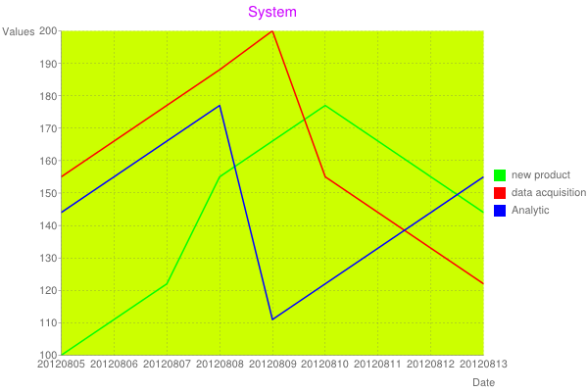

Slide 5
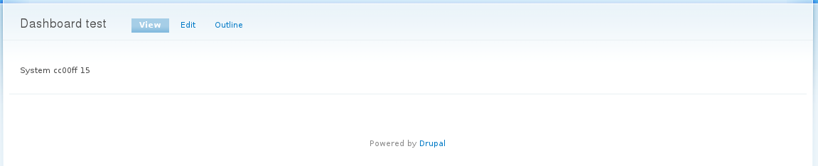
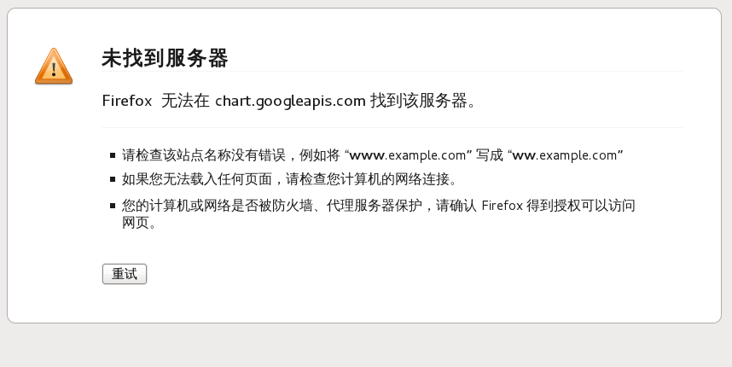

Slide 6
Fusioncharts
1、可以在JavaScript和Flash上呈现图表
2、支持3D图表
3、支持XML和JSON数据
4、支持成千上万的数据点
5、以XML为数据接口而成图表
http://www.hkaco.com/software/fusioncharts/success-stories_competition-and-us.html

Slide 7
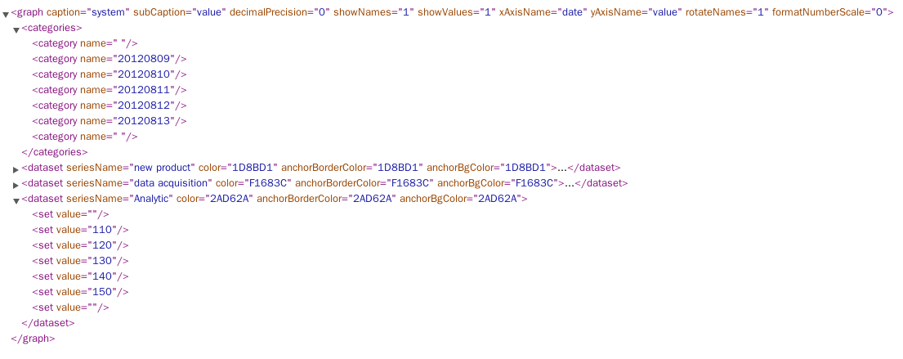
XML:data.php

Slide 8
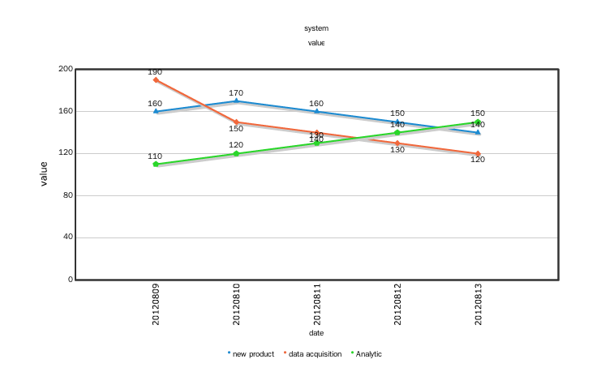

Slide 9
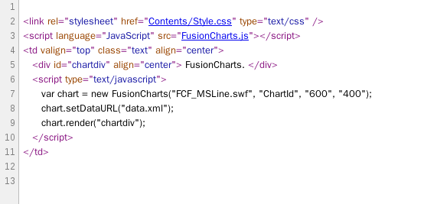
页面源代码：setDataURL

Slide 10
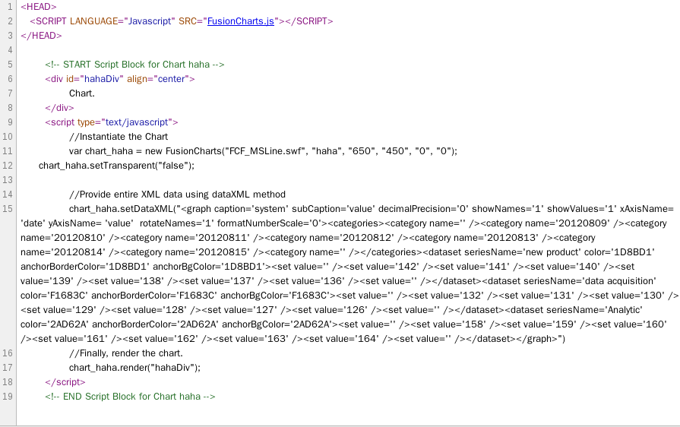
页面源代码：$strXML

Slide 11
Deals
Php mongodb 插件
Web服务:soap

Slide 12
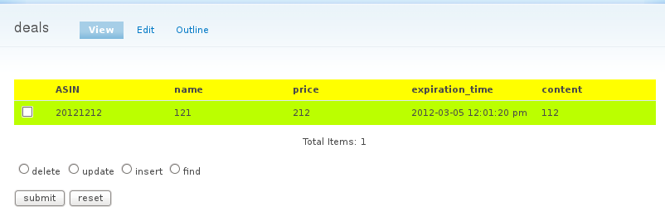
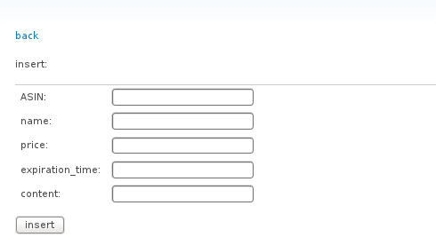
Php mongodb 插件
deals--find all:(URL:deals)
deals_result:(URL:deals/result)
delete
update
insert
find

Slide 13
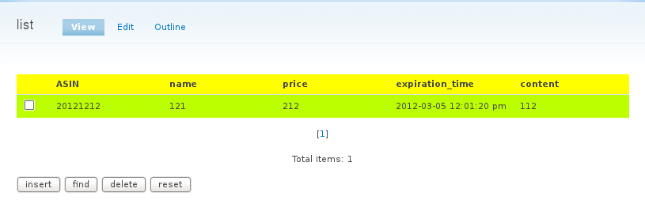
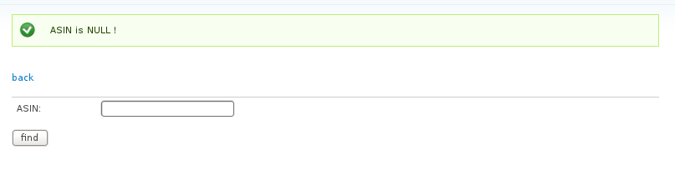
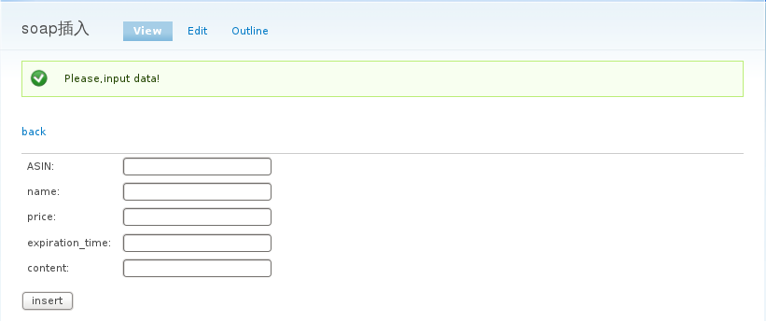
Web服务:soap
list--find all:(URL:list)
insert:(URL:list/insert)
find:(URL:list/find)
delete:(URL:list/delete)

Slide 14
Dashboard
System Operation Performance
Error Handing

Slide 15
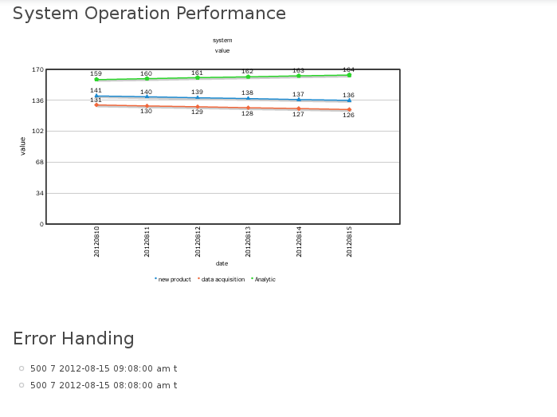
Dashboard.php

Slide 16
system_item.py
Class: System
database: system
类成员
_id
_name
_value
_updatetime
成员函数
getASIN
getName
getValue
getUpdatetime
setASIN
setName
setValue
setUpdatetime
searchByASIN
searchByName
searchByValue
searchByUpdatetime
search
searchLike
saveToDB
deleteByASIN
updateToDb

Slide 17
example
connection=mongo_utility.MongoUtility(serverip='192.168.1.110')
test=System(connection)
test.setASIN('1234')
test.setName('Analytic')
test.setValue('t')
#test.setUpdatetime(datetime.datetime.now())
test.setUpdatetime('20120816')
test.saveToDB()
result=test.searchByASIN()
if result.count()>0: print result[0]
test.setName('new product')
test.updateToDb()
result=test.searchByName()
if result.count()>0: print result[0]['name']
test.deleteByASIN()
result=test.searchByASIN()
if result.count()>0: print result[0]

Slide 18
error_log_item.py
Class: Error_log
database: error_log
类成员
_id
_type
_rank
_description
_time
成员函数
getASIN
getType
getRank
getDescription
getTime
setASIN
setType
setRank
setDescription
setTime
searchByASIN
searchByType
searchByTime
search
searchLike
saveToDB
deleteByASIN
updateToDb

Slide 19
example
connection=mongo_utility.MongoUtility(serverip='192.168.1.110')
test=Error_log(connection)
test.setASIN('134')
test.setType('500')
test.setRank(7)
test.setDescription('t')
#test.setTime(datetime.datetime.now())
test.setTime('20120815')
test.saveToDB()
result=test.searchByASIN()
if result.count()>0: print result[0]
test.setType('500')
test.updateToDb()
result=test.searchByType()
if result.count()>0: print result[0]['type']
test.deleteByASIN()
result=test.searchByASIN()
if result.count()>0: print result[0]

Slide 20
Drupal MySQL
field_data_body
node

Slide 21
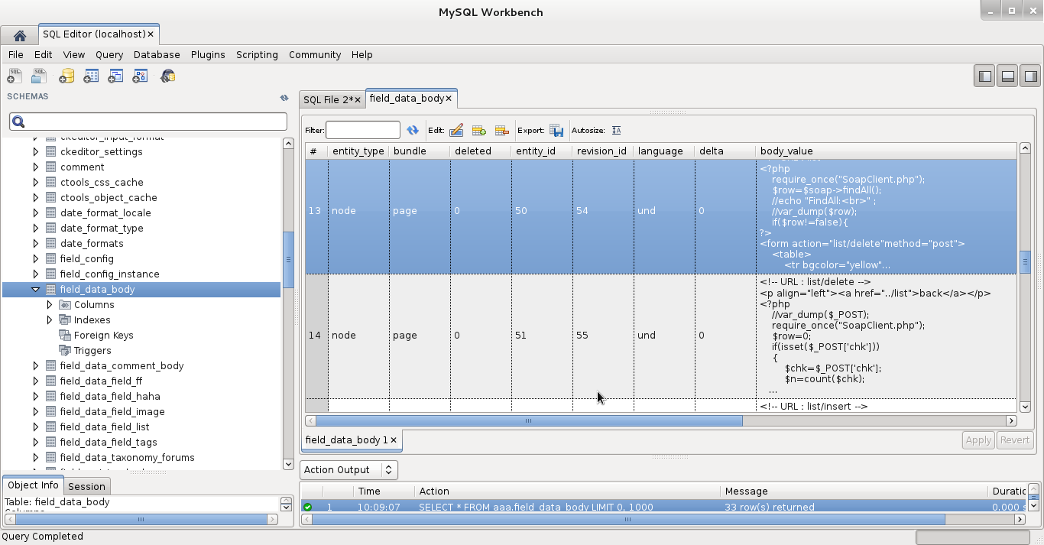
field_data_body
entity_id
revision_id
body_value

Slide 22
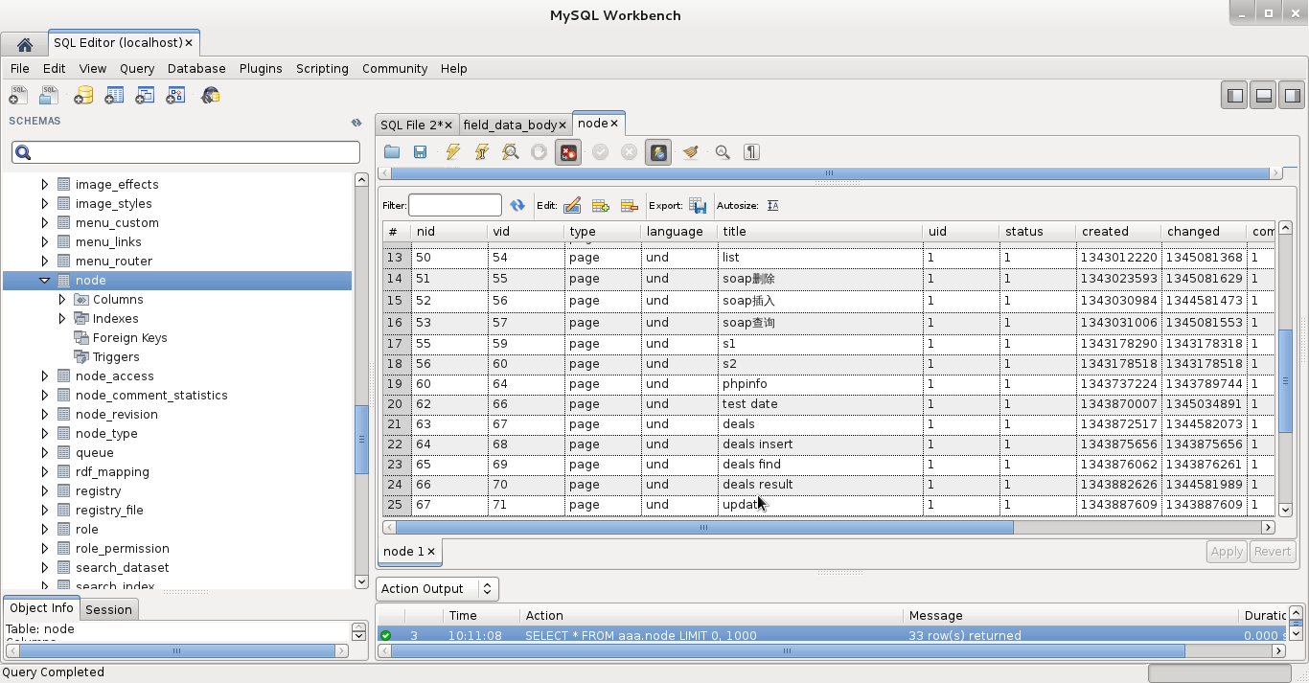
node
nid
vid
title

Slide 23
The End

