Slide 1
CPSC 449 Tutorial 13
Midterm review - part 1

Slide 2
Assignment #1 Extension
“late” deadline moved from March 5 midnight to March 15th midnight
5 mark penalty (so your best possible grade is 65/70)
If your program takes part in the A.I. tournament, all these penalties will be forgiven

Slide 3
Midterm – March 11
Will be released 9:30am on March 11th, closed for submissions 9:30 March 12th (24 hours)
Designed to take 1h:30min to 2h

Slide 4
Topics to be covered (tentative)
Today:
Hand evaluations
Working with types
Unification
Wednesday:
4. List comprehension
5. Working with trees

Slide 5
1. Hand evaluation
Nothing new, if you aced it in the lab exam then you’re in good shape
Having said that, let’s go over that lab exam question

Slide 6
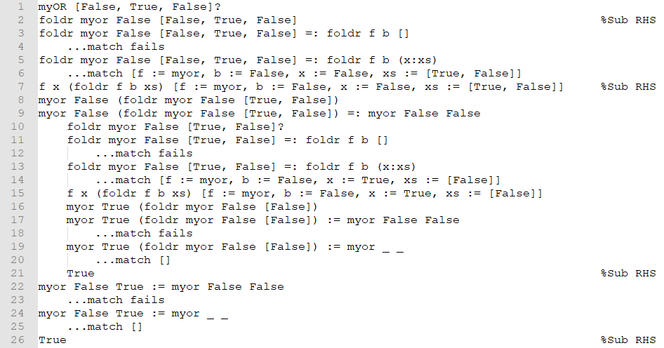
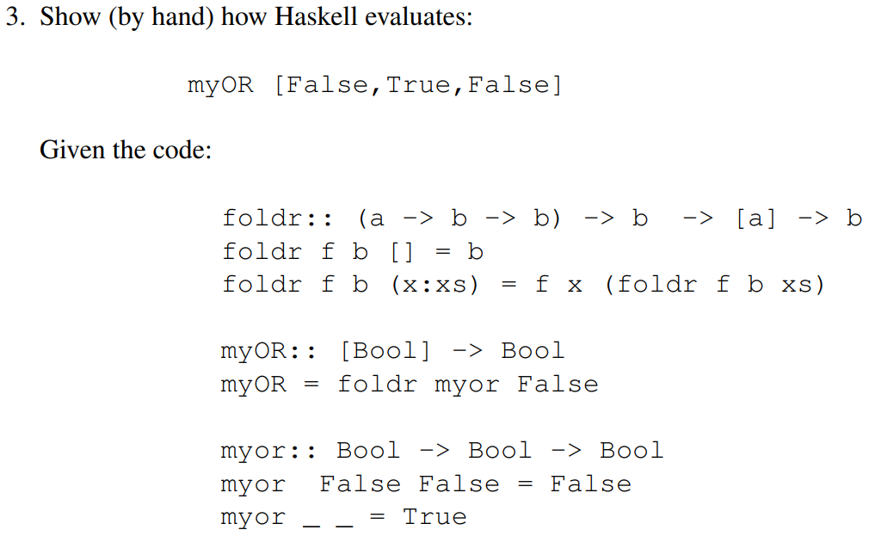
1. Hand evaluation

Slide 7
1. Hand evaluation

Slide 8
1. Hand evaluation

Slide 9
1. Hand evaluation

Slide 10
1. Hand evaluation

Slide 11
1. Hand evaluation

Slide 12
1. Hand evaluation

Slide 13
1. Hand evaluation

Slide 14
1. Hand evaluation

Slide 15
1. Hand evaluation

Slide 16
1. Hand evaluation

Slide 17
1. Hand evaluation

Slide 18
1. Hand evaluation

Slide 19
1. Hand evaluation

Slide 20
1. Hand evaluation

Slide 21
1. Hand evaluation

Slide 22
1. Hand evaluation

Slide 23
1. Hand evaluation

Slide 24
1. Hand evaluation

Slide 25
1. Hand evaluation

Slide 26
1. Hand evaluation

Slide 27
1. Hand evaluation

Slide 28
1. Hand evaluation

Slide 29
1. Hand evaluation

Slide 30
1. Hand evaluation

Slide 31
1. Hand evaluation

Slide 32
1. Hand evaluation

Slide 33
2. Working with types
Again, nothing really new from the lab exam
The questions usually go: “Given this function, what is it’s type?”

Slide 34
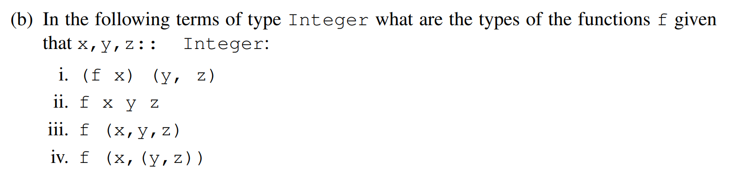

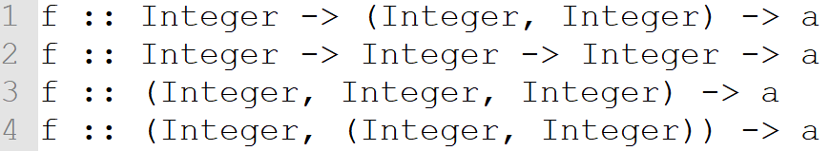
2. Working with types

Slide 35
2. Working with types

Slide 36
2. Working with types

Slide 37
2. Working with types

Slide 38
2. Working with types

Slide 39
2. Working with types
Again, nothing really new from the lab exam
The questions usually go: “Given this function, what is it’s type?”

Slide 40
2. Working with types
Again, nothing really new from the lab exam
The questions usually go: “Given this function, what is it’s type?”
Sometimes, the question will go: “Given this function, what is it’s most general type?”

Slide 41
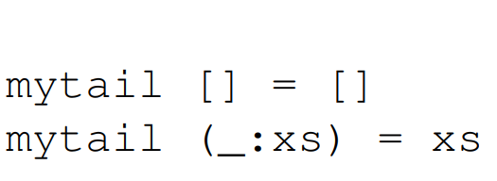
2. Working with types
Again, nothing really new from the lab exam
The questions usually go: “Given this function, what is it’s type?”
Sometimes, the question will go: “Given this function, what is it’s most general type?”

Slide 42
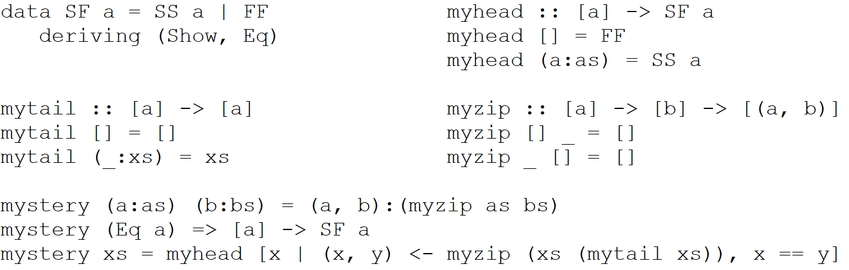
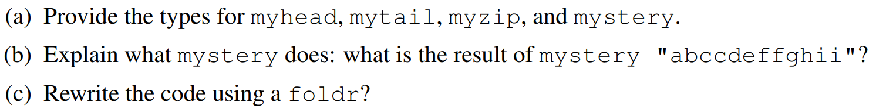
2. Working with types

Slide 43

2. Working with types

Slide 44
2. Working with types

Slide 45
2. Working with types

Slide 46
2. Working with types

Slide 47
2. Working with types

Slide 48
2. Working with types

Slide 49
2. Working with types

Slide 50
2. Working with types

Slide 51
2. Working with types

Slide 52
2. Working with types

Slide 53
2. Working with types
Finds the first consecutive character. mystery “abccdeffghii” = SS ‘c’

Slide 54

2. Working with types
Finds the first consecutive character. mystery “abccdeffghii” = SS ‘c’

Slide 55
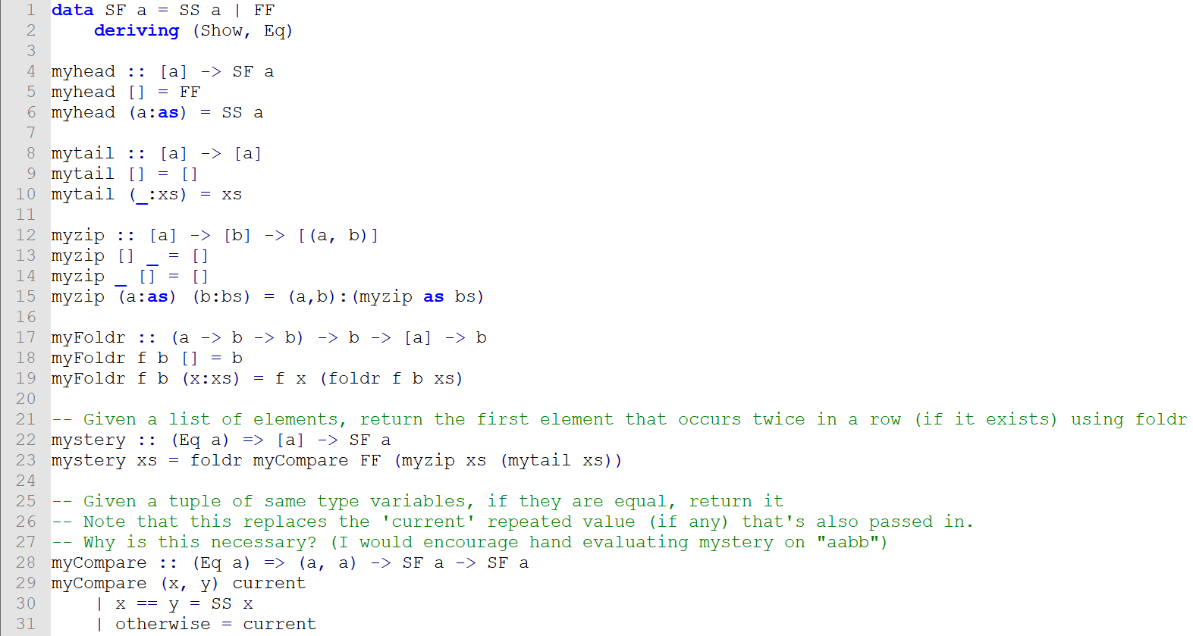
2. Working with types

Slide 56
3. Unification
One of the new topics, not overly difficult!
You will be given two terms, and be asked to unify them
Robin did mention last Tuesday that the questions will consist of hand unification

Slide 57
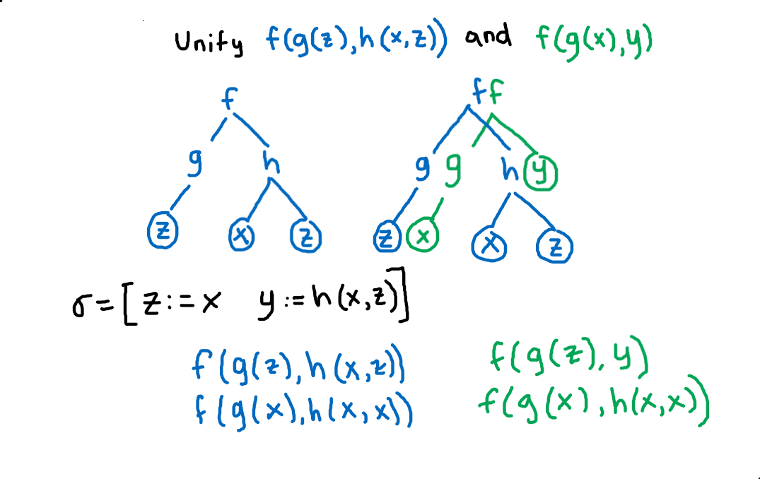
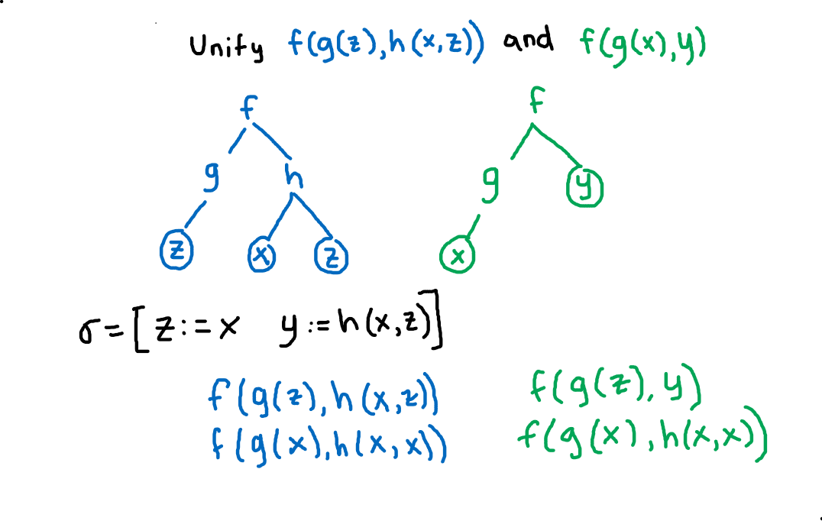

3. Unification

Slide 58

3. Unification

Slide 59
3. Unification

Slide 60
3. Unification

Slide 61
3. Unification

Slide 62
3. Unification

Slide 63
3. Unification

Slide 64

3. Unification

Slide 65
3. Unification

Slide 66
3. Unification

Slide 67
3. Unification

Slide 68
3. Unification

Slide 69
3. Unification

Slide 70
3. Unification

Slide 71
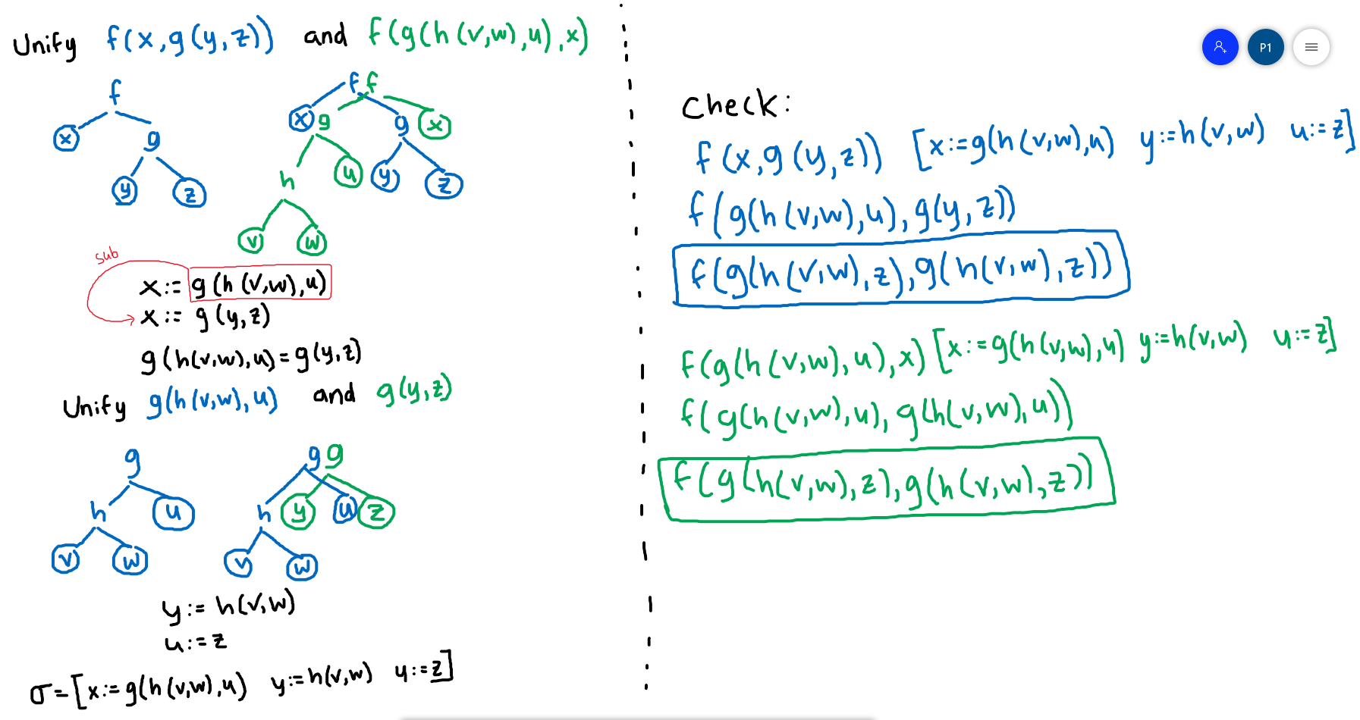

3. Unification

