Slide 1
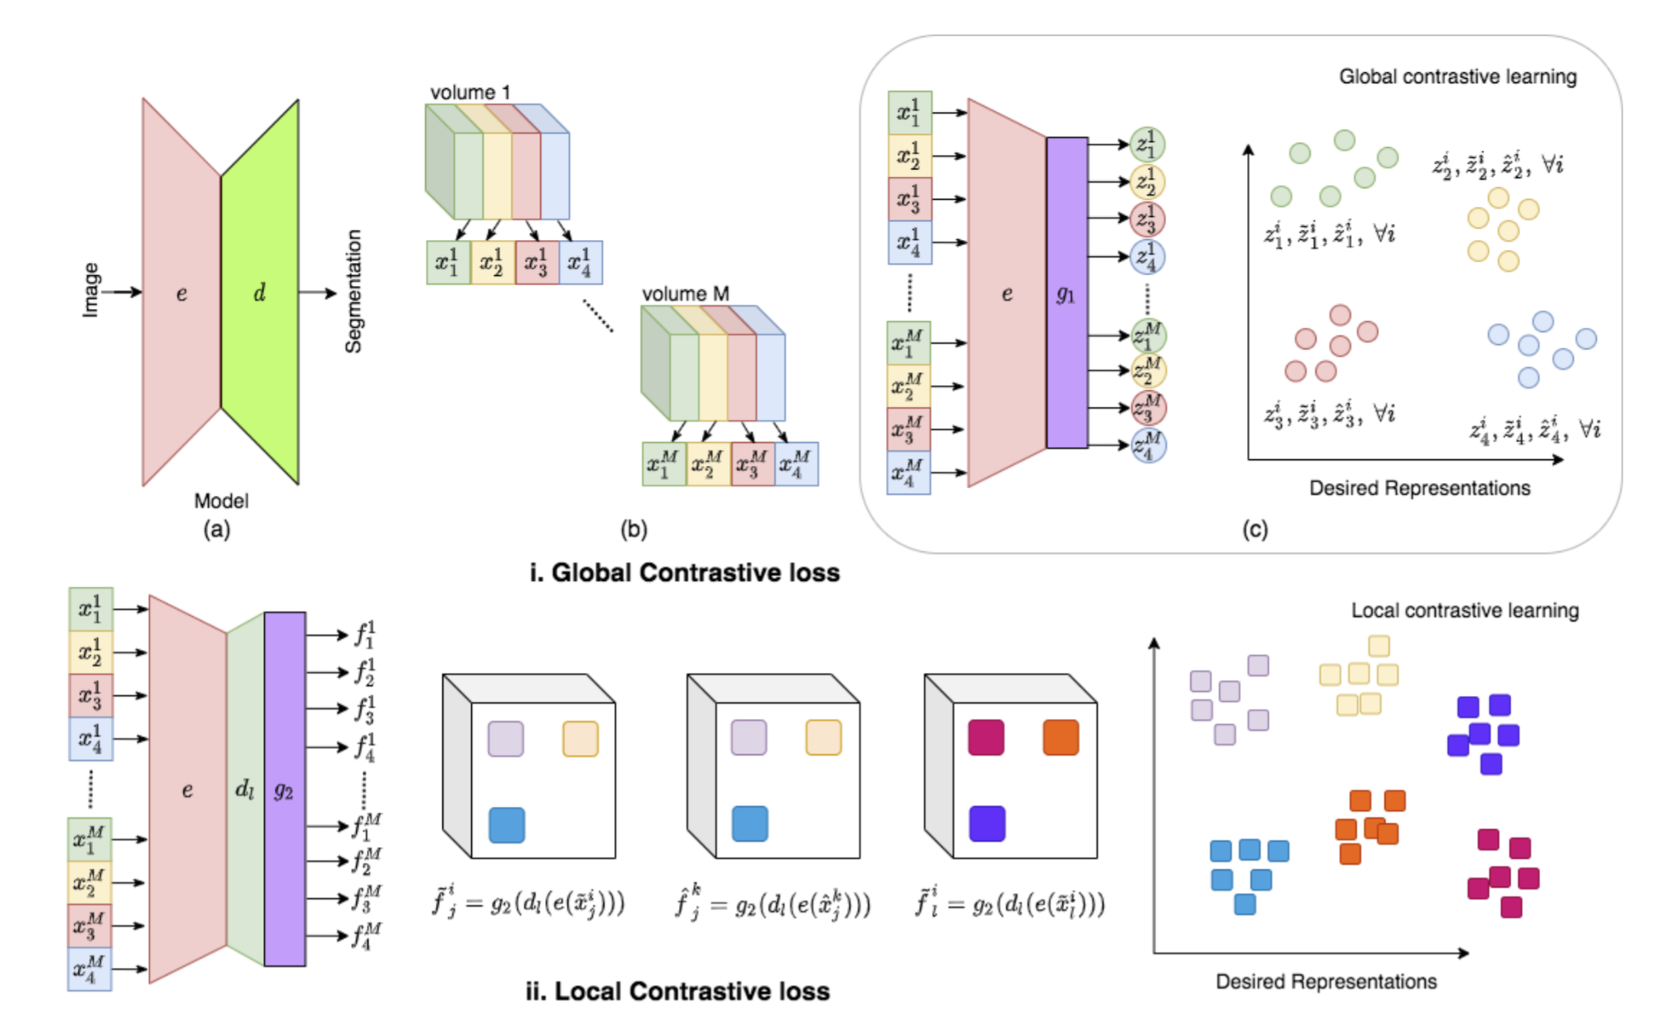
data from the same dataset
slices are roughly aligned within patients.
what sort of repsetnetatin of the output which maximize theMI and not senseible to the misalignment.
related work:
Global contrast + local contrast
Training processus:
pretrain encoder-> pretrain decoder->
finetuning all the network using small xtr and xvl
and report the values on a large test set.

Slide 2
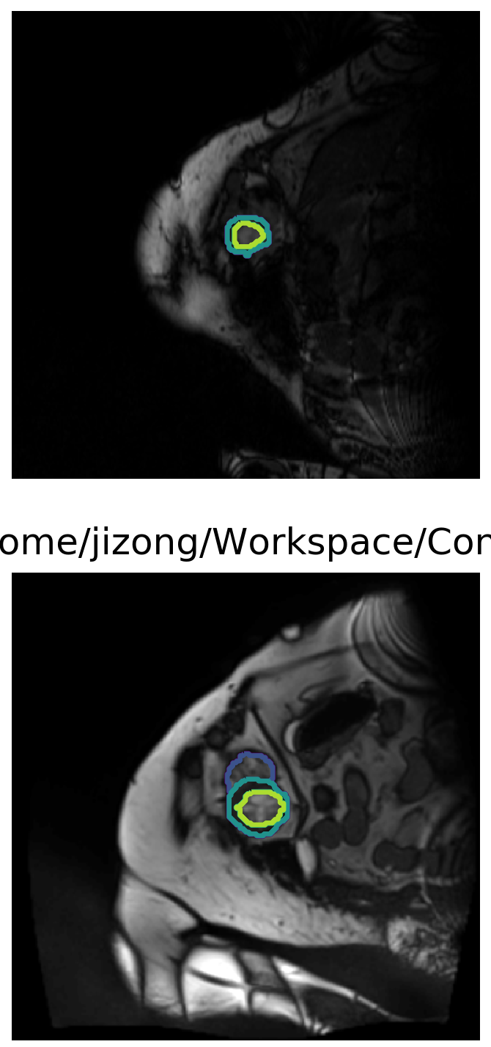
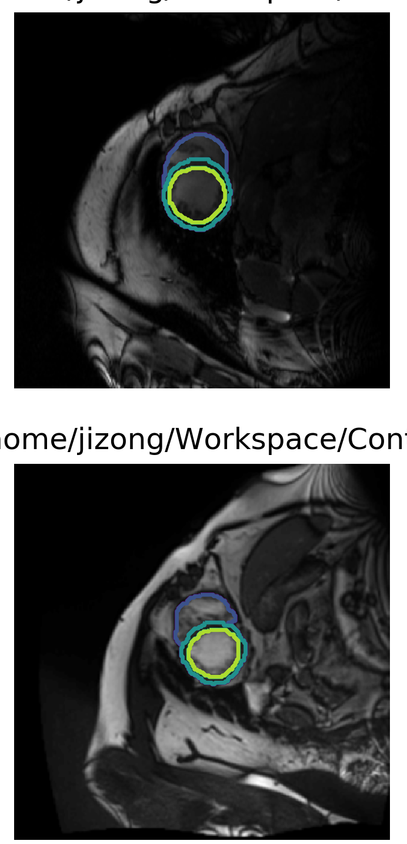
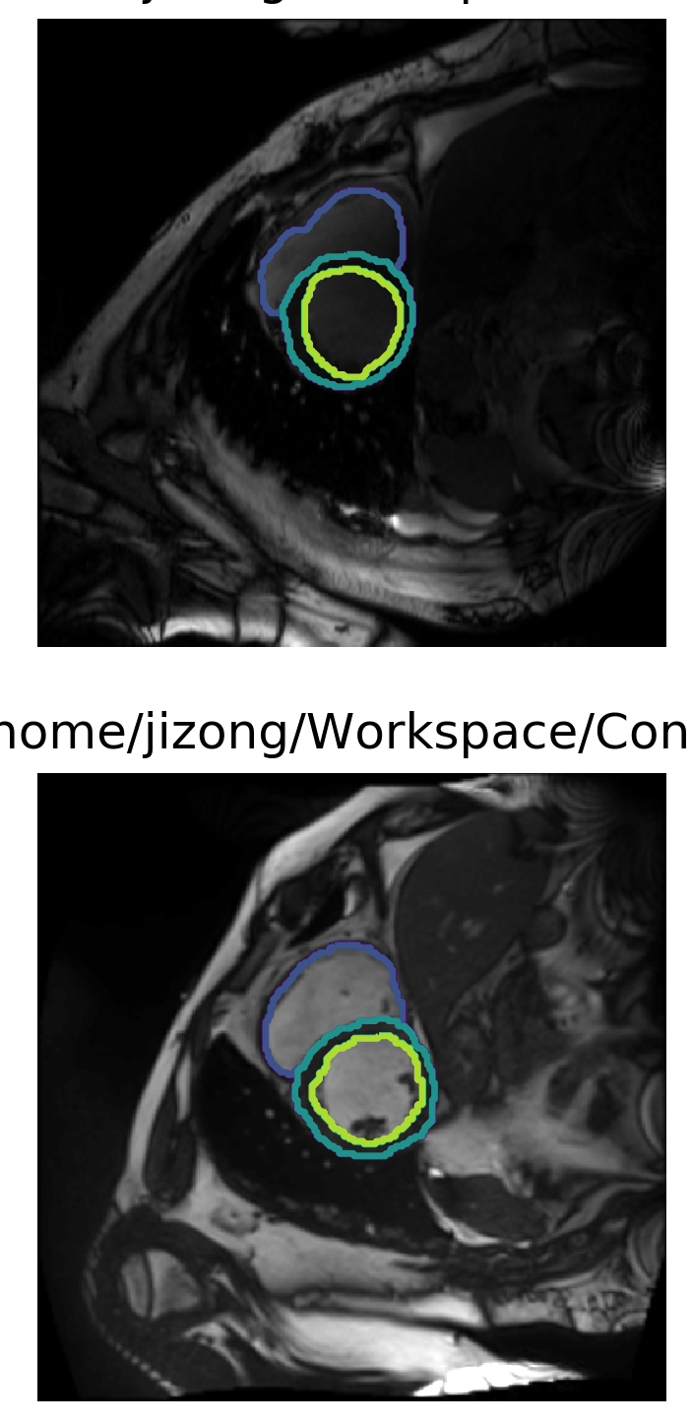
My progress:
1. we use ACDC dataset as the same as theirs.
Patient 1
Patient 2
Partition1
Partition2
Partition3

Slide 3
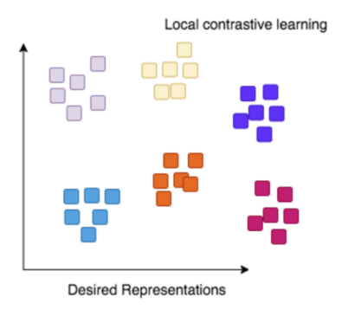

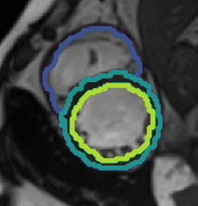
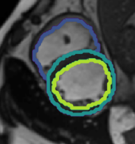
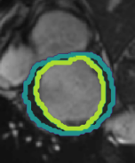

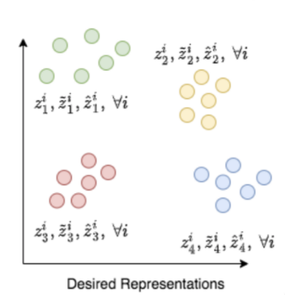
network architecture
d_{anc}
d_{pos}
d_{neg}
local contrast
encoder
anchor
anchor
positive
positive
negative
negative
e_{anc}
e_{pos}
e_{neg}
global contrast

Slide 4
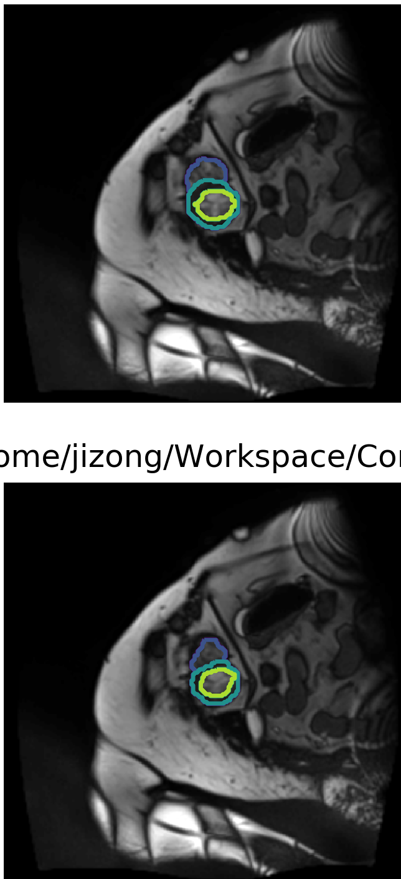
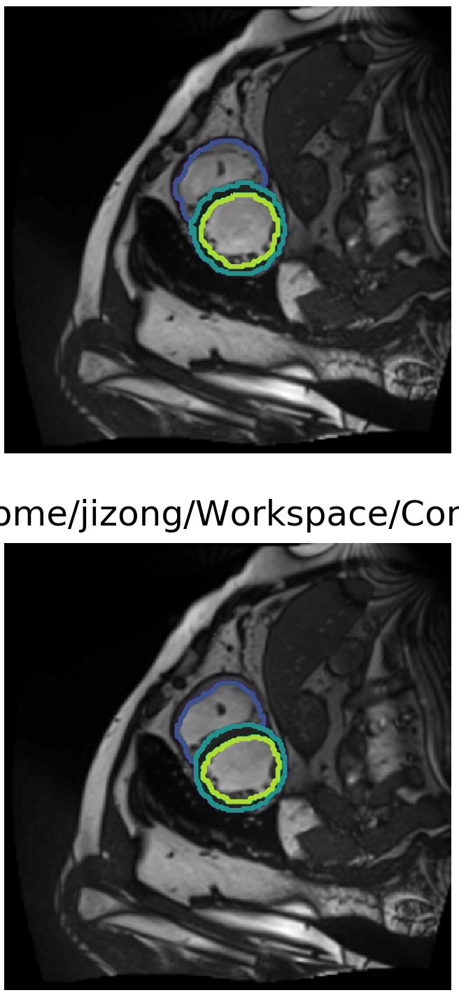
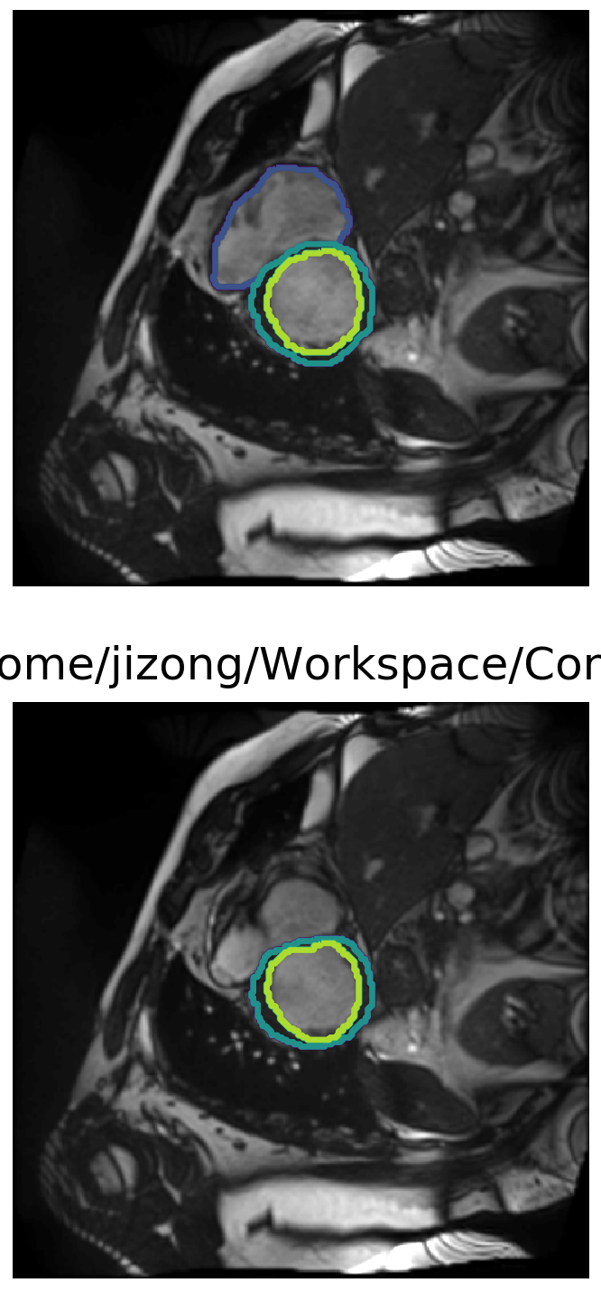
My progress:
1. we use ACDC dataset as the same as theirs.
Patient 1
ED phase
Patient 1
ES phase
Partition1
Partition2
Partition3

Slide 5
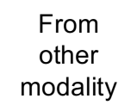
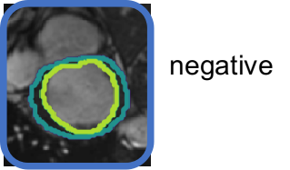
network architecture for IIC
???
anchor
anchor
IIC loss
IIC loss
roughly
aligned
images
roughly
aligned
images
e_{anc}
e_{pos}
IIC loss
negative
???
e_{neg}
???

Slide 6




network architecture for IIC + bounding box?
???
anchor
anchor
IIC loss
IIC loss (discriminator)
divergence loss
>> favorable
From
other
modality
roughly
aligned
images
roughly
aligned
images
e_{anc}
e_{pos}
IIC loss (discriminator)
negative
???
e_{neg}
???

Slide 7
Current progress:
Contrast Sampler:
return a batch with N patients and M slices per patition per patient
Data Alignment for ACDC
roughly data alignment for image and labels
Rubust test on a new codebase
A toy example on ACDC dataset with the other modality as the inverse color and 10 degree rotation of the same image.

Slide 8
Questions:
What about doing with negative examples using the initial iic idea?
How to practically intialize the bounding box?
Do we need address the local contrastive learning?
having a discriminator for

