Slide 1
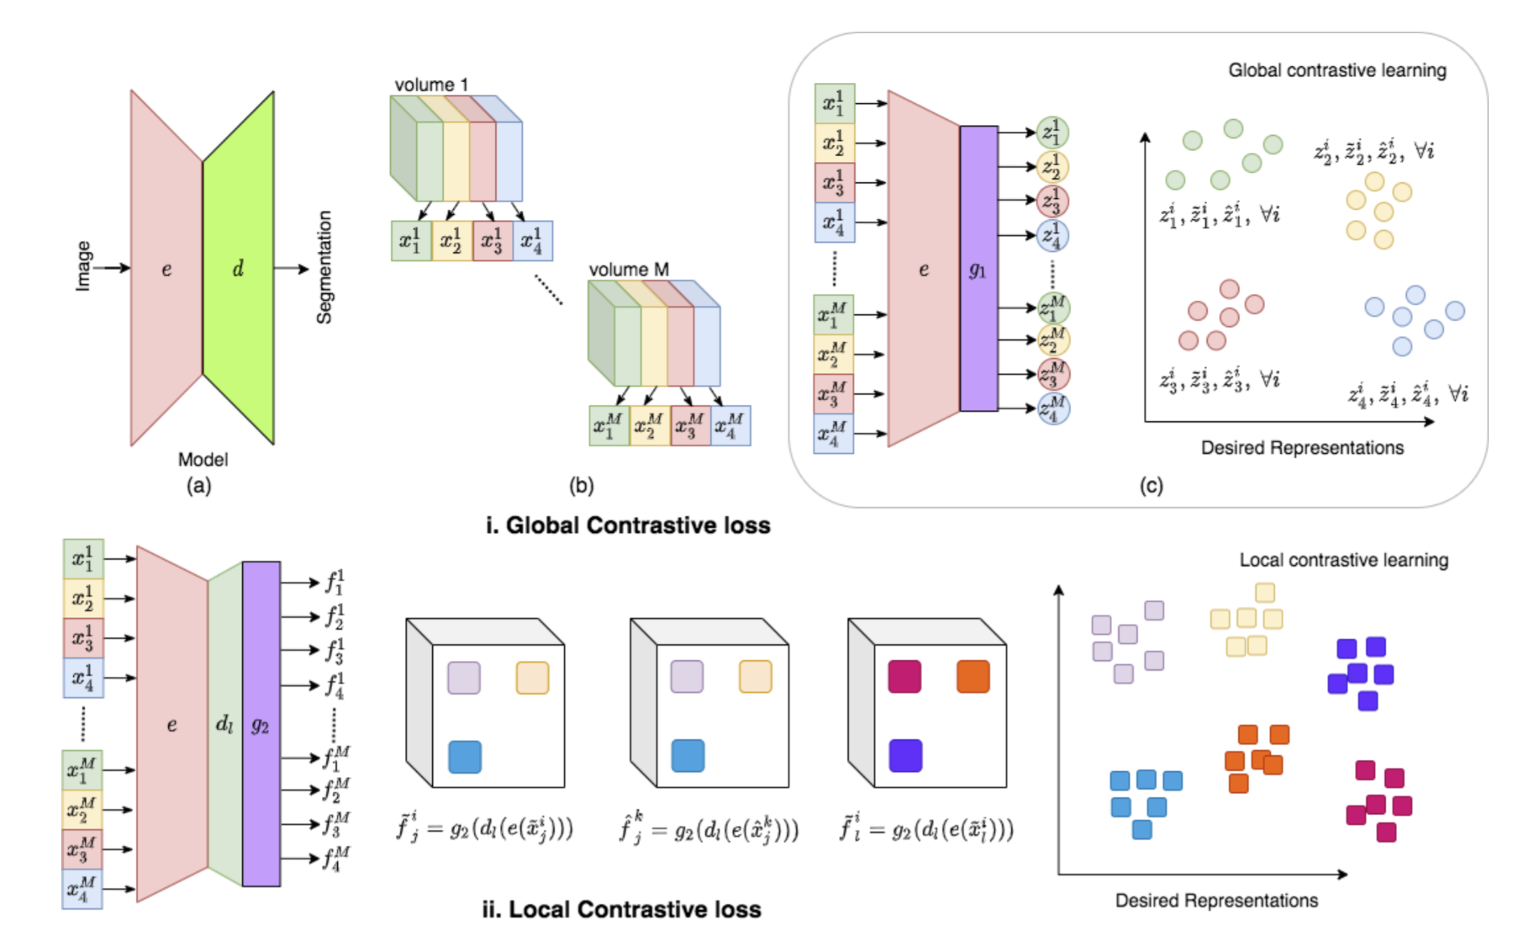
data from the same dataset
slices are roughly aligned within patients.
what sort of repsetnetatin of the output which maximize theMI and not senseible to the misalignment.
related work:
Global contrast + local contrast
Training processus:
pretrain encoder-> pretrain decoder->
finetuning all the network using small xtr and xvl
and report the values on a large test set.

Slide 2
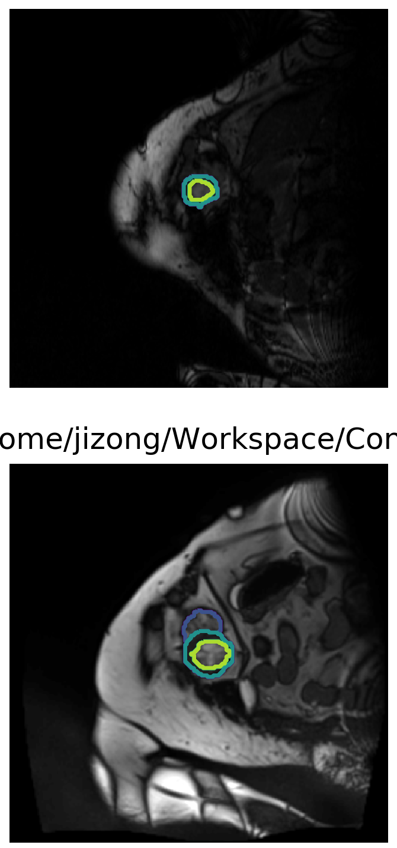
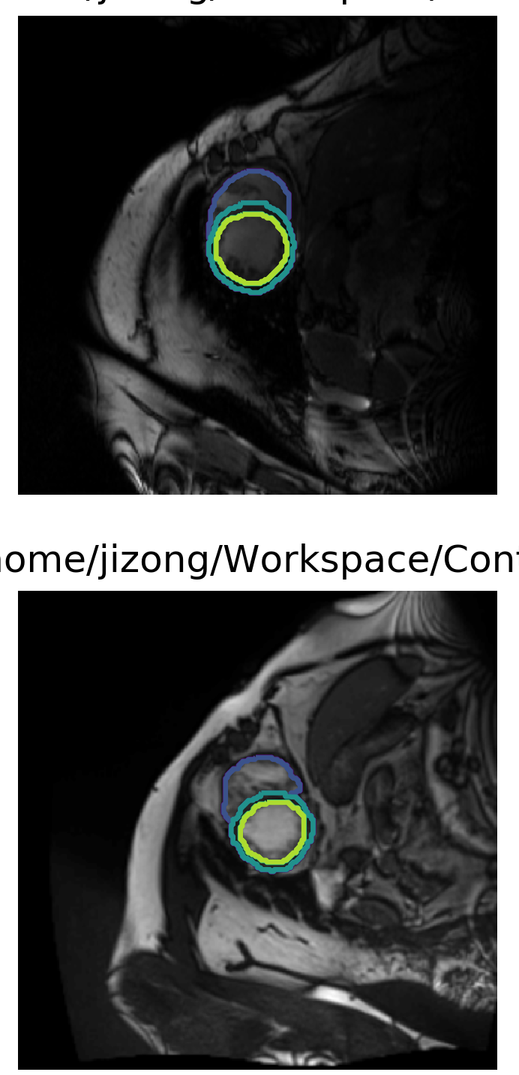
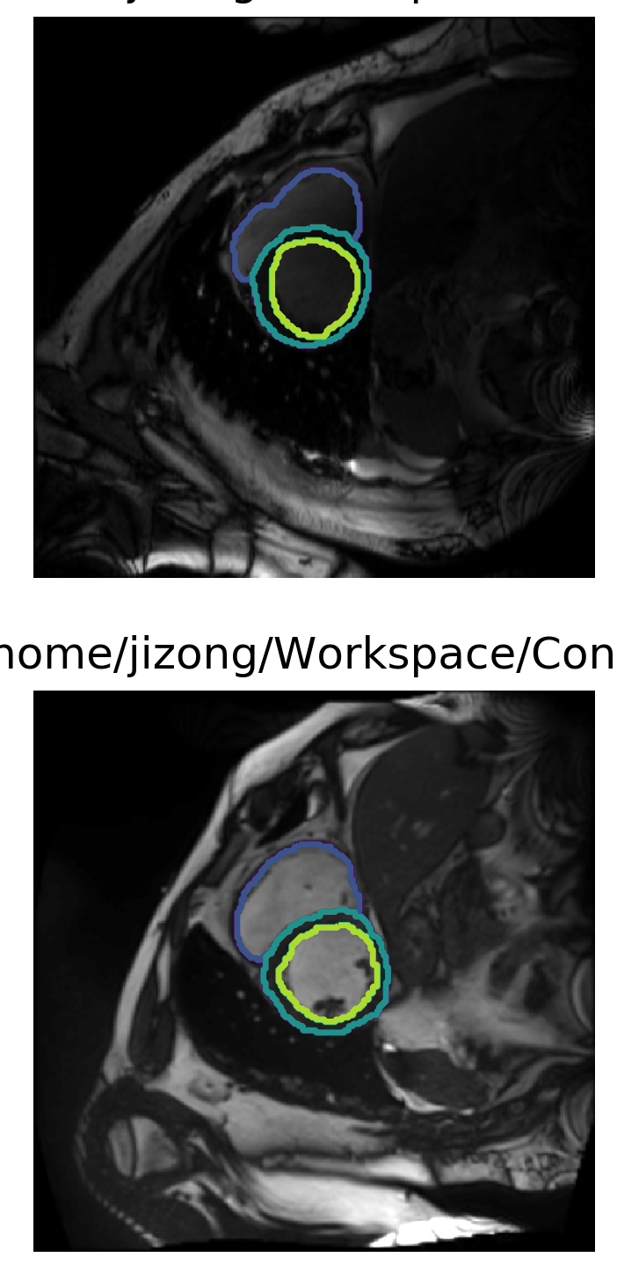
My progress:
1. we use ACDC dataset as the same as theirs.
Patient 1
Patient 2
Partition1
Partition2
Partition3

Slide 3
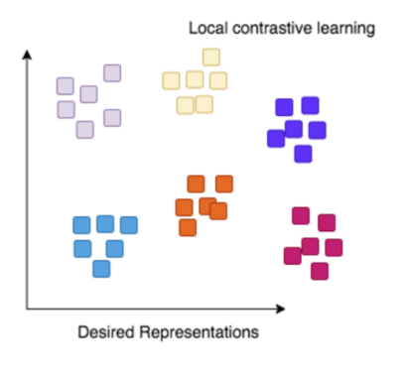

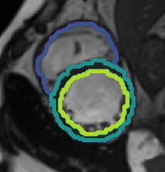
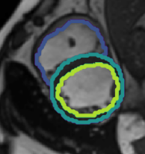
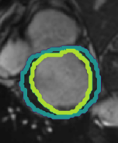

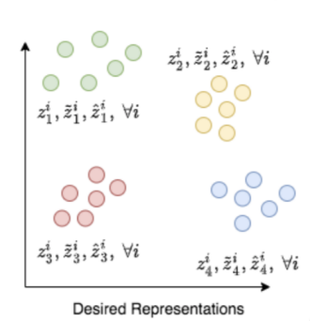
network architecture
d_{anc}
d_{pos}
d_{neg}
local contrast
encoder
anchor
anchor
positive
positive
negative
negative
e_{anc}
e_{pos}
e_{neg}
global contrast

Slide 4
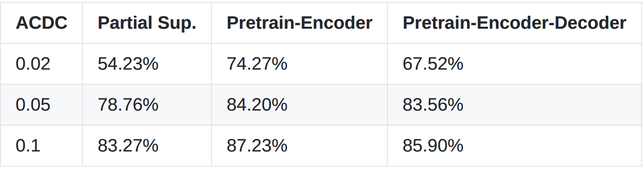
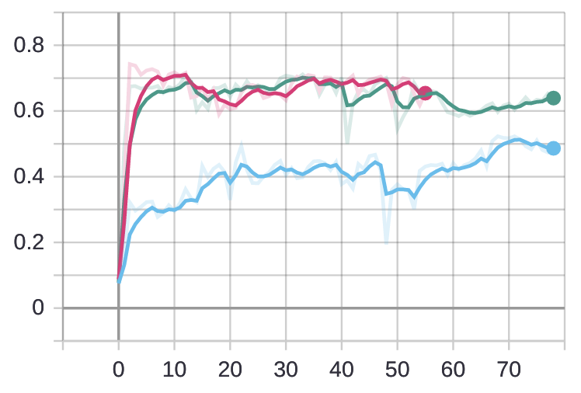
Baseline result
mean dice for the case 0.02
observations:
1. pretrain encoder is effective
2. decoder pretrain is not effective due to the unalignment
in the original paper, when training decoder, there is no positional move on images
3. IIC MI can be useful in this case.

Slide 5
Baseline result
Encoding using partition-wise contrastive
Encoding using patient-wise contrastive
to be continued

Slide 6
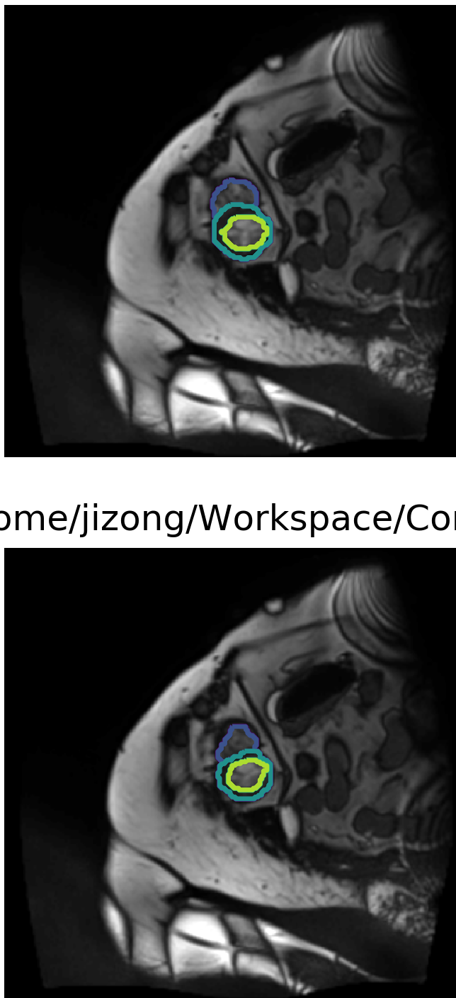
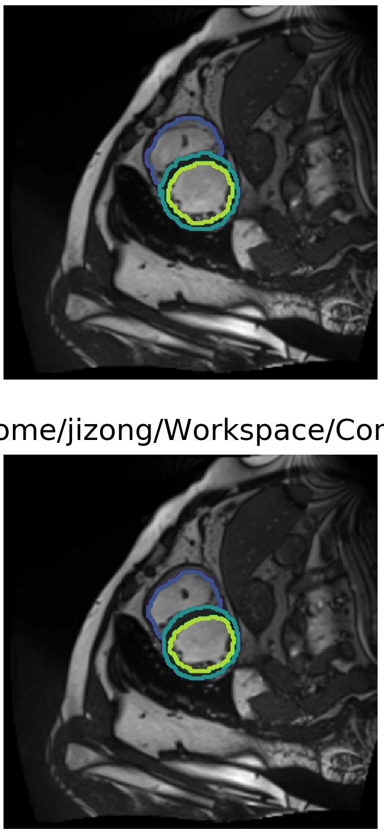
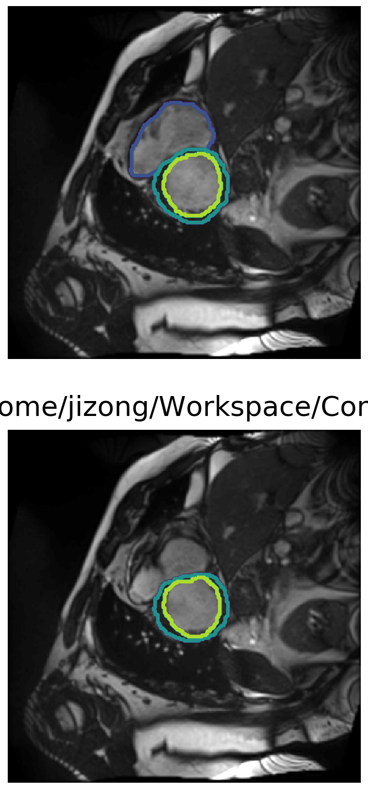
My progress:
1. we use ACDC dataset as the same as theirs.
Patient 1
ED phase
Patient 1
ES phase
Partition1
Partition2
Partition3

Slide 7




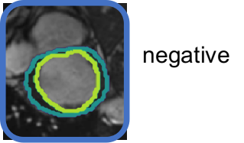
network architecture for IIC + bounding box?
IIC loss
anchor
anchor
IIC loss
IIC loss (discriminator)
From
other
modality
roughly
aligned
images
roughly
aligned
images
e_{anc}
e_{pos}
IIC loss (discriminator)??
negative
no loss here
e_{neg}
Enc_contrast

Slide 8
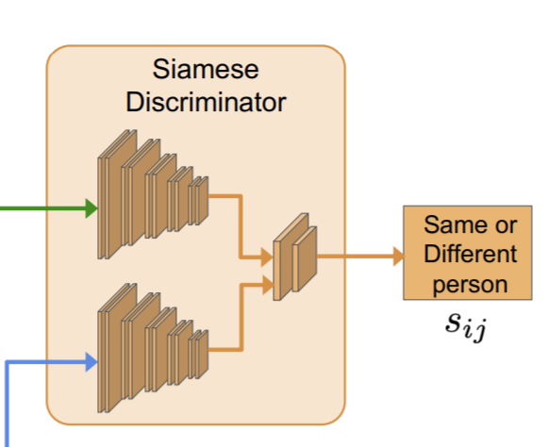
further steps
have a discriminator would help ?
Improve the learning strategy using IIC loss
Compared the different methods in `semi-supervised learning` instead of `pretrain-finetuning`: because

