Slide 2
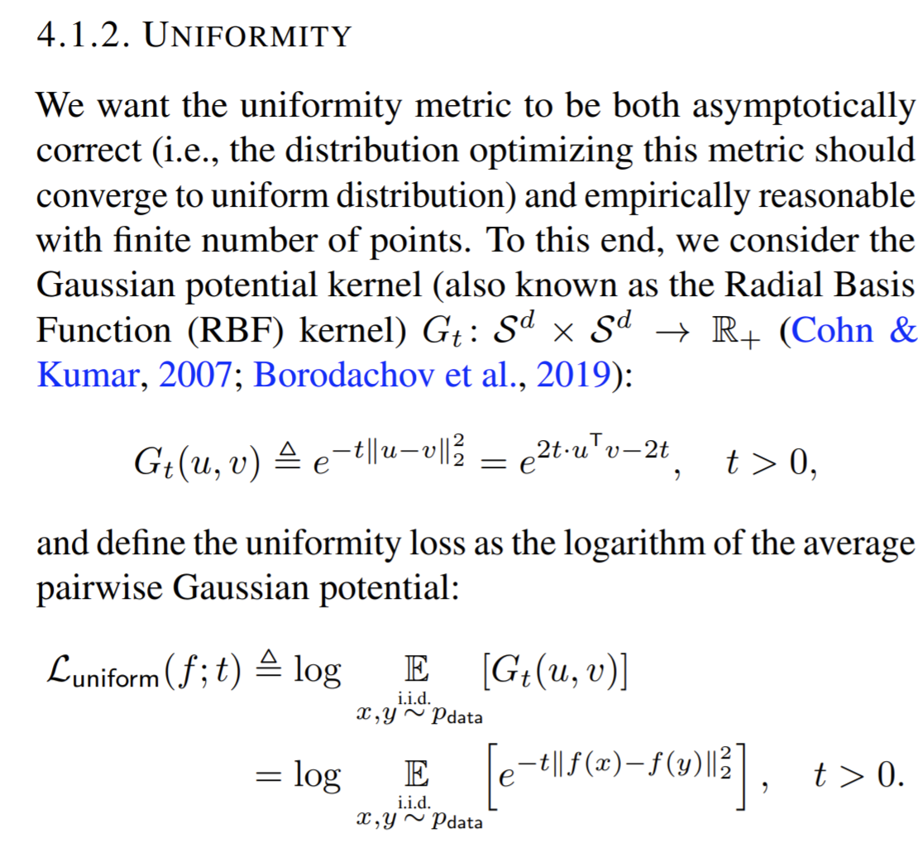
Clustering in sup-reg framework.
a distance based loss

Slide 3
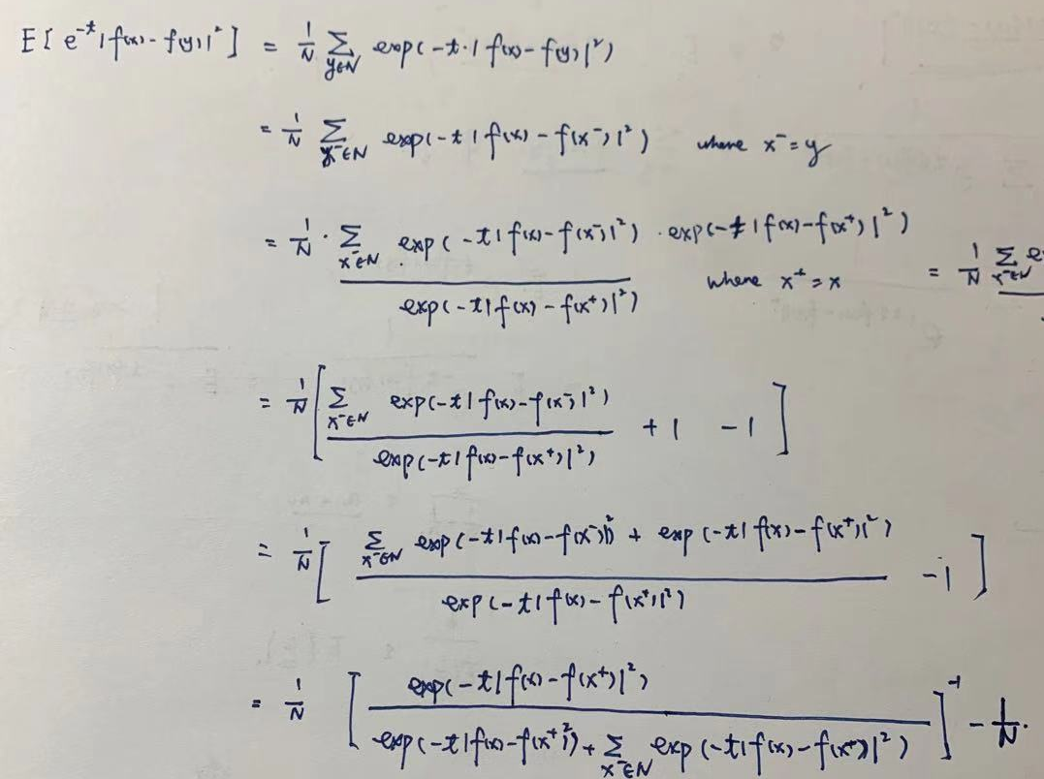
Distance base loss towards MI
Minimazing the distance based loss is equavalent to increase the infoNCE.
Loss -> -infoNCE -> -MI
We define our loss as:
1. scatter loss on prototype vectors
2. scatter loss on feature vectors
3. cluster loss on prototypes and vectors (differnetn)
Notes:
PCA variance is constant.
mean distance between points: measure of variance. 1. constant =1 2. entropy between points.

Slide 4
1. scatter prototypes
We minimize the distance based loss:
to minimize: Loss(prototype_vectors, prototype_vecotrs)
To scatter prototype_vectors to feature space

Slide 5
2. scatter features
We minimize the distance based loss:
to minimize: Loss(feature_vectors, feature_vecotrs)
To scatter feature_vectors to feature space

Slide 6
3. cluster prototype and features
We maximize the distance based loss:
to maximize: Loss(feature_vectors, prototype_vectors)
To cluster feature_vectors to prototype_vectors
?????????? Not very convincing of why

Slide 7
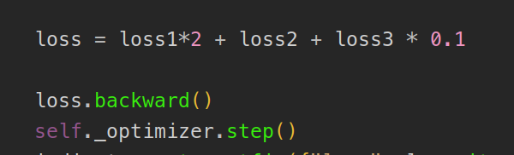
total loss

Slide 8
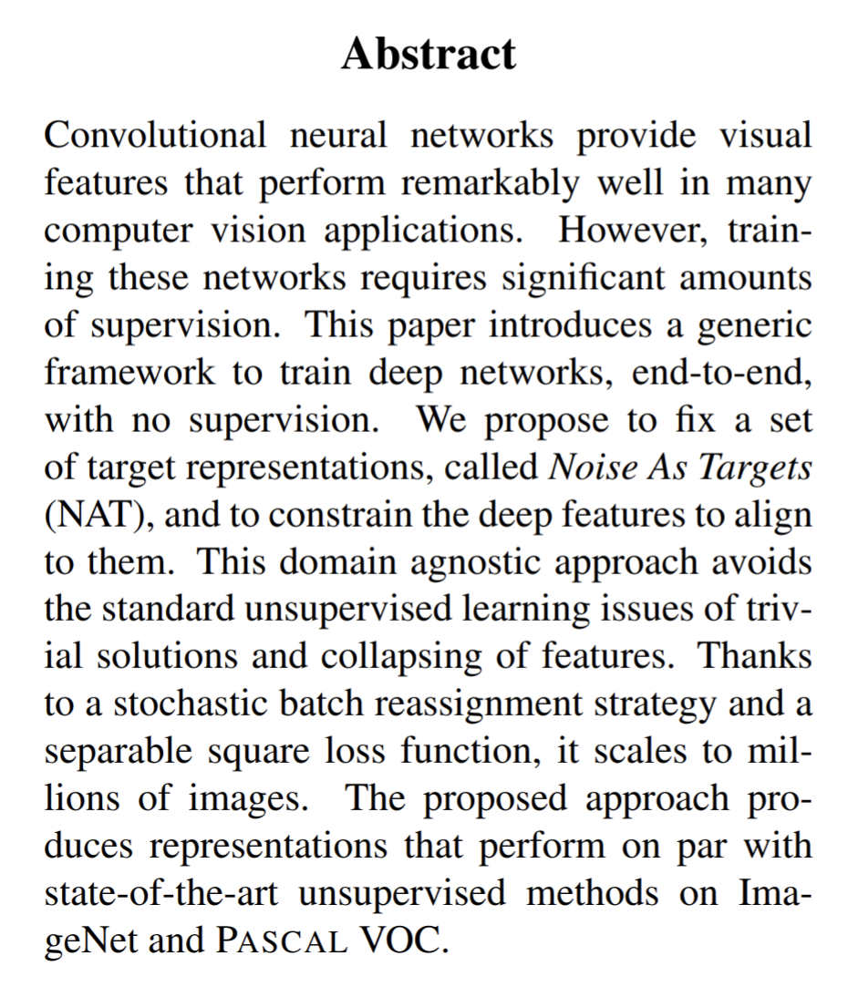
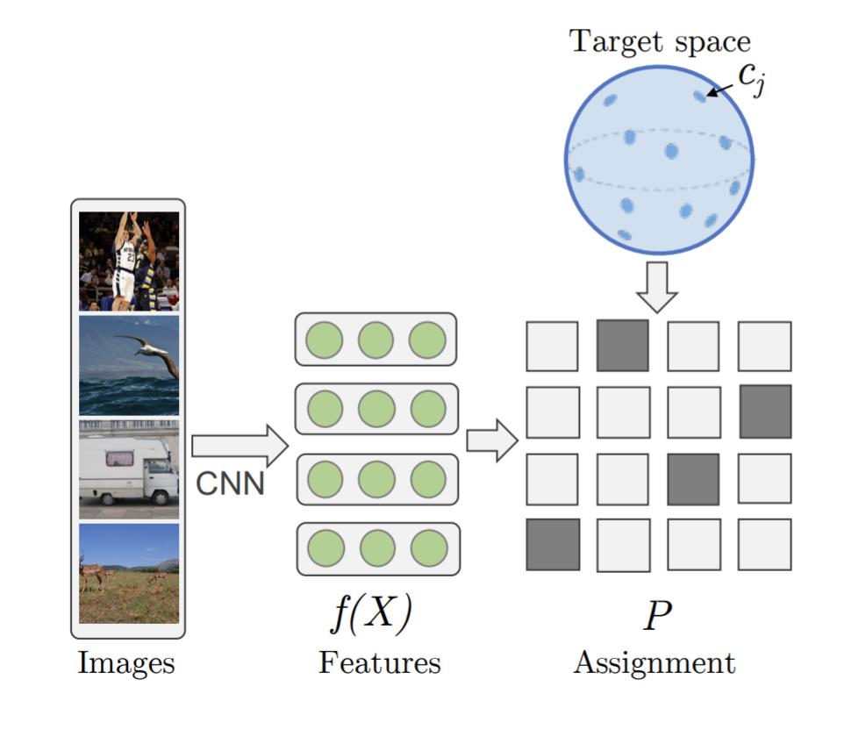
related works (1)

Slide 9
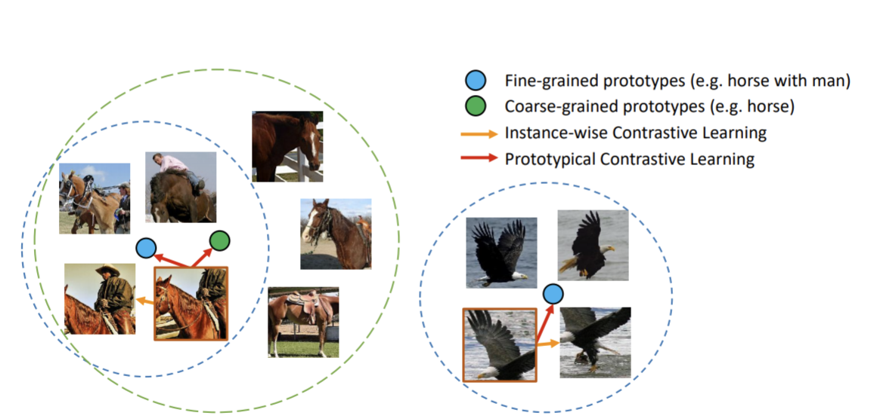
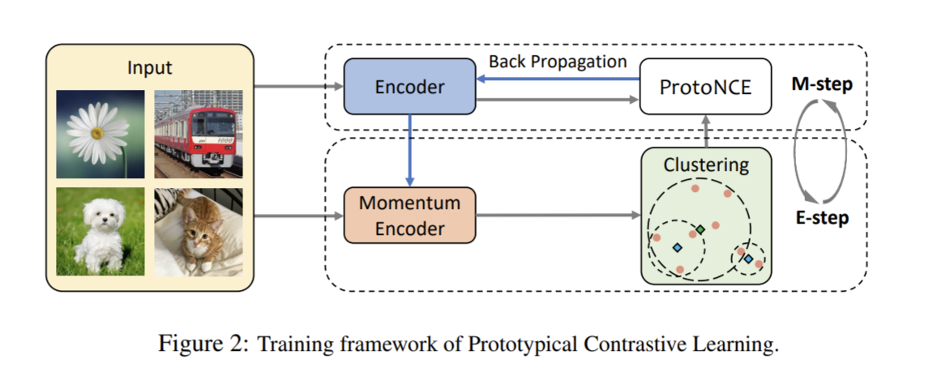
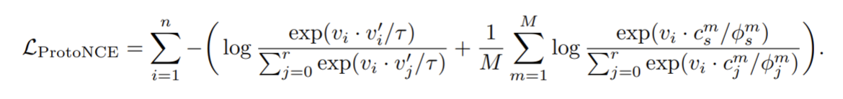
related works (2)
Prototypical Contrastive Learning of Unsupervised Representations

Slide 10
Experimental results
PS | 0.68
fs | 0.89
prototype_c=100 | 0.831
prototype_c=400 | 0.835
prototype_c=800 | 0.830
mse | 0.823
IIC | 0.79
udaiic | 0.832

