Slide 2
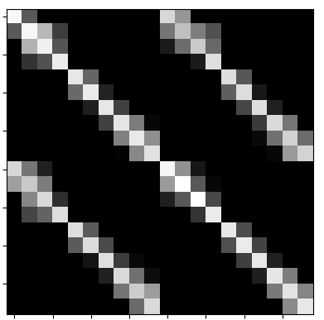
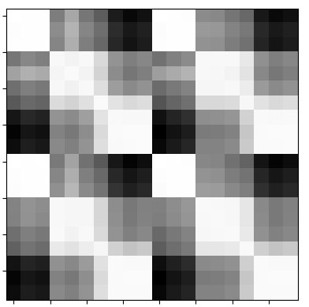
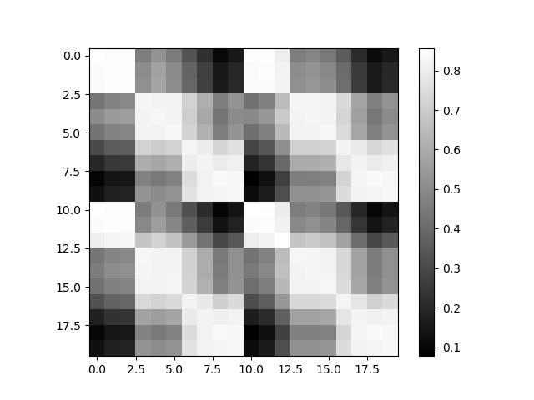
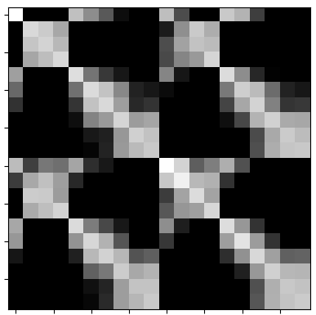
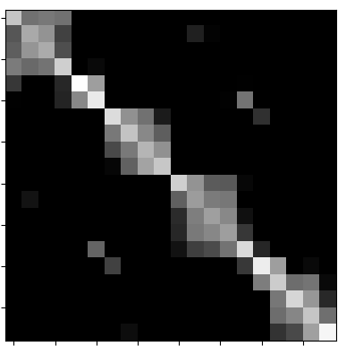
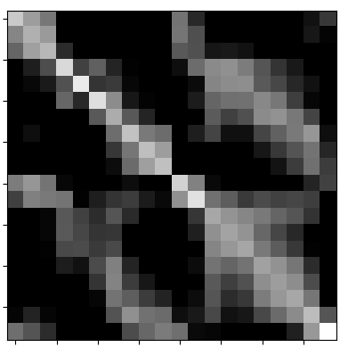
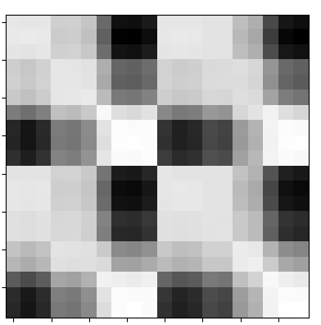
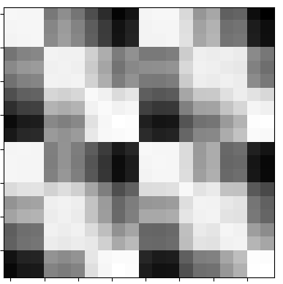
patient 004_00
patient 004_01
patient 004_00
patient 004_01
patient 004_00
patient 004_01
patient 004_00
patient 004_01
patient 004_01
patient 004_00
patient 004_01
patient 004_00
patient 004_01
patient 004_00
patient 004_01
patient 004_00
patient 004_00
patient 006_01
patient 004_00
patient 006_01
patient 004_00
patient 006_01
patient 004_00
patient 006_01
patient 006_01
patient 004_00
patient 006_01
patient 004_00
patient 006_01
patient 004_00
patient 006_01
patient 004_00

