Slide 1
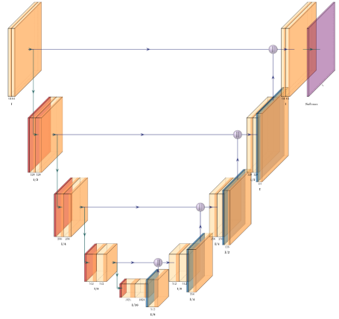

Slide 4
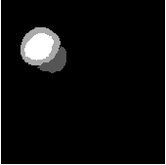
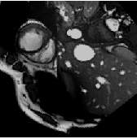

Slide 5
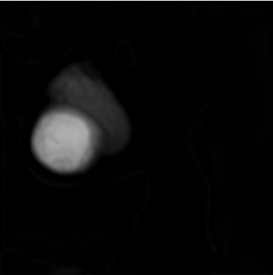
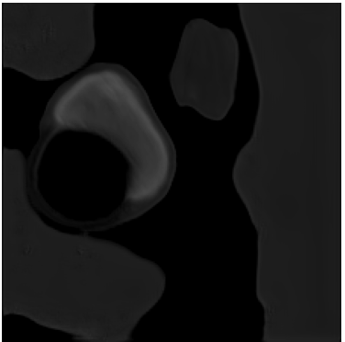
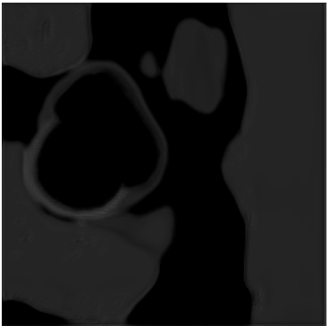
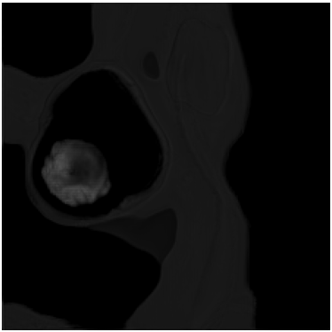
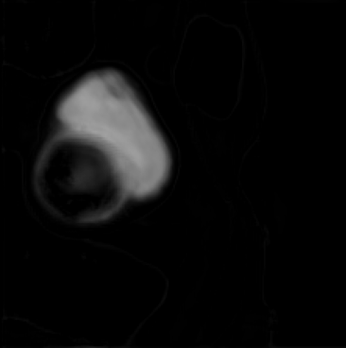
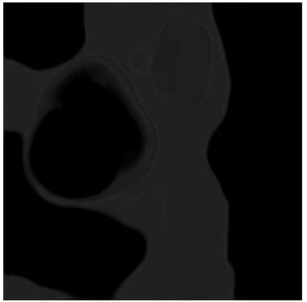
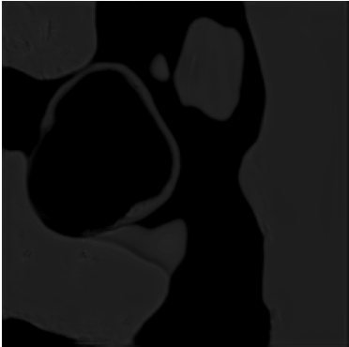
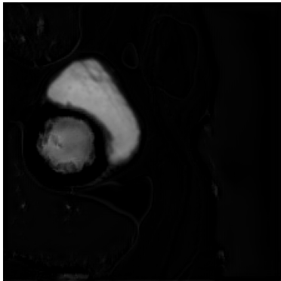
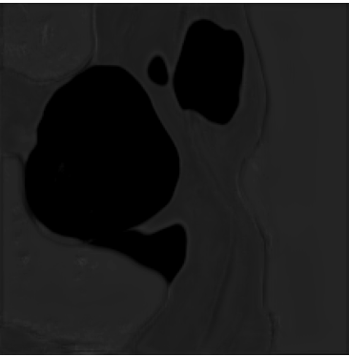
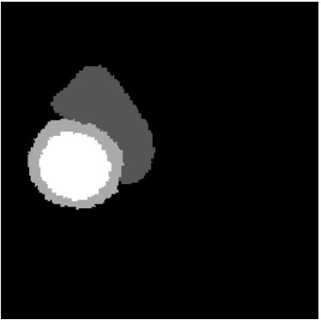
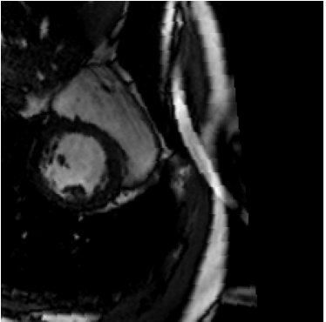
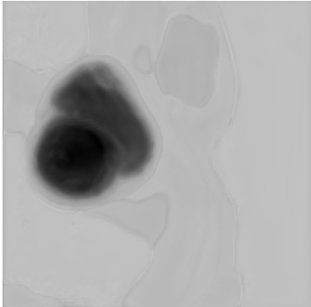
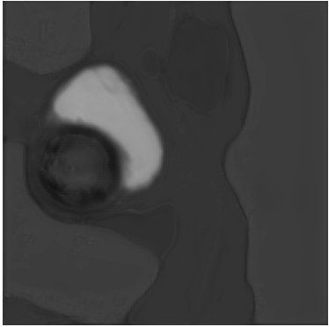
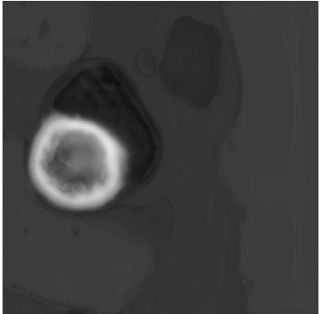
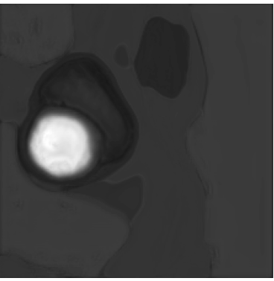
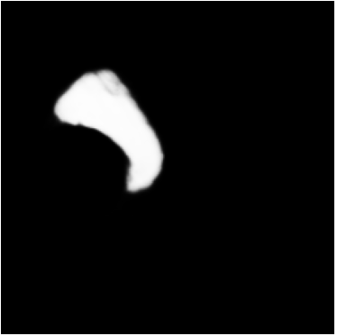
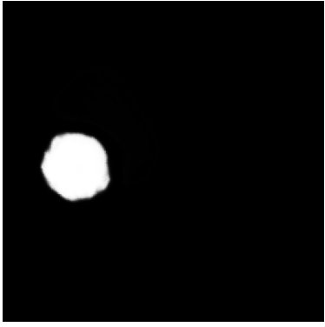
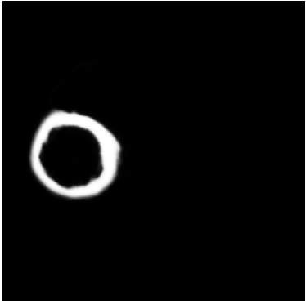
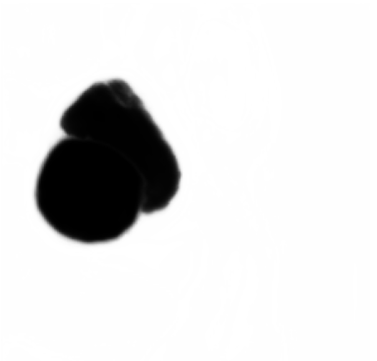

Slide 6
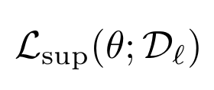
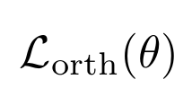
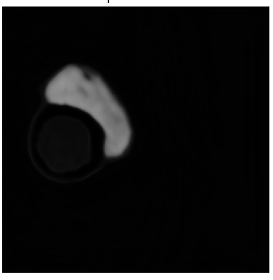
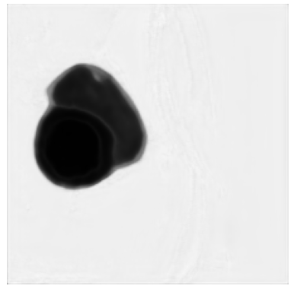
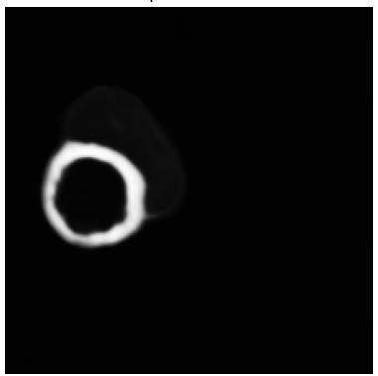
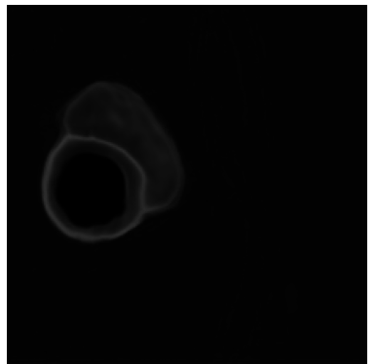
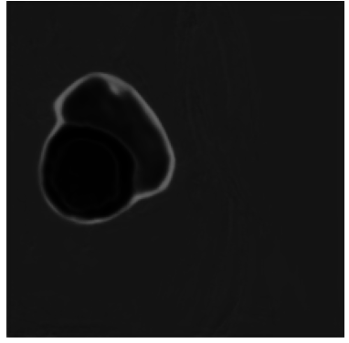
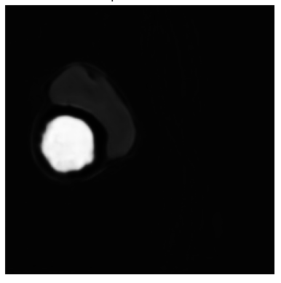
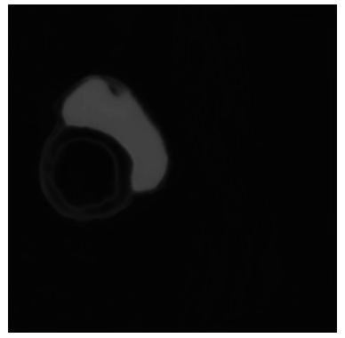
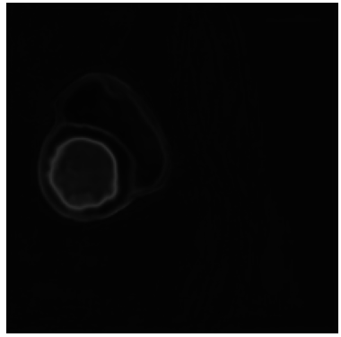
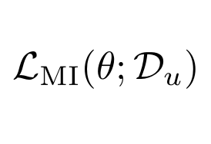
Input image
H×W×1
Feature extractor
Feature maps
H×W×N_{f}
1x1 conv + softmax
N_{f} ×C
Prediction
H×W×C
Labels
H×W×C
1×1 conv + softmax
N_{f} ×C’
Transition matrix
C’×C
1
1
1
1
1
1
1
1
Oversegmented prediction
H×W×C’
Prediction
H×W×C

Slide 7
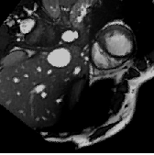
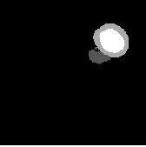
T(X_{u})
X_{u}

Slide 8
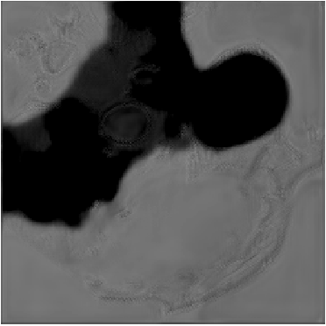
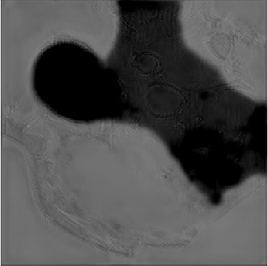
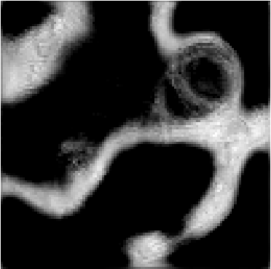
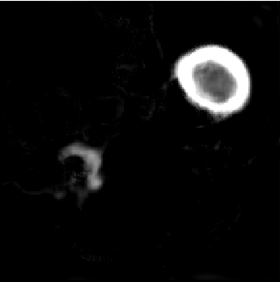
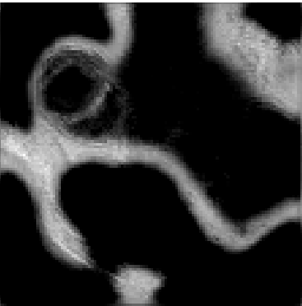
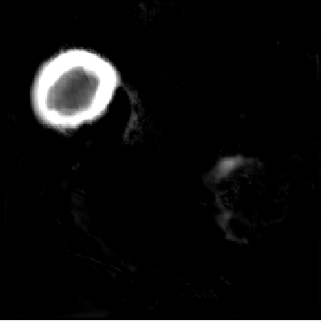
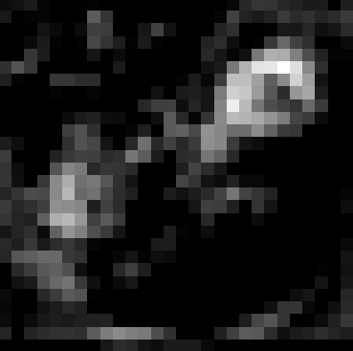
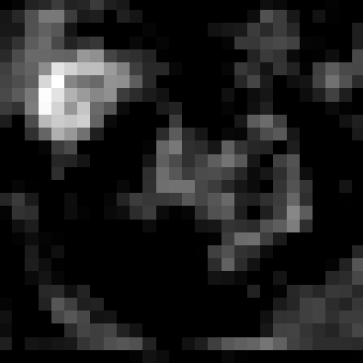
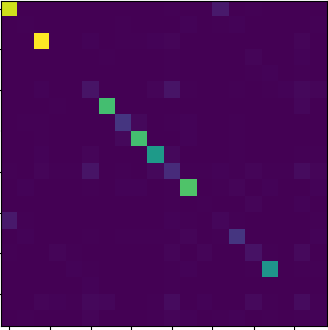

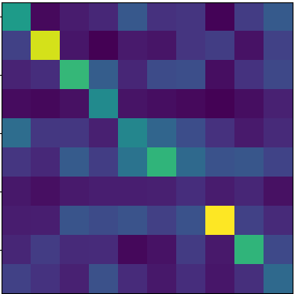
x_{u}
upconv2
deconv1
T(x_{u})
conv1
apply T
L_{cons}
conv2
upconv3
upconv4
f_{upconv3}
information flow
conv3
axillary linear projector
f_{upconv4}
f_{upconv2}
Axilluary
projector array
concatenate
conv4
upconv5
conv_relu_bn
f_{upconv5}
conv5
K₁
downsample
MI maximization
K₂
upsample
K₁
f_{conv5}
Axilluary
projector array
Joint distributions
Joint distributions

Slide 9
x_{u}
upconv2
deconv1
T(x_{u})
conv1
apply T
..
L_{cons}
upconv3
..
conv2
..
..
upconv4
..
f_{upconv3}
..
information flow
conv3
..
f_{upconv5}
..
f_{upconv4}
f_{upconv2}
Axilluary
projector array
axillary linear projector
..
concatenate
conv4
upconv5
conv_relu_bn
conv5
K₁
downsample
..
MI maximization
K₂
upsample
K₁
..
f_{conv5}
Axilluary
projector array
Joint distributions
Joint distributions

Slide 10



X
upconv2
deconv1
X΄
conv1
apply T
upconv3
..
conv2
..
..
upconv4
Φ⁴_{dec}
..
Φ³_{dec}
information flow
conv3
..
..
Axilluary
projector array
axillary linear projector
..
conv4
upconv5
..
concatenate
Φ⁵_{dec}
..
Φ²_{dec}
conv_relu_bn
conv5
K₁
downsample
..
K₂
upsample
K₁
..
Φ_{enc}
Axilluary
projector array
Joint distributions
Joint distributions

Slide 11
X
upconv2
deconv1
X΄
conv1
apply T
upconv3
..
conv2
..
..
upconv4
Φ⁴_{dec}
..
Φ³_{dec}
information flow
conv3
..
..
Axilluary
projector array
axillary linear projector
..
concatenate
conv4
upconv5
..
Φ⁵_{dec}
..
Φ²_{dec}
conv_relu_bn
K₁
downsample
conv5
..
K₁
K₂
upsample
..
Φ_{enc}
Axilluary
projector array
Joint distributions
Joint distributions

Slide 12
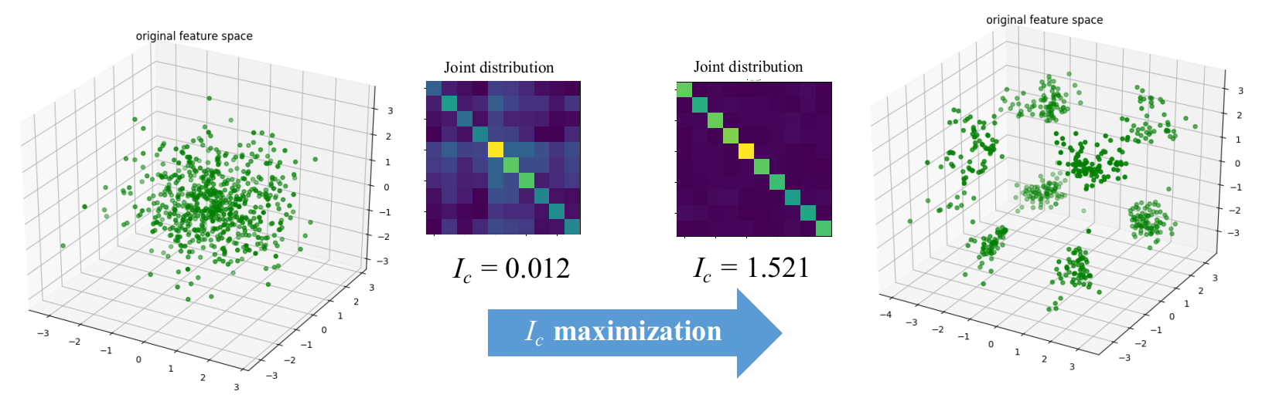
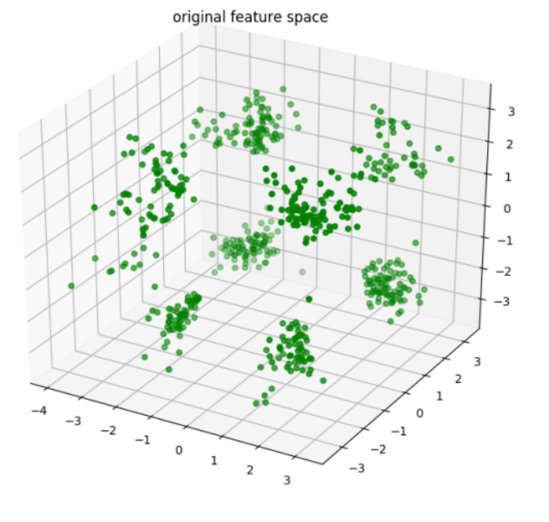

= 0.012
= 1.521
MI maxmization

