Slide 1
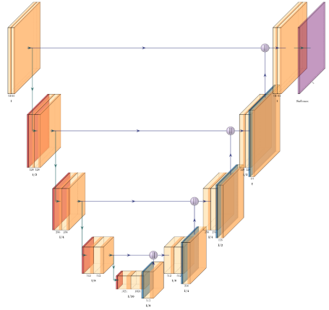

Slide 4
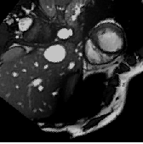
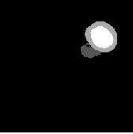
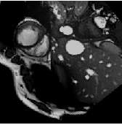
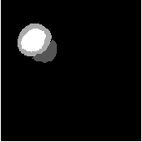

Slide 5
T(X_{u})
X_{u}

Slide 6
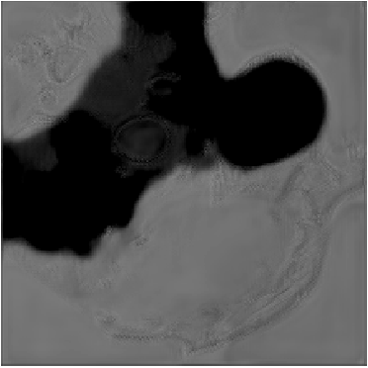
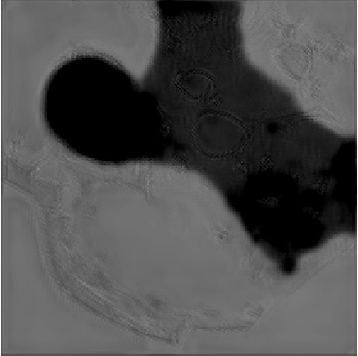
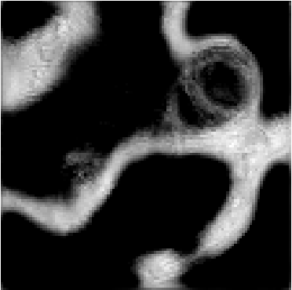
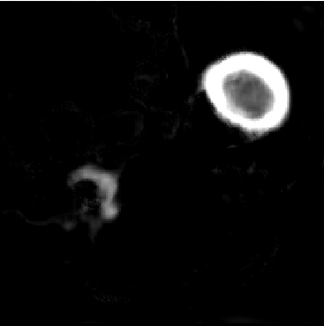
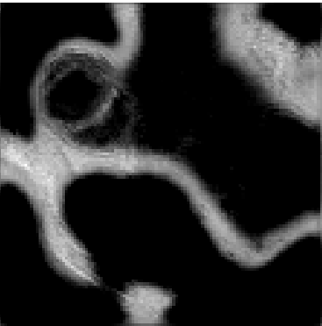
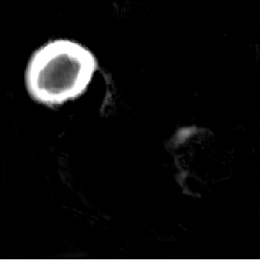
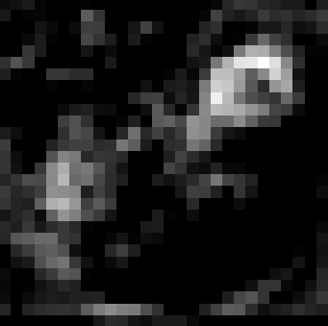
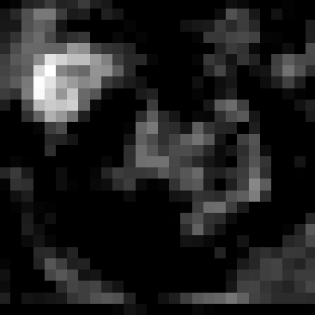
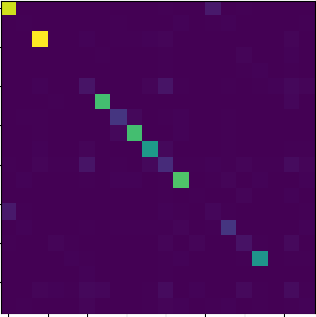

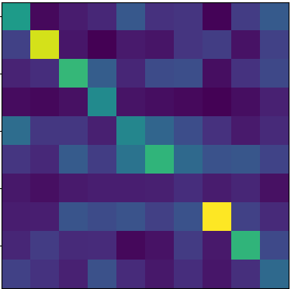
x_{u}
upconv2
deconv1
T(x_{u})
conv1
apply T
L_{cons}
conv2
upconv3
upconv4
f_{upconv3}
information flow
conv3
axillary linear projector
f_{upconv4}
f_{upconv2}
Axilluary
projector array
concatenate
conv4
upconv5
conv_relu_bn
f_{upconv5}
conv5
K₁
downsample
MI maximization
K₂
upsample
K₁
f_{conv5}
Axilluary
projector array
Joint distributions
Joint distributions

Slide 7
x_{u}
upconv2
deconv1
T(x_{u})
conv1
apply T
..
L_{cons}
upconv3
..
conv2
..
..
upconv4
..
f_{upconv3}
..
information flow
conv3
..
f_{upconv5}
..
f_{upconv4}
f_{upconv2}
Axilluary
projector array
axillary linear projector
..
concatenate
conv4
upconv5
conv_relu_bn
conv5
K₁
downsample
..
MI maximization
K₂
upsample
K₁
..
f_{conv5}
Axilluary
projector array
Joint distributions
Joint distributions

Slide 8



X
upconv2
deconv1
X΄
conv1
apply T
upconv3
..
conv2
..
..
upconv4
Φ⁴_{dec}
..
Φ³_{dec}
information flow
conv3
..
..
Axilluary
projector array
axillary linear projector
..
conv4
upconv5
..
concatenate
Φ⁵_{dec}
..
Φ²_{dec}
conv_relu_bn
conv5
K₁
downsample
..
K₂
upsample
K₁
..
Φ_{enc}
Axilluary
projector array
Joint distributions
Joint distributions

Slide 9
X
upconv2
deconv1
X΄
conv1
apply T
upconv3
..
conv2
..
..
upconv4
Φ⁴_{dec}
..
Φ³_{dec}
information flow
conv3
..
..
Axilluary
projector array
axillary linear projector
..
concatenate
conv4
upconv5
..
Φ⁵_{dec}
..
Φ²_{dec}
conv_relu_bn
K₁
downsample
conv5
..
K₁
K₂
upsample
..
Φ_{enc}
Axilluary
projector array
Joint distributions
Joint distributions

Slide 10
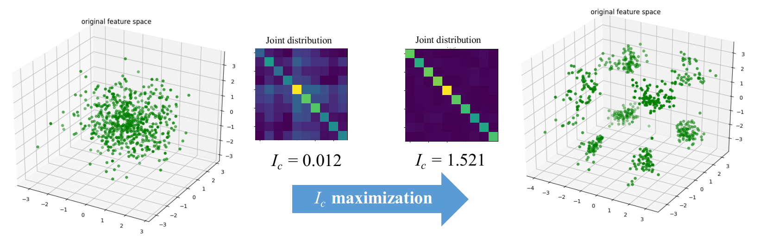
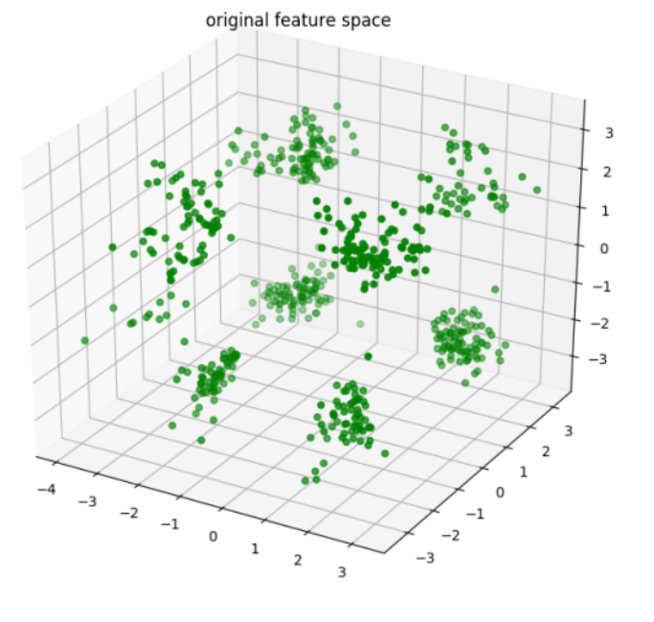

= 0.012
= 1.521
MI maxmization

