Slide 1
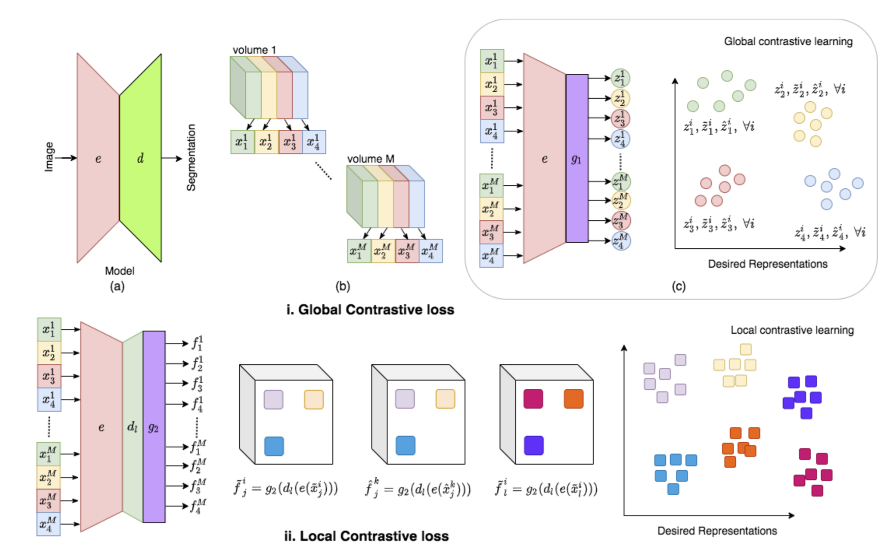
data from the same dataset
slices are roughly aligned within patients.
what sort of repsetnetatin of the output which maximize theMI and not senseible to the misalignment.
related work:
Global contrast + local contrast
Training processus:
pretrain encoder-> pretrain decoder->
finetuning all the network using small xtr and xvl
and report the values on a large test set.

Slide 2
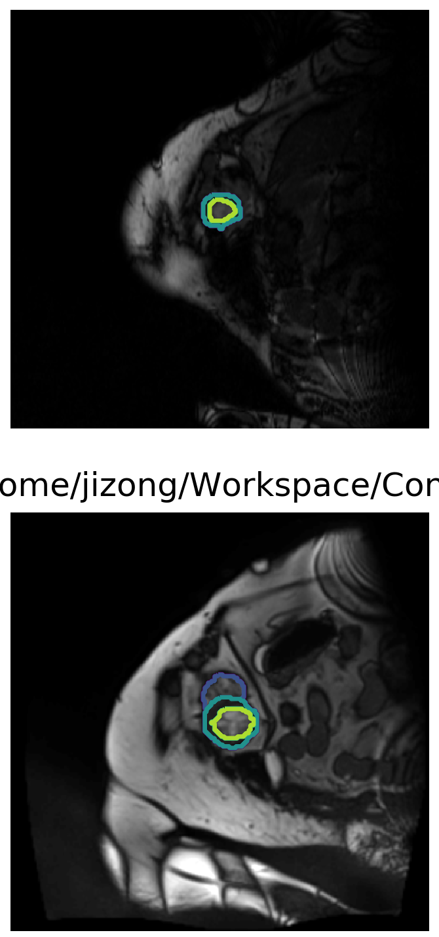
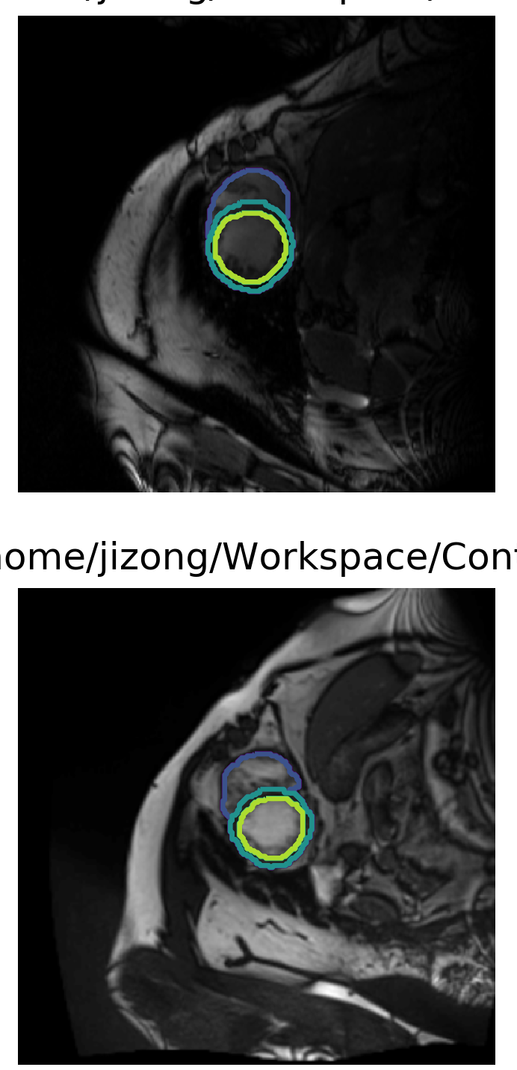
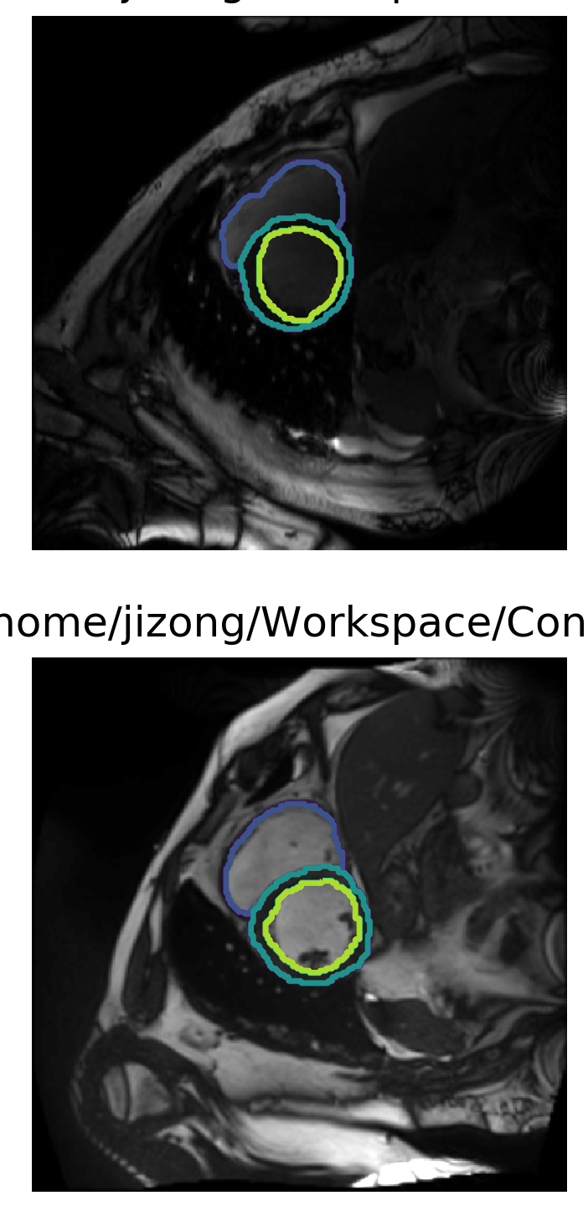
My progress:
1. we use ACDC dataset as the same as theirs.
Patient 1
Patient 2
Partition1
Partition2
Partition3

Slide 3
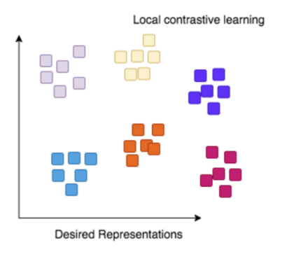

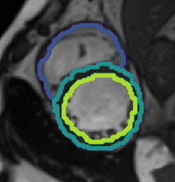
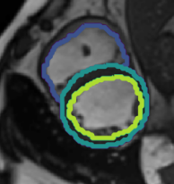
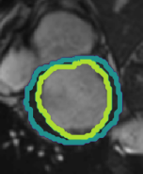

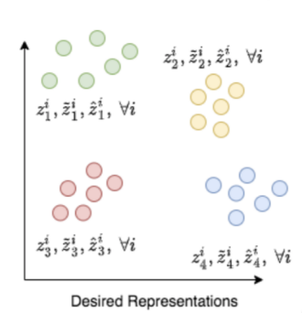
network architecture
d_{anc}
d_{pos}
d_{neg}
local contrast
encoder
anchor
anchor
positive
positive
negative
negative
e_{anc}
e_{pos}
e_{neg}
global contrast

Slide 4
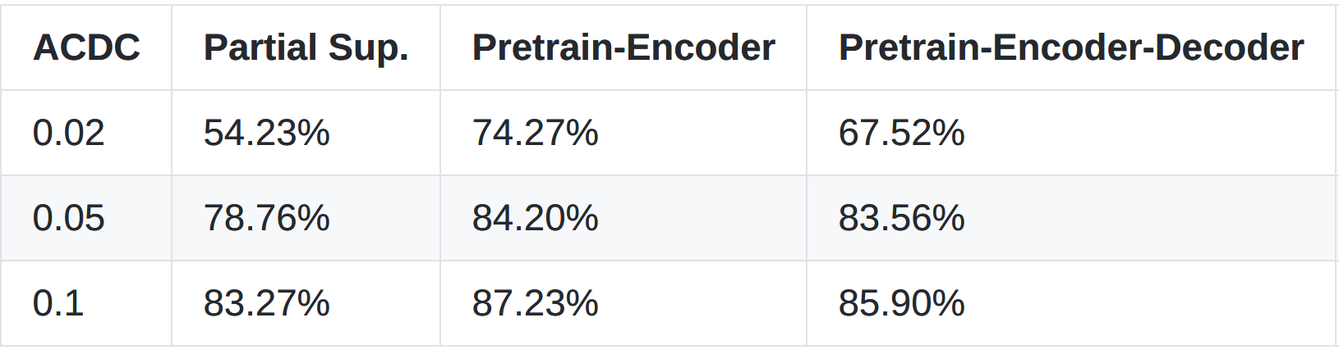
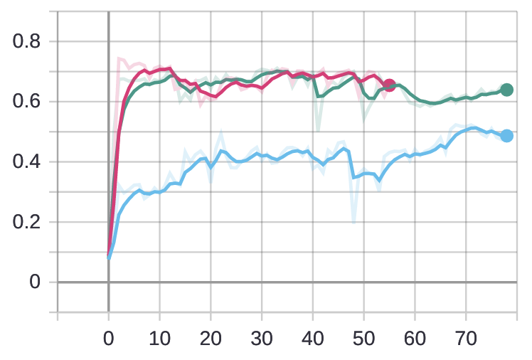
Baseline result
mean dice for the case 0.02
observations:
1. pretrain encoder is effective
2. decoder pretrain is not effective due to the unalignment
in the original paper, when training decoder, there is no positional move on images
3. IIC MI can be useful in this case.

Slide 5
Baseline result
Encoding using partition-wise contrastive
Encoding using patient-wise contrastive
to be continued

Slide 6
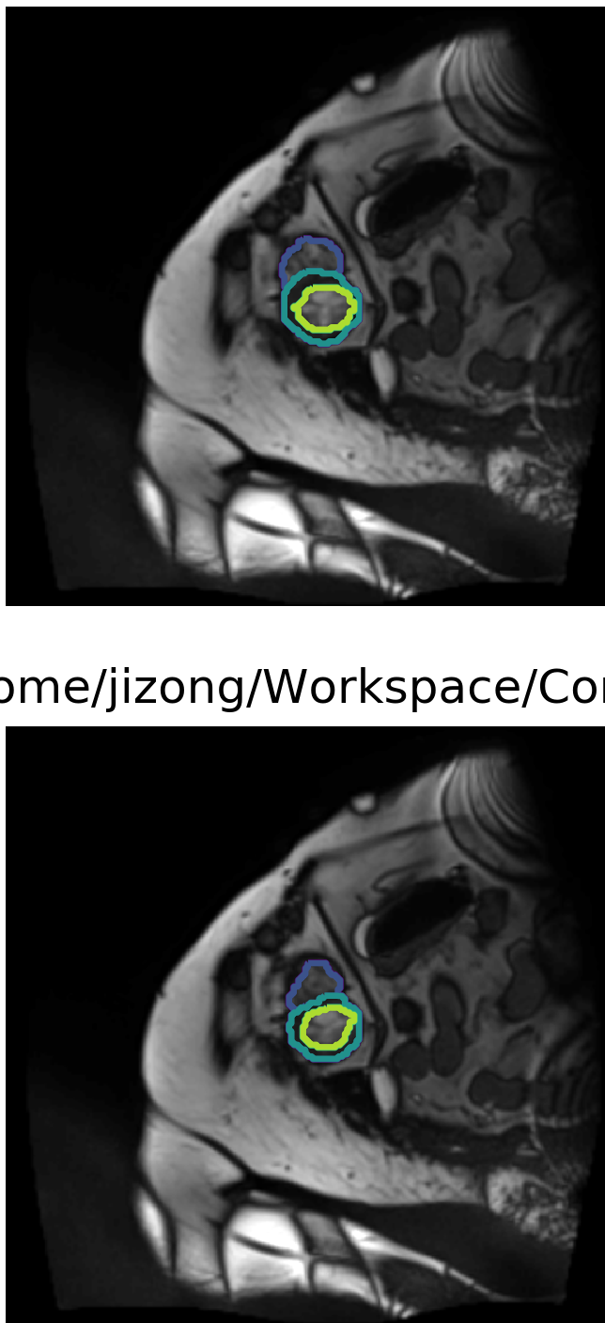
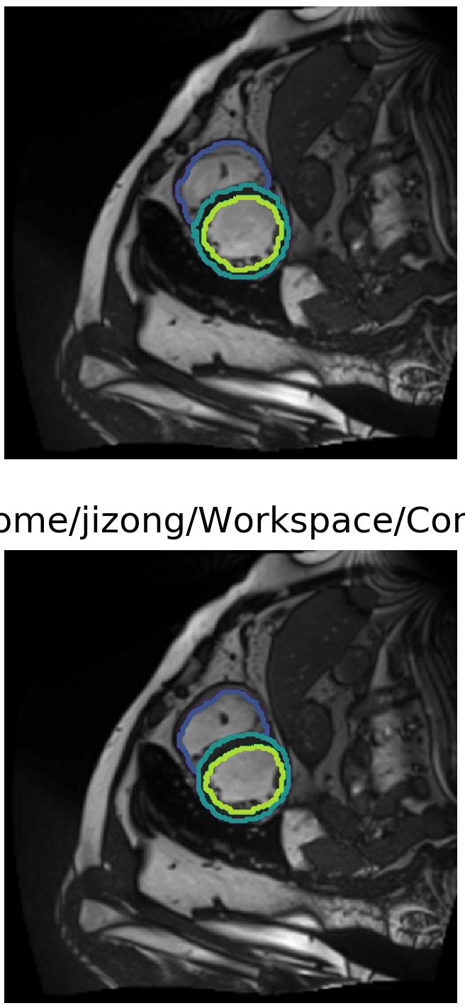
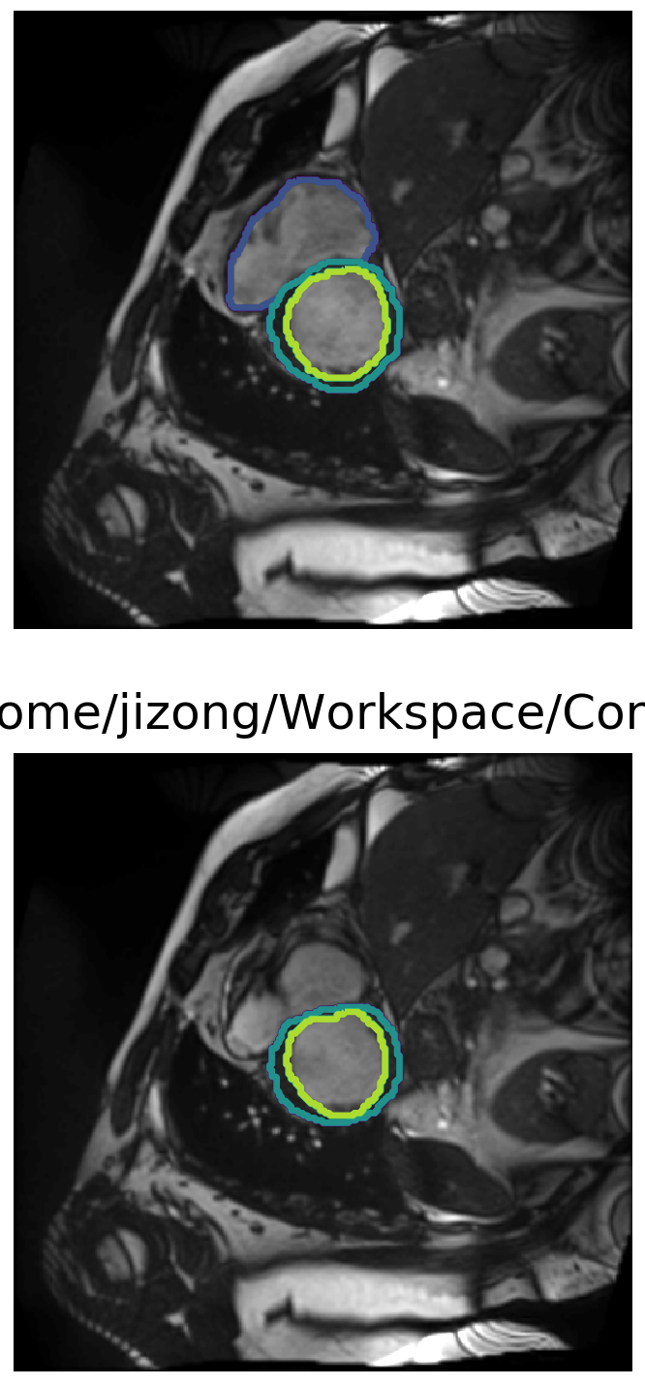
My progress:
1. we use ACDC dataset as the same as theirs.
Patient 1
ED phase
Patient 1
ES phase
Partition1
Partition2
Partition3

Slide 7




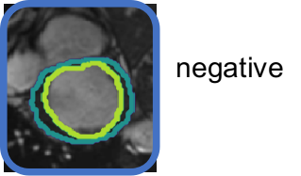
network architecture for IIC + bounding box?
IIC loss
anchor
anchor
IIC loss
IIC loss (discriminator)
From
other
modality
roughly
aligned
images
roughly
aligned
images
e_{anc}
e_{pos}
IIC loss (discriminator)??
negative
no loss here
e_{neg}
Enc_contrast

Slide 8
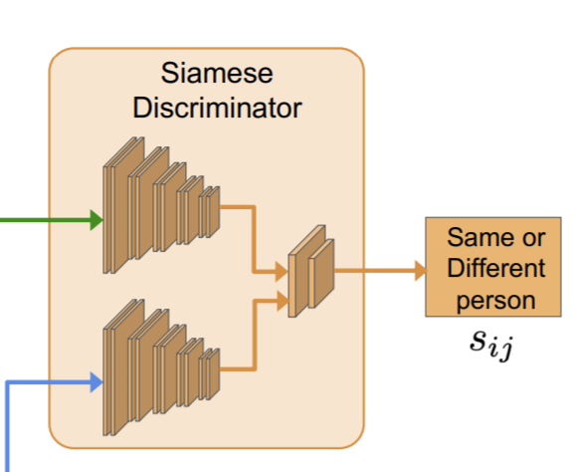
further steps
have a discriminator would help ?
Improve the learning strategy using IIC loss
Compared the different methods in `semi-supervised learning` instead of `pretrain-finetuning`: because

Slide 9
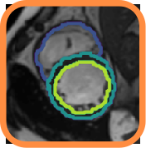





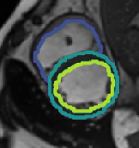
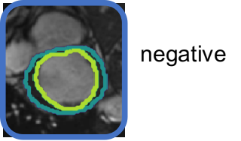
Encoder part
projection
head
e_{anc}
e_{pos}
e_{neg}
positive
Total_loss
normalized features
with reduced dim
p_{anc}
IIC_contrast
p_{pos}
p_{neg}
intemediate
features
projection
classifier

Slide 10
Encoder part
projection
head
e_{anc}
e_{pos}
e_{neg}
positive
Total_loss
normalized features
with reduced dim
p_{anc}
IIC_contrast
p_{pos}
Temperature: T
p_{neg}
num_clusters: N
intemediate
features
projection
classifier

Slide 11
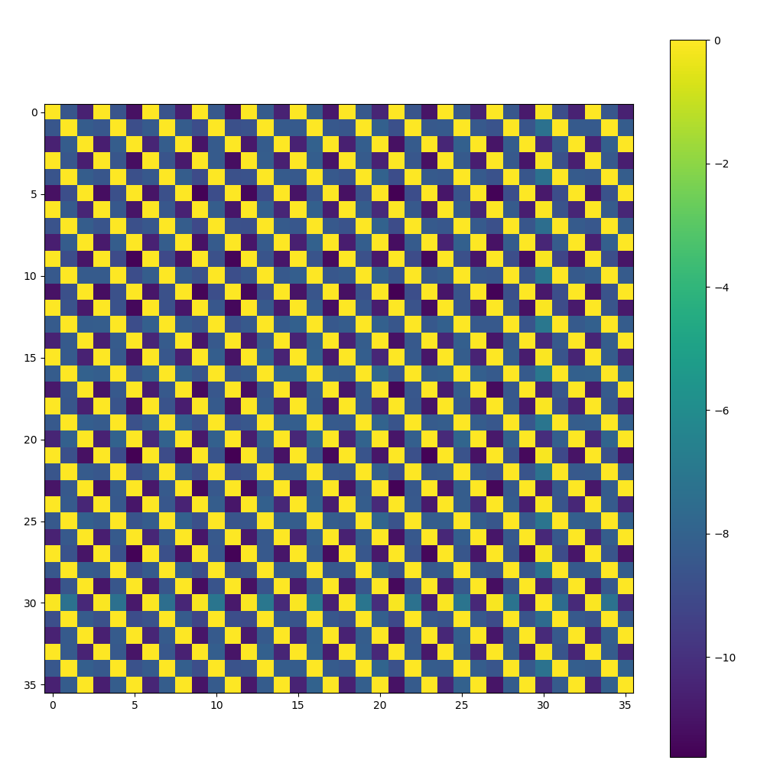
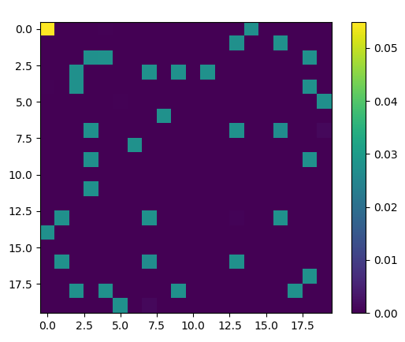
Encoder part
projection
head
e_{anc}
e_{pos}
e_{neg}
positive
normalized features
with reduced dim
p_{anc}
p_{pos}
p_{neg}
intemediate
features
projection
classifier

Slide 12
Encoder part
projection
head
lab_ratio:10% | mean dice
without pretrain | 0.857870738
pretrain using only iic | 0.842051685
pretrain using only contrast | 0.876779139
contrast + 1 * iic | 0.823987424
contrast + 3 * iic | 0.817107697
contrast + 5 * iic | 0.817107697
contrast +10 * iic | 0.797391653
e_{anc}
e_{pos}
e_{neg}
positive
normalized features
with reduced dim
lab_ratio:2% | mean dice
without pretrain | 0.754481554
pretrain using only iic | 0.673764686
pretrain using only contrast | 0.830018699
contrast + 1 * iic | 0.708584825
contrast + 3 * iic | 0.644905031
contrast + 5 * iic | 0.620922685
contrast +10 * iic | 0.645660241
p_{anc}
p_{pos}
p_{neg}
intemediate
features
projection
classifier

Slide 13
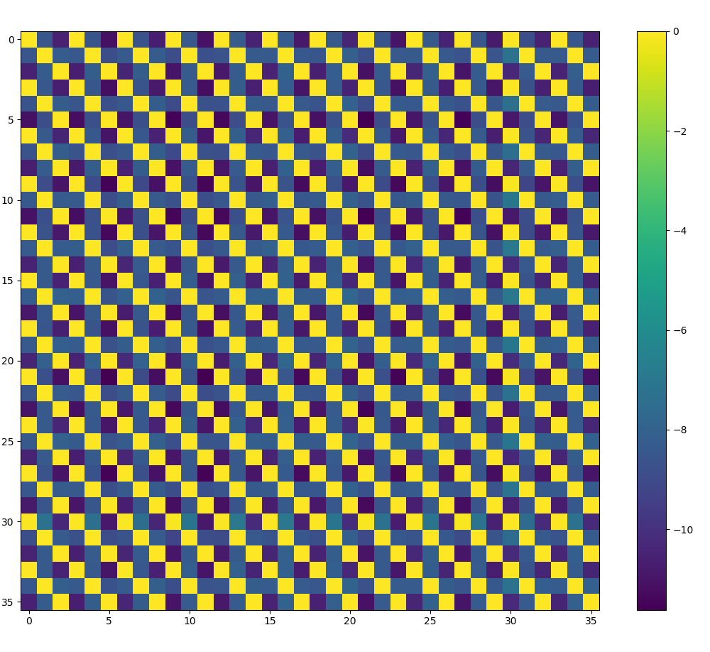
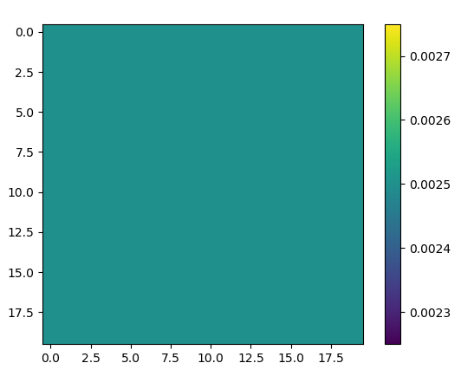
Encoder part
projection
head
lab_ratio:10% | mean dice
without pretrain | 0.857870738
pretrain using only iic | 0.842051685
pretrain using only contrast | 0.876779139
contrast + 1 * iic | 0.823987424
contrast + 3 * iic | 0.817107697
contrast + 5 * iic | 0.817107697
contrast +10 * iic | 0.797391653
e_{anc}
e_{pos}
e_{neg}
positive
normalized features
with reduced dim
p_{anc}
p_{pos}
p_{neg}
intemediate
features
projection
classifier

Slide 14
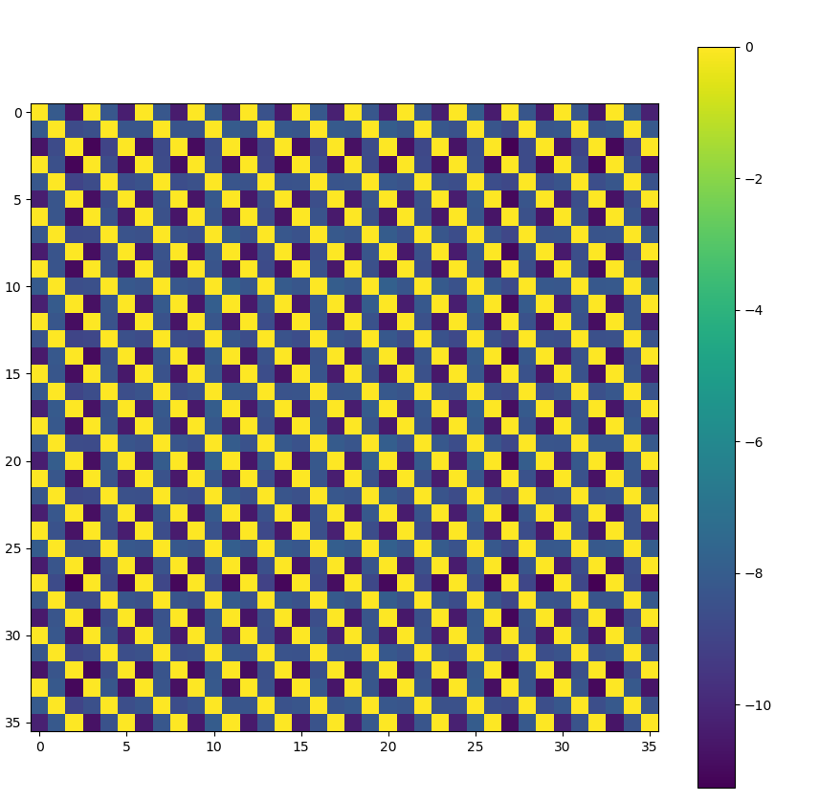
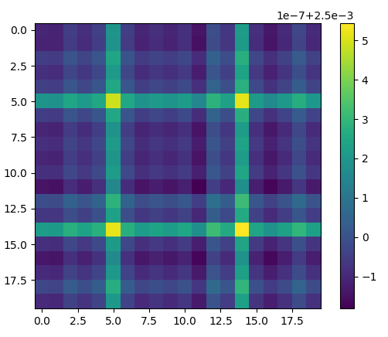
Encoder part
projection
head
lab_ratio:10% | mean dice
without pretrain | 0.857870738
pretrain using only iic | 0.842051685
pretrain using only contrast | 0.876779139
contrast + 1 * iic | 0.823987424
contrast + 3 * iic | 0.817107697
contrast + 5 * iic | 0.817107697
contrast +10 * iic | 0.797391653
e_{anc}
e_{pos}
e_{neg}
positive
normalized features
with reduced dim
p_{anc}
p_{pos}
p_{neg}
intemediate
features
projection
classifier

Slide 15
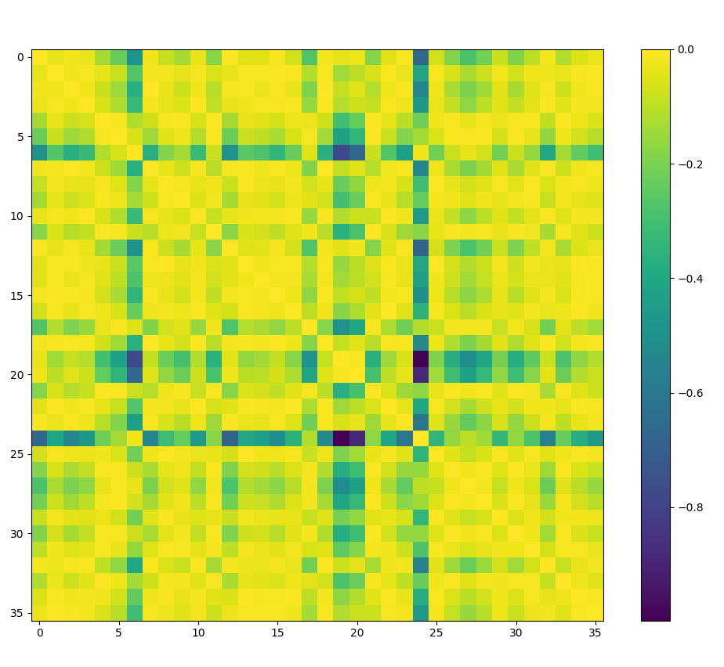
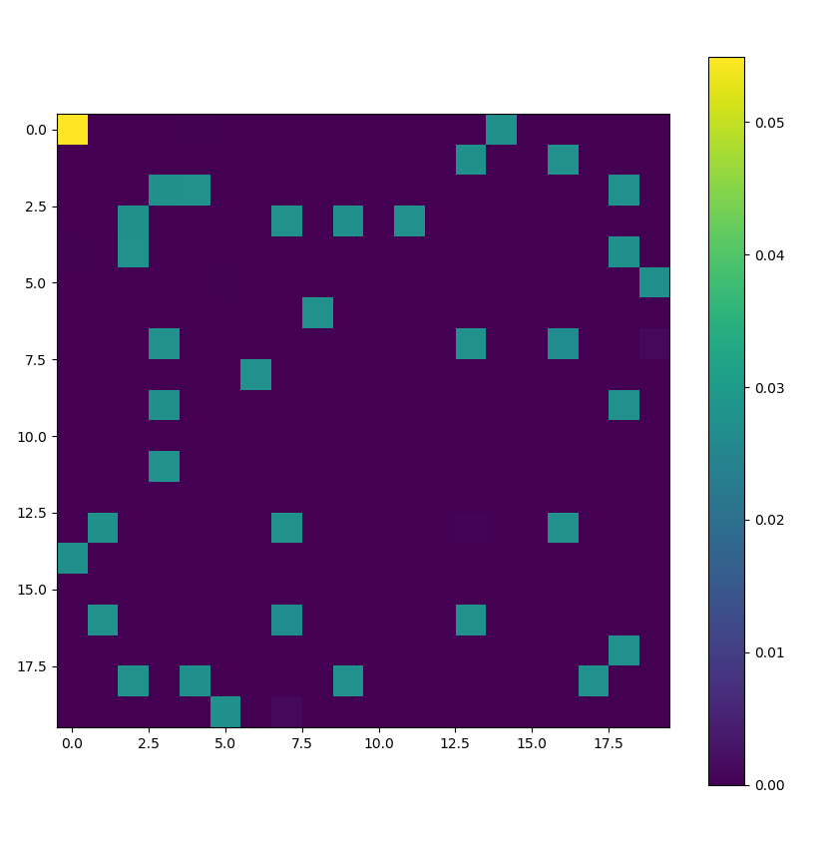
Encoder part
projection
head
lab_ratio:10% | mean dice
without pretrain | 0.857870738
pretrain using only iic | 0.842051685
pretrain using only contrast | 0.876779139
contrast + 1 * iic | 0.823987424
contrast + 3 * iic | 0.817107697
contrast + 5 * iic | 0.817107697
contrast +10 * iic | 0.797391653
e_{anc}
e_{pos}
e_{neg}
positive
normalized features
with reduced dim
p_{anc}
p_{pos}
p_{neg}
intemediate
features
projection
classifier

Slide 16
Conclusion 1
IIC loss in this sense does not do its proper jobs
Possible reasons:
1. temperature to adjust
2. num_clusters to adjust
3. reg_weight to adjust

Slide 17
Conclusion 1 extended
IIC loss in this sense does not do its proper jobs
Possible reasons:
1. temperature to adjust
2. num_clusters to adjust
3. reg_weight to adjust
 | lab_ratio:10% | mean dice
pretrain using only contrast | - | 0.876779139
contrast+5*iic | T=1.0 | 0.803779662
 | T=10 | 0.881362776
 | T=0.1 | 0.818282465
contrast+10*iic | T=1.0 | 0.797391653
 | T=10 | 0.877858798
 | T=0.1 | 0.83264641

Slide 18
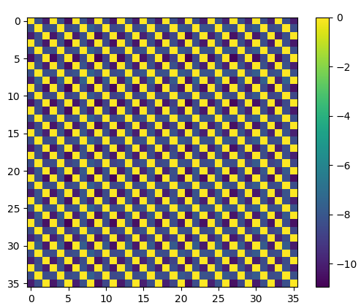
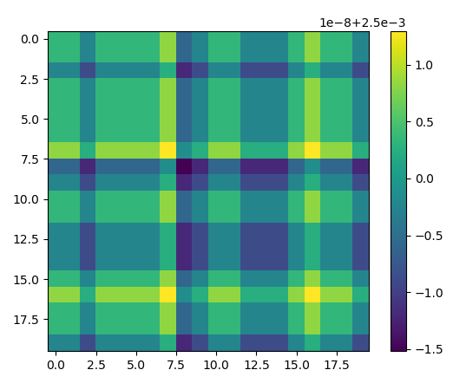
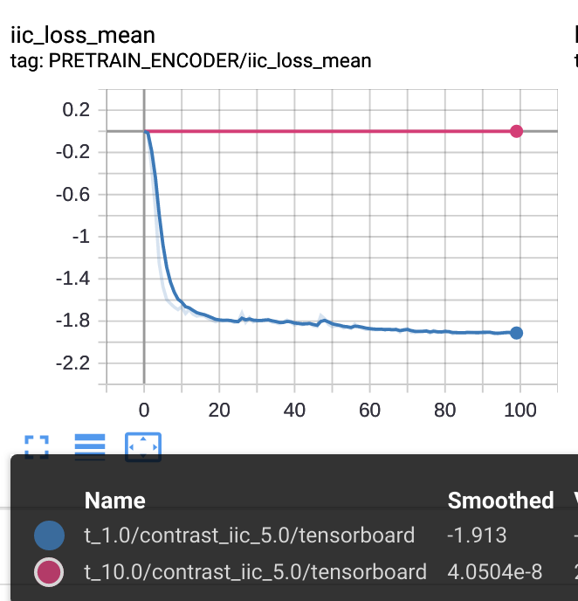
Conclusion 1 extended
IIC loss in this sense does not do its proper jobs
Possible reasons:
1. temperature to adjust
response:
large T works, but the loss did not converge
 | lab_ratio:10% | mean dice
pretrain using only contrast | - | 0.876779139
contrast+5*iic | T=1.0 | 0.803779662
 | T=10 | 0.881362776
 | T=0.1 | 0.818282465
contrast+10*iic | T=1.0 | 0.797391653
 | T=10 | 0.877858798
 | T=0.1 | 0.83264641

Slide 19
Conclusion 1
IIC loss in this sense does not do its proper jobs
Possible reasons:
1. temperature to adjust
2. num_clusters to adjust
response:
N with a larger value is better, but the gap is very large.
 | lab_ratio:10% | mean dice
pretrain using only contrast | - | 0.876779139
contrast+5*iic | N=10 | 0.803779662
 | N=20 | 0.814759254
contrast+10*iic | N=10 | 0.797391653
 | N=20 | 0.81805857

Slide 20
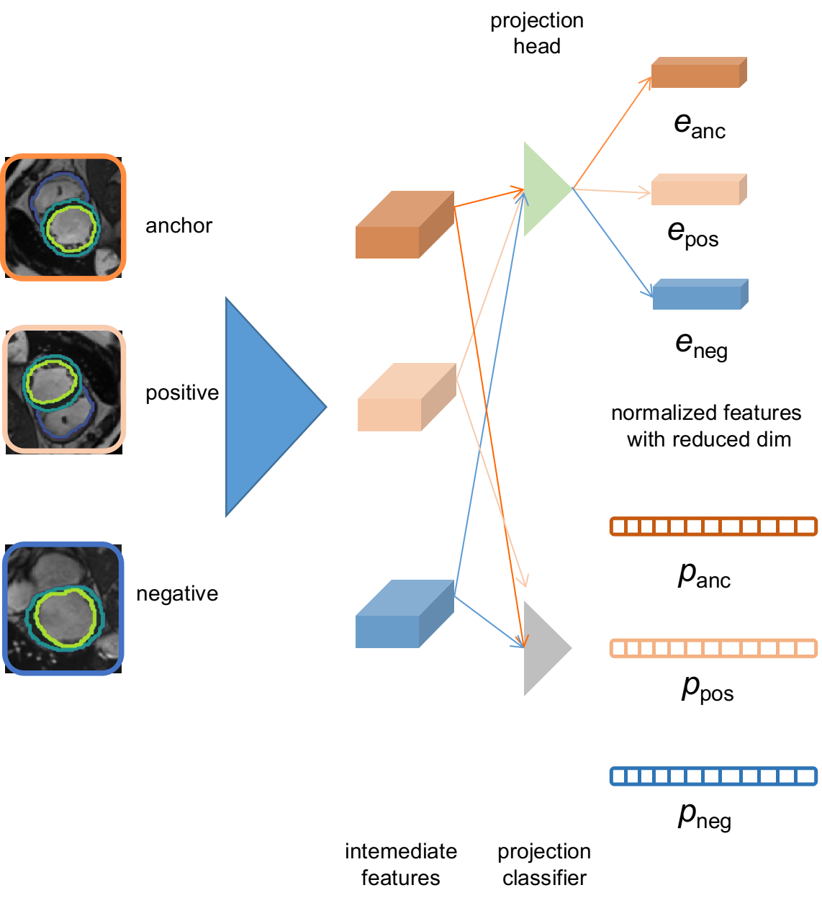
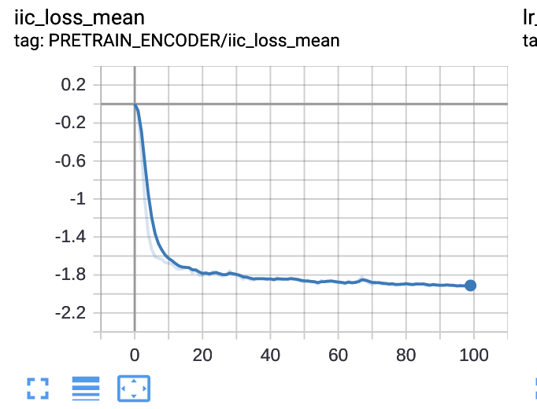
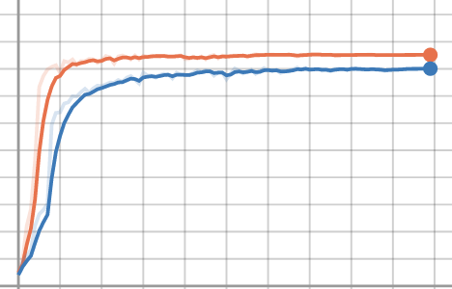
Problems to discuss
Does IIC work in this case?
IIC
baseline
IIC
why?
Augmentation is not enough so that the enc_code
is not scattered
-> try more augmentations

