Slide 1
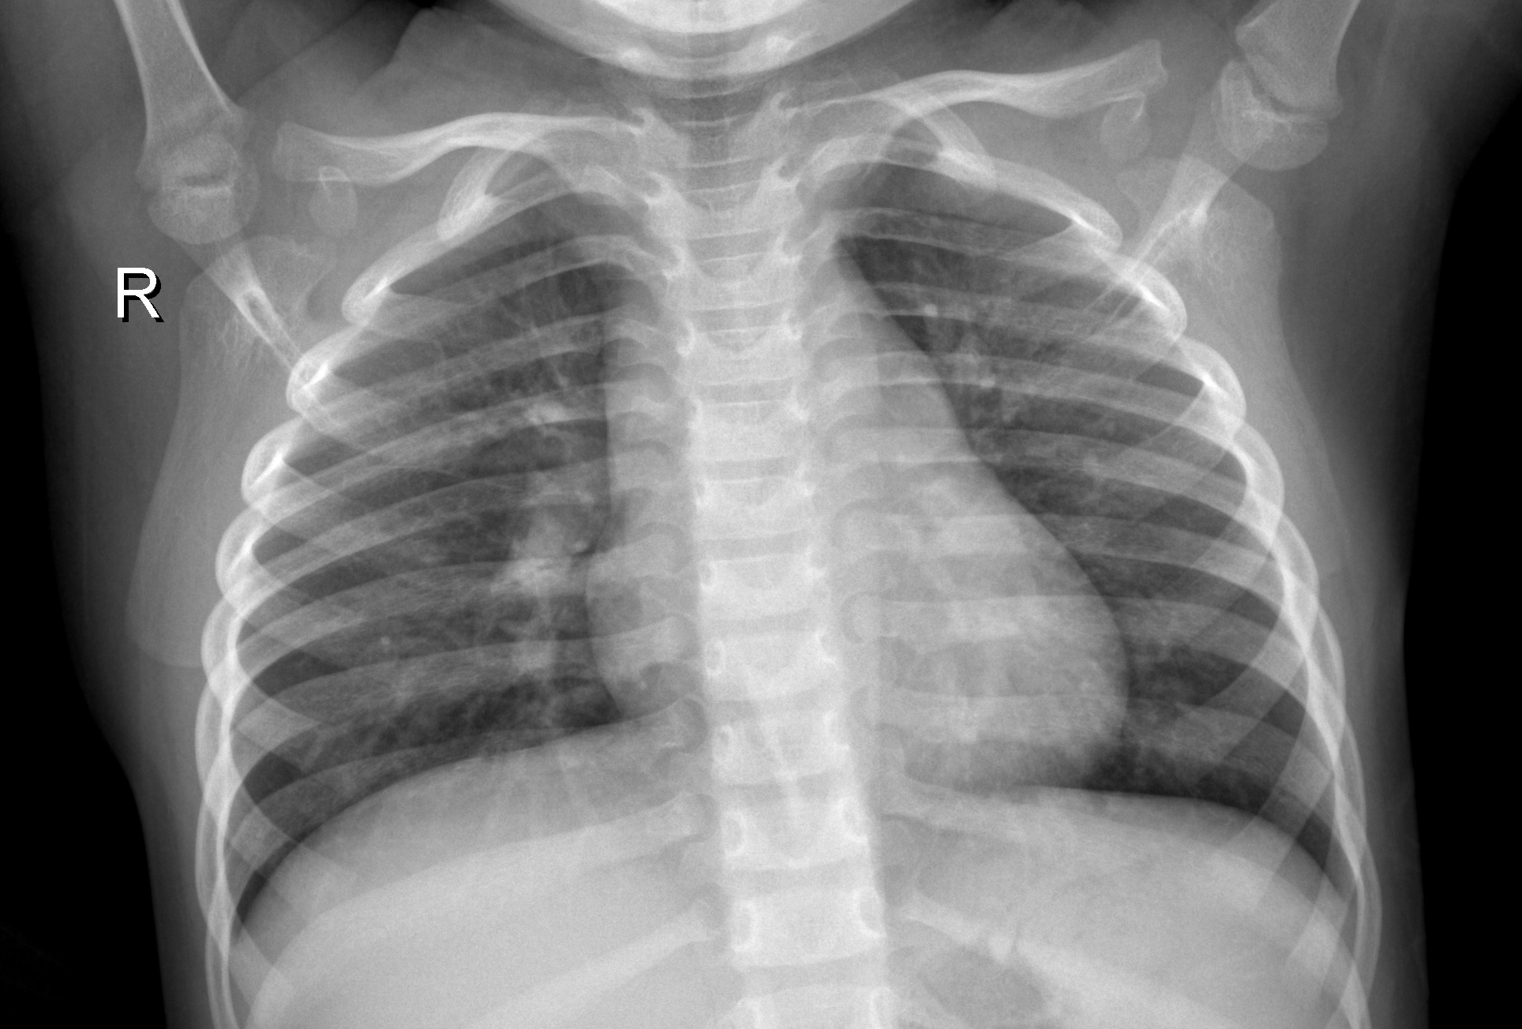
X-Ray Diagnostics: Pediatric Pneumonia
Chest X-Ray Image Classification utilizing Convolutional Neural Networks

Slide 2
What is pneumonia?
“Pneumonia is an infection that inflames [the] lungs' air sacs (alveoli).”
“Pediatric pneumonia is responsible for the deaths of more than 800,000 young children worldwide each year, according to the United Nations Children's Fund (UNICEF).”

Slide 3
What are the symptoms of pneumonia?
Cough (with Possible Greenish, Yellow or Bloody Mucus)
Fever, Sweating and Chills
Rapid, Shallow Breathing
Sharp or Stabbing Chest Pain that Worsens with Deep Breathing or Coughing
Loss of Appetite, Low energy, and Fatigue
Nausea and Vomiting
Confusion
Notes:
“Bacterial pneumonia, which is the most common form, tends to be more serious than other types of pneumonia, with symptoms that require medical care. The symptoms of bacterial pneumonia can develop gradually or suddenly. Fever may rise as high as a dangerous 105 degrees F, with profuse sweating and rapidly increased breathing and pulse rate. Lips and nailbeds may have a bluish color due to lack of oxygen in the blood. A patient's mental state may be confused or delirious.
The symptoms of viral pneumonia usually develop over a period of several days. Early symptoms are similar to influenza symptoms: fever, a dry cough, headache, muscle pain, and weakness. Within a day or two, the symptoms typically get worse, with increasing cough, shortness of breath and muscle pain. There may be a high fever and there may be blueness of the lips.”

Slide 4
How is Pneumonia Diagnosed?
Medical History
Physical Exam
Diagnostic Tests:
Pulse Oximetry
Blood Test
Arterial Blood Gas Test
Bronchoscopy
Pleural Fluid Culture
Scans—
CT Scan
Chest X-Ray
Notes:
In February 2021, the Food and Drug Administration issued an alert on limitations of pulse oximeters. If you have poor circulation, dark skin pigmentation, thick skin, currently use tobacco, your skin temperature is cool, or you are wearing dark fingernail polish, long, artificial nails or if your fingers are not clean, the pulse oximeter may give inaccurate or inconsistent readings. This is why the numbers from a pulse oximeter should not be used in isolation to determine your state of health. It is important to share readings that are abnormal or inconsistent with your healthcare provider.

Slide 5
Problems Diagnosing Pediatric Pneumonia
Pneumonia Symptoms
Pneumonia Diagnosis Process
Asymptomatic
General Symptoms
Sudden Complications
Gradual Development of Infection
Vomiting
Tired/Not Energetic
Fussy/Restless
Sudden Development of Infection
Complex Tests
Invasive Tests
Test Failure
CT Scan
Time for Test Results
Blood Test
Pulse Oximetry
Bronchoscopy
Blood Test

Slide 6
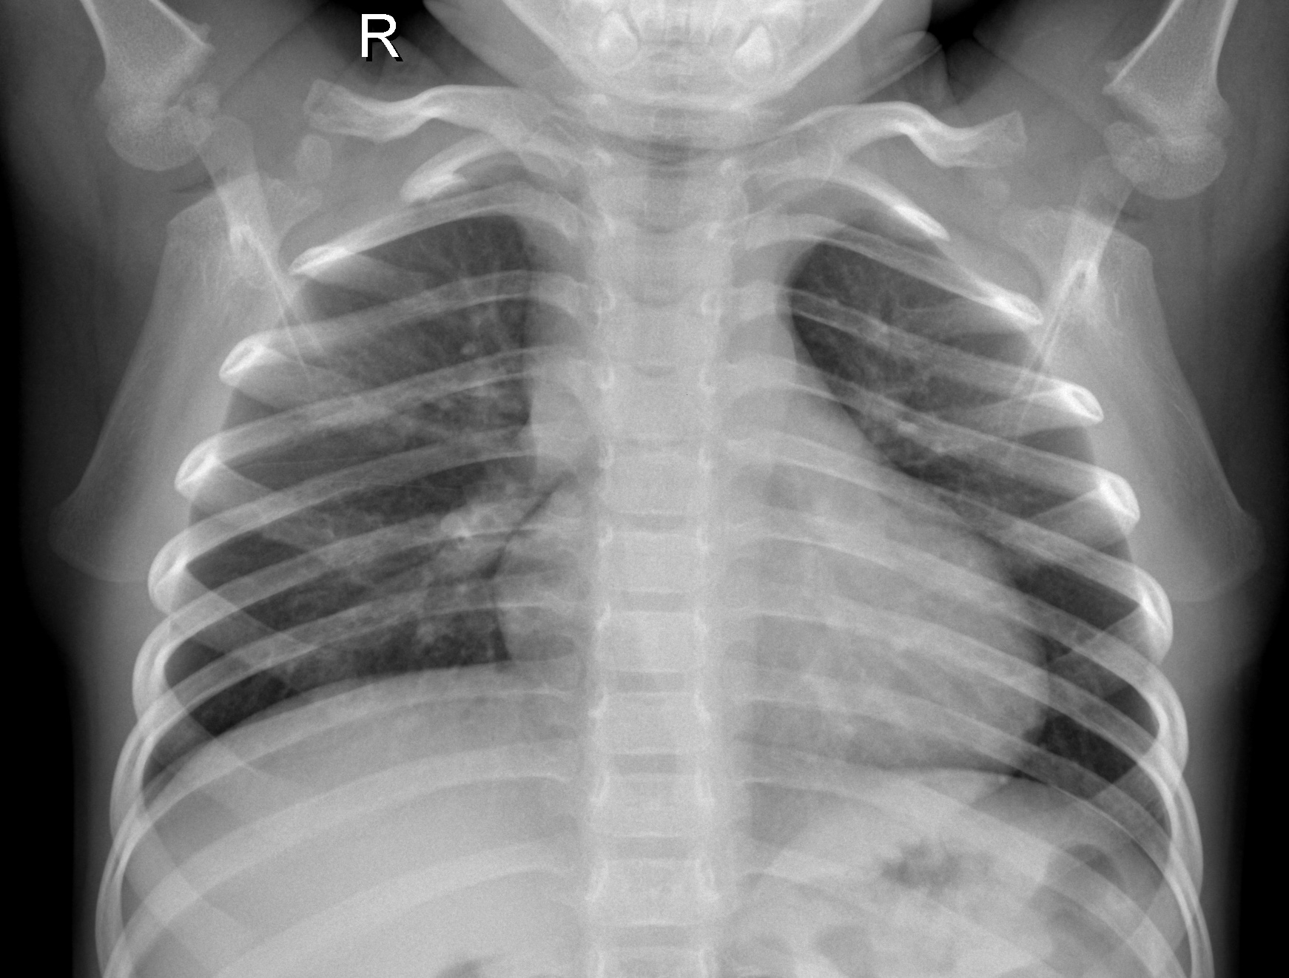
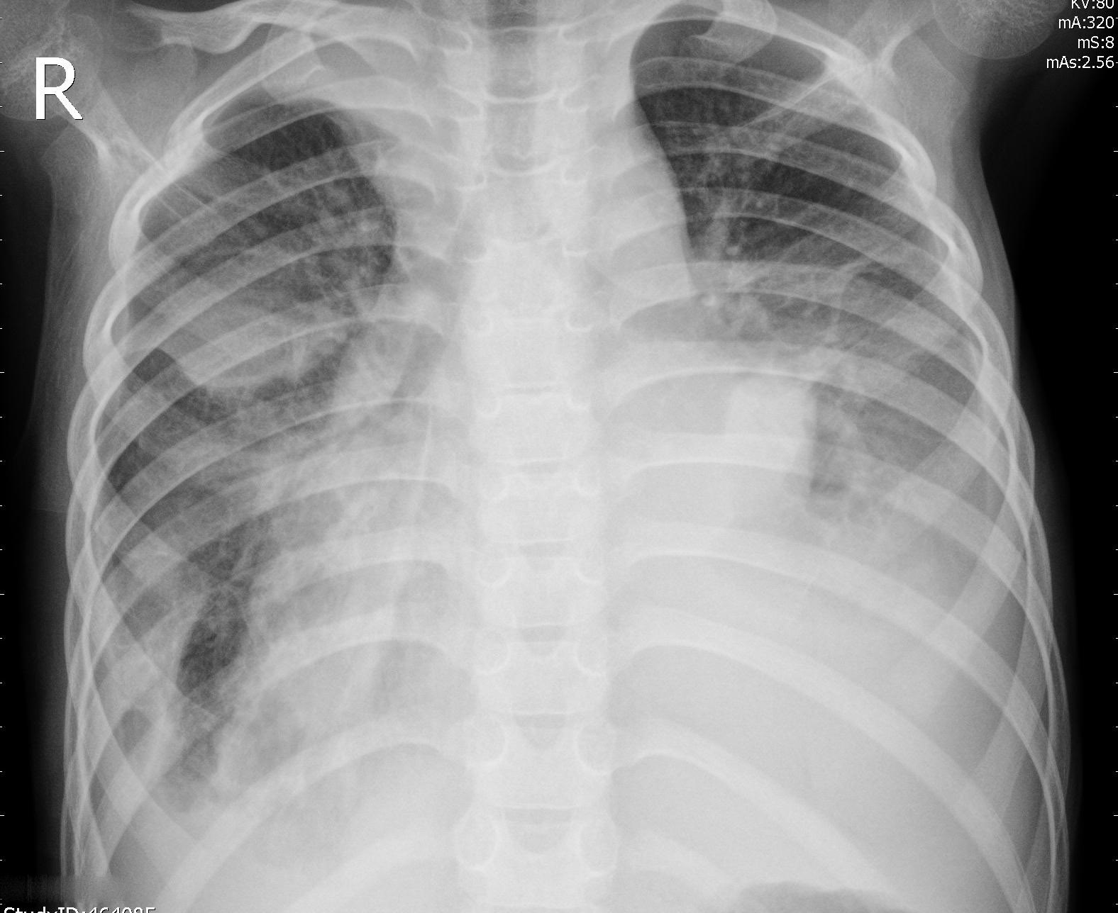
Machine Learning
Raw Data
Obtain data of validated chest x-ray images.
Image Classification
Fit and tune a model to processed data.
Working Model
Use the model to make predictions.

Slide 7
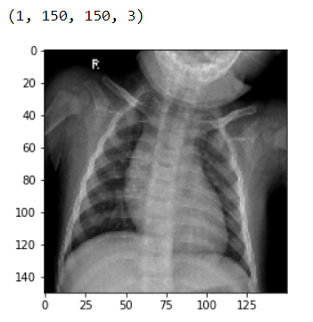
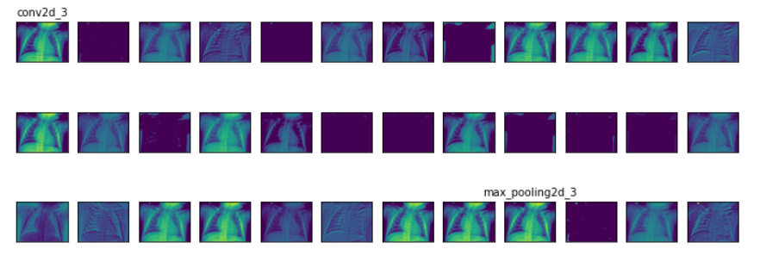
CNN Image Classification Process

Slide 8
The Results
95.4%
90.4%
99.5%
94.7%
Base Deep Neural Network:
Training Data Accuracy
Base Deep Neural Network:
Testing Data Accuracy
Convolutional Neural Network:
Training Data Accuracy
Convolutional Neural Network:
Testing Data Accuracy

Slide 9
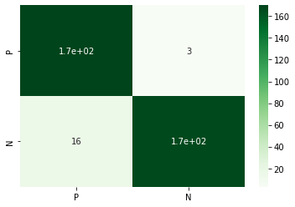
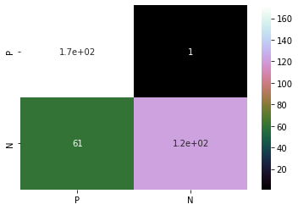
False Normal Rate: 0.57%
True Diagnosis
True Diagnosis
Predicted Diagnosis
Predicted Diagnosis

Slide 10
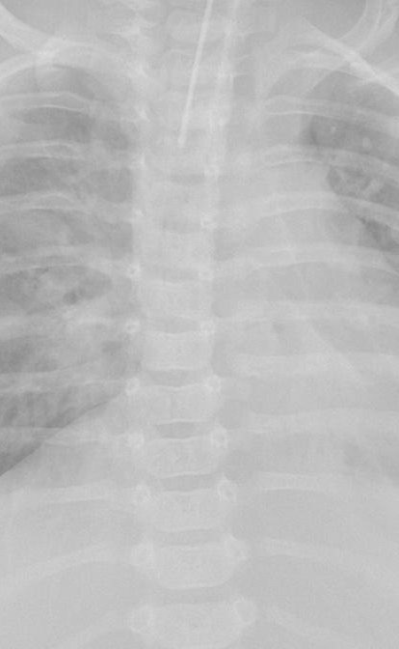
Summary
Use X-Ray Imaging with CNN for quick, accurate, and noninvasive diagnosis.
Future Developments:
Increase Training Data → Increase Accuracy
Further Research on Trends
Build onto Model for Other Applications (COVID)

Slide 11
Thank you
Jessica Yoon
Data Science Student
Flatiron SChool

Slide 12
Bibliography
Kermany D, Goldbaum M, Cai W et al. Identifying Medical Diagnoses and Treatable Diseases by Image-Based Deep Learning. Cell. 2018; 172(5):1122-1131. doi:10.1016/j.cell.2018.02.010.
https://www.lung.org/lung-health-diseases/lung-disease-lookup/pneumonia/symptoms-and-diagnosis?gclid=EAIaIQobChMIstrorKjy8AIVhrjICh2EJwIIEAAYASAAEgKDIvD_BwE
https://www.lung.org/lung-health-diseases/lung-procedures-and-tests/pulse-oximetry
https://emedicine.medscape.com/article/967822-overview

