Slide 1

Waterpoints in Tanzania
Jessica Yoon
Phase 3 Project

Slide 2
Overview
“Tanzania, as a developing country, struggles with providing clean water to its population of over 57,000,000. There are many waterpoints already established in the country, but some are in need of repair while others have failed altogether.”
-drivendata.org
Notes:
A smart understanding of which waterpoints will fail can improve maintenance operations and ensure that clean, potable water is available to communities across Tanzania.
Predict the functionality of waterpoints given variables.

Slide 3
What determines waterpoint functionality?

Slide 4
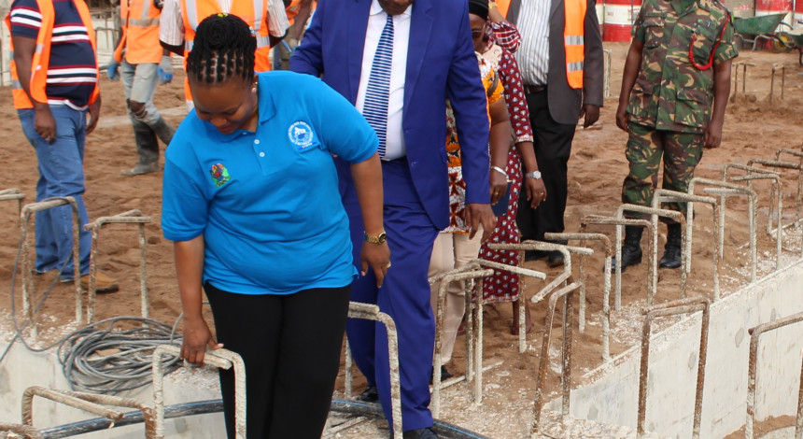
The Data
Notes:
Recorded/Gathered by GeoData Consultants Ltd, 2002-2011

Slide 5
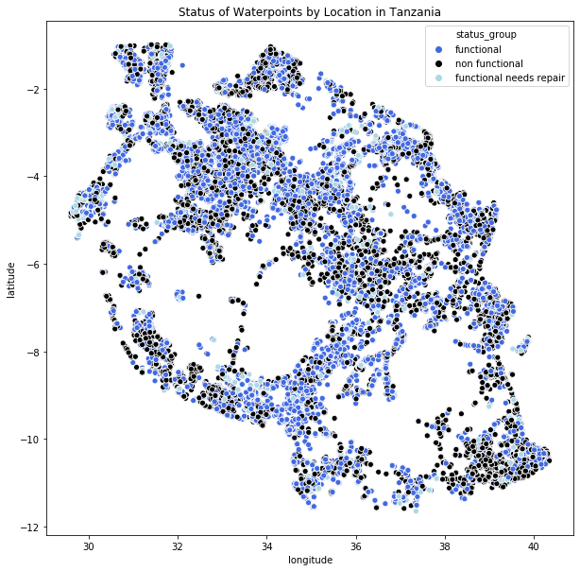


Slide 6
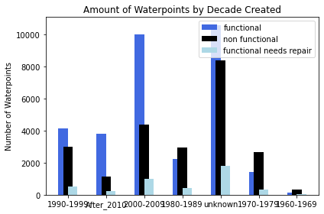
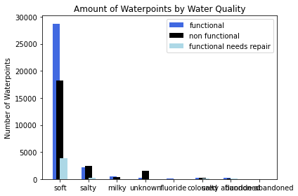
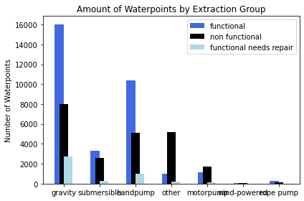
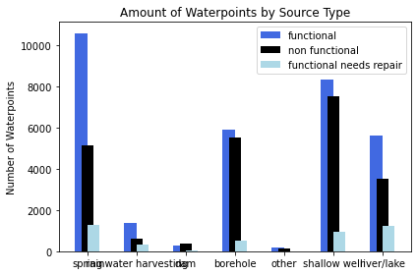
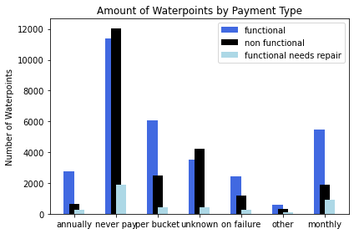
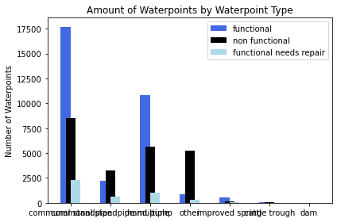
Notes:
Missing: Characteristics of pump itself
Characteristics of environment
-supply
-physical location
-community

Slide 7
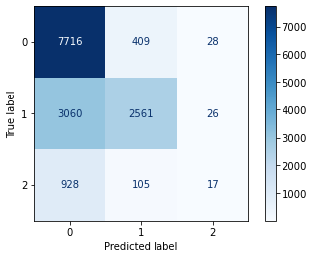
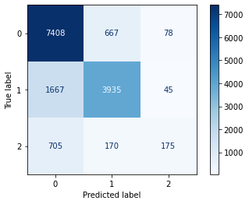
Models
Gaussian Naïve Bayes
XGBoost
Accuracy Score (Train): 68.77% Accuracy Score (Test): 69.32%
Accuracy Score (Train): 78.79% Accuracy Score (Test): 77.56%
Where 0 = Functional, 1 = Nonfunctional, 2=Functional but Needs Repair

Slide 8


Random Forest
Accuracy Score (Train): 80.02% Accuracy Score (Test): 77.72%
Where 0 = Functional, 1 = Nonfunctional, 2=Functional but Needs Repair

Slide 9
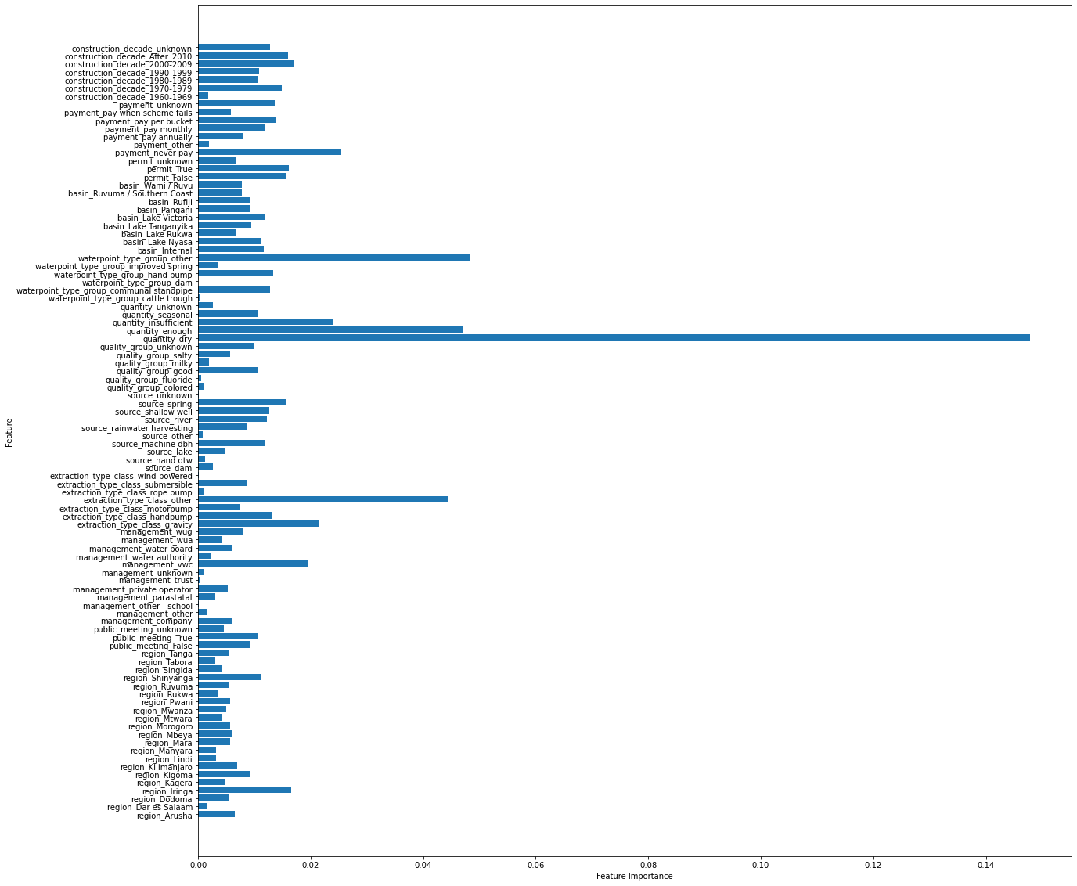
Driving Features
Quantity (dry, enough)
Waterpoint Type (other)
Extraction Type (other)
Payment Type (never pay)
Management (vwc)

Slide 10
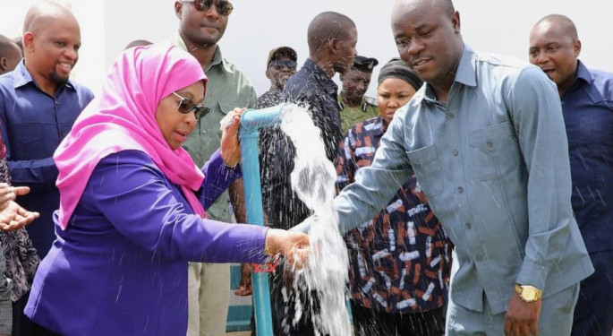

Slide 11

Summary
Resources
Quantity
Characteristics
Waterpoint Type
Extraction Type
Management
Payment Type
Management Group
Notes:
Management KNN for better training data
Data Collection
Education
Maintenance
Stronger Training Data
Other Models

Slide 12

Thank You

