Slide 1

Waterpoints in Tanzania
Jessica Yoon
Phase 3 Project

Slide 2
Overview
Current situation: Many waterpoints already established, but some are in need of repair, while others are not functional.
Tanzania, as a developing country, struggles with providing clean water to its population of over 57,000,000. There are many waterpoints already established in the country, but some are in need of repair while others have failed altogether.
A smart understanding of which waterpoints will fail can improve maintenance operations and ensure that clean, potable water is available to communities across Tanzania.
Predict the functionality of waterpoints given variables.

Slide 3
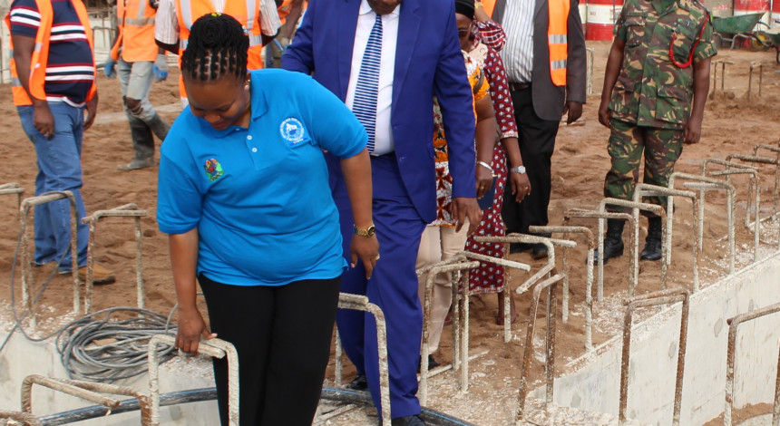
The Data
Notes:
Recorded/Gathered by GeoData Consultants Ltd, 2002-2011

Slide 4
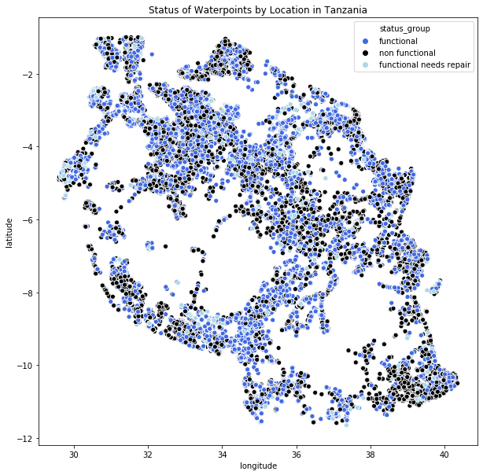


Slide 6
Models

Slide 7


Slide 8
Analysis

Slide 9
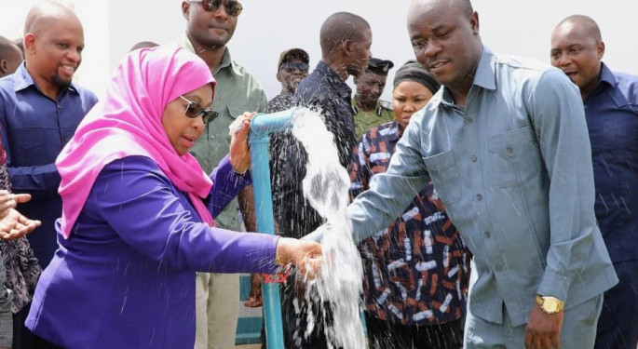

Slide 10

Summary

Slide 11
Asdf
Asdf
asdf

Slide 12

Thank You

