Slide 1

_{Object Oriented Programming} Introduction to Java
Ch. 2
March 4, 2014
Dept. of Software, Gachon University
Ahyoung Choi, Spring

Slide 2
Homework 1
Due date: One week
Programming projects
Submission form: .jar파일 + 소스파일 제출(.java)
Submission site: 레포트 제출실
Requirements
Self-documentation (comment) for your programs
Comment for each class with /** and */.

Slide 3
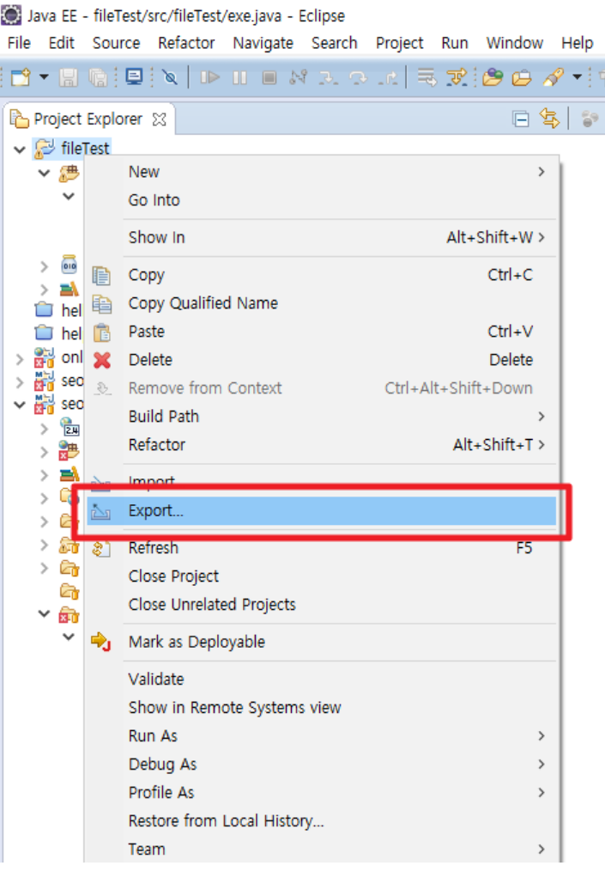
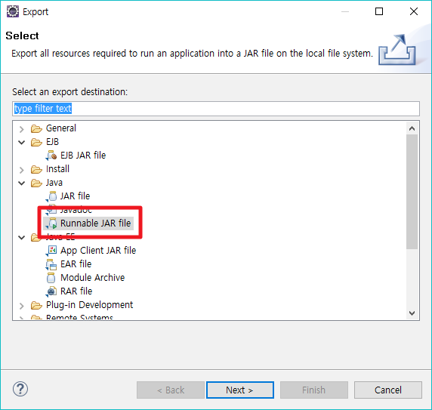
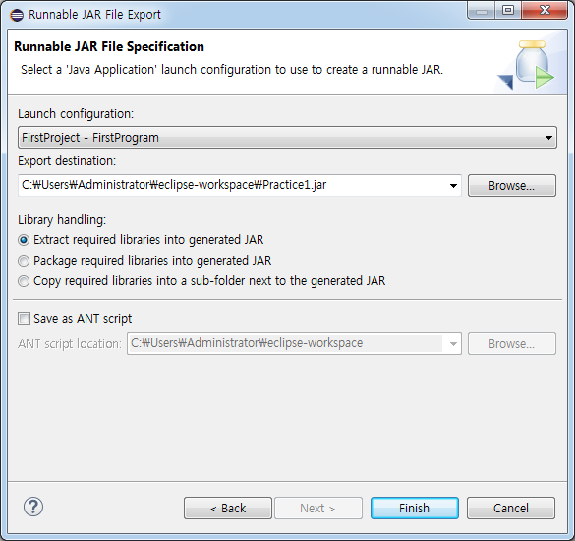
How to make a .jar file
프로젝트 선택
저장 위치 선택
옵션 선택

Slide 4
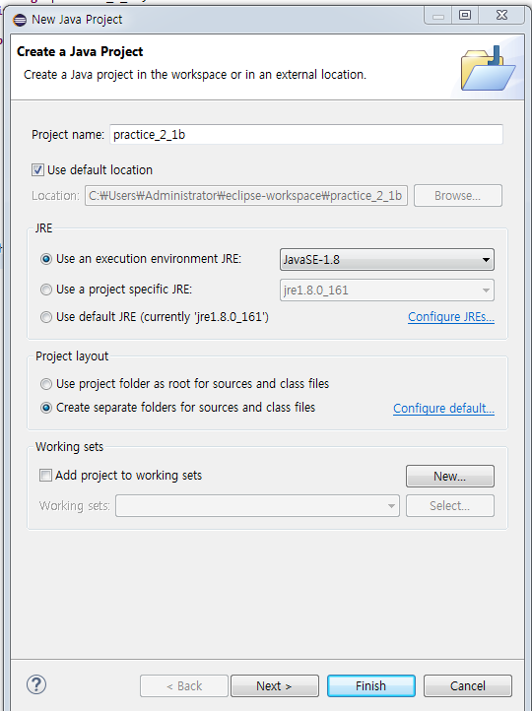
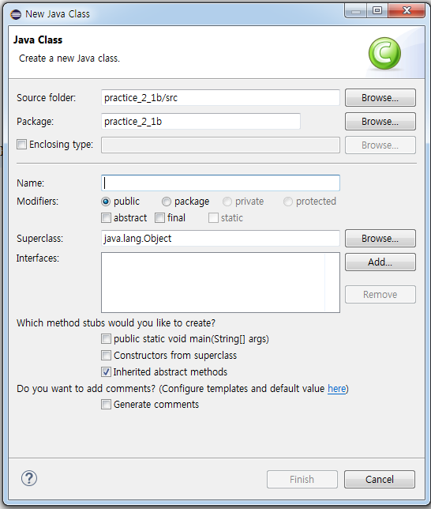
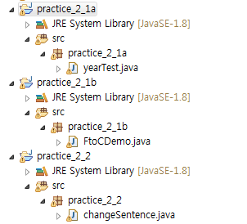
Step 1
문제별로 project를 생성

Slide 5
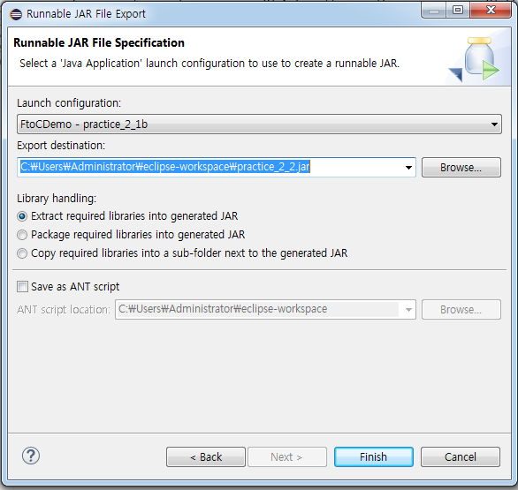

Step 2
문제별로 jar 파일 만들기
Jar 파일들을 압축파일 생성하여 제출

Slide 6
HW 1-3
Practice 2.1-2.3

Slide 7
Practice 2.1
Ex2_1a. Write a following program.
Read a four-digit integer, such as 2017
Display one digit per line, e.g., 2, 0, 1, and 7 in each line
Ex2_1b. Write a following program.
Read a temperature in Fahrenheit
Compute a temperature in Celsius and print it
C = 5 (F - 32) / 9

Slide 8
Practice 2.2
Ex2_2. Write a following program
Read a line of text
Move the first word to the end and capitalize the first character, and then print it
E.g., “Java is the language” → “Is the language Java”

Slide 9
Practice 2.3
Ex2_3a. Write a following program
Read the price of an item in cents: a multiple of 5 between 25 and 100, i.e., 25, 30, …, 95, or 100
Assume you paid a dollar(100 cents), and print the number of quarter (25cents), dime (10 cents), and nickel (5 cents) coins for the change
E.g., for an item of 45 cents, the change is 55 cents, which is given by 2 quarters, 0 dimes, and 1 nickels

Slide 10
HW 1 - 4
Write a program that asks the user to enter his roll number, name, address, and the course he studies. The program should then print the following two lines, with the user’s input replacing the items in italics:
Name has roll no Roll,
his address is address and the course he studies is course
For example, if the user entered Alec Ray as name, 12 as roll number, 10 Down Road as address, and B.S.( Computer Science) as course, then the output would be
Alec Ray has roll no. 12,
his address is 10 Down Road and the course he studies is B.S.( Computer Science).

Slide 11
HW 1 - 6
Write a program that reads a octal number (maximum 3 place) from the keyboard as a string and then converts it into decimal.
For example, if the input is 112, the output should be 74.
(Hint: Break the string into substrings and then convert each substring to a value for a single place. If the values in each place are b₀, b₁, and b₂, the decimal equivalent is 64b₁+ 8b₂+ b₃.).

Slide 12
HW 1 - 8
The Harris-Benedict equation estimates the number of calories your body needs to maintain your weight if you do no exercise. This is called your basal metabolic rate or BMR.
The calories needed for a woman to maintain her weight is:
BMR = 655 + (4.3 * weight in pounds) + (4.7 * height in inches) - (4.7 * age in years)
The calories needed for a man to maintain his weight is:
BMR = 66 + (6.3 * weight in pounds) + (12.9 * height in inches) - (6.8 * age in years)
A typical chocolate bar will contain around 230 calories. Write a program that allows the user to input their weight in pounds, height in inches, and age in years. The program should then output the number of chocolate bars that should be consumed to maintain one’s weight for both a woman and a man of the input weight, height, and age.

