Slide 1

_{Object Oriented Programming} Introduction to Java
Ch. 2. Basic Computation
Primitive Types, Strings and Console I/O
March 4, 2014
Dept. of AI. Software, Gachon University
Ahyoung Choi

Slide 2
Short Review : Class

Slide 3
Concept of Class and Object
“Class” refers to a blueprint. It defines the variables and methods the objects support
“Object” is an instance of a class. Each object has a class which defines its data and behavior

Slide 4
Class Members
A class can have three kinds of members:
fields: data variables which determine the status of the class or an object
methods: executable code of the class built from statements. It allows us to manipulate/change the status of an object or access the value of the data member
(nested classes and nested interfaces)

Slide 5
Sample Class
Sample class
class Pencil {
public String color = “white”;
public int length;
public float diameter;
public static long nextID = 0;
public void setColor (String newColor) {
color = newColor;
}
}

Slide 6
Pencil.java
public class Pencil {
public String color = “white”;
public int length;
public float diameter;
private float price;
public static long nextID = 0;
public void setPrice (float newPrice) {
price = newPrice;
}
public void printPrice () {
System.out.println(price);
}
CreatePencil.java
public class CreatePencil {
public static void main(String args[]){
Pencil p1 = new Pencil();
p1.setPrice(200);
p1.printPrice();
}
}
%> javac Pencil.java
%> javac CreatePencil.java
%> java CreatePencil

Slide 7
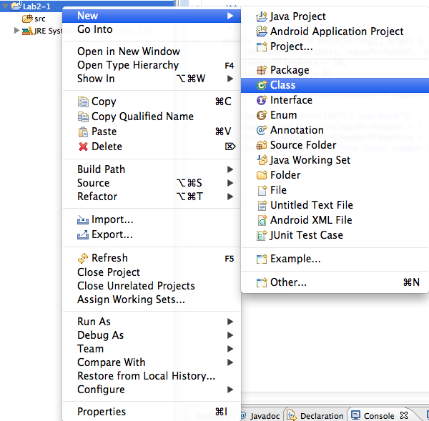
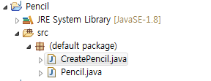
Lab: Pencil
New Java Project
Eclipse [File]-[New]->[Java Project]
Name : Lab2-0
Add Class

Slide 8
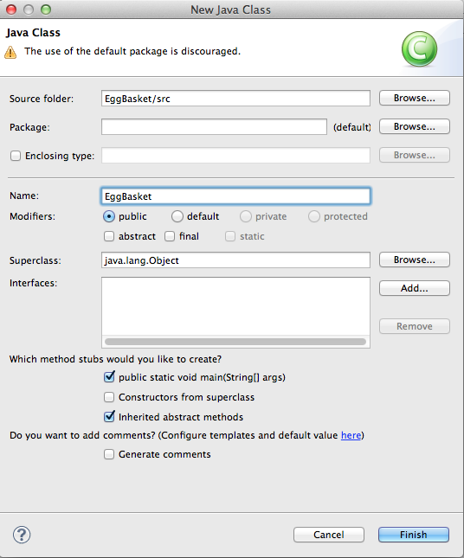
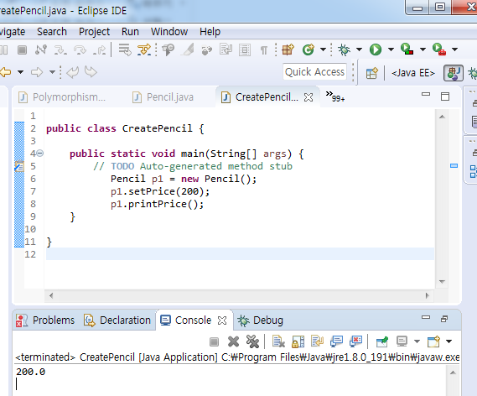
Lab: Pencil
F11
CreatePencil
Output

Slide 9
Outline
Variables and Expressions
The Class String
Keyboard and Screen I/O
Documentation and Style

Slide 10
2.1 Variables and Expressions

Slide 11
Variables
Used to store data in program
Variables store data such as numbers and letters.
Think of them as places to store data.
Correspond to memory locations.
The data stored by a variable is called its value.
The value is stored in the memory location.
Can be changed throughout program

Slide 12
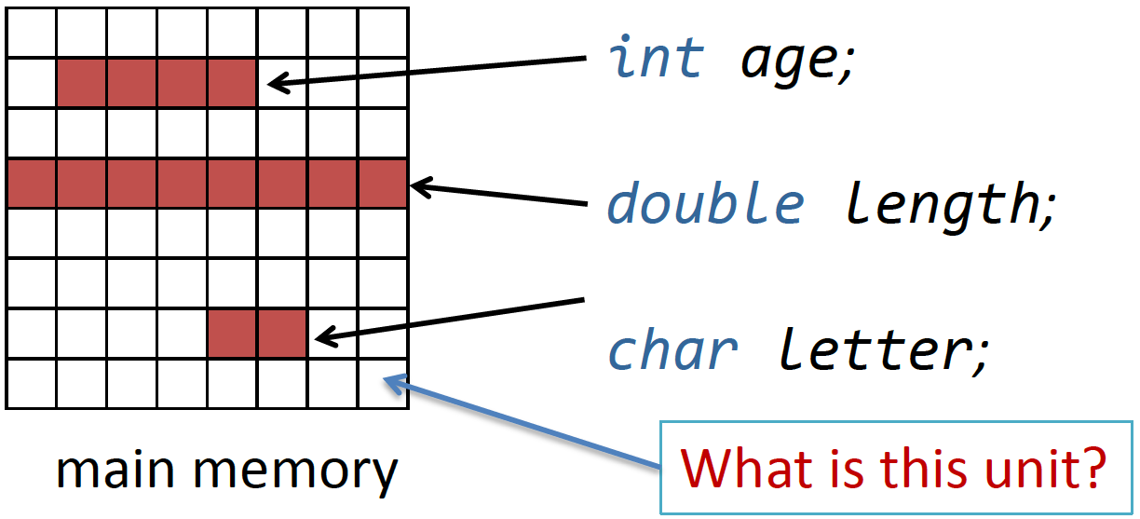
How to use variables
Declare a variable
Assign a value to the variable
Change the value of the variable
When declaring a variable, a certain amount of memory is assigned/allocated based on the declared primitive type

Slide 13
Variable declaration
A variable must be declared before it is used
Choose names that are helpful
such as count or speed, but not c or s.
You provide its type and name.
int numberOfBaskets,eggsPerBasket;
A variable's type determines what kinds of values it can hold (int, double, char, etc.).
A variable must be declared before it is used.

Slide 14
Data Types
A primitive type is used for simple, nondecomposable values such as an individual number or individual character.
int, double, and char are primitive types.
A class type is used for a class of objects and has both data and methods.
"Java is fun" is a value of class type String

Slide 15
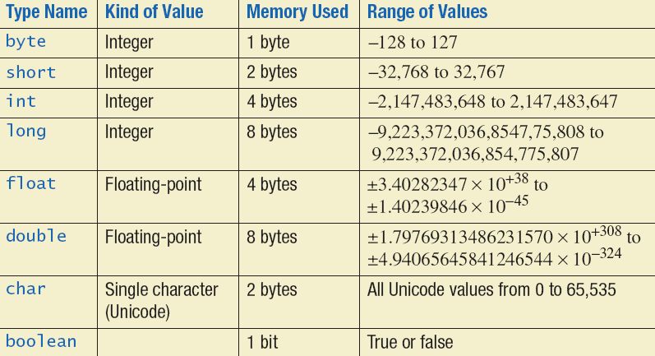
Primitive Types

Slide 16
Examples of Primitive Values
Integer types
0 -1 365 12000
Floating-point types
0.99 -22.8 3.14159 5.0
Character type
'a' 'A' '#' ' '
Boolean type
true false

Slide 17
Variable names
Exp1) No special meaning for it
int a$ ➔ possible
Exp2) javac uses $ in some automatically-generated variable names: for example, this$0 et al are used for the implicit this references from the inner classes to their outer classes.
May contain only
Letters
Digits (0 through 9)
Underscore character (_): Constant or enum (fixed set of constant)
Dollar sign symbol ($)
Cannot have a digit as its first character
Case-sensitive
i.e., stuff, Stuff, and stuFF are all different
Identifiers may not contain any spaces, dots (.), asterisks (*), or other characters:
7-11 netscape.com util.* (not allowed)
e.g.) public enum Type { WALKING, RUNNING, TRACKING, HIKING }

Slide 18
Naming Conventions
Class types begin with an uppercase letter (e.g. String).
Primitive types begin with a lowercase letter (e.g. int).
Variables of both class and primitive types begin with a lowercase letters (e.g. myName, myBalance).
Multiword names are "punctuated" using uppercase letters.
E.g., numberOfEggs, pricePerBasket

Slide 19
Keywords or Reserved Words
Words such as if are called keywords or reserved words and have special, predefined meanings.
Cannot be used as identifiers.
See Appendix 1 for a complete list of Java keywords.
Example keywords: int, public, if, class, return …

Slide 20
Where to Declare Variables
Declare a variable
1. Just before it is used or
2. At the beginning of the section of your program that is enclosed in {}.
public static void main(String[] args)
{ /* declare variables here */ . . . }

Slide 21
Initializing Variables
A variable that has been declared, but no yet given a value is said to be uninitialized.
Uninitialized class variables have the value null.
Uninitialized primitive variables may have a default value.
Examples:
int count = 0; char grade = 'A';
String flightNumber = “KE101”;

Slide 22
Lab: Variables
View sample program listing 2.1
New Java Project
Eclipse [File]-[New]->[Java Project]
Name : Lab2-1
Add Class

Slide 23
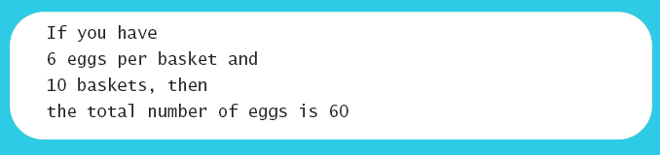
Lab: Variables
View sample program listing 2.1
Class EggBasket

Slide 24
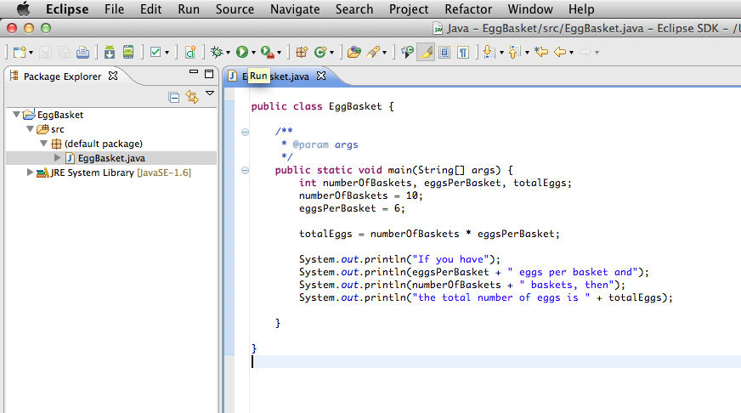
Lab: Execute / Run!
Change the variable values and check the output

Slide 25
Variables and Values
Variables (int)
numberOfBaskets
eggsPerBasket
totalEggs
Assigning values
eggsPerBasket = 6;
eggsPerBasket = eggsPerBasket - 2;

Slide 26
Assignment Statements
Assignment evaluation
The expression on the right-hand side of the assignment operator (=) is evaluated first
The result is used to set the value of the variable on the left-hand side of the assignment operator
Examples:
score = numberOfCards + handicap;
eggsPerBasket = eggsPerBasket - 2;

Slide 27
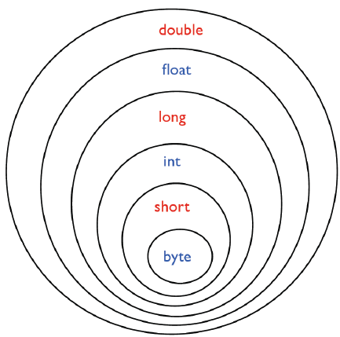
Assignment Compatibilities
A value of one type can be assigned to a variable of any type further to the right
byte --> short --> int --> long
--> float --> double
Some examples
myShort = myInt; (wrong!)
myByte = myLong; (wrong!)
myFloat = myByte; (Right)
myLong = myInt; (Right)

Slide 28
Assignment compatibility
Java is said to be strongly typed
Conversions between numbers are possible, but you can’t assign a floating point value to an integer variable
double Variable = 7;
int Variable = 3.5; (✗)
How to solve this? Type casting
You can ask the computer to change the type of values which are against the compatibility
myInt = 9.8d; (✗)
myInt = (int)9.8d; (ok)

Slide 29
Simple Input
Sometimes the data needed for a computation are obtained from the user at run time.
Keyboard input requires
import java.util.Scanner
at the beginning of the file.

Slide 30
Simple Input
Data can be entered from the keyboard using Scanner keyboard =
new Scanner(System.in);
followed, for example, by
eggsPerBasket = keyboard.nextInt();
which reads one int value from the keyboard and assigns it to eggsPerBasket.

Slide 31
Simple Screen Output
System.out.println("The count is " + count);
Outputs the sting literal "the count is "
Followed by the current value of the variable count.

Slide 32
Constants
2, 3.7, or 'y' are called constants.
Integer constants can be preceded by a + or - sign.
Example
5 is an integer constant (Default type)
5L is a long constant
5.0 is a double constant (Default type)
5.0f is a float constant

Slide 33
Named Constants
Java provides mechanism to …
Define a variable
Initialize it
Fix the value so it cannot be changed
public static final Type Variable = Constant;
Example
public static final double PI = 3.14159;

Slide 34
e Notation
Floating-point constants can be written
With digits after a decimal point or
Using e notation.
e notation is also called scientific notation or floating-point notation.
Examples
865000000.0 can be written as 8.65e8
0.000483 can be written as 4.83e-4

Slide 35
Arithmetic Operators
Arithmetic expressions can be formed using the +, -, *, and / operators together with variables or numbers referred to as operands.
If any operand is of float-point type, so is the result
hoursWorked * payRate
// 40(int) * 8.25 (double) ➔ 500.0(double)
Expressions with two or more operators can be viewed as a series of steps
balance + (balance * rate)

Slide 36
Division and modulo operator
Division operator (/) behaves as expected if one of the operands is a floating-point type.
e.g, 99/100 has a value of 0.
When both operands are integer types, the result is truncated, not rounded.
The mod (%) operator is used with operators of integer type to obtain the remainder after integer division.
e.g. 14 % 4 is equal to 2
Typical usage
Determining if an integer is odd or even
Determining if one integer is evenly divisible by another integer.

Slide 37
Increment/Decrement Operators
To increase (or decrease) the value of a variable by 1
count++ or ++count // increment operator
count-- or --count // decrement operator
After executing
int m = 4; int result = 3 * (++m);
result has a value of 15 and m has a value of 5
After executing
int m = 4; int result = 3 * (m++);
result has a value of 12 and m has a value of 5

Slide 38
Specialized Assignment Operators
Assignment operators can be combined with arithmetic operators (including -, *, /, and %).
Two assignments below yield the same result
amount = amount + 5;
amount += 5;

Slide 39
Parentheses() and Precedence
Parentheses determine the order in which arithmetic operations are performed
Examples:
(cost + tax) * discount
cost + (tax * discount)
Without parentheses, an expression is evaluated according to the rules of precedence

Slide 40
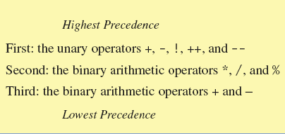
Precedence Rules
When binary operators have equal precedence, the operator on the left acts before the operator(s) on the right.

Slide 41
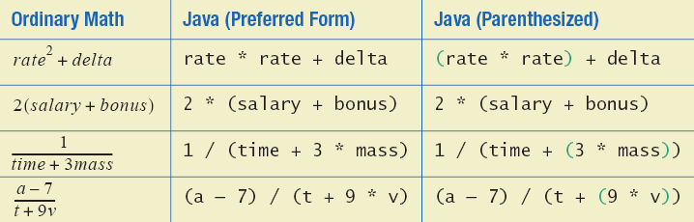
Sample Expressions
Figure 2.3 Some Arithmetic Expressions in Java

Slide 42
Practice 2.1
Ex2_1a. Write a following program.
Read a four-digit integer, such as 2017
Display one digit per line, e.g., 2, 0, 1, and 7 in each line
Ex2_1b. Write a following program.
Read a temperature in Fahrenheit
Compute a temperature in Celsius and print it
C = 5 (F - 32) / 9

Slide 43
2.2 The CLASS String

Slide 44
Strings
A value of type String is a sequence of characters
E.g., “Hello out there.”
No primitive type for strings in Java
Instead, Java provides a class called String

Slide 45
Class String
We've used constants of type String already.
Declaration
String greeting; greeting = "Hello!";
String greeting = "Hello!";
String greeting = new String("Hello!");
Print
System.out.println("Hello!");
System.out.println(greeting);

Slide 46
Concatenation of Strings
Two strings are concatenated using the + operator.
String greeting = "Hello";
String sentence;
sentence = greeting + " officer";
System.out.println(sentence);
Any number of strings can be concatenated using the + operator.
System.out.println("Good " + "morning, " + "Vietnam!");
When concatenating with the values of other types, they are first converted to String values
int result = 42; System.out.println("The answer is " + result);

Slide 47
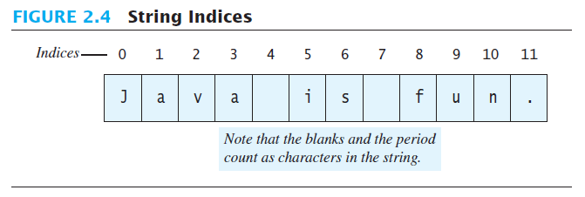
String Indices
Figure 2.4
Positions start with 0, not 1.
The 'J' in "Java is fun." is in position 0
A position is referred to an index.
The 'f' in "Java is fun." is at index 8.

Slide 48
String methods
How to obtain the length of a string ?
String greeting = "Hello";
System.out.println( strlen(greeting)) ??

Slide 49
String methods
An object of the String class stores data consisting of a sequence of characters.
Each object has methods as well as data
The length() method returns the number of characters in a particular String object.
object
String greeting = "Hello"; int n = greeting.length();
method

Slide 50
Method length()
Returns an int value indicating the number of characters in a String object
Can be used anywhere an int can be used
int count = command.length();
System.out.println("Length is " + command.length());
count = command.length() + 3;

Slide 51
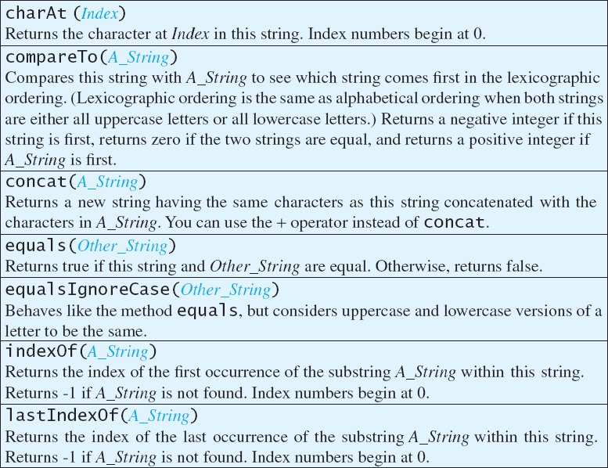
String Methods
String a = "Hello Java";
char k = a.charAt(0);
String a = “apple";
String b=“bear”;
System.out.println(a.comparTo(b));
String result = a.concat(b);
String a = "Hello";
String b=“hello”;
System.out.println(a.equals(b));
System.out.println(a.eaualsIgnoreCase(b));
String a = "Hello Java";
System.out.println(a.indexOf("Java"));
String a = “2018-03-12";
int index1= a.indexOf(“-");
int index2= a.lastIndexOf(“-");

Slide 52
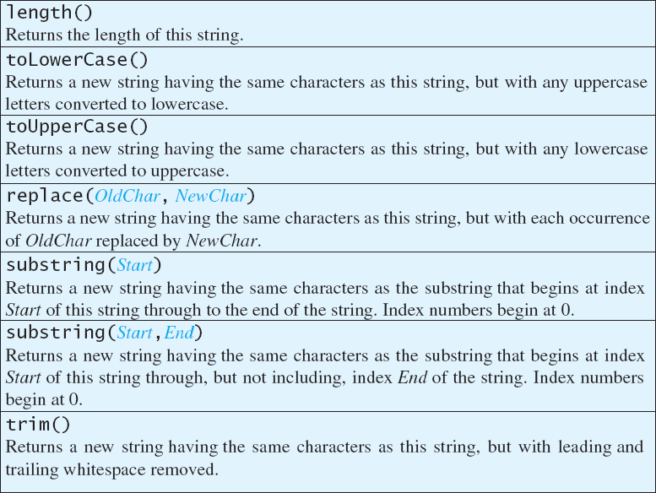
String Methods
String a = "Hello Java";
int num = a.length();
String a = “hello";
String b= a.toUpperCase();
String c=a.substring(0,1).toUpperCase();
String a = “hello";
String b = a.replace(“e”,”a”);
String a = “hello";
String b = a.substring(0,3);
String c = a.substring(1);
String a = “ hello ";
String b = a.trim();

Slide 53
Escape Characters
How would you print
"Java" refers to a language. ?
We would write:
System.out.println(""Java" refers to a language."); (✗)
System.out.println("\"Java\" refers to a language."); (ok)
Compiler is told that quotation marks (") do not signal the start or end of a string, but instead are to be printed

Slide 54
Escape Characters
Each escape sequence is a single character even though it is written with two symbols.

Slide 55
Examples
abc\def
System.out.println("abc\\def");
System.out.println("new\nline");
char singleQuote = '\'';
System.out.println(singleQuote);
new
line
'

Slide 56
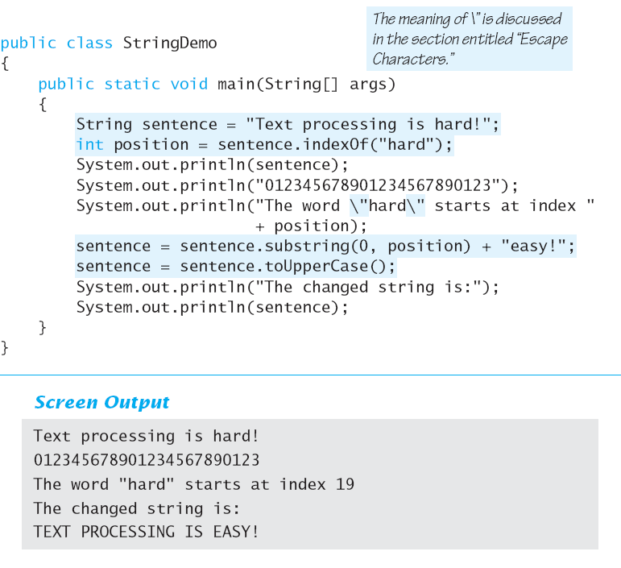
Lab: String processing
Make a program to get the following result
hard 문자를 easy로 대체 후
대문자로 출력

Slide 57
Lab: String processing

Slide 58
Unicode Character Set
Most programming languages use the ASCII character set.
Java uses the Unicode character set which includes the ASCII character set.
The Unicode character set includes characters from many different alphabets.
Unicode vs ASCII
ASCII defines 128 characters, uses 7 bits to represent a character.
Unicode defines (less than) 2²¹characters

Slide 59
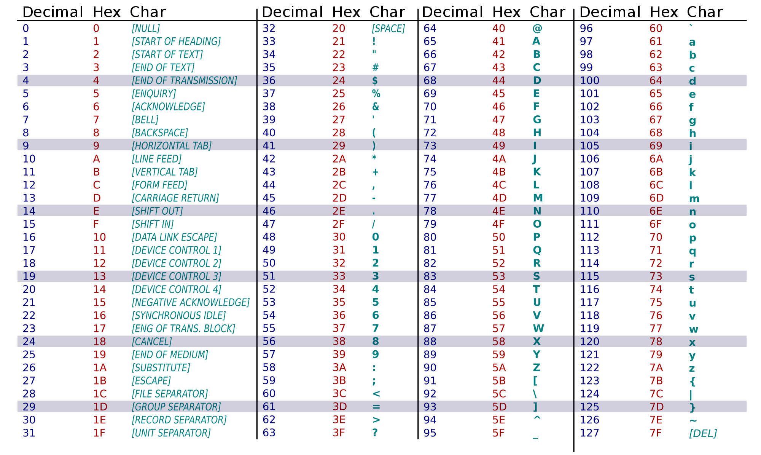
ASCII table

Slide 60
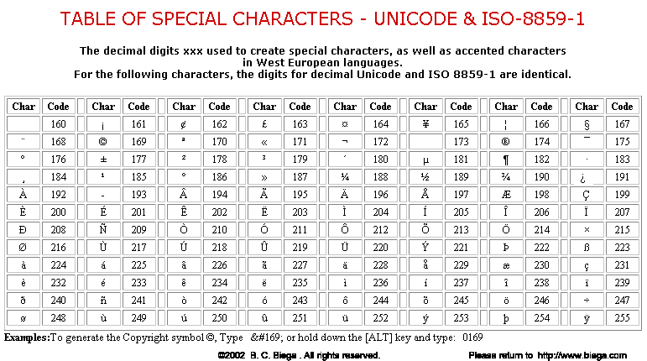
Unicode table

Slide 61
String memory size?
Memory usage of Java objects
Object header: 8 bytes of housekeeping data recording an object's class, ID and status flags
Memory for primitive fields: e.g. int 4 byte
Memory for reference fields: 4 byte each
Padding up to multiply 8
E.g. an object with a two long fields, three int fields and a boolean (40 byte)
8 bytes for the header;
16 bytes for the 2 longs (8 byte each);
12 bytes for the 3 ints (4 byte each);
1 byte for the boolean;
a further 3 bytes of padding (to make 40, a multiple of 8)

Slide 62
String memory size?
Memory usage of String objects
“String” consists of more than one object
“Char” take up two bytes
A String contains the following:
a char array containing the actual characters;
int for the cached calculation of the hash code.
(not in Java 8) offset into the array at which the string starts;
(not in Java 8) the length of the string;
E.g. Empty char array: 40 byte
8 bytes: Object header
4 byte: Memory for reference fields
12 byte: three int field (hash code)
12 byte: char array(assume 3) +length (int, 4 byte)
4 byte: padding
Minimum memory usage of a Java String
8 * (int) ((((no chars) * 2) + 45) / 8)

Slide 63
2.3 Keyboard and Screen I/O

Slide 64
System class
A static variable is common to all the instances (or objects) of the class because it is a class level variable.
Only a single copy of static variable is created and shared among all the instances of the class.
Facilities provided by System
Standard output
Error output streams
Standard input and access to externally defined properties and environment variables.
A means of loading files and libraries
It cannot be instantiated ➔ defined with “static”
Field definition | Explanation
static PrintStream err | This is the "standard" error output stream.
static InputStream in | This is the "standard" input stream.
static PrintStream out | This is the "standard" output stream.

Slide 65
Screen Output
We've seen several examples of screen output.
System.out is an object that is part of Java.
println() is one of the methods of the System.out object.
Concatenation operator (+) is useful
System.out.println("Lucky number = " + 13 + " Secret number = " + number);
Alternatively, use print()
System.out.print("One, two,");
System.out.print(" buckle my shoe.");
System.out.println(" shut the door.");
ending with a println().

Slide 66
Keyboard Input
Java 5.0 has reasonable facilities for handling keyboard input.
These facilities are provided by the Scanner class in the java.util package.
A package is a library of classes.

Slide 67
Using the Scanner Class
Near the beginning of your program, insert
import java.util.Scanner;
Create an object of the Scanner class
Scanner keyboard =
new Scanner (System.in)
Read data (an int or a double, for example)
int n1 = keyboard.nextInt();
double d1 = keyboard.nextDouble();

Slide 68
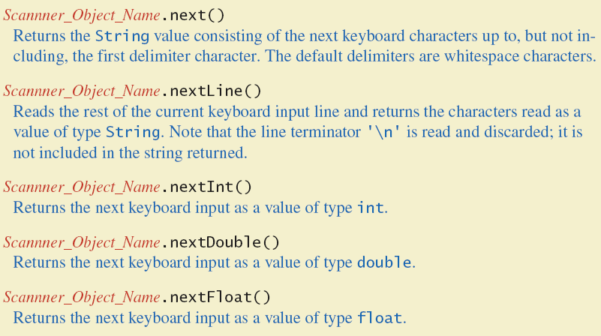
Scanner method

Slide 69
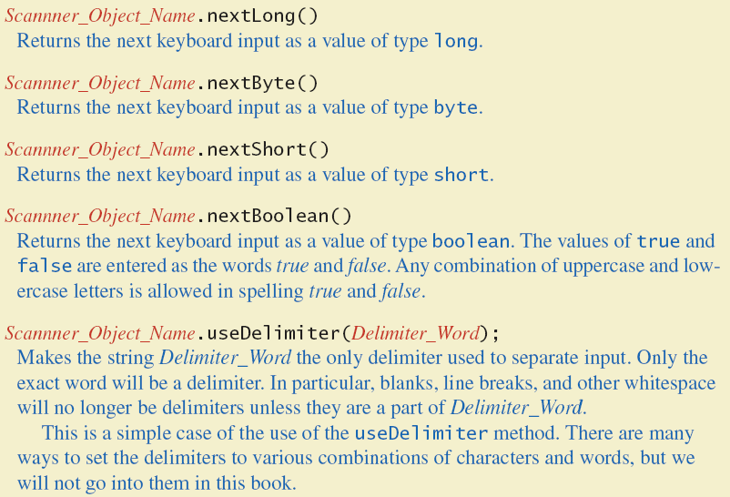
Scanner method

Slide 70
Scanner methods
Scanner methods
nextDouble() – reads one double value from keyboard
double d1 = keyboard.nextDouble();
next() – reads one word from keyboard
String s1 = keyboard.next();
nextLine() – reads an entire line
reads the remainder of the current line, even if it is empty.
String s2 = keyboard.nextLine();

Slide 71
Lab: Keyboard Input Demonstration
View sample program class ScannerDemo, listing 2.5

Slide 72
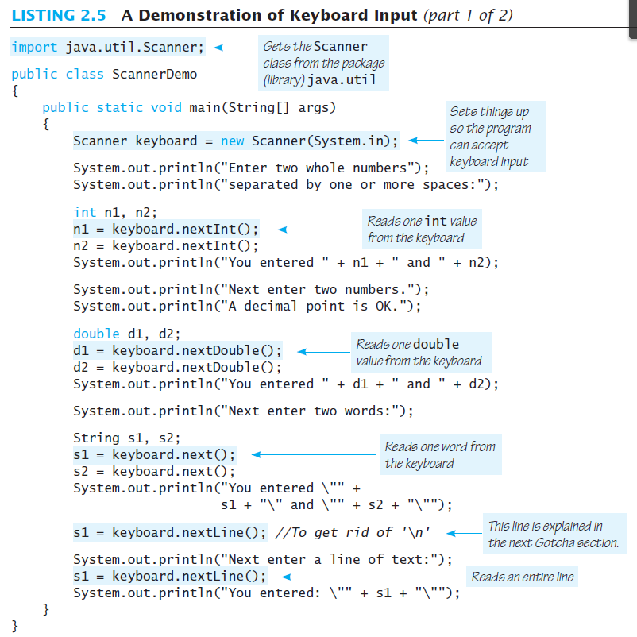

Slide 73
Practice 2.2
Ex2_2. Write a following program
Read a line of text
Move the first word to the end and capitalize the first character, and then print it
E.g., “Java is the language” → “Is the language Java”

Slide 74
2.4 Documentation and Style

Slide 75
Documentation and Style
Most programs are modified over time to respond to new requirements.
Programs which are easy to read and understand are easy to modify.
The best programs are self-documenting.
Clean style
Well-chosen names

Slide 76
Meaningful Variable Names
Observe conventions in choosing names for variables.
Use only letters and digits.
"Punctuate" using uppercase letters at word boundaries (e.g. taxRate).
Start variables with lowercase letters.
Start class names with uppercase letters.

Slide 77
Comments
Written into a program as needed for self-explanation and ignored by the compiler.
A single line comment starts with //
double radius; // in centimeters
A multi-line comment begins with /* and end with */
/* This program should only be used on alternate Thursdays */
A javadoc comment begins with /** and ends with */
Extracted automatically from Java software
/** method change requires the number of coins to be non-negative */

Slide 78
When to Use Comments
Begin each program file with an explanatory comment
What the program does
The name of the author
Contact information for the author
Date of the last modification.
Provide only those comments which the expected reader of the program file will need in order to understand it.

Slide 79
Indentation
Indentation should communicate nesting clearly
Proper indentation helps communicate to the human reader the nested structures of the program
A good choice is four spaces for each level of indentation. (You simply use [TAB] key.)
Indentation does not change the behavior of the program.

Slide 80
Using Named Constants
static? (고정된, 정적인)
Get memory only once in the class area at the time of class loading
Use to refer to the common property of all objects
final?
Define an entity that can only be assigned once.
Once the value of a constant is set,
it can be used throughout the program.
area = PI * radius * radius;
is clearer than
area = 3.14159 * radius * radius;
Place constants near the beginning of the program.
public static final double INTEREST_RATE = 6.65;
public static final String MOTTO = "The customer is always right.";
By convention, uppercase letters are used for constants.

Slide 81
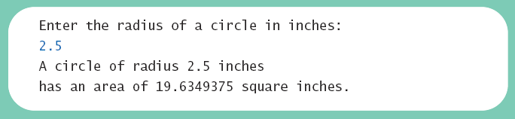
Lab: Named Constants
View sample program class CircleCalculation2, listing 2.8

Slide 82
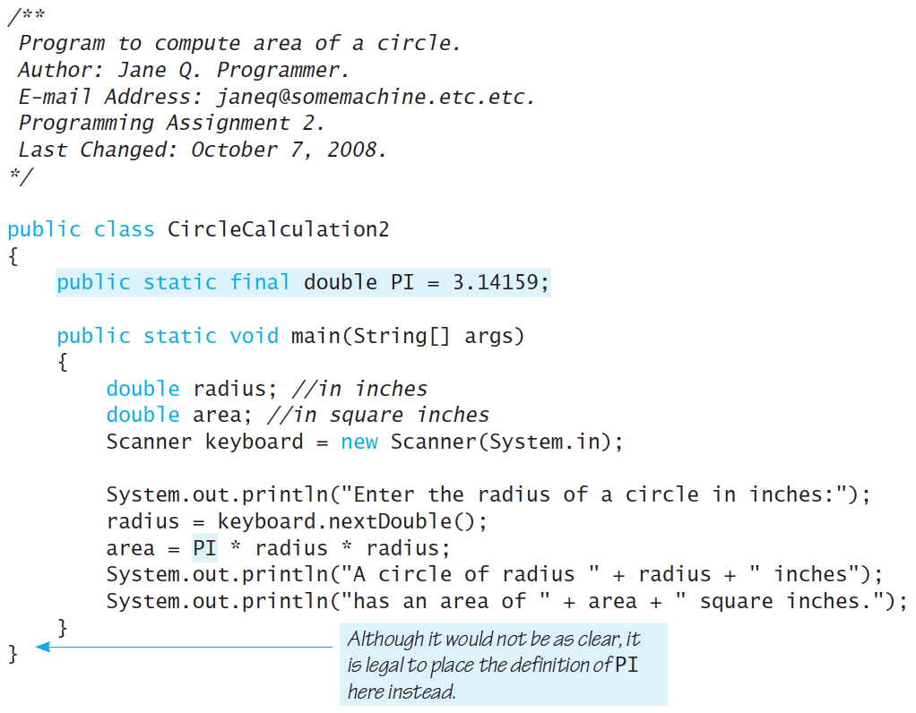

Slide 83
Practice 2.3
Ex2_3a. Write a following program
Read the price of an item in cents: a multiple of 5 between 25 and 100, i.e., 25, 30, …, 95, or 100
Assume you paid a dollar(100 cents), and print the number of quarter (25cents), dime (10 cents), and nickel (5 cents) coins for the change
E.g., for an item of 45 cents, the change is 55 cents, which is given by 2 quarters, 0 dimes, and 1 nickels

Slide 84
Assignment
Read chapter 3.1-3.3

