Slide 1

_{Object Oriented Programming} Introduction to Java
Ch. 3. Flow of Control : Branching
March 4, 2014
Dept. of Software, Gachon University
Ahyoung Choi, Spring

Slide 2
Flow of Control terminology
Flow of control
The order in which a program performs actions.
The order has been sequential.
Branching
Choose between two or more possible actions.
Loop
Repeat an action until a stopping condition occurs.

Slide 3
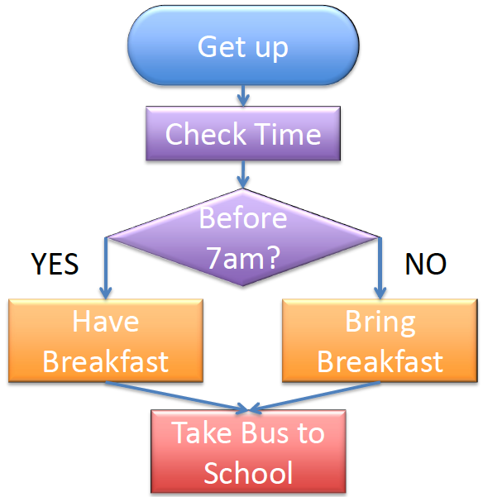
Flow Chart
Student.getUp();
if (time < 7) {
Student.haveBreakfast();
}
else { // time >= 7
Student.bringBreakfast();
}
Student.takeBus();

Slide 4
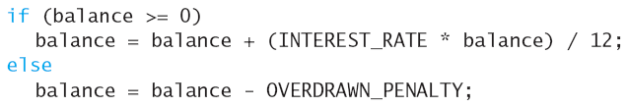
if-else Statement
A branching statement that chooses between two possible actions.
Syntax
if (Boolean_Expression)
Statements_1
else
Statements_2
Example

Slide 5
The if-else Statement
Figure 3.1 The Action of the if-else Statement sample program Listing 3.1

Slide 6
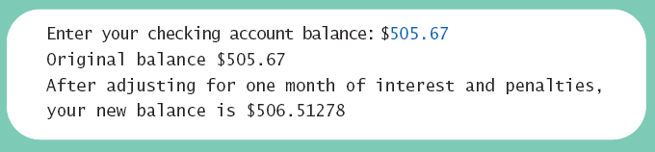
Lab: The if-else Statement

Slide 7
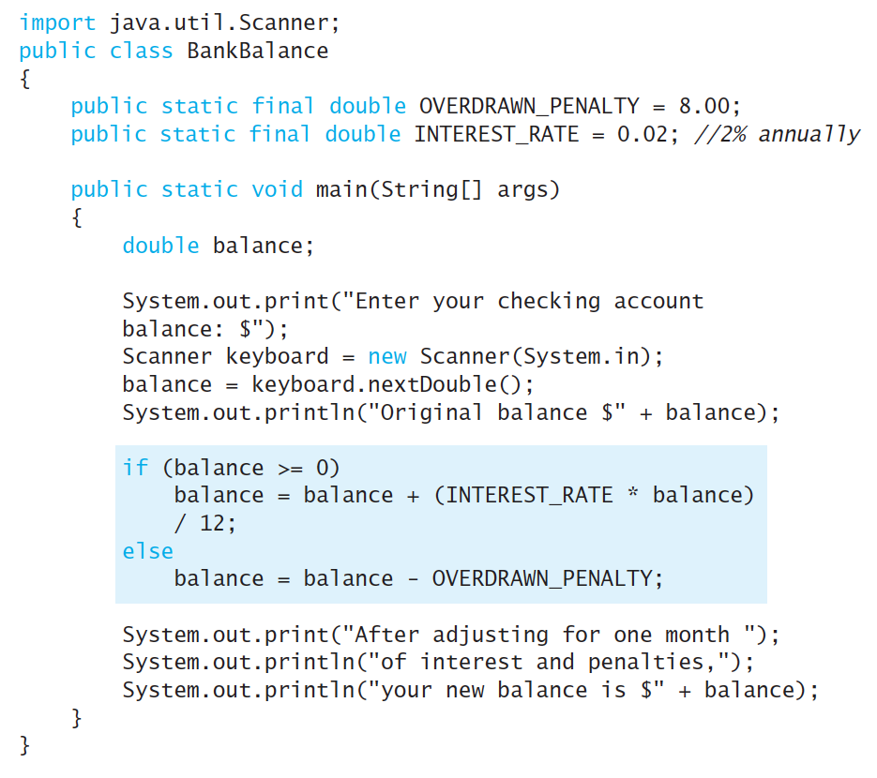
Lab: A Program Using if-else

Slide 8
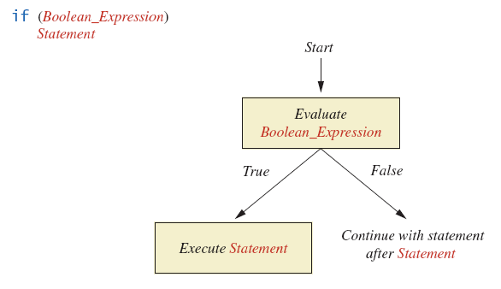
Omitting the else Part
FIGURE 3.3 The Semantics of an if Statement without an else

Slide 9
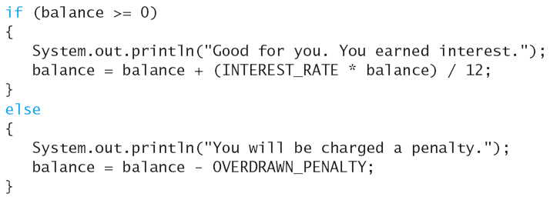
Compound statements
To include multiple statements in a branch, enclose the statements in braces { }

Slide 10
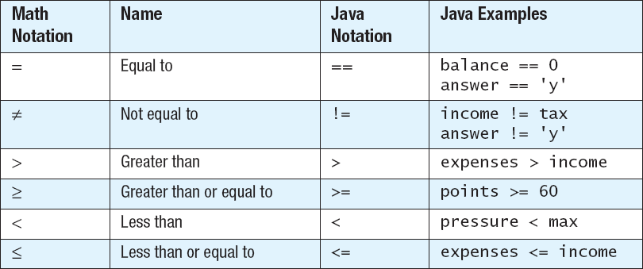
Comparison operators

Slide 11
Boolean Expressions
Expression?
An expression can be a variable, a value, or a combination made up by variables, values and operators
Arithmetic expression: a combination of numbers with a number value
10, taxRate/100, (cost + tax) * discount
String expression: a combination of Strings with a String value
“Hello”, “The total cost is “ + totalCost

Slide 12
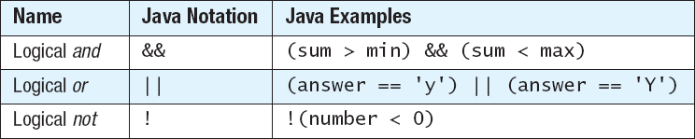
Boolean expression
Boolean expression
An expression whose value is either true or false
Examples:
5 == 3; // false
balance <= 0 // depending on the value of balance
Compound Boolean expressions (logical operators)

Slide 13
Boolean expression && : and
Boolean expressions can be combined using the "and" (&&) operator.
Not allowed
if (0 < score <= 100)
Example
if ((score > 0) && (score <= 100))

Slide 14
Boolean expression || : or
What if you need ONE expression to be true out of many expressions
Boolean expressions can be combined using the "or" (||) operator.
Example
if ((quantity > 5) || (cost < 10))

Slide 15
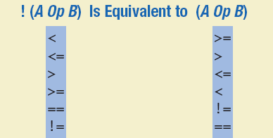
Negating a Boolean Expression ! : not
A boolean expression can be negated using the "not" (!) operator.
Syntax: !(Boolean_Expression)
Will be true if the expression is false
NOTE: for some cases, use of ! is not recommended
You will get confused; try to write expresses straightforward
Example
(a || b) && !(a && b) -> ??
Use (cost != 3) instead of !(cost == 3)

Slide 16
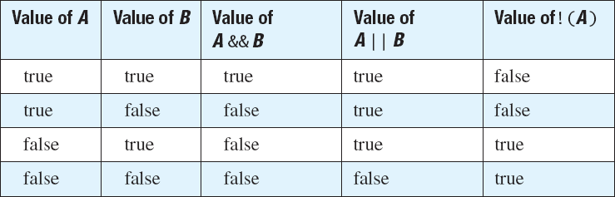
Effect of Boolean operators

Slide 17
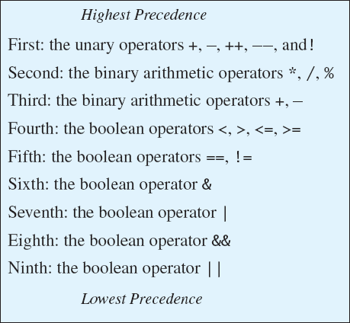
Precedence rule
Poor style: score < min / 2 − 10 || score > 90
Rather write: (score < (min / 2 – 10)) || (score > 90)

Slide 18
Precedence Rules
In what order are the operations performed?
score < min/2 - 10 || score > 90
score < (min/2) - 10 || score > 90
score < ((min/2) - 10) || score > 90
(score < ((min/2) - 10)) || score > 90
(score < ((min/2) - 10)) || (score > 90)

Slide 19
Short-circuit Evaluation
Sometimes only part of a boolean expression needs to be evaluated to determine the value of the entire expression.
If the first operand associated with an || is true, the expression is true.
If the first operand associated with an && is false, the expression is false.
This is called short-circuit or lazy evaluation.
A run-time error can result, for example, from an attempt to divide by zero.
if ((number != 0) && (sum/number > 5))

Slide 20
Using ==
== is appropriate for determining if two integers or characters have the same value.
if (a == 3)
where a is an integer type
Comparison operators connect values or variables
After connection, it’s a boolean expression
a > b
c == d

Slide 21
Assignment (=) vs. Equal To (==)
if ( n1 = n2 ) vs. if ( n1 == n2 )
if ( n1 = n2 )
Error (if your purpose is to compare) !! It’s an assignment statement !
if ( n1 == n2 )
Correct!. It’s a boolean expression now.

Slide 22
Using “==“ between two Strings
For two string objects s1 and s2, what does it mean s1 == s2 ??
== is not appropriate for determining if two objects have the same value.
if (s1 == s2), where s1 and s2 refer to strings, determines only if s1 and s2 refer the a common memory location.
E.g.
String a = “Hello”;
String b= “Hello”;
String c = new String(“Hello”);
a==b?
a==c?
Java Heap
Hello
String constant pool
Java
Hello

Slide 23
Equality of Strings (objects)
To test the equality of String values, use: s1.equals(s2) or s2.equals(s1)
To test the equality ignoring the case, use: "Hello".equalsIgnoreCase("hello")

Slide 24
Lab: String memory test
package stringCompare;
public class stringCompare {
public static void main(String[] args) {
String a, b, c, d;
a = "Hello";
b = "hello";
c = "hello";
d = new String("Hello");
if(a==b)System.out.println("true");
else System.out.println("false");
if(a==c) System.out.println("true");
elseSystem.out.println("false");
if(b==c)System.out.println("true");
else System.out.println("false");
if(a==d) System.out.println("true");
elseSystem.out.println("false");
System.out.println();
if(a.equals(d)) System.out.println("true");
elseSystem.out.println("false");
if(b.equals(d)) System.out.println("true");
elseSystem.out.println("false");
if(b.equalsIgnoreCase(d)) System.out.println("true");
elseSystem.out.println("false");
}
};
Result?
---------
false
false
true
false
true
false
true

Slide 25
Comparing Strings
Lexicographic order
Similar to alphabetical order; but it is based on the order of the characters in the ASCII (and Unicode) character set
All the digits come before all the letters
All the uppercase letters come before all the lower case letters
Comparing Strings
string_1.compareTo(string_2) returns:
Negative value, if string_1 precedes string_2
Zero, if two strings are equal
Positive value, if string_1 is preceded by string_2

Slide 26
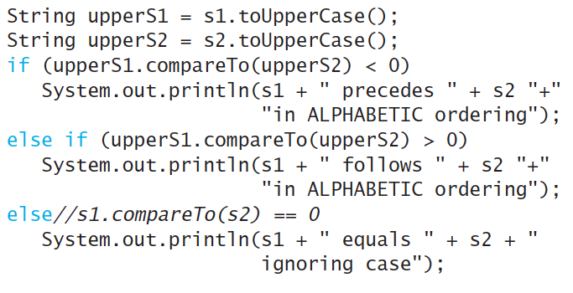
TIP: checking Alphabetic Order
To see whether two Strings of letters are in alphabetic order, you must ensure that all the letters have the same case before using the method compareTo to compare the strings

Slide 27
Nested if-else statement
An if-else statement can contain any statement(s) within it
Syntax:
if (Boolean_Expression_1) {
if (Boolean_Expression_2)
Statements_1;
else
Statements_2;
}
else {
if (Boolean_Expression_3)
Statements_3;
else
Statements_4;
}

Slide 28
Nested Statements
Each else is paired with the nearest unmatched if.
If used properly, indentation communicates which if goes with which else.
Braces can be used like parentheses to group statements.
First Form
if (a > b){ if (c > d) e = f } else g = h;
Second Form
if (a > b) if (c > d) e = f else g = h;
Same?
Different?

Slide 29
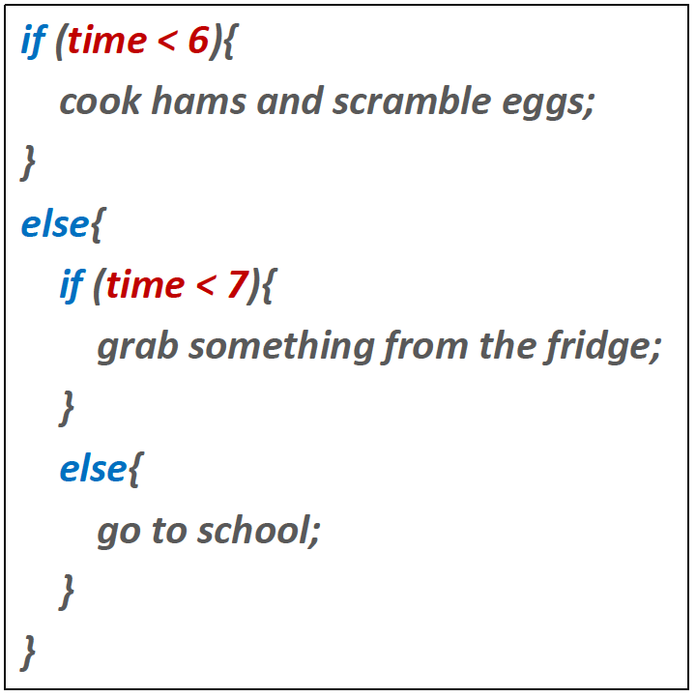
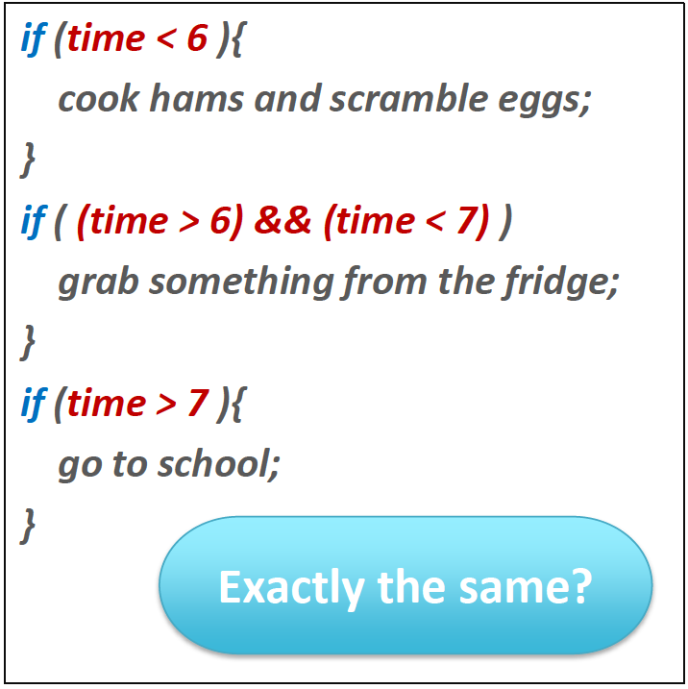
Question
Write a code doing the same task without “else”statement
Notes:
Check!! What if time is precisely 7 ?

Slide 30
BE CAREFUL!!: Using If and Else
Use if-else statement instead of two if-statements
Always pay attention to boundaries
Is it “>” or “>=” ?
Is it “<” or “<=” ?
Do you need a “==” ?

Slide 31
Conditional operator (?:)
Conditional operator (?:)
if (n1 > n2) max = n1; else max = n2;
can be written as:
max = (n1 > n2) ? n1 : n2;
Example:
System.out.println("You worked " + hours + ((hours > 1) ? " hours" ; " hour"));

Slide 32
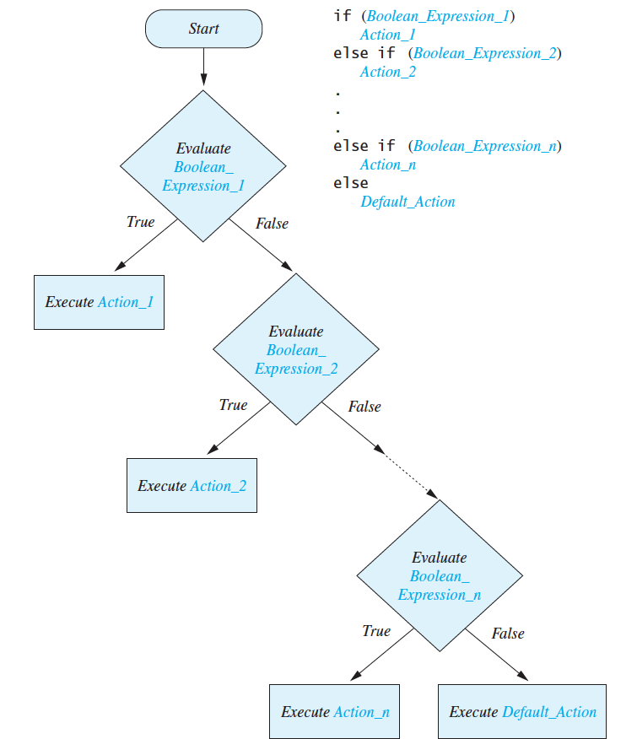
Multibranch if-else Statements
Figure 3.8 Semantics

Slide 33
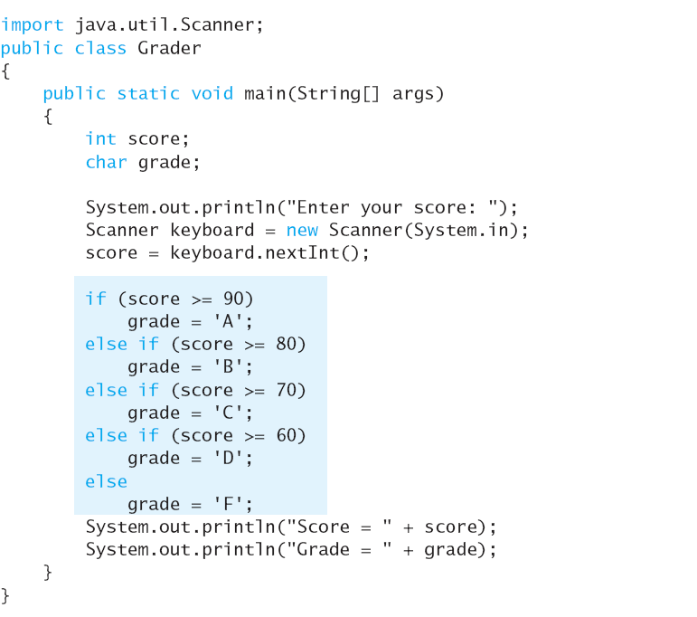
Multi-branch if-else statement

Slide 34
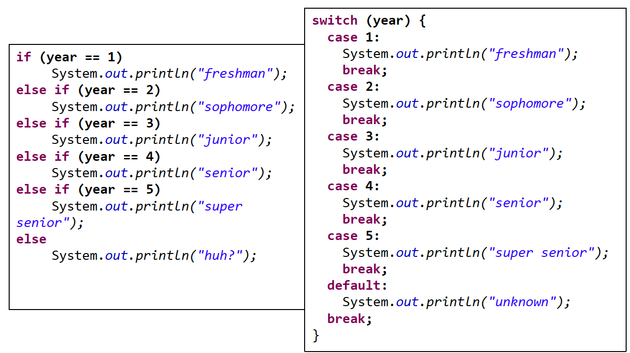
switch Statement

Slide 35
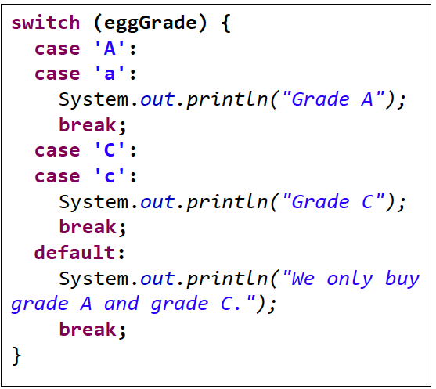
switch Statement
A multiway branch based on an integral expression
Controlling expression return only int, short, byte, or char
Each case consists of the keyword case followed by
A constant called the case label
A colon (:)
A list of ≥0 statements
break statement

Slide 36
switch Statement
A switch works with
Primitive data type: byte, short, char, and int
Enumerated types
Special classes that "wrap" certain primitive types: String, Character, Byte, Short, and Integer
Notes:
https://www.sitepoint.com/javas-switch-statement/

Slide 37
exit() method
exit() method
Sometimes a situation arises that makes continuing the program pointless
A program can be terminated normally by System.exit(0);
if (numberOfWinners == 0){
System.out.println ("Error: Dividing by zero.");
System.exit (0);
}
else {
oneShare = payoff / numberOfWinners;
System.out.println ("Each winner will receive $" + oneShare);
}

Slide 38
Type boolean
The type boolean is a primitive type with only two values: true and false.
Naming Boolean variables
Choose names such as isPositive or systemsAreOk
Avoid names such as numberSign or systemStatus

Slide 39
Input and Output of Boolean Values
Example
boolean booleanVar = false;
System.out.println(booleanVar);
System.out.println("Enter a boolean value:");
Scanner keyboard = new Scanner(System.in);
booleanVar = keyboard.nextBoolean();
System.out.println("You entered " + booleanVar);

Slide 40
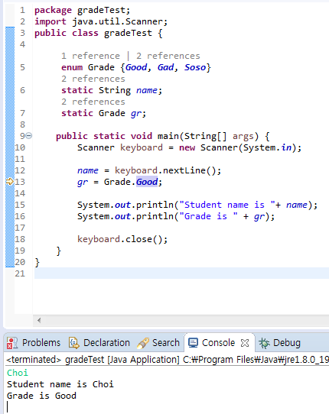
Enumerations
Consider a need to restrict contents of a variable to certain values
An enumeration lists the values a variable can have
Define in top level class, no need semicolon at the end

Slide 41
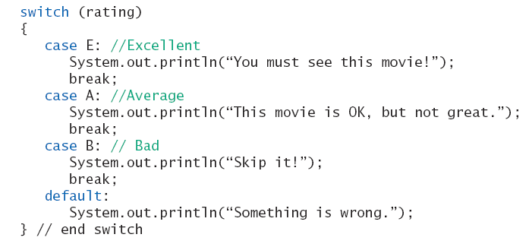
Enumerations
To use in a switch statement
enum MovieRating {E, A, B} MovieRating rating; rating = MovieRating.A;

Slide 42
Practice 3.1
Ex3_1a. Write a following program
Change the following if-else statement to switch
Ex3_1b. Update 3_1a
Assign enum type case label instead of String
Change here
Define enum type here
enum Rating {A, B, C, D, F}
Define enum type here
Rating rate;

Slide 43
Practice 3.2
Ex3_2. Write a program with a switch statement
Convert a letter grade to an equivalent numeric value
For A, B, C, and D, gradeValue is 4.0, 3.0, 2.0, and 1.0, respectively
For F and any other letter, gradeValue = 0.0
Use keyboard.next().charAt(0) to get a char value

Slide 44
Practice 3.3
Ex3_3a. Write a following program
Print cashing charge depending on check(수표) amount
If < $10, charge = $1
Else if < $100, charge = 10 percent
Else if < $1000, charge = $5 + 5 percent
Else (≥ $1000) charge = $40 + 1 percent
Ex3_3b. Extend Ex3_3a
Include input checking
Display an error message, if check amount< 1$, check amount not an integer multiple of 5

Slide 45
Assignment
Read chapter 4.1~4.2

