Slide 1

_{Object Oriented Programming} Introduction to Java
Ch. 4. Flow of Control : Loops
March 4, 2014
School of AI.Software, Gachon University
Ahyoung Choi, Spring

Slide 2
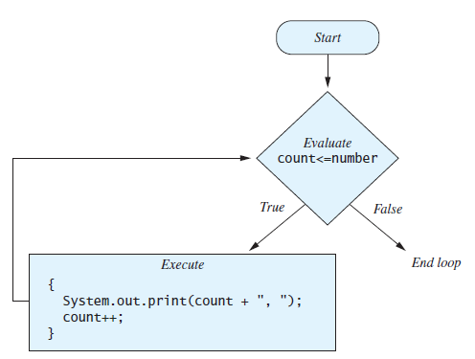
Java Loop Statements
A portion of a program that repeats a statement or a group of statements is called a loop.
E.g. A loop could be used to compute grades for each student in a class.
There must be a means of exiting the loop.
while, do-while, for statements

Slide 3
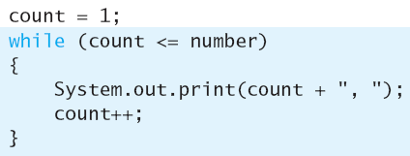
while Statement
A while statement repeats while a controlling boolean expression remains true
Start from expression evaluation
As long as it is true, repeat instructions in brackets
Syntax
while (Boolean_expression) {
Statements;
}
Example

Slide 4
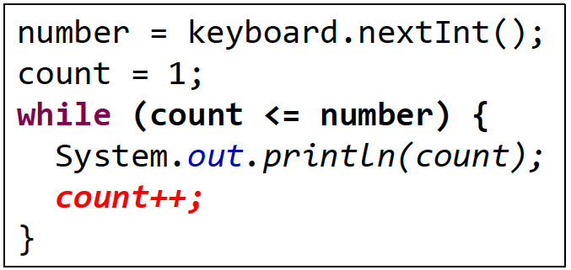
while Statement
You have to do some initialization before the statement
The loop body typically contains an action that ultimately causes the controlling boolean expression to become false.

Slide 5
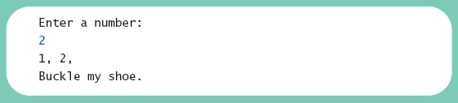
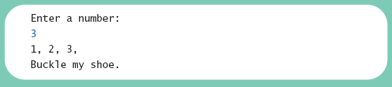
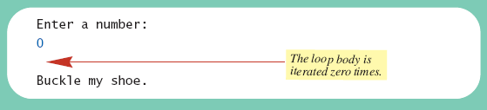
Lab: while Statement
View sample program, Listing 4.1 class WhileDemo
Write a program to count the number to buckle the shoe.
Write a program to count the odd number to buckle the shoe.

Slide 6
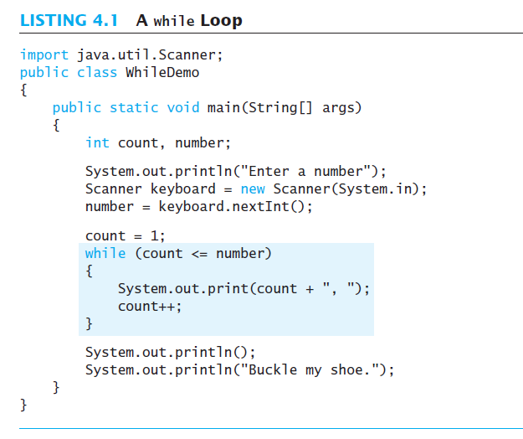

Slide 7
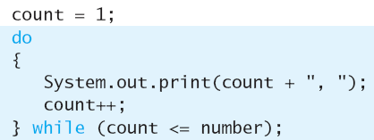
do-while Statement
Similar to a while statement, except that the loop body is executed at least once
Syntax
do {
Statements;
} while (Boolean_Expression);
Don’t forget the semicolon!

Slide 8
do-while Statement
First, the loop body is executed.
Then the boolean expression is checked.
As long as it is true, the loop is executed again.
If it is false, the loop is exited.
Equivalent while statement
Statement(s)_S1
while (Boolean_Condition)
Statement(s)_S1

Slide 9
Difference?
do-while statement will execute the body statements at least once
while statement may output nothing
Consider: number == 0

Slide 10
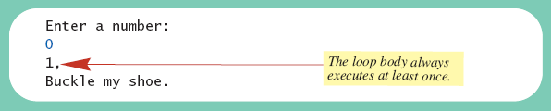
Lab: do-while Statement
View sample program, listing 4.2 class DoWhileDemo

Slide 11
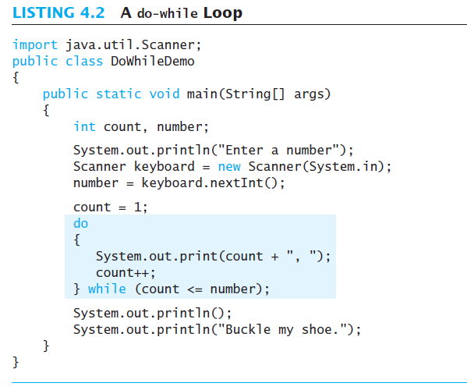

Slide 12
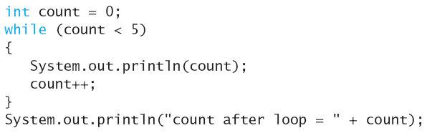
Infinite loops
A loop which repeats without ever ending
If the controlling Boolean expression never becomes false, a while/do-while loop will repeat without ending
Always make sure that your loop will end
Never forget to change the count

Slide 13
Infinite Loops
Infinite loop is not a syntax error. It’s a logical error
eclipse will not help you in this case
Write pseudo code, think, and rethink before coding

Slide 14
Nested loops
The body of a loop can contain any kind of statements, including another loop

Slide 15
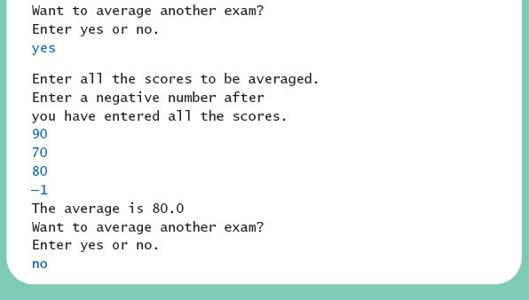
Nested Loops
Computes the average of a list of (nonnegative) exam scores. Repeats computation for more exams until the user says to stop
View listing 4.4 class ExamAverager

Slide 16
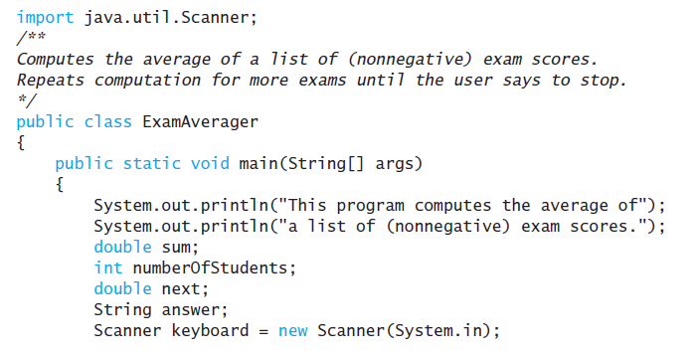
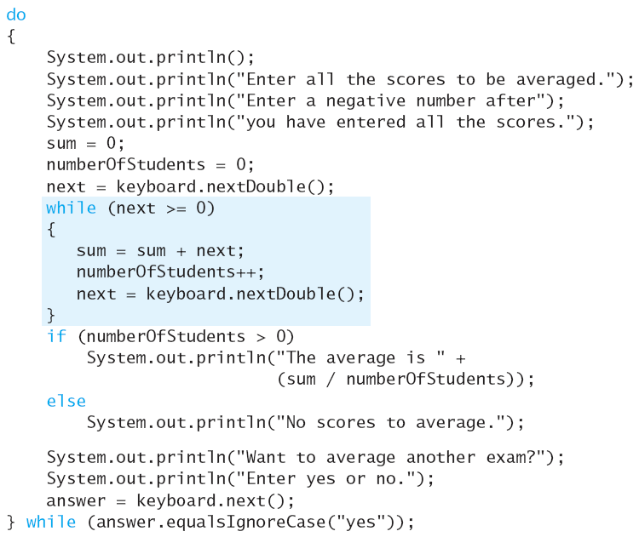

Slide 17
for Statement
for statement (or usually called for loop)
Used to executes the body of a loop a fixed number of times
While vs for
number = keyboard.nextInt();
count = 1;
while (count <= number) {
// all the actions
count++;
}
number = keyboard.nextInt();
int count;
for (count = 1; count<=number; count++) {
// all the actions
}

Slide 18

for Statement
Syntax:
for (Initialization; Boolean_Expression; Update) {
Statements;
}
Example
Initialization
Boolean Expression
Statements
Update
exit

Slide 19
Local variables
The counter can be defined in the for loop
Only available in this loop
Undefined outside of the loop
It is really a bad idea to name the count variable the same as the one outside of the loop
Local variables can also be defined in if and while statements
if (true) {
int temp = 0;
}
do {
int temp2 = 2;
} while (false);
for (int i = 0; i < 100; i++) {
// all the actions
}
System.out.println(i);
// WRONG! i is not visible outside of for loop

Slide 20
For Loop: Don’t Overcount
Repeat 3 times
Repeat 3 times
Repeat 4 times!
for (int count = 1; count <= 3; count++) {
// all the actions
}
for (int count = 0; count < 3; count++) {
// all the actions
}
for (int count = 0; count <= 3; count++) {
// all the actions
}

Slide 21

Using a comma (,)
Multiple initializations and updates can be performed in a for statement
Actions are simply separated with commas
Only one boolean expression is allowed, but it can consist of &&s, ||s, and !s.

Slide 22
For Loop: Case Study
Let the user input 10 numbers, then output the sum of those numbers
What’s wrong with this piece of code?
import java.util.Scanner;
public class input {
public static void main(String[] args) {
Scanner keyboard = new Scanner(System.in);
for (int i = 1; i <= 10; i++) {
int sum = 0;
System.out.println("Please enter a new number (" + i + " of 10):");
int input = keyboard.nextInt();
sum += input;
}
System.out.println("Total sum is: " + sum);
}
}

Slide 23
For Loop: Case Study
Let the user input 10 numbers, then output the product of those numbers
What’s wrong with this piece of code?
import java.util.Scanner;
public class input {
public static void main(String[] args) {
Scanner keyboard = new Scanner(System.in);
int product = 0;
for (int i = 1; i <= 10; i++) {
System.out.println("Please enter a new number (" + i + " of 10):");
int input = keyboard.nextInt();
product *= input;
}
System.out.println("Total product is: " + product);
}
}

Slide 24
break and continue Statements
break statement
A break statement can be used to end a loop immediately
The break statement ends only the innermost loop or switch statement that contains the break statement
break statements may make loops more difficult to understand
count = 10;
for (int i = 0; i < count; i ++) {
if (i == 3) break;
System.out.println(i);
}
System.out.println("Loop complete");

Slide 25
break and continue Statements
continue statement
Ends current loop iteration
Begins the next iteration
May introduce some complications
count = 10;
for (int i = 0; i < count; i ++) {
if (i == 3) continue;
System.out.println(i);
}
System.out.println("Loop complete");

Slide 26

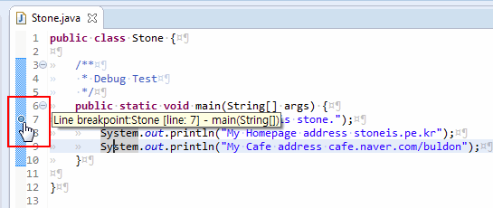
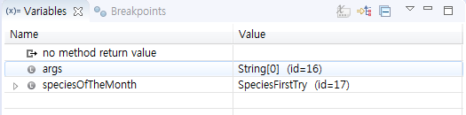
Debugging : finding errors
디버그 모드
원래 모드
Tracing variables
Watching the variables change while the program is running
Simply insert temporary output statements in your program to print the values of variables of interest or, learn to use the debugger that may be provided by your system
Setting the breakpoint: click twice on the left side line

Slide 27
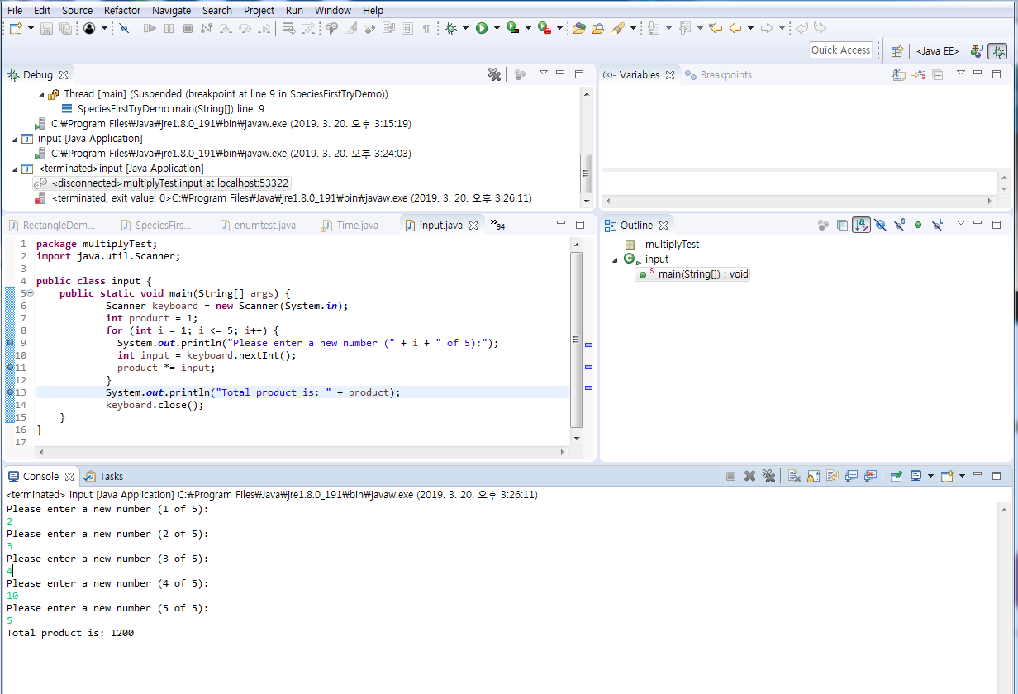

Slide 28
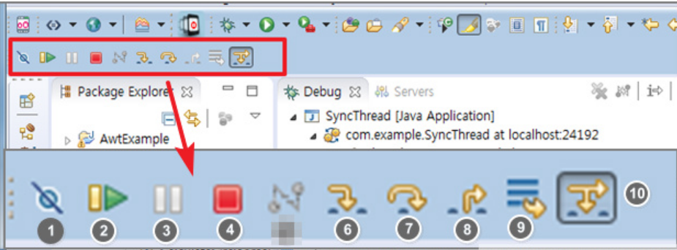
Debugging
모든 Break Point를 무시
1) Skip All Breakpoints
2) Resume(F8) : Continue to the next breakpoint
3) Suspend : Pauses the thread and is the same as that specified for the current statement.
4) Terminate : End thread
6) Step Into(F5) : If the next line is in a function, it goes into the function.
7) Step Over(F6) : Pass a function call and go one step at the current position
8) Step Return(F7) : Go back to the end of the current function, return to the function call
9) Drop to Frame : Moves to the first row of the selected stack frame. When you want to start from scratch
10) Use Step Filters(Shift+F5)
다음브레이크까지 실행
함수 안으로 들어감
한 스텝씩 진행, 현재 소스창에서 한 스텝씩 진행
함수 밖으로 빠져 나옴

Slide 29
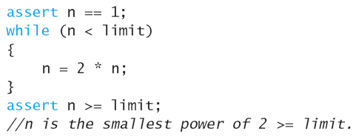
Debugging: Assertion check
Assertion
Something that says the current state of the program
Can be true or false
Should be true when no mistakes in running program
Syntax for assertion check Assert Boolean_Expression;
Assertion check

Slide 30
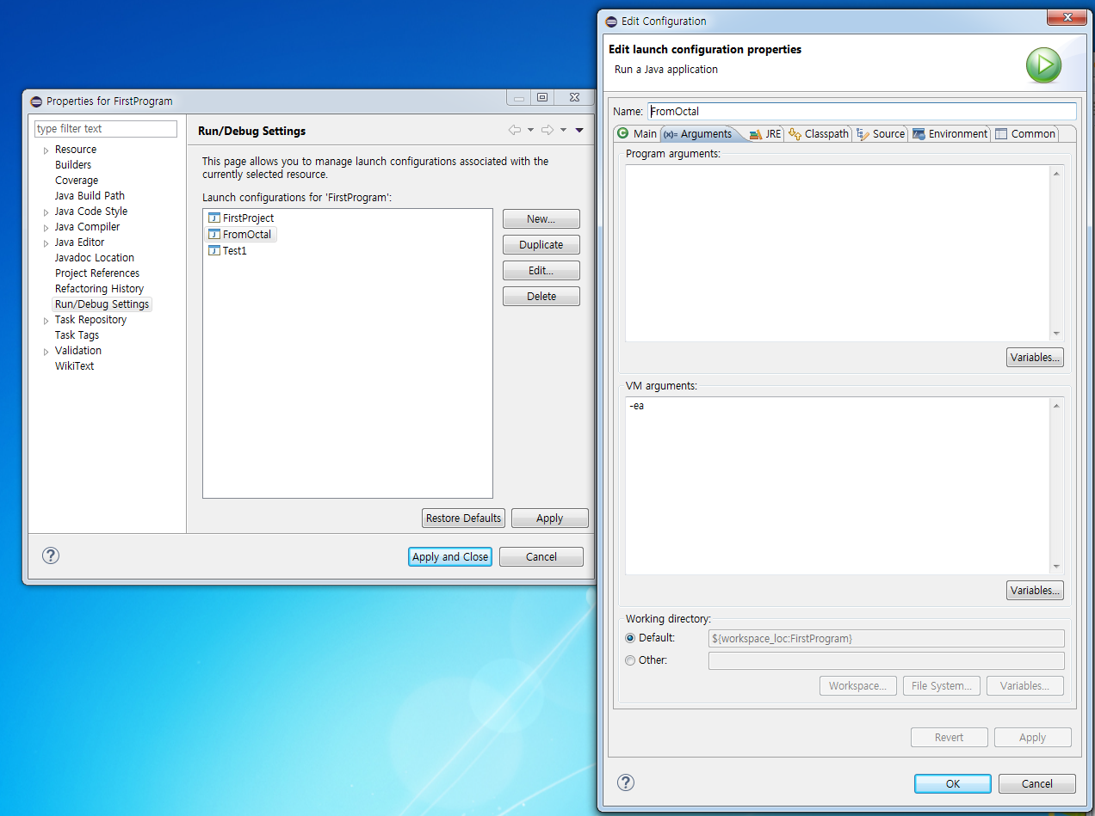
Debugging : Assertion check
Assertion on
Right click on project →Run/Debug Settings → Choose resources → click “edit” → Set VM argument “–ea”
-ea

Slide 31
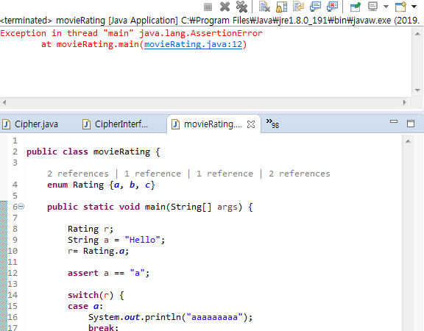

Slide 32
Practice 4
Ex4_1a. Write a following program
Read a list of non-negative integers: the end is indicated by any negative value (not included)
Print the max, min, average (double) of the integers
Ex4_1b. Extend Ex4_1b
Read integer percentage (0 ~ 100): ignore values > 100
Set grade for each value: A (90~100), B (80~89), C (70~79), D (60~69), F (0~59)
Print total count of grades and the count for each grade
E.g., 98 87 86 78 -1 → total count: 4 A count: 1, B count: 2, C count: 1, D count: 0, F count: 0

