Slide 1

_{Object Oriented Programming} Introduction to Java
Ch. 5. Classes and Methods (1)
March 4, 2014
Dept. of Software, Gachon University
Ahyoung Choi, Spring

Slide 2
Introduction : OOP

Slide 3
Intro: OOP
Object-oriented programming (OOP) helps people to organize code and programs
How to organize data?
How to organize manipulations of data?
OOP uses classes and objects to get good organization

Slide 4
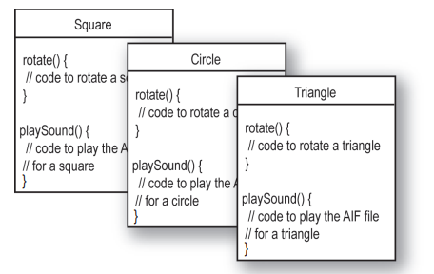
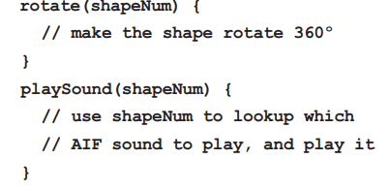
Why do we need it?
There will be shapes on a square, a circle, and a triangle. When the user clicks on a shape, the shape will rotate clockwise 360 degree and play an AIF sound file specific to particular shape.
* C version
* Java version

Slide 5
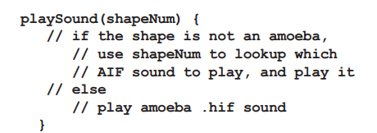
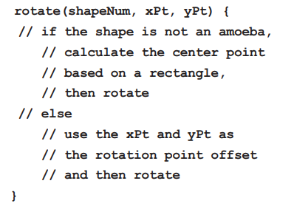
Why do we need it?
What if new function is added?
There will be an amoeba shape on the screen, with the others. When the user clicks on the amoeba, it will rotate like the others, and play a .hif sound file

Slide 6
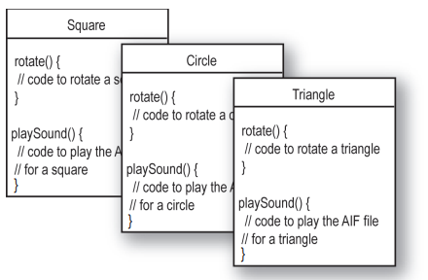
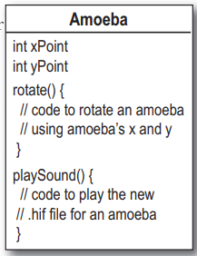
Why do we need it?
What if new function is added?
There will be an amoeba shape on the screen, with the others. When the user clicks on the amoeba, it will rotate like the others, and play a .hif sound file
No need to change here!

Slide 7
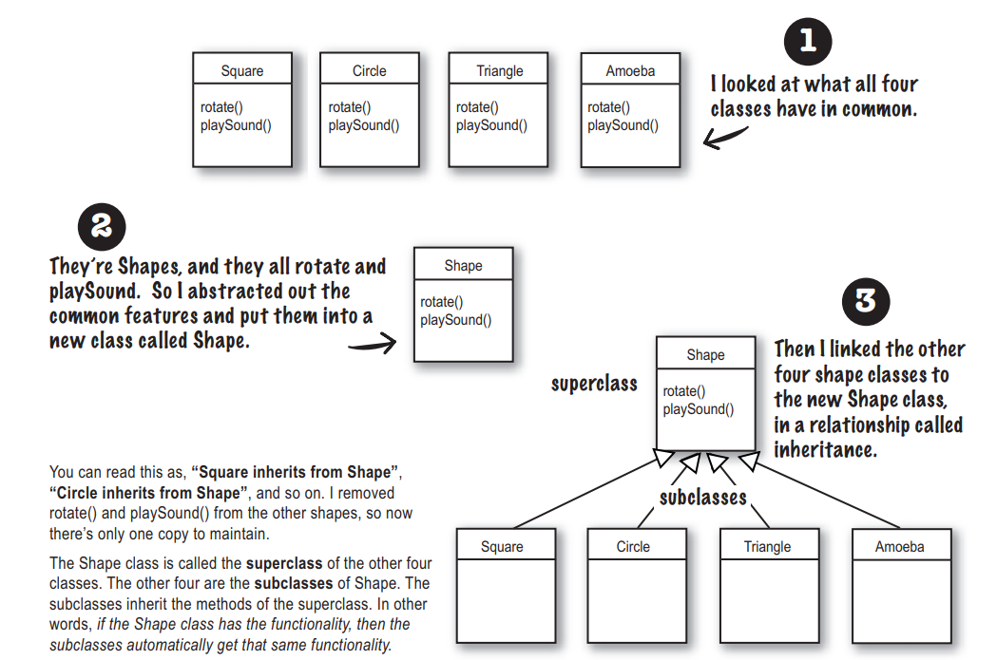
Why do we need it?
Inheritance!

Slide 8
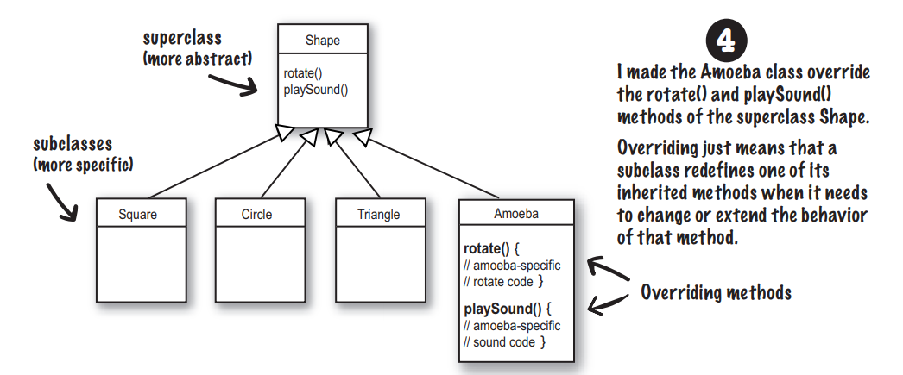
Why do we need it?
Overriding!

Slide 9
Reusability
How does good organization (or usually called “good design”) help you?
If I can make it work, it is a good design?
Good design means better reusability
You can use part of your program in another program
You can use part of your program in a new version
You can change only one part if you know other parts are good
Others can use part of, or the whole of your program
They don’t even have to know the details if they trust you
That’s how programmers collaborate

Slide 10
Cont.
You have seen many program components that you can use without knowing the details
Scanner
next(), nextLine(), nextInt()
String
length(), indexOf(), substring(), trim()
Scanner class has more than 1500 lines of code
But you can use it without copying a single line

Slide 11
Cont.
The rules of reusability
Generic design
A component (a class in Java) should perform a general function
High cohesion (높은 결합력)
What’s in a class (data and methods) should be closely related to each other
Low coupling (느슨한 의존성)
Classes should be independent of other classes

Slide 12
5.1 Class and Method Definition

Slide 13
Class and Method Definitions
Java program consists of objects
Objects of class types
Objects that interact with one another
Program objects can represent
Objects in real world
Abstractions

Slide 14
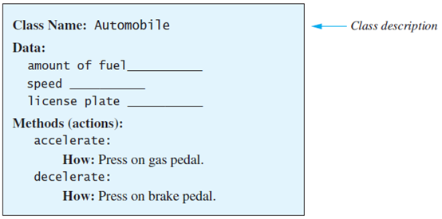
Class and Method Definitions
Figure 5.1 A class as a blueprint

Slide 15
Objects (Instances)
Instances of the class Automobile
Object Name: patsCar
Amount of fuel: 10 gallons
Speed: 55 miles per hour
License plate: “135XJK”
Object Name: suesCar
Amount of fuel: 14 gallons
Speed: 0 miles per hour
License plate: “SUES CAR”
Object Name: ronsCar
Amount of fuel: 2 gallons
Speed: 75 miles per hour
License plate: “351 WLF”

Slide 16
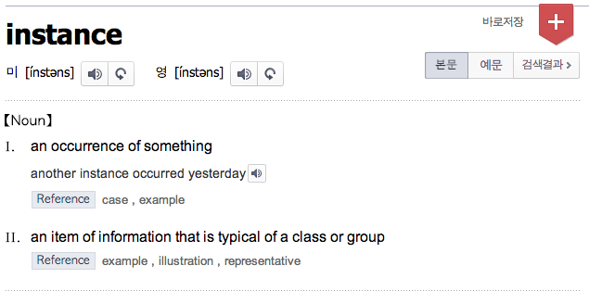
Hey..

Slide 17
Objects
Important!
- Classes do not have data; individual objects have data
Classes specify what kind of data objects have

Slide 18
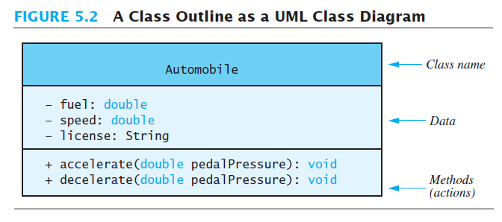
Class and Method Definitions
Figure 5.2 A class outline as a UML class diagram
Class name
Data
Method (action)

Slide 19
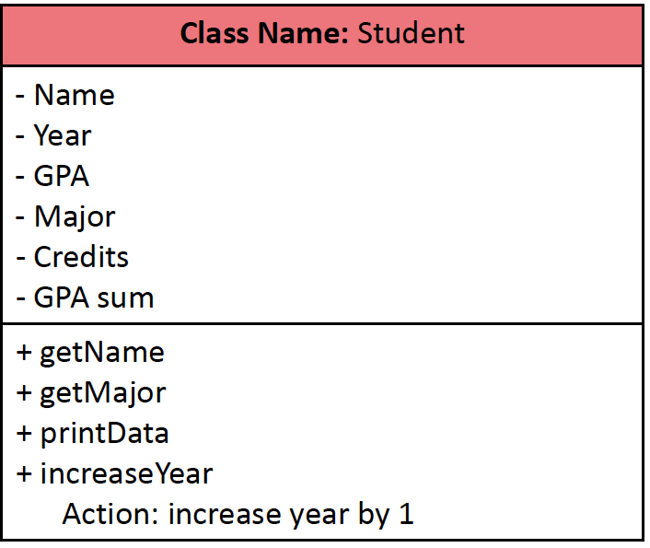
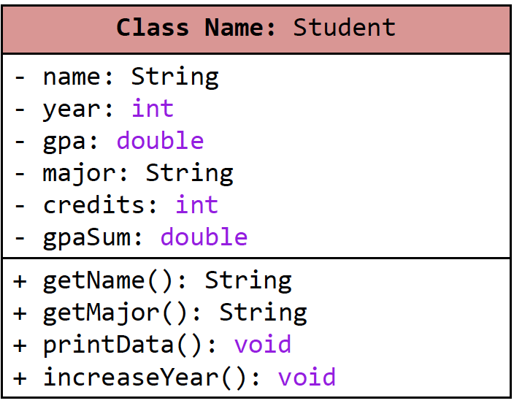
Class Student
UML class specification
In Java

Slide 20
Class Files and Separate Compilation
Each Java class definition usually in a file by itself
File begins with name of the class
Ends with .java
Class can be compiled separately
Helpful to keep all class files used by a program in the same directory
What happens when you compile a .java file?
.java file gets compiled into a .class file
Contains Java bytecode (instructions)
You can send the .class file to people who use it, without revealing your actual code

Slide 21
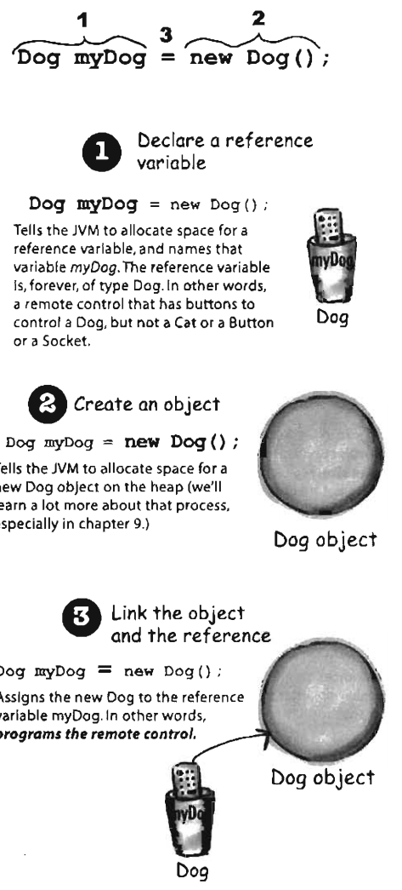
Creating an Object
Syntax rule
What does the statement do?
The computer will create a new object, and assign its memory address to ObjectName
ObjectName is sometimes called an class type variable
It is a variable of class type ClassName
Why do we need new?
So we know ClassName() is not executing a method but creating an object
ClassName ObjectName= new ClassName();

Slide 22
Creating an Object
Creating an object ppopy of class Dog
Dog ppopy = new Dog();
Scanner keyboard = new Scanner(System.in);
Creating an object keyboard of class Scanner
Assign memory address of object to variable
Create an object & return its memory address

Slide 23
Instance Variable vs. Local Variable
Instance variables
Declared in a class (outside of methods)
Confined(국한됨) to the class
Can be used anywhere in the class that declares the variable, including inside the class’ methods
(Java does not have global variables)
Local variables
Declared in a method
Confined(국한됨) to the method
Can only be used inside the method that declares the variable

Slide 24
Instance Variables
Data defined in the class are called instance variables
(defined outside of methods)
Java does not have global variables!
public String name;
public String breed;
public int age;
Variable names
type: int, double, String …
public: no restrictions on how these instance variables are used (more details later!)

Slide 25
Using Instance Variables inside a Class
public class Dog
{
public String name;
public String breed;
public int age;
public int getAgeInHumanYears()
{
int humanAge = 0;
if (age <= 2)
{
humanAge = age * 11;
}
else
{
humanAge = 22 + ((age-2) * 5);
}
return humanAge;
}
}
Any instance variables can be freely used in the class definition.
Any method can freely access all the instance variables in the object as if they were declared in the method

Slide 26
Local Variables
Variables declared inside a method are called local variables
May be used only inside the method
All variables declared in method main are local to main
Local variables having the same name and declared in different methods are different variables

Slide 27
Local Variables
listing 5.5A & 5.5B
public class BankAccount {
public double amount;
public double rate;
public void showNewBalance() {
double newAmount = amount + (rate / 100.0) * amount;
System.out.println("With interest added, the new amount is $" + newAmount);
}
public static void main(String[] args)
{
BankAccount myAccount = new BankAccount();
myAccount.amount = 100.00;
myAccount.rate = 5;
double newAmount = 800.00;
myAccount.showNewBalance();
System.out.println("I wish my new amount were $" + newAmount);
}
}
Two different variables named newAmount

Slide 28
Methods
public String getMajor()
{
return major;
}
public void increaseYear()
{
classYear++;
}
What is the difference between these??

Slide 29
Methods
Two kinds of Java methods
Methods that return a value
Examples: String’s substring() method, String’s indexOf() method
Methods that return nothing – a void method
Perform some other action
Example: System.out.println()
“return” means “produce”
A method can produce a value so that other parts of the program can use it, or simply perform some actions
When you use a method you "invoke" or "call" it

Slide 30
Methods
public String getMajor()
{
return major;
}
public void increaseYear()
{
classYear++;
}
Returns a String
Return type
Returns nothing

Slide 31
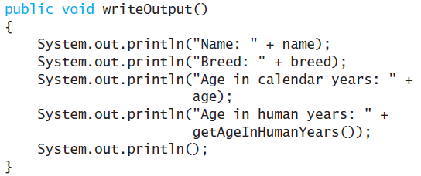
Defining void Methods
Most method definitions we will see as public
Method does not return a value
Specified as a void method
Heading includes parameters
Body enclosed in braces { }
Think of method as defining an action to be taken

Slide 32
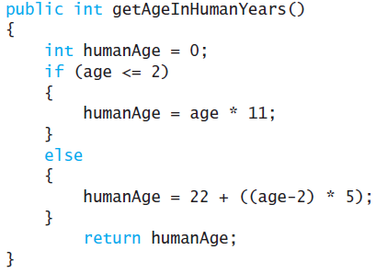
Methods That Return a Value
Consider method getAgeInHumanYears( )
Heading declares type of value to be returned
Last statement executed is return

Slide 33
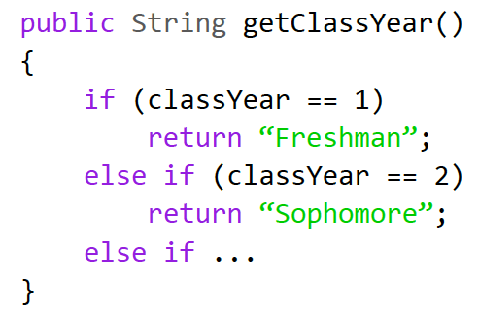
return Statement
A method that returns a value must have at least one return statement
Terminates the method, and returns a value
Syntax:
return Expression;
Expression can be any expression that produces a value of type specified by the return type in the method heading

Slide 34
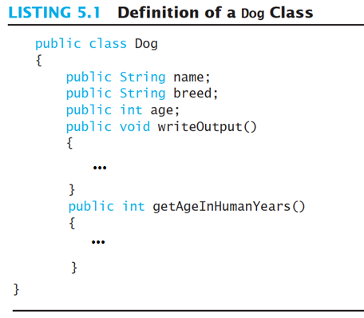
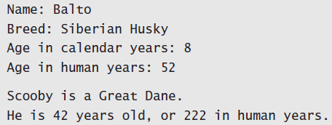
Lab: Dog class test
Implement a class Dog and write a test program
Note class has
Three pieces of data (instance variables)
String name, String breed, int age
Two behaviors (methods)
writeOutput(), getAgeInHumanYears()
Each instance of this type has its own copies of the data items
Use of public
No restrictions on how variables used
Later will replace with private
Sample screen output

Slide 35
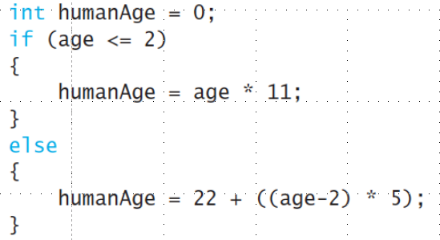
Lab: Dog class test
Implement a class Dog and write a test program
writeOutput(): print all instance variable data in dog class
getAgeInHumanYears(): convert dog age to human years
Write a test class DogDemo
Add separate java file in project
Make instances and set the values
Print matched human age and output

Slide 36
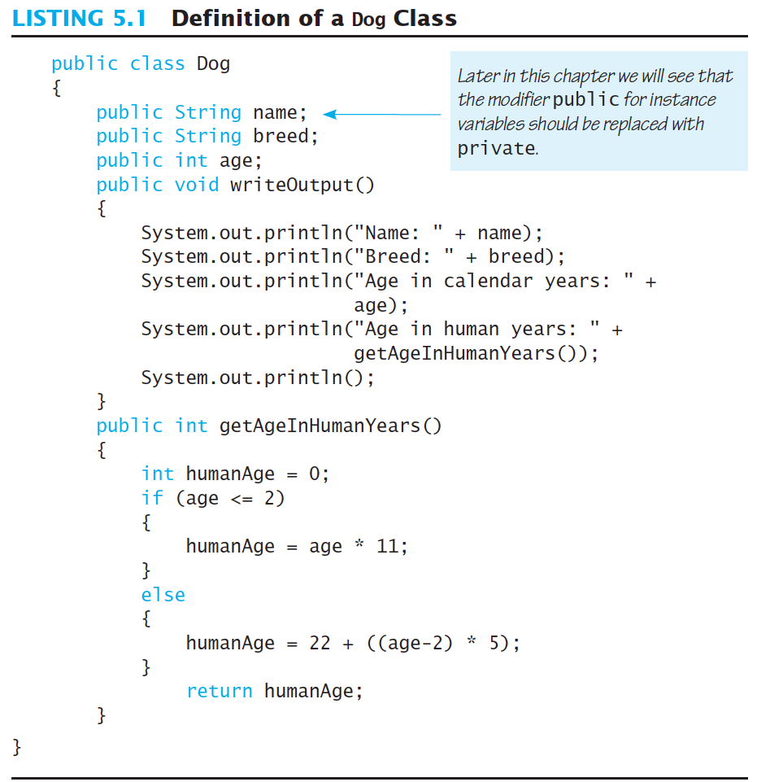
Class name
Data (Instance variables)
Methods

Slide 37
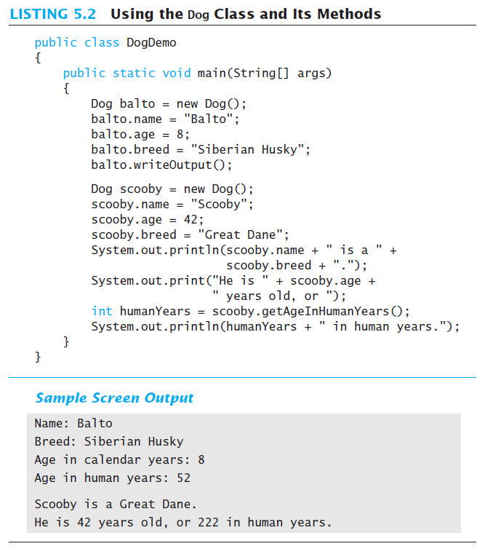

Slide 38
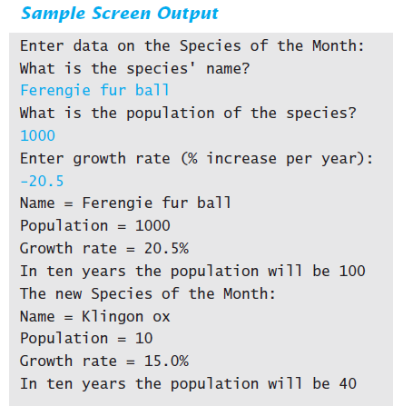
Lab: Species class
Implement a class Species and write a test program (List 5.3 & 5.4)
SpeciesFirstTry Class
Data: Name, population, and growth rate
Action
readInput(): read data
writeOutput(): print result
getPopulationIn10: compute the population in 10 years

Slide 39
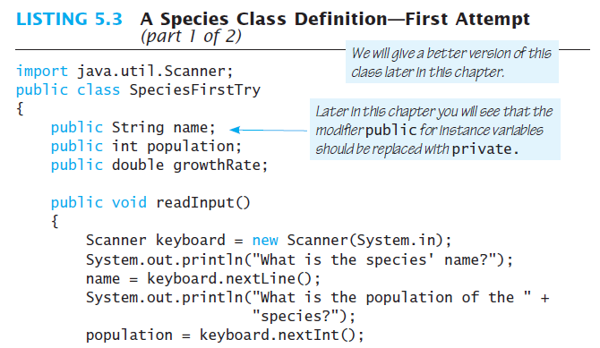
Lab: Species class

Slide 40
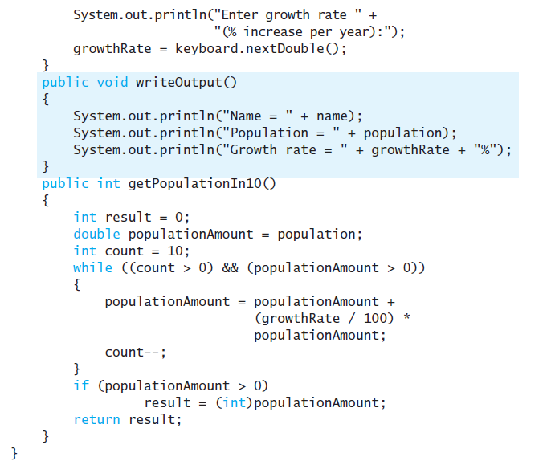

Slide 41
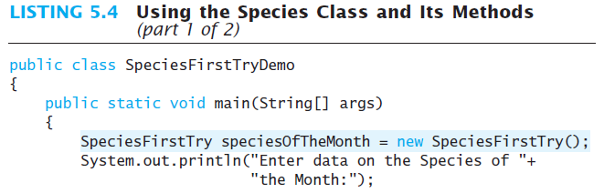
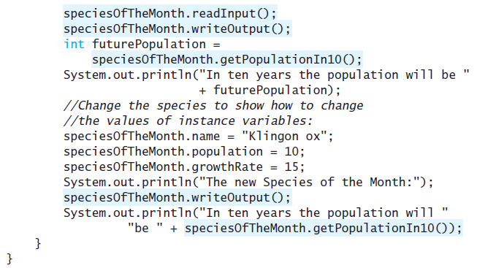

Slide 42
Keyword this
Within a method definition, you can use the keyword this as a name for the object receiving the method call. (객체 자기자신)
Example this.name = keyboard.nextLine();

Slide 43
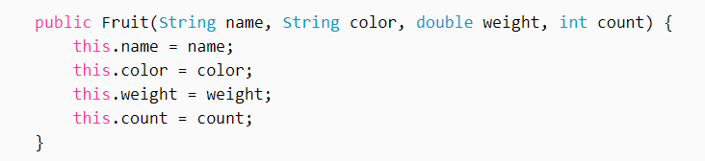
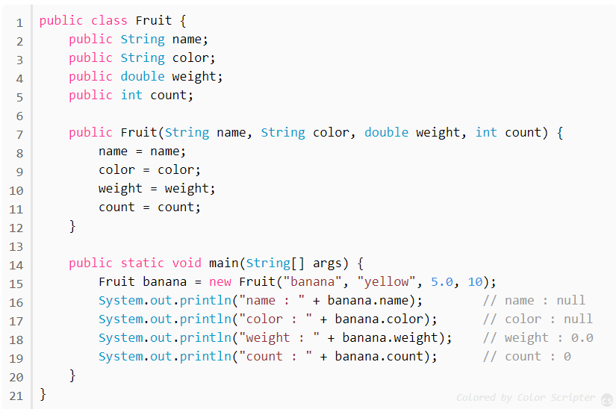
Keyword this

Slide 44
Blocks { }
Recall compound statements
Enclosed in braces { }
When you declare a variable within a compound statement
The compound statement is called a block
The scope of the variable is from its declaration to the end of the block
Variable declared outside the block usable both outside and inside the block

Slide 45
Methods with Parameters
We can make it more versatile by giving the method a parameter to specify how many years
Note sample program, listing 5.6
public int getPopulationIn10()
{
int result = 0;
double populationAmount = population;
int count = 10;
while ((count > 0) && (populationAmount > 0)) {
populationAmount = populationAmount +
(growthRate / 100) * populationAmount;
count--;
}
if (populationAmount > 0)
result = (int)populationAmount;
return result;
}
public int predictPopulation(int year)
{
int result = 0;
double populationAmount = population;
int count = year;
while ((count > 0) && (populationAmount > 0)) {
populationAmount = populationAmount +
(growthRate / 100) * populationAmount;
count--;
}
if (populationAmount > 0)
result = (int)populationAmount;
return result;
}

Slide 46
Parameters of Primitive Type
Note the declaration public int predictPopulation(int years)
The formal parameter is years
Calling the method int futurePopulation = speciesOfTheMonth.predictPopulation(10);
The actual parameter (=argument) is the integer 10
View sample program, listing 5.7 class SpeciesSecondClassDemo

Slide 47
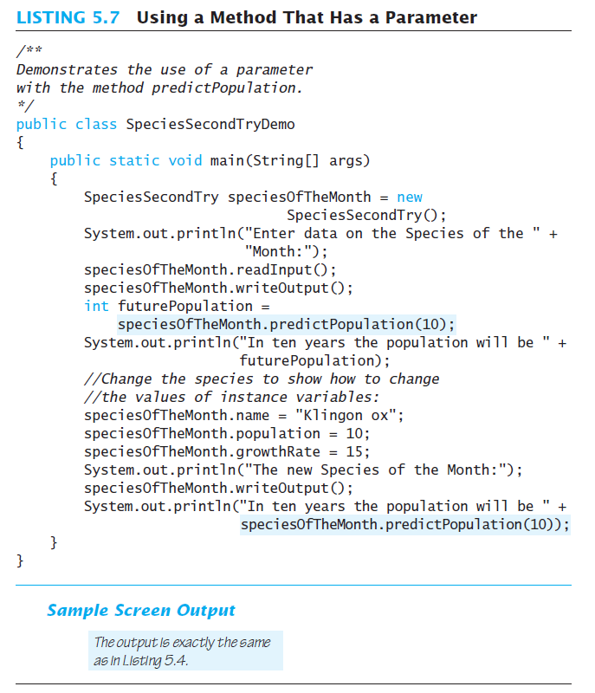

Slide 48
Parameter vs. Argument
These two terms parameter and argument are sometimes loosely used interchangeably
Difference ?
parameter (sometimes called formal parameter) is often used to refer to the variable as found in the function definition
argument (sometimes called actual parameter) refers to the actual input passed.

Slide 49
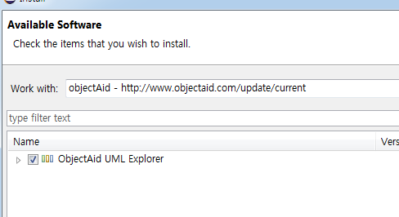
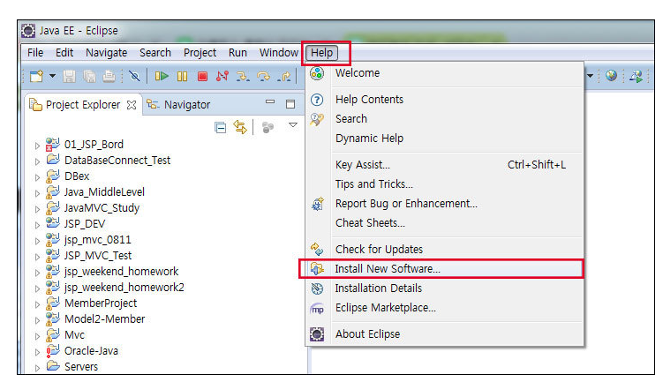
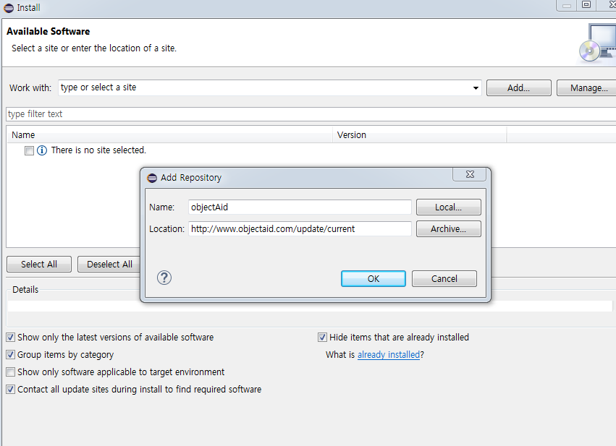
UML diagram
Add plug-in for UML
ObjectAid plug-in
http://www.objectaid.com/update/current

Slide 50
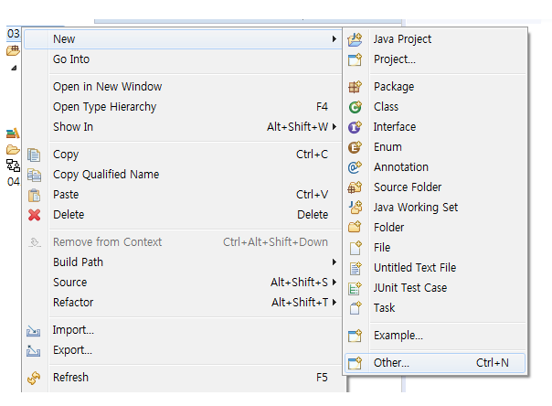
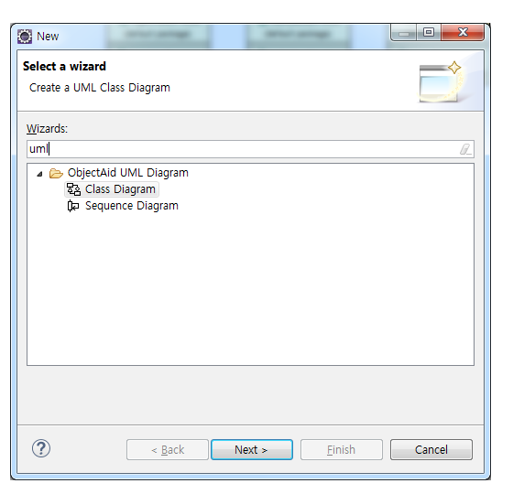
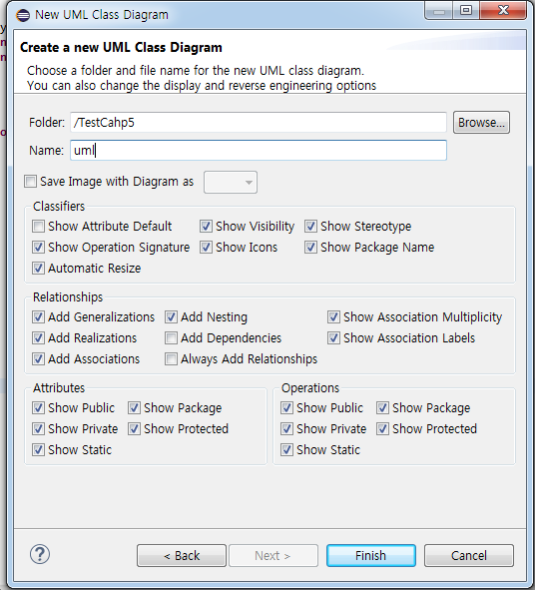
Install UML diagram
Project right click-> new-> other->type “UML”-> select “Class Diagram” ->define name anything

Slide 51
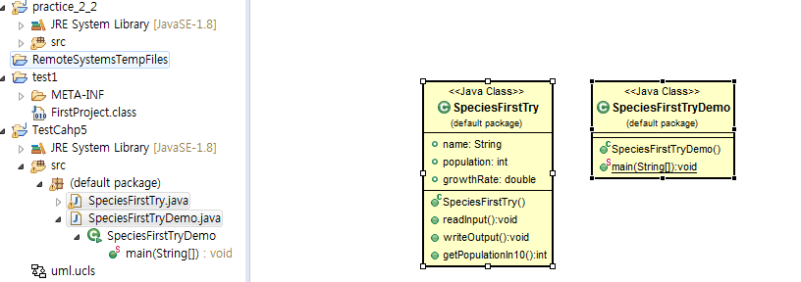
Install UML diagram
Drag java files to uml.ucls window

Slide 52
5.2 Information Hiding, Encapsulation

Slide 53
Information Hiding
Programmer using a class method need not know details of implementation
Only needs to know what the method does
Information hiding:
Designing a method so it can be used without knowing details
Also referred to as abstraction
Method design should separate what from how

Slide 54
public/private Modifier
public class Student
{
public int classYear;
public void setMajor();
private String major;
private void setYear();
}
public
there is no restriction on how you can use the method or instance variable
private
can not directly use the method or instance variable’s name outside the class

Slide 55
public/private Modifier
public class Student
{
public int classYear;
private String major;
}
public class StudentTest{
public static void main(String[] args){
Student jack = new Student();
jack.classYear = 1;
jack.major = “Computer Science”;
}
}
OK, classYear is public
Error!!! major is private

Slide 56
public and private Modifiers
Type specified as public
Any other class can directly access that object by name
Classes generally specified as public
Instance variables usually not public
Instead specify as private

Slide 57
More about private
Hides instance variables and methods inside the class/object. The private variables and methods are still there, holding data for the object.
Invisible to external users of the class
Users cannot access private class members directly
Information hiding !

Slide 58
Programming Example
// Rectangle.java
public class Rectangle {
private int width, height;
private int area;
public void setDimensions(int newWidth, int newHeight) {
width = newWidth; height = newHeight;
area = width * height;
}
public int getArea() {
return area;
}
}
Output 50!
// RectangleTest.java
public class RectangleTest {
public static void main(String[] args) {
Rectangle box = new Rectangle();
box.setDimensions(10, 5);
System.out.println("Area is: " + box.getArea());
box.width = 6;
System.out.println("Area is: " + box.getArea());
}
}
Statement such as box.width = 6; is illegal since width is private Keeps remaining elements of the class consistent in this example
Error!!

Slide 59
Programming Example
Another implementation of a Rectangle class
Note setDimensions method
Only way the width and height may be altered outside the class
// Rectangle.java
public class Rectangle {
private int width, height;
public void setDimensions(int newWidth, int newHeight) {
width = newWidth; height = newHeight;
}
public int getArea() {
return width * height;
}
}
// RectangleTest.java
public class RectangleTest {
public static void main(String[] args) {
Rectangle box = new Rectangle();
box.setDimensions(10, 5);
System.out.println("Area is: " + box.getArea());
box.setDimensions(6, 5);
System.out.println("Area is: " + box.getArea());
}
}
Now prints a correct area

Slide 60
Accessor and Mutator Methods
How do you access private instance variables?
Accessor methods (a.k.a. get methods, getters)
Typically named getSomeValue
Allow you to look at data in private instance variables
Mutator methods (a.k.a. set methods, setters)
Allow you to change data in private instance variables
Typically named setSomeValue

Slide 61
Accessor and Mutator Methods
public class Student
{
private String name;
private int age;
public void setName(String studentName) {
name = studentName;
}
public void setAge(int studentAge) {
age = studentAge;
}
public String getName() {
return name;
}
public int getAge() {
return age;
}
}
Mutators
Accessors

Slide 62
Accessor and Mutator Methods
public class Student
{
private String name;
private int age;
public void setName(String studentName) {
name = studentName;
}
public void setAge(int studentAge) {
if( studentAge > 0 )
age = studentAge;
else
System.out.println(“The input for age shuld be positive”);
}
public String getName() {
return name;
}
public int getAge() {
return age;
}
}
Mutators
Accessors

Slide 63
Accessor and Mutator Methods
Consider an example class with accessor and mutator methods
Lab: View sample code, listing 5.11 class SpeciesFourthTry
Note the mutator method
setSpecies
Note accessor methods
getName, getPopulation, getGrowthRate

Slide 64
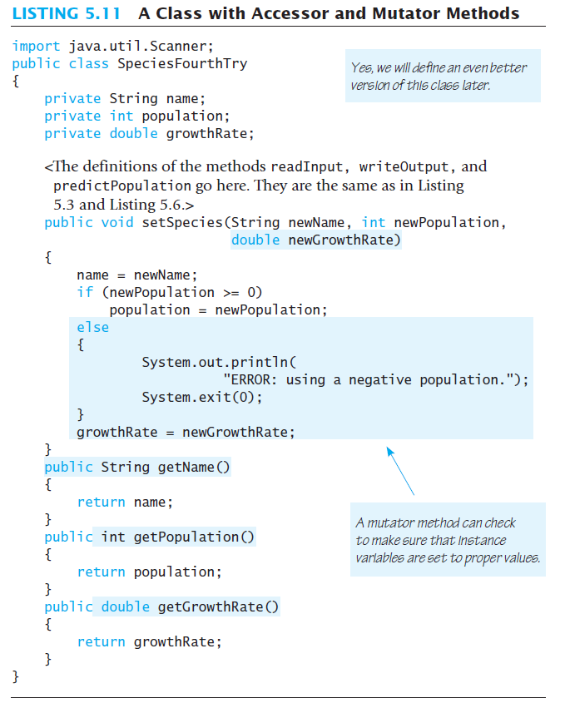

Slide 65
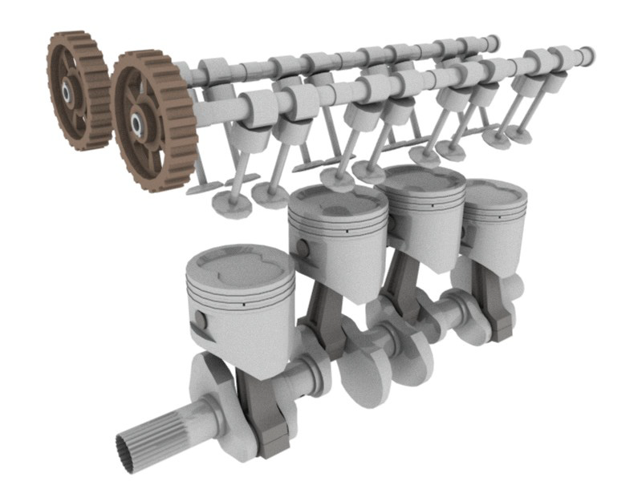
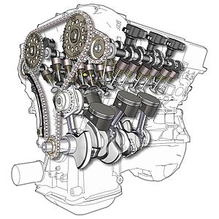
Why make methods private?
Why make methods private?
Helper methods that will only be used from inside a class should be private
External users have no need to call these methods
Encapsulation

Slide 66
Encapsulation
Consider example of driving a car
We see and use break pedal, accelerator pedal, steering wheel – know what they do
We do not see mechanical details of how they do their jobs
Encapsulation divides class definition into
Class interface
Class implementation

Slide 67
Encapsulation
A class interface
Tells what the class does
Gives headings for public methods and comments about them
A class implementation
Contains private variables
Includes definitions of public and private methods

Slide 68
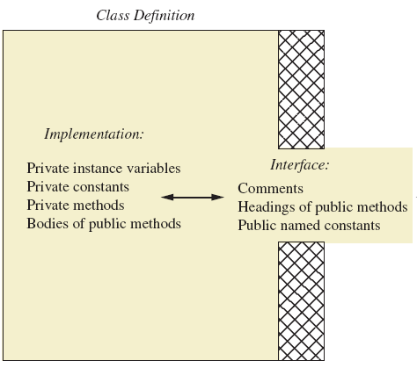
Encapsulation
Figure 5.3 A well encapsulated class definition
Programmer who uses the class

Slide 69
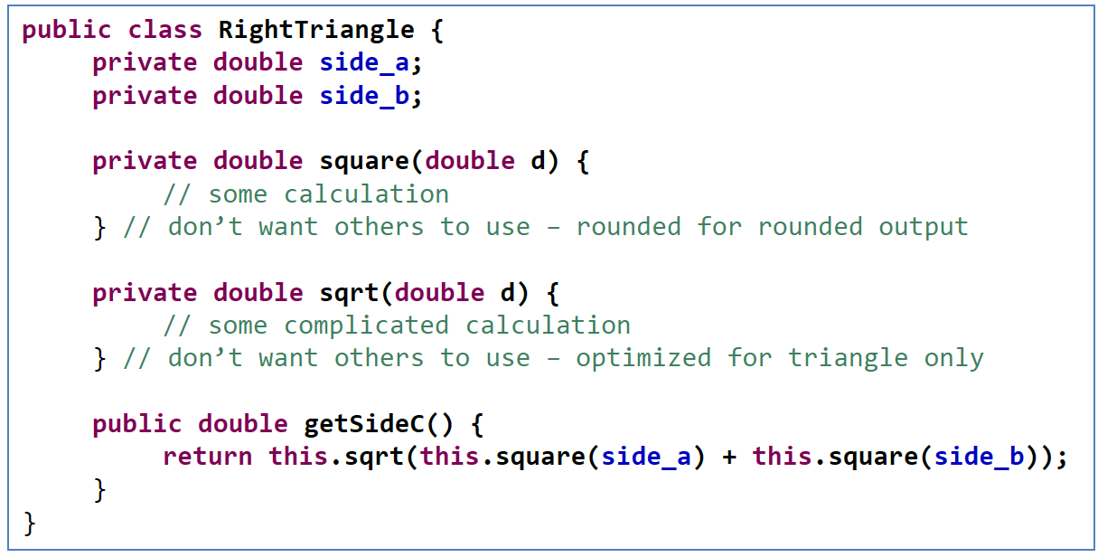
Example : private Method
Make helping methods private

Slide 70
Guidelines When You Define a Class
Comments before class definition (this is your header) and before method
Instance variables are private
Provide public accessor and mutator methods
Make helping methods private
/* */ for user-interface comments and // for implementation comments

Slide 71
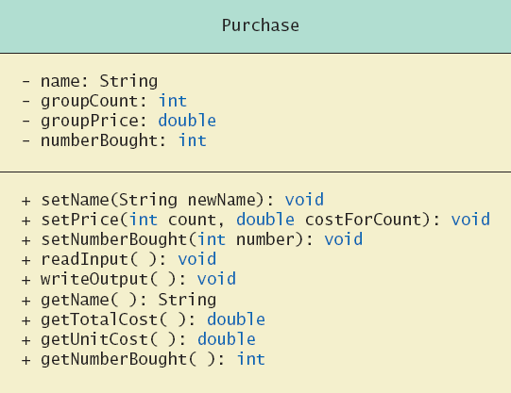
UML Class Diagrams
Recall a UML class diagram
Minus signs imply private methods
Plus signs imply public methods

Slide 72
Access modifier
private
default
protected
public
Easy to access!
 | Current Class Only | Same package |  | Different package |  | All Classes
 |  | Subclass (상속) | Not subclass | Subclass (상속) | Not subclass
private | O | X | X | X | X | X
(default) | O | O | O | X | X | X
protected | O | O | O | O | X | X
public | O | O | O | O | O | O

Slide 73
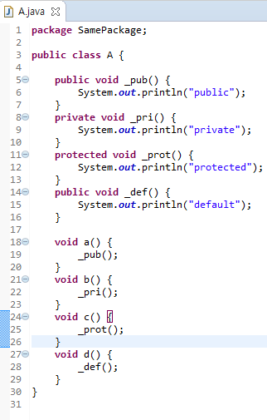
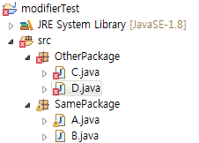
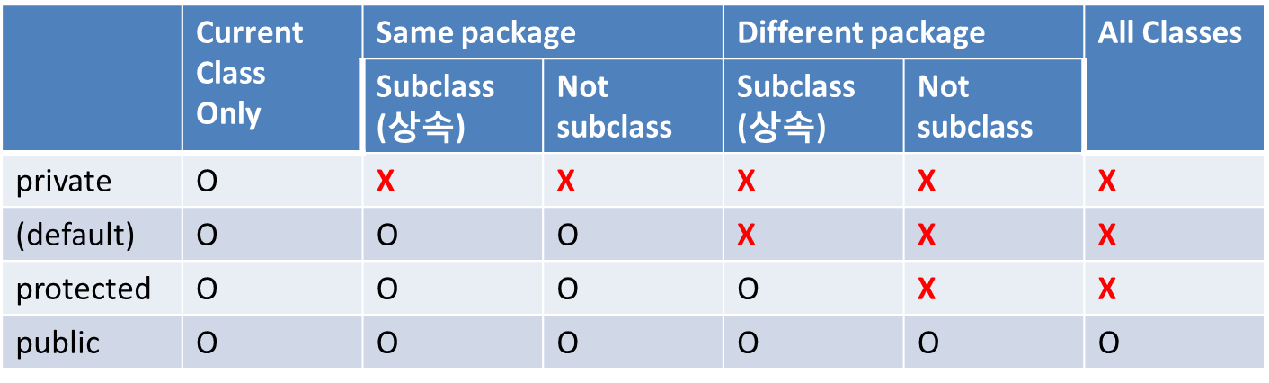
Lab: Access modifier

Slide 74
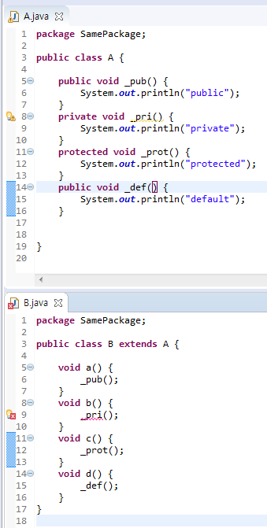
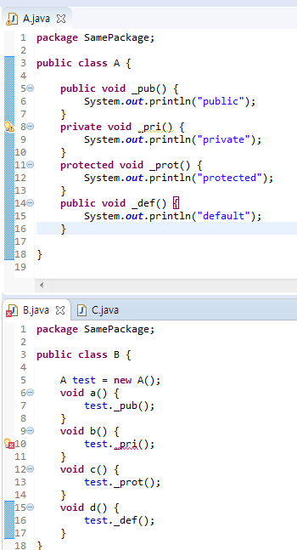
Lab: Access modifier
Private type
access error!
Private type
access error!

Slide 75
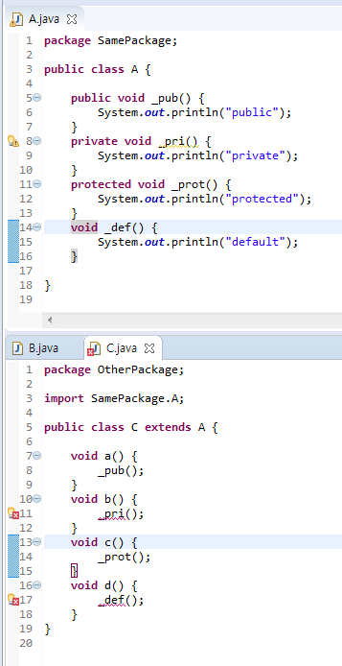
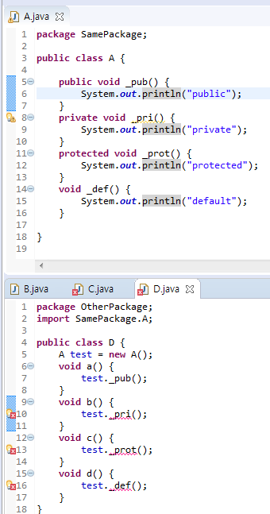
Lab: Access modifier
Private & default & protected
type access error!
Private & default type
access error!

Slide 76
Practice 5
Ex5_1. Implement a class MotorBoat and write a test program
Attributes (public):
Capacity of fuel tank (C), Amount of fuel in the tank (f)
Maximum speed (M), Current speed (s)
Efficiency of the boat’s motor (e)
Methods:
Given a parameter (time t), print the amount of fuel used at the maximum and current speeds (f=e*s²*t)
Given a time t, print the travel distance (s*t)
For current speed s and fuel amount f, print the travel distance

Slide 77
Practice 5
Ex5_2. Modify Ex5_1
Make tank capacity (C) and maximum speed (M) constants
public static final double tankCapacity = 60.0;
Make all other instance variables private, and implement their getter/setter methods
Check if fuel amount (f) and current speed (s) exceeds C and M; if so, print an error message
Modify the test program accordingly

