Slide 1

_{Object Oriented Programming} Introduction to Java
Ch. 6. More About Objects and Methods
March 4, 2014
Dept. of Software, Gachon University
Ahyoung Choi, Spring

Slide 2
6.1 Constructors

Slide 3
Object Creation
Body sun = new Body( );
class Body {
private long idNum;
private String name;
private Body orbits;
private static long nextID = 0;
}
define a variable sun to refer to a Body object
create a new Body object
Question:
Can we initialize the member variables of the new object sun before its first use?

Slide 4
Constructors
constructor
a way to initialize an object before the reference to the object is returned by new
has the same name as the class
can have parameters
To specify initial values if desired
may have multiple definitions
Each with different numbers or types of parameters

Slide 5
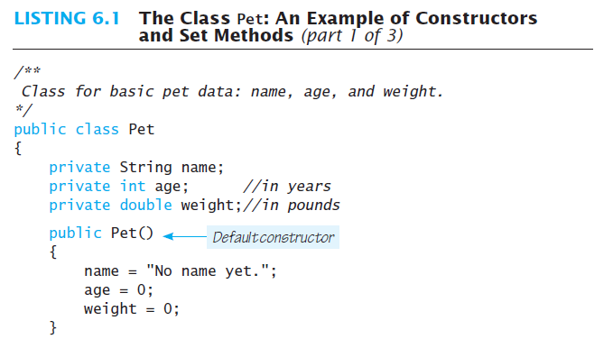
Default constructor
No return type (e.g., void, int) is required!!

Slide 6
Default constructor
Default constructor
Constructor without parameters
Java will define this automatically if the class designer does not define any constructors
If you do define a constructor, Java will not automatically define a default constructor
Usually default constructors not included in class diagram

Slide 7
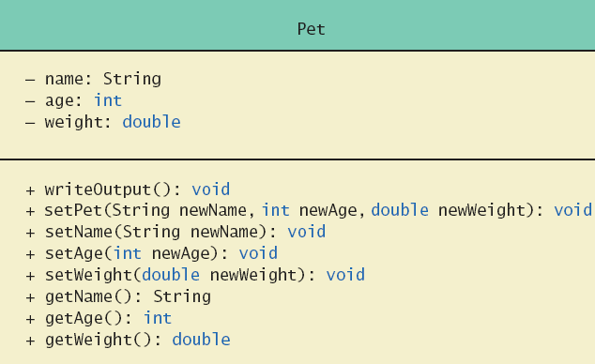
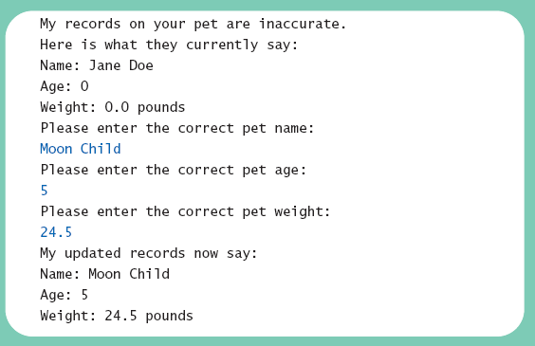
Lab: pet class
Note sample code, listing 6.1 class Pet
Note different constructors
Default
With 3 parameters
With String parameter
With double parameter
Note sample program, listing 6.2 class PetDemo

Slide 8
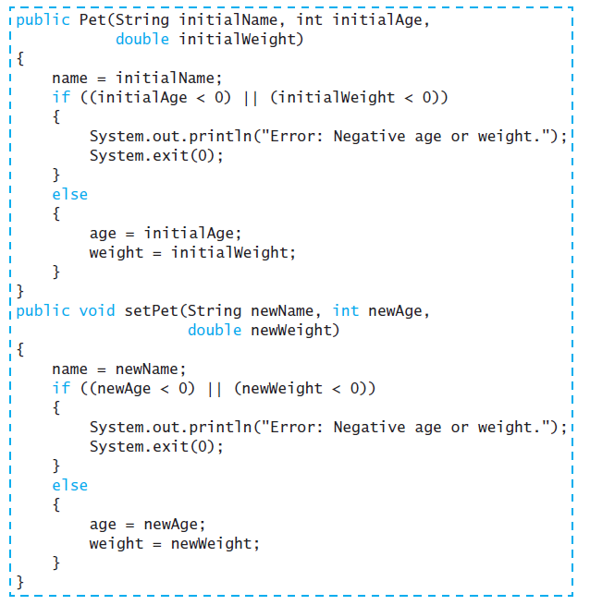
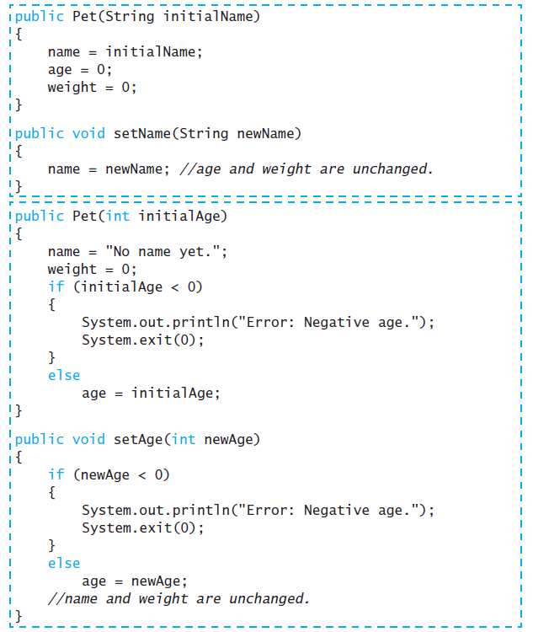

Slide 9
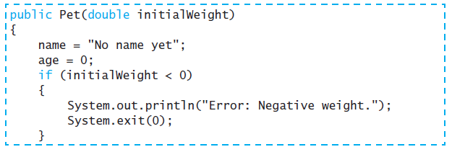
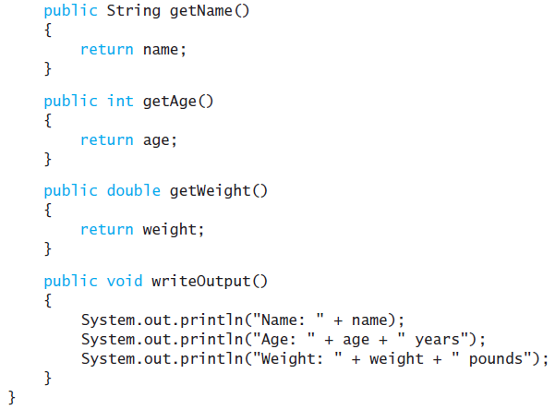
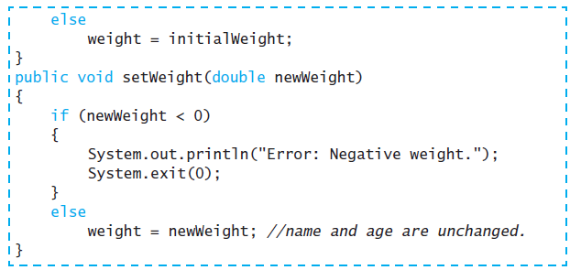

Slide 10
Defining Constructors

Slide 11
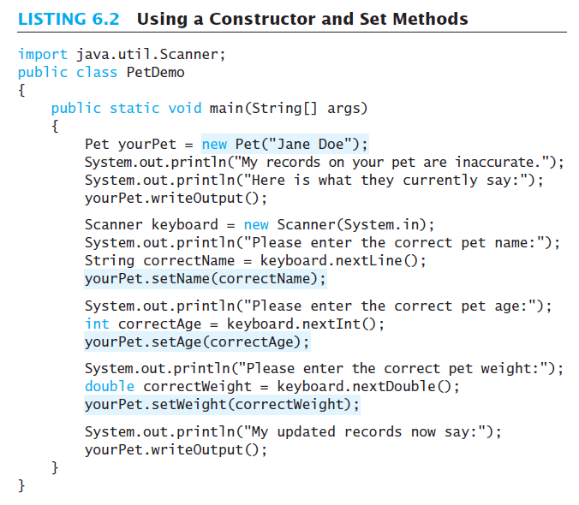
Differences between mutator (setter method) vs constructor?
➔ Can call once vs
Can call whenever want

Slide 12
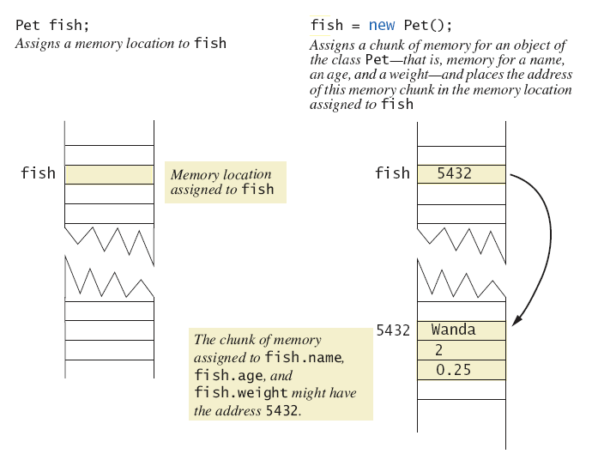
Defining Constructors
Figure 6.2 A constructor returning a reference

Slide 13
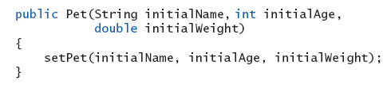
Calling Methods from Other Constructors
Method can call other methods within a classes.
Similarly constructor can call methods within a class
Keeps from (avoid) repeating code

Slide 14
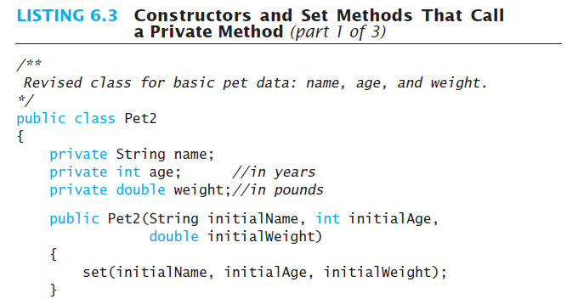
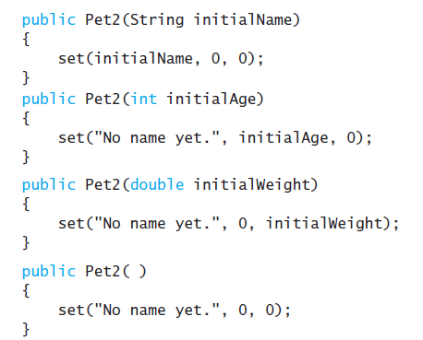
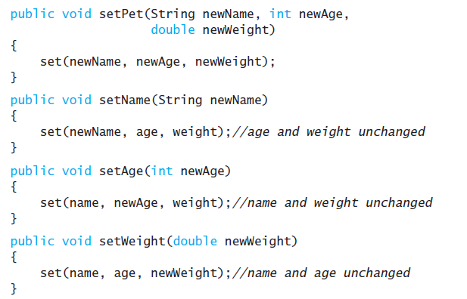
Lab: pet class – Let’s make it simple
View sample code, listing 6.3 class Pet2
private void set(String newName, int newAge, double newWeight){
name = newName;
if ((newAge < 0) || (newWeight < 0)){
System.out.println("Error: Negative age or weight.");
System.exit(0);
}
else{
age = newAge;
weight = newWeight;
}
}

Slide 15
Calling Constructor from Other Constructors
Use initial constructor and method set
In the other constructors use the this reference to call initial constructor
View revised class, listing 6.4 class Pet3
Note calls to initial constructor

Slide 16
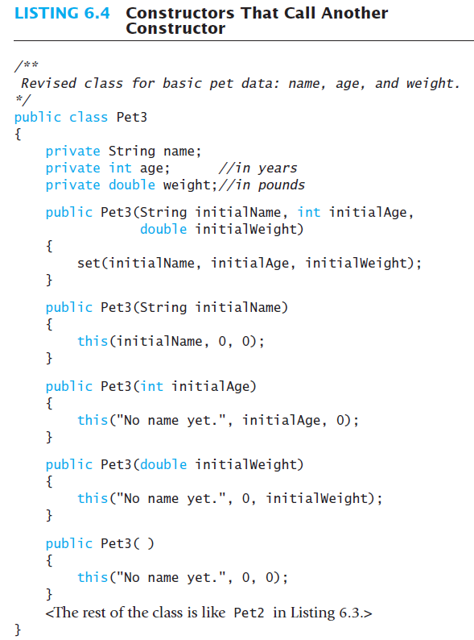
Initial constructor
Use!
Use!
Use!
Use!

Slide 17
6.2 Static Variables and Static Methods

Slide 18
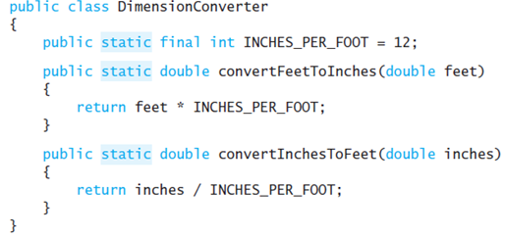
Question
What does “static final” mean ?
What is it implemented ?
If you generate N objects of a class DimemsionCoverter, how many variable INCHES_PER_FOOT are generated ?

Slide 19
Recall
Recall that “classes do not have data; individual objects have data”
This is not always true – classes can have data, too
static variables and methods belong to a class as a whole, not to an individual object
When would you want a method that does not need an object?
If the method perform a general function instead of actions on an object

Slide 20
Static Variables
Static means “belonging to the class in general”, not to an individual object
A variable may be declared with the static keyword
e.g. static int numTicketsSold;
There is one variable numTickets for the class not one per object!!!
Static variables are shared by all objects of a class
Variables declared static final are considered constants – value cannot be changed

Slide 21
Static Variables
Variables declared static (without final) can be changed
Only one instance of the variable exists
It can be accessed (shared) by all instances of the class
A public static variable may be accessed by
ClassName.variableName
E.g. Math.PI

Slide 22
Static Methods
Some methods may have no relation to any type of object
Example
Compute max of two integers
Convert character from upper- to lower case
A method may be declared with the static keyword
Static method declared in a class
Can be invoked without using an object
Static methods live at class level, not at object level

Slide 23
Static Methods (contd..)
A static method that is public can be accessed
ClassName.methodName(args)
Static methods access static variables and methods, but not instance variables
double result = Math.sqrt(25.0);
int numSold = Ticket.getNumberSold();
public static int getNumSold(){
return numTicketsSold;
}

Slide 24
Problem?
public class JustAdd {
int x;
int y;
int z;
public static void main(String args[]) {
x = 5;
y = 10;
z = x + y;
}
}
all are wrong

Slide 25
Static method - System class
Facilities provided by System
Standard output
Error output streams
Standard input and access to externally defined properties and environment variables.
A means of loading files and libraries
It cannot be instantiated ➔ defined with “static”
Field definition | Explaination
static PrintStream err | This is the "standard" error output stream.
static InputStream in | This is the "standard" input stream.
static PrintStream out | This is the "standard" output stream.
A static variable is common to all the instances (or objects) of the class because it is a class level variable. Only a single copy of static variable is created and shared among all the instances of the class.

Slide 26
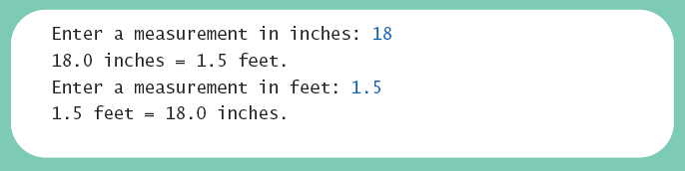
Lab: Static Methods
View sample class, listing 6.5 class DimensionConverter
View demonstration program, listing 6.6 class DimensionConverterDemo

Slide 27
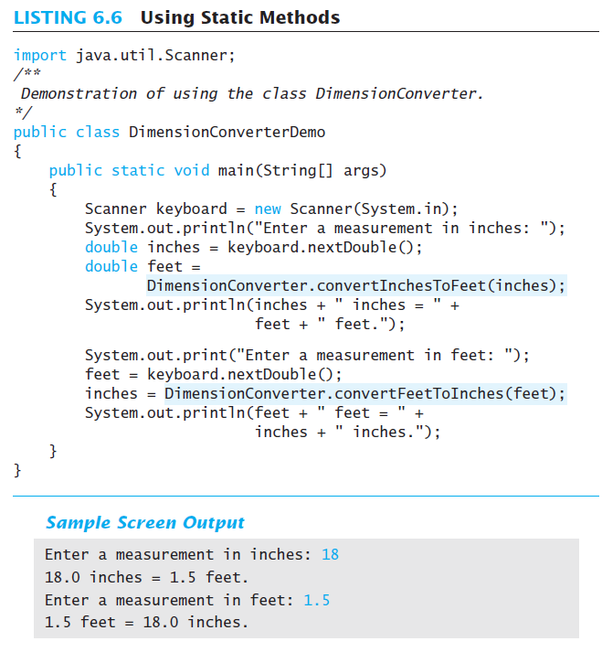
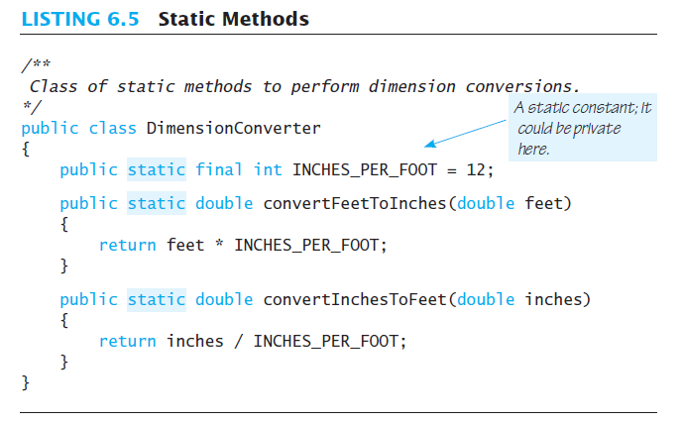
6.5-6.6
Notes:
class DimensionCoverter

Slide 28
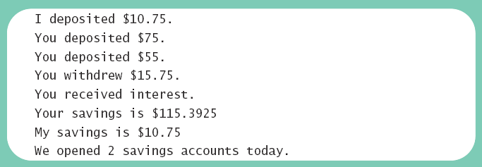
Lab: Mixing Static and Nonstatic Methods
View sample class, listing 6.7 class SavingsAccount
View demo program, listing 6.8 class SavingsAccountDemo

Slide 29
import java.util.Scanner;
public class SavingsAccount {
private double balance;
public static double interestRate = 0;
public static int numberOfAccounts = 0;
public SavingsAccount () {
balance = 0;
numberOfAccounts++;
}
public static void setInterestRate (double newRate) {
interestRate = newRate;
}
public static double getInterestRate () {
return interestRate;
}
public static double getNumberOfAccounts () {
return numberOfAccounts;
}
public void deposit (double amount) {
balance = balance + amount;
}
public double withdraw (double amount) {
if (balance >= amount) balance = balance - amount;
else amount = 0;
return amount;
}
public void addInterest () {
double interest = balance * interestRate;
balance = balance + interest;
}
public double getBalance () { return balance; }
public static void showBalance (SavingsAccount account) {
System.out.print (account.getBalance ());
}
}
외부 공유 필요한 변수를 Static 변수 선언
생성자 선언 및 초기화
Static 변수 접근을 위한 함수는 static method 선언
Interest rate 값 의 setter getter 함수 구현
전체 account number 변수를 위한 setter, getter 구현
함수 : 입금 함수
함수 : 출금 계산 (금액 출금 후 잔액 저장)
함수 : 이율계산
함수 : balance 변수 getter 함수
함수 : balance 출력

Slide 30
public class SavingsAccountDemo {
public static void main (String [] args) {
SavingsAccount.setInterestRate (0.01); // 이율 set
SavingsAccount mySavings = new SavingsAccount (); // account 인스턴스 2개 생성
SavingsAccount yourSavings = new SavingsAccount ();
System.out.println ("I deposited $10.75.");
mySavings.deposit (10.75); // 첫번째 계좌에 10.75불 입금
System.out.println ("You deposited $75.");
yourSavings.deposit (75.00); // 두번째 계좌에 75불 입금
double cash = yourSavings.withdraw (15.00); // 두번째 계좌에서 15불 출금
System.out.println ("You withdrew $" + cash + ".");
if (yourSavings.getBalance () > 100.00) { // 예금액 100불 이상이면 이율계산
System.out.println ("You received interest.");
yourSavings.addInterest ();
}
System.out.println ("Your savings is $" + yourSavings.getBalance ()); // 두번째 계좌 발란스 확인
System.out.print ("My savings is $");
SavingsAccount.showBalance (mySavings); // 첫번째 계좌 발란스 확인
System.out.println ();
int count = SavingsAccount.getNumberOfAccounts (); // 총 개설 account 확인
System.out.println ("We opened " + count " savings accounts today.");
}
}

Slide 31
Tasks of main in Subtasks
Program may have
Complicated logic
Repetitive code
Create static methods to accomplish subtasks
Consider example code, listing 6.9 a main method with repetitive code
Note alternative code, listing 6.10 uses helping methods
main()
{
…
… //sub_task1
….
… // sub_task2
..
}
main()
{
…
method_for_subtask1()
….
method_for_subtask2()
..
}
Static method_for_subtask1() {
… // sub_task1
}
static method_for_subtask2() {
… // sub_task2
}

Slide 32
Adding Method main to a Class
Method main used so far in its own class within a separate file
Often useful to include method main within class definition
To create objects in other classes
To be run as a program
Note example code, listing 6.11 a redefined class Species
When used as ordinary class, method main ignored

Slide 33
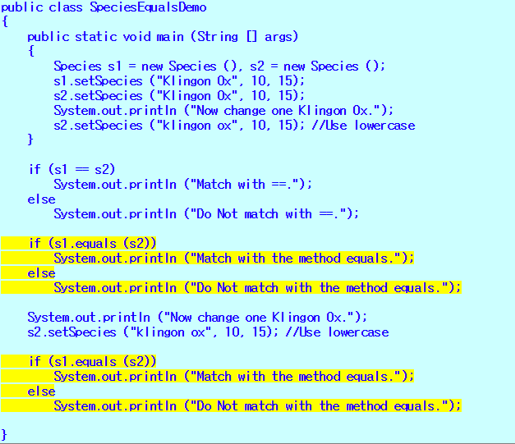
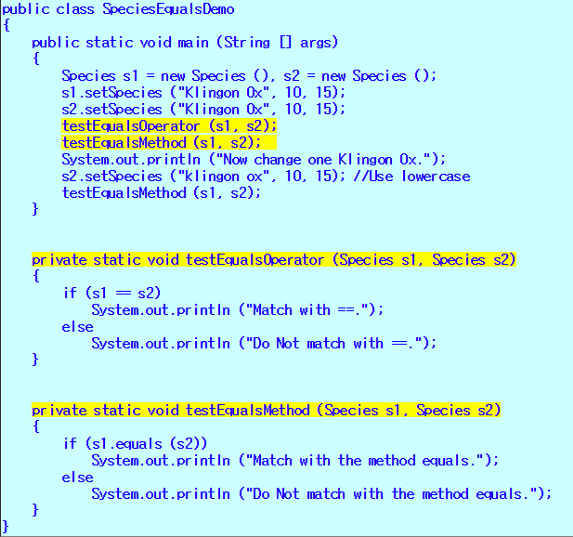

Slide 34
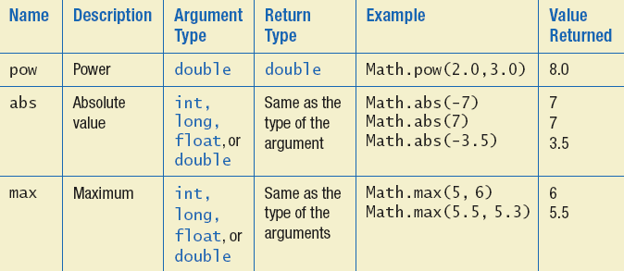
The Math Class
Provides many standard mathematical methods
Automatically provided, no import needed
Example methods, figure 6.3a

Slide 35
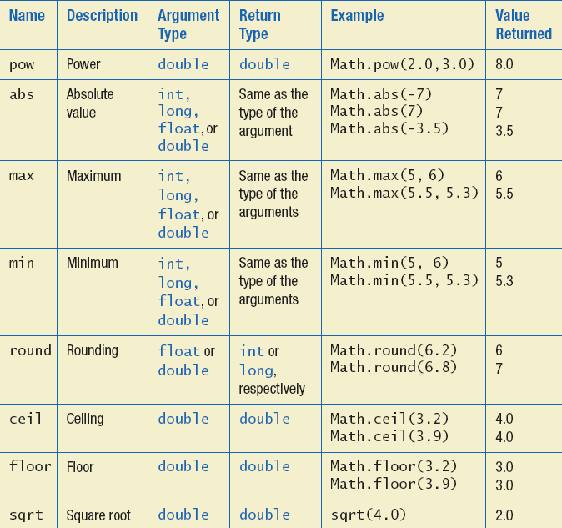
Math Class
Example methods, figure 6.3b

Slide 36
Random Numbers
Math.random()returns a random double that is greater than or equal to zero and less than 1
Java also has a Random class to generate random numbers
Can scale using addition and multiplication; the following simulates rolling a six sided die
int die = (int) (6.0 * Math.random()) + 1;

Slide 37
Question
Can you write a traditional swap(a,b) method ?
Swap(a,b) : switching the values of variables a and b
void swap(int arg1, int arg2) {
int temp = arg1;
arg1 = arg2;
arg2 = temp;
}
main( ) {
int n1 = 10, n2 = 20;
swap(n1, n2);
System.out.println(n1+”,”+n2);
}
public class swap {
public static void main(String[] args) {
int n1 = 10, n2 = 20;
swapMethod(n1, n2);
System.out.println(n1 + "," + n2);
}
static void swapMethod(int arg1, int arg2) {
int temp = arg1;
arg1 = arg2; arg2 = temp;
}
}

Slide 38
Possible solution – int holder
n1
n2
2029
2033
public class test {
public static void main(String[] args) {
IntHolder n1 = new IntHolder();
IntHolder n2 = new IntHolder();
n1.value = 10; n2.value =20;
System.out.println(n1.value + " " + n2.value);
swap(n1, n2);
System.out.println(n1.value + " " + n2.value);
}
static void swap(IntHolder a, IntHolder b){
int temp = a.value;
a.value = b.value;
b.value = temp;
}
}
class IntHolder { public int value = 0; }
value
10
value
20
temp

Slide 39
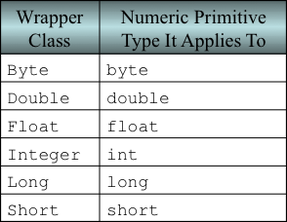
Wrapper Classes
Recall that arguments of primitive type treated differently from those of a class type
May need to treat primitive value as an object
Java provides wrapper classes for each primitive type
Byte, Short, Long, Float, Double, and Character

Slide 40
Wrapper Classes
Boxing: the process of going from a value of a primitive type to an object of its wrapper class
Integer obj = new Integer(42);
Integer obj = Integer.valueOf(10000);
Unboxing: the process of going from an object of a wrapper class to the corresponding value of a primitive type
int i = obj.intValue();
char a = obj.charValue();
To Boxing : valueOf()
To unboxing: type+Value()

Slide 41
Creating a Wrapper Class : Boxing
To create objects from these wrapper classes, you can pass a value to the constructor:
Wrapper classes have no default constructor : Programmer must specify an initializing value when creating new object
You can also assign a primitive value to a wrapper class object:
Starting with JDK 1.5, Java can automatically do boxing and unboxing
No need to creat a wrapper class object using the new operation
Integer number = new Integer(7);
Boxing
Automatic Boxing
Integer number = 7;

Slide 42
Constants in Wrapper Classes
Constants that provide the largest and smallest values for any of the primitive number types
Integer.MAX_VALUE, Integer.MIN_VALUE, Double.MAX_VALUE, Double.MIN_VALUE
Constants of type Boolean in Boolean class
Boolean.TRUE and Boolean.FALSE
Boolean objects that correspond to the values true and false of the primitive type boolean

Slide 43
Method in wrapper class
valueOf(), valueOf(String s), valueOf(String s, int radix)
To create Wrapper object for given primitive or String.
xxxValue()
To get the primitive for the given Wrapper Object
parseXxx(), parseXxx(String s, int radix)
To convert String to primitive
toString(), toString( , int radix)
Every wrapper class contains the following toString() method to convert Wrapper Object to String type.

Slide 44
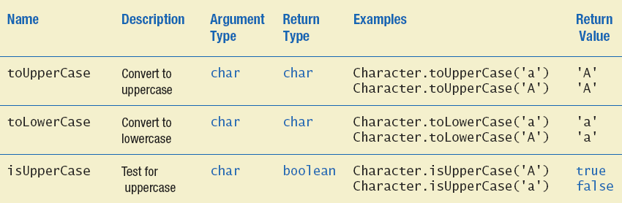
Wrapper Classes
Figure 6.4a Static methods in class Character

Slide 45
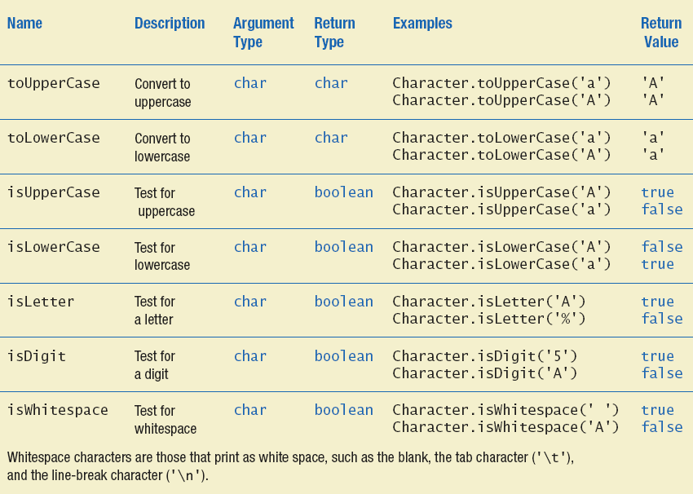
Wrapper Classes
Figure 6.4b Static methods in class Character

Slide 46
Lab: Wrapper class
public class wrapper {
public static void main(String[] args) {
Double avg = new Double("3.145");
System.out.println(avg);
Integer I = Integer.valueOf("10");
System.out.println(I);
Double D = Double.valueOf("10.0");
System.out.println(D);
Boolean B = Boolean.valueOf("true");
System.out.println(B);
Character C = Character.valueOf('a');
System.out.println(C);
Integer I1 = Integer.valueOf("1111", 2);
System.out.println(I1);
System.out.println(I.byteValue());
System.out.println(I.shortValue());
System.out.println(I.intValue());
System.out.println(I.longValue());
System.out.println(I.floatValue());
System.out.println(I.doubleValue());
int i = Integer.parseInt("10");
double d = Double.parseDouble("10.5");
boolean b = Boolean.parseBoolean("true");
System.out.println(i);
System.out.println(d);
System.out.println(b);
String s = I.toString();
System.out.println(s);
String s1 = Integer.toString(15, 2);
System.out.println(s1);
Integer age1 = new Integer(30);
Integer age2 = 30; // age2와 3에 1000 테스트
Integer age3 = 30;
System.out.println(age1);
System.out.println(age1.intValue());
System.out.println(age2);
System.out.println(age2.intValue());
if(age1 == age2)
System.out.println("reference same");
if(age2 == age3)
System.out.println("reference same");
if(age1.intValue() == age2.intValue())
System.out.println("value same");
}
}

Slide 47
Practice 6.1
Ex6_1. Create a class RoomOccupancy
Instance variables (private): roomNumber, peopleInRoom
Static variables: totalNumber – number of total people
Write the following methods:
Constructor – gets roomNumber and peopleInRoom parameters
addOneToRoom – increases peopleInRoom and totalNumber
removeOneFromRoom – decreases peopleInRoom and totalNumber, if both are > 0
getNumber – returns roomNumber
getTotal (static) – returns totalNumber
Write a program to test the class with ≥2 objects

Slide 48
Practice 6.1
Test class
public class RoomOccupancyDemo {
public static void main(String[] args) {
RoomOccupancy r = new RoomOccupancy(101, 2);
RoomOccupancy s = new RoomOccupancy(102, 3);
System.out.println(RoomOccupancy.getTotal());
r.addOneToRoom();
r.addOneToRoom();
s.removeOneFromRoom();
System.out.println(r.getPeopleInRoom());
System.out.println(s.getPeopleInRoom());
System.out.println(RoomOccupancy.getTotal());
}
}

Slide 49
6.4 Overloading

Slide 50
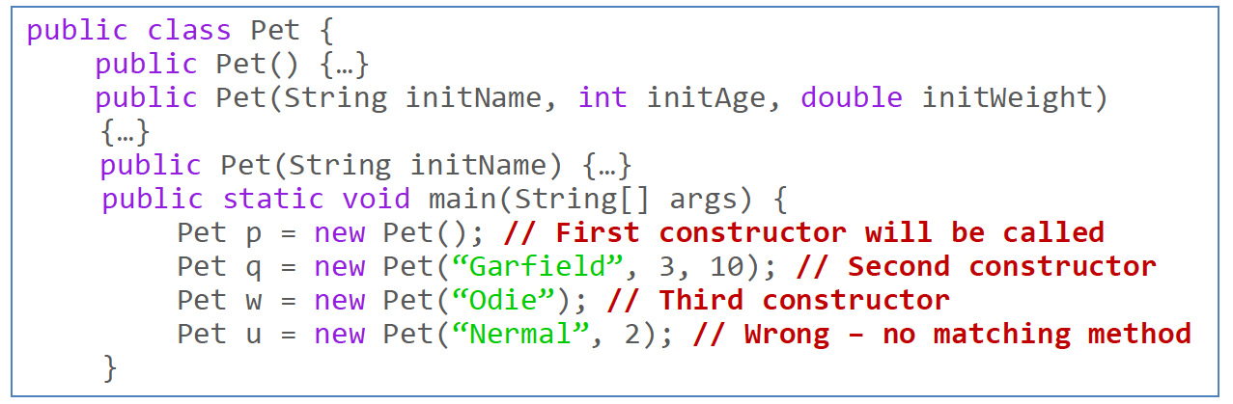
Methods Overloading
We’ve seen that a class can have multiple constructors. Notice that they have the same name.

Slide 51
Overloading Basics
When two or more methods have same name within the same class
It is not only for constructors
Parameter lists must be different
Java distinguishes the methods by number and types of parameters; it attempts to do type conversions
public double average(int n1, int n2)
public double average(double n1, double n2)
public double average(double n1, double n2, double n3)

Slide 52
Overloading : Method Signature
A method's name and number and type of parameters is called the signature
Java knows what to use based on the number and types of the arguments
Signature does NOT include return type
Cannot have two methods with the same signature in the same class
System.out.println(“The result is”); // String type parameter
System.out.println(20); // int type parameter
public double average(int n1, int n2)
public int average(int n1, int n2) // Wrong overloading
public int average(char n1, char n2) // it is okay

Slide 53

Overloading Basics
View example program, listing 6.15 class Overload
Note overloaded method getAverage

Slide 54
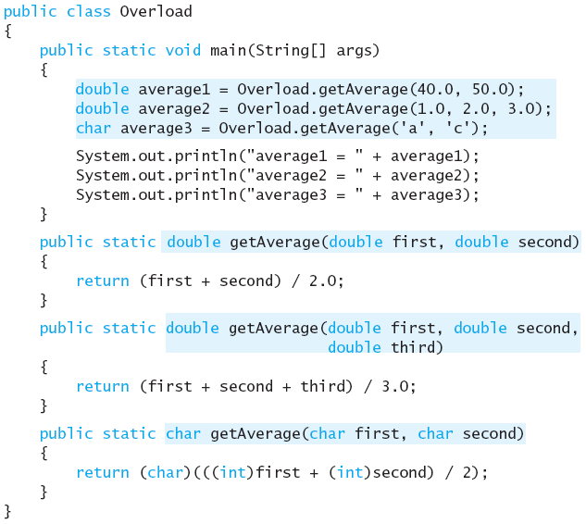

Slide 55
Overloading and Type Conversion
Java always tries to find an exactly matching method. If it fails, it tries type conversion
If a class has the following two methods:
public double average(int n1, int n2)
public double average(double n1, double n2)
If the method call is average(3,3), the first method will be called
However, if a class only have a method:
public double average(double n1, double n2)
If the method call is average(3,3), it will be converted to average(3.0,3.0) and call the (only) method
Recall: byte->short->int->long->float->double

Slide 56
How to Use Overloading
Use it only if two or more methods are performing exactly the same function
public void setPet(String newName)
public void setPet(String newName, int newAge, double newWeight)
Bad idea to create methods that have the same name but do different things
public void setPet(int newAge)
public void setPet(double newWeight)
What happens if we call setPet(3)?
Use setAge() and setWeight() instead
Usually we do not overload methods if parameters can be converted

Slide 57
6.6 Enumeration as a Class

Slide 58
Enumeration
Consider the case to restrict a variable to have only the values in a certain set
An enumeration lists the values a variable can have
Example
enum Suit {CLUBS, DIAMONDS, HEARTS, SPADES}
Suit suit=Suit.DIAMONDS;

Slide 59
Enumeration as a Class
When an enumeration is defined, Java creates a class with methods:
Compiler creates a class with methods
equals() – returns true if equal
compareTo() – returns a negative value if comes earlier
ordinal() – returns the position ≥ 0
toString() – returns a String
valueOf() – returns an enum value

Slide 60
Enumeration as a Class
protected Object | clone()Throws CloneNotSupportedException.
int | compareTo(E o)Compares this enum with the specified object for order.
boolean | equals(Object other)Returns true if the specified object is equal to this enum constant.
protected void | finalize()enum classes cannot have finalize methods.
Class<E> | getDeclaringClass()Returns the Class object corresponding to this enum constant's enum type.
int | hashCode()Returns a hash code for this enum constant.
String | name()Returns the name of this enum constant, exactly as declared in its enum declaration.
int | ordinal()Returns the ordinal of this enumeration constant (its position in its enum declaration, where the initial constant is assigned an ordinal of zero).
String | toString()Returns the name of this enum constant, as contained in the declaration.
static <T extends Enum<T>> T | valueOf(Class<T> enumType, String name)Returns the enum constant of the specified enum type with the specified name.
https://docs.oracle.com/javase/7/docs/api/java/lang/Enum.html#equals(java.lang.Object)

Slide 61
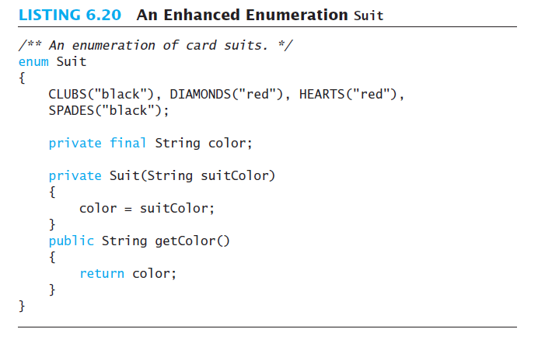
Enhanced enumeration
Define your own class for enumeration – with additional instance variables and methods (including constructors)

Slide 62
Lab: enum test
Write a developer class that use enum type for development type
Use enum class functions to get data
enum DevType1 { MOBILE, WEB, SERVER }
enum DevType2 {
MOBILE("Android"), WEB("CSS"), SERVER("LINUX");
final private String name;
public String getName() { return name; }
private DevType2(String name){ this.name = name; }
}

Slide 63
public class test {
public String name;
public int career;
public DevType1 type1;
public static void main(String[] args) {
test developer = new test();
// test basic enum usage
developer.name = "Kim";
developer.career = 3;
developer.type1 = DevType1.WEB;
System.out.println("Developer name : "+ developer.name);
System.out.println("Experience : "+ developer.career);
System.out.println("Experties : "+ developer.type1);
// test enum class methods 1
DevType1 tp1 = DevType1.MOBILE;
DevType1 tp2 = DevType1.valueOf("WEB");
System.out.println(tp1);
System.out.println(tp2);
System.out.println(tp1.ordinal());
System.out.println(tp2.ordinal());
for(DevType1 type1 : DevType1.values()){
System.out.println(type1);
}
// test enum class methods 2
for( DevType2 type2: DevType2.values()){
System.out.println(type2.getName());
}
}
}
// 기존 for 구문
String[] numbers = {"one", "two", "three"};
for(int i=0; i<numbers.length; i++)
{ System.out.println(numbers[i]); }
// For each 구문
for (type var: iterate)
{ body-of-loop }
String[] numbers = {"one", "two", "three"};
for(String number: numbers)
{ System.out.println(number); }

Slide 64
6.7 Packages

Slide 65
Packages and Importing
A package is a collection of classes grouped together into a folder
Name of folder is name of package
Each class
Placed in a separate file
Has this line at the beginning of the file package Package_Name;
Classes use packages by use of import statement

Slide 66
Package Names and Directories
Package name tells compiler path name for directory containing classes of package
Search for package begins in class path base directory
Package name uses dots in place of / or \
Name of package uses relative path name starting from any directory in class path

Slide 67
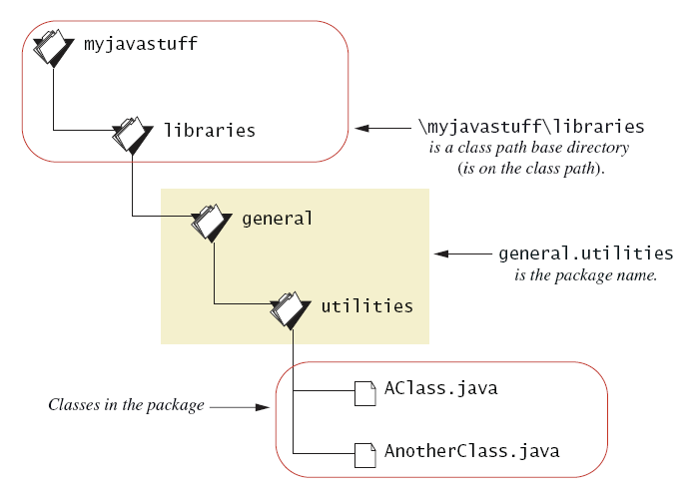
Package Names and Directories
Figure 6.5 A package name

Slide 68
Name Clashes
Packages help in dealing with name clashes
Different programmers may give same name to two classes
Ambiguity resolved by using the package name
<folder>
src/species/cat/kitty.java src/species/dog/poodle/puppy.java
How to define?
How to use?
Package species.cat;
public class kitty { }
import species.cat.kitty;
import species.cat.*;
import species.dog.poodle.puppy;
import species.dog.poodle.*;
Package species.dog.poodle; public class puppy { }

