Slide 1

_{Object Oriented Programming} Introduction to Java
Ch. 7. Arrays
March 4, 2014
Dept. of Software, Gachon University
Ahyoung Choi, Spring 2021

Slide 2
7.1 Array Basics

Slide 3
Arrays
An array is a collection of items of the same type
Think of as collection of variables of same type
Like a list of different variables, but with a nice, compact way to name them
An array is a special kind of object in Java
Loops repeat things temporally; arrays repeat things spatially

Slide 4
Creating and Accessing Arrays
Creating an array with 7 variables of type double
To access
temperature[i] , where 0 <= i < 7
Variables such as temperature[0] that have an integer expression in square brackets are known as:
indexed variables, subscripted variables, array elements, or simply elements
double[] temperature = new double[7];

Slide 5
Creating and Accessing Arrays
Syntax:
BaseType[] arrayName = new BaseType[length];
BaseType can be either a primitive type or a class (String, etc.)
Examples:
int[] pressure = new int[100];
int[] pressure; pressure = new int[100];
int pressure[] = new int[100]; // possible but, discouraged!
public static final int readings = 100; int[] pressure = new int[readings]; // constant length
int numScores = keyboard.nextInt(); int[] scores = new int[numScores]; // dynamic allocation

Slide 6
Creating and Accessing Arrays
Create an array with given length saved in constants
public static final int NUMBER_OF_READINGS = 100;
int[] pressure = new int[NUMBER_OF_READINGS];
Then,
Create an array with user input length
System.out.println("How many scores?");
int numScores = keyboard.nextInt();
int[] scores = new int[numScores];
for (int i = 0; i < NUMBER_OF_READINGS ; i++)
scoreSum += keyboard.nextInt();

Slide 7
Index
An index (or subscript) is an integer expression inside the square brackets that indicates an array element
To access an element use: ArrayName[index]
Array indices begin at 0
The reason is that the array name represents a memory address, and the i^{th} element can be accessed by the address plus i
temperature
temperature[5]
0 | 1 | 2 | 3 | 4 | 5 | 6
32.0 | 30.0 | 25.7 | 26.0 | 34.0 | 31.5 | 29.0
← index

Slide 8
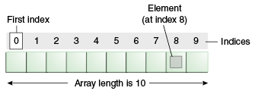
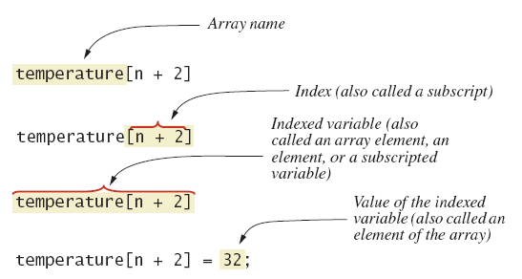
Array Details
Array terminology

Slide 9
Finding Length of An Existing Array
An array is a special kind of object
As an object an array has only one public instance variable
Variable length
Contains number of elements in the array
length is equal to the length of the array
Pet[] pets = new Pet[20];
pets.length has the value 20
You cannot change the value of length because it is final

Slide 10
Finding Length of An Existing Array
Do not be OUT OF BOUND!
Indices must be in bound
double[] entry = new double[5]; // from [0] to [4]
entry[5] = 3.7; // ERROR! Index out of bound

Slide 11
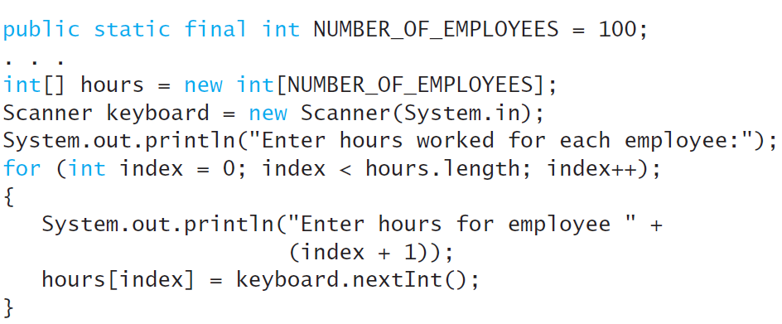
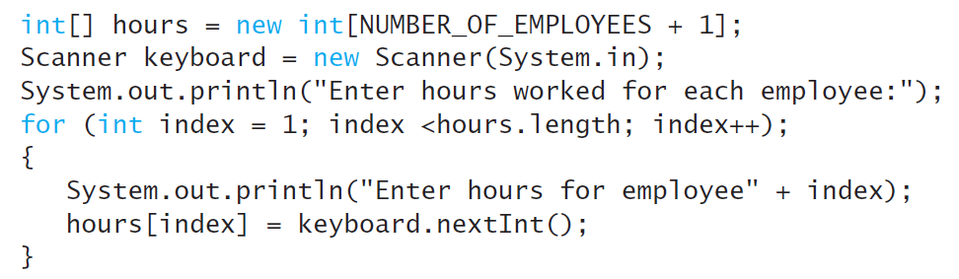
Question: Array Indexing
vs
It is OK to waste element 0
There is no answer, but The bottom line is that all programmers collaborating on a project should use the same coding practices.

Slide 12
More About Array Indices
Index of first array element is 0
Last valid Index is arrayName.length – 1
Array indices must be within bounds to be valid
When program tries to access outside bounds, run time error occurs

Slide 13
Initializing Arrays
Initialize an array when it is declared
int[] scores = { 68, 97, 102 };
Equivalent to:
int[] scores = new int[] { 68, 97, 102 };
int[] scores = new int[3]; scores[0] = 68; scores[1] = 97; scores[2] = 102;
You can use for-loop
for (int i = 0; i < 100; i ++) count[i] = 0;

Slide 14
Initializing Arrays
For primitive types:
int[] myIntArray = new int[3];
int[] myIntArray = {1,2,3};
int[] myIntArray = new int[]{1,2,3};
For classes, for example String,
String[] myStringArray = new String[3];
String[] myStringArray = {"a","b","c"};
String[] myStringArray = new String[]{"a","b","c"};

Slide 15
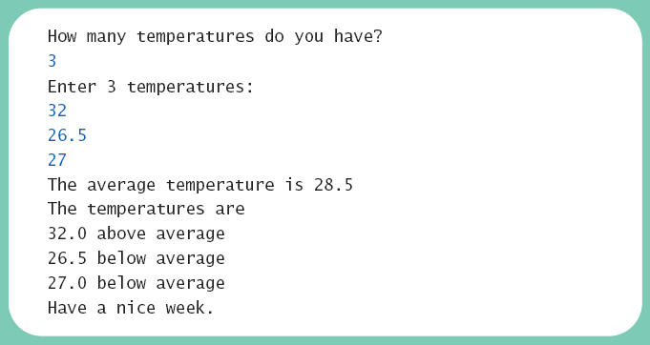
Lab: Creating and Accessing Arrays
class ArrayOfTemperatures
Read temperatures from the user and shows which are above and which are below the average of all the temperatures.

Slide 16
import java.util.Scanner;
public class ArrayOfTemperatures2
{
public static void main (String [] args)
{
Scanner keyboard = new Scanner (System.in);
System.out.println ("How many temperatures do you have?");
int size = keyboard.nextInt ();
double [] temperature = [ ????? ];
// Read temperatures and compute their average:
System.out.println ("Enter " + temperature.length +
" temperatures:");
double sum = 0;
for (int index = 0 ; index < temperature.length ; index++)
{
}
double average = sum / temperature.length;
System.out.println ("The average temperature is " +
average);
// Display each temperature and its relation to the average:
System.out.println ("The temperatures are");
for (int index = 0 ; index < temperature.length ; index++)
{
}
System.out.println ("Have a nice week.");
}
}
???
???

Slide 17
7.2 Arrays in Classes and Methods

Slide 18
Arrays of Objects
You create an array of objects (Array object) like this:
Student[] students = new Student[35];
NOTE: Each of the elements of students is not yet an object !
You have to instantiate each individual one
students[0] = new Student();
students[1] = new Student();
…or do this in a loop

Slide 19
Arrays of Objects
Student[] group1= new Student[3];
for (int i = 0; i < group1.length; i++) {
group1[i] = new Student();
}
[0]
[1]
[2]
group1
0 | 0 | 0

Slide 20
Arrays of Objects
Student[] group1= new Student[3];
for (int i = 0; i < group1.length; i++) {
group1[i] = new Student();
}
[0]
[1]
[2]
group1
1045 | 2548 | 2836
1045
2548
2836
No name
0
No name
0
No name
0

Slide 21
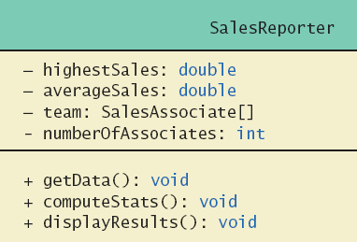
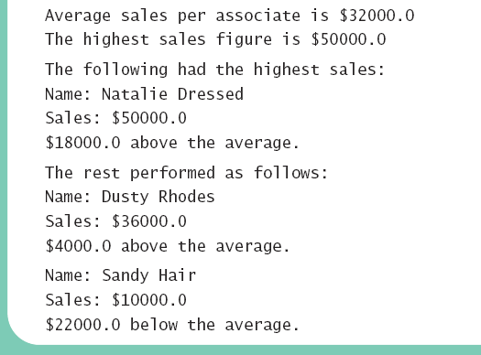
Lab: array object
Class diagram for class SalesReporter

Slide 22
package arrayTest;
import java.util.Scanner;
public class SalesAssociate{
private String name;
private double sales;
public SalesAssociate( ) {
name = "No record";
sales = 0;
}
public SalesAssociate(String initialName, double initialSales) {
set(initialName, initialSales);
}
public void set(String newName, double newSales) {
name = newName;
sales = newSales;
}
public void readInput( ) {
System.out.print("Enter name of sales associate: ");
Scanner keyboard = new Scanner(System.in);
name = keyboard.nextLine( );
System.out.print("Enter associate's sales: $");
sales = keyboard.nextDouble( );
}
public void writeOutput( ) {
System.out.println("Name: " + name);
System.out.println("Sales: $" + sales);
}
public String getName( ) { return name; }
public double getSales( ) { return sales; }
}
SalesAssociate.java
Copy and use this file

Slide 23
package arrayTest;
import java.util.Scanner;
public class SalesReporter {
private double highestSales;
private double averageSales;
private SalesAssociate[] team; //The array object
private int numberOfAssociates; //Same as team.length
// Reads the number of sales associates and data for each one.
public void getData( ) {
Scanner keyboard = new Scanner(System.in);
System.out.println("Enter number of sales associates:");
numberOfAssociates = keyboard.nextInt( );
team = new SalesAssociate[numberOfAssociates + 1];//We won't use team[0]
for (int i = 1; i <= numberOfAssociates; i++) {
team[i] = new SalesAssociate( );
System.out.println("Enter data for associate " + i);
team[i].readInput( );
} }
// Computes the average and highest sales figures.
public void computeStats( ) {
double nextSales = team[1].getSales( );
highestSales = nextSales;
double sum = nextSales;
for (int i = 2; i <= numberOfAssociates; i++) {
nextSales = team[i].getSales( );
sum = sum + nextSales;
if (nextSales > highestSales)
highestSales = nextSales; //highest sales so far.
}
averageSales = sum / numberOfAssociates; }
// Displays sales report on the screen.
public void displayResults( ) {
System.out.println("Average sales per associate is $" + averageSales);
System.out.println("The highest sales figure is $" + highestSales);
System.out.println("The following had the highest sales:");
for (int i = 1; i <= numberOfAssociates; i++) {
double nextSales = team[i].getSales( );
if (nextSales == highestSales) team[i].writeOutput( );
} }
public static void main(String[] args) {
SalesReporter clerk = new SalesReporter( );
clerk.getData( );
clerk.computeStats( );
clerk.displayResults( ); } }
SalesReporter.java
Create instances of array objects
Find highest sales

Slide 24
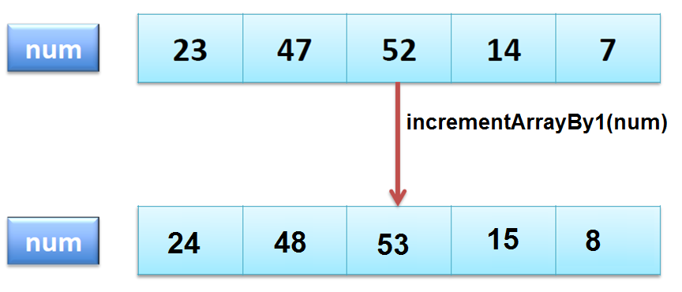
Arrays as Parameters
public static void incrementArray(int[] arr) {
for(int i = 0; i < arr.length; i++) arr[i]++;
}
public void testArray() {
int[] a = new int[] { 23, 47, 52, 14, 7 };
incrementArray(a);
System.out.println(a[3]);
}
Prints 15, why?

Slide 25
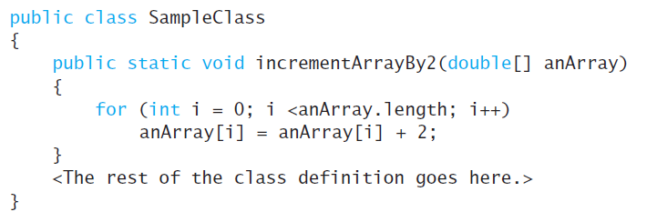
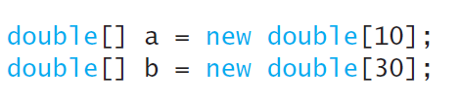

Arrays as Parameters
Array Parameters Do Not Specify the Array Length

Slide 26
Then, you can understand..
public static void main(String[] args)

Slide 27
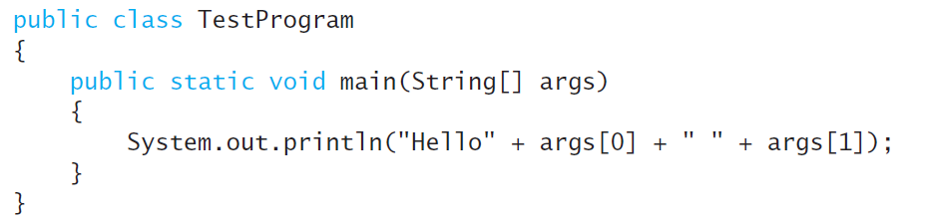
Argument for the Method main
public static void main(String[] args)
Command-Line Arguments
When you run a program, you can provide additional strings (if you like) e.g., > java TestProgram Sally Smith
This allows the user to specify configuration information when the application is launched.

Slide 28
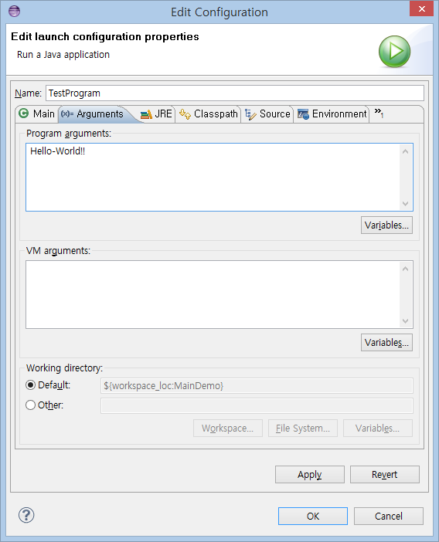
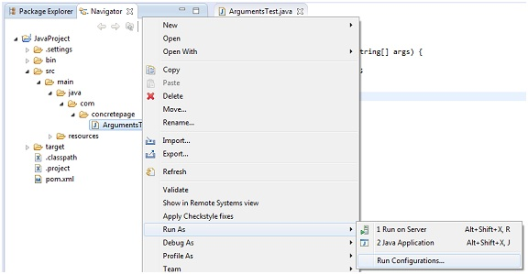
How to Pass Command Line Arguments to Java Program in Eclipse

Slide 29
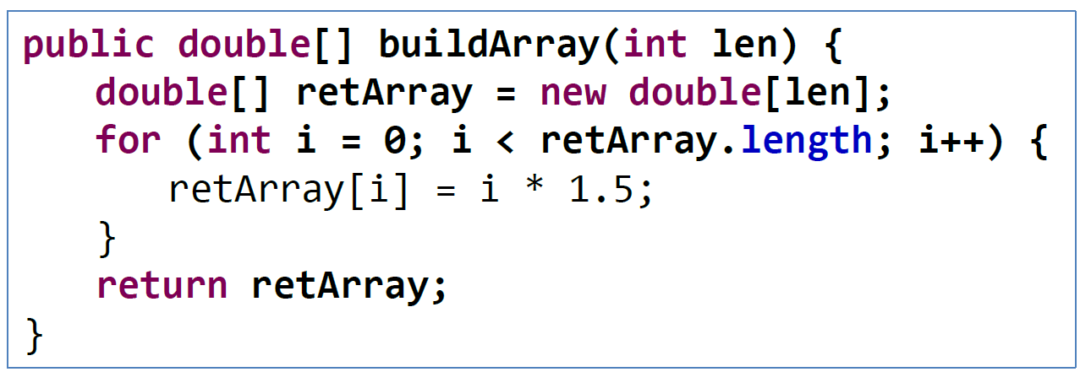
Arrays as Return Types
Create an array and return it

Slide 30
Lab: return array
firstScore
nextScore[3]
30
30 | 35 | 40
import java.util.Scanner;
public class ReturnArrayDemo{
public static void main(String[] args) {
Scanner keyboard = new Scanner(System.in);
System.out.println("Enter your score on exam 1:");
int firstScore = keyboard.nextInt( );
int[] nextScore = new int[3];
for (int i = 0; i < nextScore.length; i++)
nextScore[i] = firstScore + 5 * i;
double[] averageScore = getArrayOfAverages(firstScore, nextScore);
for (int i = 0; i < nextScore.length; i++) {
System.out.println("If your score on exam "+ (i+2) + " is" + nextScore[i]); System.out.println("your average will be " + averageScore[i]);
}
}
public static double[] getArrayOfAverages(int firstScore, int[] nextScore) {
double[] temp = new double[nextScore.length];
for (int i = 0; i < temp.length; i++)
temp[i] = getAverage(firstScore, nextScore[i]);
return temp;
}
public static double getAverage(int n1, int n2)
{
return (n1 + n2) / 2.0;
}
}
30 | 32 | 35
average[3]

Slide 31
7.4 Sorting, Searching Arrays

Slide 32
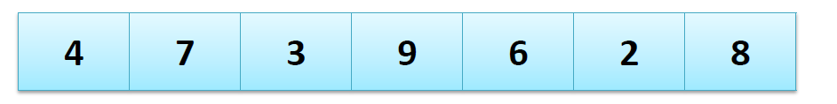
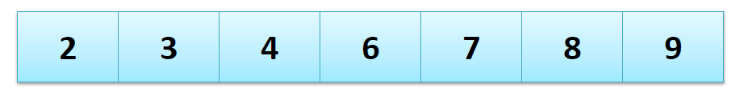
Sorting
Given an array of values, order them from lowest to highest (ascending order) or from highest to lowest (descending order)
Before sorting:
After sorting:
Sorting is an extremely important question in computer science

Slide 33
Selection Sort
Ascending order selection sort
Take the remaining array except the front
Find the minimum value in array
Swap the minimum value with the front
Then minimum value put in the front
Repeat until we meet the end of array

Slide 34
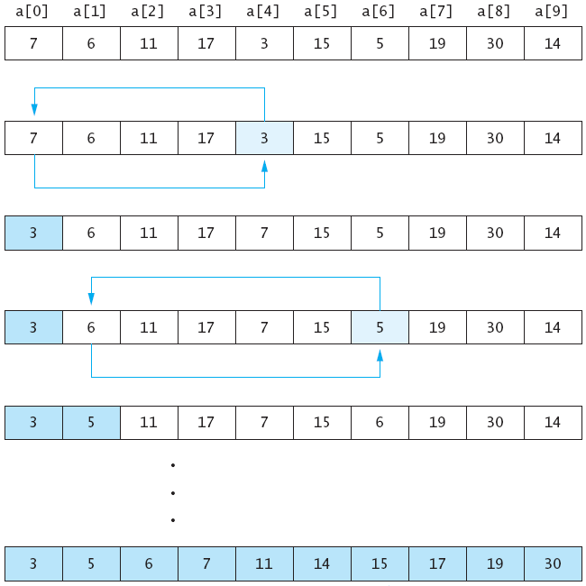

Slide 35
Hint: Swap
public static void swap(int i,int j, int [] a) {
int temp = a[i];
a[i] = a[j];
a[j] = temp;
}
This method will swap the value of a[i] and a[j]
Remember that “a” is a memory address
None of a, i and j are changed in this code
Only a[i] and a[j] are changed – they are not local!

Slide 36
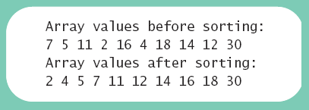
Lab: Selection Sort
View implementation of selection sort, listing 7.10 class ArraySorter
View demo program, listing 7.11 class SelectionSortDemo

Slide 37
test class
public class SelectionSortDemo {
public static void main(String[] args) {
int[] b = {7, 5, 11, 2, 16, 4, 18, 14, 12, 30};
display (b, "before");
ArraySorter.selectionSort(b);
display (b, "after");
}
public static void display(int[] array, String when){
System.out.println("Array values " + when + " sorting:");
for (int i = 0; i < array.length; i++)
System.out.print(array[i] + " ");
System.out.println( );
}
}

Slide 38
public class ArraySorter{
public static void selectionSort(int[] anArray) {
for (int index = 0; index < anArray.length - 1; index++) {
int indexOfNextSmallest = getIndexOfSmallest(index, anArray);
swap(index, indexOfNextSmallest, anArray);
}
}
// Returns the index of the smallest value in the portion of the array
private static int getIndexOfSmallest(int startIndex, int[] a) {
int min = a[startIndex];
int indexOfMin = startIndex;
for (int index = startIndex + 1; index < a.length; index++) {
if (a[index] < min) {
min = a[index];
indexOfMin = index;
}
}
return indexOfMin;
}
// swap ith and jth element in an array
private static void swap(int i, int j, int[] a) {
int temp = a[i];
a[i] = a[j];
a[j] = temp; //original value of a[i]
}
}

Slide 39
Other Sorting Algorithms
Sorting algorithms
Selection sort is the simplest
Many other efficient algorithms for large arrays
Java Class Library provides for efficient sorting
The class java.util.Arrays provides multiple (overloaded) static sort methods
Arrays.sort(anArray);
Arrays.sort(anArray, first, last);

Slide 40
Insertion Sort
Assignment: Survey this algorithm!
No grading, self-study!

Slide 41
7.5 Multidimensional Arrays

Slide 42
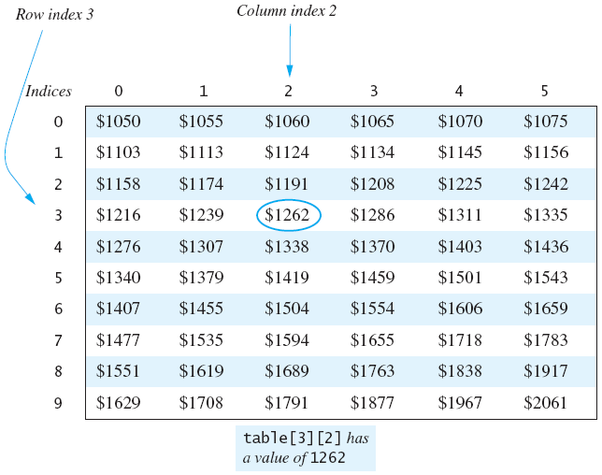
2D Arrays
Array (or 1D array) gives you a list of variables
int[] score = new int[5] gives you score[0], score[1], …
2D array gives you a table of variables
int[][] t = new int[3][4];

Slide 43
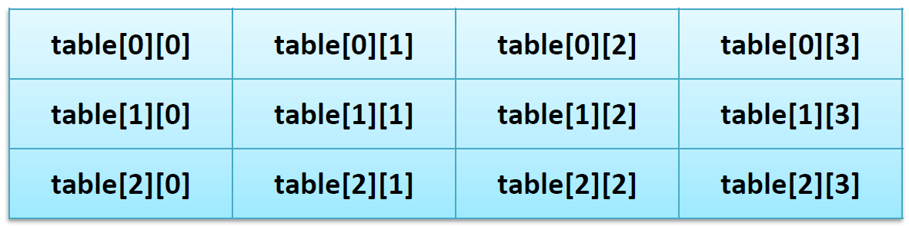
Declaring and Creating 2D Arrays
Two pairs of square brackets means 2D
int[][] table = new int[3][4];
or
int[][] table;
table = new int[3][4];

Slide 44
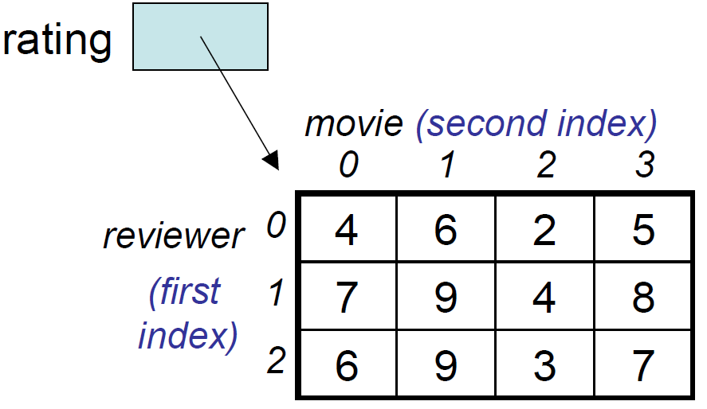
Two-Dimensional Arrays
Two-dimensional (2D) arrays are indexed by two subscripts, one for the row and one for the column.
Example:
row
col
rating[0][2] = 2
rating[1][3] = 8

Slide 45
Accessing 2D arrays
We use a nested loop to access 2D arrays
cf. We used a loop to access 1D arrays
int[][] table = new int[4][3];
for (int i = 0; i < 4; i++) {
for (int j = 0; j < 3; j++) {
table[i][j] = i * 3 + j; System.out.println(table[i][j]);
}
}
for (int r = 0; r < table.length; r++) {
for (int c = 0; c < table[r].length; c++) {
table[r][c] = r * 5 + c;
System.out.println(table[r][c]);
}
}

Slide 46
Length of 2D arrays
Java’s representation of a 2D array: array of array
E.g., int[][] table = new int[3][4];
Array table is actually 1D array of type int[]
table.length → 3;
table[0].length → 4
table
0 | 1 | 2 | 3
0
1
2

Slide 47
Array of Array!
Base_Type[] Array_Name = new Base_Type[Length];
int[] scores = new int[5];
scores is a one-dimensional array
base type is int
int[][] table = new int[4][3];
table is still in fact a one-dimensional array
base type is int[]
Array table is actually 1 dimensional of type int[]
It is an array of arrays

Slide 48
Initializing 2D arrays
int[][] hours = new int[5][3];
hours[0][0] = 8; hours[0][1] = 0; hours[0][2] = 9;
hours[1][0] = 8; hours[1][1] = 0; hours[1][2] = 9;
hours[2][0] = 8; hours[2][1] = 8; hours[2][2] = 8;
hours[3][0] = 8; hours[3][1] = 8; hours[3][2] = 4;
hours[4][0] = 8; hours[4][1] = 8; hours[4][2] = 8;
int[][] hours = {
{ 8, 0, 9 },
{ 8, 0, 9 },
{ 8, 8, 8 },
{ 8, 8, 4 },
{ 8, 8, 8 }
};

Slide 49
Multidimensional Arrays
You can have more than two dimensions
int[][][] cube = new int[4][3][4];
Use more nested loops to access all elements
for (int i…)
for (int j…)
for (int k…)

Slide 50
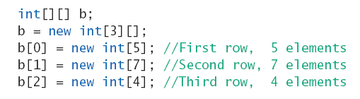
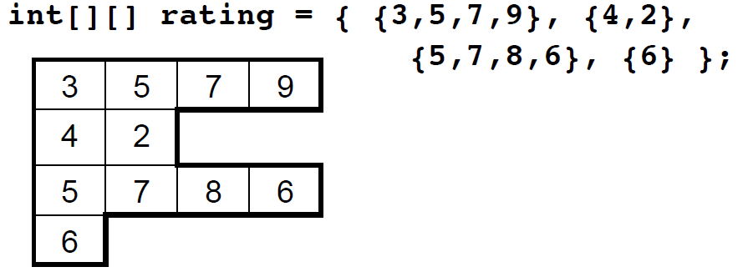
Ragged Arrays
Not necessary for all rows to be of the same length
Example:

Slide 51
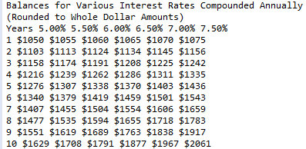
Multidimensional-Array Parameters and Returned Values
public class InterestTable2 {
public static final int ROWS = 10;
public static final int COLUMNS = 6;
public static void main (String [] args) {
int [] [] table = new int [ROWS] [COLUMNS];
for (int row = 0 ; row < ROWS ; row++)
for (int column = 0 ; column < COLUMNS ; column++)
table [row] [column] = getBalance (1000.00, row + 1, (5 + 0.5 * column));
System.out.println ("Balances for Various Interest Rates " + "Compounded Annually");
System.out.println ("(Rounded to Whole Dollar Amounts)");
System.out.println ("Years 5.00% 5.50% 6.00% 6.50% 7.00% 7.50%");
showTable (table);
}
public static void showTable (int [] [] anArray) {
for (int row = 0 ; row < ROWS ; row++) {
System.out.print ((row + 1) + " ");
for (int column = 0 ; column < COLUMNS ; column++) System.out.print ("$" + anArray [row] [column] + " ");
}
}
public static int getBalance (double startBalance, int years, double rate) {
double runningBalance = startBalance;
for (int count = 1 ; count <= years ; count++) runningBalance = runningBalance * (1 + rate / 100);
return (int) (Math.round (runningBalance));
}
}

Slide 52
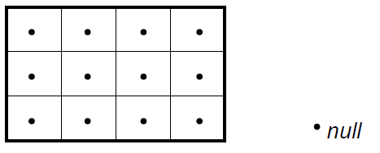
2D Array of Object References
Recall that creating an array of object references fills the array with null values
Example:
Student[][] class1= new Student[3][4];

Slide 53
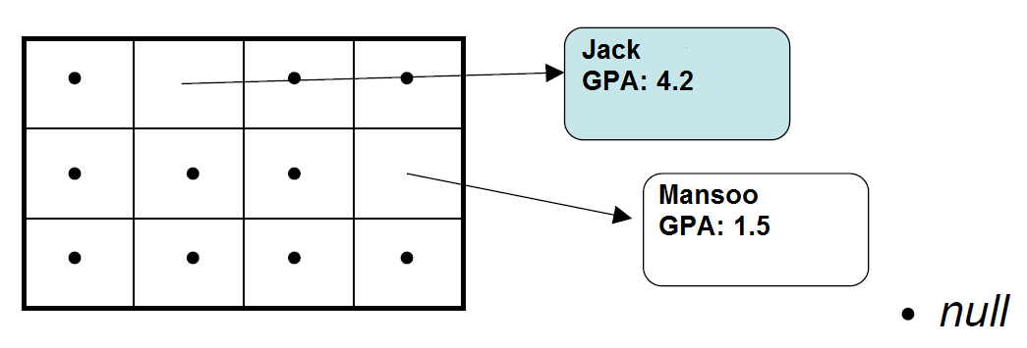
2D Array of Object References
Need to create the objects and assign the references to the array elements
Example:
class1[0][1] = new Student(“Jack”, 4.2);
class1[1][3] = new Student(“Mansoo”, 1.5);

Slide 54
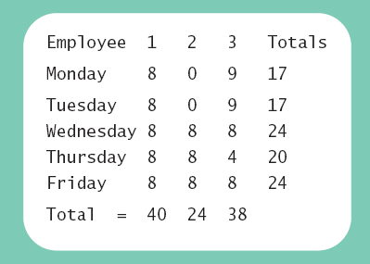
Lab: Employee Time Records
Reads hours worked for each employee on each day of the work week into the two-dimensional array hours.
Computes the total weekly hours for each employee and the total daily hours for all employees combined.
Define
Two-dimensional array stores hours worked
For each employee
For each of 5 days of work week
Array is private instance variable of class
View sample program, listing 7.14 class TimeBook

Slide 55
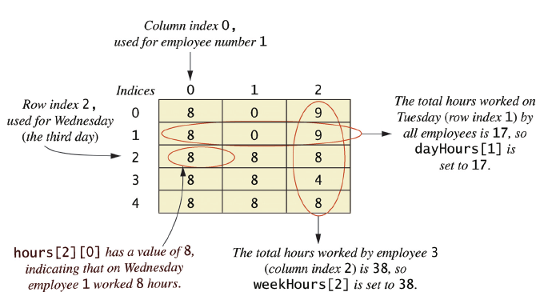
Programming Example
Figure 7.8 Arrays for the class TimeBook

Slide 56
public class TimeBook{
private int numberOfEmployees;
private int[][] hours; //hours[i][j] has the hours for employee j on day i.
private int[] weekHours;//weekHours[i] has the week's hours worked for
private int[] dayHours; //dayHours[i] has the total hours worked by all
private static final int NUMBER_OF_WORKDAYS = 5;
private static final int MON = 0;
private static final int TUE = 1;
private static final int WED = 2;
private static final int THU = 3;
private static final int FRI = 4;
public static void main(String[] args) {
final int NUMBER_OF_EMPLOYEES = 3;
TimeBook book = new TimeBook(NUMBER_OF_EMPLOYEES);
book.setHours( );
book.update( );
book.showTable( );
}
public TimeBook(int theNumberOfEmployees) {
numberOfEmployees = theNumberOfEmployees;
hours = new int[NUMBER_OF_WORKDAYS][numberOfEmployees];
weekHours = new int[numberOfEmployees];
dayHours = new int[NUMBER_OF_WORKDAYS];
}
public void setHours( ) {
hours[0][0] = 8; hours[0][1] = 0; hours[0][2] = 9;
hours[1][0] = 8; hours[1][1] = 0; hours[1][2] = 9;
hours[2][0] = 8; hours[2][1] = 8; hours[2][2] = 8;
hours[3][0] = 8; hours[3][1] = 8; hours[3][2] = 4;
hours[4][0] = 8; hours[4][1] = 8; hours[4][2] = 8;
}
public void update( ) {
computeWeekHours( );
computeDayHours( );
}
// 생성자: 고용자 숫자 입력 후 배열 생성
// 근무시간 설정, 입력 없이 초기화
// 주당 총 근무시간 계산
// 인당 총 근무시간 계산
.. 이어서…

Slide 57
private void computeWeekHours( ) {//Process one employee:
for (int employeeNumber = 1; employeeNumber <= numberOfEmployees; employeeNumber++) {
int sum = 0;
for (int day = MON; day <= FRI; day++)
sum = sum + hours[day][employeeNumber - 1];
weekHours[employeeNumber - 1] = sum;
}
}
private void computeDayHours( ) {//Process one day (for all employees):
for (int day = MON; day <= FRI; day++) {
int sum = 0;
for (int employeeNumber = 1; employeeNumber <= numberOfEmployees;employeeNumber++)
sum = sum + hours[day][employeeNumber - 1];
dayHours[day] = sum;
}
}
public void showTable( ) {
// heading
System.out.print("Employee ");
for (int employeeNumber = 1; employeeNumber <= numberOfEmployees; employeeNumber++)
System.out.print(employeeNumber + " ");
System.out.println("Totals");
System.out.println( );
// row entries
for (int day = MON; day <= FRI; day++) {
System.out.print(getDayName(day) + " ");
for (int column = 0; column < hours[day].length; column++)
System.out.print(hours[day][column] + " ");
System.out.println(dayHours[day]);
}
System.out.println( );
System.out.print("Total = ");
for (int column = 0; column < numberOfEmployees; column++)
System.out.print(weekHours[column] + " ");
System.out.println( );
}
// 인당 총 근무시간 계산
// 세로로 더하기
// 주당 총 근무시간 계산
// 가로로 더하기
// table 그리기

Slide 58
… 이어서
private String getDayName(int day) {
String dayName = null;
switch (day) {
case MON:
dayName = "Monday ";
break;
case TUE:
dayName = "Tuesday ";
break;
case WED:
dayName = "Wednesday";
break;
case THU:
dayName = "Thursday ";
break;
case FRI:
dayName = "Friday ";
break;
default:
System.out.println("Fatal Error.");
System.exit(0);
break;
}
return dayName;
}
}
// 기타 코드 : 출력시 요일 이름 출력

