Slide 1

_{Object Oriented Programming} Introduction to Java
Ch. 9. Exception Handling
March 4, 2014
Dept. of Software, Gachon University
Ahyoung Choi, Spring

Slide 2
Question
When a program runs into a runtime error, the program terminates abnormally.
How can you handle the runtime error so that the program can continue to run or terminate gracefully?

Slide 3
Approach 1 : Traditional Methods of Handling Errors
In most procedural languages, the standard way of indicating an error condition is by returning an error code.
The calling code typically did one of the following:
Testing the error code and taking the appropriate action.
Ignoring the error code.

Slide 4
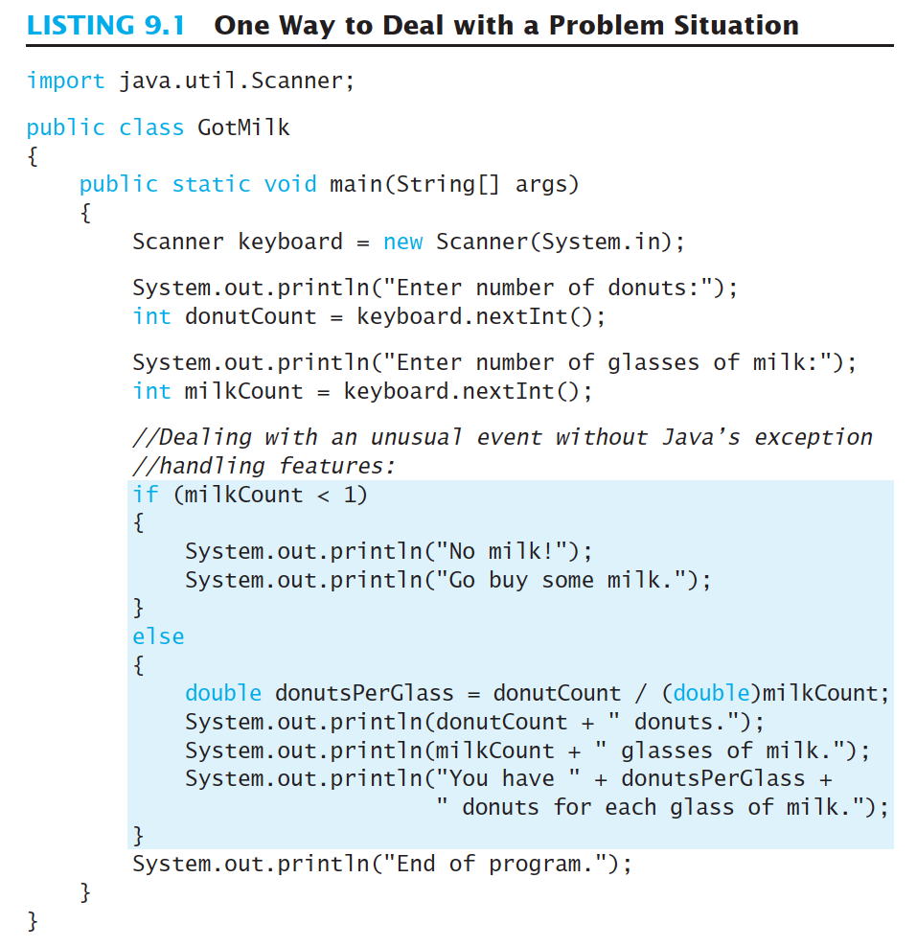
Check the condition using the return value

Slide 5
Another Approach : Exception concept
Exception Concept
When an error occurs (that represents an exceptional condition),
Exceptions cause the current program flow to be interrupted and transferred to a registered exception handling block.
Exception handling involves a well-structured goto

Slide 6
9.1 Basic Exception Handling

Slide 7
Exception
Java provides a way to handle certain kinds of special conditions in your program
You can divide your codes into:
Sections for the normal case
Sections for the exceptional case
Exception as an object
Throwing an exception
Signals an occurrence of unusual event during program execution
Catching the exception
It detects and deals with the exception at a separate section

Slide 8
Exception
Throwing an exception: (호출자에게 보고)
Do not specify some action
Only creates an object that has a message.
Can make a constructor and throws this exception object
Catching exceptions: (에러 발생시 처리)
Basic mechanism for handling exceptions
throw new Exception("message");
-----------------------------------------------
Exception e = new Exception(“message”);
throw e;
try {
statements
} catch (exceptionType1 identifier1) {
handler code for exceptionType1
} catch (exceptionType2 identifier1) {
handler code for exceptionType2
}

Slide 9
Pre-defined exception classes
Java has defined exception classes in Java Class Library
Can place method invocation in try block
Follow with a catch block for this type of exception
Examples:
BadStringOperationException
ClassNotFoundException
IOException
NoSuchMethodException

Slide 10
Exception hierarchy (partial)
EOFException
FileNotFoundException
Object
IOException
MalformedURLException
Throwable
UnknownHostException
CloneNotSupportedException
Error
Exception
ArithmeticException
ReflectiveOperationException
ClassCastException
IllegalArgumentException
RuntimeException
IllegalStateException
IndexOutOfBoundsException
NegativeArraySizeException
NullPointerException

Slide 11
Example : Throwing
String readData(Scanner in) throws EOFException {
...
while( ...) {
if (!in.hasNext()) //EndOfFile encountered {
if(n < len)
throw (new Exception(“Exception: EOF Error”));
}
. . .
}
return s; }
}

Slide 12
try/catch block
try block
Contains code where something could possibly go wrong
If it does go wrong, it throws an exception
catch block
When an exception is thrown, catch block begins execution
Similar to a method with a parameter
Parameter is the thrown exception object
Any number of catch blocks for different exceptions

Slide 13
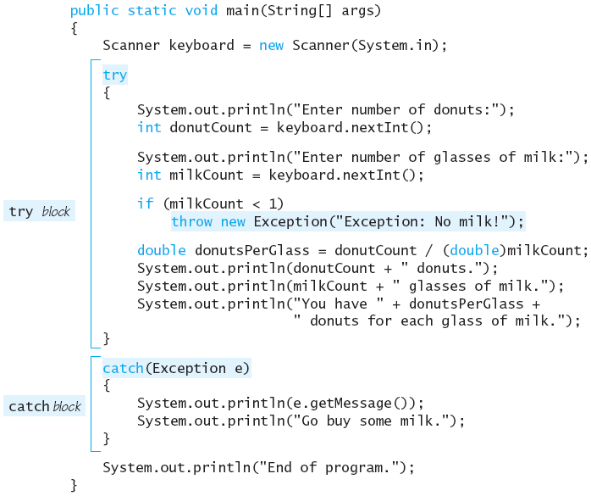
Example: normal case

Slide 14
Example: exception case
This code is NOT executed

Slide 15
Lab: calculator
1:
2:
3:
4:
5:
6:
7:
8:
9:
10: 11:
12:
13:
14:
15:
16:
17:
18:
19:
class Calculator{
int left, right;
public void setOprands(int left, int right){
this.left = left;
this.right = right;
}
public void divide(){
System.out.print("계산결과는 ");
System.out.print(this.left/this.right);
System.out.print(" 입니다.");
}
}
public class CalculatorDemo {
public static void main(String[] args) {
Calculator c1 = new Calculator();
c1.setOprands(10, 0);
c1.divide();
}
}

Slide 16
Lab: calculator
Exception in thread "main" 계산결과는 java.lang.ArithmeticException: / by zero
at Calculator.divide(CalculatorDemo.java:9)
at CalculatorDemo.main(CalculatorDemo.java:17)
1:
2:
3:
4:
5:
6:
7:
8:
9:
10: 11:
12:
13:
14:
15:
16:
17:
18:
19:
class Calculator{
int left, right;
public void setOprands(int left, int right){
this.left = left;
this.right = right;
}
public void divide(){
System.out.print("계산결과는 ");
System.out.print(this.left/this.right);
System.out.print(" 입니다.");
}
}
public class CalculatorDemo {
public static void main(String[] args) {
Calculator c1 = new Calculator();
c1.setOprands(10, 0);
c1.divide();
}
}
에러가 발생한 원인
에러가 발생한 함수내 위치
함수를 콜해서 에러난 지점

Slide 17
Lab: calculator – modify it!
class Calculator{
int left, right;
public void setOprands(int left, int right){
this.left = left;
this.right = right;
}
public void divide(){
try {
System.out.print("계산결과는 ");
System.out.print(this.left/this.right);
System.out.print(" 입니다.");
} catch(Exception e){
System.out.println("오류 : "+e.getMessage());
}
} }
public class CalculatorDemo {
public static void main(String[] args) {
Calculator c1 = new Calculator();
c1.setOprands(10, 0);
c1.divide();
Calculator c2 = new Calculator();
c2.setOprands(10, 5);
c2.divide();
}
}
결과 확인!!
오류가 발생하였으나 프로그램 동작에는 문제 없음
------------------------------------------------
계산결과는 오류 : / by zero
계산결과는 2 입니다.

Slide 18
Lab: calculator –exception methods
class Calculator{
int left, right;
public void setOprands(int left, int right){
this.left = left;
this.right = right;
}
public void divide(){
try {
System.out.print("계산결과는 ");
System.out.print(this.left/this.right);
System.out.print(" 입니다.");
} catch(Exception e){
System.out.println("\n 오류 출력 1 \n "+e.getMessage());
System.out.println("\n 오류 출력 2 \n "+e.toString());
System.out.println("\n 오류 출력 3");
e.printStackTrace();
}
}
}
public class CalculatorDemo {
public static void main(String[] args) {
Calculator c1 = new Calculator();
c1.setOprands(10, 0);
c1.divide();
}
}
계산결과는
오류 출력 1
/ by zero
오류 출력 2
java.lang.ArithmeticException: / by zero
오류 출력 3
java.lang.ArithmeticException: / by zero
at Calculator.divide(CalculatorDemo.java:10)
at CalculatorDemo.main(CalculatorDemo.java:24)

Slide 19
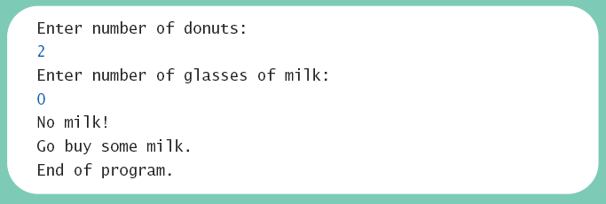
Exceptions in Java
Consider a program to assure us of a sufficient supply of milk
View possible solution, listing 9.1 & 9.2 class GotMilk
Sample screen output

Slide 20
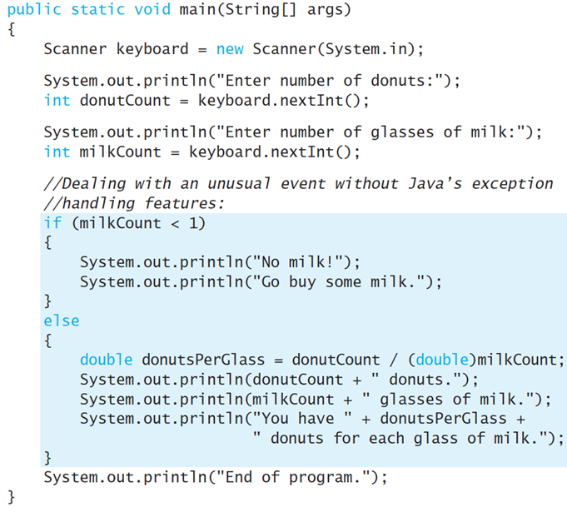
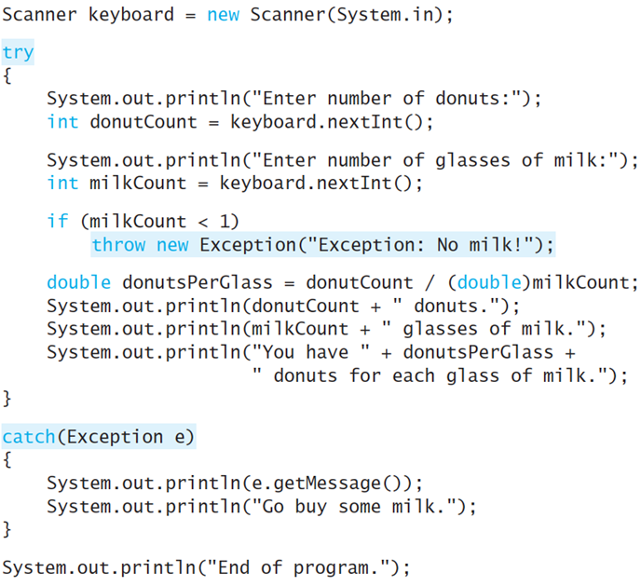
Class GotMilk, ExceptionDemo

Slide 21
finally block
Possible to add after the sequence of catch blocks
Code in finally block executed
Whether or not an exception is thrown
Whether or not a required catch exists
A good place to put clean-up code, i.e., close open files
try {
// Code to try: possibly throws an exception
}
catch (IOException x) { ... }
catch (Exception x) { ... }
finally {
// This code is ‘always’ executed
}

Slide 22
Other exceptions
EOFException
FileNotFoundException
Object
IOException
MalformedURLException
Throwable
UnknownHostException
CloneNotSupportedException
Error
Exception
ArithmeticException
ReflectiveOperationException
ClassCastException
IllegalArgumentException
RuntimeException
IllegalStateException
IndexOutOfBoundsException
NegativeArraySizeException
NullPointerException

Slide 23
Example 1
public void read(String fileName) {
}
try {
InputStream in = new FileInputStream(fileName);
int b;
//the read() method below is one which will throw an IOException
while ((b = in.read()) != -1) {
process input
}
} catch (IOException e) {
e.printStackTrace();
}

Slide 24
Example 2
try {
access the database …
} catch (SQLException e) {
Throwable se = new ServletException(“database error”);
se.setCause(e);
throw se;
}

Slide 25
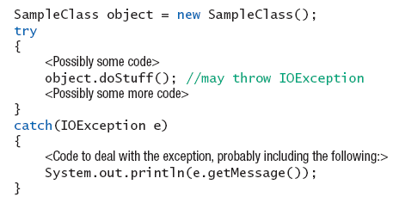
Example 3

Slide 26
Lab: multiple exceptions
class ArrayData{
private int[] arr = new int[3];
ArrayData(){
arr[0]=0;
arr[1]=10;
arr[2]=20;
}
public void z(int first, int second){
System.out.println(arr[first] / arr[second]);
}
}
public class ExceptionDemo {
public static void main(String[] args) {
ArrayData a = new ArrayData();
a.z(10, 2); //test1
a.z(1, 0); //test2
}
}
ctrl + space 키로 컴파일러 추천 코드 확인 가능
Modify it using multiple exception class!

Slide 27
class ArrayData{
private int[] arr = new int[3];
ArrayData(){
arr[0]=0;
arr[1]=10;
arr[2]=20;
}
public void z(int first, int second){
try {
System.out.println(arr[first] / arr[second]);
} catch(ArrayIndexOutOfBoundsException e){
System.out.println("ArrayIndexOutOfBoundsException");
} catch(ArithmeticException e){
System.out.println("ArithmeticException");
} catch(Exception e){
System.out.println("Exception");
}
}
}
public class ExceptionDemo {
public static void main(String[] args) {
ArrayData a = new ArrayData();
a.z(10, 2); //test1
a.z(1, 0); //test2
}
}
ctrl + space 키로 컴파일러 추천 코드 확인 가능

Slide 28
9.2 Defining Your Own Exception Classes (Optional topic)

Slide 29
Defining Your Own Exception Classes
You can define your own exception classes
Must be derived class of some predefined exception class
Any exception class can be derived
Textbook uses classes derived from class Exception
Method getMessage defined in exception classes
Returns string passed as argument to constructor
If no actual parameter used, default message returned
catch(Exception e) {
System.out.println(e.getMessage());
}

Slide 30
Defining Your Own Exception Classes
Guidelines
Use the Exception as the base class
Define at least two constructors
Default, no parameter
With String parameter
Start constructor definition with call to constructor of base class using super
Don’t override inherited getMessage() in exception classes

Slide 31
Example
List 9.5
public class DivideByZeroException extends Exception
{
public DivideByZeroException ()
{
super ("Dividing by Zero!");
}
public DivideByZeroException (String message)
{
super (message);
}
}

Slide 32
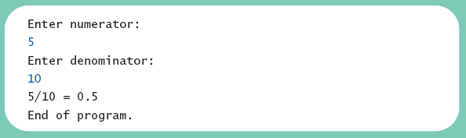
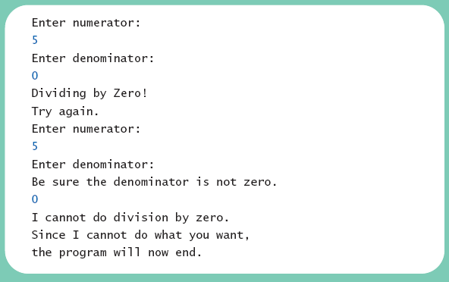
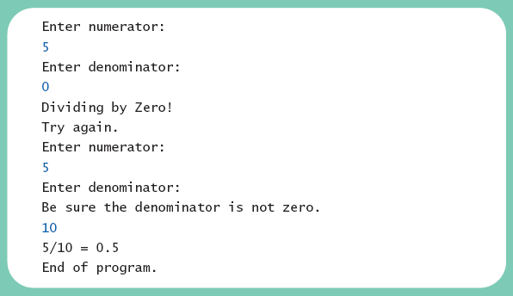
Lab: DivideByZeroDemo
Different runs of the program
Sample screen output 1
Sample screen output 3
Sample screen output 2

Slide 33
Lab: modify the code
import java.util.Scanner;
public class DivideByZeroDemo {
private int numerator;
private int denominator;
private double quotient;
public static void main (String [] args) {
DivideByZeroDemo oneTime = new DivideByZeroDemo ();
oneTime.doIt ();
}
public void doIt () {
System.out.println ("Enter numerator:");
Scanner keyboard = new Scanner (System.in);
numerator = keyboard.nextInt ();
System.out.println ("Enter denominator:");
denominator = keyboard.nextInt ();
quotient = numerator / (double) denominator;
System.out.println (numerator + "/" + denominator + " = "
+ quotient);
System.out.println ("End of program.");
}
// code continues to the next page
Make the code robust !

Slide 34
Lab: modify the code
public void giveSecondChance ()
{
System.out.println ("Try again:");
System.out.println ("Enter numerator:");
Scanner keyboard = new Scanner (System.in);
numerator = keyboard.nextInt ();
System.out.println ("Enter denominator:");
System.out.println ("Be sure the denominator is not zero.");
denominator = keyboard.nextInt ();
if (denominator == 0)
{
System.out.println ("I cannot do division by zero.");
System.out.println ("Since I cannot do what you want,");
System.out.println ("the program will now end.");
System.exit (0);
}
quotient = ((double) numerator) / denominator;
System.out.println (numerator + "/" + denominator +
" = " + quotient);
}
}

Slide 35
9.3 More About Exception Classes

Slide 36
Declaring Exceptions
You caught the exception inside the method in Section 9.2
and, your code handled the exception immediately
Problem ?

Slide 37
Declaring Exceptions
Consider method where code throws exception
May want to handle immediately
May want to delay until something else is done
Method that does not catch an exception
Notify programmers with throws clause
Pass the responsibility (“pass the buck”) to handle exception from the method itself to any method that calls it
public void sampleMethod() throws DivideByZeroException

Slide 38
Declaring Exceptions
public void methodA() throws IOException
Hey, methodB(),
If you invoke me, you must
worry about any IOException that I throw
public void methodB() {
obj.methodA();
}
try
{
}
catch(IOException e){
System.out.println(e.getMessage());
System.exit(0);
}
OK!!

Slide 39
Declaring Exceptions
Note syntax for throws clause
Note distinction
Keyword throw used to throw exception
Keyword throws used in method heading to declare an exception

Slide 40
Lab.: class DoDivision
If a method throws exception and exception not caught inside the method
Method ends immediately after exception thrown
Recall class DivideByZeroDemo for lab

Slide 41
Recall class DivideByZeroDemo
List 9.5
public class DivideByZeroException extends Exception
{
public DivideByZeroException ()
{
super ("Dividing by Zero!");
}
public DivideByZeroException (String message)
{
super (message);
}
}

Slide 42
import java.util.Scanner;
public class DoDivision
{
private int numerator;
private int denominator;
private double quotient;
public static void main (String [] args)
{
DoDivision doIt = new DoDivision ();
doIt.doNormalCase ();
System.out.println ("End of program.");
}
public void doNormalCase () throws DivideByZeroException
{
System.out.println ("Enter numerator:");
Scanner keyboard = new Scanner (System.in);
numerator = keyboard.nextInt ();
System.out.println ("Enter denominator:");
denominator = keyboard.nextInt ();
if (denominator == 0)
throw new DivideByZeroException ();
quotient = numerator / (double) denominator;
System.out.println (numerator + "/" + denominator +
" = " + quotient);
}
// giveSecondChance() is given in 9.6
}
Modify here!
if the denominator is zero, give the user second chance by invoking giveSecondChance();
doNormalCase 에서 받은 exception을 main에서 처리

Slide 43
Differences? (again)
import java.util.Scanner;
public class DoDivision {
…………
public void doNormalCase () throws DivideByZeroException
{
System.out.println ("Enter numerator:");
Scanner keyboard = new Scanner (System.in);
numerator = keyboard.nextInt ();
System.out.println ("Enter denominator:");
denominator = keyboard.nextInt ();
if (denominator == 0) throw new DivideByZeroException ();
quotient = numerator / (double) denominator;
System.out.println (numerator + "/" + denominator +
" = " + quotient);
}
}
VS
public class DivideByZeroDemo {
…..
public static void main (String [] args) {
DivideByZeroDemo oneTime = new DivideByZeroDemo ();
oneTime.doIt ();
}
public void doIt () {
try{ …
System.out.println ("Enter denominator:");
denominator = keyboard.nextInt ();
if (denominator == 0) throw new DivideByZeroException ();
quotient = numerator / (double) denominator;
System.out.println (numerator + "/" + denominator + " = " + quotient);
}
catch(DivideByZeroException e){
System.out.println(e.getMessage());
giveSecondChance();
}
System.out.println ("End of program.");
}

Slide 44
Differences between throw vs throws
Keyword throw used to throw exception
Catch the possible exception in a catch block within the method definition
Keyword throws used in method heading to declare an exception
Declare the possible exception by writing a throws clause in the method’s heading
Let whoever uses the method worry about how to handle the exception

Slide 45
Kinds of Exceptions
In most cases, exception is caught …
In a catch block … or
Be declared in throws clause
But Java has exceptions you don’t need to account for
Categories of exceptions
Checked exceptions
Unchecked exceptions

Slide 46
Kinds of Exceptions
Checked exception
Must be caught in catch block
Or declared in throws clause
Unchecked exception
Also called run-time
Need not be caught in catch block or declared in throws
Exceptions that coding problems exist, should be fixed

Slide 47
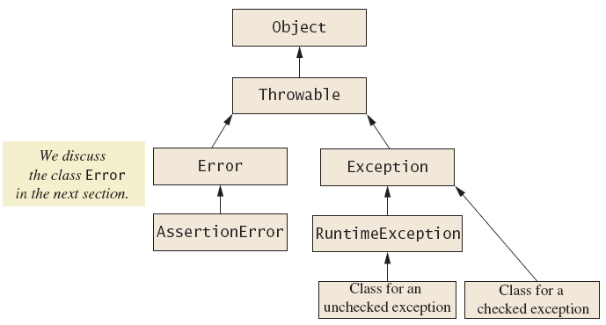
Kinds of Exceptions
Examples why unchecked exceptions to are thrown
Use array index out of bounds or division by zero
Uncaught runtime exception terminates program execution

Slide 48
Errors
An error is an object of class Error
Similar to an unchecked exception
Need not catch or declare in throws clause
Object of class Error generated when abnormal conditions occur
Errors are more or less beyond your control
Require change of program to resolve

Slide 49
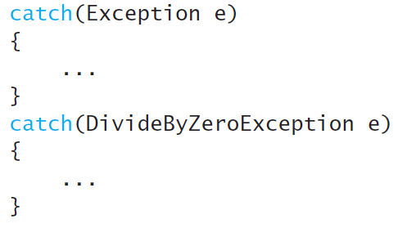
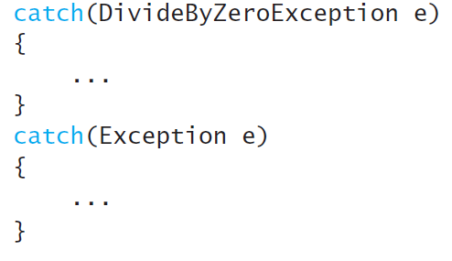
Multiple Throws and Catches
Which one is better ?
A
B
//The second catch block can never be reached.

Slide 50
Multiple Throws and Catches
A try block can throw any number of exceptions of different types
Each catch block can catch exceptions of only one type
Order of catch blocks matter
View example program, listing 9.8 class TwoCatchesDemo
View exception class used, listing 9.9 class NegativeNumberException

Slide 51
Multiple Throws and Catches
When catching multiple exceptions, the order of the catch blocks can be important.
When an exception is thrown in a try block, the catch blocks are examined in order of appearance.

Slide 52
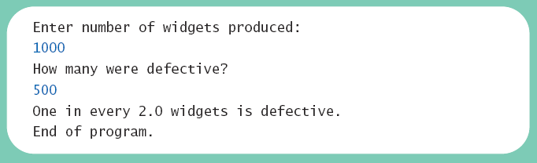
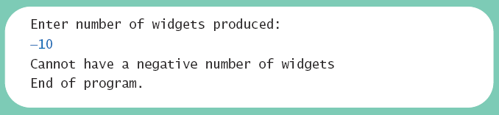
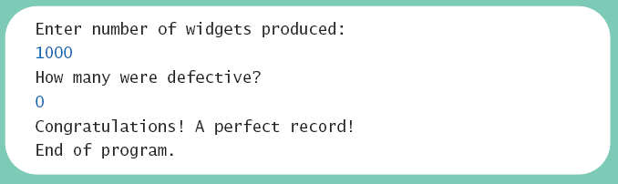
Lab: Multiple Throws and Catches
Sample screen output 1
Sample screen output 2
Sample screen output 2

Slide 53
public static void main (String [] args)
{
try
{
System.out.println ("Enter number of widgets produced:");
Scanner keyboard = new Scanner (System.in);
int widgets = keyboard.nextInt ();
if (widgets < 0)
throw new NegativeNumberException ("widgets");
System.out.println ("How many were defective?");
int defective = keyboard.nextInt ();
if (defective < 0)
throw new NegativeNumberException ("defective widgets");
double ratio = exceptionalDivision (widgets, defective);
System.out.println ("One in every " + ratio +
" widgets is defective.");
}
System.out.println ("End of program.");
}
public static double exceptionalDivision (double numerator,
double denominator) throws DivideByZeroException
{
if (denominator == 0)
throw new DivideByZeroException ();
return numerator / denominator;
}
catch (DivideByZeroException e)
{
…
}
catch (NegativeNumberException e)
{
…
}

Slide 54
Lab: case study calculator2
A Line-Oriented Calculator
Should do addition, subtraction, division, multiplication
Will use line input/output
User will enter
Operation, space, number
Calculator displays result

Slide 55
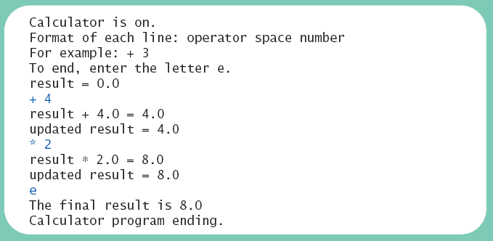
Lab: calculator2
View exception class, listing 9.10 class UnknownOpException
View first version of calculator, listing 9.11 class PreLimCalculator
Sample screen output

Slide 56
Lab: calculator2
Proposed initial methods
Method to reset value of result to zero
Method to evaluate result of one operation
Method doCalculation to perform series of operations
Accessor method getResult: returns value of instance variable result
Mutator method setResults: sets value of instance variable result

Slide 57
Lab: calculator2
import java.util.Scanner;
public class PrelimCalculator{
private double result;
private double precision = 0.0001; // Numbers this close to zero
public static void main(String[] args) throws DivideByZeroException,
UnknownOpException
{
PrelimCalculator clerk = new PrelimCalculator( );
System.out.println("Calculator is on.");
System.out.print("Format of each line: ");
System.out.println("operator space number (e.g) + 3");
System.out.println("To end, enter the letter e.");
clerk.doCalculation();
System.out.println("The final result is " + clerk.getResult( ));
System.out.println("Calculator program ending.");
}
public PrelimCalculator( ) { result = 0; }
public void reset( ) { result = 0; }
public void setResult(double newResult) { result = newResult; }
public double getResult( ) { return result; }

Slide 58
public void doCalculation( ) throws DivideByZeroException, UnknownOpException {
Scanner keyboard = new Scanner(System.in);
boolean done = false;
result = 0;
System.out.println("result = " + result);
while (!done) {
char nextOp = (keyboard.next( )).charAt(0);
if ((nextOp == 'e') || (nextOp == 'E'))
done = true;
else {
double nextNumber = keyboard.nextDouble( );
result = evaluate(nextOp, result, nextNumber);
System.out.println("result " + nextOp + " " +
nextNumber + " = " + result);
System.out.println("updated result = " + result);
}
}
}
public double evaluate(char op, double n1, double n2) throws DivideByZeroException, UnknownOpException {
double answer;
switch (op) {
case '+':
answer = n1 + n2;
break;
case '-':
answer = n1 - n2;
break;
case '*':
answer = n1 * n2;
break;
case '/':
if ((-precision < n2) && (n2 < precision))
throw new DivideByZeroException( );
answer = n1 / n2;
break;
default:
throw new UnknownOpException(op);
}
return answer;
}
}

Slide 59
Lab: calculator2
public class DivideByZeroException extends Exception{
public DivideByZeroException( ) {
super("Dividing by Zero!");
}
public DivideByZeroException(String message) {
super(message);
}
}
public class UnknownOpException extends Exception {
public UnknownOpException( ) {
super("UnknownOpException");
}
public UnknownOpException(char op) {
super(op + " is an unknown operator.");
}
public UnknownOpException(String message) {
super(message);
}
}

Slide 60
Lab: Modify calculator2!
Final version adds exception handling
Ways to handle unknown operator
Catch exception in method evaluate
Let evaluate throw exception, catch exception in doCalculation
Let evaluate, doCalculation both throw exception, catch in main

Slide 61
Change main
public static void main(String[] args) {
Calculator clerk = new Calculator( );
try {
System.out.println("Calculator is on.");
System.out.print("Format of each line: ");
System.out.println("operator space number");
System.out.println("For example: + 3");
System.out.println("To end, enter the letter e.");
clerk.doCalculation();
}
catch(UnknownOpException e)
{
clerk.handleUnknownOpException(e);
}
catch(DivideByZeroException e)
{
clerk.handleDivideByZeroException(e);
}
System.out.println("The final result is " + clerk.getResult( ));
System.out.println("Calculator program ending.");
}

Slide 62
Add handling methods
public void handleDivideByZeroException(DivideByZeroException e) {
System.out.println("Dividing by zero.");
System.out.println("Program aborted");
System.exit(0);
}
public void handleUnknownOpException(UnknownOpException e) {
System.out.println(e.getMessage( ));
System.out.println("Try again from the beginning:");
try {
System.out.print("Format of each line: ");
System.out.println("operator number");
System.out.println("For example: + 3");
System.out.println("To end, enter the letter e.");
doCalculation( );
}
catch(UnknownOpException e2)
{
System.out.println(e2.getMessage( ));
System.out.println("Try again at some other time.");
System.out.println("Program ending.");
System.exit(0);
}
catch(DivideByZeroException e3) {
handleDivideByZeroException(e3);
}
}

