Slide 1

_{Object Oriented Programming} Introduction to Java
Ch. 10. Streams and File I/O
March 4, 2014
Dept. of Software, Gachon University
Ahyoung Choi, Spring

Slide 2
10.1 An Overview of Streams and File I/O

Slide 3
Concept of a Stream
Use of files
Store Java classes, programs
Store pictures, music, videos
Can also use files to store program I/O
A stream is a flow of (input or output) data
Ordered sequences of data that have a source (input streams) or a destination (output streams)
Data: characters, numbers, bytes

Slide 4
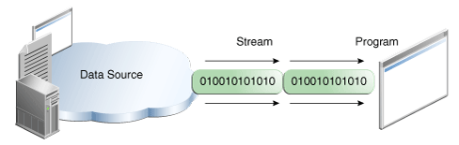
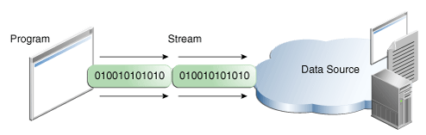
Concept of a Stream
I/O Streams
Implemented as objects of special stream classes
Input stream: a stream that provides input to a program
System.in is an input stream object
Output stream: a stream that accepts output from a program
System.out is an output stream object

Slide 5
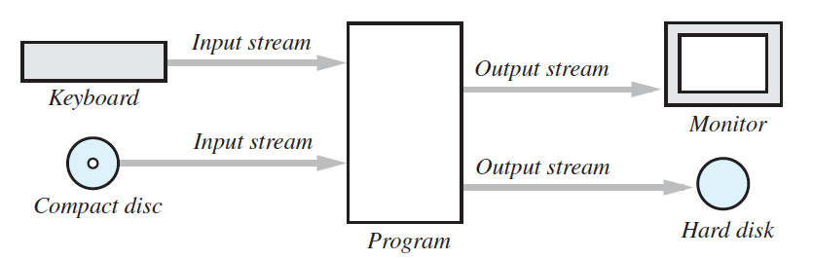
Concept of a Stream
A stream connects a program to an I/O object
System.out connects a program to the screen
System.in connects a program to the keyboard

Slide 6
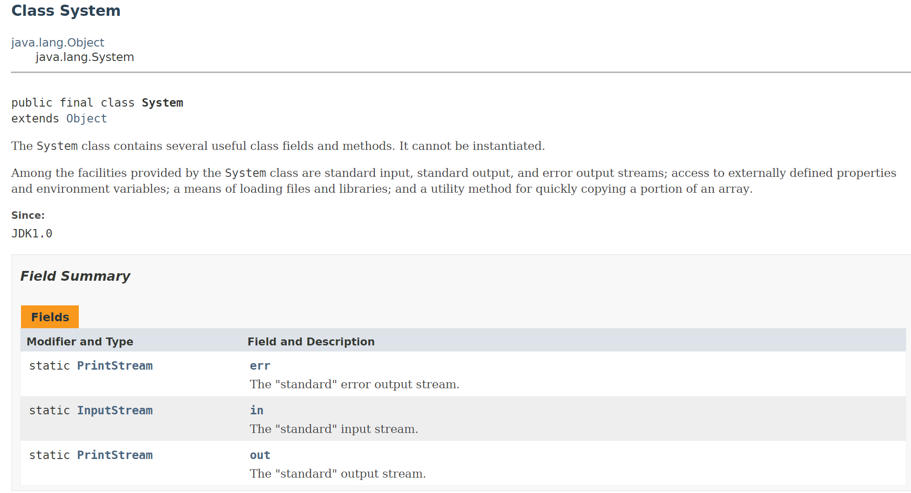
https://docs.oracle.com/javase/8/docs/api/

Slide 7
Why Use Files for I/O
I/O = Input/Output
Advantages of file I/O
permanent copy
output from one program can be input to another
input can be automated (rather than entered manually)

Slide 8
Text Files and Binary Files
All data and programs are ultimately just 0s and 1s
each digit can have one of two values, hence binary
Text files
Sequences of characters
Lines are separated by newline (\n) characters
E.g., Java program source code
Can be viewed and edited with text editors
Binary files
Bytes represent various types of encoded information
E.g., movie (avi), image (jpg), music (mp3)
Require specialized programs for view/edit

Slide 9
Text Files and Binary Files
text file:
31 | 32 | 37
Number: 127 (decimal)
Text file
Three bytes: “1”, “2”, “7”
ASCII (decimal): 49, 50, 55
ASCII (octal): 61, 62, 67
ASCII (binary): 00110001, 00110010, 00110111
Binary file:
One byte (byte): 01111111 (7F)
Two bytes (short): 00000000 01111111 (00 7F)
Four bytes (int): 00000000 00000000 00000000 01111111 (00 00 00 7F)
binary file:
00 | 00 | 00 | 7F

Slide 10
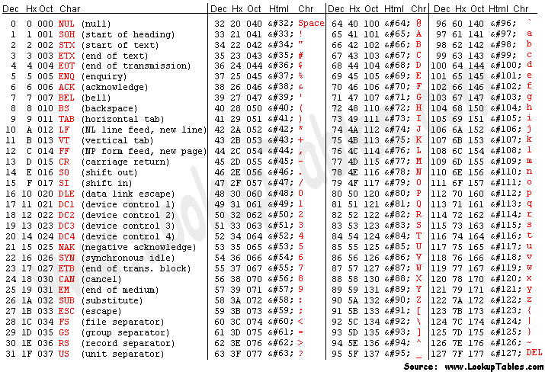

Slide 11
10.1 JAVA I/O

Slide 12
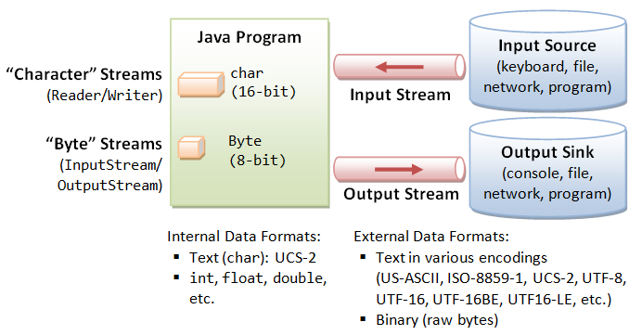
Java I/O

Slide 13
Java I/O is very powerful
Java I/O is very powerful, with an overwhelming number of options
Any given kind of I/O is not particularly difficult
The trick is to find your way through the maze of possibilities

Slide 14
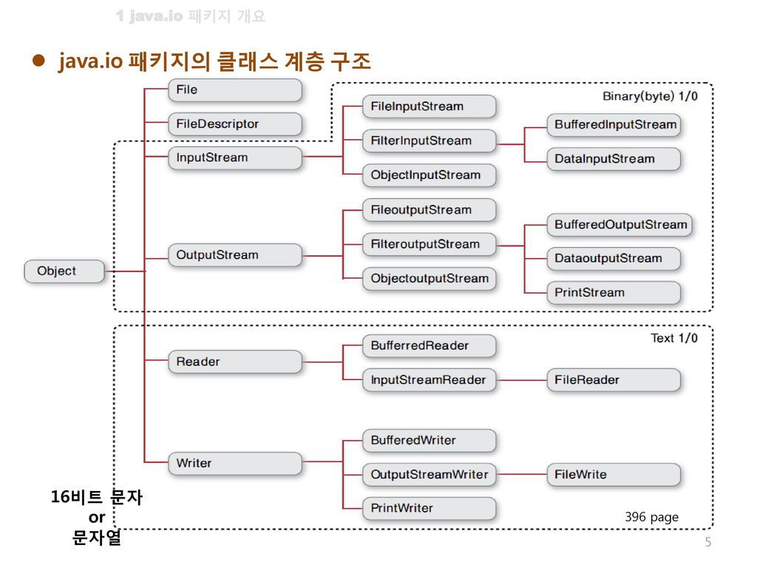
Java I/O - Too much choice?
There’s a bewildering array of choices ...

Slide 15
Java I/O – Summary
Class | Description
File | A class that can obtain file information from the file system.
Console | A class that can input and output characters from the console
InputStream / OutputStream | Top-level stream class for byte-based input and output
FileInputStream / FileOutputStream DataInputStream / DataOutputStream ObjectInputStream / ObjectOutputStream BufferedInputStream / BufferedOutputStream PrintStream | A sub-stream class for byte-based input and output
Reader / Writer | Top-level stream class for character-based input and output
FileReader / FileWriter InputStreamReader / OutputStreamWriter BufferedReader / BufferedWriter PrintWriter | A sub-stream class for character-based input and output
More for naming
File~~~ : Class to input or output from a file
Filter~~: Inheritance required, It is used to filter what users want.
Data~~: It is used for I/O of various data formats. In particular, it is advantageous to output basic type values (Int, float, double)
Buffer~~: Use memory when you want to reduce the bottleneck in I/O

Slide 16
Basic IO
Scanner class (J2SE 5.0 later)
import java.util.Scanner;
InputStreamReader / OutputStreamReader class
import java.io.InputStreamReader;
import java.io.OutputStreamWriter;

Slide 17
Scanner class
Buffer size 1024
import java.util.Scanner;
public class inputTest {
public static void main(String[] args) {
Scanner sc = new Scanner(System.in);
int numInt = sc.nextInt();
double numDouble = sc.nextDouble();
String tmp = sc.nextLine();
String str = sc.nextLine();
System.out.println("Entered number is " + numInt);
System.out.println("Entered real number is " + numDouble);
System.out.println("Entered string is " + str);
sc.close();
}
}

Slide 18
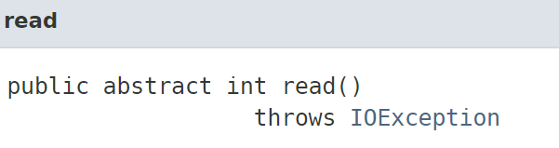
Basic IO
import java.io.IOException;
public class inputTest {
public static void main(String[] args) throws IOException {
// 한개 - 숫자, 문자 입력
System.out.println("Read data 1");
int numInt2 = System.in.read();
//System.in.read(); // stream에서 enter는 \r\n
//System.in.read(); // or System.in.skip(2);
System.in.skip(2);
System.out.println((char)numInt2);
// 여러개 - 문자열 입력
byte data[] = new byte[100];
System.out.println("Read data 2");
System.in.read(data);
for (int i=0; i<data.length; i++)
System.out.print((char)data[i]);
}
}
Or you can add
Import java.io.InputStream;
inputStream = System.in;
inputStream.read();

Slide 19
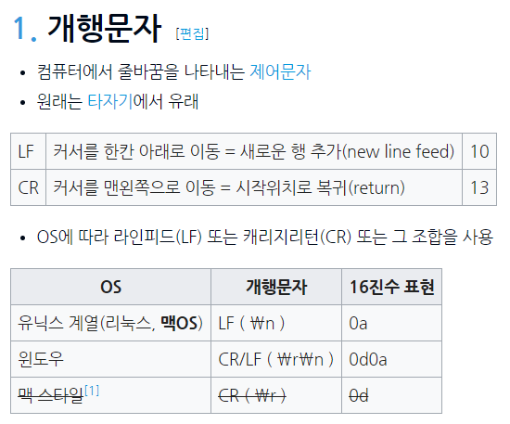
Appendix

Slide 20
I/O Stream class
import java.io.IOException;
import java.io.InputStreamReader;
import java.io.OutputStreamWriter;;
public class inputTest {
public static void main(String[] args) throws IOException {
InputStreamReader is = new InputStreamReader(System.in);
OutputStreamWriter os = new OutputStreamWriter(System.out);
int readInt = is.read();
os.write((char)readInt);
is.close();
os.close();
}
}

Slide 21
I/O Stream + Buffer class
import java.io.IOException;
import java.io.InputStreamReader;
import java.io.OutputStreamWriter;
import java.io.BufferedReader;
import java.io.BufferedWriter;
public class inputTest {
public static void main(String[] args) throws IOException {
InputStreamReader is = new InputStreamReader(System.in);
BufferedReader br = new BufferedReader(is);
OutputStreamWriter os = new OutputStreamWriter(System.out);
BufferedWriter bw = new BufferedWriter(os);
String line = br.readLine();
bw.write(line);
bw.flush();
bw.close();
}
}
Buffer size 8192

Slide 22
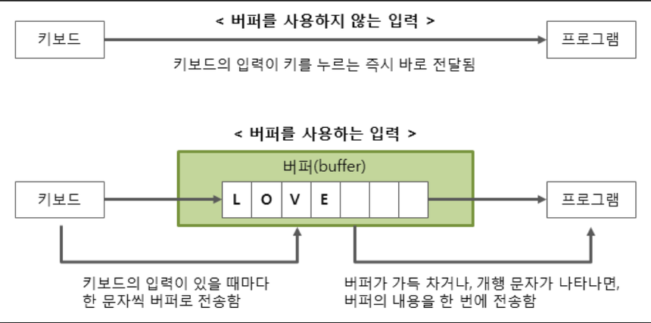

Slide 23
More about String & String buffer
public class inputTest2 {
public static void main(String[] args) {
String stringValue1 = "TEST 1";
String stringValue2 = "TEST 2";
String stringValue3 = "TEST";
String stringValue4 = " 1";
System.out.println("stringValue1: " + stringValue1.hashCode());
System.out.println("stringValue2: " + stringValue2.hashCode());
System.out.println("stringValue3: " + stringValue3.hashCode());
System.out.println("stringValue4: " + stringValue4.hashCode());
stringValue1 = stringValue1 + stringValue2;
System.out.println("stringValue1: " + stringValue1.hashCode());
stringValue3 = stringValue3 + stringValue4;
System.out.println("stringValue3: " + stringValue3.hashCode());
StringBuffer sb = new StringBuffer();
System.out.println("sb: " + sb.hashCode());
sb.append("TEST StringBuffer");
System.out.println("sb: " + sb.hashCode());
}
}
String = immutable(변경불가)
StringBuffer= mutable(변경가능)

Slide 24
Using “==“ between two Strings
See lecture 3 slide 22
For two string objects s1 and s2, what does it mean s1 == s2 ??
== is not appropriate for determining if two objects have the same value.
if (s1 == s2), where s1 and s2 refer to strings, determines only if s1 and s2 refer the a common memory location.
E.g.
String a = “Hello”;
String b= “Hello”;
String c = new String(“Hello”);
a==b?
a==c?
Java Heap
Hello
String constant pool
Java
Hello

Slide 25
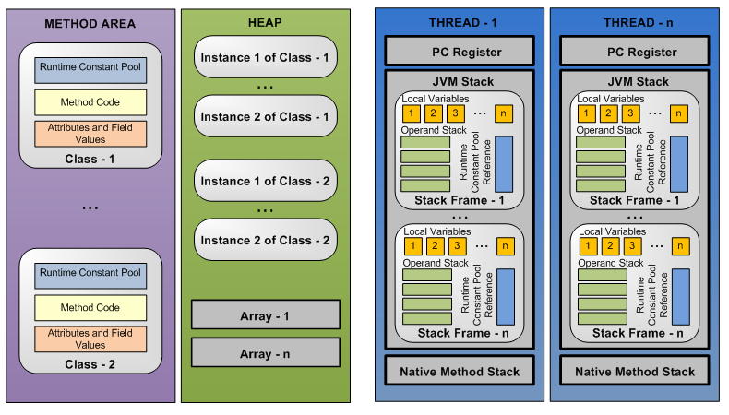
JVM memory structure
Common memory areas

Slide 26
10.2 Text-File I/O

Slide 27
Creating a Text File
Class PrintWriter
a stream class that can be used to write to a text file
Provides useful methods such as print(), println(), etc.
Requires try/catch blocks
To create the file
Declare stream variable for referencing the stream
PrintWriter outputStream;
Invoke PrintWriter constructor, pass file name as argument
outputStream = new PrintWriter (fileName);
Requires try and catch blocks
For more information http://docs.oracle.com/javase/tutorial/essential/io/index.html

Slide 28
Creating a Text File
File is empty initially
Contents of an existing file with the same name are removed
Write to the file with methods print(), println(), etc.
E.g. outputStream.println("This is line 1.");
Data goes initially to memory buffer
When the buffer is full, data goes to the file
Write explicitly the buffered output to disk using flush
Closing file, empties buffer, disconnects from stream
If a program ends normally, it will close all open files
Close files explicitly!
outputStream.close();

Slide 29
java.io package
Most of the classes covered in the I/O Streams section are in the java.io package
All the file I/O classes that follow are in the package java.io, so a program that uses PrintWriter will start with a set of import statements:
import java.io.PrintWriter;
import java.io.FileOutputStream;
import java.io.FileNotFoundException;

Slide 30
Creating a Text File
import java.io.PrintWriter;
import java.io.FileNotFoundException;
import java.util.Scanner;
public class TextFileOutputDemo
{
public static void main (String [] args)
{
String fileName = "out.txt"; //The name could be read from the keyboard.
PrintWriter outputStream = null;
try
{
outputStream = new PrintWriter (fileName);
}
catch (FileNotFoundException e)
{
System.out.println ("Error opening the file " + fileName);
System.exit (0);
}
String line = keyboard.nextLine ();
outputStream.println (count + " " + line);
}
}
fileI/O의 경우 Exception 처리가 필수임
두가지 방법으로 처리 가능
1
throws FileNotFoundException
파일 인스턴스 생성
2
파일에 문장 작성

Slide 31
Every File Has Two Names
outputStream = new PrintWriter (“out.txt”);
stream name used by Java
outputStream in the example
name used by the operating system
out.txt in the example

Slide 32
A try Block Is a Block
Problem ?
try
{
PrintWriter outputStream = new PrintWriter(fileName);
}
PrintWriter outputStream = null;
try
{
outputStream = new PrintWriter(fileName);
}

Slide 33

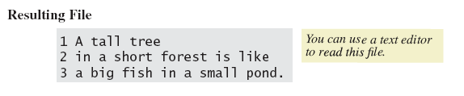
Lab: Creating a Text File
View sample program, listing 10.1 class TextFileOutput

Slide 34
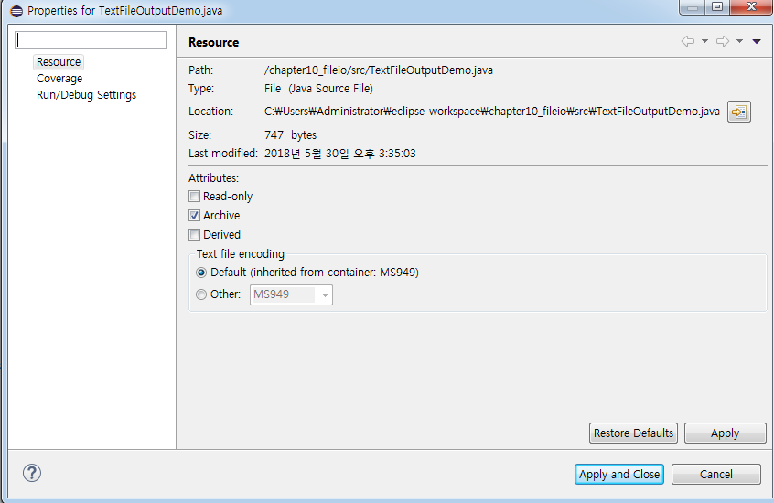
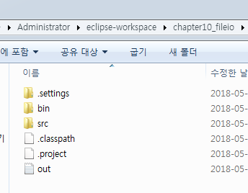
Lab: Creating a Text File
Where is output folder?
경로를 지정하지 않으면 프로젝트 폴더 밑에 저장
import java.io.PrintWriter;
import java.io.FileNotFoundException;
import java.util.Scanner;
public class TextFileOutputDemo
{
public static void main (String [] args)
{
String fileName = "out.txt"; //you can set directory " c:/out.txt "
PrintWriter outputStream = null;
try
{
outputStream = new PrintWriter (fileName);
}
catch (FileNotFoundException e)
{
System.out.println ("Error opening the file " + fileName);
System.exit (0);
}
System.out.println ("Enter three lines of text:");
Scanner keyboard = new Scanner (System.in);
for (int count = 1 ; count <= 3 ; count++)
{
String line = keyboard.nextLine ();
outputStream.println (count + " " + line);
}
outputStream.close ();
System.out.println ("Those lines were written to " + fileName);
}
}

Slide 35
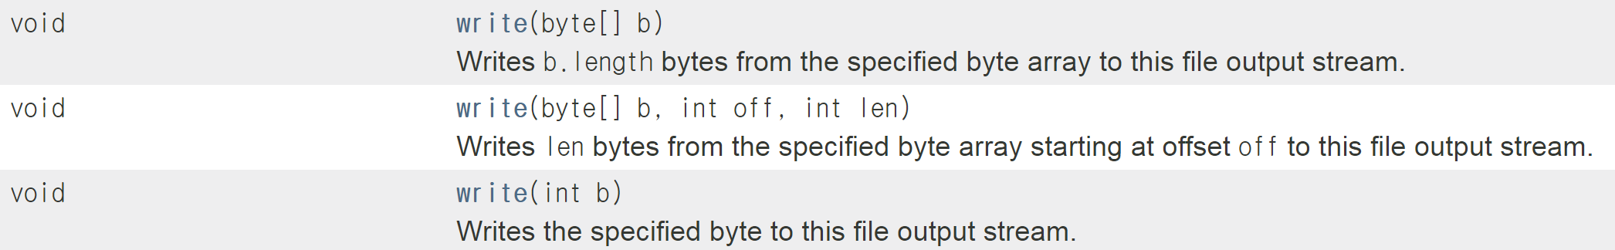
Why use PrintWriter ?
키보드 입력시 숫자나 문자 1개는 ok
String은 byte로 변환 필요
FileOutputStream is enough to open/write to a file
import java.io.FileOutputStream;
import java.io.IOException;
import java.util.Scanner;
public class CopyBytes {
public static void main(String[] args) throws IOException {
FileOutputStream out = null;
Scanner sc = new Scanner(System.in);
try {
out = new FileOutputStream("output.txt");
String add = sc.nextLine();
out.write(add.getBytes());
} finally {
if (in != null) {
in.close(); }
if (out != null) {
out.close(); }
}
}
}
https://docs.oracle.com/javase/7/docs/api/java/io/FileOutputStream.html

Slide 36
Why use PrintWriter ?
To open a text file for output
Connect a text file to a stream for writing
PrintWriter outputStream = new PrintWriter(new FileOutputStream("out.txt”));
Or
FileOutputStream s = new FileOutputStream("out.txt");
PrintWriter outputStream = new PrintWriter(s);
PrintWriter
FileOutputStream
Memory
Disk
outputStream
out.txt
PrintWriter provides useful methods for easier writing !

Slide 37
Methods for PrintWriter
Similar to methods for System.out
println
print
format
flush: write buffered output to disk
close: close the PrintWriter stream (and file)
outputStream.println(count + " " + line);

Slide 38
Appending to a Text File
Opening a file new begins with an empty file
If already exists, will be overwritten
When appending data to an existing file
Second parameter: whether to append to the end if the file exists
Method print(), println() will append text at the end
outputStream = new PrintWriter(new FileOutputstream(fileName, true));

Slide 39
Closing a File
A file should be closed when you are done writing to it
An input file should also be closed when you are done reading it
Use close() method of class PrintWriter
If a program ends normally, it will close all open files
outputStream.close();

Slide 40
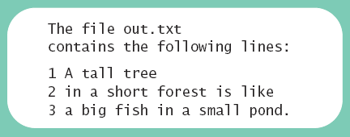
Lab: Reading from a Text File (Scanner)
= To open a text file for input
Note text file reading program, listing 10.2 class TextFileInputDemo
Reads text from file, displays on screen
Note
Statement which opens the file
Use of Scanner object
Boolean statement which reads the file and terminates reading loop
(use hasNextLine() method)

Slide 41
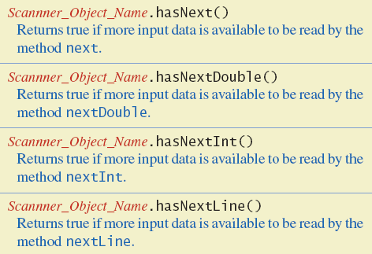
Lab: Reading from a Text File (Scanner)
Figure 10.3 Additional methods in class Scanner

Slide 42
Lab: Reading from a Text File (Scanner)
import java.io.File;
import java.io.FileNotFoundException;
import java.util.Scanner;
public class TextFileInputDemo {
public static void main(String[] args) {
String fileName = "out.txt";
Scanner inputStream = null;
System.out.println("The file " + fileName +
"\ncontains the following lines:\n");
try {
inputStream = new Scanner(new File(fileName));
} catch(FileNotFoundException e) {
System.out.println("Error opening the file " + fileName);
System.exit(0);
}
while (inputStream.hasNextLine()) {
String line = inputStream.nextLine();
System.out.println(line);
}
inputStream.close();
}
}
Open a text file for input
Check if there left something to read

Slide 43
Reading from a Text File (Another way)
To open a text file for input
Connect a text file to a stream for reading, use
BufferedReader
FileReader (or FileInputStream)
BufferedReader inputStream =
new BufferedReader(new FileReader(“smiley.txt"));
BufferedReader
FileReader
Memory
Disk
smiley.txt
inputStream
c. f. PrintWriter outputStream = new PrintWriter(FileOutputStream("out.txt"));

Slide 44
Methods for BufferedReader
readLine: read a line into a String
No methods to read numbers directly, so read numbers as Strings and then convert them (StringTokenizer later)
read: read a char at a time
close: close BufferedReader stream

Slide 45
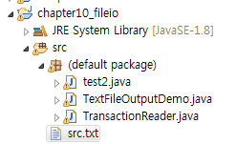
Lab: copy file
Write a program that copies the contents of a text file to another file.
Source file name: src.txt
Destination file name: dest.txt
Note: Assume src.txt file already exists!
1) src.txt 파일 만들기
2) 프로젝트에 복사
Hello
How are you?

Slide 46
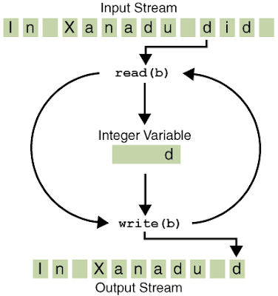
Lab : case 1
import java.io.FileReader;
import java.io.FileWriter;
import java.io.BufferedReader;
import java.io.PrintWriter;
import java.io.IOException;
public class CopyLines {
public static void main(String[] args) throws IOException {
BufferedReader inputStream = null;
PrintWriter outputStream = null;
try {
inputStream = new BufferedReader(new FileReader("src.txt"));
outputStream = new PrintWriter(new FileWriter("dest.txt"));
String l;
while ((l = inputStream.readLine()) != null) {
outputStream.println(l);
}
} finally {
if (inputStream != null) {
inputStream.close();
}
if (outputStream != null) {
outputStream.close();
}
}
}}

Slide 47
Lab : case 2
import java.io.FileOutputStream;
import java.io.FileInputStream;
import java.io.IOException;
public class CopyLines {
public static void main(String[] args) throws IOException {
FileInputStream in = null;
FileOutputStream out = null;
try {
in = new FileInputStream(" src.txt ");
out = new FileOutputStream("dest.txt");
int c;
while ((c = in.read()) != -1) {
out.write(c); }
} finally {
if (in != null) {
in.close(); }
if (out != null) {
out.close(); }
}
}
}

Slide 48
10.3 Techniques for Any File

Slide 49
Recall: Every File Has Two Names
outputStream = new PrintWriter (“out.txt”);
stream name used by Java
outputStream in the example
name used by the operating system
out.txt in the example
Is there a general way to represent file names in Java ??

Slide 50
Class File
Provides a way to represent a file/folder in a general way
Some stream classes accept a file name as a String
Some accept only a File object
E.g., Scanner class (p.38)
is = new Scanner(new File(fileName));

Slide 51
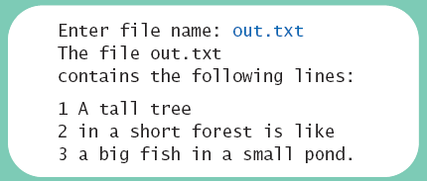
Programming Example
Reading a file name from the keyboard
View sample code, listing 10.3 class TextFileInputDemo2

Slide 52
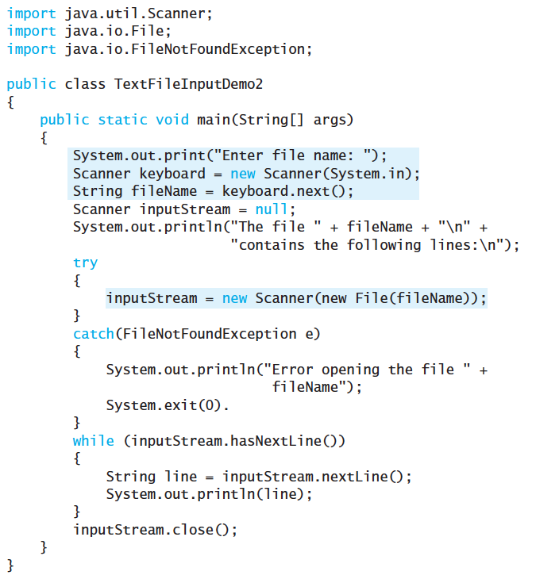

Slide 53
Path Names
Files opened in our examples assumed to be in same folder as where program run
Possible to specify path names − absolute or relative
Path name tells the name of file and directory the file is in
Be aware of differences of pathname styles in different operating systems (UNIX /(slash), windows \(backslash))
Absolute path
In Windows, either “C:\\homework\\hw1\\data.txt” or “C:/homework/hw1/data.txt” is ok
Relative path
In windows, you can use “..\\output.txt”
문자열에서 \는 escaping character

Slide 54
Question
If you want to read a file data.txt in the directory “C:\homework\hw\”, you would write
Scanner inputStream = new Scanner( new File(“C:\\homework\\hw1\\data.txt”));
In Windows, it is okay to use “C:/homework/hw/data.txt”,

Slide 55
Revisit Lab : copy file
import java.io.FileReader;
import java.io.FileWriter;
import java.io.BufferedReader;
import java.io.PrintWriter;
import java.io.IOException;
public class CopyLines {
public static void main(String[] args) throws IOException {
BufferedReader inputStream = null;
PrintWriter outputStream = null;
try {
inputStream = new BufferedReader(new FileReader("src.txt"));
outputStream = new PrintWriter(new FileWriter(“C:\\dest.txt"));
String l;
while ((l = inputStream.readLine()) != null) {
outputStream.println(l);
}
} finally {
if (inputStream != null) {
inputStream.close();
}
if (outputStream != null) {
outputStream.close();
}
}
}}
Change the destination file path

Slide 56
Methods of the Class File
Class File has methods to access information about a path and the files in it
Whether the file exists
Whether it is specified as readable or not

Slide 57
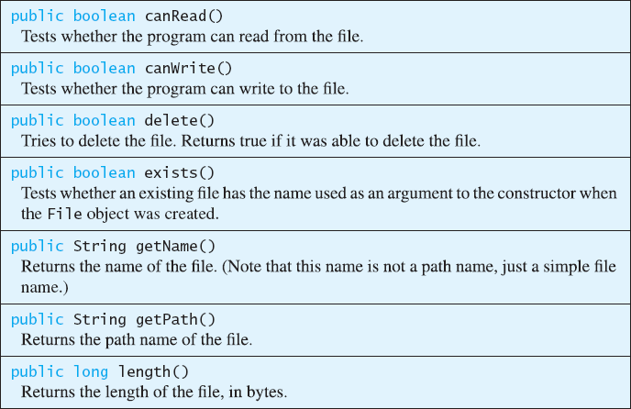
Methods of the Class File
File file = new File("trasure.txt");
if (!file.exists())
System.out.println("No file by that name");
if (!file.canRead())
System.out.println("Not allowed to read from that file");

Slide 58
File Objects in Stream class
Constructors of FileInputStream and FileOutputStream
Take a File argument as well as String argument
PrintWriter smileyOutStream =
new PrintWriter(new FileOutputStream(“smiley.txt”));
Or
File smileyFile = new File(“smiley.txt”);
if (smileyFile.canWrite())
PrintWriter smileyOutStream =
new PrintWriter(new FileOutputStream(smileyFile));

Slide 59
Defining a Method to Open a Stream
Method will have a String parameter
The file name
Method will return the stream object PrintWriter
Will throw exceptions
If file not found
If some other I/O problem arises
Should be invoked inside a try block and have appropriate catch block

Slide 60
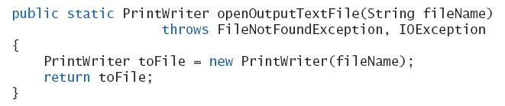
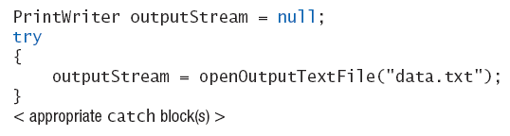
Defining a Method to Open a Stream
Example code
Example call

Slide 61
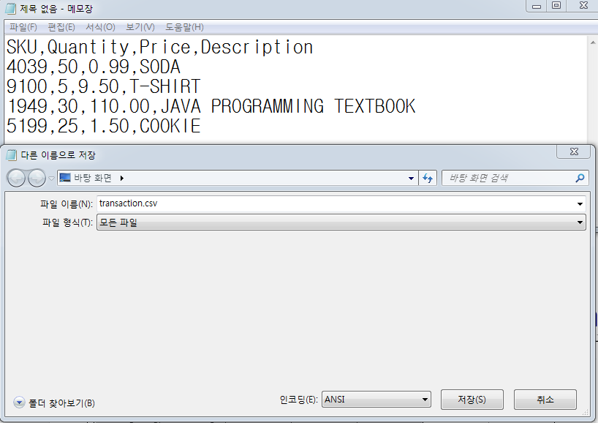
Processing a CSV file
A comma-separated values (CSV) file is a simple text file used to store a list of records
Use split() method (in String class) to put strings separated by a delimiter into an array
SKU,Quantity,Price,Description
4039,50,0.99,SODA
9100,5,9.50,T-SHIRT
1949,30,110.00,JAVA PROGRAMMING TEXTBOOK
5199,25,1.50,COOKIE
// transaction.csv
String str = "4039,50,0.99,SODA";
String[] arr = str.split(",");
System.out.println(arr[0]); // 4039
System.out.println(arr[1]); // 50
System.out.println(arr[2]); // 0.99
System.out.println(arr[3]); // SODA
메모장에 transaction.csv파일로 저장
Excel에서 읽을 수 있음

Slide 62
Processing a CSV file
Example from log of a cash register’s transactions for the day:
Transactions.csv
The first line is a header line,
SKU,Quantity,Price,Description 4039,50,0.99,SODA 9100,5,9.50,T-SHIRT
1949,30,110.00,JAVA PROGRAMMING TEXTBOOK
5199,25,1.50,COOKIE
quantity
price of one unit
SKU: stock keeping unit

Slide 63
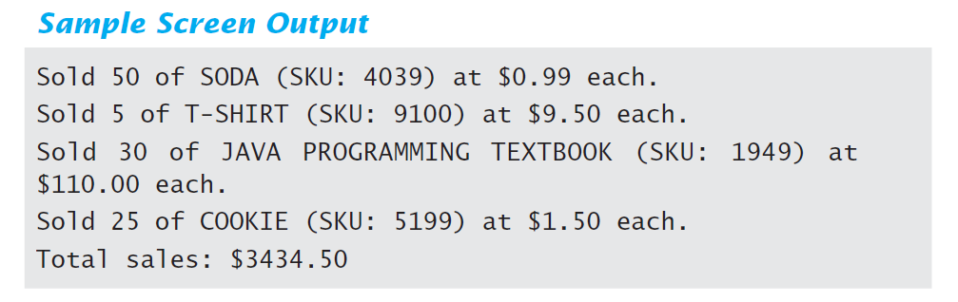
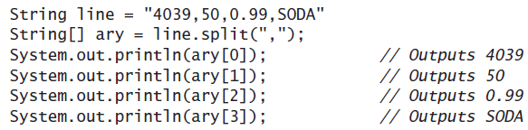
Lab: case study
View program that calculates total sales, listing 10.4 class TransactionReader
Uses the split method (in String class) which puts strings separated by a delimiter into an array

Slide 64
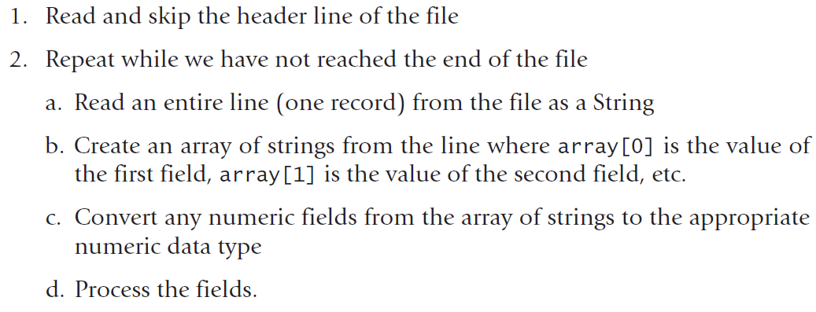
Lab: case study
Processing a Comma-Separated Values File

Slide 65
import java.io.FileInputStream;
import java.io.FileNotFoundException;
import java.io.IOException;
import java.io.File;
import java.util.Scanner;
public class TransactionReader {
public static void main(String[] args) {
String fileName = "C:\\Users\\Administrator\\Desktop\\transaction.csv";
try {
Scanner inputStream = new Scanner(new File(fileName));
String line = inputStream.nextLine(); // Read the header line
double total = 0; // Total sales
while (inputStream.hasNextLine()) {// Read the rest of the file line by line
line = inputStream.nextLine();
String[] ary = line.split(",");
// Extract each item
String SKU = ary[0];
int quantity = Integer.parseInt(ary[1]);
double price = Double.parseDouble(ary[2]);
String description = ary[3];
// Output item
System.out.printf("Sold %d of %s (SKU: %s) at $%1.2f each.\n",quantity, description, SKU, price);
// Compute total
total += quantity * price;
}
System.out.printf("Total sales: $%1.2f\n",total);
inputStream.close( );
}
catch(FileNotFoundException e) {
System.out.println("Cannot find file " + fileName);
}
catch(IOException e) {
System.out.println("Problem with input from file " + fileName);
}
}
}
.txt 로 작성해도 무방

Slide 66
(Appendix) Reading Words in a String: Using StringTokenizer Class
StringTokenizer can be used to parse a line into words
import java.util.*
some of its useful methods are shown in the text
e.g. test if there are more tokens
you can specify delimiters (the character or characters that separate words)
the default delimiters are "white space" (space, tab, and newline)

Slide 67
(Appendix) Example: StringTokenizer
Display the words separated by any of the following characters: space, new line (\n), period (.) or comma (,).
String inputLine = keyboard.nextLine();
StringTokenizer wordFinder =
new StringTokenizer(inputLine, " \n.,"); //the second argument is a string of the 4 delimiters
while(wordFinder.hasMoreTokens())
{
System.out.println( wordFinder.nextToken() );
}
Question 2b or !tooBee
Entering "Question,2b.or !tooBee." gives this output:

Slide 68
10.4 Basic Binary-File I/O

Slide 69
Basic Binary File I/O: Object Streams
Important classes for binary file output (to the file)
ObjectOutputStream
FileOutputStream
Important classes for binary file input (from the file):
ObjectInputStream
FileInputStream
Use “import java.io.*;”

Slide 70
Object Streams
ObjectInputStream and ObjectOutputStream:
have methods to read or write data one byte at a time
Regarding file name
ObjectOutputStream and ObjectInputStream cannot take file names as arguments for their constructors
FileOutputStream and FileInputStream are used only for the constructors; constructors take file names
E.g., ObjectOutputStream outputStream = new ObjectOutputStream(new FileOutputStream("numbers.dat"));

Slide 71
Handling IOException
IOException cannot be ignored
either handle it with a catch block
or defer it with a throws-clause
We will put code to open the file and write to it in a try-block and write a catch-block for this exception :
catch(IOException e)
{
System.out.println("Problem with output...";
}

Slide 72
ObjectOutputStream Methods
1. To open a file named numbers.dat:
2. Use methods defined in ObjectOutputStream
writeInt(int n)
writeDouble(double x)
writeBoolean(boolean b)
etc.
Note that each write method throws IOException
3. Close when the writing is done
outputStream.close();
ObjectOutputStream outputStream = new ObjectOutputStream( new FileOutputStream("numbers.dat"));

Slide 73
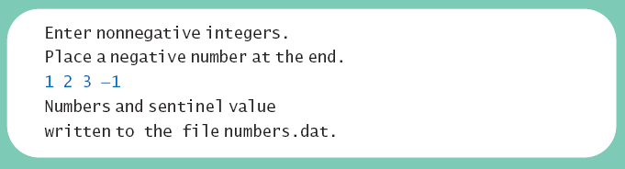
Lab: Creating a Binary File
Writing primitive values to a binary file
Note the line to open the file
Constructor for ObjectOutputStream cannot take a String parameter
Constructor for FileOutputSream can take a String parameter

Slide 74
public class BinaryOutputDemo
{
public static void main (String [] args)
{
String fileName = "numbers.dat";
try
{
ObjectOutputStream outputStream =
new ObjectOutputStream (new FileOutputStream (fileName));
Scanner keyboard = new Scanner (System.in);
System.out.println ("Enter nonnegative integers.");
System.out.println ("Place a negative number at the end.");
int anInteger;
do {
anInteger = keyboard.nextInt ();
outputStream.writeInt (anInteger);
}
while (anInteger >= 0);
System.out.println ("Numbers and sentinel value");
System.out.println ("written to the file " + fileName);
outputStream.close ();
}
catch (FileNotFoundException e)
{
System.out.println ("Problem opening the file " + fileName);
}
catch (IOException e)
{
System.out.println ("Problem with output to file " + fileName);
}
}}
Open a binary file for output
Write an integer value to the file
Close when the writing is done

Slide 75
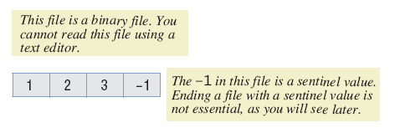
Methods in ObjectOutputStream
Method println not available
Instead use writeInt method
Binary file stores numbers in binary form
A sequence of bytes
One immediately after another

Slide 76
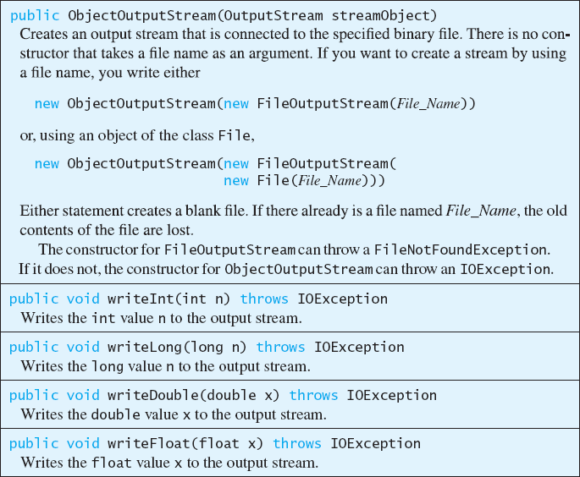
Methods in ObjectOutputStream
provide writeXXX() methods

Slide 77
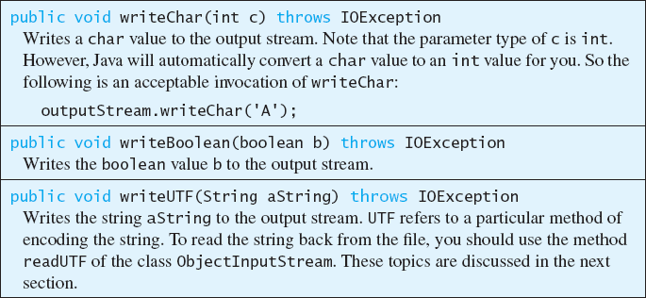
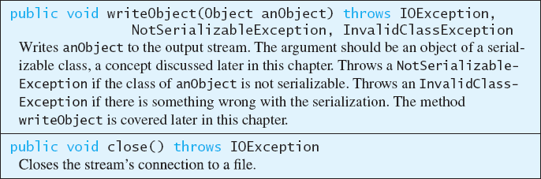
Methods in ObjectOutputStream

Slide 78
Writing Strings to a Binary File
Use method writeUTF
Example outputStream.writeUTF("Hi Mom");
UTF stands for Unicode Text Format
Uses a varying number of bytes to store different strings
Depends on length of string
Contrast to writeInt which uses same for each

Slide 79
Reading from a Binary File
File must be opened as an ObjectInputStream
Read from binary file using methods which correspond to write methods
Integer written with writeInt will be read with readInt

Slide 80
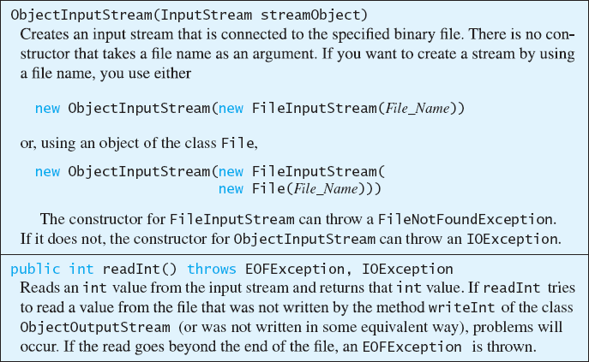
Reading from a Binary File
Some methods of class ObjectInputStream
provide readXXX() methods

Slide 81
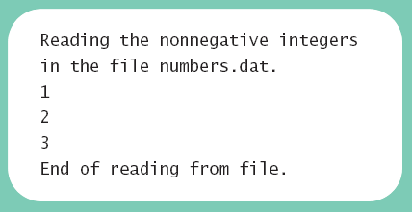
Lab: Reading from a Binary File
View program to read, listing 10.6 class BinaryInputDemo

Slide 82
public class BinaryInputDemo {
public static void main (String [] args) {
String fileName = "numbers.dat";
try {
ObjectInputStream inputStream =
new ObjectInputStream (new FileInputStream (fileName));
System.out.println ("Reading the nonnegative integers");
System.out.println ("in the file " + fileName);
int anInteger = inputStream.readInt ();
while (anInteger >= 0)
{
System.out.println (anInteger);
anInteger = inputStream.readInt ();
}
System.out.println ("End of reading from file.");
inputStream.close ();
}
catch (FileNotFoundException e)
{
System.out.println ("Problem opening the file " + fileName);
}
catch (EOFException e)
{
System.out.println ("Problem reading the file " + fileName);
System.out.println ("Reached end of the file.");
}
catch (IOException e)
{
System.out.println ("Problem eading the file " + fileName);
}
}
}

Slide 83
Class EOFException
Many methods that read from a binary file will throw an EOFException
Can be used to test for end of file
Thus can end a reading loop
View example program, listing 10.7 class EOFExceptionDemo

Slide 84
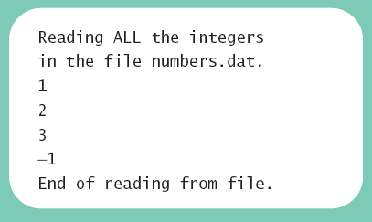
Class EOFException
Note the -1 formerly needed as a sentinel value is now also read
Always a good idea to check for end of file even if you have a sentinel value

Slide 85
Class EOFException
EOFException을 사용하여
여기를 변경
public class BinaryInputDemo {
public static void main (String [] args) {
String fileName = "numbers.dat";
try {
ObjectInputStream inputStream =
new ObjectInputStream (new FileInputStream (fileName));
System.out.println ("Reading the nonnegative integers");
System.out.println ("in the file " + fileName);
int anInteger = inputStream.readInt ();
while (anInteger >= 0)
{
System.out.println (anInteger);
anInteger = inputStream.readInt ();
}
System.out.println ("End of reading from file.");
inputStream.close ();
}
catch (FileNotFoundException e) { …. }
catch (EOFException e) { …. }
catch (IOException e) {…. }
}

Slide 86
public class EOFExceptionDemo
{
public static void main (String [] args)
{
String fileName = "numbers.dat";
try
{
ObjectInputStream inputStream =
new ObjectInputStream (new FileInputStream (fileName));
System.out.println ("Reading ALL the integers");
System.out.println ("in the file " + fileName);
try
{
while (true)
{
int anInteger = inputStream.readInt ();
System.out.println (anInteger);
}
}
catch (EOFException e)
{
System.out.println ("End of reading from file.");
}
inputStream.close ();
}
catch (FileNotFoundException e)
{
System.out.println ("Cannot find file " + fileName);
}
catch (IOException e)
{
System.out.println ("Problem with input from file " + fileName);
}
}
}
Intentional "infinite" loop to process data from input file
Loop exits when end-of-file exception is thrown
Processing continues after EOFException: the input file is closed

Slide 87
10.5 Binary-File I/O, Objects & Arrays

Slide 88
Binary-File I/O with Class Objects
Consider the need to write/read objects other than Strings
Possible to write the individual instance variable values
Then reconstruct the object when file is read
You can also read and write objects to files !

Slide 89
Serialization
Java provides object serialization to write/read an entire object to/from a file
A serialized object is represented as a sequence of bytes that contains the object’s data and its type information
It can be read from the file and de-serialized to reconstruct the object in memory
The class must implement Serializable interface
Serializable interface does not define any methods: No need to implement additional methods!

Slide 90
How to use it?
Class must be serializable
import java.io.*
implement Serializable interface
add implements Serializable to heading of class definition
Methods used:
public class Species implements Serializable
to write object to file:
writeObject method in ObjectOutputStream
to read object from file: readObject method in ObjectInputStream

Slide 91
Writing objects to a file
ObjectOutputStream objectOut = new ObjectOutputStream( new BufferedOutputStream( new FileOutputStream(fileName)));
objectOut.writeObject(serializableObject);
objectOut.close( );

Slide 92
Reading objects from a file
ObjectInputStream objectIn = new ObjectInputStream( new BufferedInputStream( new FileInputStream(fileName)));
myObject = (itsType)objectIn.readObject( );
objectIn.close( );

Slide 93
Example
ObjectOutputStream outputStream = null;
String fileName = "species.records";
try {
outputStream = new ObjectOutputStream(new FileOutputStream(fileName));
} catch(IOException e) {
System.out.println("Error opening output file: " + fileName);
System.exit(0);
}
Species califCondor = new Species("Calif.Condor", 27, 0.02);
try {
outputStream.writeObject(califCondor);
outputStream.close();
} catch(IOException e) {
System.out.println("Error writing to file: " + fileName);
System.exit(0);
}
System.out.println("Record sent to file: " + fileName);
Write an object to a binary file

Slide 94
Example cont’d
ObjectInputStream inputStream = null;
try {
inputStream = new ObjectInputStream(new FileInputStream(fileName));
} catch(IOException e) {
System.out.println("Error opening input file: " + fileName);
System.exit(0);
}
Species readOne = null;
try {
readOne = (Species)inputStream.readObject();
inputStream.close();
} catch(Exception e) {
System.out.println("Error reading from file: " + fileName);
System.exit(0);
}
System.out.println("The following were read from the file: " + fileName);
System.out.println(readOne);
System.out.println("End of program.");
Read an object from a binary file
readObject returns a reference to type Object so it must be cast to Species before assigning to readOne

Slide 95
Requirements to be serializable
Requirements for a class to be serializable
Implements interface Serializable
Any instance variables of a class type are also objects of a serializable class
Class’s direct superclass (if any) is either serializable or defines a default constructor
Effects of making a class serializable
Java assigns a serial number( 일련번호) to each object of the class it writes to ObjectOutputStream
If an object is written to the stream multiple times, only the serial number is written after the first write

Slide 96
Array objects in binary files
Array objects in binary files
Since an array is an object, it is possible to use writeObject() with entire array
Similarly, use readObject() to read entire array

Slide 97
Example : class Employee
public class Employee {
private int id;
private String name;
private String department;
private double expLevel;
public int getId() {
return id;
}
public void setId(int id) {
this.id = id;
}
public String getName() {
return name;
}
public void setName(String name) {
this.name = name;
}
public String getDepartment() {
return department;
}
public void setDepartment(String department) {
this.department = department;
}
public double getExpLevel() {
return expLevel;
}
public void setExpLevel(double expLevel) {
this.expLevel = expLevel;
}
}
you want to save Employee objects to file and load them at a later date

Slide 98
Example : class Employee
you want to save Employee objects to file and load them at a later date
public class Employee implements Serializable {
private int id;
private String name;
private String department;
private double expLevel;
public int getId() {
return id;
}
public void setId(int id) {
this.id = id;
}
public String getName() {
return name;
}
public void setName(String name) {
this.name = name;
}
public String getDepartment() {
return department;
}
public void setDepartment(String department) {
this.department = department;
}
public double getExpLevel() {
return expLevel;
}
public void setExpLevel(double expLevel) {
this.expLevel = expLevel;
}
}
That’s all you have to do

Slide 99
“Good News!” Implementing the Serializable interface is very easy
To “implement” an interface means to define all the methods declared by that interface, but...
The Serializable interface does not define any methods!
Question: What possible use is there for an interface that does not declare any methods?
Answer: Serializable is used as flag to tell Java it needs to do extra work with this class

Slide 100
Lab: serialization
EmployMain.java
import java.io.*;
public class EmployeeMain {
public static void main(String[] args) {
File file = new File("./test_serialization.txt");
try {
FileOutputStream foStream = new FileOutputStream(file);
ObjectOutputStream oStream = new ObjectOutputStream(foStream);
Employee employee = new Employee();
employee.setId(1);
employee.setName("Tom");
employee.setDepartment("SWDM");
employee.setExpLevel(5.0);
System.out.println("Object values to be serialized = " +employee.getName() +";" +employee.getId() +";"+employee.getDepartment() +";"
+employee.getExpLevel());
oStream.writeObject(employee);
ObjectInputStream iStream = new ObjectInputStream(new FileInputStream(file));
Employee emp = (Employee)iStream.readObject();
System.out.println("De serialized object values = "+emp.getName() +";"+emp.getId() +";"+emp.getDepartment() +";"
+emp.getExpLevel());
oStream.close();
iStream.close();
} catch (FileNotFoundException fn) {
fn.printStackTrace();
} catch (IOException io) {
io.printStackTrace();
}catch(ClassNotFoundException cnf){
cnf.printStackTrace();
}
}
}

Slide 101
Lab: serialization
Employ.java
public class Employee implements Serializable {
private int id;
private String name;
private String department;
private double expLevel;
public int getId() {
return id;
}
public void setId(int id) {
this.id = id;
}
public String getName() {
return name;
}
public void setName(String name) {
this.name = name;
}
public String getDepartment() {
return department;
}
public void setDepartment(String department) {
this.department = department;
}
public double getExpLevel() {
return expLevel;
}
public void setExpLevel(double expLevel) {
this.expLevel = expLevel;
}
}

Slide 102
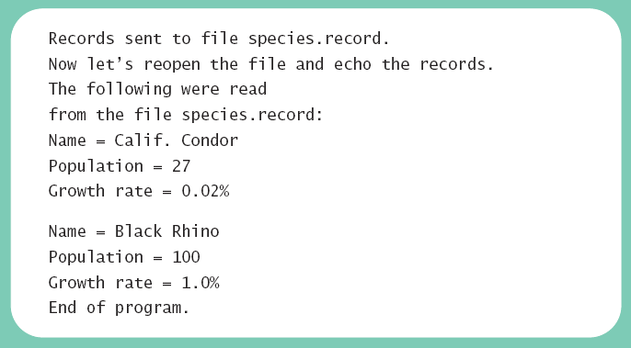
Practice: Binary-File I/O
Interface Serializable is an empty interface
No need to implement additional methods
Tells Java to make the class serializable (class objects convertible to sequence of bytes)
View sample class , listing 10.9 class Species

Slide 103
import java.io.Serializable;
import java.util.Scanner;
public class Species implements Serializable{
private String name;
private int population;
private double growthRate;
public Species( ) {
name = null;
population = 0;
growthRate = 0;
}
public Species(String initialName, int initialPopulation, double initialGrowthRate) {
name = initialName;
if (initialPopulation >= 0) population = initialPopulation;
else {
System.out.println("ERROR: Negative population.");
System.exit(0);
}
growthRate = initialGrowthRate;
}
public String toString() {
return ("Name = " + name + "\n" + "Population = " + population + "\n" + "Growth rate = " + growthRate + "%");
}
public void readInput( ) {
Scanner keyboard = new Scanner(System.in);
System.out.println("What is the species' name?");
name = keyboard.nextLine( );
System.out.println("What is the population of the species?");
population = keyboard.nextInt( );
while (population < 0) {
System.out.println("Population cannot be negative.");
System.out.println("Reenter population:");
population = keyboard.nextInt( );
}
System.out.println("Enter growth rate (% increase per year):");
growthRate = keyboard.nextDouble( );
}
public void writeOutput( ) {
System.out.println("Name = " + name);
System.out.println("Population = " + population);
System.out.println("Growth rate = " + growthRate + "%");
}
public int predictPopulation(int years) {
int result = 0;
double populationAmount = population;
int count = years;
while ((count > 0) && (populationAmount > 0)) {
populationAmount = (populationAmount + (growthRate / 100) * populationAmount);
count--;
}
if (populationAmount > 0) result = (int)populationAmount;
return result;
}
public void setSpecies(String newName, int newPopulation, double newGrowthRate) {
name = newName;
if (newPopulation >= 0)
population = newPopulation;
else {
System.out.println("ERROR: using a negative population.");
System.exit(0);
}
growthRate = newGrowthRate;
}
public String getName( ) { return name; }
public int getPopulation( ) { return population; }
public double getGrowthRate( ) { return growthRate; }
public boolean equals(Species otherObject) {
return (name.equalsIgnoreCase(otherObject.name)) && (population == otherObject.population) &&
(growthRate == otherObject.growthRate);
}
}

Slide 104
import java.io.FileInputStream;
import java.io.FileOutputStream;
import java.io.IOException;
import java.io.ObjectInputStream;
import java.io.ObjectOutputStream;
public class ClassObjectIODemo{
public static void main(String[] args) {
ObjectOutputStream outputStream = null;
String fileName = "species.records";
try {
outputStream = new ObjectOutputStream( new FileOutputStream(fileName));
}
catch(IOException e) {
System.out.println("Error opening output file " + fileName + ".");
System.exit(0);
}
Species califCondor = new Species("Calif. Condor", 27, 0.02);
Species blackRhino = new Species("Black Rhino", 100, 1.0);
try {
outputStream.writeObject(califCondor);
outputStream.writeObject(blackRhino);
outputStream.close( );
}
catch(IOException e) {
System.out.println("Error writing to file " + fileName + ".");
System.exit(0);
}
System.out.println("Records sent to file " + ileName + ".");
System.out.println("Now let's reopen the file and echo the records.");
ObjectInputStream inputStream = null;
try {
inputStream = new ObjectInputStream(new FileInputStream("species.records"));
}
catch(IOException e) {
System.out.println("Error opening input file " + fileName + ".");
System.exit(0);
}
Species readOne = null, readTwo = null;
try {
readOne = (Species)inputStream.readObject( );
readTwo = (Species)inputStream.readObject( );
inputStream.close( );
}
catch(Exception e) {
System.out.println("Error reading from file " +fileName + ".");
System.exit(0);
}
System.out.println("The following were read\n" + "from the file " + fileName + ".");
System.out.println(readOne);
System.out.println( );
System.out.println(readTwo);
System.out.println("End of program.");
}
}

Slide 105
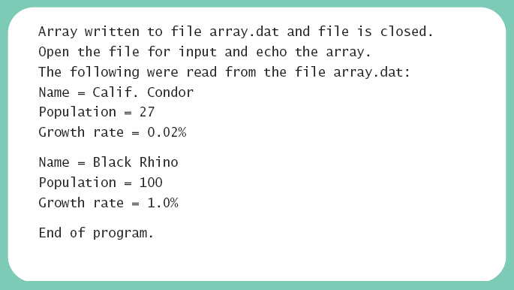
Array Objects in Binary Files
Since an array is an object, possible to use writeObject with entire array
Similarly use readObject to read entire array
View array I/O program, listing 10.11 class ArrayIODemo

Slide 106
import java.io.FileInputStream;
import java.io.FileOutputStream;
import java.io.IOException;
import java.io.ObjectInputStream;
import java.io.ObjectOutputStream;
public class ArrayIODemo{
public static void main(String[] args) {
Species[] oneArray = new Species[2];
oneArray[0] = new Species("Calif. Condor", 27, 0.02);
oneArray[1] = new Species("Black Rhino", 100, 1.0);
String fileName = "array.dat";
try {
ObjectOutputStream outputStream = new ObjectOutputStream(new FileOutputStream(fileName));
outputStream.writeObject(oneArray);
outputStream.close( );
}
catch(IOException e) {
System.out.println("Error writing to file " + fileName + ".");
System.exit(0);
}
System.out.println("Array written to file " +fileName + " and file is closed.");
System.out.println("Open the file for input and " + "echo the array.");
Species[] anotherArray = null;
try {
ObjectInputStream inputStream = new ObjectInputStream(new FileInputStream(fileName));
anotherArray = (Species[])inputStream.readObject( );
inputStream.close( );
}
catch(Exception e) {
System.out.println("Error reading file " + fileName + ".");
System.exit(0);
}
System.out.println("The following were read from " + "the file " + fileName + ":");
for (int i = 0; i < anotherArray.length; i++) {
System.out.println(anotherArray[i]);
System.out.println( );
}
System.out.println("End of program.");
}
}

