Slide 1

_{Object Oriented Programming} Introduction to Java
Ch. 13 GUI with Swing
March 4, 2014
Dept. of Software, Gachon University
Ahyoung Choi, Spring

Slide 2
Introduction
Graphical user interface (GUI)
Allows users to interact with graphical icons and visual indicators
GUI elements: window, menu, button, etc.
Event-driven programming
A programming paradigm in which the flow of a program is determined by events
E.g., user actions (mouse clicks, key presses, button clicks, etc.), messages from other programs
The main loop listens for events, and triggers an event handler when an event is detected

Slide 3
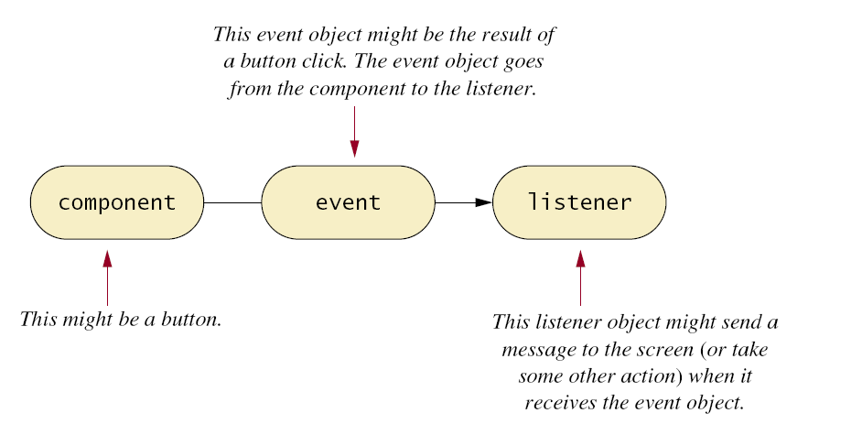
Event-driven programming
An event is an object that represents an action expecting to call a response
There is a registered listener (object) to react to the event
An associated handler method is invoked!
Event handler: a method dealing with the event

Slide 4
Java’s GUI classes
Swing
A set of GUI classes − Java’s standard library
Much better than the previous library (AWT)
AWT (Abstract Window Toolkit)
Java’s original set of classes for building GUIs
Uses peer components of the OS − heavyweight
Not truly portable; looks different on different OSs
Classes
import java.awt.*, java.awt.event.*, javax.swing.*;
(AWT)
(event)
(Swing)

Slide 5
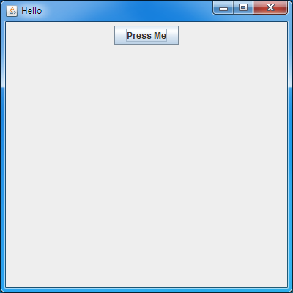
Lab: Simple window
import javax.swing.*;
public class HelloSwing {
public static void main(String[] args) {
JFrame f = new JFrame("Hello");
JPanel p = new JPanel();
JButton b = new JButton("Press Me");
f.setSize(400, 400);
f.setContentPane(p); // add panel to frame
p.add(b); // add button to panel
f.setVisible(true);
}
}

Slide 6
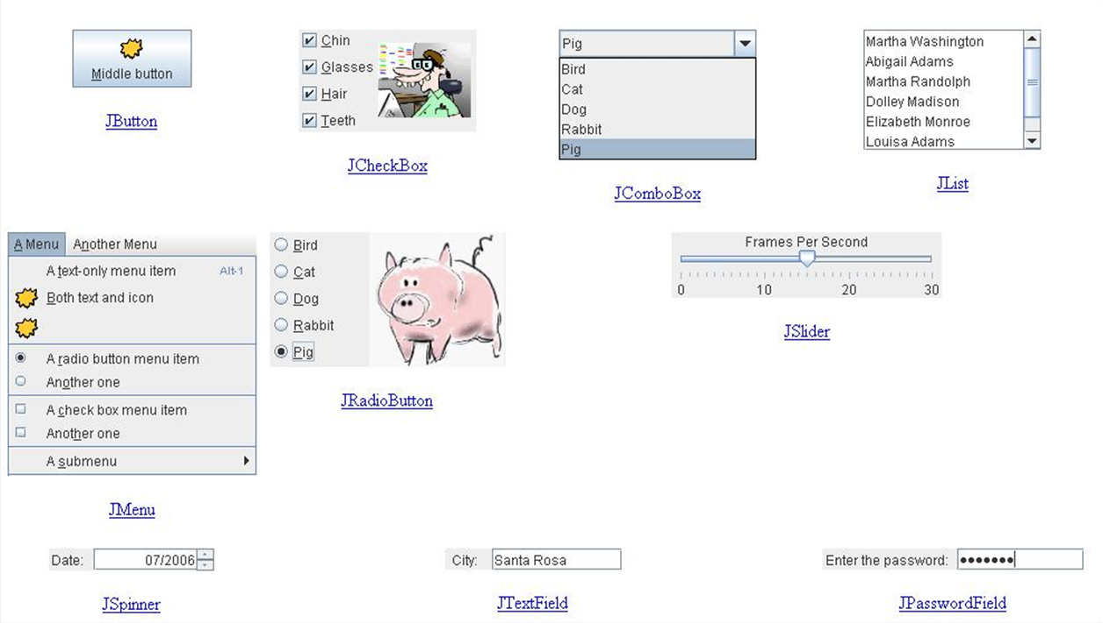
Swing components − basic controls
Label, button, list, combo box, menu, …

Slide 7
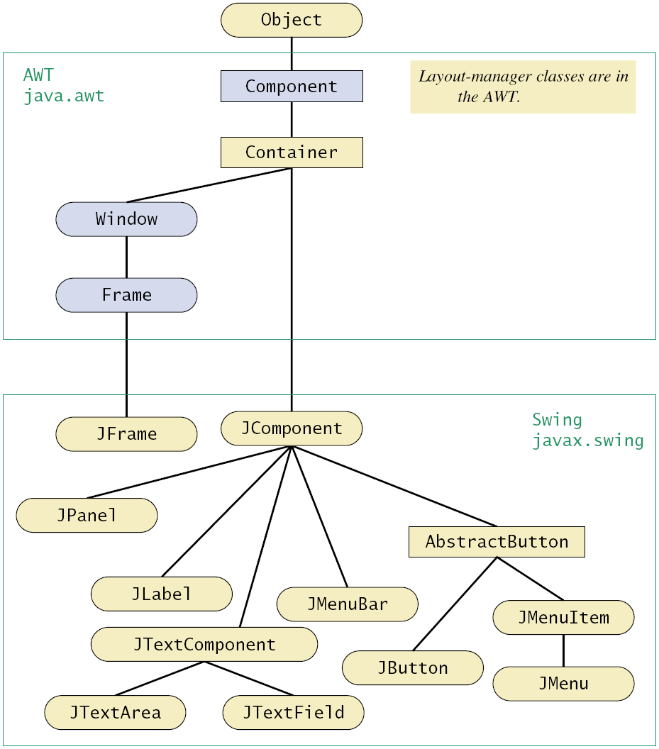
Swing class hierarchy
Component and Container are abstract classes
Notes:
This color shading indicates a class that is not used in this text, but is included here for reference. You can safely ignore the shaded classes.

Slide 8
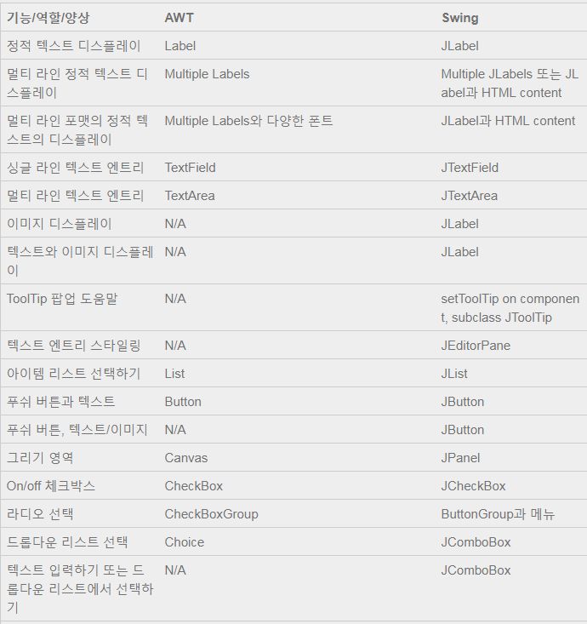
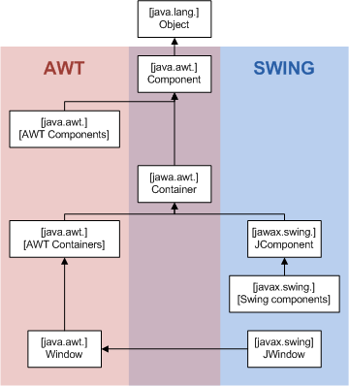
AWT vs Swing

Slide 9
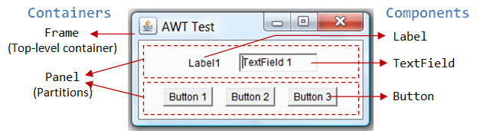
Swing components − basic controls
Swing components − containers
Frame, dialog
Panel, scroll pane, tabbed pane, …
Using a GUI component
Create it:
JButton b = new JButton("press me");
Configure it:
b.setText("press me");
Add it:
panel.add(b);
Listen to it:
frame.addWindowListener(wl);

Slide 10
Jframe class
JFrame: top-level container
Top-level window with a title and a border
Usually used as a program’s main window
Widgets (basic components) are added to content pane
Use getContentPane() to obtain it
JFrame
containers
JPanel
JButton
JLabel

Slide 11
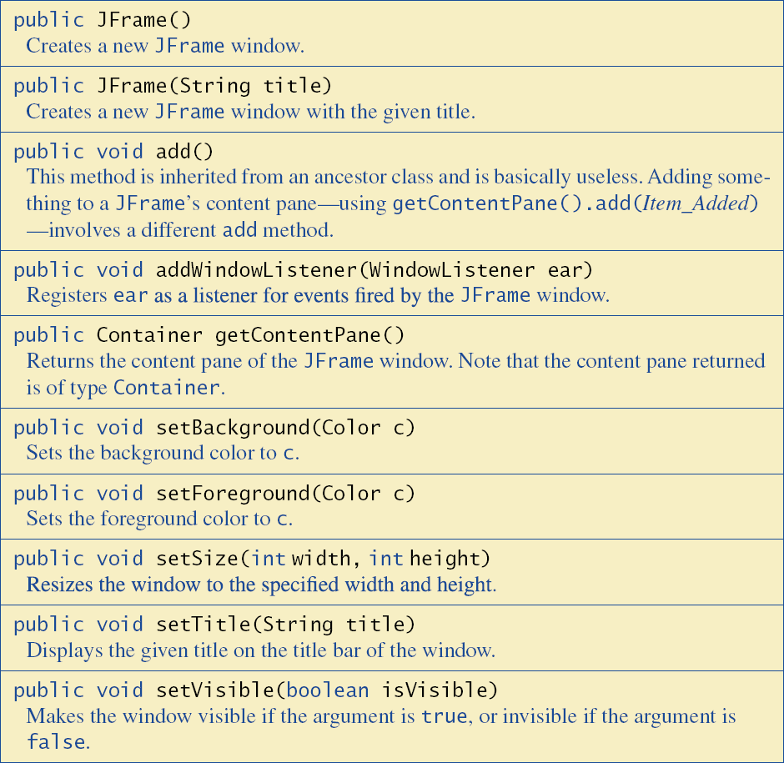
JFrame methods

Slide 12
Container and JPanel Classes
Building a Swing GUI uses:
Inheritance
Make your window class derived from JFrame class
Containment
Use a Swing container class to place components within
Class JPanel
Simple container, can have a color
Group other component objects using add() method
Can also be a component of the other Container

Slide 13
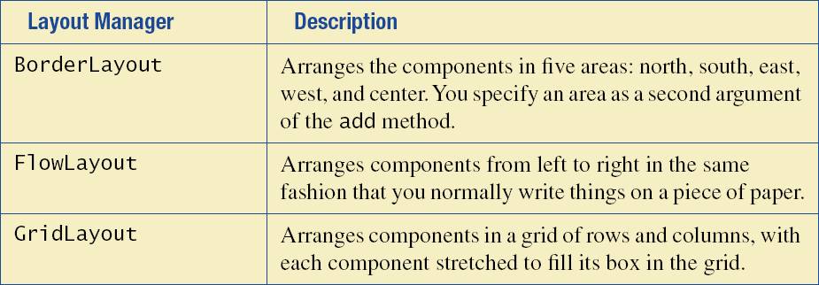
Layout
Each container(Jframe, Jpannel) has a layout manager
Determines the size and location of contained widgets
Classes implementing LayoutManager interface:
BorderLayout, FlowLayout, GridLayout
BoxLayout
동서남북중앙
5개 영역 배치
왼쪽에서 오른쪽 배치
2차원 그리드로 배치

Slide 14
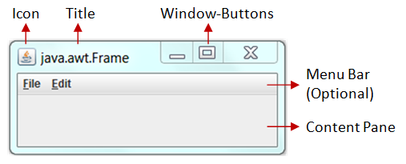
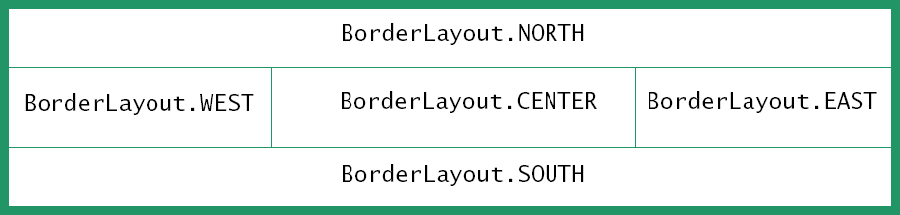
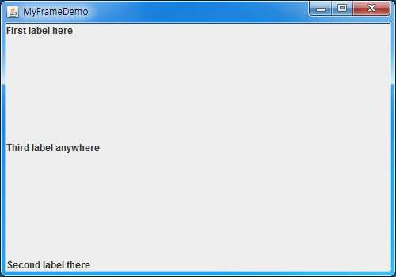
Border layout
Five regions
Example
Container content = f.getContentPane();
content.setLayout(new BorderLayout());
content.add(new JLabel("First label here"),
BorderLayout.NORTH);
content.add(new JLabel("Second label there"),
BorderLayout.SOUTH);
content.add(new JLabel("Third label anywhere"),
BorderLayout.CENTER);

Slide 15
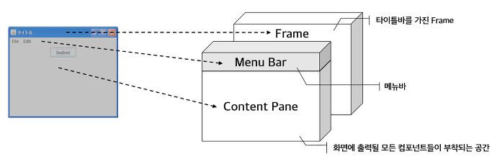
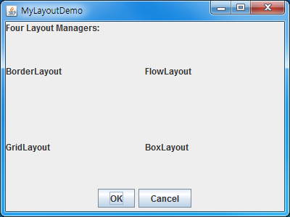
import java.awt.*;
import javax.swing.*;
public class LayoutDemo {
public static final int WIDTH = 500;
public static final int HEIGHT = 350;
public static void main(String[] args) {
JFrame win = new JFrame("MyLayoutDemo");
win.setSize(WIDTH, HEIGHT);
Container content = win.getContentPane();
content.setLayout(new BorderLayout());
content.add(new JLabel("Four Layout Managers:"), BorderLayout.NORTH);
JPanel gridPane = new JPanel();
gridPane.setLayout(new GridLayout(2,2));
gridPane.add(new JLabel("BorderLayout"));
gridPane.add(new JLabel("FlowLayout"));
gridPane.add(new JLabel("GridLayout"));
gridPane.add(new JLabel("BoxLayout"));
content.add(gridPane, BorderLayout.CENTER);
JPanel buttonPane = new JPanel();
buttonPane.setLayout(new FlowLayout());
buttonPane.add(new JButton("OK"));
buttonPane.add(new JButton("Cancel"));
content.add(buttonPane, BorderLayout.SOUTH);
win.setVisible(true);
}
}

Slide 16
Swing listeners
Swing defines all sorts of Listener interfaces
E.g., ActionListener, MouseMotionListener, WindowListener
There are default (empty) implementations for many of the listeners
E.g., MouseMotionAdapter, WindowAdapter

Slide 17
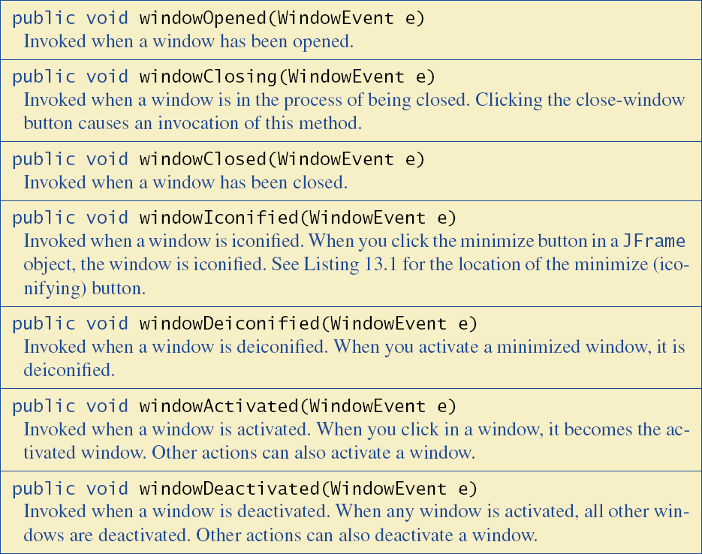
Event listener class
Derived from class WindowAdapter

Slide 18
Lab: MyFrame & eventlistner Demo
import javax.swing.*;
public class MyFrameDemo {
public static final int WIDTH = 500;
public static final int HEIGHT = 350;
public static void main(String[] args) {
JFrame f = new JFrame("MyFrameDemo");
f.setSize(WIDTH, HEIGHT);
JLabel myLabel = new JLabel("Click the window close button (x)!");
f.getContentPane().add(myLabel);
WindowHandler wh = new WindowHandler();
f.addWindowListener(wh);
f.setVisible(true);
}
}
Represented in pixels

Slide 19
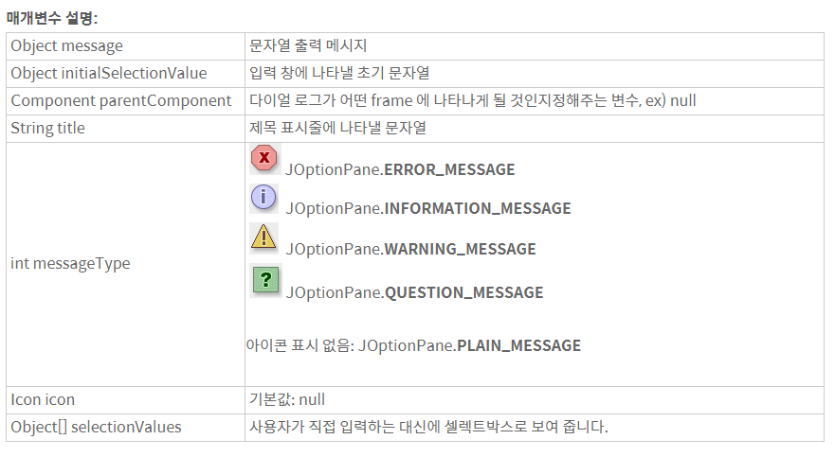
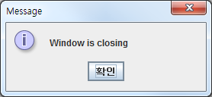
Lab: MyFrame & eventlistner Demo
import java.awt.event.*;
import javax.swing.*;
public class WindowHandler extends WindowAdapter {
@Override
public void windowClosing(WindowEvent e) {
JOptionPane.showMessageDialog(null,
"Window is closing", "Message", JOptionPane.INFORMATION_MESSAGE);
super.windowClosing(e);
}
}

Slide 20
Buttons and Action Listeners
Handling button events
Define a class that implements ActionListener interface
class MyActionHandler implements ActionListener { … }
Define the method to be invoked when an event is sent to the listener
public void actionPerformed(ActionEvent e)
Register the listener for each button
goButton.addActionListener(new MyActionHandler());

Slide 21
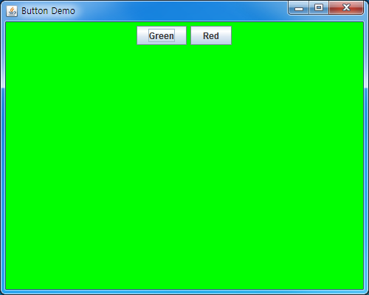
Lab: buttonDemo
import java.awt.*;
import java.awt.event.*;
import javax.swing.*;
public class ButtonDemo extends JFrame implements ActionListener {
public static final int WIDTH = 500;
public static final int HEIGHT = 350;
public ButtonDemo() {
setSize(WIDTH, HEIGHT);
setTitle("Button Demo");
Container contentPane = getContentPane();
contentPane.setLayout(new FlowLayout());
JButton goButton = new JButton("Green");
goButton.addActionListener(this);
contentPane.add(goButton);
JButton stopButton = new JButton("Red");
stopButton.addActionListener(this);
contentPane.add(stopButton);
}
@Override
public void actionPerformed(ActionEvent e) {
Container contentPane = getContentPane();
if (e.getActionCommand().equals("Green")) contentPane.setBackground(Color.GREEN);
if (e.getActionCommand().equals("Red")) contentPane.setBackground(Color.RED);
}
public static void main(String[] args) {
new ButtonDemo().setVisible(true);
}
}
Green을 왼쪽 Red를 오른쪽에 배치

Slide 22
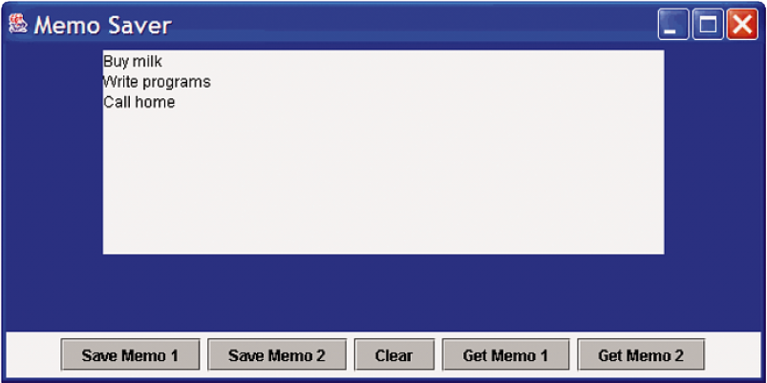
Text Areas, Text Fields
Class JTextArea
Implements a text area that contains multi-line user input or program output
Class JTextField
Allows editing of a single-line of text
Methods
setText(String arg) − changes text in a text area/field
String getText() − retrieves text in a text area/field

Slide 23
Numbers as input & output
With Swing, all input and output are of type String
For numeric input, it must be converted from String
E.g., int n = Integer.parseInt(textField.getText().trim());
Numeric output values must be converted to String
E.g., textField.setText(Integer.toString(n));

