Slide 1
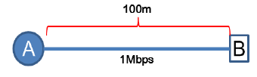
Review Discussion
Explain the terms: link, host, router, and internetwork
What is a protocol? Why do we need network protocols?
Explain the advantage of packet switching over circuit switching
What kind of delay will happen in case of circuit switching & packet switching?
Consider the link between A and B as shown below. Host A wants to send a 1000-bit packet to B. What is the transmission delay and propagation delay? Assume that the bit propagation speed is 10⁵ m/s.
1

