Slide 1
論文撰寫、發表與投稿經驗分享
Chin-Chung Tsai, National Professor
Computers & Education, Co-Editor
International Journal of Science Education, Editor
National Taiwan Normal University
蔡今中 (國家講座)

Slide 2
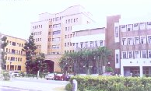

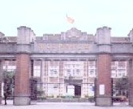



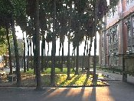
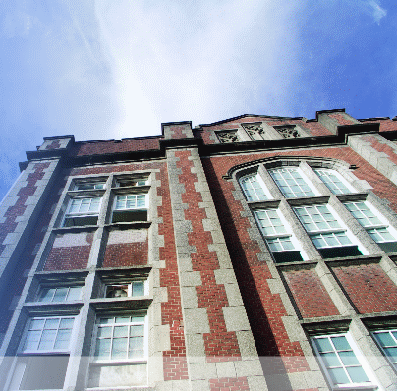
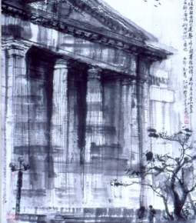
Education and experiences
1992.6 Department of Physics, Taiwan Normal University
1992-1993 Physics teacher in a local public junior high school, Taipei

Slide 3



1992.6 Department of Physics, National Taiwan Normal University, B.S.
1992-1993 Physics teacher in a local public junior high school, Taipei
1993-1994 Harvard Graduate School of Education, Master of Education

Slide 4



1992.6 Department of Physics, National Taiwan Normal University, B.S.
1992-1993 Physics teacher in a local public junior high school, Taipei
1993-1994 Harvard Graduate School of Education, Master of Education
1996/2 Teachers College, Columbia University, Master of Education
1996/5 Teachers College, Columbia University, Doctor of Education

Slide 5
工作經驗
交通大學(1996-2006)
台灣科技大學(2006-2017)
  教育領域QS世界排名51-100 (2015-2017)
  教育領域Times泰晤士報世界排名45 (2017九月公布，第一次以教育為學科獨立排名)
台灣師範大學(2017-)
  教育(education and training)領域QS世界排名40 (2017)
  教育領域Times泰晤士報世界排名22 (2017九月公布)

Slide 6
學術三大資料庫
Google Scholar
Elsevier (Scopus, SciVal)
ISI (SCI, SSCI)

Slide 7
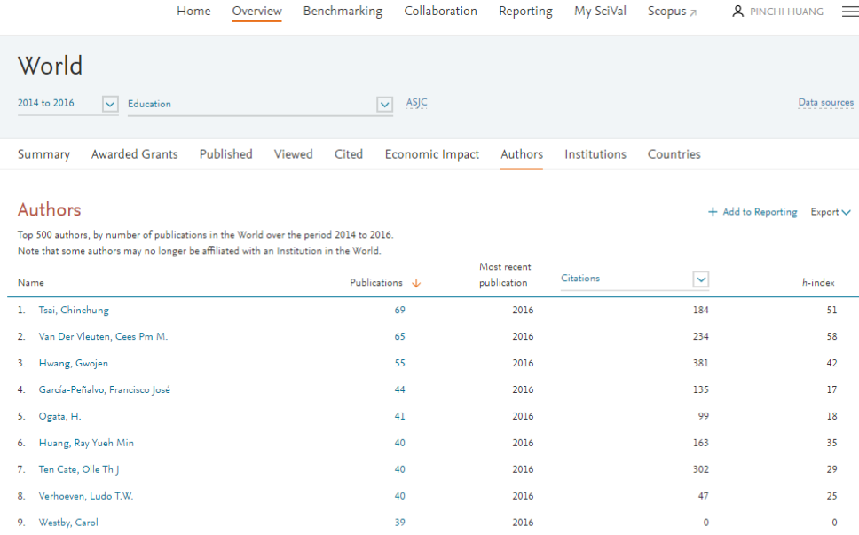
Education: 2014-2016

Slide 8
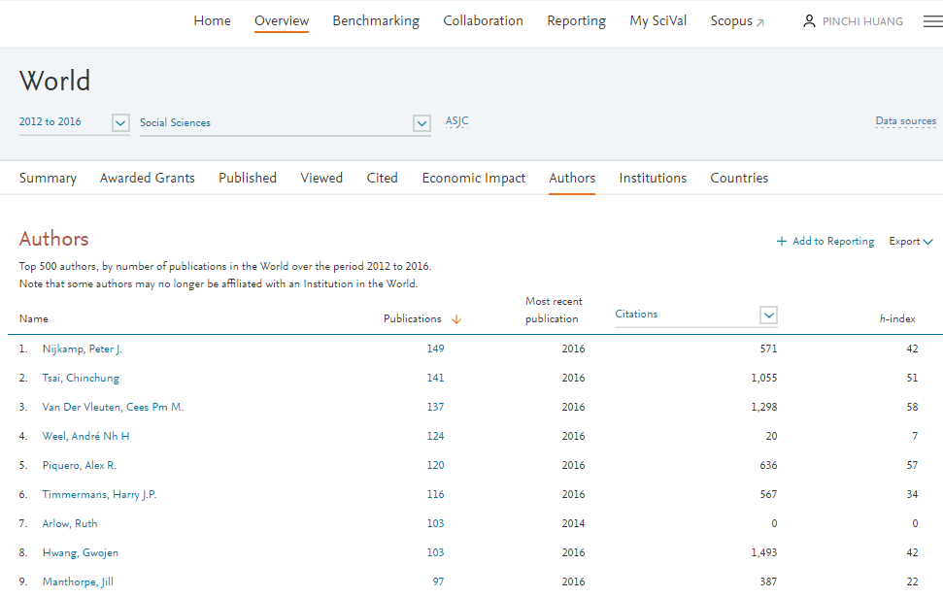
Social Sciences: 2012-2016

Slide 9
SSCI education ranking
排名 | 姓名：單位 | 論文數
1 | Tsai, Chin-Chung: Natl Taiwan Normal Univ (蔡今中) | 94
2 | Hwang, Gwo-Jen: Natl Taiwan Univ Sci & Technol (黃國禎) | 62
3 | de Guzman, Allan B.: Univ Santo Tomas | 56
4 | Huang, Yueh-Min: Natl Cheng Kung Univ (黃悅民) | 40
5 | Chang, Chun-Yen: Natl Taiwan Normal Univ (張俊彥) | 39
6 | Chen, Nian-Shing: Natl Sun Yat Sen Univ (陳年興) | 39
7 | Van Petegem, Peter: Univ Antwerp | 34
8 | Valcke, Martin: Univ Ghent | 31
9 | Chai, Ching Sing: Nanyang Technol Univ | 30
10 | Hwang, Wu-Yuin: Natl Cent Univ (黃武元) | 30
11 | Liang, Jyh-Chong: Natl Taiwan Normal Univ (梁至中) | 29
12 | Pascarella, Ernest T.: Univ Iowa | 29
13 | Chang, Chi-Cheng: Natl Taiwan Normal Univ (張基成) | 28
14 | Hou, Huei-Tse: Natl Taiwan Univ Sci & Technol (侯惠澤) | 27
15 | Hsu, Ying-Shao: Natl Taiwan Normal Univ (許瑛玿) | 27
16 | Fisher, Douglas: San Diego State Univ | 26
17 | Verhoeven, Ludo: Radboud Univ Nijmegen | 25
18 | Eilks, Ingo: Univ Bremen | 25
19 | Frey, Nancy: San Diego State Univ | 25
20 | Roth, Wolff-Michael: Univ Victoria | 25
2012-2016年SSCI資料庫教育領域發表排名前20名學者

Slide 10
Journal Editor Profile
International Journal of Science and Mathematics Education, Associate Editor, (2003-2009) (SSCI, Impact factor: 1.104, Rank: 84/230)
Computers & Education, Co-Editor (2009-now) (SSCI, Impact factor: 3.819, Rank: 7/235, JCR 2016)
International Journal of Science Education, Editor (2016-now) (SSCI, Impact factor: 1.132, Rank: 61/224, JCR 2014)

Slide 11
Outline
Attitude for research and publication
Criteria of a good paper
Writing tips

Slide 12
Publication attitude
期刊投稿比喻(journal versus submission)：巢 (nest) V.S. 蛋(egg)
How to have research innovation?
© Chin-Chung Tsai
12

Slide 13
Important factors for selecting journals
Scope
Impact factor value
Review time
Publication time
Length
Format
Research preference
Editor

Slide 14
Acceptance v.s. rejection
The criteria of a good paper

Slide 15
Reject before review
What kinds of papers will be rejected before review??

Slide 16
How does the Editor assign each paper for external review?
By intuition
By references
By database
By matching system
By the suggestion proposed by the reviewers who decline to review
By the author’s suggestion

Slide 17
Reviewer Form (International Journal of Science and Mathematics Education) 1/2
Relevance (e.g., Does the topic of the paper have significance for the readers of IJSME? Is the research question clearly identified? Does the study establish a relationship between the study and previous research? Is the guiding theoretical framework explained and justified?).
Methodology (e.g., Does the study provide and justify a link between the problem and the study design? Are the context of the study and the selection of participants adequately described? Does the study demonstrate that the procedures and methods of analyses are appropriate for the type of research being conducted?)

Slide 18
Reviewer Form (International Journal of Science and Mathematics Education) 2/2
Results and Findings (e.g., Does the study report adequate data to support its findings? Are the assertions supported by the data? Are the interpretations valid? Does the paper present information and ideas in a clearly organized way? Are the arguments made by the paper logically consistent?)
Significance (e.g., Do the findings or the arguments of the paper add new knowledge to existing literature?)
Overall comments

Slide 19
論文審查表
(Computers and Education)
1. does the paper discuss or employ computers in education?
2. is the abstract a concise account of the work and conclusions?
3. is the introduction a satisfactory background to the work?
4. are any technical methods adequately described and analysed?
5. are the results adequately described and analysed?
6. are the conclusions supported by the data?
7. have alternative interpretations of the data been considered?
8. is the arrangement of material satisfactory?
9. can parts of the paper be presented more concisely?

Slide 20
論文審查表(International Journal of Science Education)
1. Importance to science education in the context in which the study was conducted.
2. Clear, well-formulated research question(s).
3. Data collection procedures: design, sampling, instruments.
4. Data reduction procedures, i.e., analysis.
5. Use of relevant literature.
6. Strength of argumentation: clarity of concepts, internal logic, and organization.
7. Interpretation, presentation, and discussion of findings.
8. Adequacy of tables and figures.
9. Quality of conclusions and implications.

Slide 21
So, what are the most important criteria?
Presentation?
Theory?
Method? Analysis?
Results?
The soundness of Discussion?
Significance?

Slide 22
Which part is the most difficult? What part is relatively easier?
Presentation?
Theory?
Method? Analysis?
Results?
The soundness of Discussion?
Significance?

Slide 23
當你身為一位作者，在撰寫文章時…
文章格式要符合期刊要求
多引用想要投的期刊之前所刊登的文章
寫一個好的摘要(Abstract)
要有好的文章結構
文章段落要做適當的切割
文章內容敘述清楚(logic, consistency, clarity)
投稿前先自己模擬審查結果

Slide 24
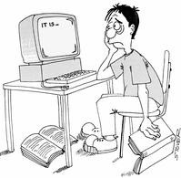
Tips
  Read abundantly
  Write regularly (better everyday)
  Draft carefully
  Try bravely
  Think positively
  Wait patiently

Slide 25


