Slide 1
Objective is to make a lightweight app that can be hosted on GitHub pages like the Belly Button Biodiversity that provides a list of movies that might be of interest for viewing.
Dataset
(ml-25m) describes 5-star rating and free-text tagging activity from [MovieLens](http://movielens.org)
Files to leverage: movies.csv, genome-score.csv, ratings.csv, tags.csv
ML Strategy
The genome-scoring file contains tags like action packed, alternate endings, android, animals which are then scored with a relevance for each movie.
Using this relevance scoring on the movie tags it is desired to apply an unsupervised machine learning model to group movies that might be also of similar interest.

Slide 2
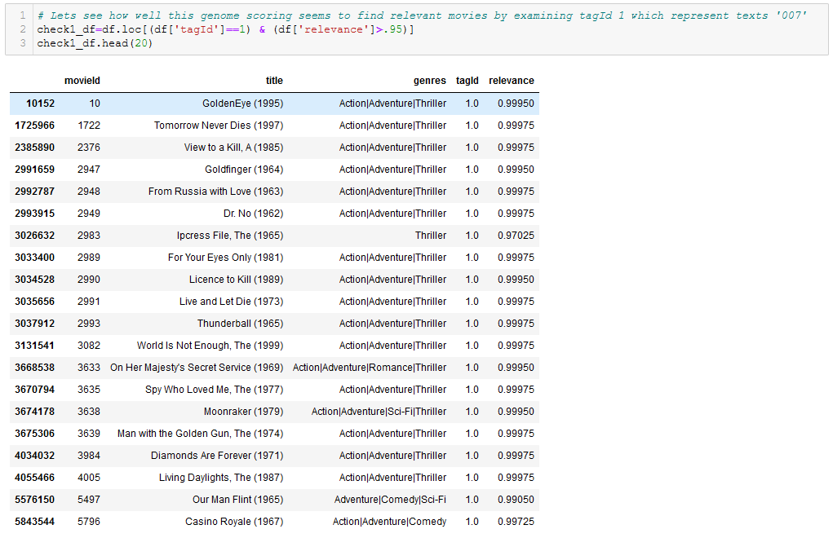
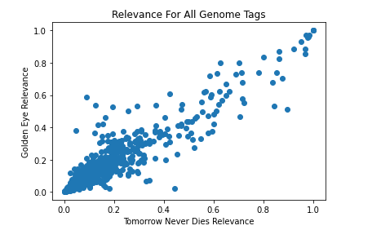
ML Strategy
Table of tagId 1 ‘007’ which with a relevance filter of .95 shows bond movies
Check of all Tags for Relevance Correlation between Two Similar Bond Movies

Slide 3
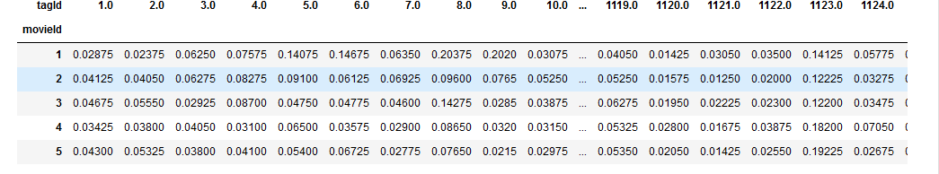
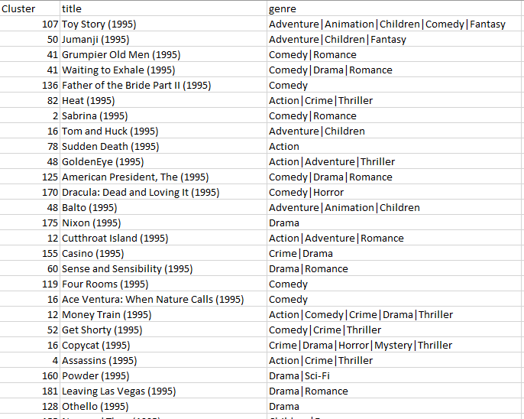
ML Strategy
Perform Unsupervised Clustering with X like below
Genome Tags
Movie Ids
As output Get Clustering of movies to utilize
Relevance Values relating Movies to the Tags

Slide 4
Database Strategy
SQLite file contains ML output of clustering groups
SQLite file also contains a summary of ratings like average rating, count of ratings
SQLite file also contains a using NLP of user tags from the tags.csv by movieId for the word cloud

Slide 5
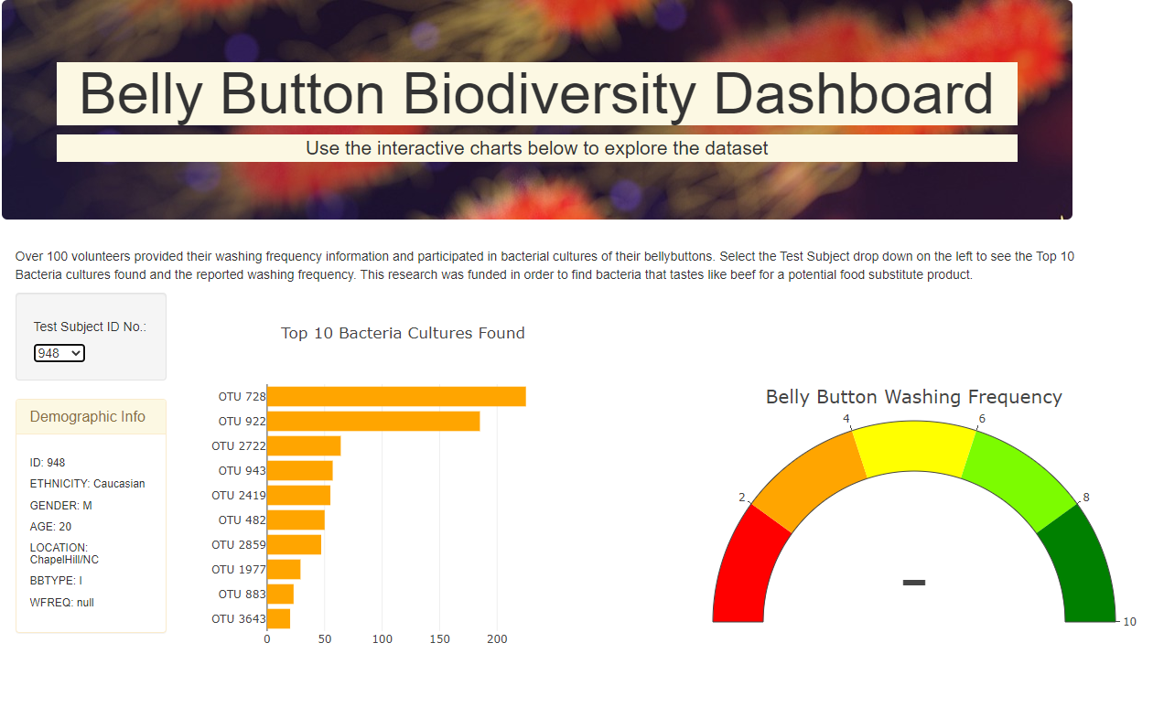
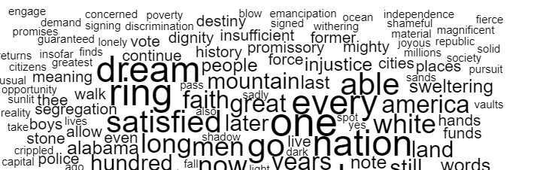
Movie Finder
D3 wordcloud using movieid and tags.csv
Updates with selection of each movie in pareto
Using MovieLens dataset a kmeans clustering was performed to group movies by their genome tag scoring…..
Movie Title Selection
Similar Movies Found
Movie Stats
Rating Counts 93
Average Rating: 4.5
Genre:
Change to Movie Titles
States from ratings summary file
Review Counts*Ratings

