Slide 1
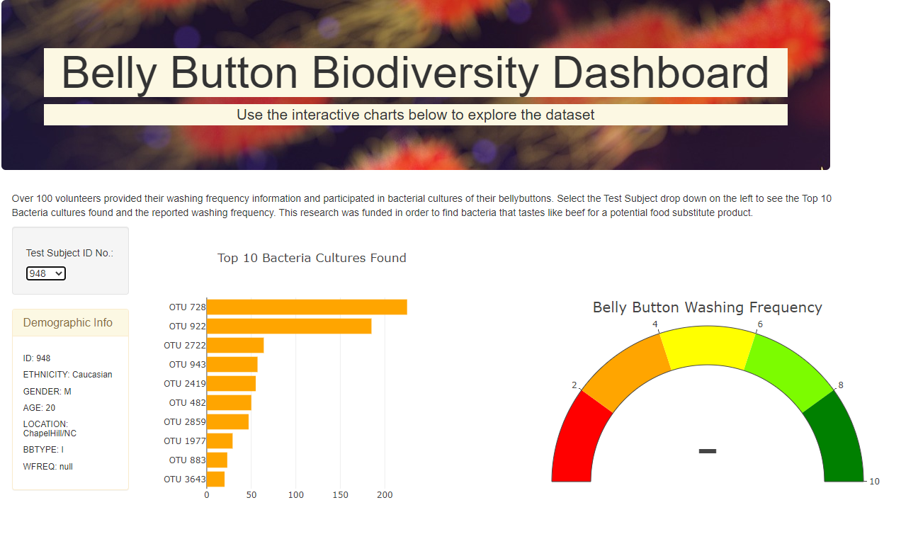
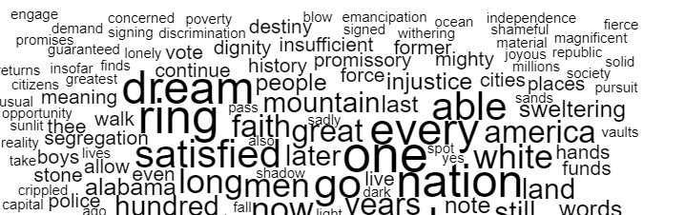
Movie Finder
D3 wordcloud using movieid and tags.csv
Updates with selection of each movie in pareto
Using MovieLens dataset a kmeans clustering was performed to group movies by their genome tag scoring…..
Movie Title Selection
Similar Movies Found
Movie Stats
Rating Counts 93
Average Rating: 4.5
Genre:
States from ratings summary file
Review Counts*Ratings

