Slide 1
Simultaneous Mode and Wavelength Division (De)Multiplexer
11/17/2017
Ali Binaie, Jun Heyk Jang

Slide 2
Outline
M/W (De)Mux – Concept of Design
Design of Compact wavelength (De)Mux
Design of MMI Based Mode (De)Mux
Final structure and Results

Slide 3
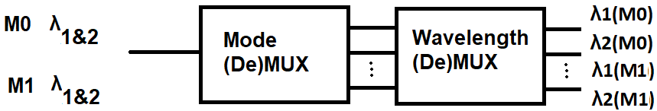
M/W (De)Mux – Concept of Design
Wavelength and Mode multiplexing are used to increase the date rate per channel
In Mode and Wavelength (DE)MUX system, we merge/separate different Wavelengths and Modes in one structure
Notes:
Full-duplex (FD) wireless communication is a recently emerged technology in which radios can transmit and receive simultaneously on the same frequency channel. Unlike legacy half-duplex wireless networks, full-duplex has great potential to increase throughput and support more flexible spectrum use;
MIMO technology can be tracked back to the 1970’s. It can deliver higher diversity and provide spatial multiplexing;
Traditional MIMO systems can only communication with one single user (i.e., single-user MIMO [SU-MIMO]). multi-user MIMO (MU-MIMO) has been introduced and implemented (e.g., 802.11ac). MU-MIMO transceivers can serve multiple users simultaneously by leveraging spatial degrees of freedom (DoFs) to separate the data streams to different users;
Due to the very limited wireless spectrum resources and the increasing data traffic in next-generation wireless networks, a natural question arises: can we combine the technologies of full-duplex and MIMO such that the aforementioned demands can be met;
In this proposal, we take a holistic cross-layered approach to explore full-duplex MIMO wireless. We will jointly design the PHY and MAC layers to allow IC implementations of full-duplex MIMO transceivers support realistic networking scenarios.

Slide 4
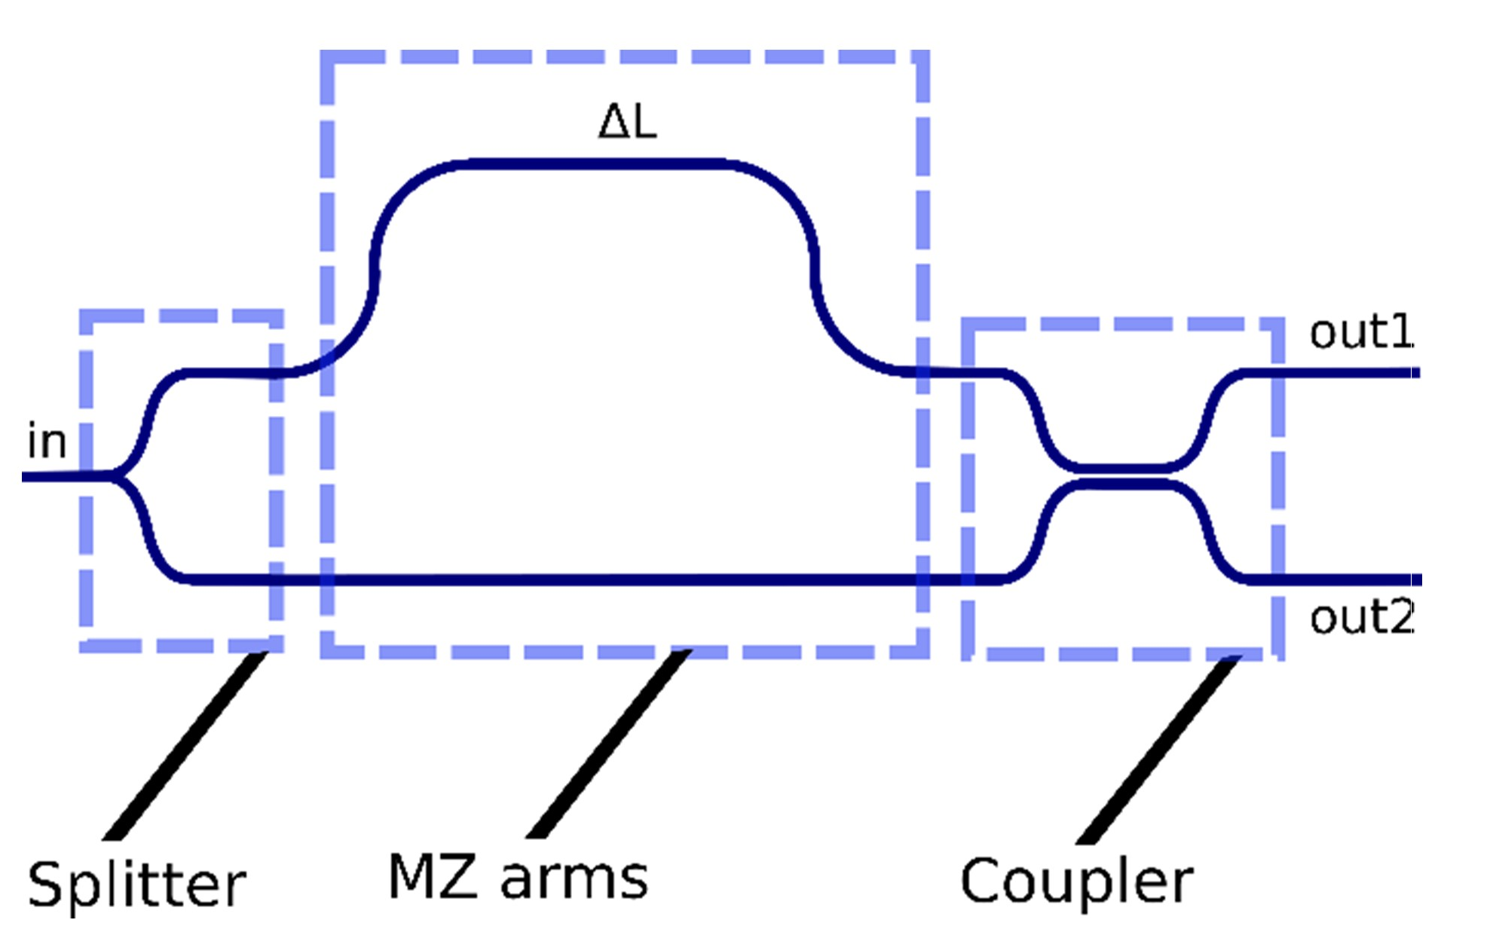
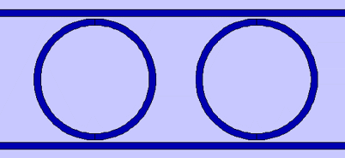
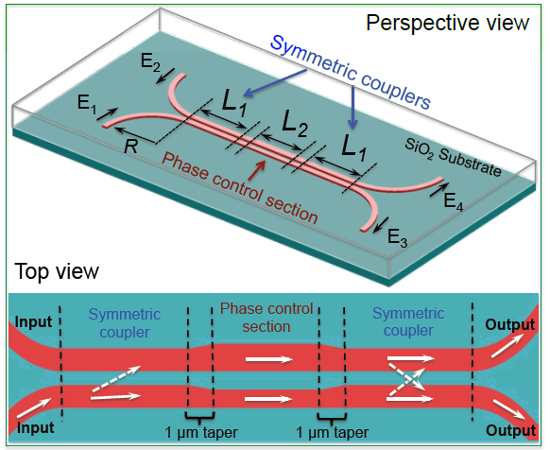
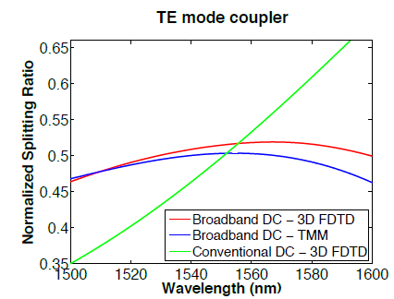
Wavelength (De)MUX
Usually, Wavelength (De)MUX is done by either MZ or Ring-Resonator
Previously, two WGs with different widths were used to make the directional coupler wideband
Reference:
Broadband silicon photonic directional coupler using asymmetric-waveguide based phase control
OPTIC EXPRESS 2015
Notes:
On the PHY side, we will first investigate combining full-duplex operation with multi-antenna phased arrays as a first step towards full-duplex massive MIMO;
The key insight is to repurpose beamforming degrees of freedom (DoFs) for TX SIC. In general, in an N-element TX and RX phased array, there are 2x(N-1) complex DoFs for beamforming, which can be used to set the main beam direction for the TX and RX as well as null directions. We can sacrifice a few of these DoFs (for instance, nulls) to cancel the TX SI at the RX after beamforming over a wide bandwidth;
We have run preliminary simulations using the measured S parameters of a 2x2 antenna array at RF. Simulations show that by sacrificing one DoF each on the TX side and the RX side, 40 dB of SIC can be achieved over 20 MHz bandwidth;
It is noteworthy that SIC is being achieved by repurposing the beamforming hardware with no explicit RF/analog cancellers, thus representing an area and power efficient solution. Furthermore, the SIC performance is particularly wideband because the delays in the SI channel are being repurposed for cancellation;
Finally, a key insight is that antenna array design (including antenna geometry and placement within the array) plays a key role in defining the SI and cross-talk SI channels, and therefore, optimizing the antenna array design can relax the trade-off between SIC and beamforming gain.

Slide 5
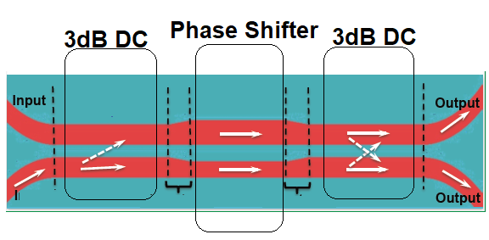
Using DC as MZ
To increase the phase shift in Asymm DC, we can increase the length or increase the width difference between two WGs in phase shifter
Asymmetrical DC can shift phase at much shorter lengths compared to MZ arm lengths
Based on phase shift property of Asymm DC, we increase the length of phase-shifter section to achieve affects of Compact Wideband MZ
5
Notes:
On the PHY side, we will first investigate combining full-duplex operation with multi-antenna phased arrays as a first step towards full-duplex massive MIMO;
The key insight is to repurpose beamforming degrees of freedom (DoFs) for TX SIC. In general, in an N-element TX and RX phased array, there are 2x(N-1) complex DoFs for beamforming, which can be used to set the main beam direction for the TX and RX as well as null directions. We can sacrifice a few of these DoFs (for instance, nulls) to cancel the TX SI at the RX after beamforming over a wide bandwidth;
We have run preliminary simulations using the measured S parameters of a 2x2 antenna array at RF. Simulations show that by sacrificing one DoF each on the TX side and the RX side, 40 dB of SIC can be achieved over 20 MHz bandwidth;
It is noteworthy that SIC is being achieved by repurposing the beamforming hardware with no explicit RF/analog cancellers, thus representing an area and power efficient solution. Furthermore, the SIC performance is particularly wideband because the delays in the SI channel are being repurposed for cancellation;
Finally, a key insight is that antenna array design (including antenna geometry and placement within the array) plays a key role in defining the SI and cross-talk SI channels, and therefore, optimizing the antenna array design can relax the trade-off between SIC and beamforming gain.

Slide 6
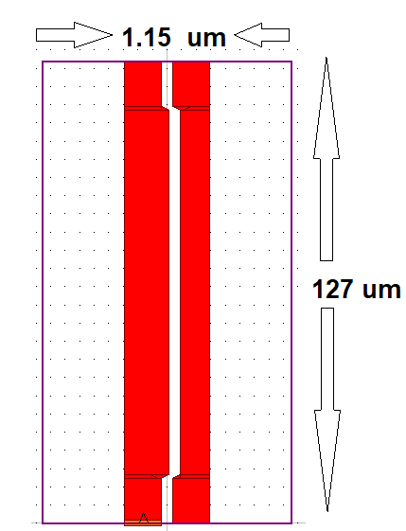
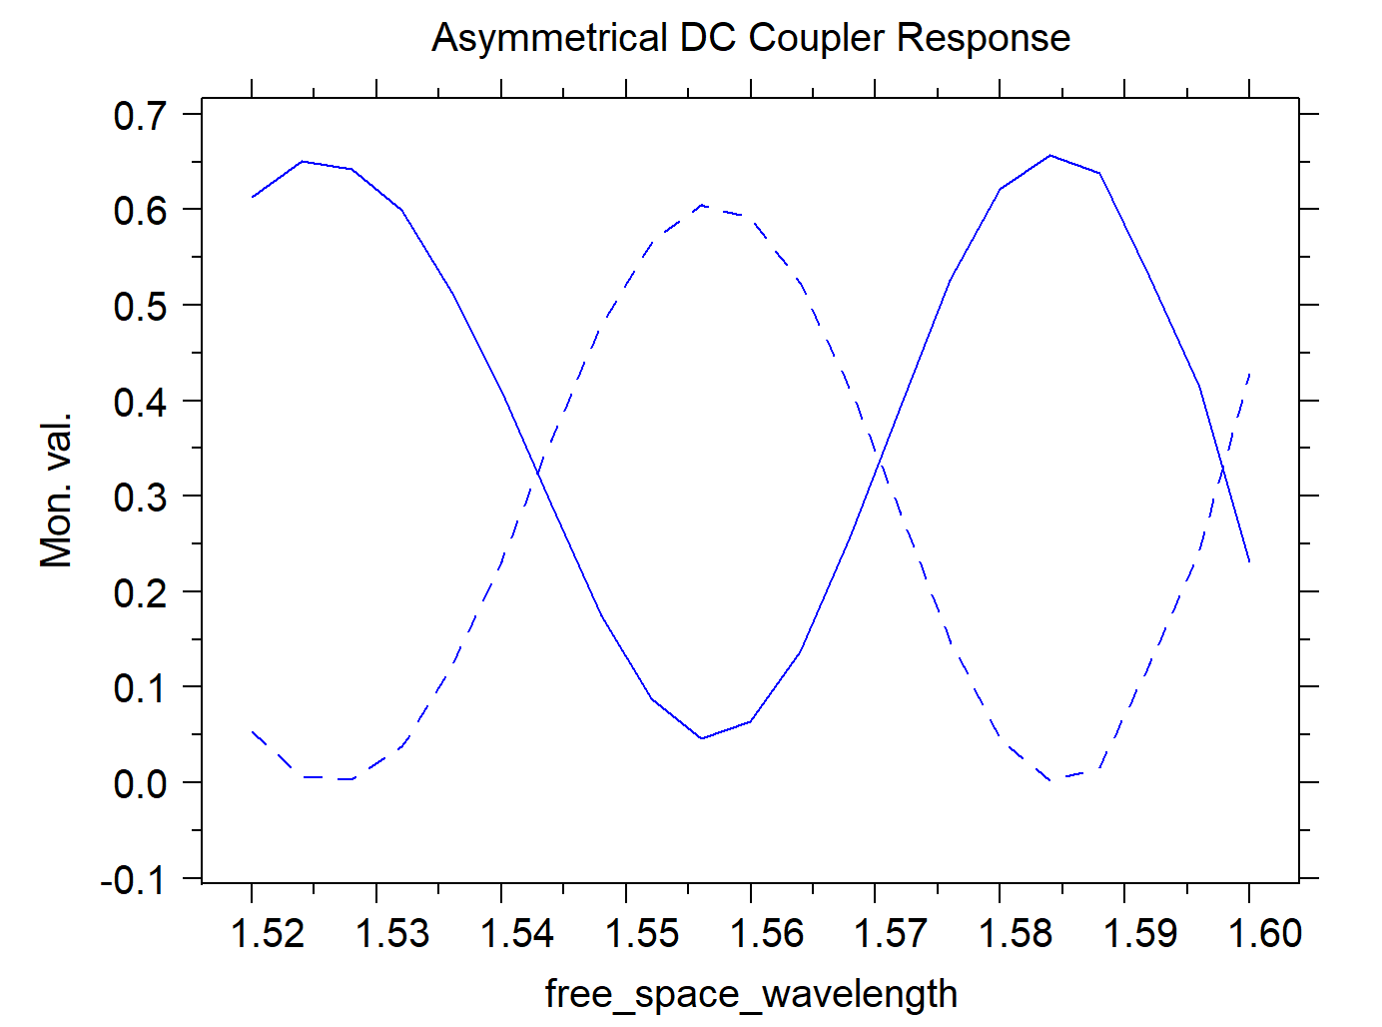
Design of Wavelength-(De)MUX
We optimize width difference and phase shifting length to achieve effect of MZ
Constant width to make application in Optical Computer more viable
Notes:
On the PHY side, we will first investigate combining full-duplex operation with multi-antenna phased arrays as a first step towards full-duplex massive MIMO;
The key insight is to repurpose beamforming degrees of freedom (DoFs) for TX SIC. In general, in an N-element TX and RX phased array, there are 2x(N-1) complex DoFs for beamforming, which can be used to set the main beam direction for the TX and RX as well as null directions. We can sacrifice a few of these DoFs (for instance, nulls) to cancel the TX SI at the RX after beamforming over a wide bandwidth;
We have run preliminary simulations using the measured S parameters of a 2x2 antenna array at RF. Simulations show that by sacrificing one DoF each on the TX side and the RX side, 40 dB of SIC can be achieved over 20 MHz bandwidth;
It is noteworthy that SIC is being achieved by repurposing the beamforming hardware with no explicit RF/analog cancellers, thus representing an area and power efficient solution. Furthermore, the SIC performance is particularly wideband because the delays in the SI channel are being repurposed for cancellation;
Finally, a key insight is that antenna array design (including antenna geometry and placement within the array) plays a key role in defining the SI and cross-talk SI channels, and therefore, optimizing the antenna array design can relax the trade-off between SIC and beamforming gain.

Slide 7
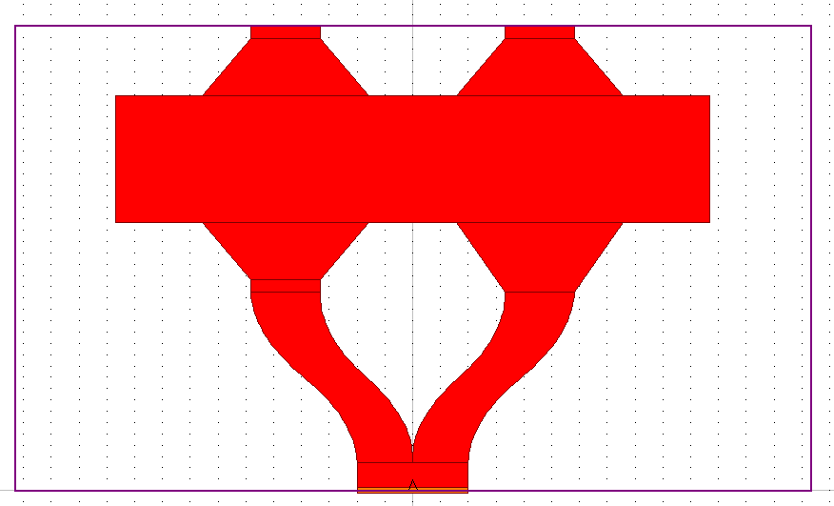
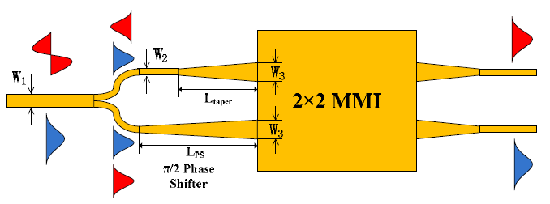
Design of Mode-(De)MUX
Design of Mode-(De)MUX based on 2X2 MMI
Different tapering lengths at the input causes π/2 phase shift in higher mode
Results in separation of modes at the output
M=1
M=0
Reference:
Compact two-mode (de)multiplexer based on symmetric Y-junction and Multimode interference waveguides
Notes:
On the PHY side, we will first investigate combining full-duplex operation with multi-antenna phased arrays as a first step towards full-duplex massive MIMO;
The key insight is to repurpose beamforming degrees of freedom (DoFs) for TX SIC. In general, in an N-element TX and RX phased array, there are 2x(N-1) complex DoFs for beamforming, which can be used to set the main beam direction for the TX and RX as well as null directions. We can sacrifice a few of these DoFs (for instance, nulls) to cancel the TX SI at the RX after beamforming over a wide bandwidth;
We have run preliminary simulations using the measured S parameters of a 2x2 antenna array at RF. Simulations show that by sacrificing one DoF each on the TX side and the RX side, 40 dB of SIC can be achieved over 20 MHz bandwidth;
It is noteworthy that SIC is being achieved by repurposing the beamforming hardware with no explicit RF/analog cancellers, thus representing an area and power efficient solution. Furthermore, the SIC performance is particularly wideband because the delays in the SI channel are being repurposed for cancellation;
Finally, a key insight is that antenna array design (including antenna geometry and placement within the array) plays a key role in defining the SI and cross-talk SI channels, and therefore, optimizing the antenna array design can relax the trade-off between SIC and beamforming gain.

Slide 8
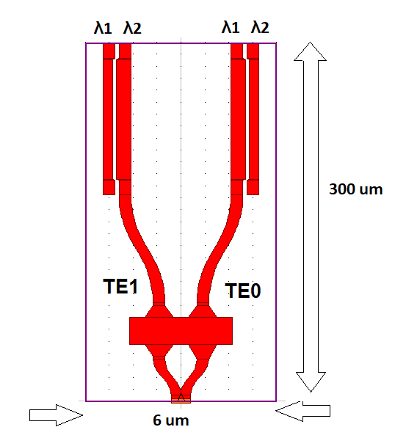
Simultaneous M/W Division (De)Mux
Attach Asymm DC at the output of Mode (De)MUX MMI
Extra S-bend between DC and MMI so that two DCs would not couple
Reference:
Compact two-mode (de)multiplexer based on symmetric Y-junction and Multimode interference waveguides (OPTICS EXPRESS 2014)
Notes:
On the PHY side, we will first investigate combining full-duplex operation with multi-antenna phased arrays as a first step towards full-duplex massive MIMO;
The key insight is to repurpose beamforming degrees of freedom (DoFs) for TX SIC. In general, in an N-element TX and RX phased array, there are 2x(N-1) complex DoFs for beamforming, which can be used to set the main beam direction for the TX and RX as well as null directions. We can sacrifice a few of these DoFs (for instance, nulls) to cancel the TX SI at the RX after beamforming over a wide bandwidth;
We have run preliminary simulations using the measured S parameters of a 2x2 antenna array at RF. Simulations show that by sacrificing one DoF each on the TX side and the RX side, 40 dB of SIC can be achieved over 20 MHz bandwidth;
It is noteworthy that SIC is being achieved by repurposing the beamforming hardware with no explicit RF/analog cancellers, thus representing an area and power efficient solution. Furthermore, the SIC performance is particularly wideband because the delays in the SI channel are being repurposed for cancellation;
Finally, a key insight is that antenna array design (including antenna geometry and placement within the array) plays a key role in defining the SI and cross-talk SI channels, and therefore, optimizing the antenna array design can relax the trade-off between SIC and beamforming gain.

Slide 9
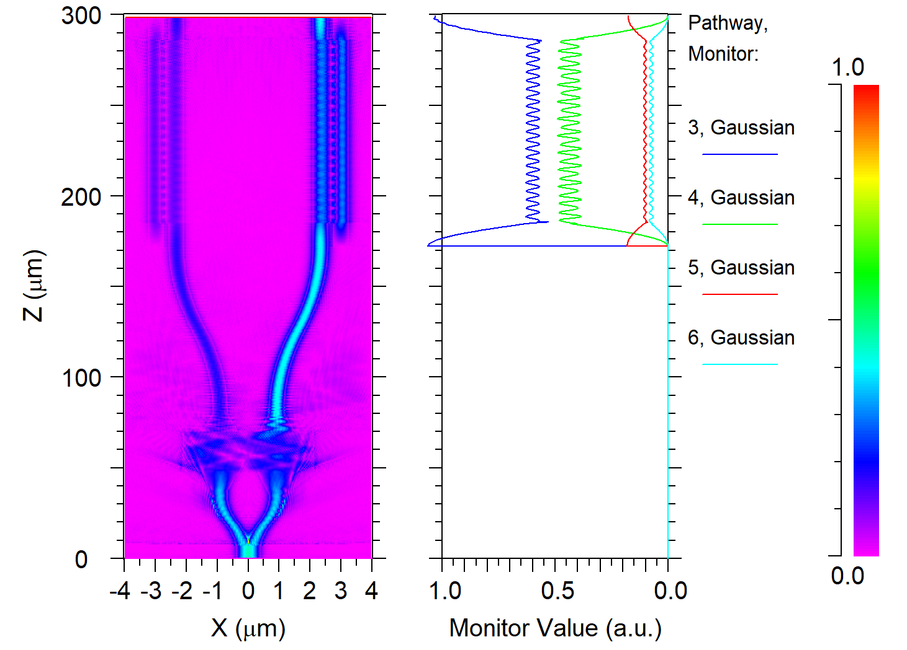
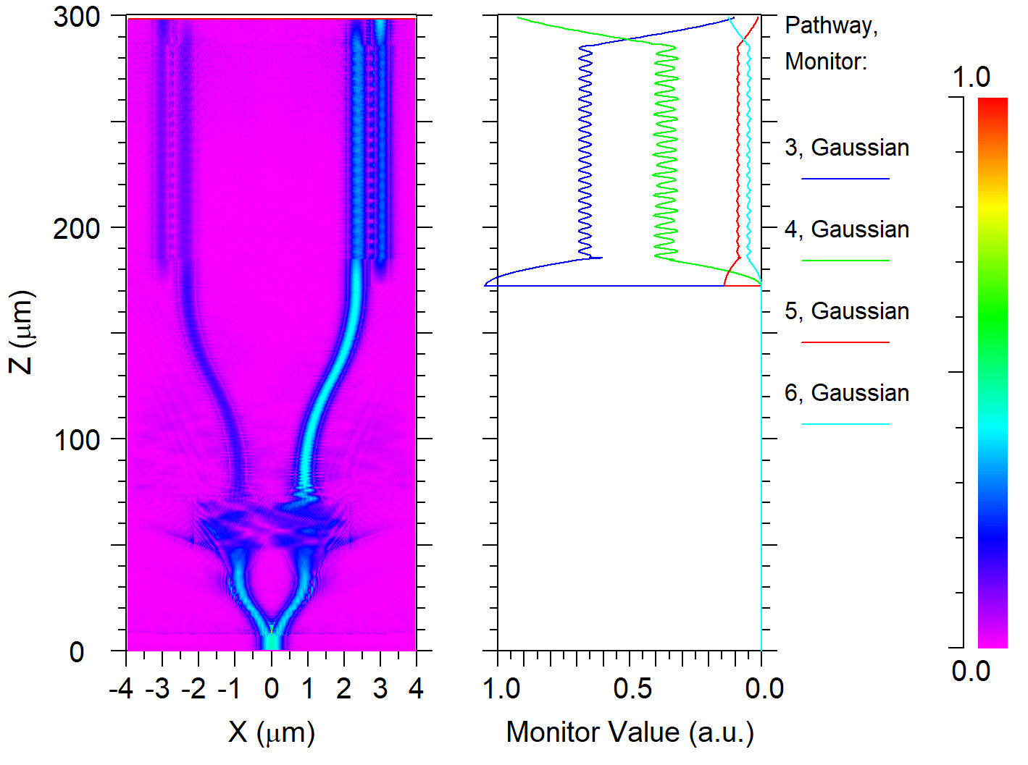
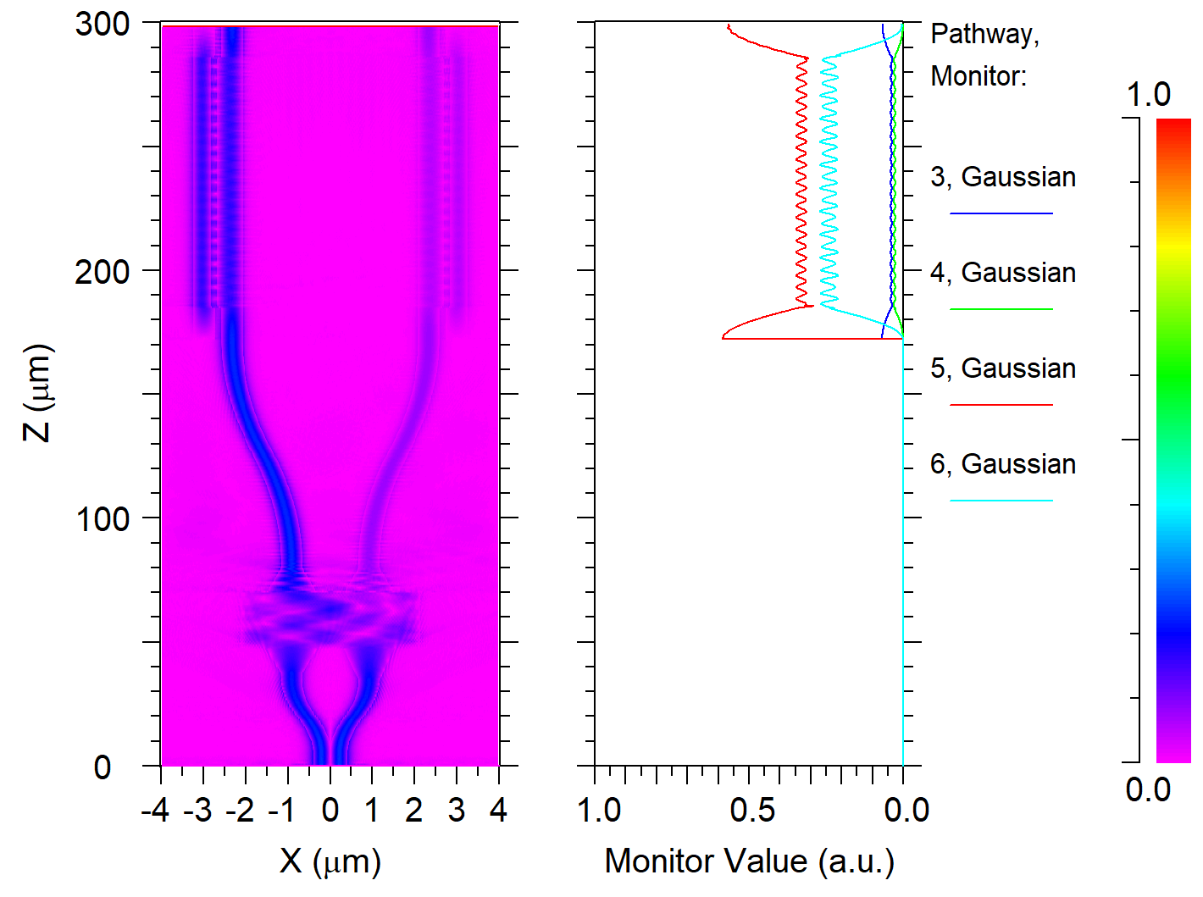
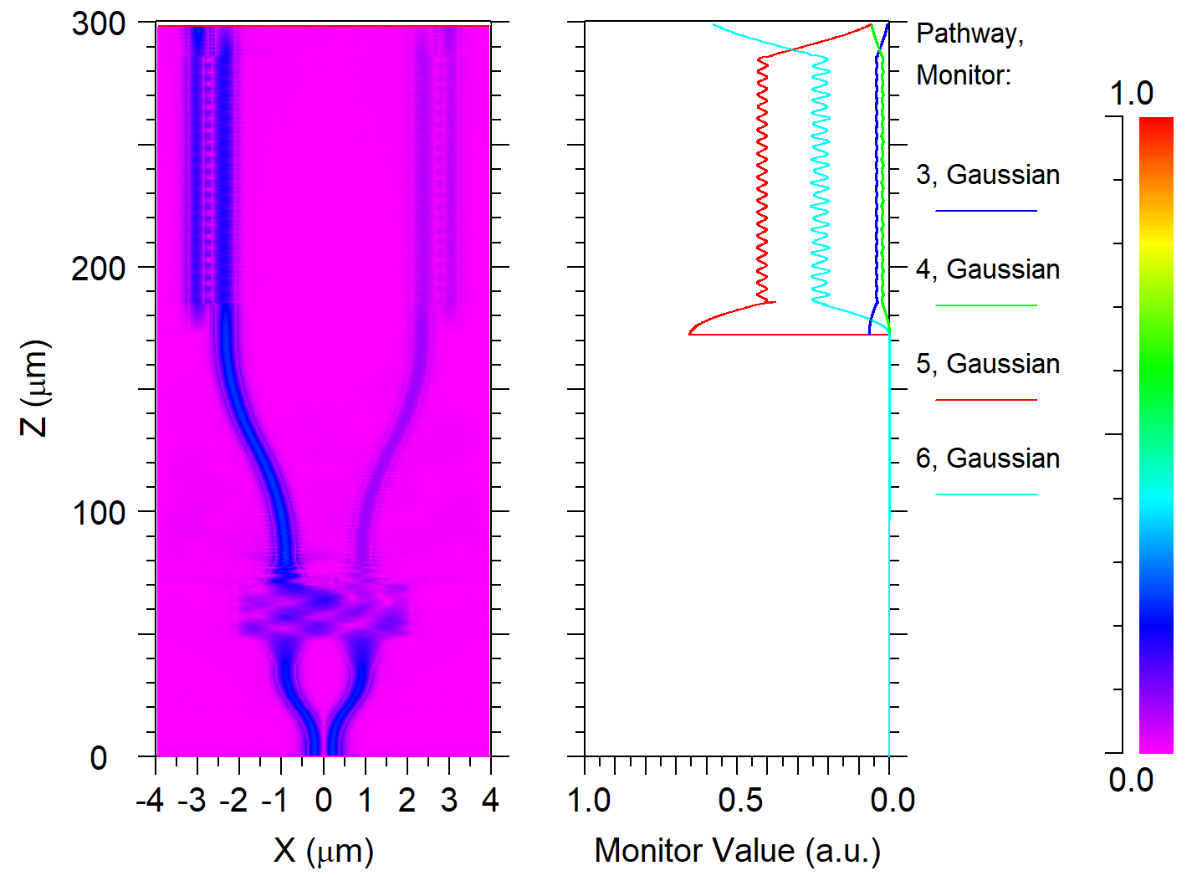
Final Results (not optimized)
Wavelength: 1.565um 1.585 um TE0 TE1
Notes:
On the PHY side, we will first investigate combining full-duplex operation with multi-antenna phased arrays as a first step towards full-duplex massive MIMO;
The key insight is to repurpose beamforming degrees of freedom (DoFs) for TX SIC. In general, in an N-element TX and RX phased array, there are 2x(N-1) complex DoFs for beamforming, which can be used to set the main beam direction for the TX and RX as well as null directions. We can sacrifice a few of these DoFs (for instance, nulls) to cancel the TX SI at the RX after beamforming over a wide bandwidth;
We have run preliminary simulations using the measured S parameters of a 2x2 antenna array at RF. Simulations show that by sacrificing one DoF each on the TX side and the RX side, 40 dB of SIC can be achieved over 20 MHz bandwidth;
It is noteworthy that SIC is being achieved by repurposing the beamforming hardware with no explicit RF/analog cancellers, thus representing an area and power efficient solution. Furthermore, the SIC performance is particularly wideband because the delays in the SI channel are being repurposed for cancellation;
Finally, a key insight is that antenna array design (including antenna geometry and placement within the array) plays a key role in defining the SI and cross-talk SI channels, and therefore, optimizing the antenna array design can relax the trade-off between SIC and beamforming gain.

Slide 10
Thank you

