Slide 1

Auto-Segmentation of OCT Images of Heart
By Jun Hyek Jang
TRANSCENDING DISCIPLINES, TRANSFORMING LIVES

Slide 2
Segmenting between Endocardium and Myocardium
Endocardium: Uppermost tissue layer in OCT of Heart (Brightest layer)
Myocardium: Below endocardium (Dark Grey)
2 | Auto-Segmentation of OCT Images of Heart

Slide 3
Issues
Very hard to distinguish boundary (gradient & artifacts)
Hard to handle various dataset
Hard to create training dataset for DL
3 | Auto-Segmentation of OCT Images of Heart

Slide 4
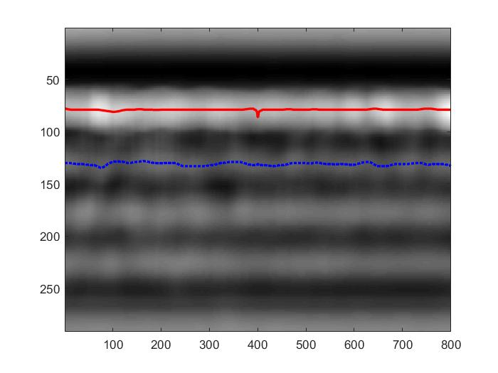
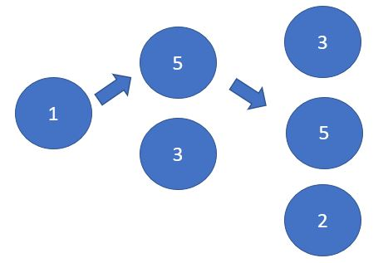
Method
Preprocessing: BM-3D Filtering
Boundary Searching: Graph Method (lowest energy)
Layer Searching: Calculate Layer Weight (adipose)
4 | Auto-Segmentation of OCT Images of Heart

Slide 5
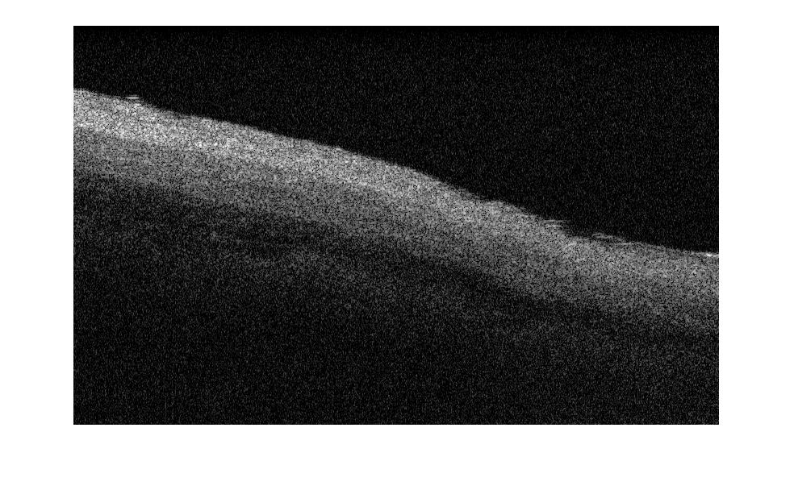
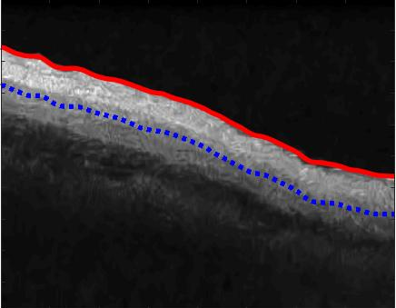

Result
5 | Auto-Segmentation of OCT Images of Heart

Slide 6
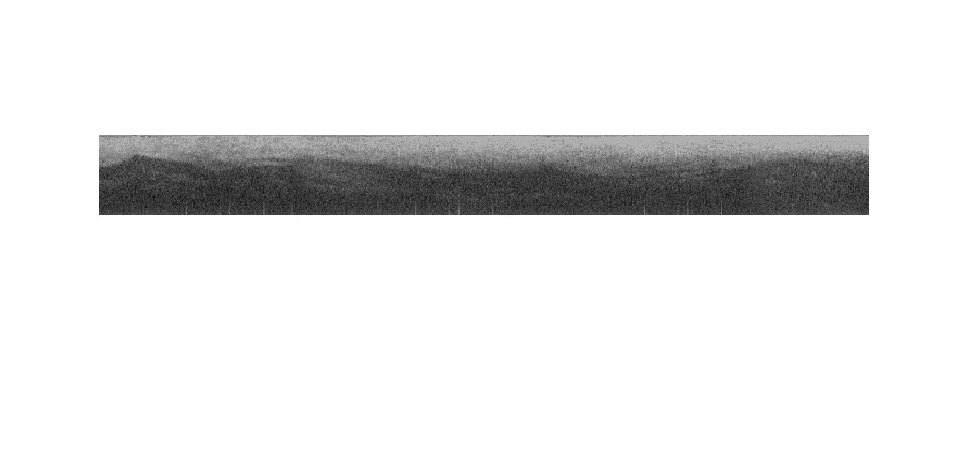
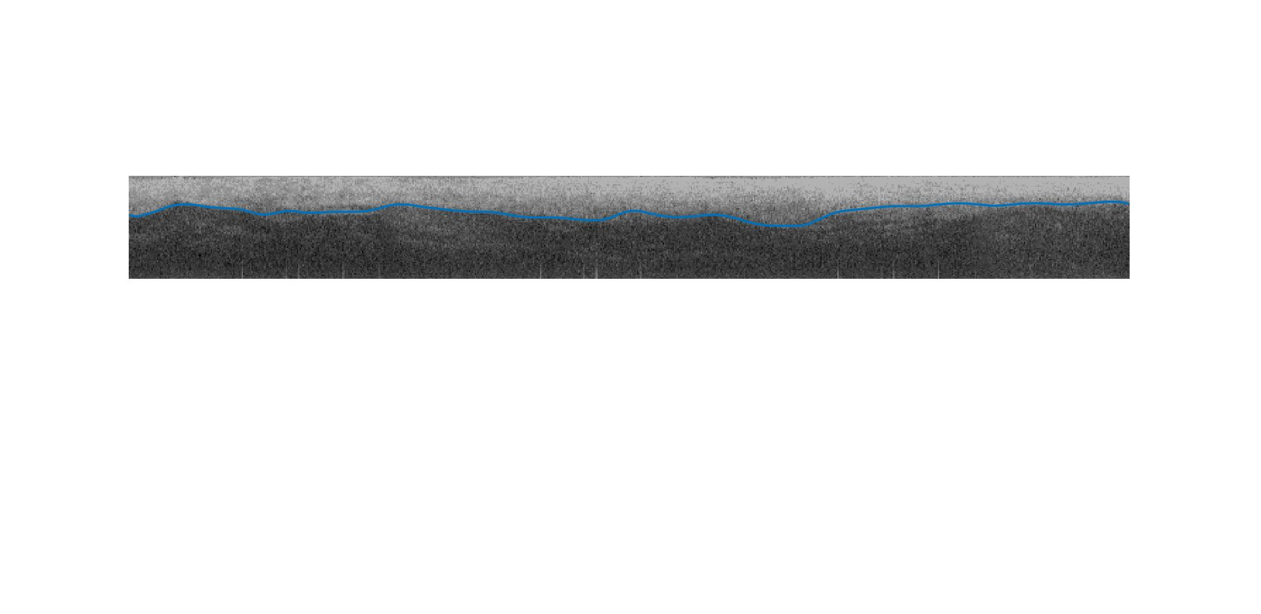
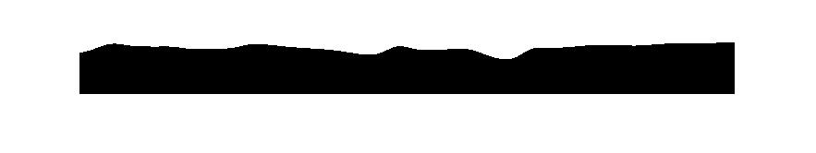
Result
6 | Auto-Segmentation of OCT Images of Heart

Slide 7
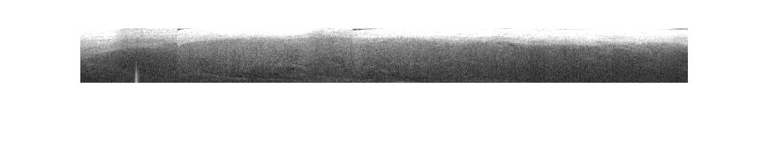
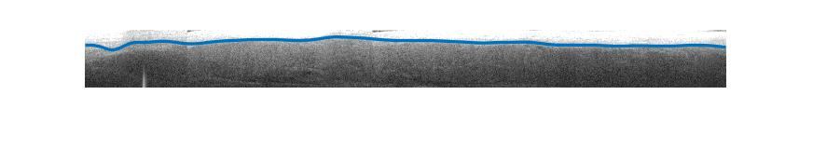
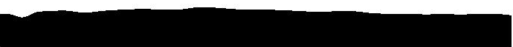
Result
7 | Auto-Segmentation of OCT Images of Heart

Slide 8
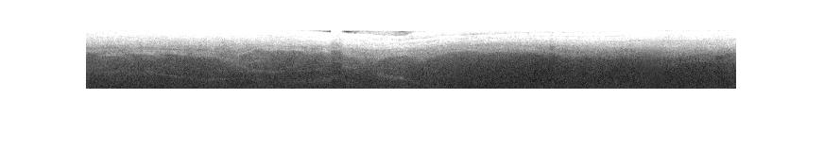
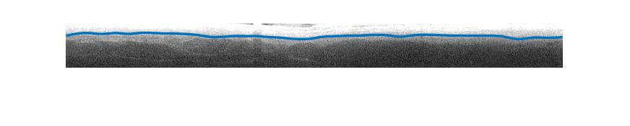
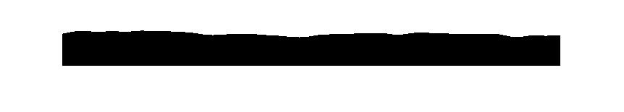
Result
8 | Auto-Segmentation of OCT Images of Heart

Slide 9
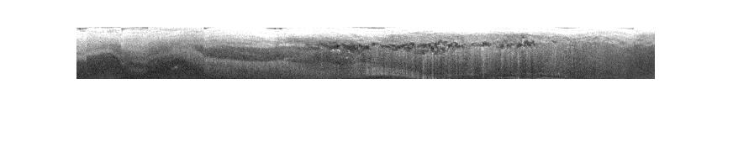
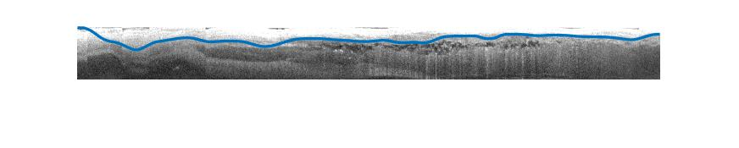
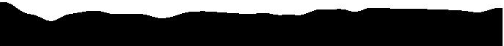
Result with Large Artifact
9 | Auto-Segmentation of OCT Images of Heart

Slide 10
Further Expansion
Improve extracting information from image
- Histogram, Image Size, Artifact etc
Generate more dataset using GAN
10 | Auto-Segmentation of OCT Images of Heart

Slide 11
Thank You!
11 | Auto-Segmentation of OCT Images of Heart

