Slide 1
Summer Research 2017
Jun Hyek Jang

Slide 2
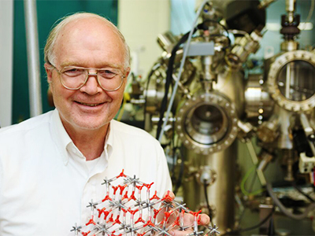

Research Topic
Finding Image Potential States of Oxygen Intercalated Graphene on Iridium via 2 Photon Photoemission
Professor Osgood
PhD Student: Yi Lin

Slide 3
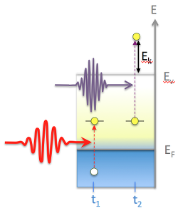
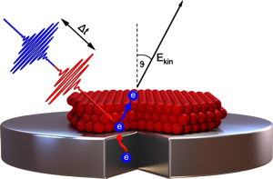
2 Photon Photoemission
Photoemission: Emission of photoelectron from a surface when a photon strikes the surface
2PPE: Pump laser produces photoelectron from the surface to Intermediate State
Probe laser photoexcites electrons in Intermediate State to above Vacuum Energy

Slide 4
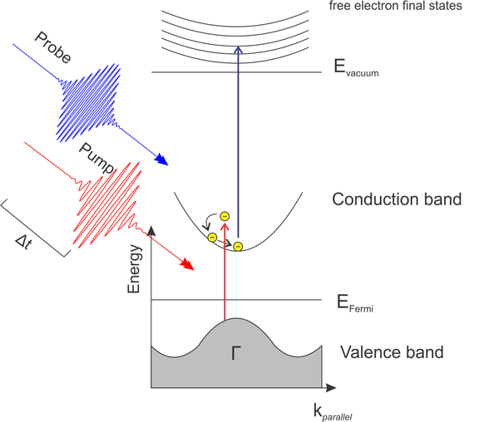
Image Potential States
Image-potential states are quantized electronic states that exist at metal surfaces with a band gap near the vacuum level

Slide 5
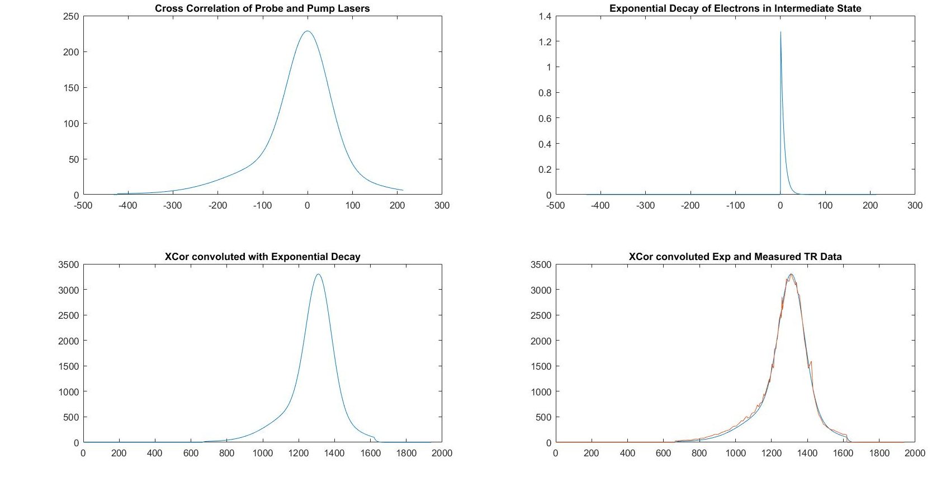
Time Resolved 2 Photon Photoemission
Using Delay Line, delay the time of Pump Laser arriving at the sample
Can capture decay time of electrons in intermediate state

Slide 6
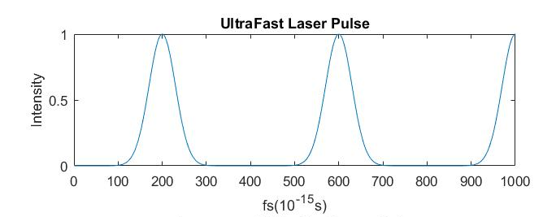
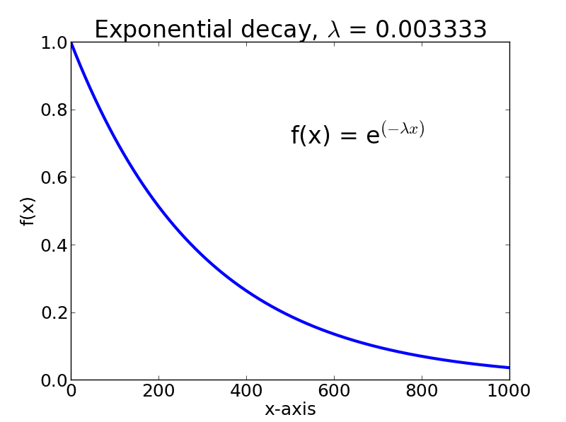
UltraFast Laser
Mode-locked
Lasers are pulsed
Pulsewidth ~40fs
Pulsewidth has to be smaller than lifetime of electron in intermediate state

Slide 7
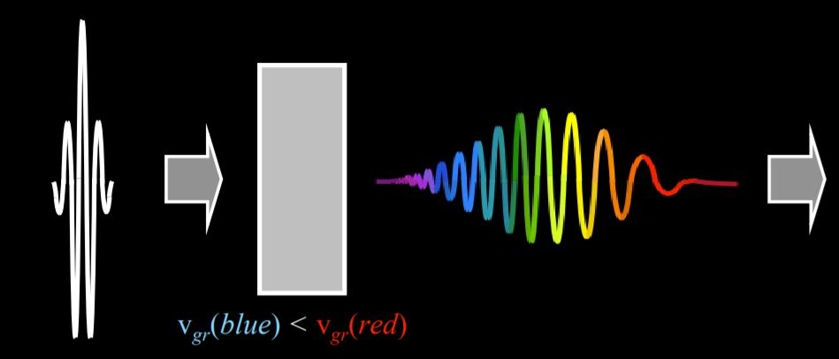
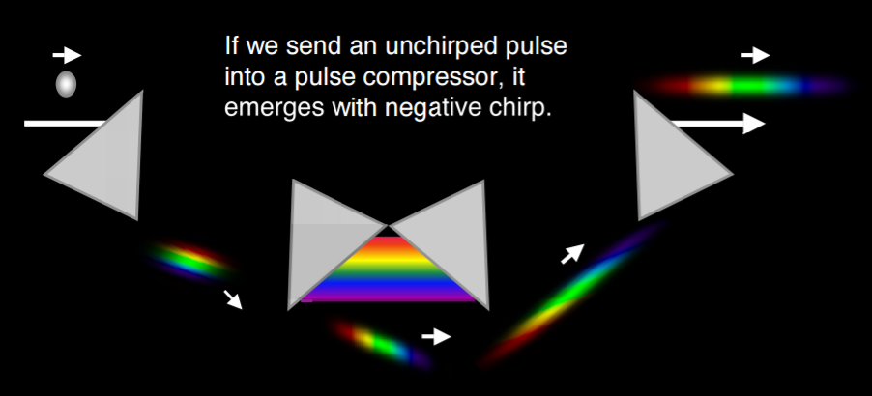
Negative Group Delay Dispersion
Naturally, laser pulsewidth increases as laser passes through transparent materials (Increasing GDD)
To maintain pulsewidth of laser short, apply Negative GDD

Slide 8
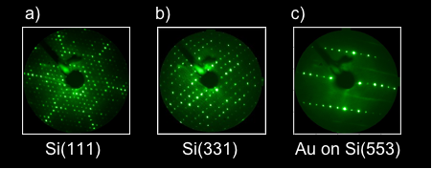
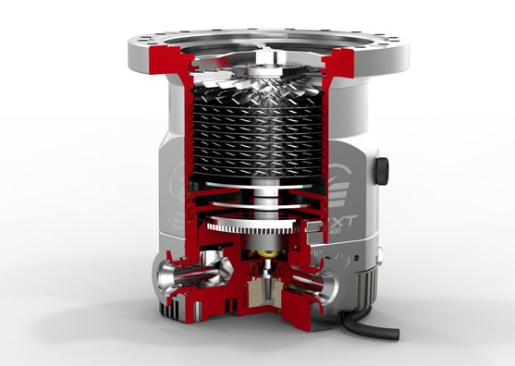
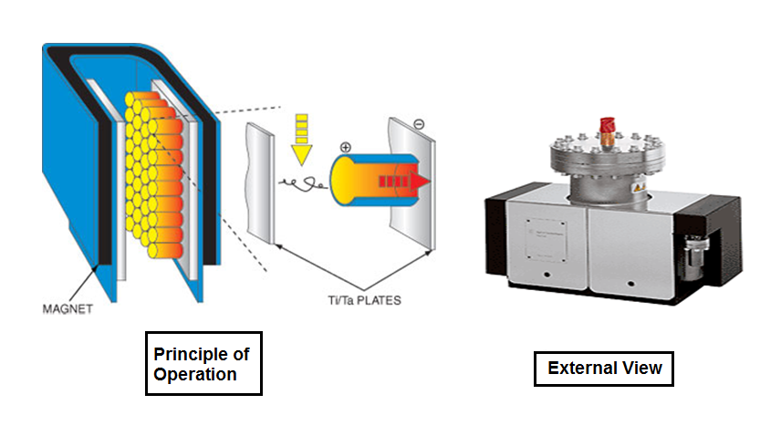
Miscellaneous Topics
LEED
AutoCorrelation
Pumps: Turbo, Manifold, Ion
Knife-edge Method
Sample Preparation
Growing Graphene
Oxygen Intercalation
Oxygen firing

Slide 9
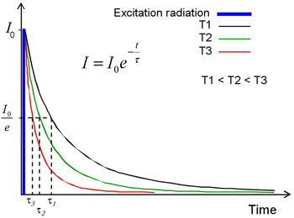
Data Analysis
Curve Fitting Software
Matlab, Mathematica, Igor Pro
Better idea of how to fit data
Physical Interpretation of Graph
Appropriate approximation of certain data

Slide 10

Final Remark
Developed me into a better scientist
Think critically
Step by step, detailed
Have better idea of careers in science field
Meet awesome people
FUN!!

