Slide 1
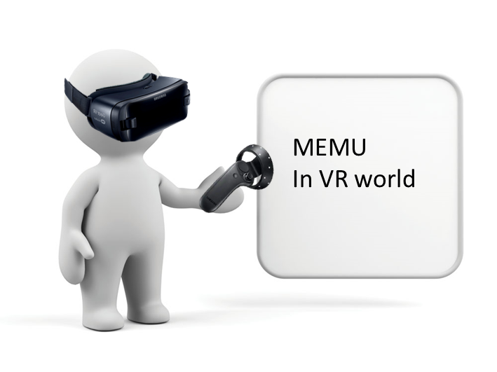
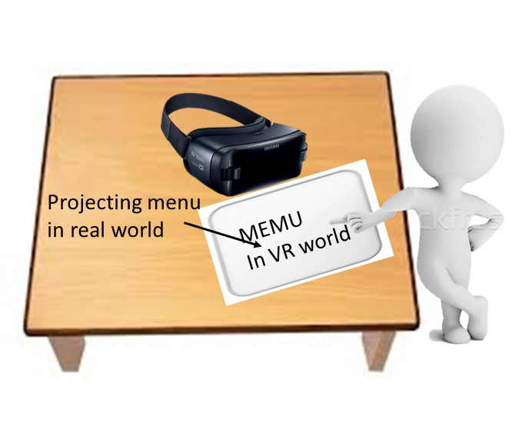
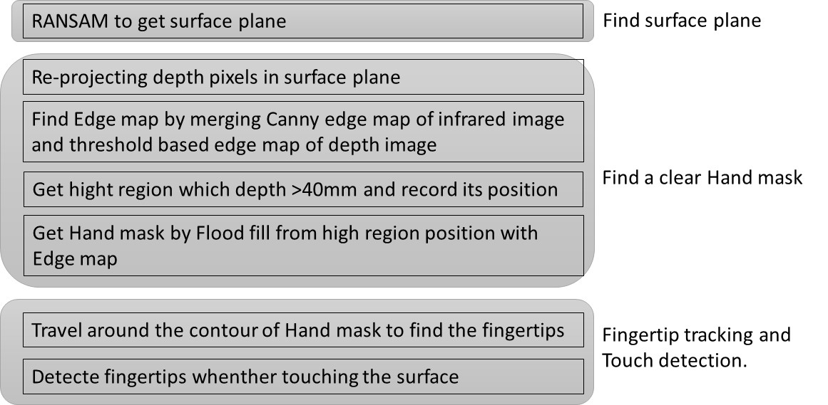
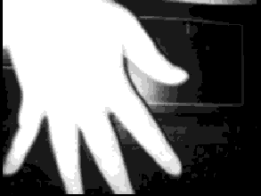
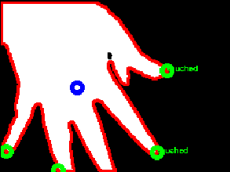
Hsin-Yu Chen, Yuan-Syun Ye
Motivation
Nowadays, various products and applications related to AR and VR are becoming more and more popular. And in the near future, mobile HMD will replace glasses and some smart phone functions, which exist in people‘s daily lives.
The features that can be operated on the VR scene only after the HMD is put on will become less intuitive and inconvenient. Therefore, we hope that when the HMD is placed on the desktop, the user can manipulate the VR scene in some way.
Method
We use a depth camera with computer vision technology to track the position of the fingertips and determine if a touch has occurred, and design a painting application that uses our techniques.
The implementation can be roughly divided into three parts, namely Image Streamer, Tracker Engine and Application.
Image Streamer : Save the depth data and infrared image from depth camera
Tracker Engine :
Application : a painting application that uses techniques for fingertip tracking and touch detection.
Result

