Slide 1
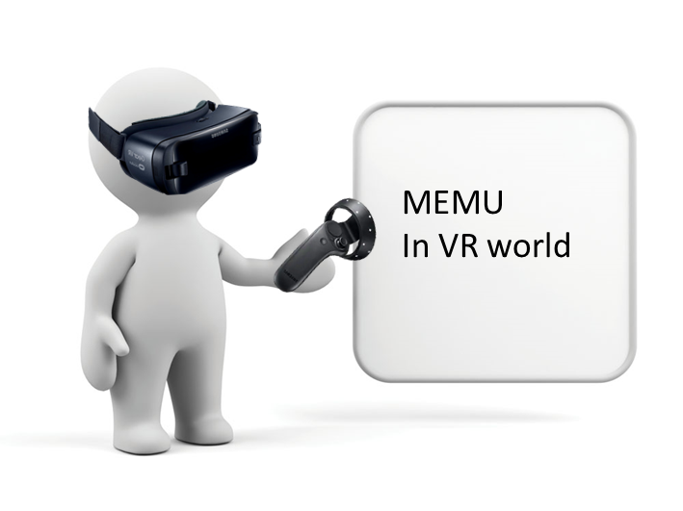
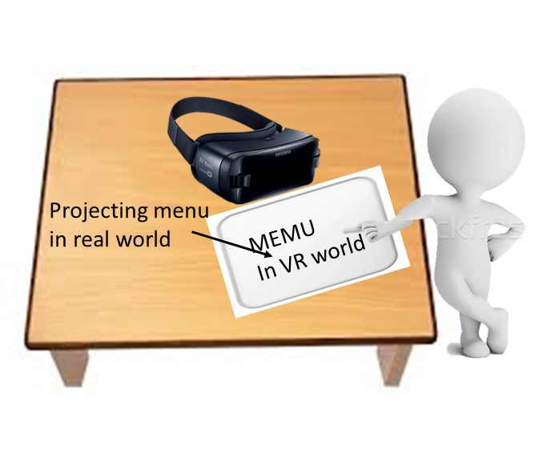
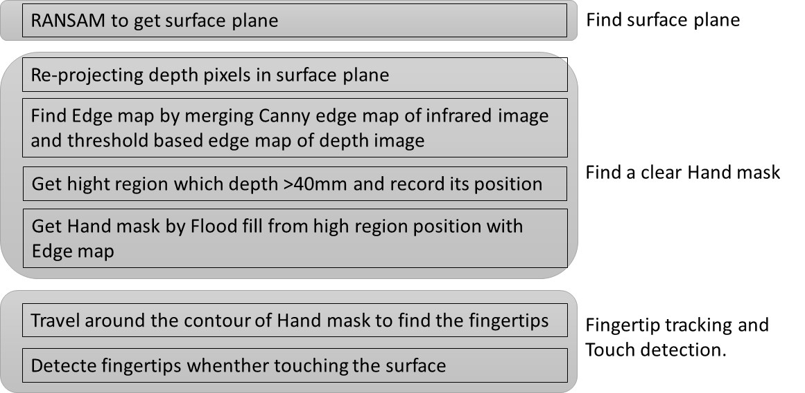
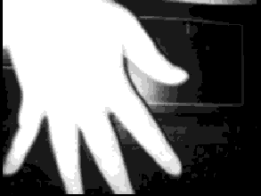
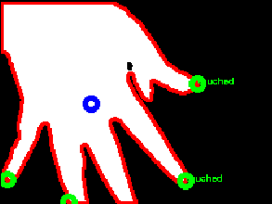
Hsin-Yu Chen, Yuan-Syun Ye
Motivation
Nowadays, various products and applications related to AR and VR are becoming more and more popular. And in the near future, mobile HMD will exist in people‘s daily lives.
The features that can be operated on the VR scene only after the HMD is put on will become less intuitive and inconvenient. Therefore, we hope that when the HMD is placed on the desktop, the user can manipulate the VR scene in some way.
Method
We use a depth camera with computer vision technology to track the position of the fingertips and determine if a touch has occurred, and design a painting application that uses our techniques.
The implementation can be roughly divided into three parts, namely Image Streamer, Tracker Engine and Application.
Image Streamer : Save the depth data and infrared image from depth camera
Tracker Engine :
Application : a painting application that uses techniques for fingertip tracking and touch detection.
Result

Slide 2
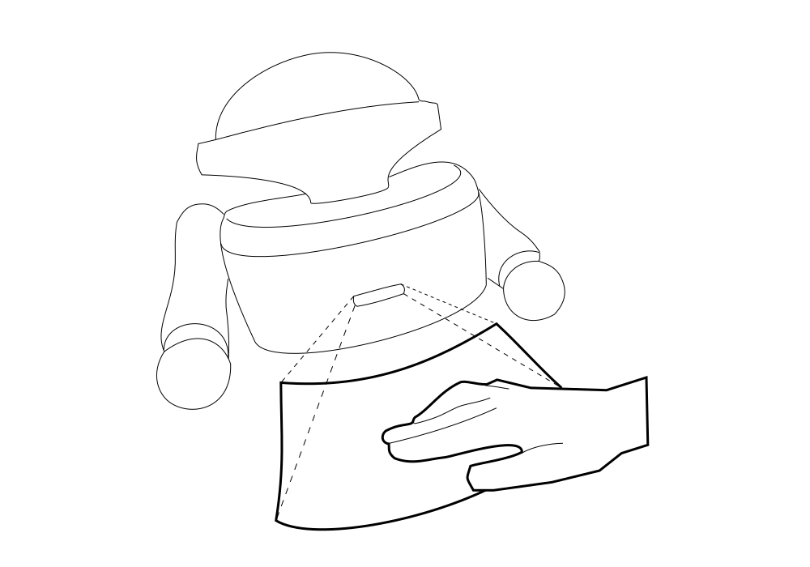
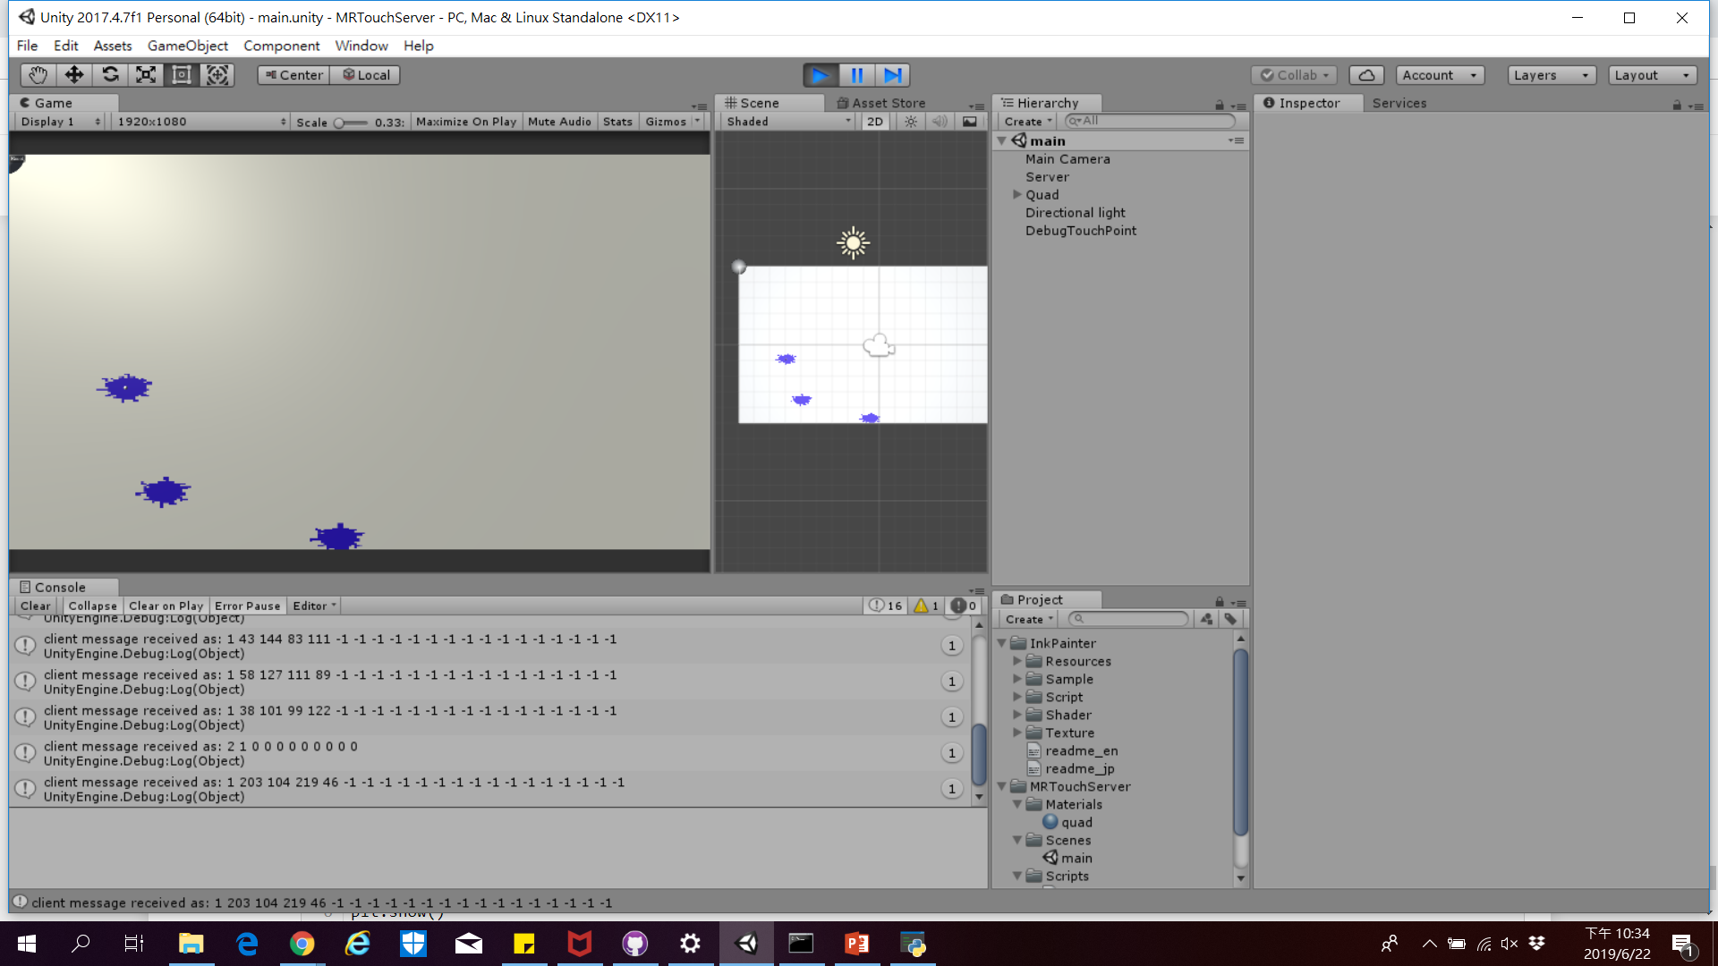
Enhance The Interaction of Glasses or Head-Mounted Displays On a Surface
NCTU 2019 CV Team 21 Hsin-Yu Chen, Yuan-Syun Ye
Motivation
Tracker Engine
Image Steamer
Find Surface Plane
Find a clear hand mask
Fingertip tracking
& touch detection
Nowadays, various products and applications related to AR and VR are becoming more and more popular. And in the near future, mobile HMD will exist in people‘s daily lives. The features that can be operated on the VR scene only after the HMD is put on will become less intuitive and inconvenient. Therefore, we hope that when the HMD is placed on the desktop, the user can manipulate the VR scene in some way.
Using RANSAM to get surface plane normal
Re-projecting depth pixels in surface plane
Find Edge map by merging Canny edge of infrared image and threshold based edge map of depth image
Get high region which depth higher than 40mm from surface plane and record its pixels
Travel around the contour of hand mask to find the fingertips by finding the largest curvature.
Use a 7x7 mask on fingertips to get max height difference between fingertips and the surface.
The judgment of the touch depends on the hysteresis height, the height is less than 10mm to indicate the trigger touch, and the height greater than 15 mm means the left surface
Architecture
Image Source
Image Steamer
Tracker Engine
TCP/IP
Touch Information
Application
Result
We use a depth camera (CamBoard pico flex, which Resolution is 244*171 px, placed on the upper edge of the HMD) with computer vision technology to track the position of the fingertips and determine if a touch has occurred, and design a painting application that uses our techniques. The implementation can be roughly divided into three parts, namely Image Streamer, Tracker Engine and Application.
Image Streamer : Save the depth data and infrared image from depth camera
Tracker Engine: In order to track the continuous touch of the same finger.
Application : a painting application that uses techniques for fingertip tracking and touch detection.
We use Python as our development used is i5-6300HQ, which takes about 10ms, and uses multiple threads to receive streaming data for about 110 ms. The average FPS is about 8.4. In summary, our project can be placed on any head-mounted display or glasses, so that interactive detection on the desktop can be achieved, such as selecting an application before mount the HMD enter the virtual reality, or you can write notes on any desktop.

