Slide 1

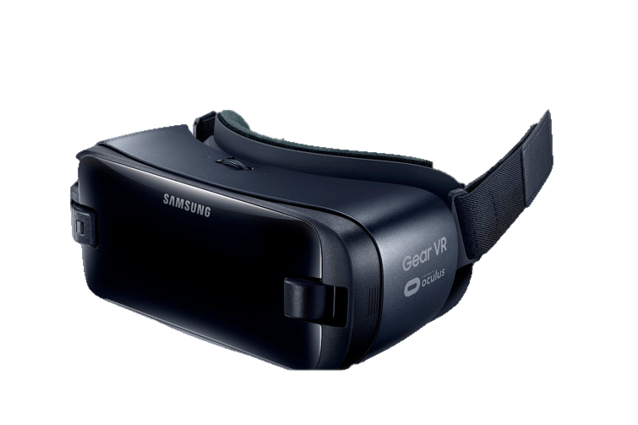
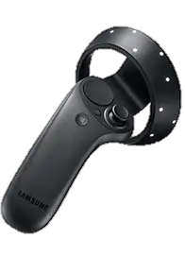
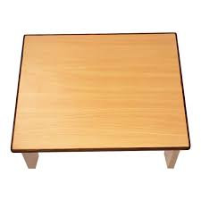

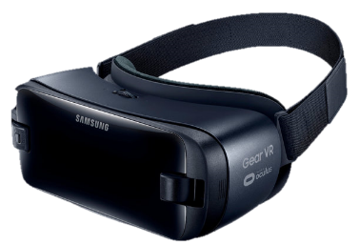
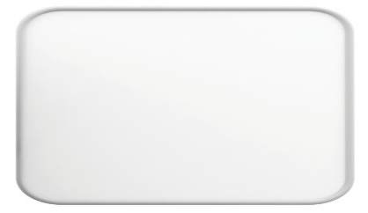

MEMU
In VR world
Projecting menu in real world
MEMU
In VR world

Slide 2
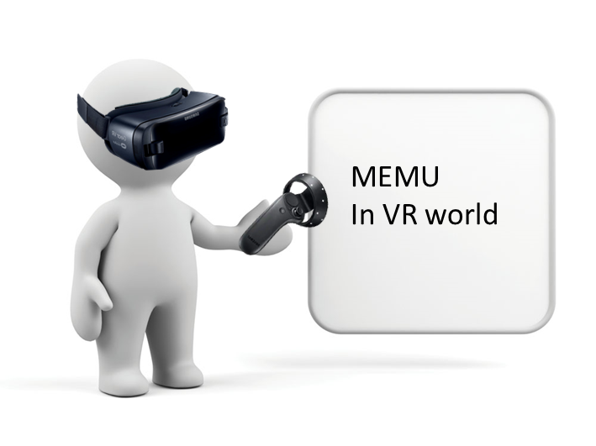
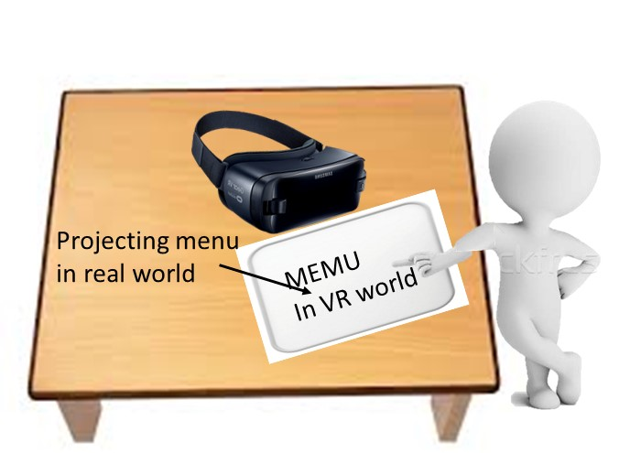
Figure1 : the user first selects the VR game in the real world and sets the corresponding game settings. Then wear HMD into the VR world and start the game directly.

Slide 3
RANSAM to get surface plane
Find surface plane
Re-projecting depth pixels in surface plane
Find Edge map by merging Canny edge map of infrared image and threshold based edge map of depth image
Get hight region which depth >40mm and record its position
Find a clear Hand mask
Get Hand mask by Flood fill from high region position with Edge map
Travel around the contour of Hand mask to find the fingertips
Fingertip tracking and Touch detection.
Detecte fingertips whenther touching the surface

Slide 4
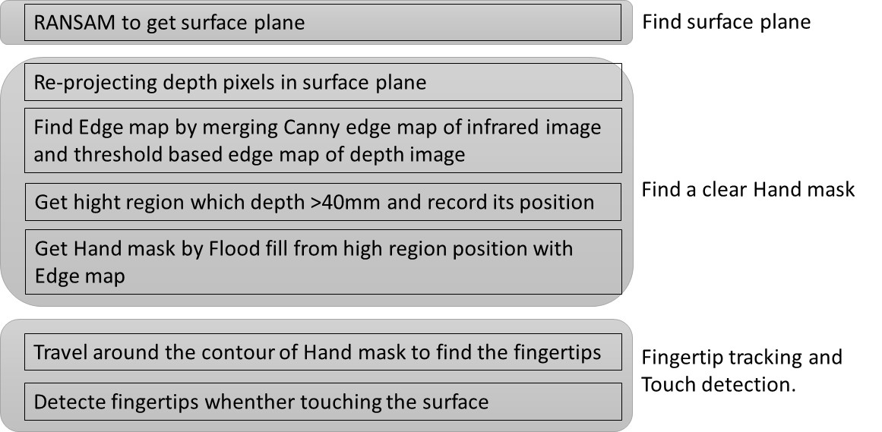

Slide 5
