Slide 1
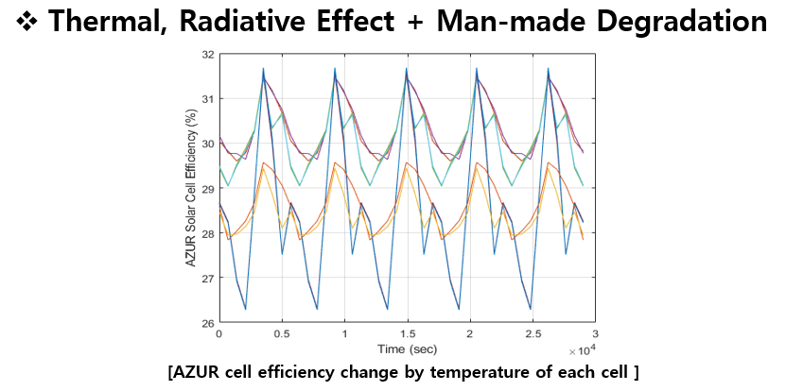
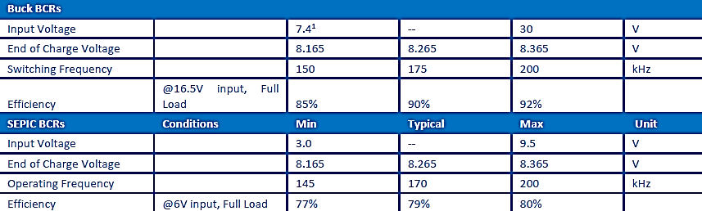
Efficiency
Efficiency of charging method
Eff_tmp (90%) : Efficiency for Charging due to Temperature of PV Cell
Eff_id (80%) : Efficiency for Charging due to Inherent Degradation
Eff_bcr (80%) : Conversion Efficiency for charging Battery
Eff_pcm (90%) : Conversion Efficiency for Regulation

Slide 2
0. Energy Balance : Detumbling mode
 | Mode | Unit
 | Detumbling
Total Power Consumption | 3.7670 | W
Generated Energy (Orbit average) | 3.1994 | Wh
Required Energy (Orbit average) | 5.9404 | Wh
Power Margin Value | -2.7410 | Wh
Power Margin | -46.1410 | %
Residual/Generation | -85.6702 | %
Charging Rate | -6.8524 | %

Slide 3
1. Energy Balance : Mission & UHF COM mode
 | Mode |  |  | Total | Unit
 | Stand-by(D) | Stand-by(N) | Mission & UHF
Total Power Consumption | 4.2768 | 2.8355 | 1.5113 | 8.6236 | W
Generated Energy (Orbit average) | 12.1482 |  |  | 12.1482 | Wh
Required Energy (Orbit average) | 6.7443 | 4.4714 | 2.3833 | 13.5989 | Wh
Power Margin Value | -1.4508 |  |  | -1.4508 | Wh
Power Margin | -10.6684 |  |  | -10.6684 | %
Residual/Generation | -11.9425 |  |  | -11.9425 | %
Charging Rate | -13.51 | -11.18 | -5.96 | -3.65 | %

Slide 4
2. Energy Balance : S-band COM mode(@Night)
 | Mode |  |  | Total | Unit
 | Stand-by(D) | Stand-by(N) | S-band
Total Power Consumption | 4.3883 | 1.8487 | 1.6284 | 7.8655 | W
Generated Energy (Orbit average) | 14.9307 |  |  | 14.9307 | Wh
Required Energy (Orbit average) | 6.9201 | 2.9154 | 2.5679 | 14.9307 | Wh
Power Margin Value | 2.5273 |  |  | 2.5273 | Wh
Power Margin | 20.3761 |  |  | 20.3761 | %
Residual/Generation | 16.927 |  |  | 16.927 | %
Charging Rate | 20.03 | -7.29 | -6.42 | 6.32 | %

Slide 5
3. Energy Balance : S-band COM mode(@Day)
 | Mode |  |  | Total | Unit
 | Stand-by(D) | Stand-by(N) | S-band
Total Power Consumption | 3.5705 | 2.7460 | 1.7938 | 8.1103 | W
Generated Energy (Orbit average) | 12.1482 |  |  | 12.1482 | Wh
Required Energy (Orbit average) | 5.6304 | 4.3303 | 2.8287 | 12.7895 | Wh
Power Margin Value | -0.6413 |  |  | -0.6413 | Wh
Power Margin | -5.0146 |  |  | -5.0146 | %
Residual/Generation | -5.2793 |  |  | -5.2793 | %
Charging Rate | 16.29 | -10.83 | -7.07 | -1.61 | %

Slide 6
4. Energy Balance : Standby mode
 | Mode |  | Total | Unit
 | Stand-by(D) | Stand-by(N)
Total Power Consumption | 4.5641 | 2.8434 | 7.4075 | W
Generated Energy (Orbit average) | 14.9307 |  | 14.9307 | Wh
Required Energy (Orbit average) | 7.1974 | 4.4839 | 11.6812 | Wh
Power Margin Value | 3.2495 |  | 3.2495 | Wh
Power Margin | 27.8179 |  | 27.8179 | %
Residual/Generation | 21.7637 |  | 21.7637 | %
Charging Rate | 19.33 | -11.21 | 8.12 | %

Slide 7
5. Energy Balance : Commissioning mode 1
 | Mode | Unit
 | Commissioning 1
Total Power Consumption | 4.1955 | W
Generated Energy (Orbit average) | 3.1994 | Wh
Required Energy (Orbit average) | 6.6161 | Wh
Power Margin Value | -3.4166 | Wh
Power Margin | -51.6414 | %
Residual/Generation | -106.7882 | %
Charging Rate | -8.54 | %

Slide 8
6. Energy Balance : Commissioning mode 2
 | Mode | Unit
 | Commissioning 2
Total Power Consumption | 8.2730 | W
Generated Energy (Orbit average) | 14.9307 | Wh
Required Energy (Orbit average) | 13.0461 | Wh
Power Margin Value | 1.8846 | Wh
Power Margin | 14.4460 | %
Residual/Generation | 12.6225 | %
Charging Rate | 4.71 | %

Slide 9
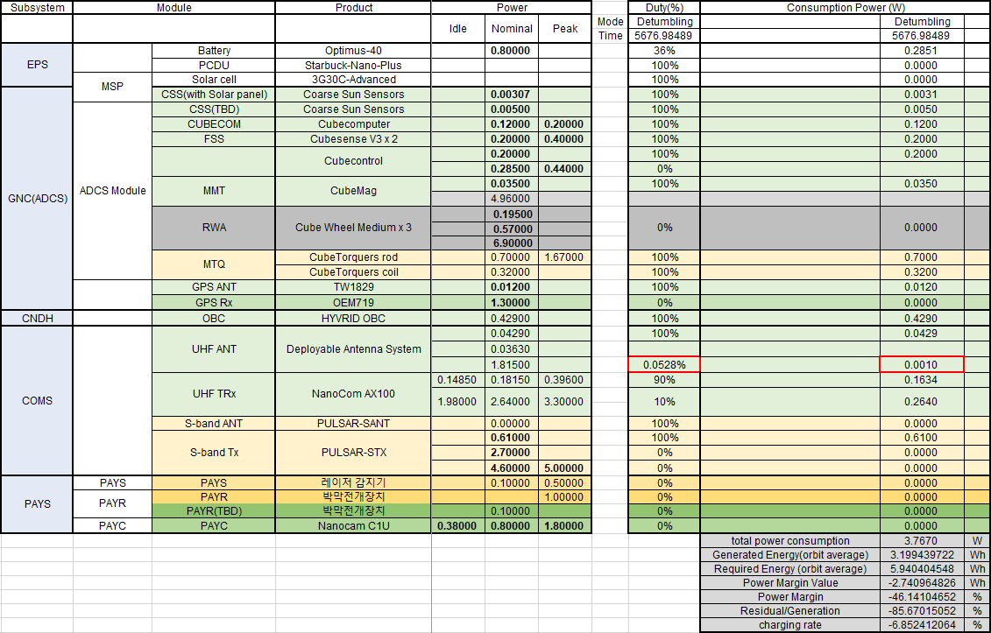
0. Power Budget : Detumbling mode

Slide 10
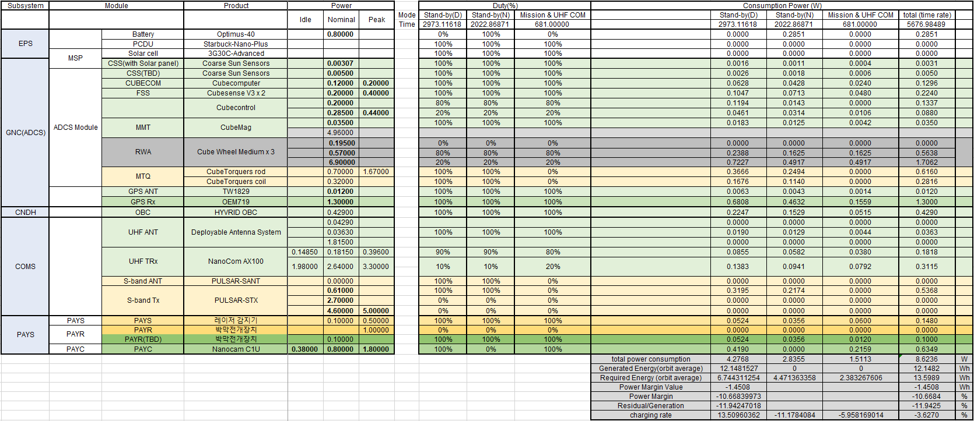
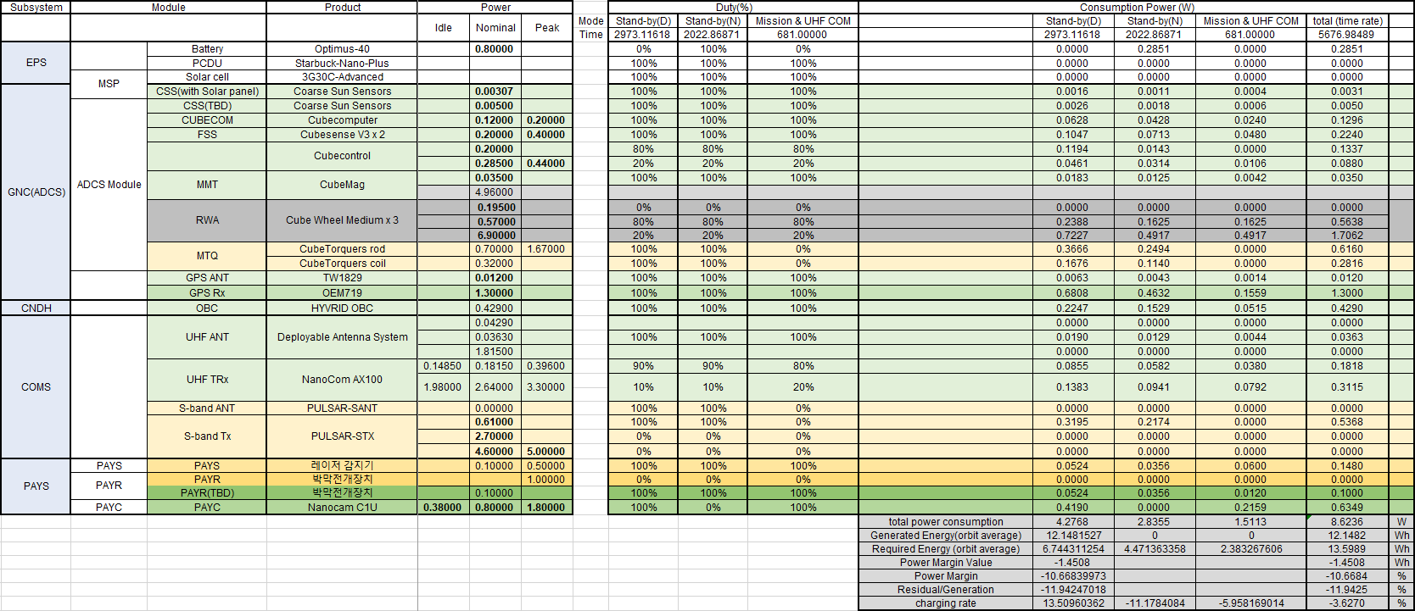
1. Power Budget : Mission & UHF COM mode

Slide 11
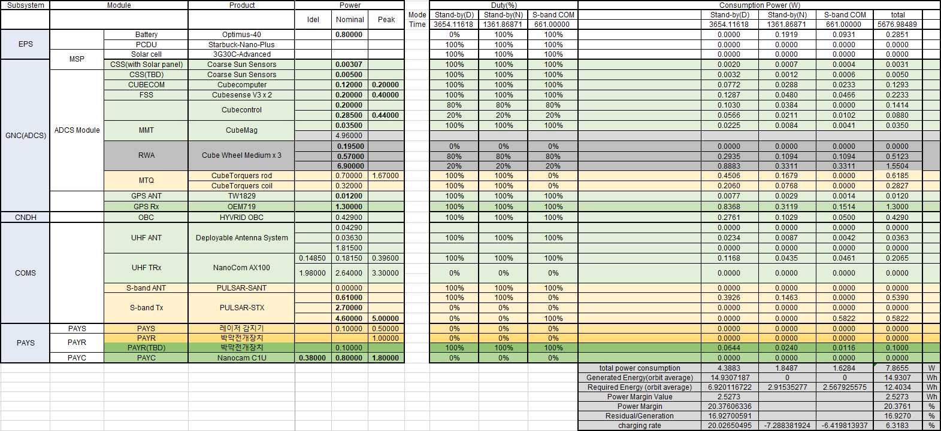
2. Power Budget : S-band COM mode(@Night)

Slide 12
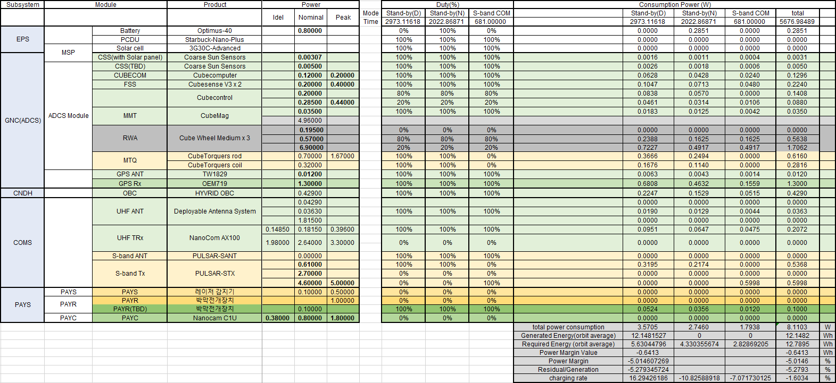
3. Power Budget : S-band COM mode(@Day)

Slide 13
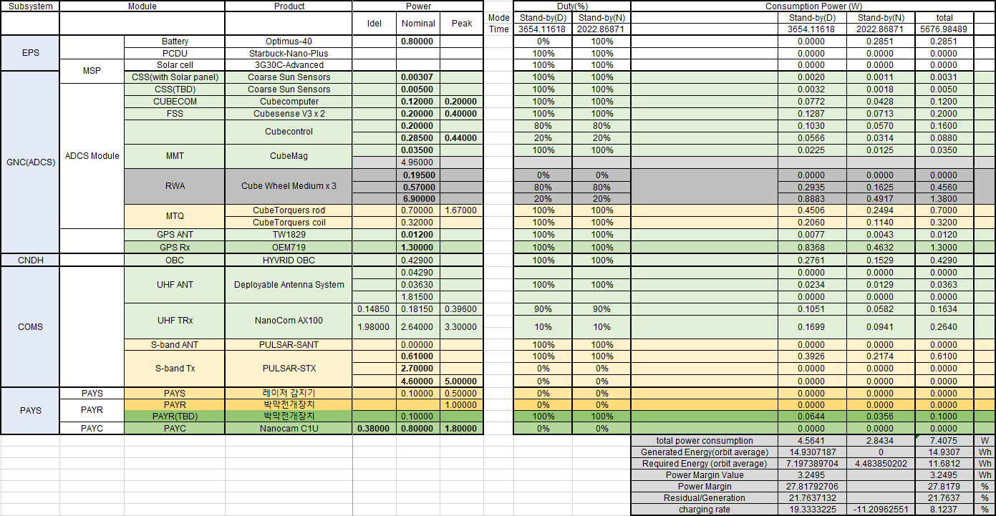
4. Power Budget : Stand-by mode

Slide 14
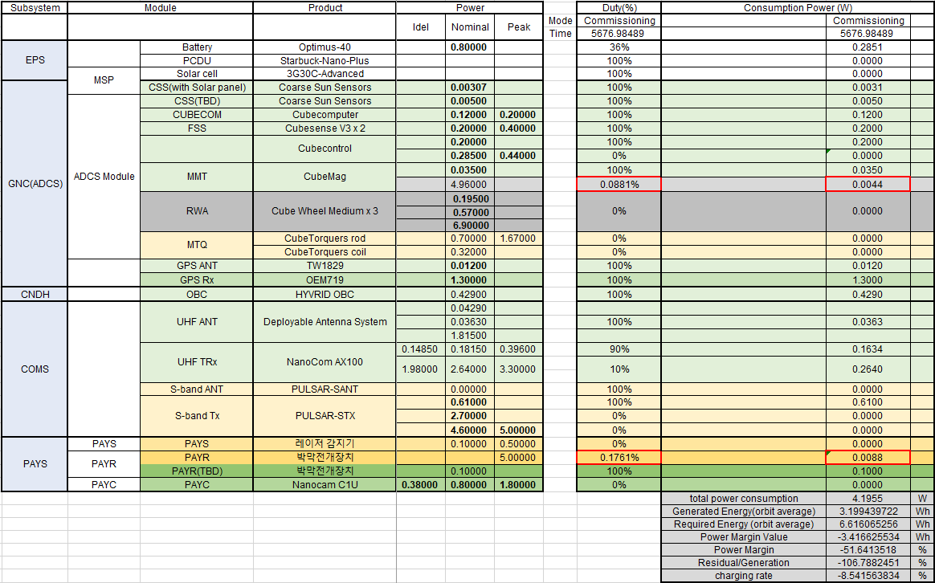
5. Power Budget : Commissioning mode 1

Slide 15
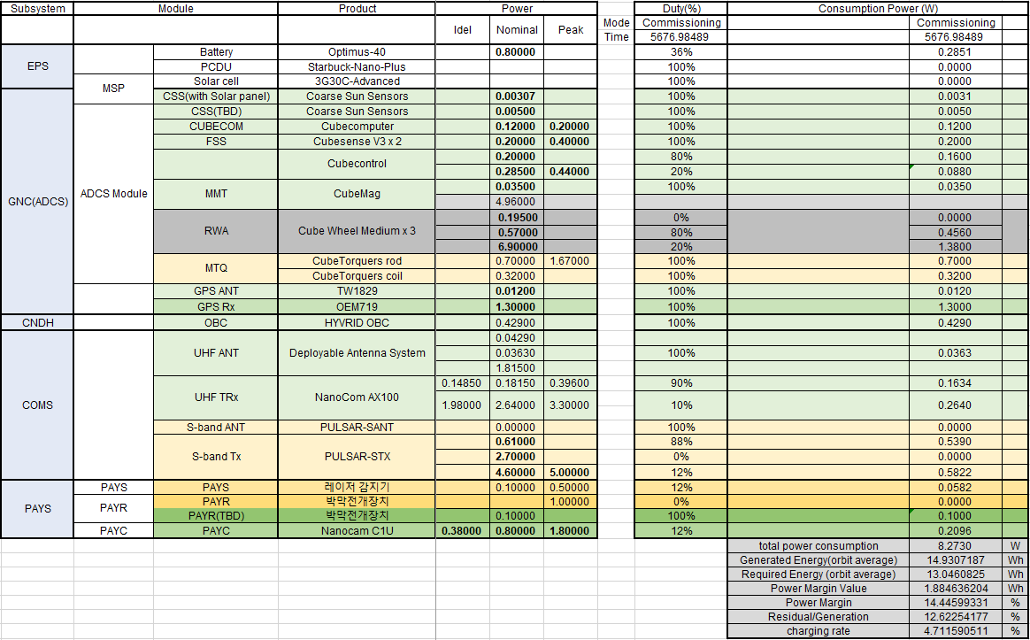
6. Power Budget : Commissioning mode 2

Slide 16
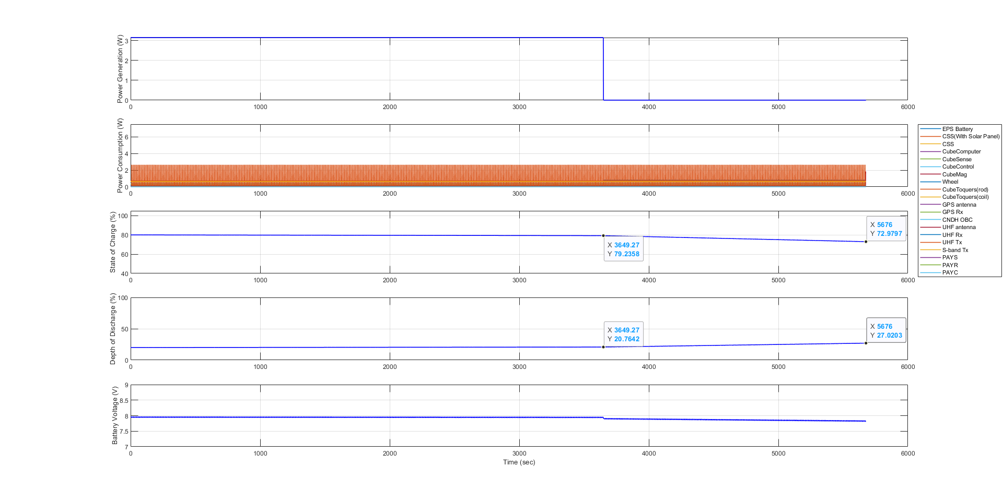
0. Plot Result : Detumbling mode

Slide 17
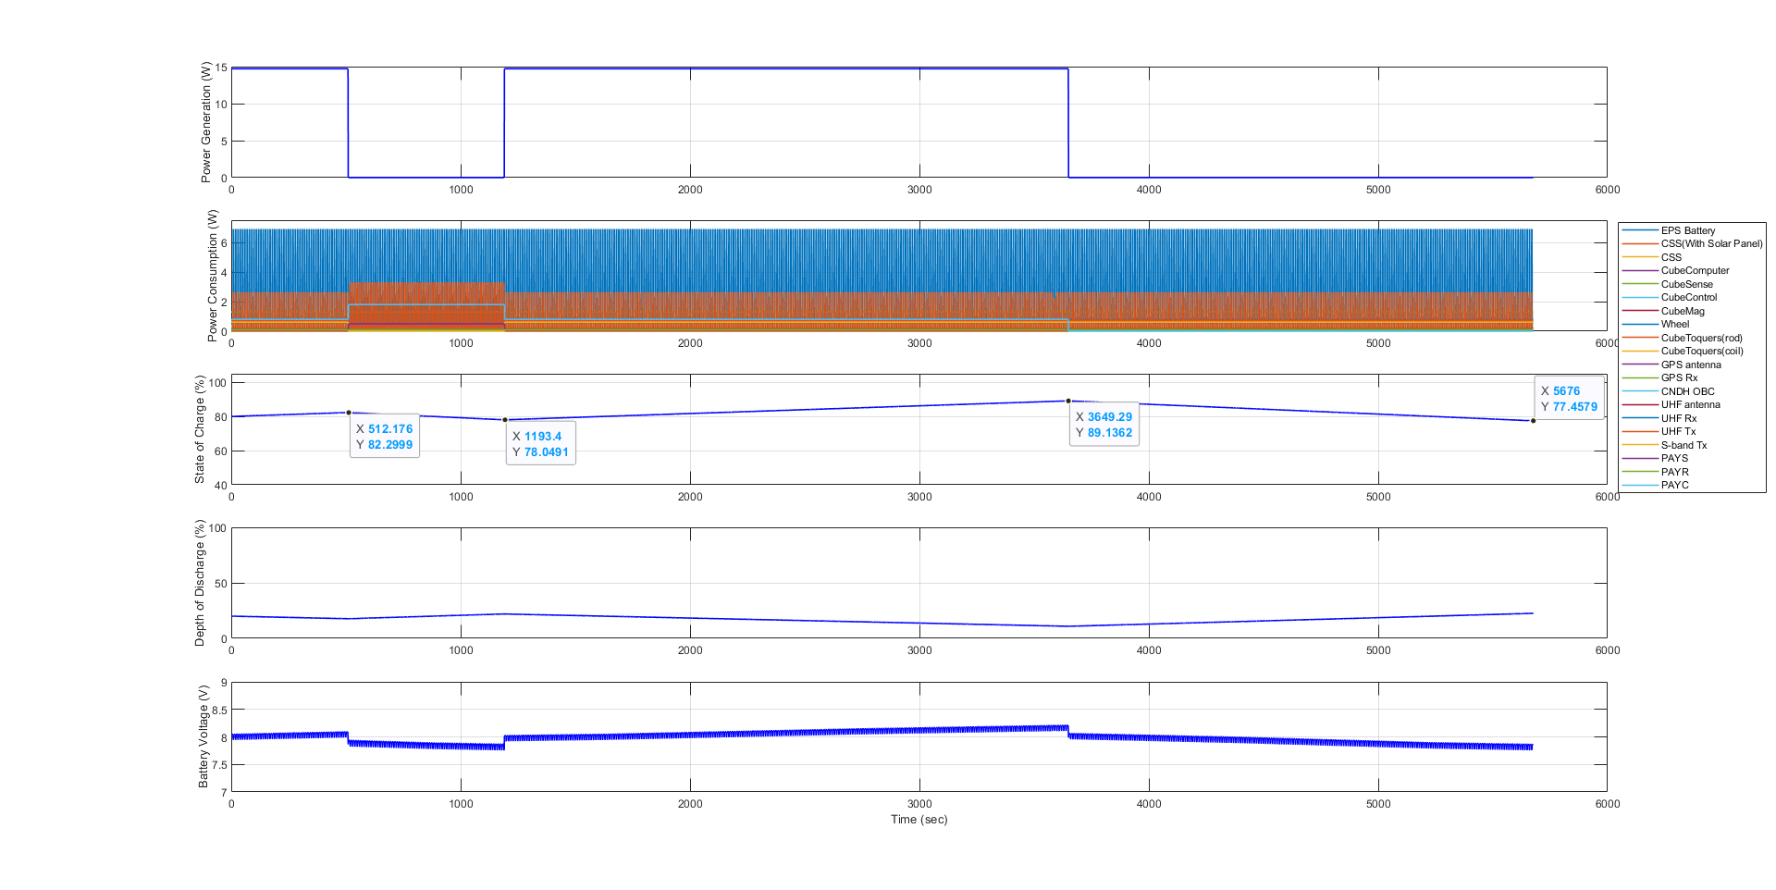
1. Plot Result : Mission & UHF COM mode

Slide 18
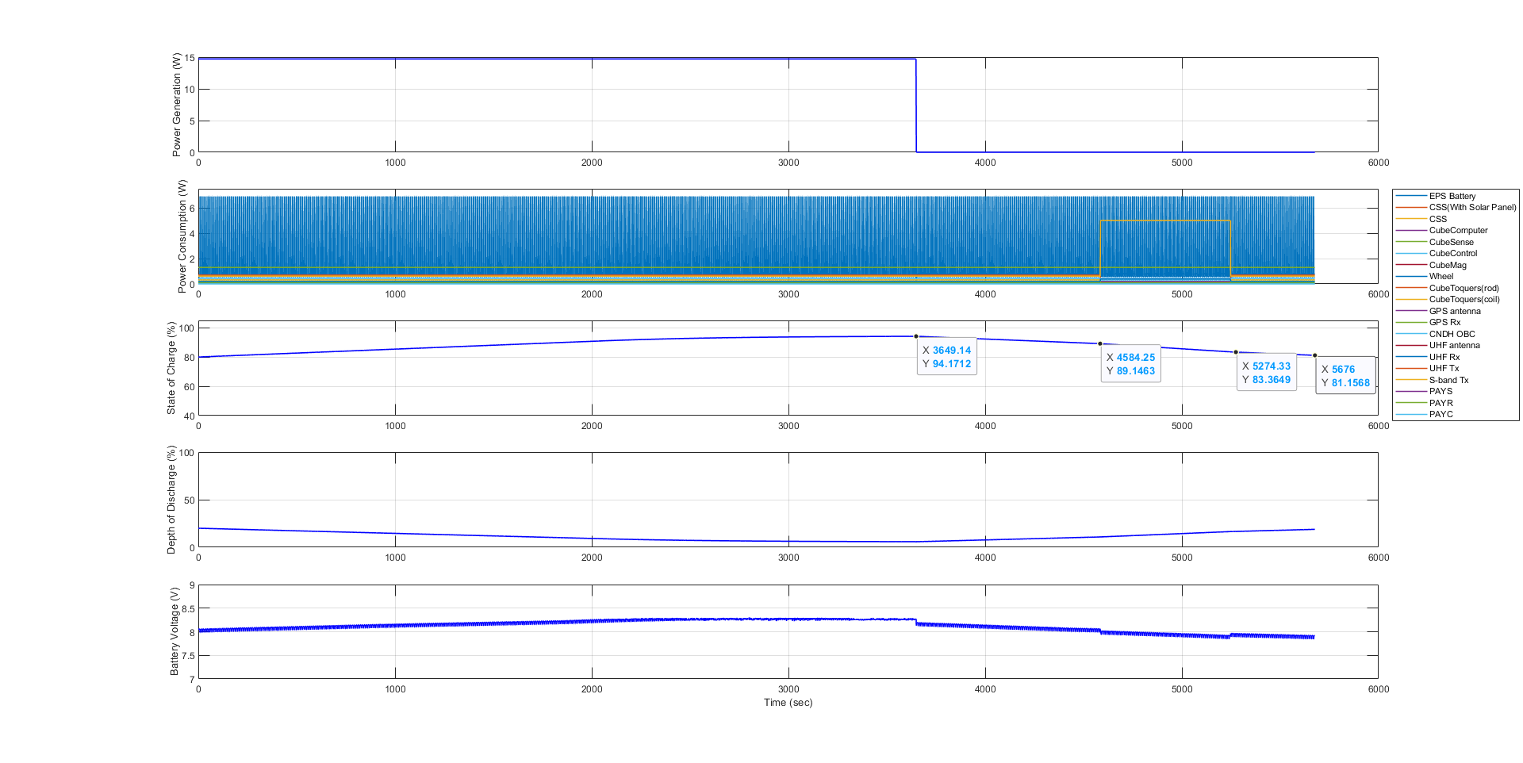
2. Plot Result : S-band COM mode(@Night)

Slide 19
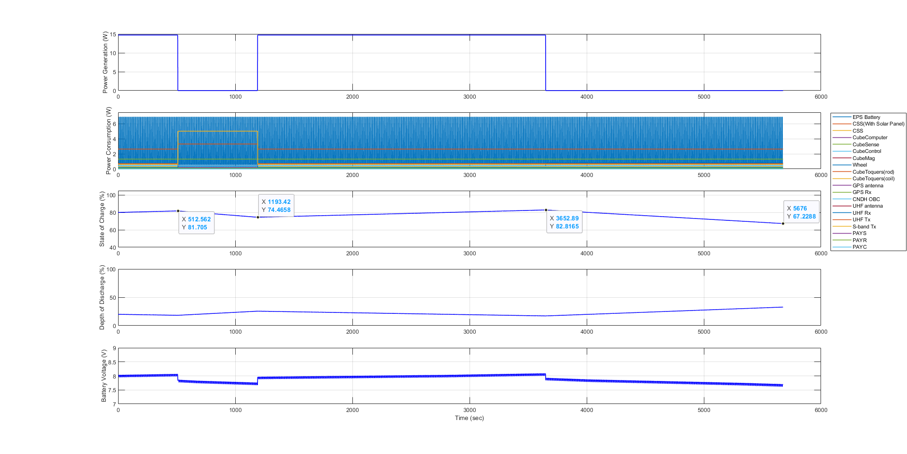
3. Plot Result : S-band COM mode(@Day)

Slide 20
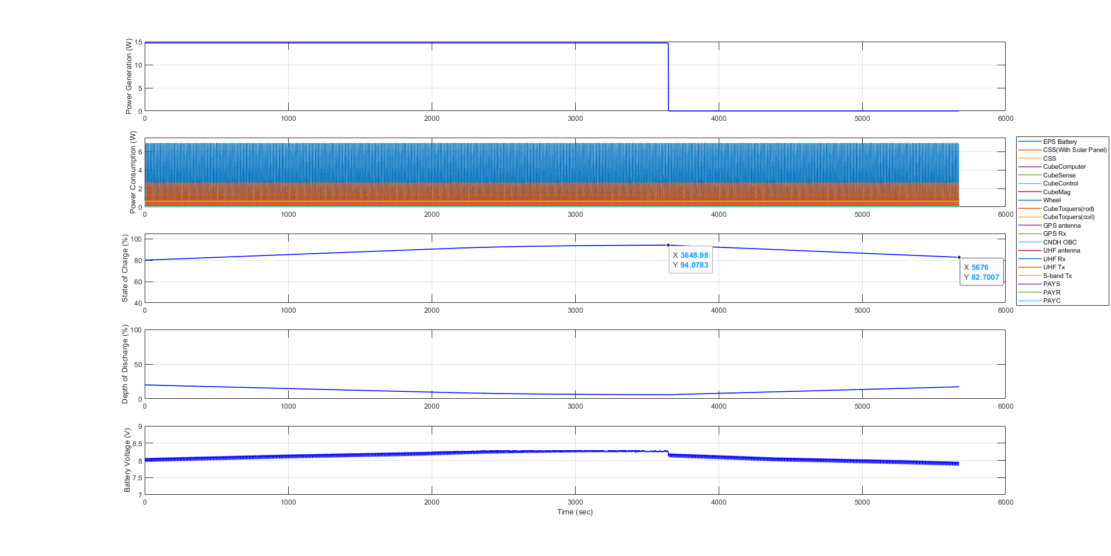
4. Plot Result : Stand-by mode

Slide 21
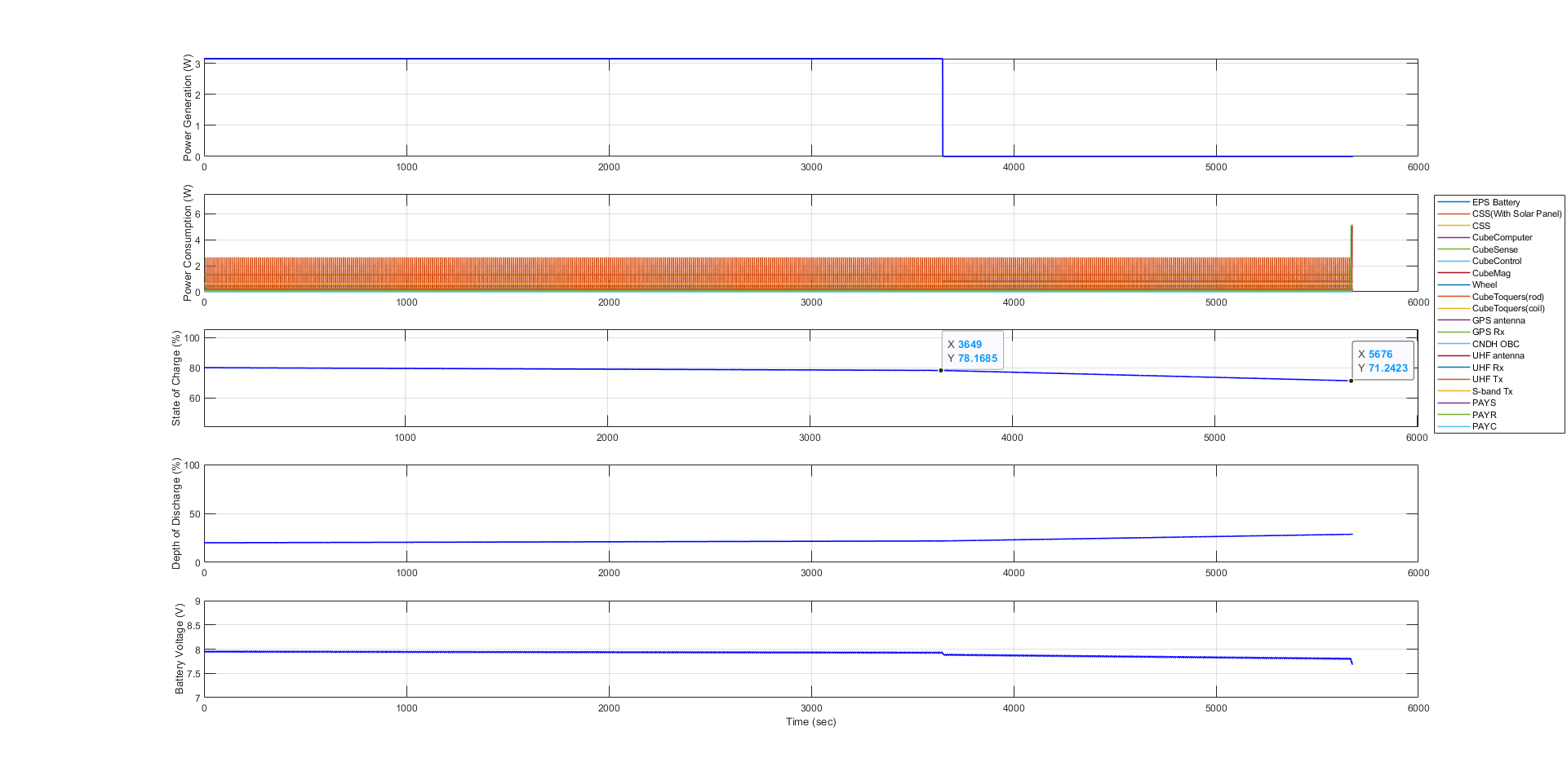
5. Plot Result : Commissioning mode 1

Slide 22
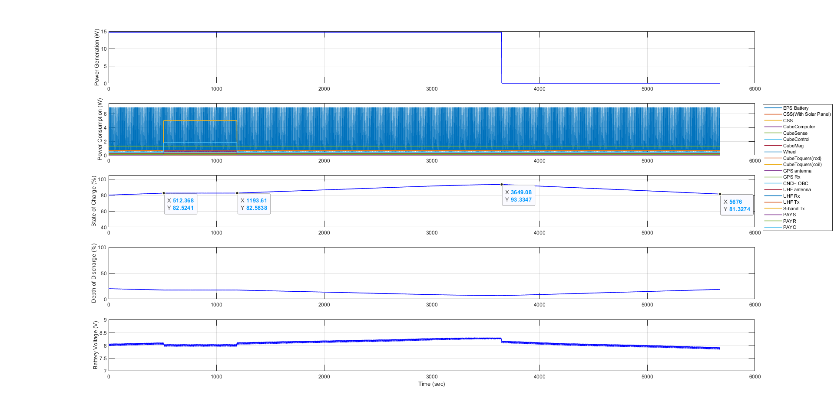
6. Plot Result : Commissioning mode 2

