Slide 1
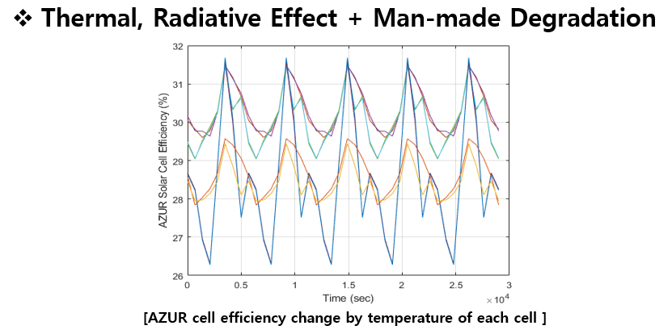
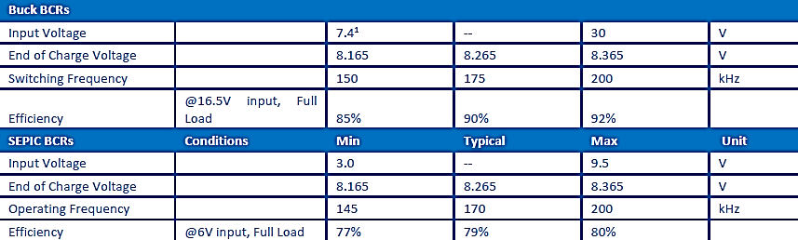
Efficiency
Efficiency of charging method
Eff_tmp (90%) : Efficiency for Charging due to Temperature of PV Cell
Eff_id (80%) : Efficiency for Charging due to Inherent Degradation
Eff_bcr (80%) : Conversion Efficiency for charging Battery
Eff_pcm (90%) : Conversion Efficiency for Regulation

Slide 2
0. Energy Balance : Detumbling mode
 | Mode | Unit
 | Detumbling
Total Power Consumption | 3.7670 | W
Generated Energy (Orbit average) | 3.1994 | Wh
Required Energy (Orbit average) | 5.9404 | Wh
Power Margin Value | -2.7410 | Wh
Power Margin | -46.1410 | %
Residual/Generation | -85.6702 | %
Charging Rate | -6.8524 | %

Slide 3
1. Energy Balance : Mission & UHF COM mode
 | Mode |  |  | Total | Unit
 | Stand-by(D) | Stand-by(N) | Mission & UHF
Total Power Consumption | 4.2768 | 2.8355 | 1.5113 | 8.6236 | W
Generated Energy (Orbit average) | 12.1482 |  |  | 12.1482 | Wh
Required Energy (Orbit average) | 6.7443 | 4.4714 | 2.3833 | 13.5989 | Wh
Power Margin Value | -1.4508 |  |  | -1.4508 | Wh
Power Margin | -10.6684 |  |  | -10.6684 | %
Residual/Generation | -11.9425 |  |  | -11.9425 | %
Charging Rate | -13.51 | -11.18 | -5.96 | -3.65 | %

Slide 4
2. Energy Balance : S-band COM mode(@Night)
 | Mode |  |  | Total | Unit
 | Stand-by(D) | Stand-by(N) | S-band
Total Power Consumption | 4.3883 | 1.8487 | 1.6284 | 7.8655 | W
Generated Energy (Orbit average) | 14.9307 |  |  | 14.9307 | Wh
Required Energy (Orbit average) | 6.9201 | 2.9154 | 2.5679 | 14.9307 | Wh
Power Margin Value | 2.5273 |  |  | 2.5273 | Wh
Power Margin | 20.3761 |  |  | 20.3761 | %
Residual/Generation | 16.927 |  |  | 16.927 | %
Charging Rate | 20.03 | -7.29 | -6.42 | 6.32 | %

Slide 5
3. Energy Balance : S-band COM mode(@Day)
 | Mode |  |  | Total | Unit
 | Stand-by(D) | Stand-by(N) | S-band
Total Power Consumption | 3.5705 | 2.7460 | 1.7938 | 8.1103 | W
Generated Energy (Orbit average) | 12.1482 |  |  | 12.1482 | Wh
Required Energy (Orbit average) | 5.6304 | 4.3303 | 2.8287 | 12.7895 | Wh
Power Margin Value | -0.6413 |  |  | -0.6413 | Wh
Power Margin | -5.0146 |  |  | -5.0146 | %
Residual/Generation | -5.2793 |  |  | -5.2793 | %
Charging Rate | 16.29 | -10.83 | -7.07 | -1.61 | %

Slide 6
4. Energy Balance : Standby mode
 | Mode |  | Total | Unit
 | Stand-by(D) | Stand-by(N)
Total Power Consumption | 4.6128 | 2.8703 | 7.4831 | W
Generated Energy (Orbit average) | 14.9307 |  | 14.9307 | Wh
Required Energy (Orbit average) | 7.2741 | 4.5263 | 11.8004 | Wh
Power Margin Value | 3.1303 |  | 3.1303 | Wh
Power Margin | 26.5274 |  | 26.5274 | %
Residual/Generation | 20.9657 |  | 20.9657 | %
Charging Rate | 19.14 | -11.32 | 7.82 | %

Slide 7
5. Energy Balance : Commissioning mode 1
 | Mode | Unit
 | Commissioning 1
Total Power Consumption | 4.1955 | W
Generated Energy (Orbit average) | 3.1994 | Wh
Required Energy (Orbit average) | 6.6161 | Wh
Power Margin Value | -3.4166 | Wh
Power Margin | -51.6414 | %
Residual/Generation | -106.7882 | %
Charging Rate | -8.54 | %

Slide 8
6. Energy Balance : Commissioning mode 2
 | Mode | Unit
 | Commissioning 2
Total Power Consumption | 8.2730 | W
Generated Energy (Orbit average) | 14.9307 | Wh
Required Energy (Orbit average) | 13.0461 | Wh
Power Margin Value | 1.8846 | Wh
Power Margin | 14.4460 | %
Residual/Generation | 12.6225 | %
Charging Rate | 4.71 | %

Slide 9
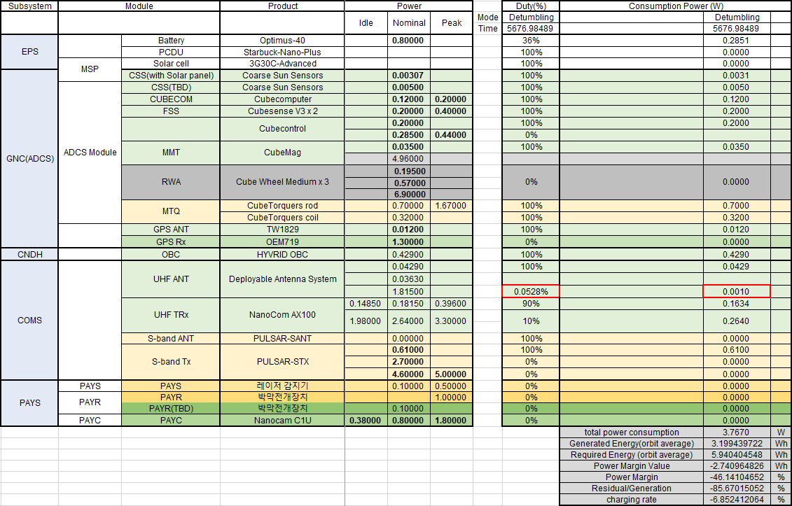
0. Power Budget : Detumbling mode

Slide 10
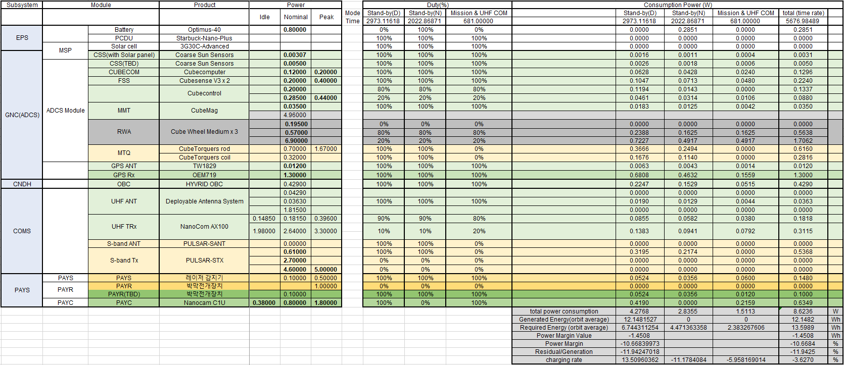
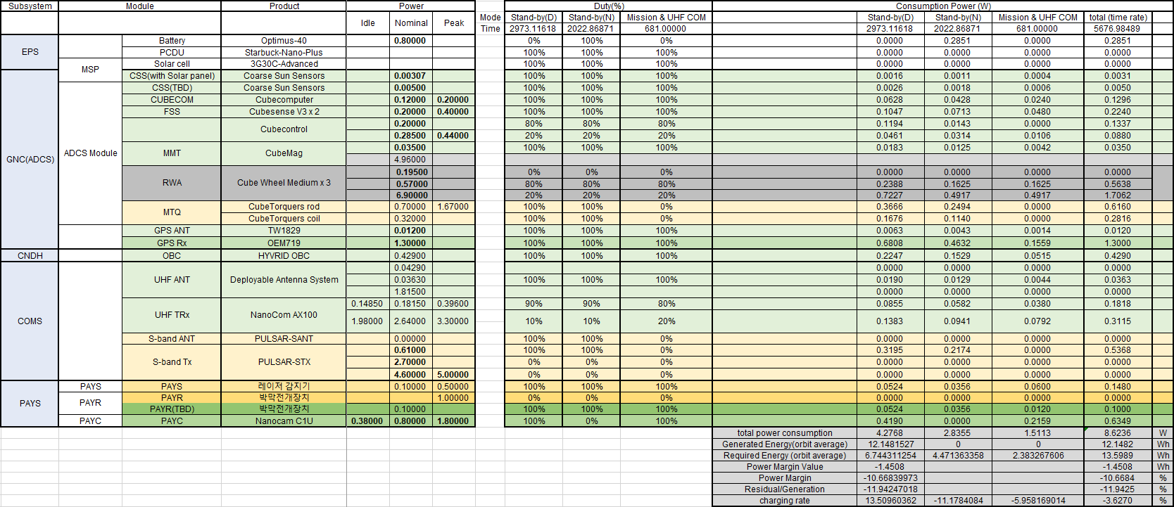
1. Power Budget : Mission & UHF COM mode

Slide 11
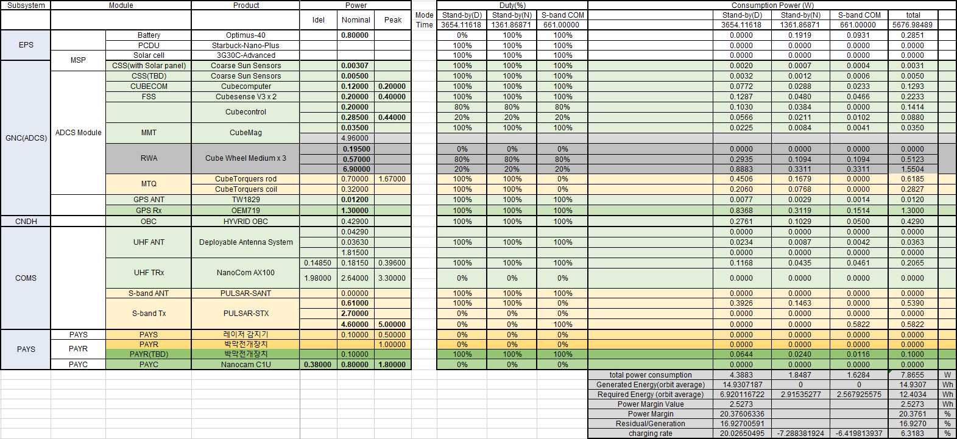
2. Power Budget : S-band COM mode(@Night)

Slide 12
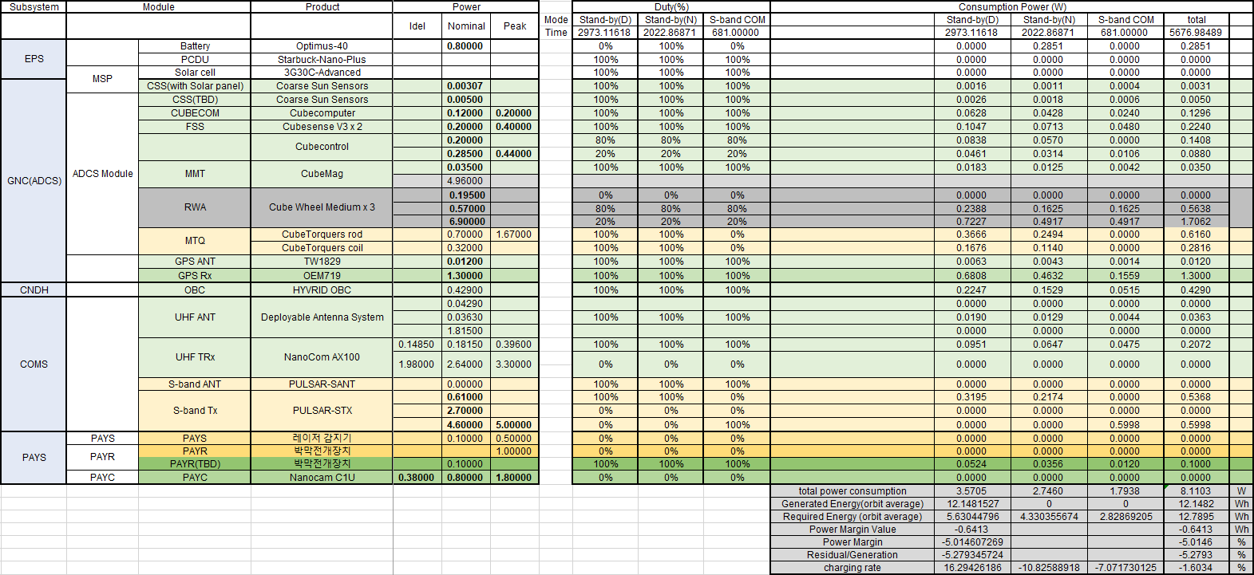
3. Power Budget : S-band COM mode(@Day)

Slide 13
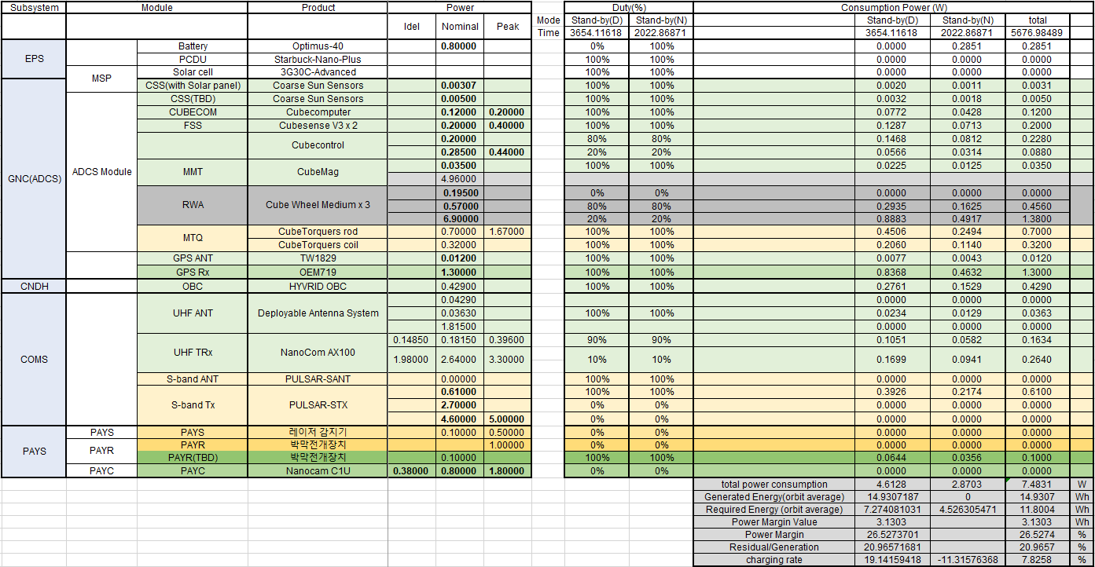
4. Power Budget : Stand-by mode

Slide 14
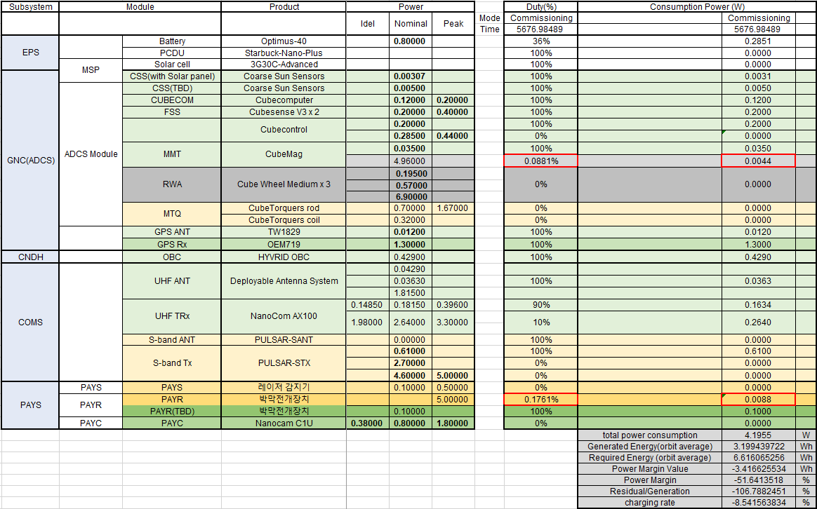
5. Power Budget : Commissioning mode 1

Slide 15
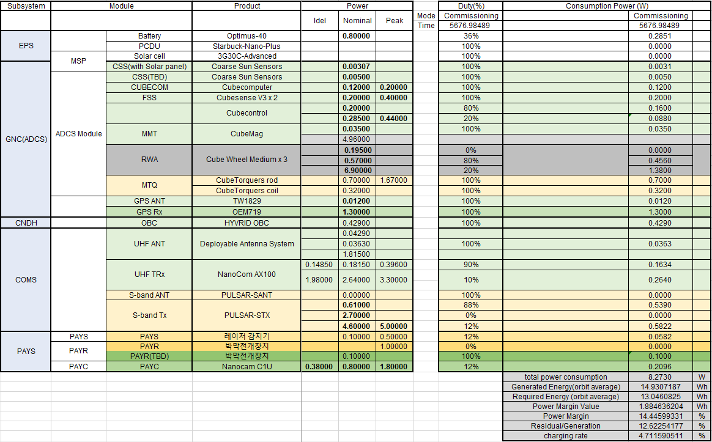
6. Power Budget : Commissioning mode 2

Slide 16
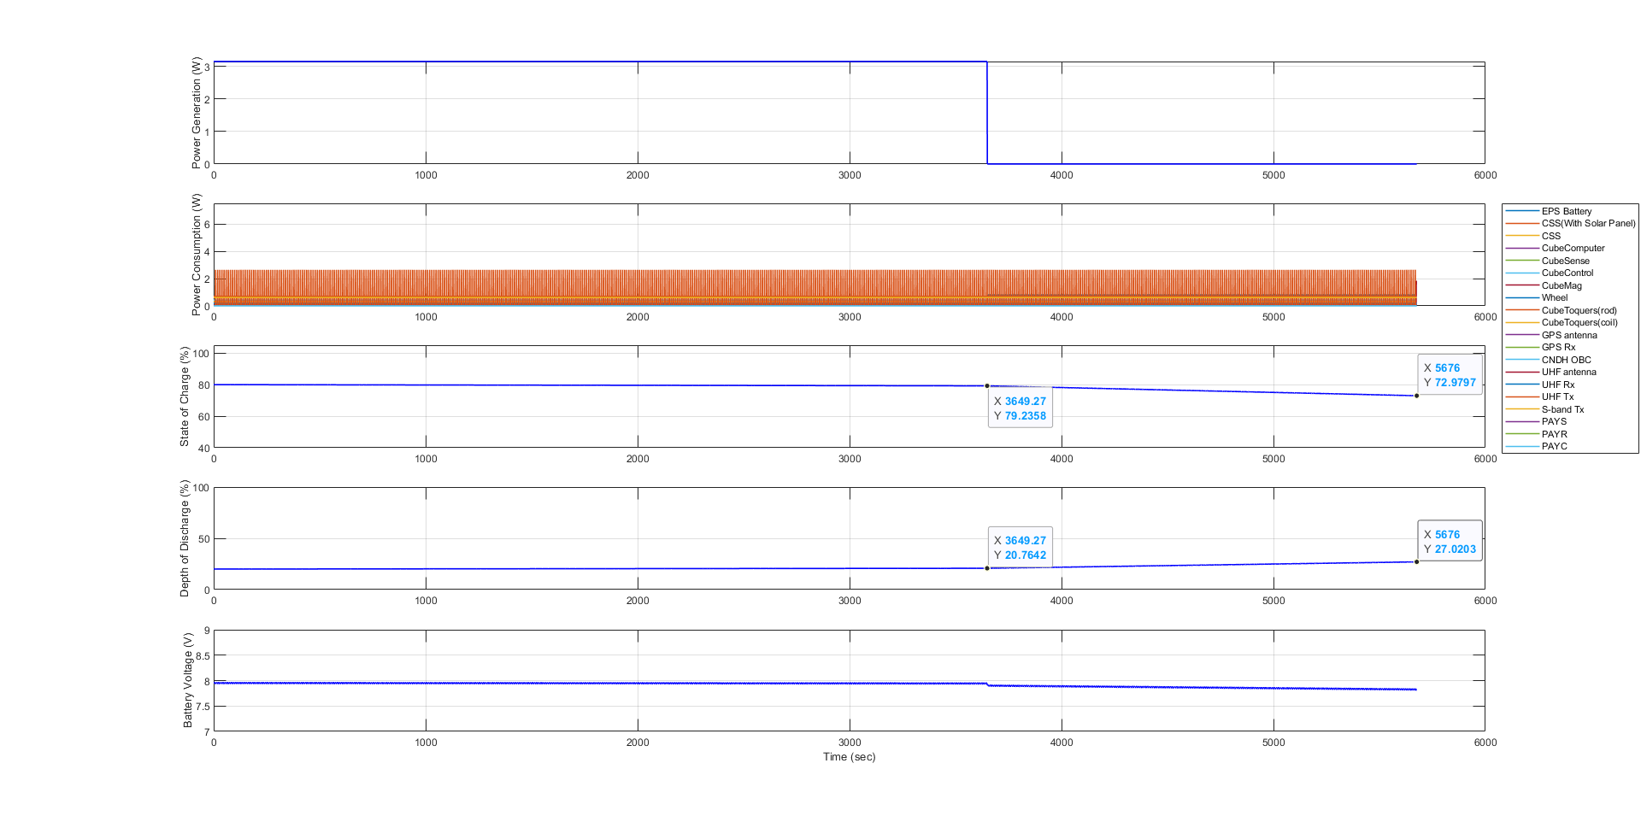
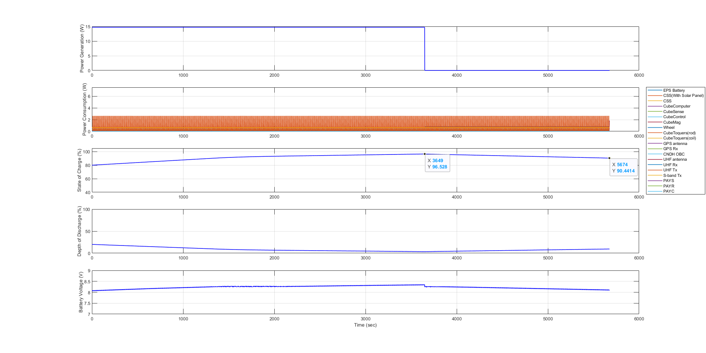
0. Simulink Plot Result : Detumbling mode

Slide 17
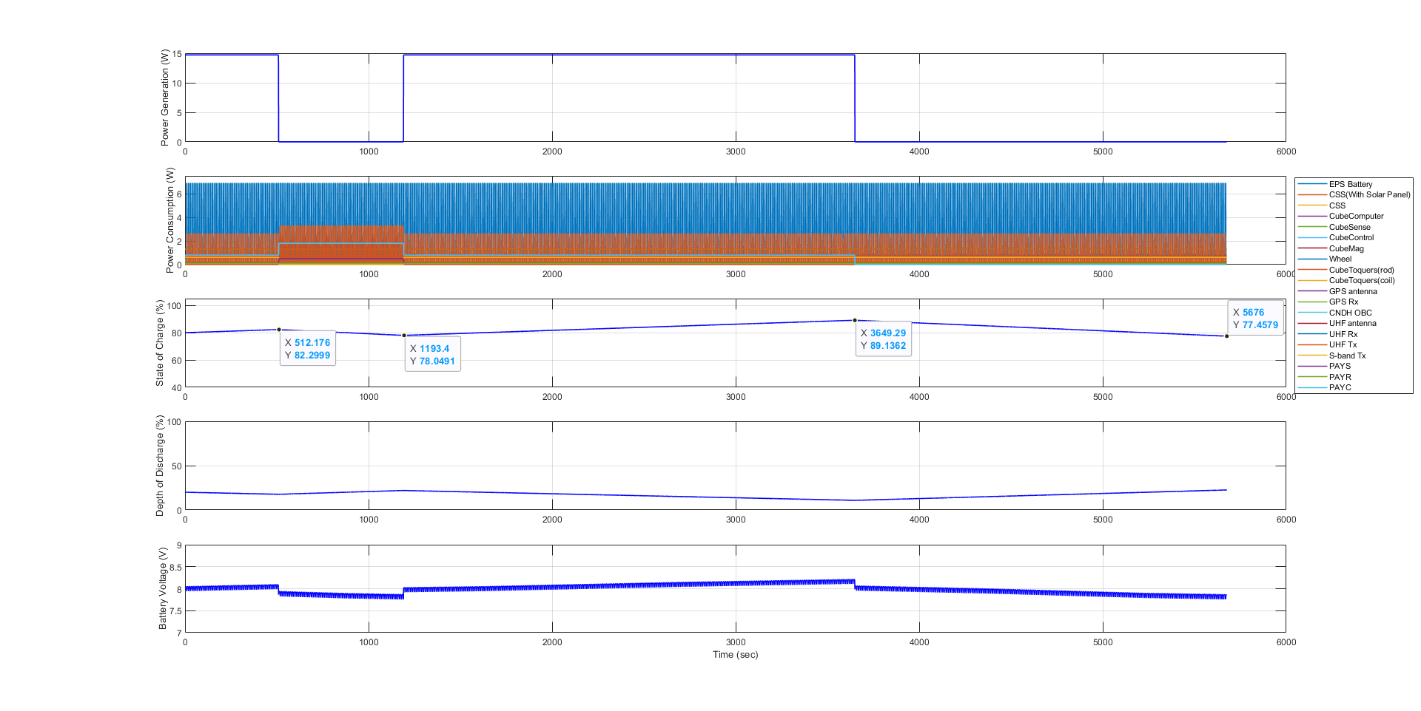
1. Simulink Plot Result : Mission & UHF COM mode

Slide 18
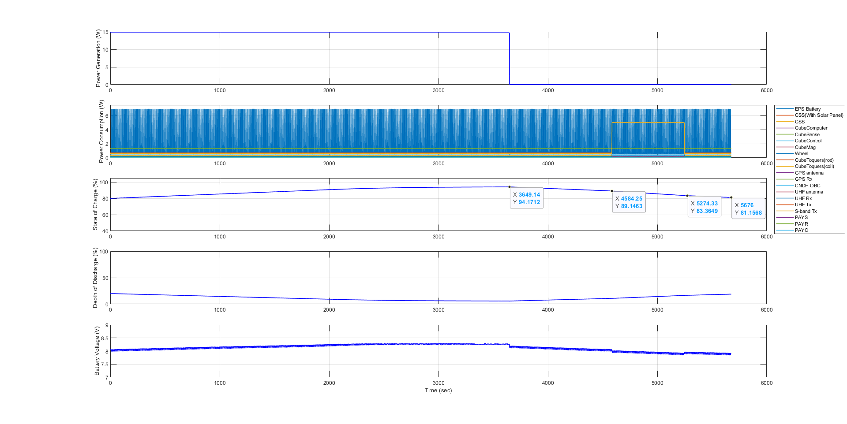
2. Simulink Plot Result : S-band COM mode(@Night)

Slide 19
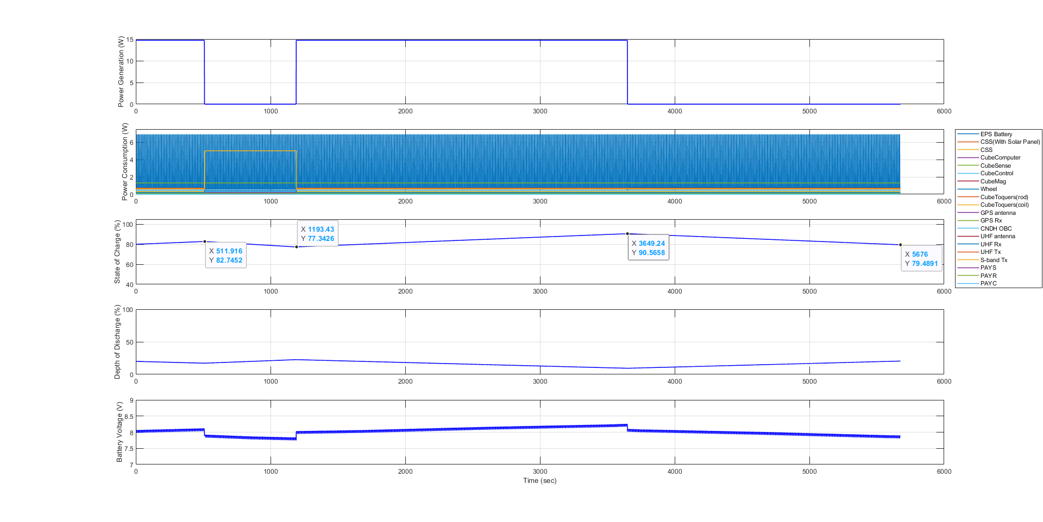
3. Simulink Plot Result : S-band COM mode(@Day)

Slide 20
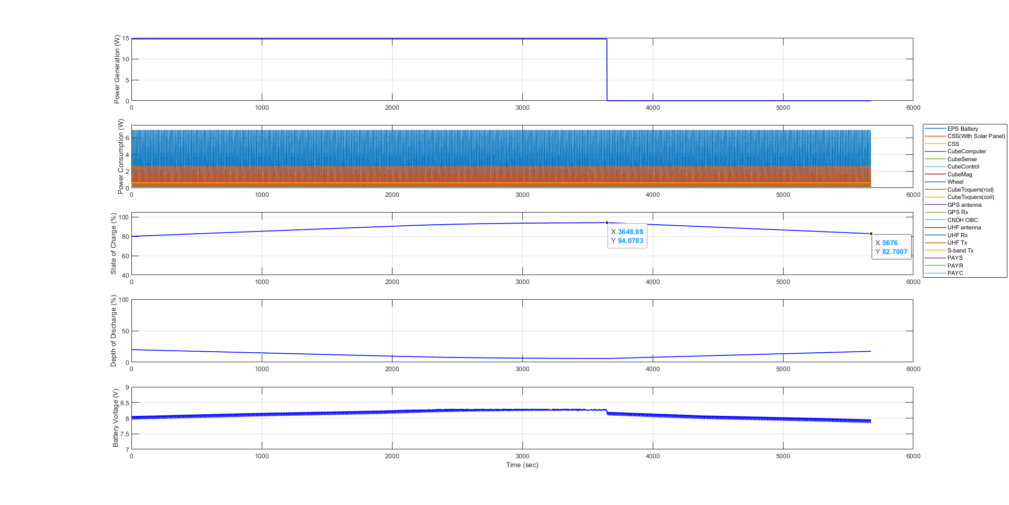
4. Simulink Plot Result : Stand-by mode

Slide 21
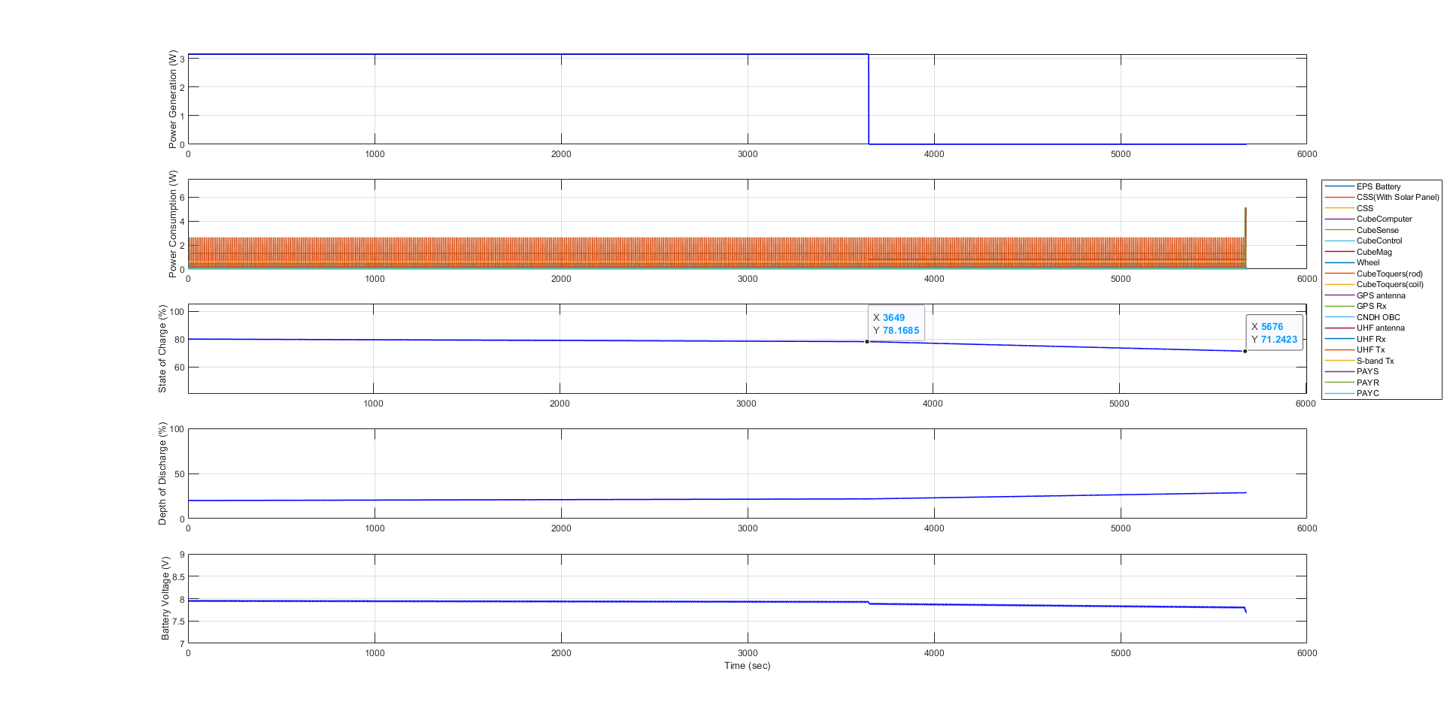
5. Simulink Plot Result : Commissioning mode 1

Slide 22
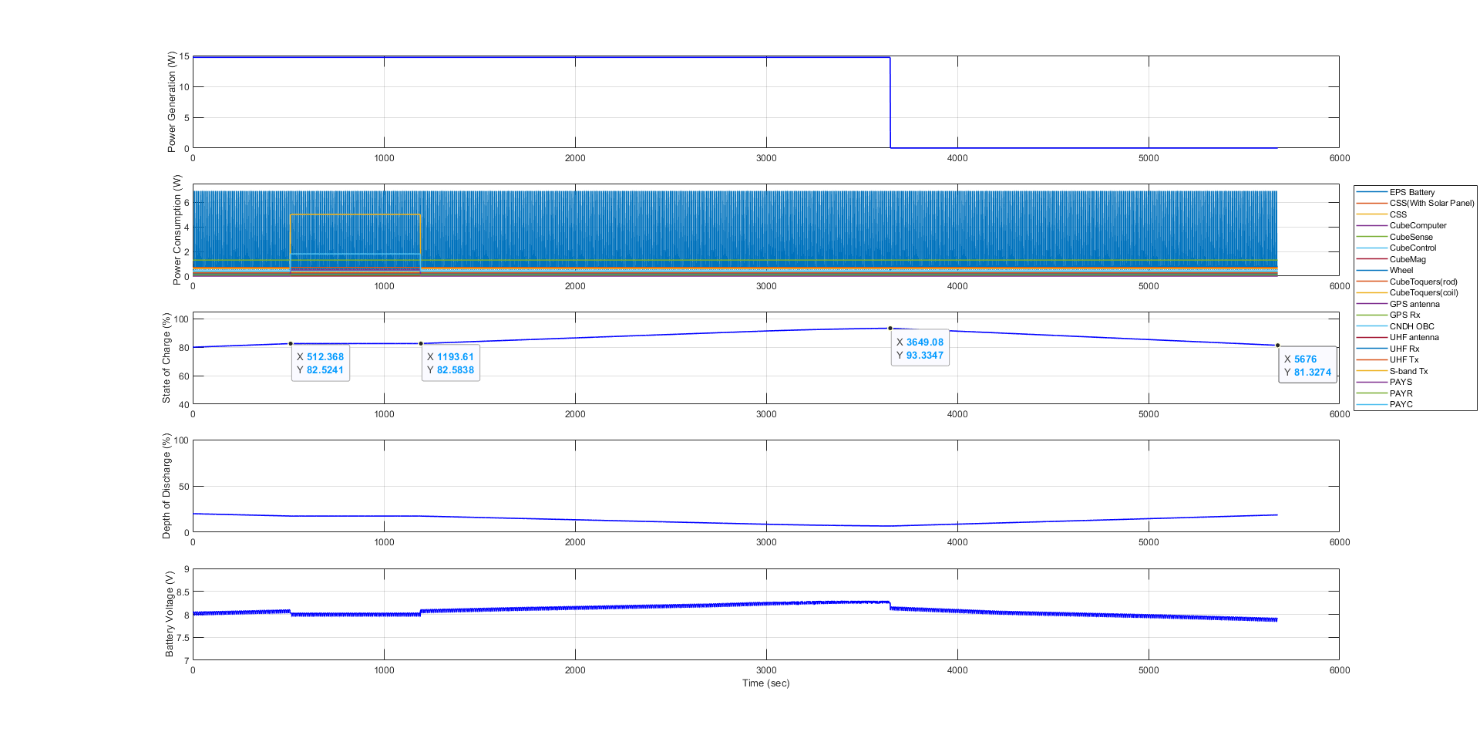
6. Simulink Plot Result : Commissioning mode 2

Slide 23
Simulink Data result
Product | Mode |  |  |  | Total |  |  | Unit
 | EO | Commissioning 1 | Commissioning 2 | Mission & UHF Com | S-band Com (@Night) | S-band Com (@Day) | Stand-by
Total Power Consumption | 3.7670 | 4.1955 | 8.2730 | 8.6236 | 7.8655 | 8.1103 | 7.4831 | W
Generated Energy (Orbit average) | 3.1994 | 3.1994 | 14.9307 | 12.1482 | 14.9307 | 12.1482 | 14.9307 | Wh
Required Energy (Orbit average) | 5.9404 | 6.6161 | 13.0461 | 13.5989 | 14.9307 | 12.7895 | 11.8004 | Wh
Power Margin Value | -2.7410 | -3.4166 | 1.8846 | -1.4508 | 2.5273 | -0.6413 | 3.1303 | Wh
Power Margin | -46.1410 | -51.6414 | 14.4460 | -10.6684 | 20.3761 | -5.0146 | 26.5274 | %
Residual/Generation | -85.6702 | -106.7882 | 12.6225 | -11.9425 | 16.927 | -5.2793 | 20.9657 | %
Charging Rate | -6.85 | -8.54 | 4.71 | -3.65 | 6.32 | -1.61 | 7.82 | %
End SOC | 72.98 (-7.02%) | 71.24 (-8.76%) | 81.33 (+1.33%) | 77.46 (-2.54%) | 81.16 (+1.16%) | 79.49 (-0.51%) | 82.70 (+2.70%) | %
Notes:
모든 모드의 parameter를 기록하였습니다.

Slide 24
Simulink Data result (alpha*1.0)
 | Start | 1 | 2 | 3 | 4 | 5 | 6 | 7 | 8 | 9 | 10 | 11 | 12 | 13 | 14 | End
EO | 80 | 73.15 | 66.3 | 59.45 | 52.6 | 45.75 | 38.9 | 32.05 | 25.2 | 18.35 | 11.5 | 4.65
Com1 | 80 | 71.46 | 62.92 | 54.38 | 45.84 | 37.3 | 28.76 | 20.22 | 11.86 | 3.14
Com2 | 80 | 84.71 | 89.42 | 94.13 | 98.84
Stand-by | 80 | 87.82 |  | 91.99 | 99.81 | 100 | 100 | 100 |  | 100 | 100 | 100 | 100 | 100 | 100 | 100
Mission |  |  | 84.17
S-band Com |  |  |  |  |  |  |  |  | 100
Notes:
Power Budget Excel 기준으로 한 주기동안 처음(80%)보다 얼마나 감소하였는지를 매 주기마다 적용한 표입니다.

Slide 25
Simulink Data result (alpha*0.9)
 | Start | 1 | 2 | 3 | 4 | 5 | 6 | 7 | 8 | 9 | 10 | 11 | 12 | 13 | 14 | End
EO | 80 | 72.94 | 65.88 | 58.82 | 51.76 | 44.7 | 37.64 | 30.58 | 23.52 | 16.46 | 9.40 | 2.34
Com1 | 80 | 71.25 | 62.50 | 53.75 | 45 | 36.25 | 27.5 | 18.75 | 10 | 1.25
Com2 | 80 | 83.91 | 87.82 | 91.73 | 95.64 | 99.55
Stand-by | 80 | 87.02 |  | 89.56 | 96.58 | 100 | 100 | 100 |  | 100 | 100 | 100 | 100 | 100 | 100 | 100
Mission |  |  | 82.54
S-band Com |  |  |  |  |  |  |  |  | 100
Notes:
Power Budget Excel 기준으로 한 주기동안 처음(80%)보다 얼마나 감소하였는지를 매 주기마다 적용한 표입니다.

Slide 26
Simulink Data result (alpha*0.8)
 | Start | 1 | 2 | 3 | 4 | 5 | 6 | 7 | 8 | 9 | 10 | 11 | 12 | 13 | 14 | End
EO | 80 | 72.75 | 65.5 | 58.25 | 51 | 43.75 | 36.5 | 29.25 | 22 | 14.75 | 7.5 | 0.25
Com1 | 80 | 71.06 | 62.12 | 53.18 | 44.24 | 35.3 | 26.36 | 17.42 | 8.48
Com2 | 80 | 83.16 | 86.32 | 89.48 | 92.64 | 95.8 | 98.96
Stand-by | 80 | 86.28 |  | 87.85 | 94.13 | 100 | 100 | 100 |  | 100 | 100 | 100 | 100 | 100 | 100 | 100
Mission |  |  | 81.57
S-band Com |  |  |  |  |  |  |  |  | 100
Notes:
Power Budget Excel 기준으로 한 주기동안 처음(80%)보다 얼마나 감소하였는지를 매 주기마다 적용한 표입니다.

Slide 27
Simulink Data result (alpha*0.5)
 | Start | 1 | 2 | 3 | 4 | 5 | 6 | 7 | 8 | 9 | 10 | 11 | 12 | 13 | 14 | End
EO
Com1
Com2
Stand-by
Mission
S-band Com
Notes:
Power Budget Excel 기준으로 한 주기동안 처음(80%)보다 얼마나 감소하였는지를 매 주기마다 적용한 표입니다.

