Slide 1
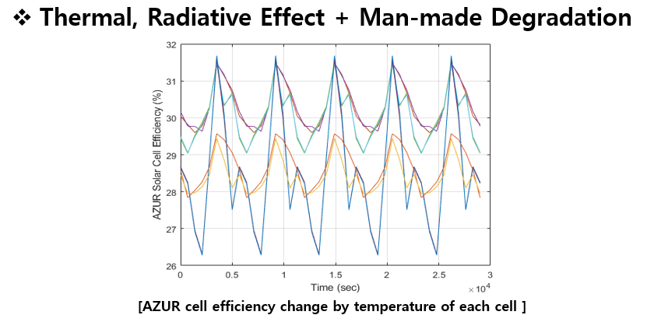
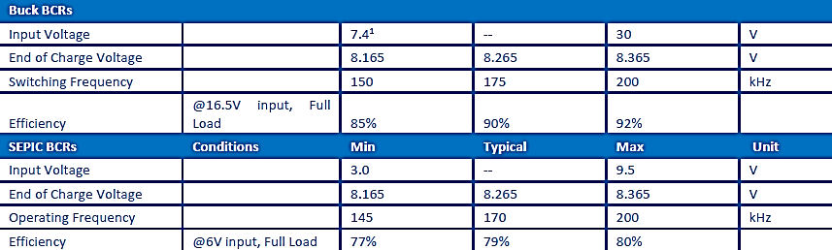
Efficiency
Efficiency of charging method
Eff_tmp (90%) : Efficiency for Charging due to Temperature of PV Cell
Eff_id (80%) : Efficiency for Charging due to Inherent Degradation
Eff_bcr (80%) : Conversion Efficiency for charging Battery
Eff_pcm (90%) : Conversion Efficiency for Regulation

Slide 2
0. Energy Balance : Detumbling mode
 | Mode | Unit
 | Detumbling
Total Power Consumption | 3.7670 | W
Generated Energy (Orbit average) | 3.1994 | Wh
Required Energy (Orbit average) | 5.9404 | Wh
Power Margin Value | -2.7410 | Wh
Power Margin | -46.1410 | %
Residual/Generation | -85.6702 | %
Charging Rate | -6.8524 | %

Slide 3
1. Energy Balance : Mission & UHF COM mode
 | Mode |  |  | Total | Unit
 | Stand-by(D) | Stand-by(N) | Mission & UHF
Total Power Consumption | 4.2768 | 2.8355 | 1.5113 | 8.6236 | W
Generated Energy (Orbit average) | 12.1482 |  |  | 12.1482 | Wh
Required Energy (Orbit average) | 6.7443 | 4.4714 | 2.3833 | 13.5989 | Wh
Power Margin Value | -1.4508 |  |  | -1.4508 | Wh
Power Margin | -10.6684 |  |  | -10.6684 | %
Residual/Generation | -11.9425 |  |  | -11.9425 | %
Charging Rate | -13.51 | -11.18 | -5.96 | -3.65 | %

Slide 4
2. Energy Balance : S-band COM mode(@Night)
 | Mode |  |  | Total | Unit
 | Stand-by(D) | Stand-by(N) | S-band
Total Power Consumption | 4.3883 | 1.8487 | 1.6284 | 7.8655 | W
Generated Energy (Orbit average) | 14.9307 |  |  | 14.9307 | Wh
Required Energy (Orbit average) | 6.9201 | 2.9154 | 2.5679 | 14.9307 | Wh
Power Margin Value | 2.5273 |  |  | 2.5273 | Wh
Power Margin | 20.3761 |  |  | 20.3761 | %
Residual/Generation | 16.927 |  |  | 16.927 | %
Charging Rate | 20.03 | -7.29 | -6.42 | 6.32 | %

Slide 5
3. Energy Balance : S-band COM mode(@Day)
 | Mode |  |  | Total | Unit
 | Stand-by(D) | Stand-by(N) | S-band
Total Power Consumption | 3.5705 | 2.7460 | 1.7938 | 8.1103 | W
Generated Energy (Orbit average) | 12.1482 |  |  | 12.1482 | Wh
Required Energy (Orbit average) | 5.6304 | 4.3303 | 2.8287 | 12.7895 | Wh
Power Margin Value | -0.6413 |  |  | -0.6413 | Wh
Power Margin | -5.0146 |  |  | -5.0146 | %
Residual/Generation | -5.2793 |  |  | -5.2793 | %
Charging Rate | 16.29 | -10.83 | -7.07 | -1.61 | %

Slide 6
4. Energy Balance : Standby mode
 | Mode |  | Total | Unit
 | Stand-by(D) | Stand-by(N)
Total Power Consumption | 4.6128 | 2.8703 | 7.4831 | W
Generated Energy (Orbit average) | 14.9307 |  | 14.9307 | Wh
Required Energy (Orbit average) | 7.2741 | 4.5263 | 11.8004 | Wh
Power Margin Value | 3.1303 |  | 3.1303 | Wh
Power Margin | 26.5274 |  | 26.5274 | %
Residual/Generation | 20.9657 |  | 20.9657 | %
Charging Rate | 19.14 | -11.32 | 7.82 | %

Slide 7
5. Energy Balance : Commissioning mode 1
 | Mode | Unit
 | Commissioning 1
Total Power Consumption | 4.1955 | W
Generated Energy (Orbit average) | 3.1994 | Wh
Required Energy (Orbit average) | 6.6161 | Wh
Power Margin Value | -3.4166 | Wh
Power Margin | -51.6414 | %
Residual/Generation | -106.7882 | %
Charging Rate | -8.54 | %

Slide 8
6. Energy Balance : Commissioning mode 2
 | Mode | Unit
 | Commissioning 2
Total Power Consumption | 8.2730 | W
Generated Energy (Orbit average) | 14.9307 | Wh
Required Energy (Orbit average) | 13.0461 | Wh
Power Margin Value | 1.8846 | Wh
Power Margin | 14.4460 | %
Residual/Generation | 12.6225 | %
Charging Rate | 4.71 | %

Slide 9
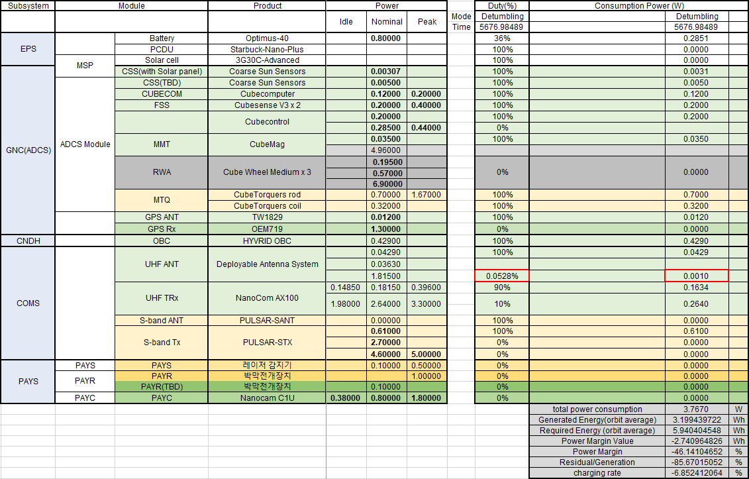
0. Power Budget : Detumbling mode

Slide 10
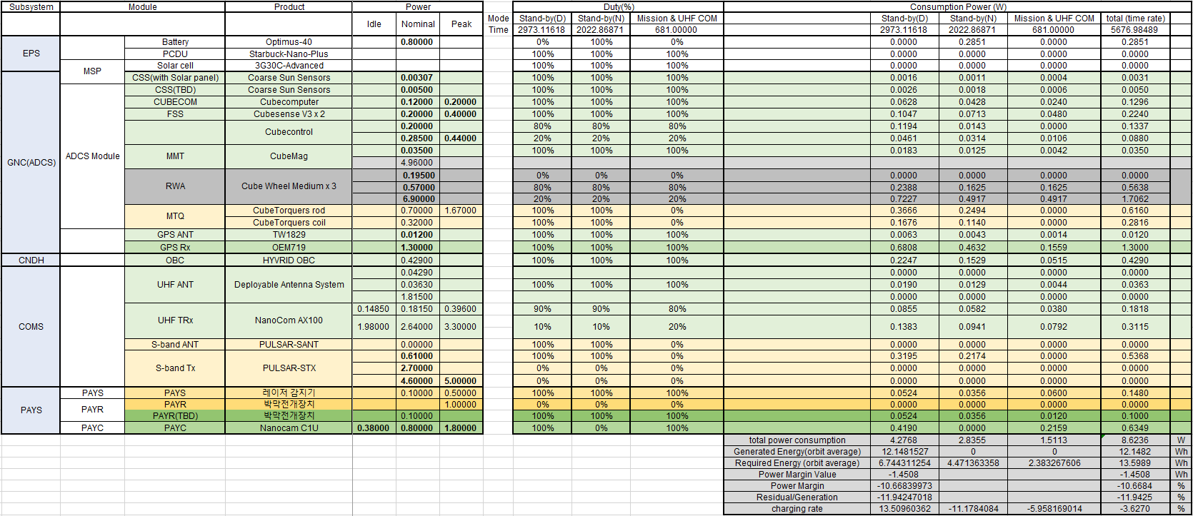
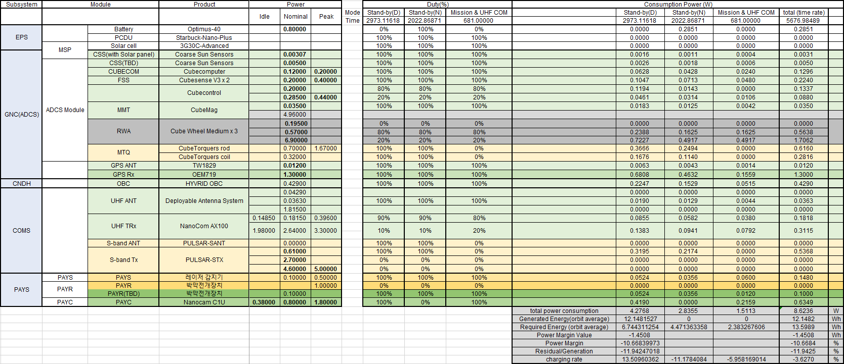
1. Power Budget : Mission & UHF COM mode

Slide 11
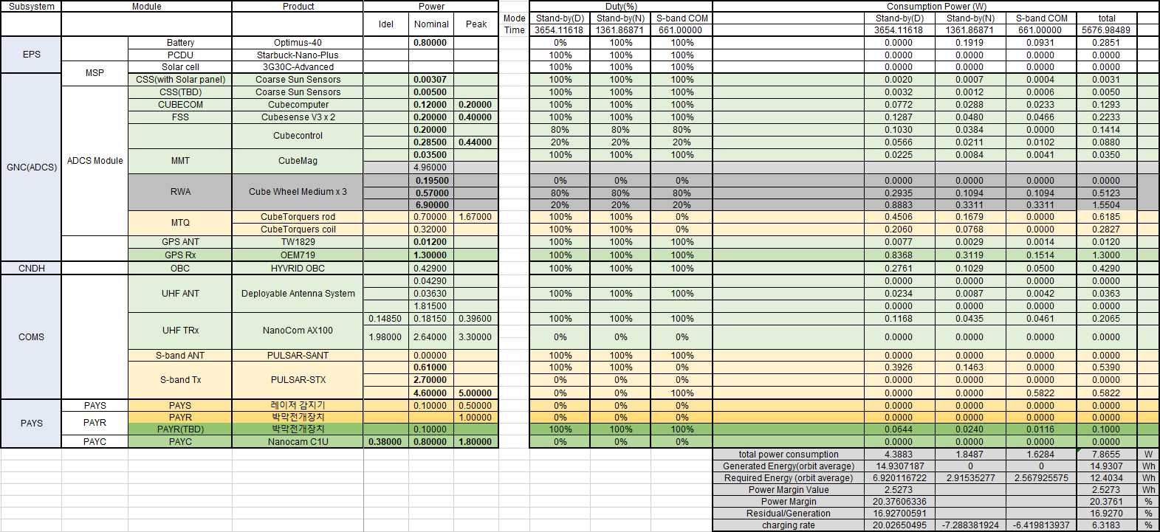
2. Power Budget : S-band COM mode(@Night)

Slide 12
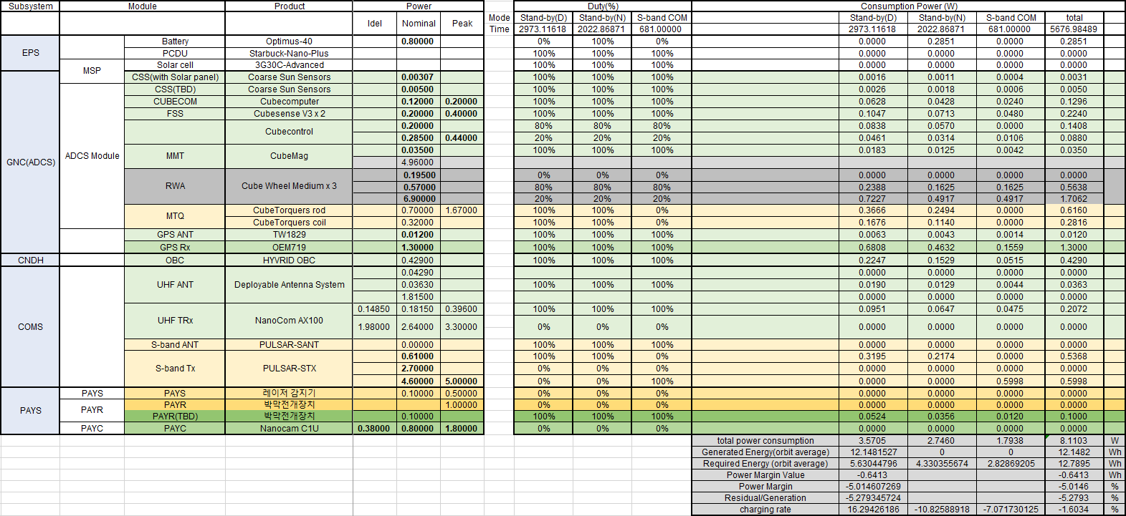
3. Power Budget : S-band COM mode(@Day)

Slide 13
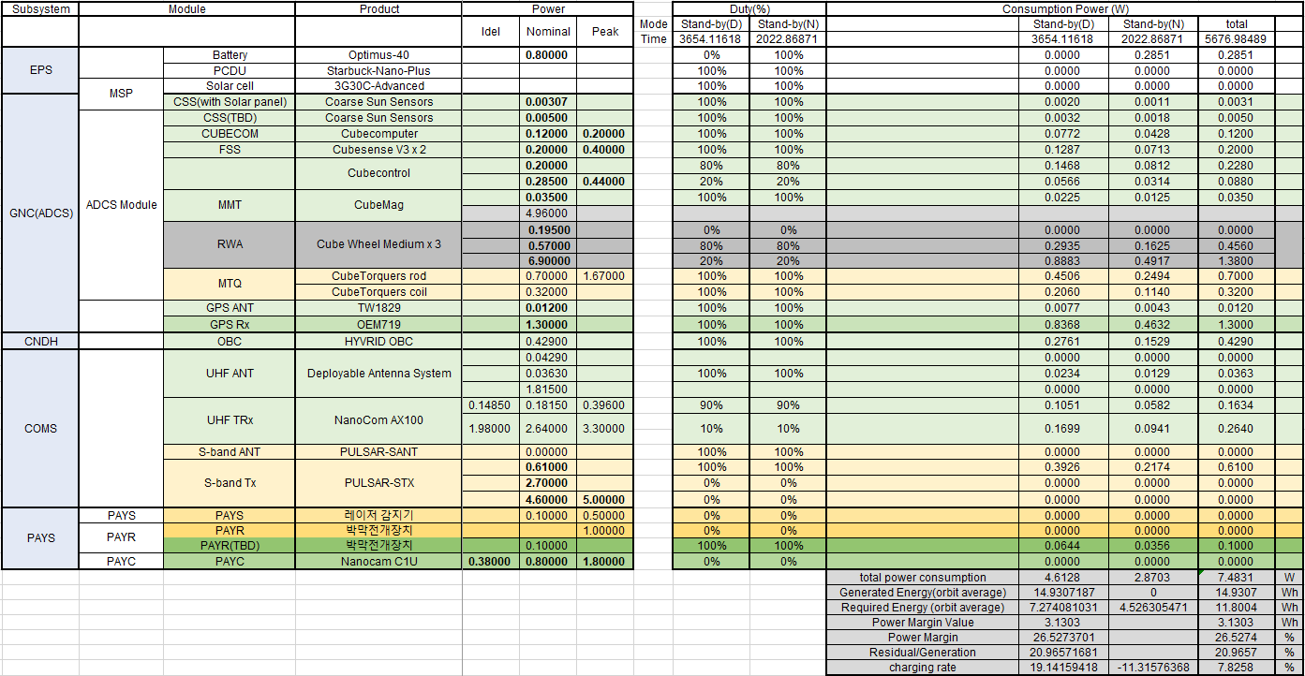
4. Power Budget : Stand-by mode

Slide 14
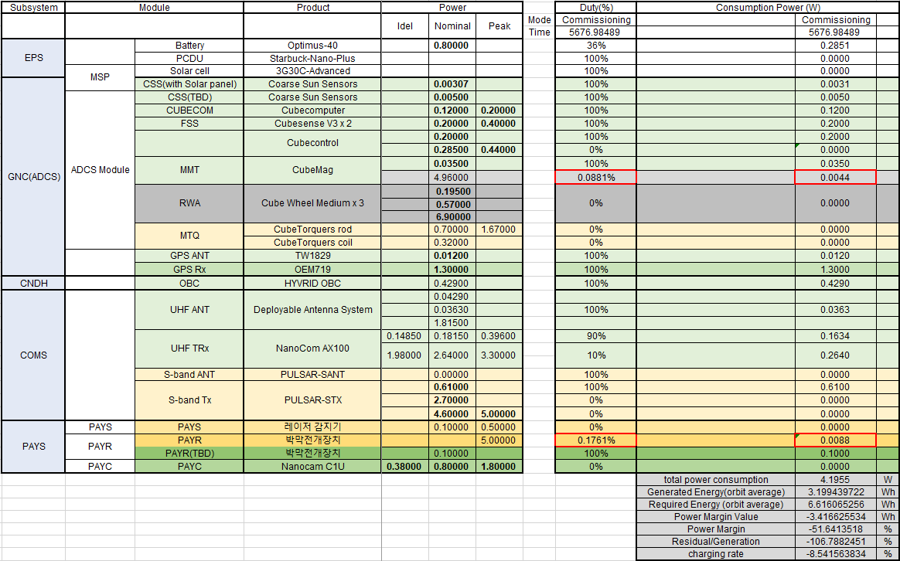
5. Power Budget : Commissioning mode 1

Slide 15
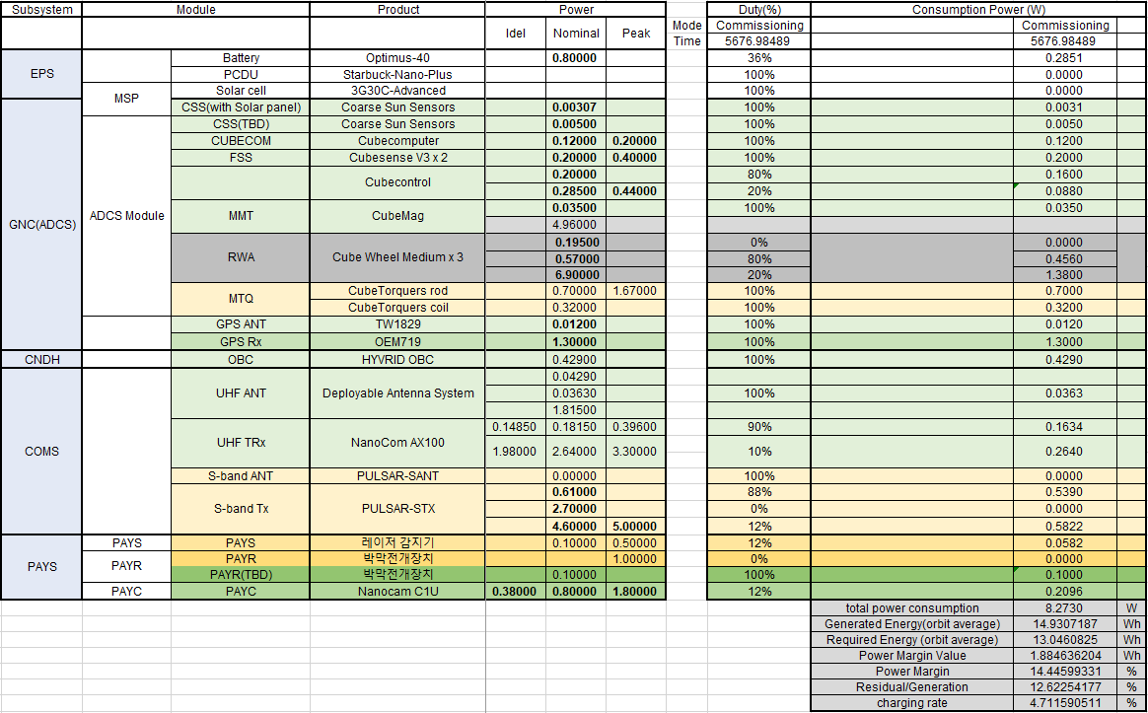
6. Power Budget : Commissioning mode 2

Slide 16
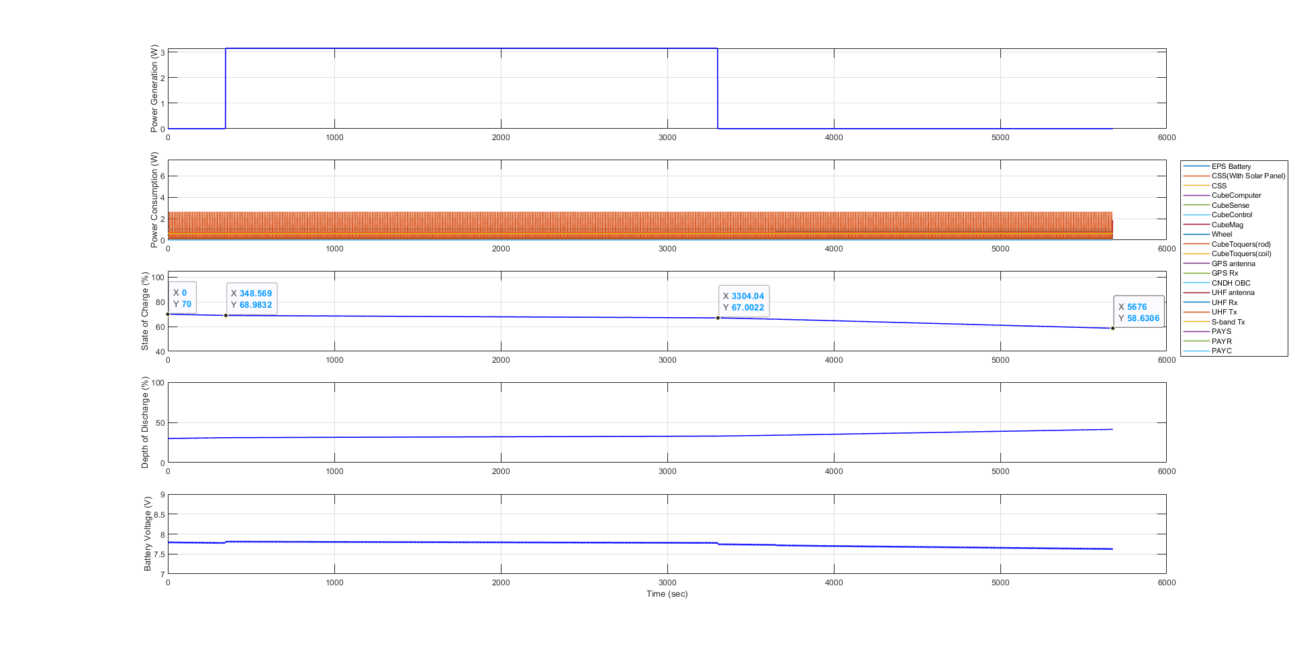
0. Simulink Plot Result : EO mode
alpha*0 (태양지향 시간을 약 5분 47초씩 감소시켰을 때)

Slide 17
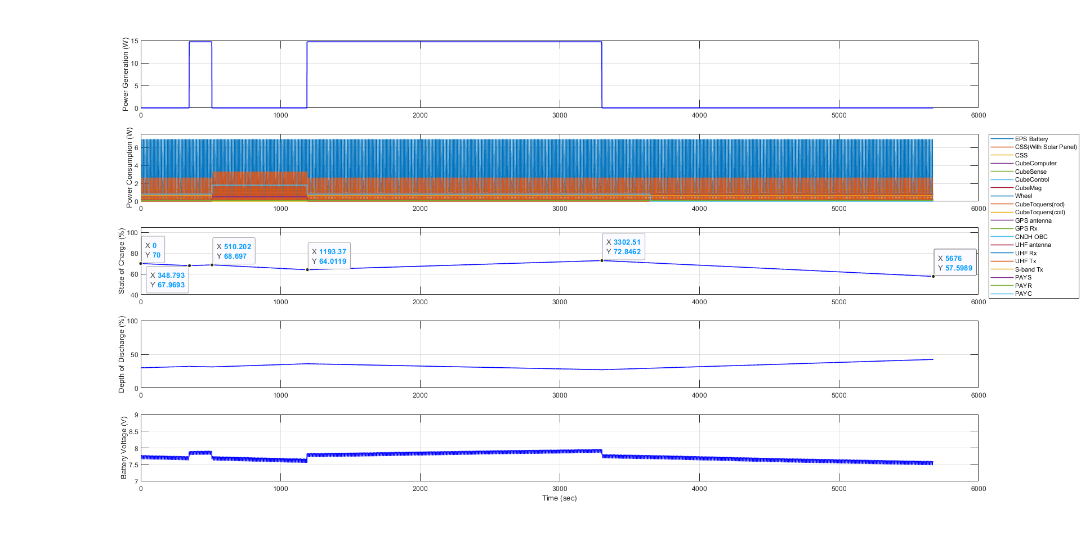
1. Simulink Plot Result : Mission & UHF COM mode
alpha*0 (태양지향 시간을 약 5분 47초씩 감소시켰을 때)

Slide 18
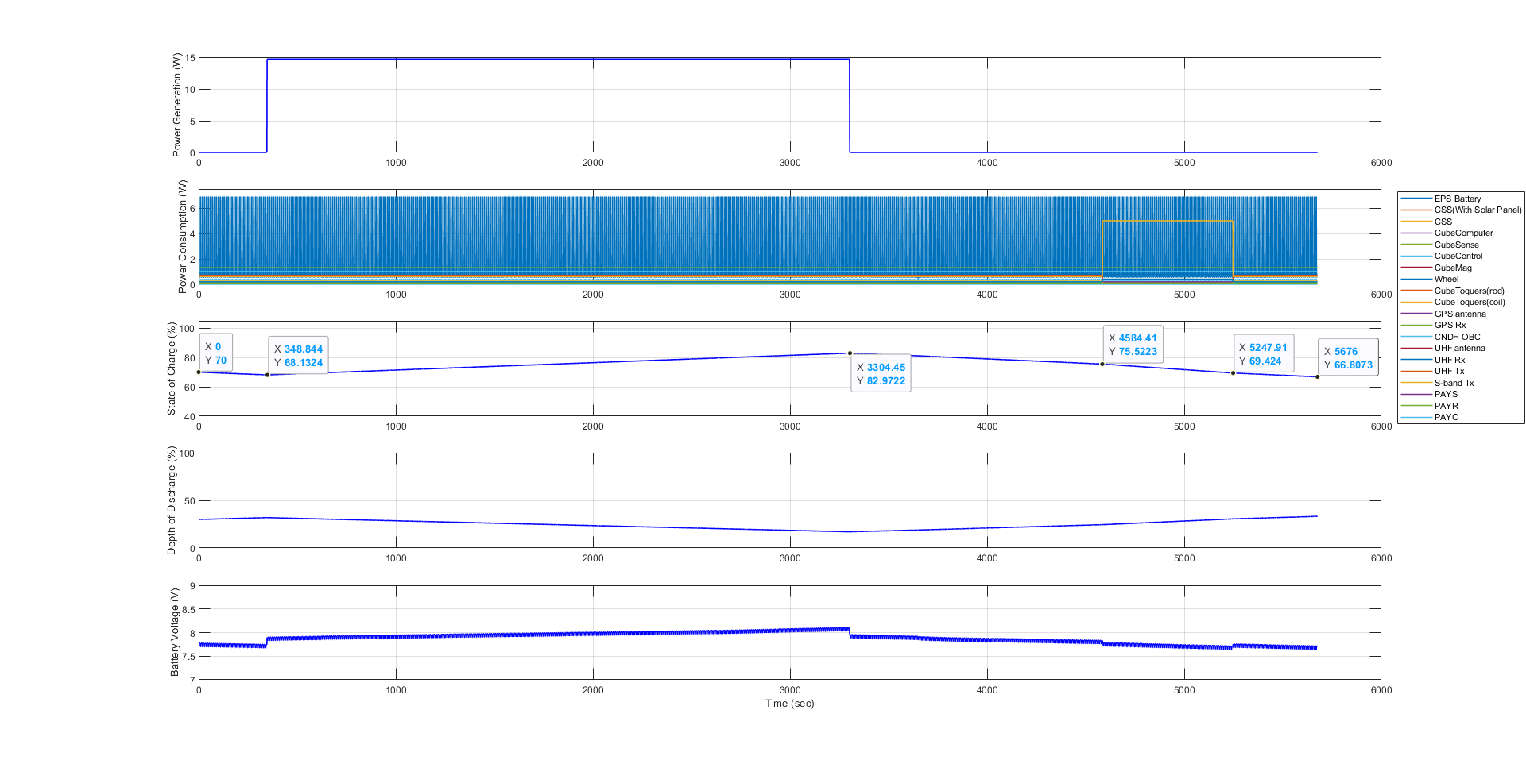
2. Simulink Plot Result : S-band COM mode(@Night)
alpha*0 (태양지향 시간을 약 5분 47초씩 감소시켰을 때)

Slide 19
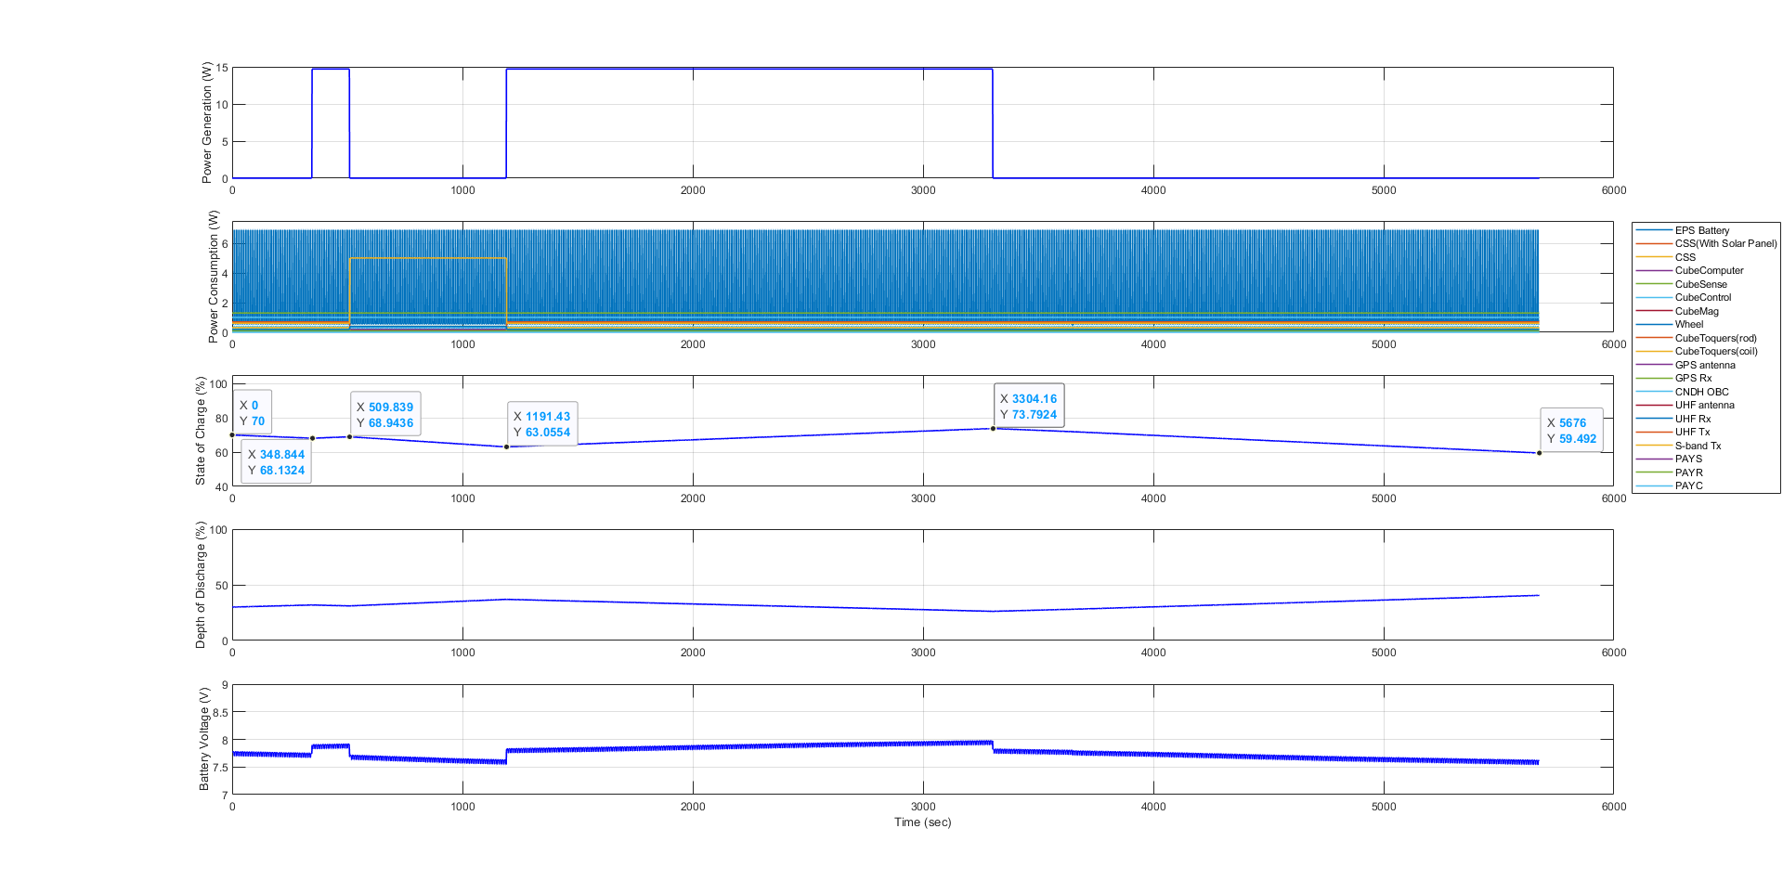
3. Simulink Plot Result : S-band COM mode(@Day)
alpha*0 (태양지향 시간을 약 5분 47초씩 감소시켰을 때)

Slide 20
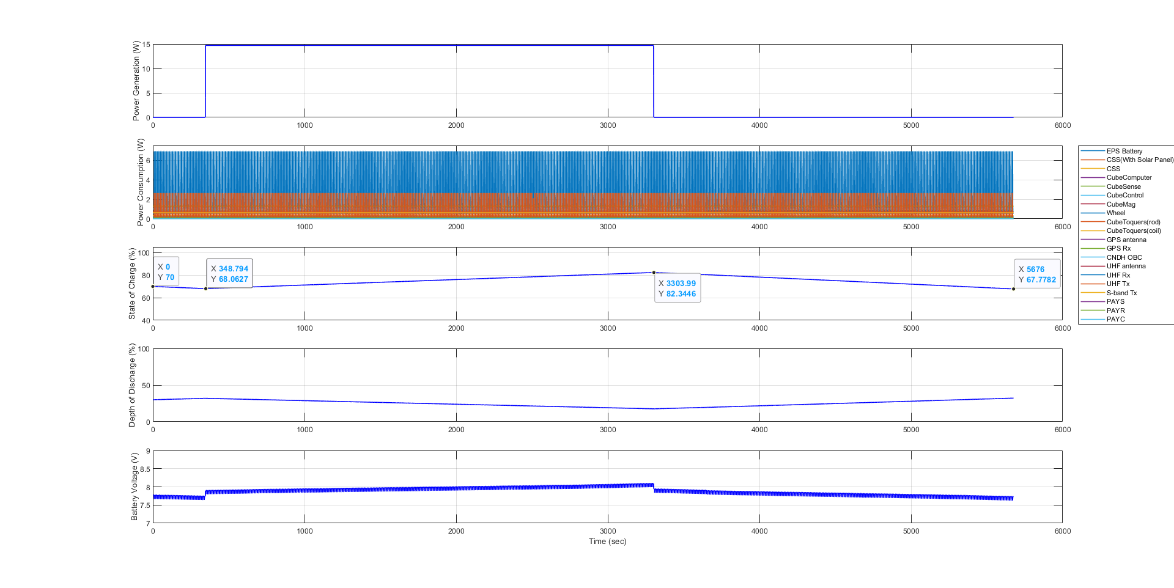
4. Simulink Plot Result : Stand-by mode
alpha*0 (태양지향 시간을 약 5분 47초씩 감소시켰을 때)

Slide 21
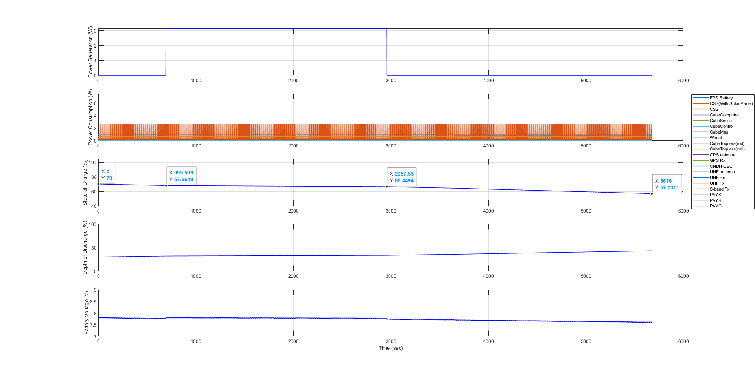
0. Simulink Plot Result : EO mode
alpha*(-1) (태양지향 시간을 약 11분 33초씩 감소시켰을 때)

Slide 22
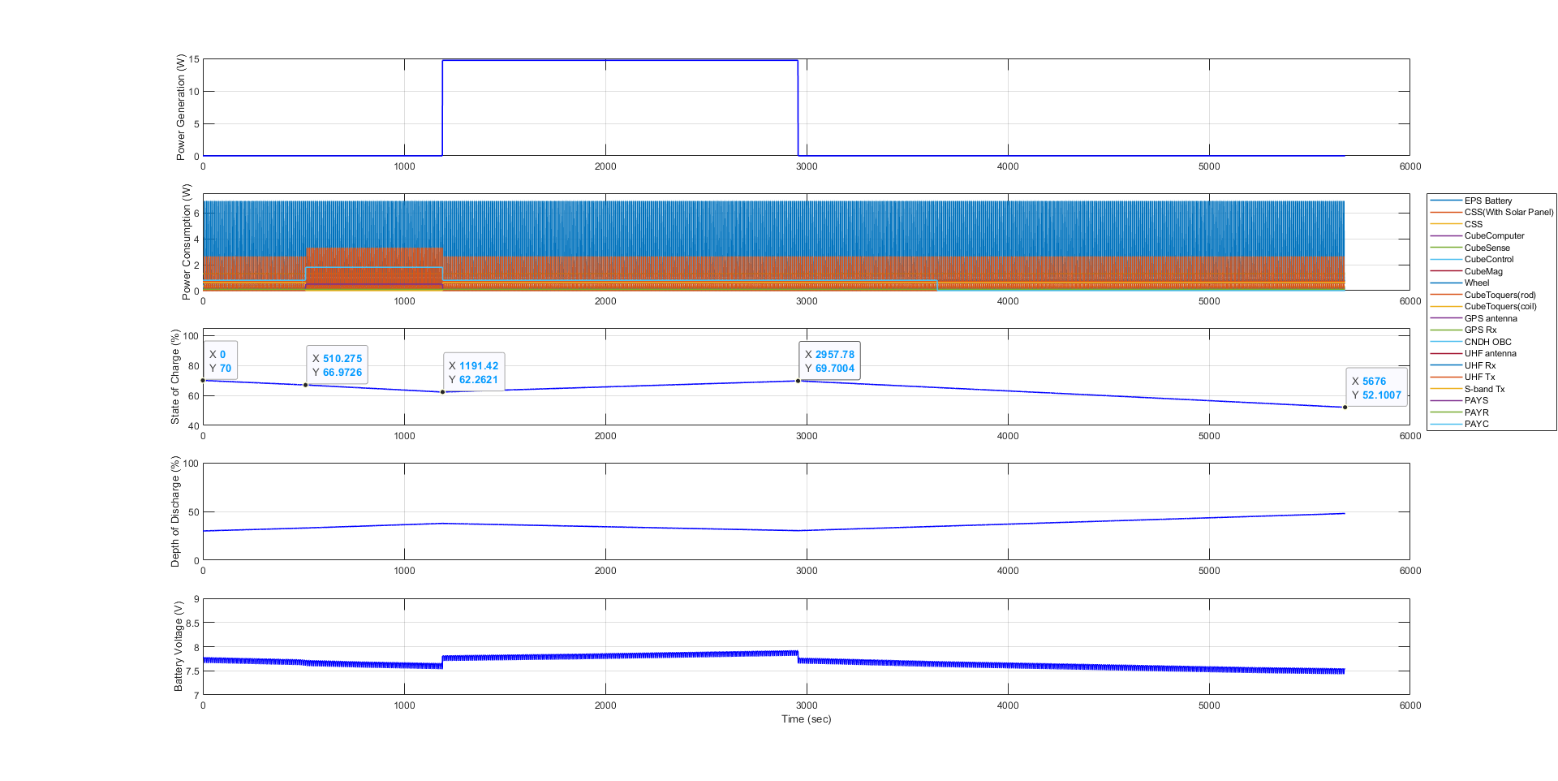
1. Simulink Plot Result : Mission & UHF COM mode
alpha*(-1) (태양지향 시간을 약 11분 33초씩 감소시켰을 때)

Slide 23
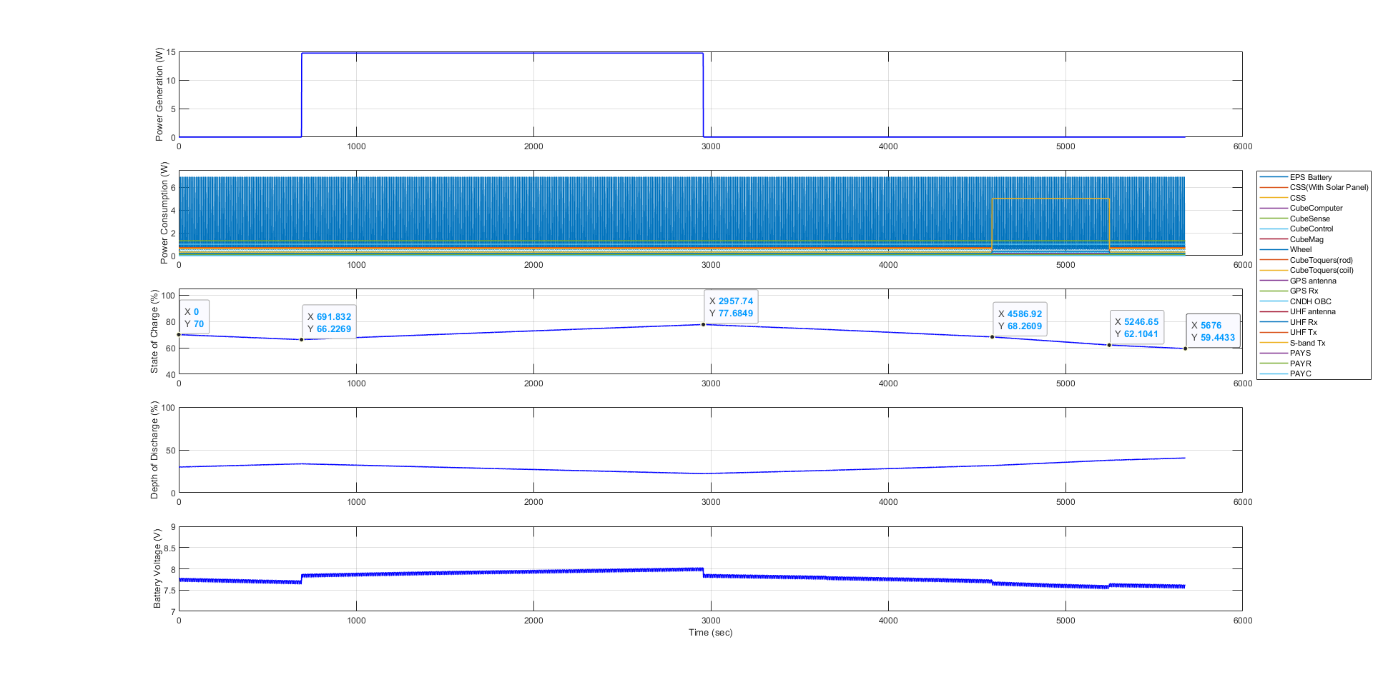
2. Simulink Plot Result : S-band COM mode(@Night)
alpha*(-1) (태양지향 시간을 약 11분 33초씩 감소시켰을 때)

Slide 24
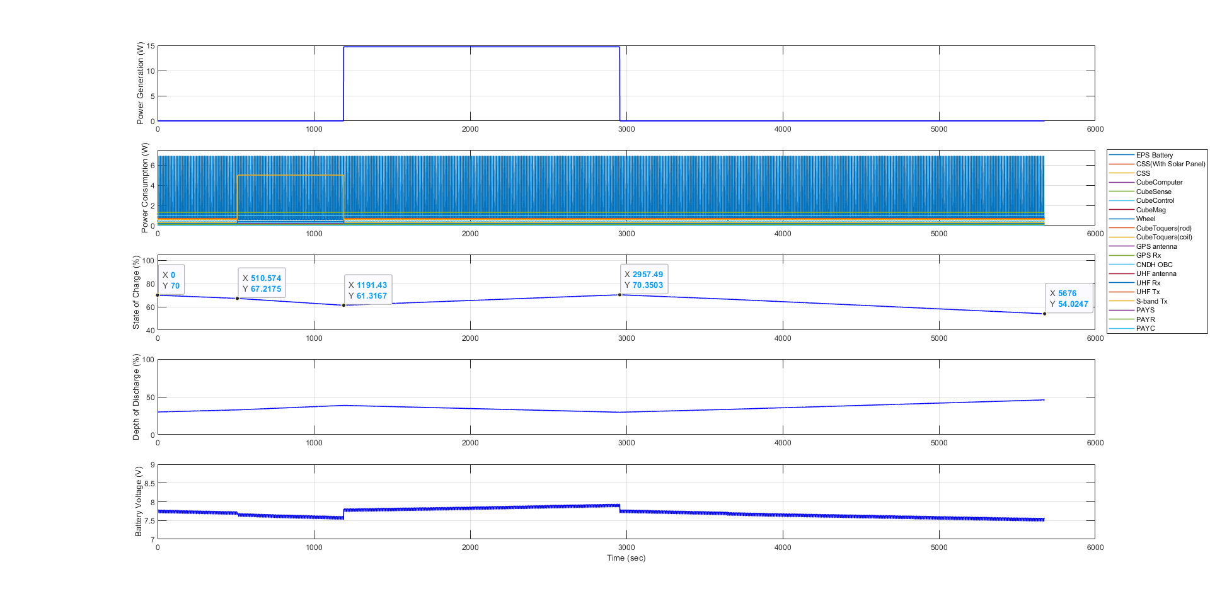
3. Simulink Plot Result : S-band COM mode(@Day)
alpha*(-1) (태양지향 시간을 약 11분 33초씩 감소시켰을 때)

Slide 25
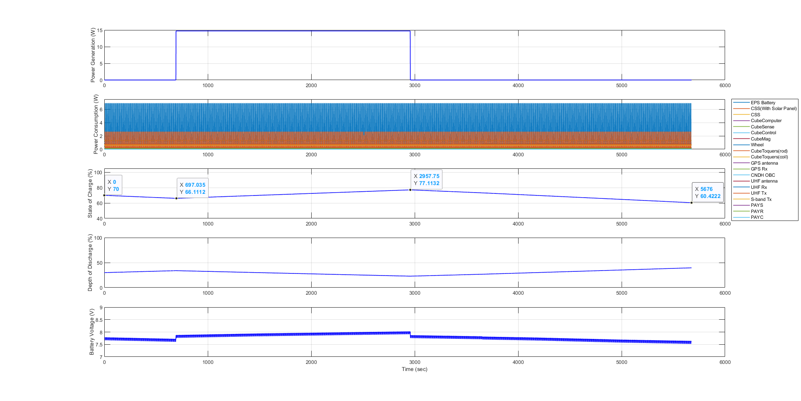
4. Simulink Plot Result : Stand-by mode
alpha*(-1) (태양지향 시간을 약 11분 33초씩 감소시켰을 때)

Slide 26
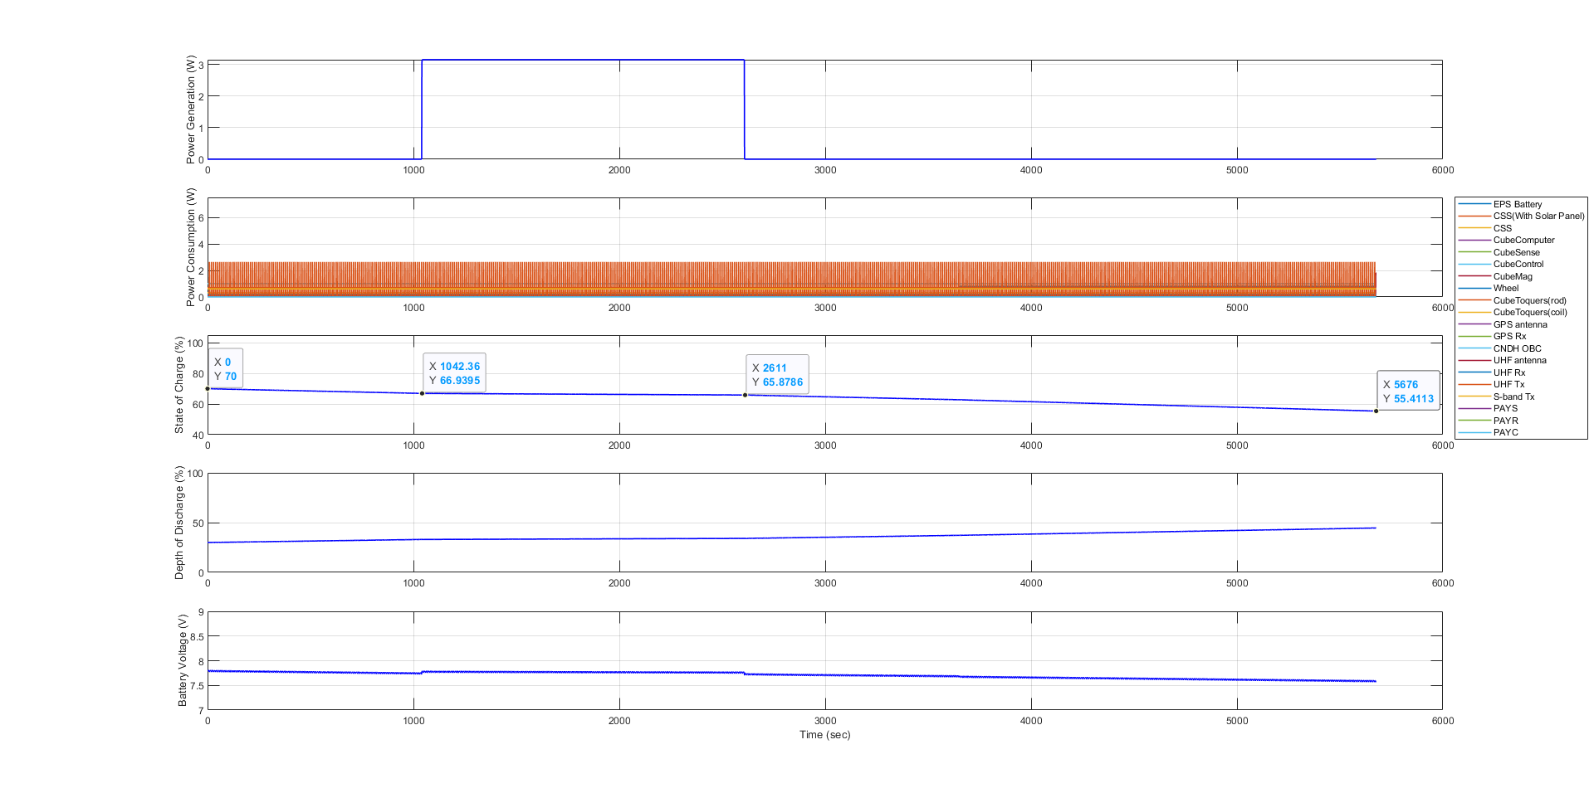
0. Simulink Plot Result : EO mode
alpha*(-2) (태양지향 시간을 약 17분 21초씩 감소시켰을 때)

Slide 27
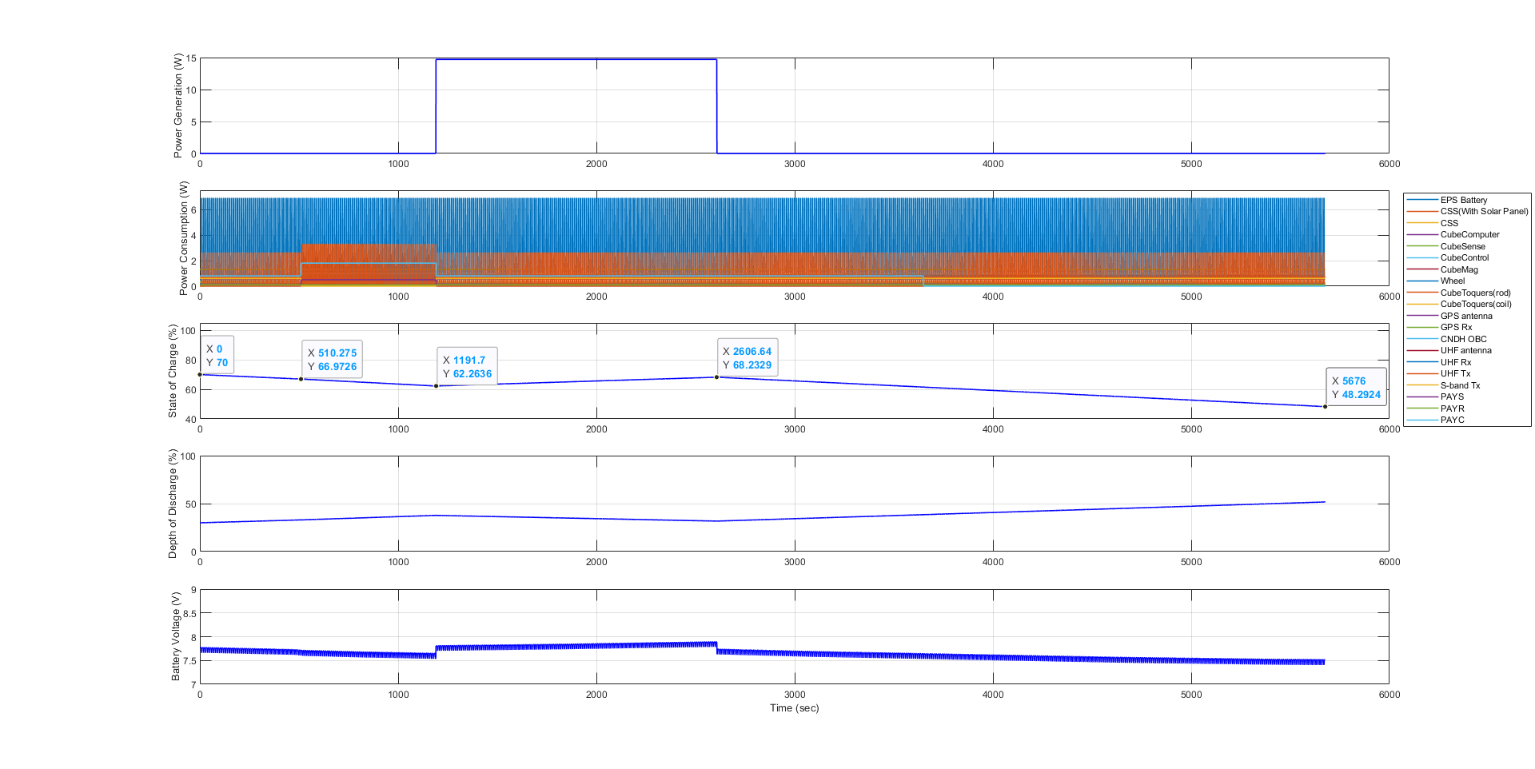
1. Simulink Plot Result : Mission & UHF COM mode
alpha*(-2) (태양지향 시간을 약 17분 21초씩 감소시켰을 때)

Slide 28
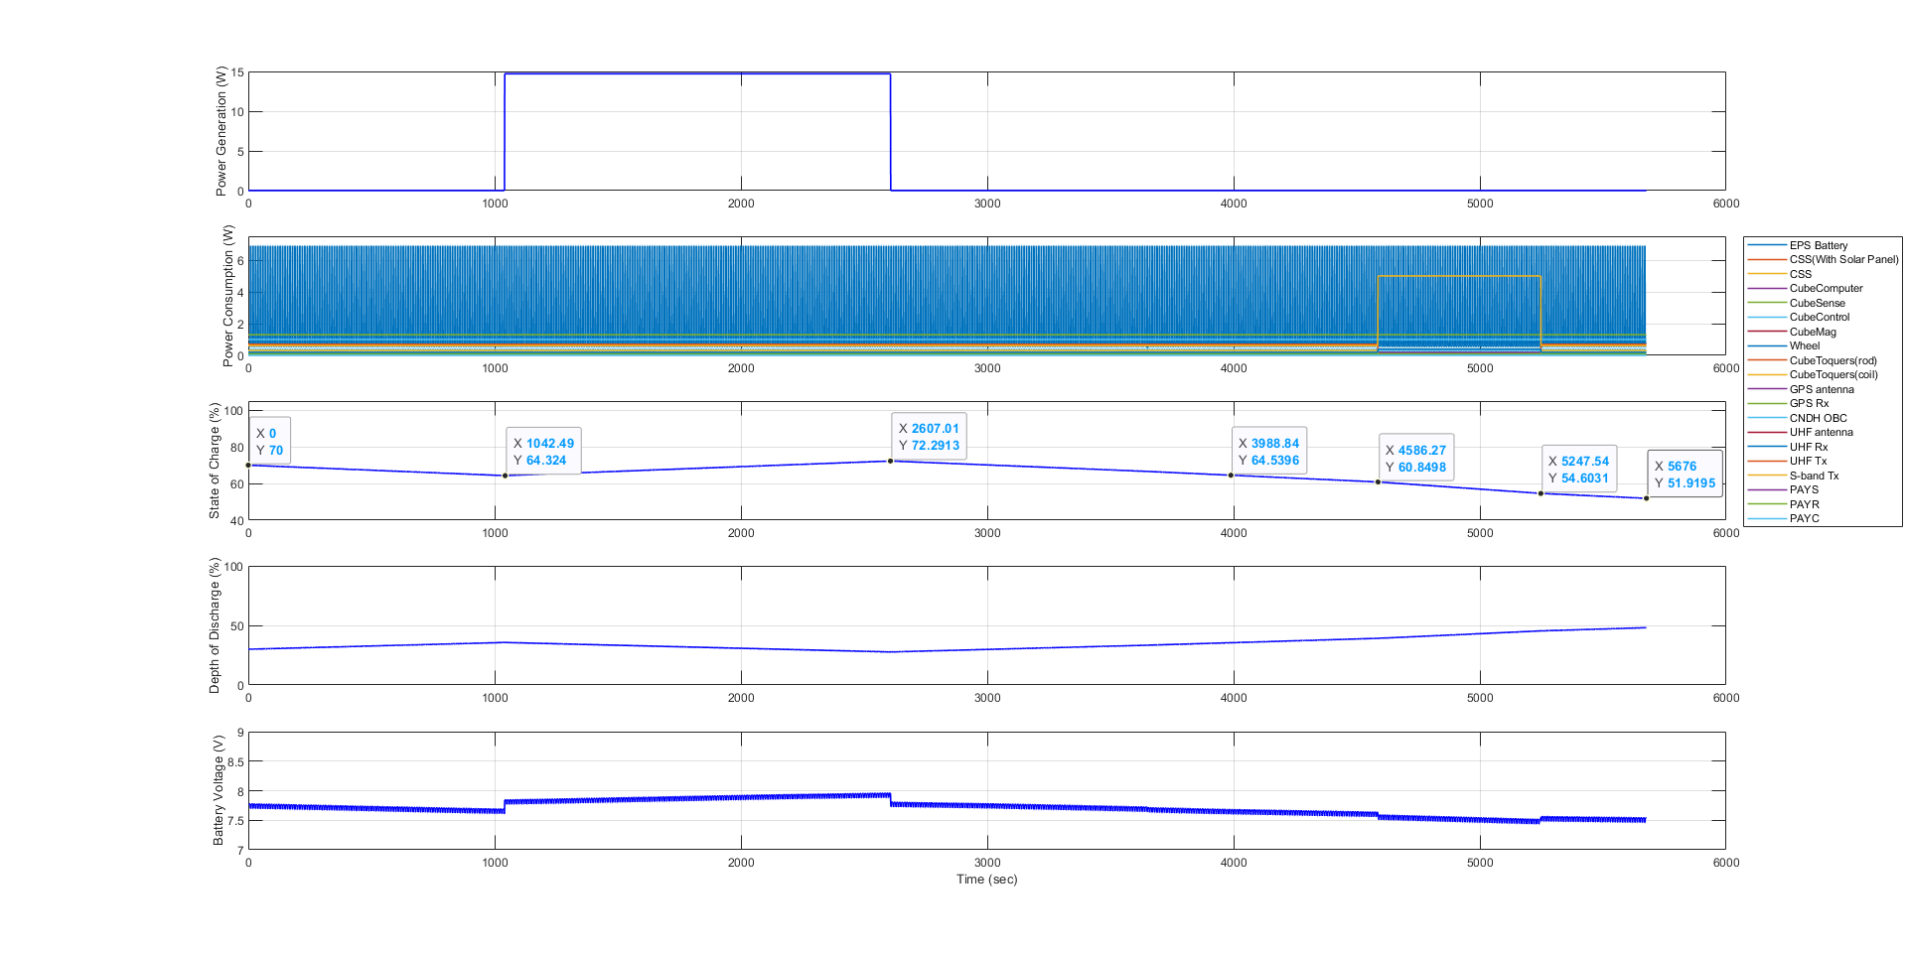
2. Simulink Plot Result : S-band COM mode(@Night)
alpha*(-2) (태양지향 시간을 약 17분 21초씩 감소시켰을 때)

Slide 29
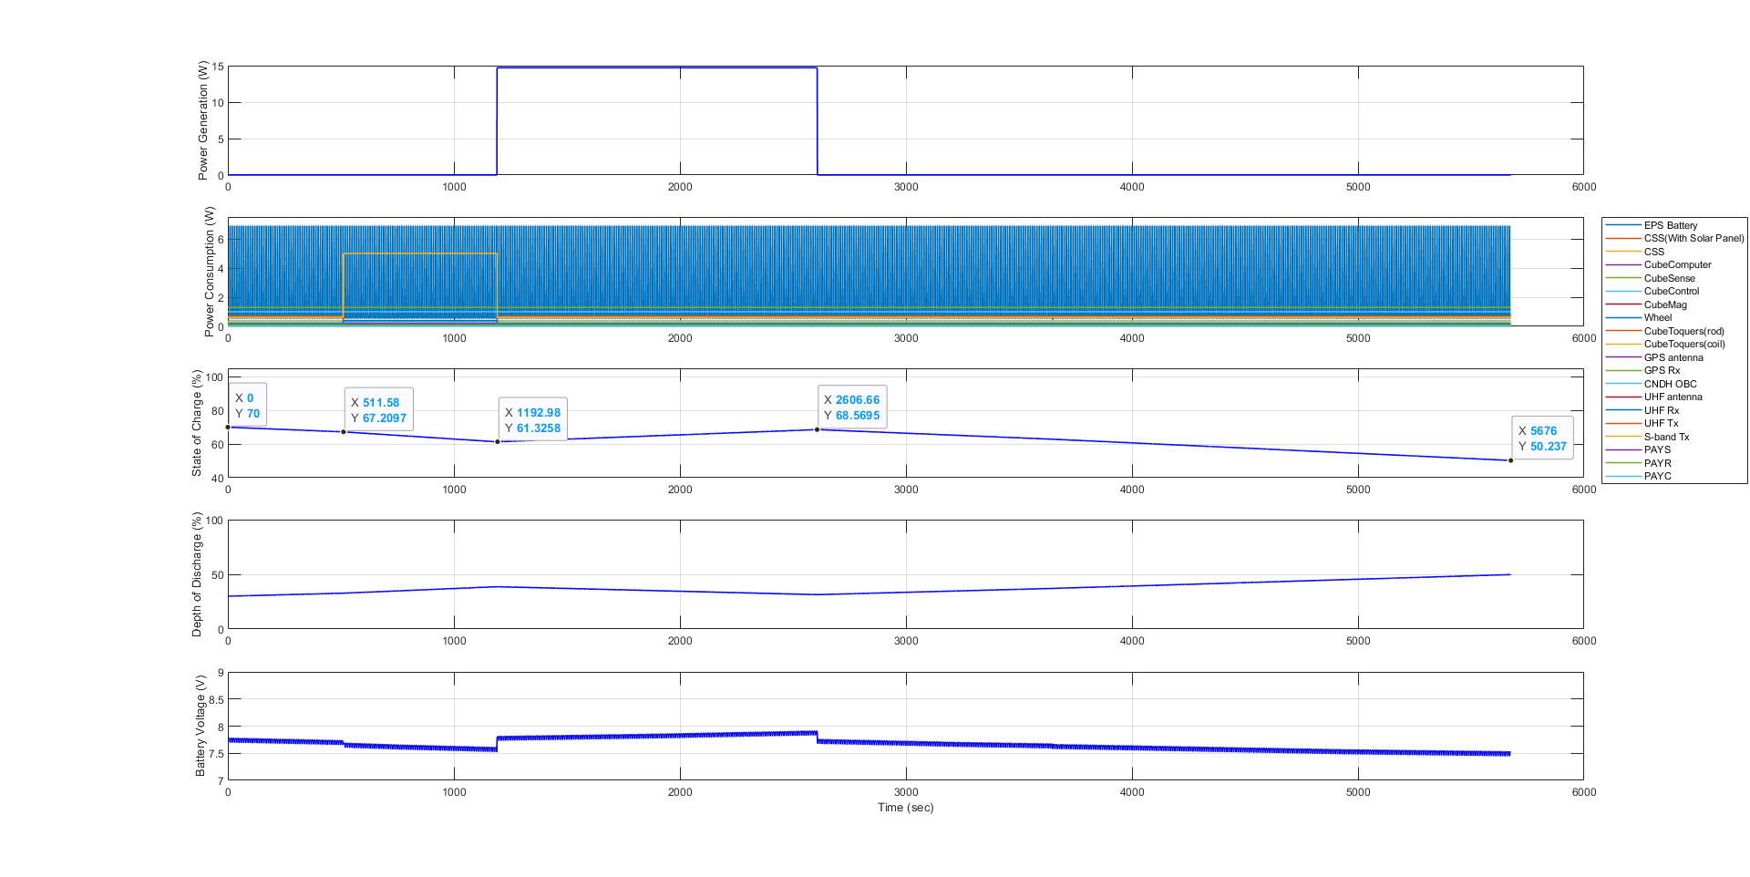
3. Simulink Plot Result : S-band COM mode(@Day)
alpha*(-2) (태양지향 시간을 약 17분 21초씩 감소시켰을 때)

Slide 30
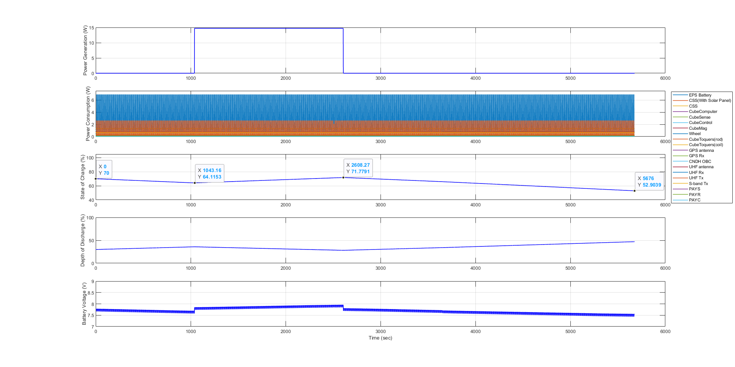
4. Simulink Plot Result : Stand-by mode
alpha*(-2) (태양지향 시간을 약 17분 21초씩 감소시켰을 때)

Slide 31
Simulink Data result (alpha*0)
Product | Mode |  | Total |  |  | Unit
 | EO | Mission & UHF Com | S-band Com (@Night) | S-band Com (@Day) | Stand-by
Generated Energy (Orbit average) | 2.59 | 9.30 | 12.08 | 9.30 | 12.08 | Wh
Required Energy (Orbit average) | 7.14 | 14.26 | 13.36 | 13.50 | 12.97 | Wh
Start SOC | 70 | 70 | 70 | 70 | 70 | %
End SOC | 58.63 | 57.60 | 66.81 | 59.49 | 67.78 | %
Charging Rate | -11.37 | -12.40 | -3.19 | -10.51 | -2.22 | %
Notes:
모든 모드의 parameter를 기록하였습니다.

Slide 32
Simulink Data result (alpha*(-1))
Product | Mode |  | Total |  |  | Unit
 | EO | Mission & UHF Com | S-band Com (@Night) | S-band Com (@Day) | Stand-by
Generated Energy (Orbit average) | 1.98 | 7.22 | 9.25 | 7.22 | 9.25 | Wh
Required Energy (Orbit average) | 7.17 | 14.38 | 13.48 | 13.61 | 13.09 | Wh
Start SOC | 70 | 70 | 70 | 70 | 70 | %
End SOC | 57.03 | 52.10 | 59.44 | 54.02 | 60.42 | %
Charging Rate | -12.97 | -17.90 | -10.56 | -15.98 | -9.58 | %
Notes:
모든 모드의 parameter를 기록하였습니다.

Slide 33
Simulink Data result (alpha*(-2))
Product | Mode |  | Total |  |  | Unit
 | EO | Mission & UHF Com | S-band Com (@Night) | S-band Com (@Day) | Stand-by
Generated Energy (Orbit average) | 1.37 | 5.79 | 6.40 | 5.79 | 6.40 | Wh
Required Energy (Orbit average) | 7.21 | 14.47 | 13.63 | 13.70 | 13.24 | Wh
Start SOC | 70 | 70 | 70 | 70 | 70 | %
End SOC | 55.41 | 48.29 | 51.92 | 50.24 | 52.90 | %
Charging Rate | -14.59 | -21.71 | -18.08 | -19.76 | -17.10 | %
Notes:
모든 모드의 parameter를 기록하였습니다.

Slide 34
Simulink Data result (alpha*0)
 | Start | 1 | 2 | 3 | 4 | 5 | 6 | 7 | 8 | 9 | 10 | 11 | 12 | 13 | 14 | End
EO
Stand-by
Mission
S-band Com
Notes:
Power Budget Excel 기준으로 한 주기동안 처음(80%)보다 얼마나 감소하였는지를 매 주기마다 적용한 표입니다.

